Slide 1
Status of the GSNL initiative
Stefano Salvi
Chair of the Supersites Advisory Committee
CEOS WG Disasters meeting, Rome, March 2017

Slide 2
Active Supersites
Hawaiian volcanoes – USGS, USA
Icelandic volcanoes – Univ. of Iceland & IMO, Iceland
Etna volcano – INGV – Catania, Italy
Campi Flegrei volcano – INGV – Naples, Italy
Western North Anatolian Fault – KOERI – Istanbul, Turkey
Taupo Volcano – GNS Science - Lower Hutt, New Zealand
Tungurahua/Cotopaxi volcanoes – IGEPN – Quito, Ecuador
Evoikos, Corinth rift, Ionian Sea – ITSAK – Athens, Greece

Slide 3
Supersite reporting status
Supersite | Biennial report due date | Status
Hawaiian volcanoes | 25-Oct-16 | 2nd report delivered, to be approved at SIT
Icelandic volcanoes | 5-Nov-17 | 2nd report
Etna volcano | 9-Apr-18 | 2nd report
Campi Flegrei volcano | 9-Apr-18 | 2nd report
Western North Anatolian Fault | 9-Apr-18 | 2nd report
Taupo Volcano | 29-Oct-16 | 1st report, to arrive before SIT
Tungurahua/Cotopaxi volcanoes | 29-Oct-16 | 1st report, to arrive before SIT
Evoikos, Corinth rift, Ionian Sea | 8-Nov-18

Slide 4
February 21st: kick off of the of the
EnCeladus hellenic Supersite (Evoikos, Corinth rift and Ionian Sea)
EO data acquisitions started
PoCs were identified for each EO data type
First contacts with space agencies for ordering and access procedures
In situ data will be shared through EPOS
Coordinator (A. Savvaidis) is very proactive
Good outreach plan

Slide 5
Status of the
San Andreas Fault Natural Laboratory
Positively reviewed by SAC.
Proposal reviewed by DCT.
ESA, DLR and ASI have expressed the intention to support the NL.
Letter of support by USGS (new rule) received by GSNL Chair.
We propose to approve the NL at the SIT meeting.

Slide 6
New Supersite proposals
Sinabung volcano Event Supersite (M. Poland, USGS) - positively evaluated by DCT (DLR, ASI)
Permanent Supersite in the Southern Andes (L. Lara, SERNAGEOMIN) – under review by SAC
Permanent Supersite on the Virunga volcanic zone, D.R. of Congo (C. Balagizi, Goma Volc. Obs.) – to be submitted soon
Other proposals to be presented/discussed at the EGU conference in April

Slide 7
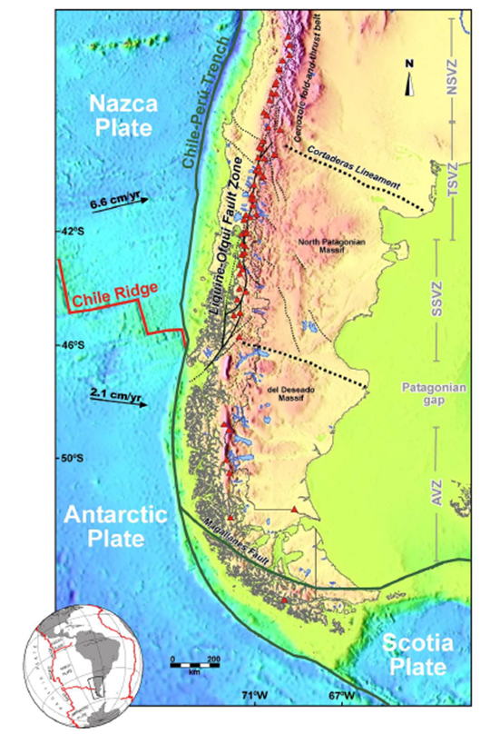
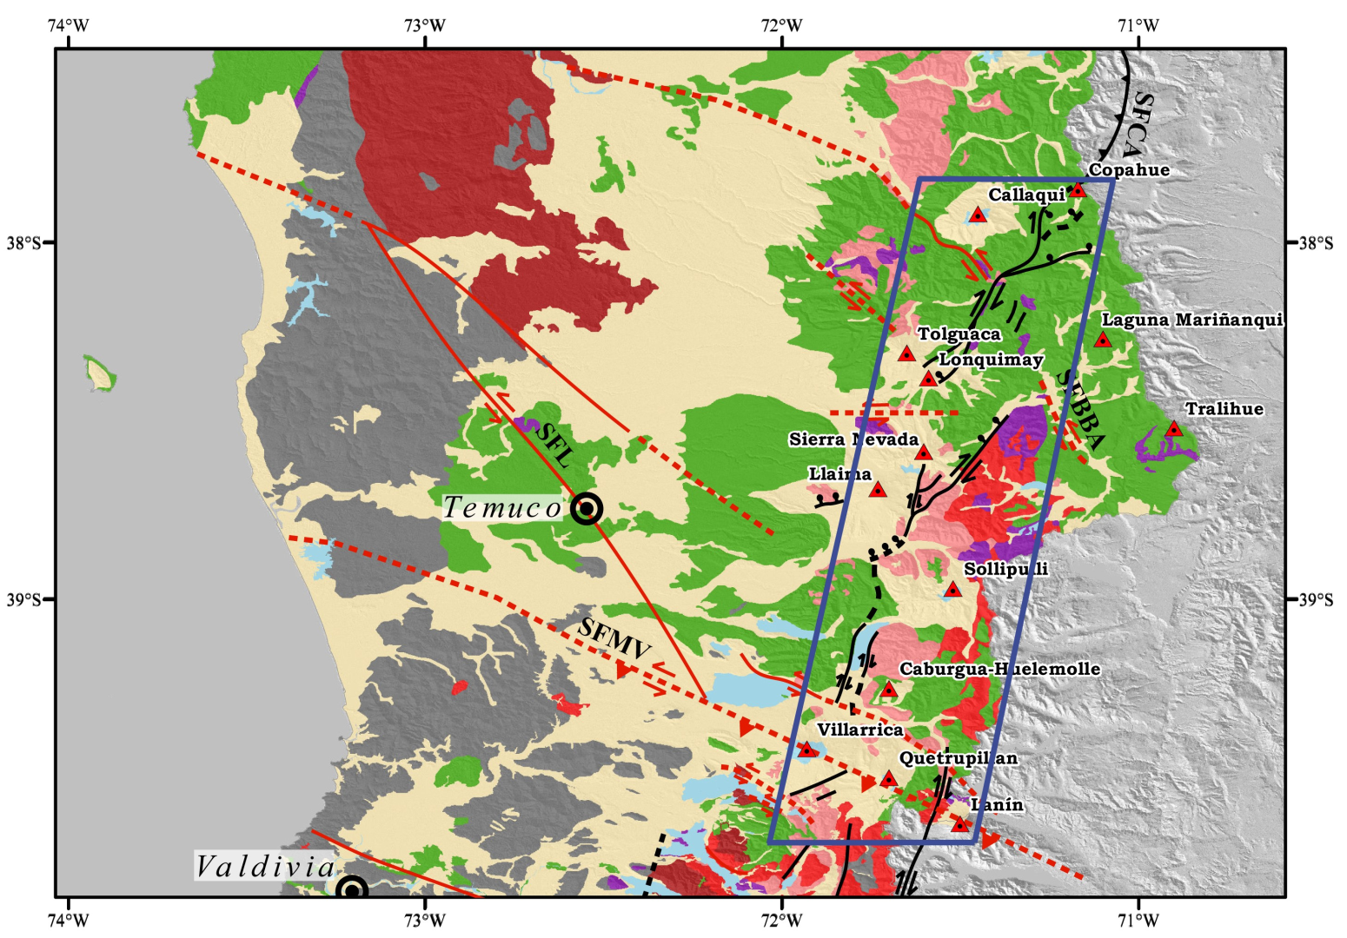
Permanent Supersite proposal:
Coupled geohazards at Southern Andes: Copahue-Lanín arc volcanoes and adjacent crustal faults (GeoHaZSA)

Slide 8
Coupled geohazards at Southern Andes: Copahue-Lanín arc volcanoes and adjacent crustal faults (GeoHaZSA)
General features:
~50 x 200 km area, covering 9 stratovolcanoes, 2 volcanic fields, a large strike-slip fault
Strong volcanic hazards - lahars, tephra fallout, ash plumes; + seismic hazard
80 eruptions since the 1900
Potentially affected population ~200 k
EO data not widely used, little local capacity
GEO Chile strongly supports the proposal

Slide 9
Coupled geohazards at Southern Andes: Copahue-Lanín arc volcanoes and adjacent crustal faults (GeoHaZSA)
Main goals:
To establish regional source models for faults/volcanoes.
To develop a rapid strategy for ground deformation monitoring based on InSAR.
To develop an early warning system for volcanic unrest based on InSAR, GPS, seismicity and gas measurements.
To improve capability to measure effusion/emission rates.
To generate high resolution hazards maps.
To provide information to first responders, society and scientific communities.

Slide 10
Coupled geohazards at Southern Andes: Copahue-Lanín arc volcanoes and adjacent crustal faults (GeoHaZSA)
In situ data sets:
Type of data | Data source | Data access
Seismic data | SERNAGEOMIN (OVDAS) network (35 stations) | Open access with registration form; server to remote download scheduled. Time-series for registered scientists under specific agreements
GNSS data | SERNAGEOMIN (OVDAS) (16), IGM (1) and CSN (1) network and GPS Campaigns | Open access to GNSL scientists
DOAS and Gas measurements | SERNAGEOMIN (OVDAS) network (5 continuous stations) and Campaigns | Open access to GNSL scientists
Infrasound | SERNAGEOMIN (OVDAS) 2 stations | Open access to GNSL scientists

Slide 11
Coupled geohazards at Southern Andes: Copahue-Lanín arc volcanoes and adjacent crustal faults (GeoHaZSA)
EO data requests:
Type of data | Data source | Data needs (tentative)
SAR X-band | ASI - DLR | Ascending/descending coverage every two weeks for 11 volcanic zones: ~ 560 images/yr Can be focused on more active volcanoes.
SAR C-band | ESA – CSA | Ascending/descending coverage every two weeks for 1-2 sites (fault/volcanoes): ~ 100 images/yr
SAR L-band | JAXA | Would be extremely useful. Perhaps within a scientific AO ?
Optical data | CNES | One initial tri-stereo coverage for each volcano, then one more each time there are substantial morphological changes (1-2 per year on average?)

Slide 12
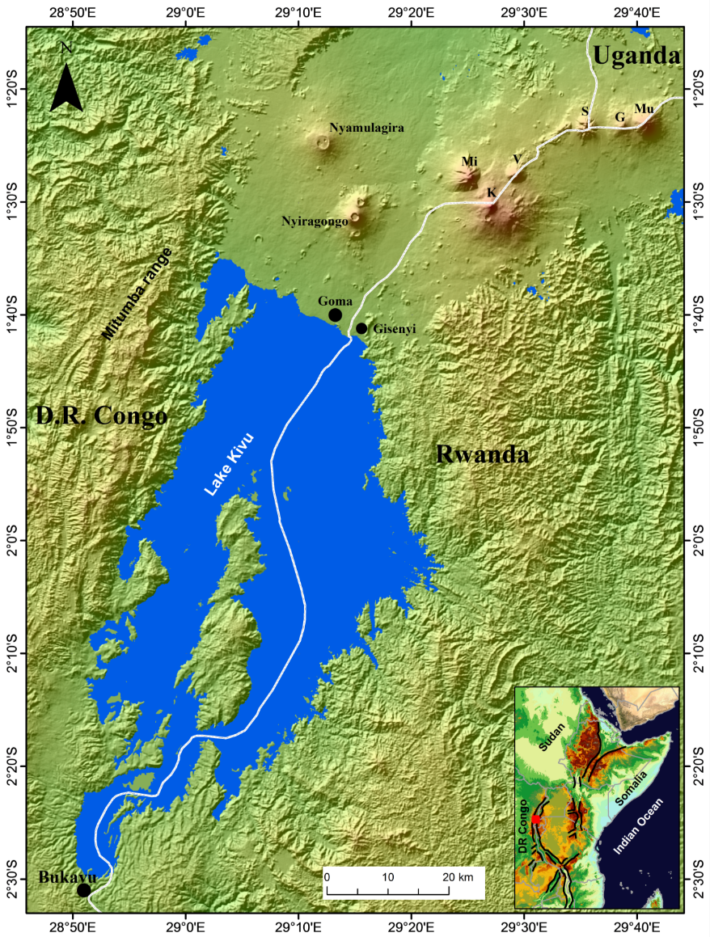
Upcoming Permanent Supersite proposal:
Virunga volcanic area (Democratic Republic of Congo)
Area accounts for 40% of historical African eruptions
High volcanic risk for over 1.5 M people (Goma city)
Strong need for scientific investigations of the volcanic system
Very poor in situ monitoring capacities
No EO data are used, but would be very useful (part of the area is a war zone)
Potential strong societal benefits from international collaboration.

Slide 13
GSNL to include other scientific goals
The success of the Supersites has stimulated other communities to adopt the same concept in different contexts.
Requests have been received to include other geohazards, as landslides, glacial outbursts, basin overflows, ground subsidence.
These hazards can be investigated on existing Supersites (e.g. Cotopaxi)
But also on multiple hazard Supersites under discussion (Peru)
Further discussions are envisioning “olistic” Supersites, to study the Earth Critical Zone, considering geological, biological, ecological, biogeochemical, climatic and biogeographical aspects, as well as their relationship with the anthropogenic impact on the environment
The GSNL community will discuss these new ideas at the EGU 2017 in Vienna

Slide 14
GSNL Data Policy guidelines
Guidelines setting the minimum requirements for data sharing, licensing and attribution, compliant with GEO principles
Refers to both in situ and satellite EO data
Data, metadata and products should be openly shared
It recognize the existence of exceptions due to commercial obligations, or other impediments
It is fully compatible with the space agencies’ data policies and licenses

Slide 15
New GSNL website
Contract for redesign just awarded by INGV
It will be placed outside of the GEOSec website
It will be the main point of access for the Supersite network, containing web pages for each Supersite whose content will be self-managed by the Coordinators
It will provide better visibility of Supersite achievements
It will provide a coordinated view of the GSNL resources contributed by the partnership, directing the users to the various data/product/service portals (e.g. UNAVCO, IRIS, GEP, DLR portal, EarthExplorer, EVER-EST, EPOS, etc.)

Slide 16
Issues with EO data access
DLR portal ok but two issues remain with compatibility with UNAVCO’s SSARA: multiple data sets in one tar file, and unnecessary need for cookie updating
ASI data still not available online. We asked the GEP to host the data and make them downloadable.
Same solutions foreseen for CNES and CSA data, but the data PoC needs to manage authorizations
Need to explore if the new GEOSS portal can distribute data to authorized users
ALOS-2 data still not provided to GSNL. Will it be possible to use an AO?

