Slide 1
CEOS Volcano Pilot Project: main results and lesson learned
Mike Poland (USGS)
Simona Zoffoli (ASI)
WG Disasters #8
Buenos Aires, Argentina
4–6 September 2017
PILOT TEAM: Juliet Biggs, David Arnold (University of Bristol), Susi Ebmeier (University of Leeds), Matt Pritchard, Francisco Delgado (Cornell University), Christelle Wauthier (Penn State University), Falk Amelung (University of Miami), Fabrizio Ferrucci (Open University), Mike Pavolonis (NOAA), Rick Wessels (USGS), Eugenio Sansosti (IREA-CNR), Elske de Zeeuw - van Dalfsen (KNMI)

Slide 2
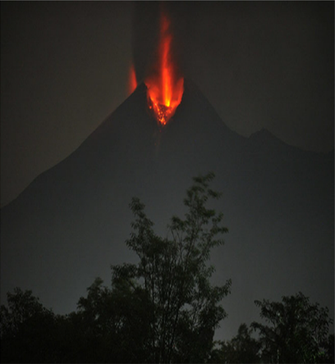
WHAT IS MISSING?
Motivation
up to 45% of the worlds ~ 1400 Holocene age volcanoes are not monitored
What EO data are most critical for detecting changes in unrest and eruptive activity vs. different volcanism and environment?
Strategy for satellite observations depending on volcanoes level of activity
Merapi, Indonesia, erupting in 2010. From Pallister and others, 2013

Slide 3
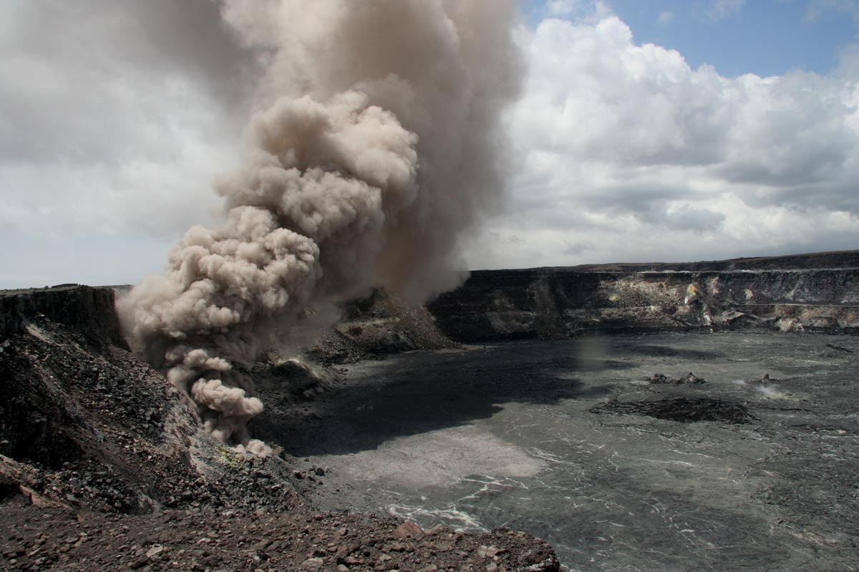
Scope
Demonstrate the potential impact of EO data for better understand volcano hazard and reduce impacts and risks from eruptions.
Enforce coordination between Space Agencies, value-added providers and end users to ensure that the agencies who are responsible for volcano monitoring have access to, and understanding of, those data sets that are most critical for making informed DRM decisions
Propose a strategy for a global satellite monitoring system

Slide 4
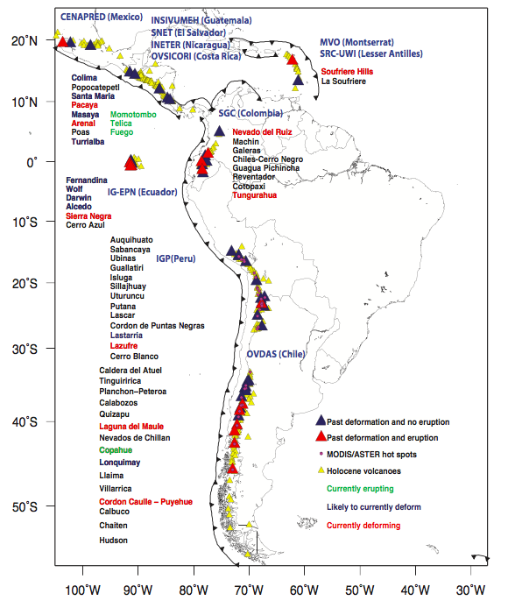
Regional demonstration over Latin America
Demonstrate potential impact of EO data: regional focus on Latin America (319 volcanoes)
Identify volcanoes that may became active in the near future
Track new and ongoing eruptive activity
Why Latin America?
Range of eruption type/ages and environments
Abundant volcanic activity
Impact on people/air traffic
Well established observatories
~202 volcanoes in the region have no ground monitoring of any type
Notes:
Triangles are all volcanoes in Latin America. Red triangles are target volcanoes from the CEOS pilot plan. Black boxes and text show regions for planned quarterly monitoring with C-Band (Sentinel-1) and L-Band (ALOS 2) InSAR. Grey text shows the local end users (monitoring agency).

Slide 5
Participants in the Pilot
CEOS Agencies:
USGS, ASI, CNES, CSA, DLR, ESA, NASA, NOAA, JAXA
Value-added providers:
University of Bristol (UK), Cornell University (US), University of Miami (US), Pennsylvania State University (US), IREA/CNR (IT), Open University (UK), NOAA, USGS
End users:
Observatorio Volcanológico de Los Andes del Sur (OV-DAS) Chile; Instituto Geofísico del Perú; Instituto Geofísico de la Universidad Nacional de San Agustín, Peru; Instituto Geofísico, Escuela Politécnica Nacional, Ecuador; Servicio Geológico Colombiano, Colombia, Buenos Aires Volcanic Ash Advisory Center, Argentina, Instituto nacional de sismología, vulcanologia, meteorología e hidrologia, (NSIVUMEH), Guatemala, Instituto Nicaraguense de Estudios Territoriales (INETER), Nicaragua

Slide 6
EO data
Optical and IR data for detecting thermal anomalies, gas emissions, and ash plumes
Radar data for ground deformation, new volcanic deposits, and topographic changes
FOCUS on Radar data (ALOS, RADARSAT-2, COSMO-SkyMed, Terra SAR-X, Tandem-X, Sentinel 1) to understand how the entire international SAR constellation could be used for detecting and characterizing volcano behavior.

Slide 7
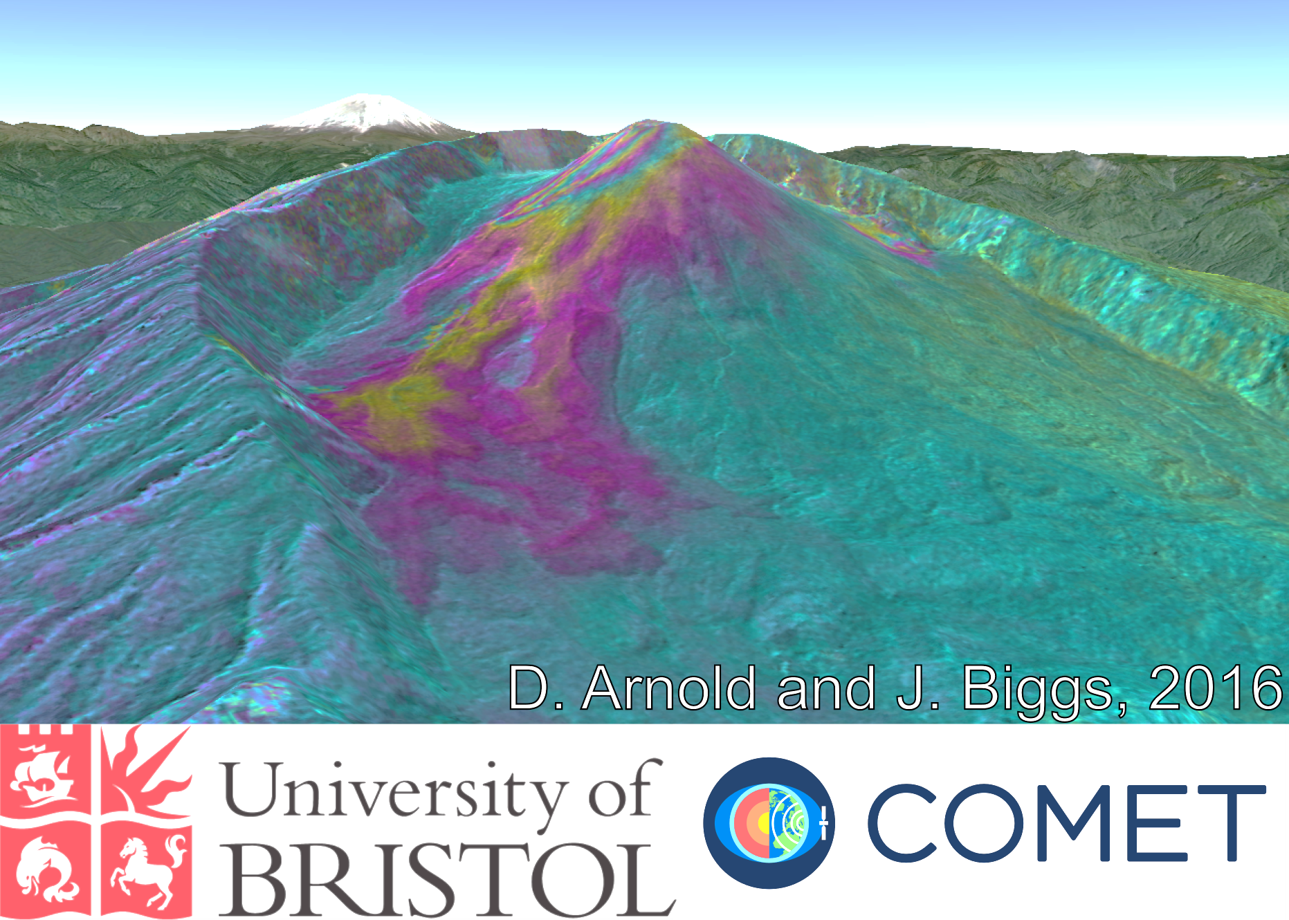
Noteworthy results
Pacaya (Guatemala)
  Santiaguito (Guatemala)
    Masaya (Nicaragua)
      Arenal (Costa Rica)
        Soufrière Hills Volcano (Montserrat)
          Chiles – Cerro Negro (Colombia / Ecuador)
            Reventador (Ecuador)
            Cotopaxi (Ecuador)
          Wolf (Galápagos)
        Fernandina (Galápagos)
      Sabancaya (Perú)
    Cordón Caulle (Chile)
  Calbuco (Chile)
Villarica (Chile)

Slide 8

Utility of data
How have satellite data been useful?
Monitored volcanoes with no ground networks and motivated installation of new sensors (Cordon Caulle)
Provided data for determining alert levels (Chiles-CN)
Complemented ground-based data and contributed to situational awareness during a crisis (Chiles-CN, Calbuco, Villarica, Manutombo)
Filled “gaps” at volcanoes that have some ground-based monitoring (Tungarahua, Pacaya, Santiaguito)
Provide otherwise inaccessible data (Reventador, SHV)
Research (Ubinas)
Notes:
map topographic change to get eruption rates

Slide 9
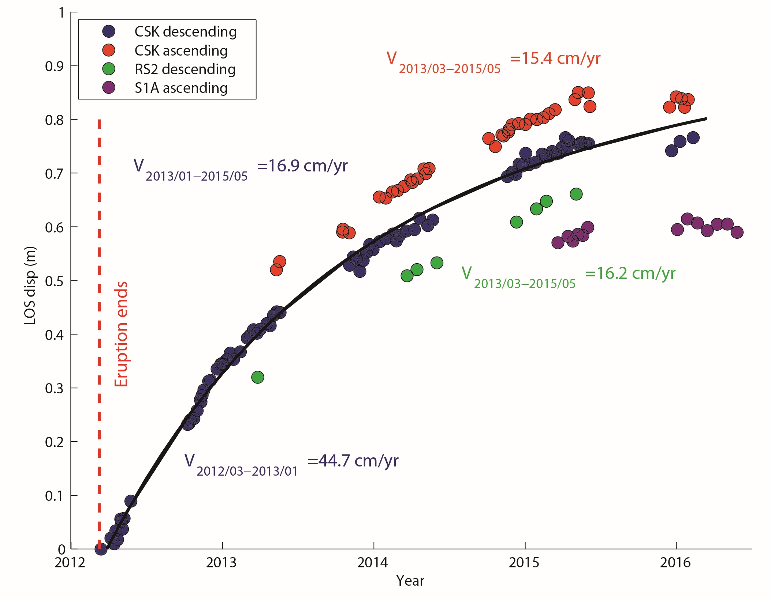
Cordón Caulle, Chile
Inflation of Cordón Caulle, Chile, after the 2011-2012, has been a significant result of the pilot. This deformation would not otherwise be known without EO data.
The inflation seemed to have stopped in mid-2015.
Post-eruptive uplift of up to 0.8 m between March 2012 and May 2015. The line-of-sight uplift rates reached 45 cm/yr, but the deformation was not accompanied by earthquakes

Slide 10
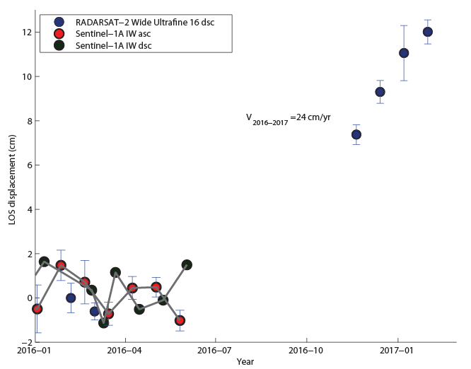
Cordón Caulle, Chile
New results indicate that inflation at Cordón Caulle resumed in mid-2016!
In response to these observations, OVDAS is installing a continuous GNSS station to establish ground-based monitoring of the volcano.

Slide 11
Utility of data
The project frequently responded to requests from local observatories to provide satellite data to complement ground based measurements of unrest.
Satellite observations were requested often to assess whether there is evidence of large magma accumulation during a seismic crisis or to confirm observation of deformation from a single sensor.
EO observations have showed a lack of magma driven deformation during crises at Chiles and Cerro Negro de Mayasquer, Monotombo,Sabanacaya and Nevados de Chillan and have consequently been instrumental in the decision not to raise the alert level.

Slide 12
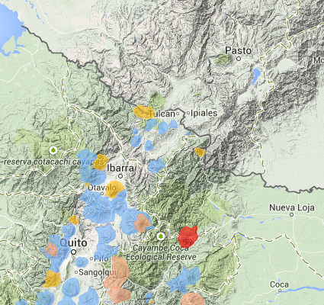
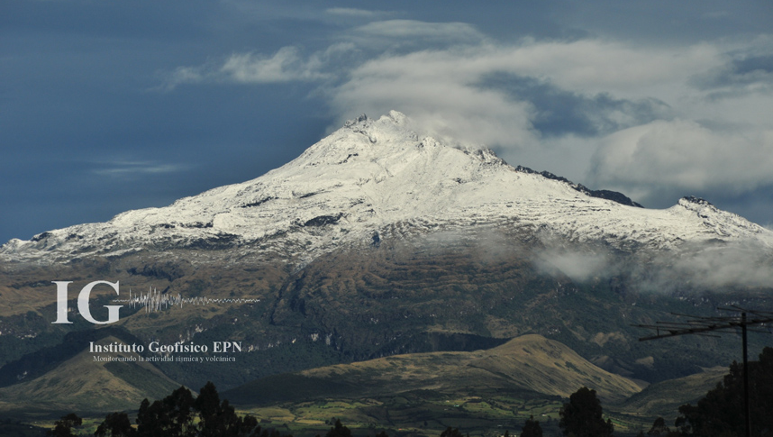

Chiles – Cerro Negro, Ecuador-Colombia border
Volcán Chiles
Very limited monitoring
Potentially Active
Inaccessible

Slide 13
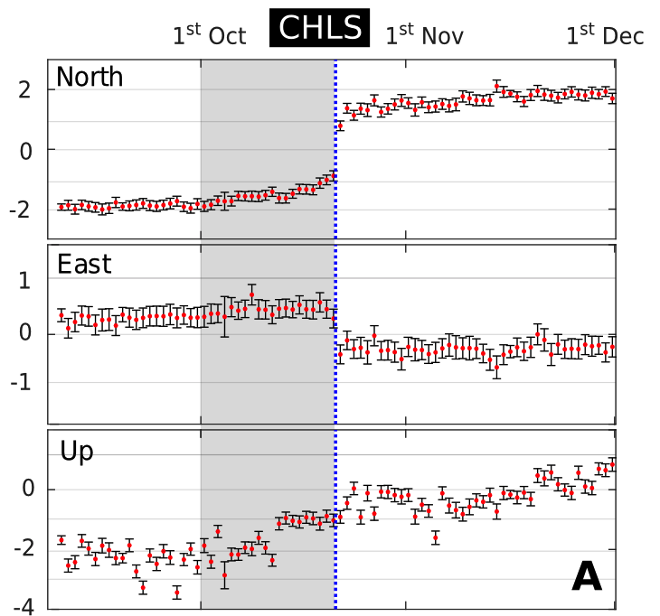
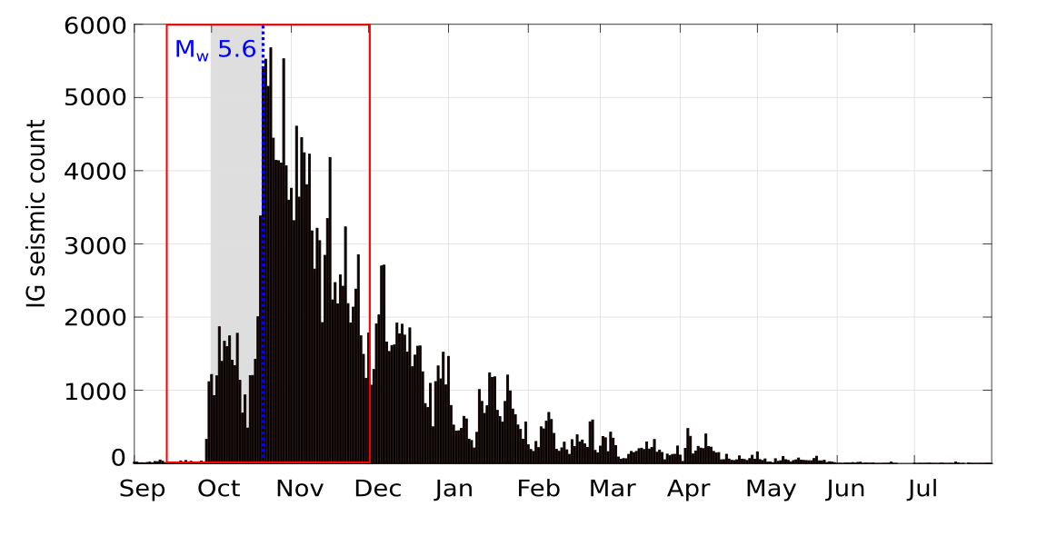
Chiles – Cerro Negro

Slide 14
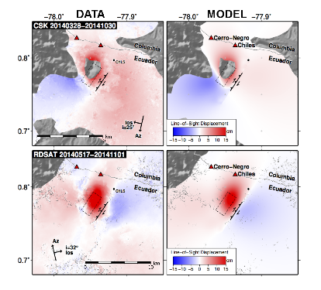
Chiles – Cerro Negro, Ecuador-Colombia border
Cerro Negro
Chiles
TerraSAR-X
18th Oct- 27th Nov 2014
Ground deformation – is it magma or “just” the earthquake?
CEOS data indicated about 30 cm of ground movement associated with the earthquake, but no deformation indicative of magma accumulation or transport.
The lack of deformation in INSAR images played a key role in the decision to reduce rather than elevate the alert level of volcano.

Slide 15
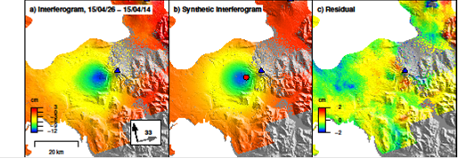
Calbuco, Chile
Observed (left), modeled (center), and residual (right) deformation (from Sentinel-1a, spanning April 14–26, 2015) due to an eruption at Calbuco, Chile, on April 22, 2015.
A model of the deflation indicates that the source is located about 5 km SW of the volcano’s summit at a depth of 9.3 km beneath the surface.
Confirmed single ground base sensor co-eruptive and showed post eruptive sensor unreliable.
OVDAS used this source model to validate their tilt meter records

Slide 16
Calbuco, Chile
Feedback from Buenos Aires VAAC manager on May 3, 2015:
“I thank you and congratulate you for the excellent work in making available of all images and products that allow us to significantly improve the tasks of detecting and tracking volcanic eruptions and clouds and ash, since we only have GOES13 and some polar satellites images.”
In the wake of the explosive eruption of Calbuco, the Buenos Aires VAAC used the products to help brief aviation stakeholders

Slide 17
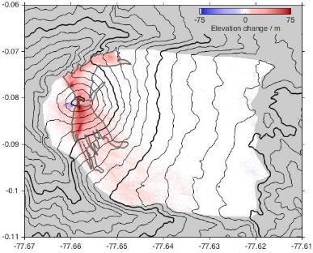
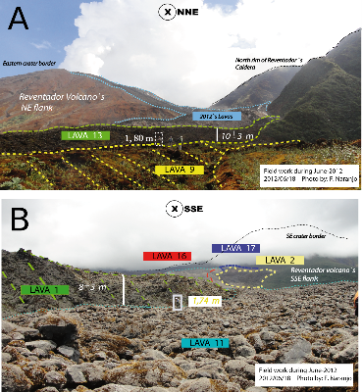
Results: Reventador
IG monitors lava effusion rate using field measurements and photos from overflights (irregular sampling and dependent on clear weather)
Thickness of new lava flows between 2011 and 2014 from TDX CoSSCs
InSAR data provide independent measure of effusion rates. Recent data from CoSSCs have imaged activity that was unknown to IG
Interferograms provide the only source of deformation measurement, important for assessing whether magma is accumulating

Slide 18
User Feedback
Patricia Mothes, Geophysicist, Instituto Geofísico (Ecuador)
Luis Lara, Director, Observatorio Volcanológico de los Andes del Sur (OVDAS, Chile)
Carlos Andrés Laverde, Geohazards Direction team, Colombian Geological Survey (Colombia)
Gustavo A. Chigna, volcanologist, INSIVUMEH (Guatemala)
Lourdes Narvaes Medina, volcanologist, Observatorio Vulcanologio y Seismologico de Pasto (Colombia)
John Pallister, Chief, Volcano Disaster Assistance Program, U.S. Geological Survey (USA)
Ing. Victor Aguilar Puruhuaya, Jefe de Sismología, Instituto Geofísico, Universidad Nacional San Agustin de Arequipa (Perú)
Armando Saballos, Dirección Gral. de Geología y Geofísica, INETER (Nicaragua)
Christina Neal, Scientist-in-Charge, Hawaiian Volcano Observatory, U.S. Geological Survey (USA)

Slide 19
Lessons learned
6 principles for SAR component of a global satellite monitoring system:
A volcano monitoring system must involve multiple space agencies and satellite platforms to make the most of each satellite system, to get nearly daily coverage when needed and to have updated high resolution topographic maps
Data quotas should be assigned for a) systematic background observations using the needed observing mode (spatial resolution, polarization, etc.), b) case studies requiring dense datasets and c) flexible response to unrest and eruption.
A systematic background mission using ascending and descending passes should take into account both the level of activity at each volcano and the temporal and spatial baselines required to form coherent interferograms and observe deformation transients
Notes:
principles

Slide 20
Lessons learned
Acquisition plans need to be flexible to accommodate changes in activity, evolving methods and improved understanding of data types
Near real-time data access is vital for decision making, requiring frequent overpasses, rapid tasking and short data latency
Coordination between space agencies, scientists and volcano observatories is crucial in order to provide an operational response and avoid conflicting requests for satellite tasking or interpretations of satellite observations to observatories.

Slide 21
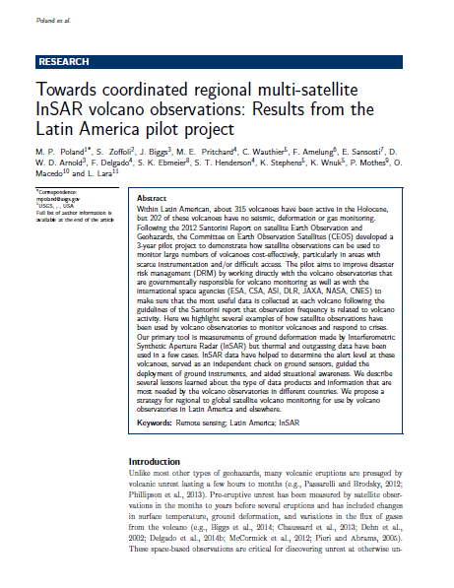
References
A summary publication describes the Latin America aspect of the pilot project, lessons learned, and potential future applications (submitted to Journal of Applied Volcanology ).

Slide 22
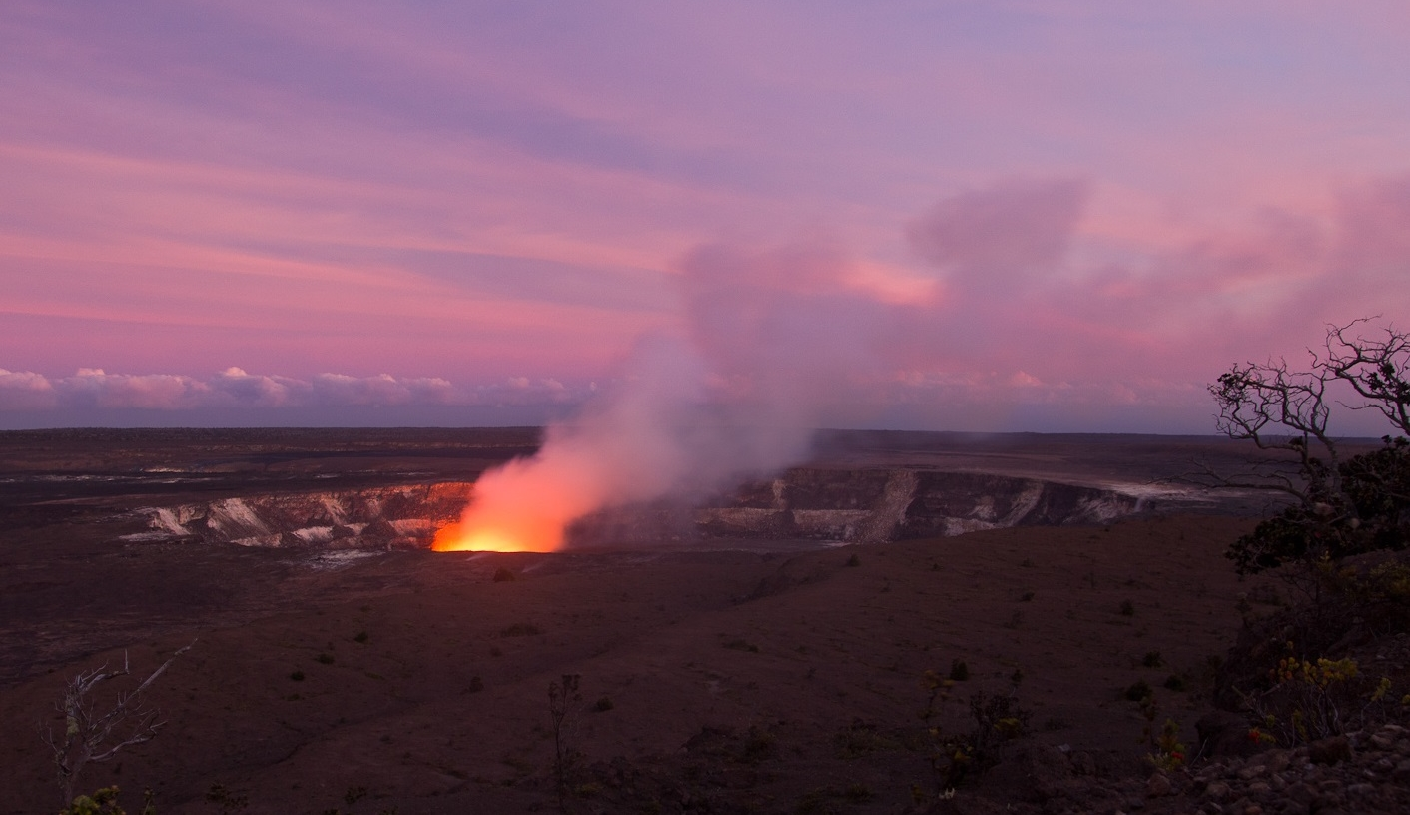
Thank you

