Slide 1

Committee on Earth Observation Satellites
GEO-DARMA
Status and Update
Ivan Petiteville, ESA
Andrew Eddy, Athena Global
WG Disasters # 8
Buenos Aires, Argentina

Slide 2
Table of Contents
Introduction and GEO-DARMA overview
Steering Committee – role, terms of reference, schedule
Background and Current Status
Samples of CEOS Pilot Success relevant for GEO-DARMA

Slide 3
GEO-DARMA Overview
Goal:
Enhance use of EO data for better-informed Disaster Risk Reduction and Resilience decision making
How:
Series of end-to-end projects addressing priorities of the “Sendai Framework for Disaster Risk Reduction 2015-2030”.
International Cooperation. Engagement of all stakeholders (end users, data & risk information providers, internat./national agencies, donor institutions,…)
Notes:
DARMA = Data Access for Risk Management.
The Japanese Daruma or Darma, a traditional handmade Japanese wishing doll (referred to as a "GOAL DOLL") that keeps people focused on achieving their goals.
GEO-DARMA Concept still to be consolidated

Slide 4
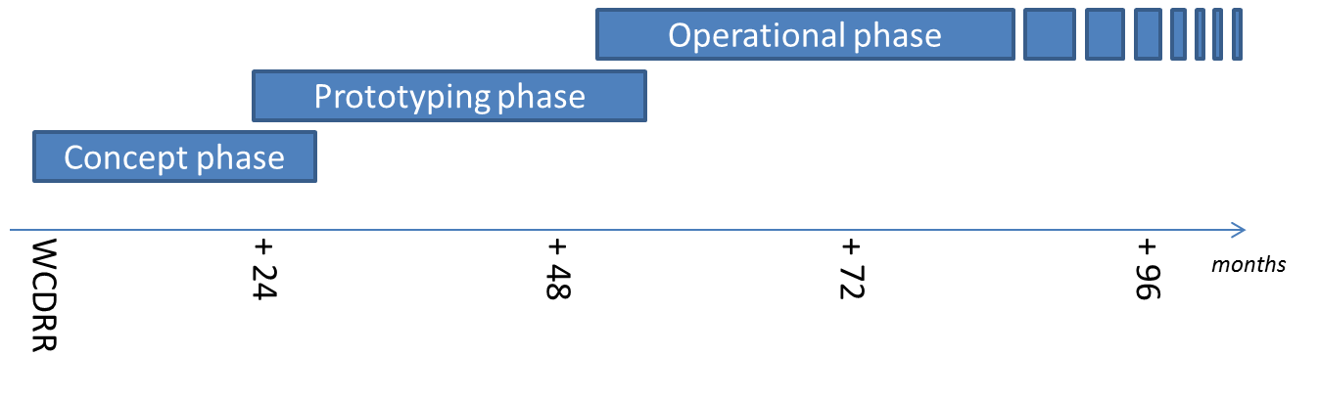
GEO-DARMA Partnership
Intention: build an international partnership with key stakeholders to define a strategy addressing high priorities of Sendai framework with resources available, on a best effort basis, adopting a phased approach
if extra resources and funding
identified
8
24

Slide 5
GEO-DARMA Concept Phase
Data providers not fully aware of DRR priorities & user needs, and users not aware of EO potential.
Dialogue with knowledgeable regional bodies needed for ….
.. independent assessment of DRR priorities for 2015-2030:
At regional level, 2 or 3 independent and authoritative regional institutions or global stakeholders with regional role, such as World Bank, GFDRR, UNISDR, UNDP, UNESCAP, CDEMA, ECOWAS, RCMRD, others, … (start with 3 regions: Africa, Asia-Pacific and Latin American and Caribbean)
Identification of hazards affecting most of the countries in the region (e.g. highest human and economic losses) or of transboundary risks that require regional and multi-country involvement.
Identification of 1st set of national projects within the region that could integrate EO in their objectives and delivery.

Slide 6
GEO-DARMA Prototype Phase
1. Realistic assessment of recommendations from Regional Institutions, given resources from the potential actors (e.g. data providers, value-added information providers, ..)
2. Define and implement possible prototype projects at country level to address recommended priorities;
close iterations with end users;
maximum reuse of existing initiatives / activities incl. operational, research, capacity building, …
3. Progressive extension to neighboring countries where applicable.
4. If “successful” prototype projects and if strong request from end users to continue → Assess transition to operation with identification of donors for future operational phase

Slide 7
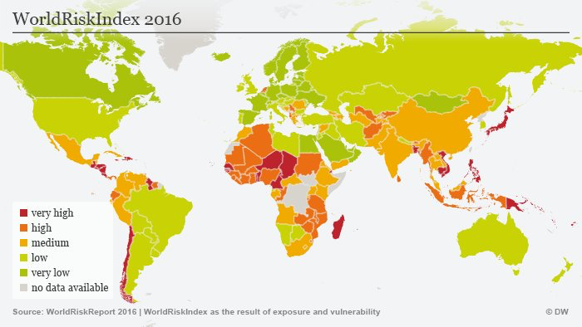

Slide 8
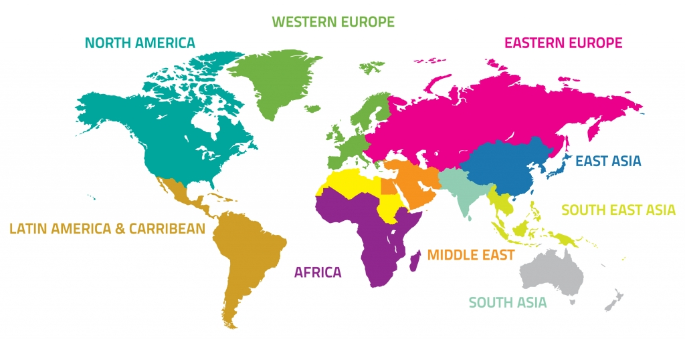

GEO-DARMA Approach
Identification of users needs and DRR priorities per region
For each region:
Types of hazards,
DRR Issues to be solved,
Initial countries

Slide 9
GEO-DARMA Approach (2)
(project dots only an illustration)
Prototype projects – progressive extension to neighbouring countries

Slide 10
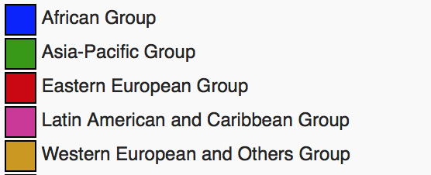
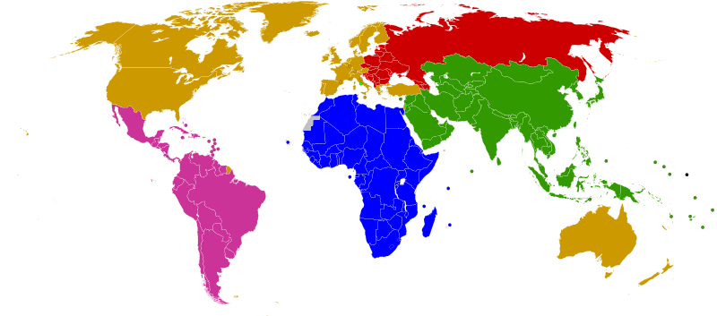
GEO-DARMA Partnership Approach
.
ASEAN
ADPC
ADRC
SDMC (SAARC)
UNESCAP
APEC
Others?
Asia-Pacific
Africa
Latin America
Caribbean
SADC
ECOWAS
IGAD
RCMRD
AUC
Others?
CDEMA
CEPRELAC
INDM (OAS)
CAPRADE
ECLAC
Others?
Legend:
Blue (e.g. ASEAN) is prospective Regional Institution partner
Red (e.g. UNESCAP) is identified Regional Institution partner
Regional programmes of global partners (e.g. World Bank, GFDRR, UNDP, UNEP, UNESCO, UNISDR) to be considered across all regions)

Slide 11
KO Workshop March 14th
First planning meeting held in Rome March 14th (18 people) with CEOS WG Disasters, extended to a few interested parties, to discuss next steps and :
Understand Sendai Framework priorities as they apply to EO
Examine Sendai Framework monitoring indicators and relevance for EO
Examine regional organizations of interest
Take stock of relevant regional DRR programs in three regions
Begin planning for 1st SC meeting and Concept workshop in Cancun

Slide 12
Role and Schedule for Steering Committee
Steering Committee (SC) composed of high-level advisors to guide and steer GEO-DARMA initiative;
SC to meet once a year face-to-face and once or twice by telcon; 1st meeting in Cancun May 2017; second meeting planned for October 2017 (telcon)
SC membership is voluntary does not imply or require funding commitment from members to GEO-DARMA;
SC provides advice to management team and Technical Committee, which is made up of representatives of all projects partners (some organizations sit on both SC and Technical Committee – e.g. UNESCAP, ADPC, ECOWAS, CDEMA).
Terms of reference draft completed and will be reviewed at 2nd SC meeting

Slide 13
Concept Workshop & 1st SC meeting
25 May, Cancun
Introduced Steering Committee Members to GEO-DARMA Concept and forge collective approach on way forward
Reviewed role and schedule for SC
Reviewed high-level GEO-DARMA approach and refined schedule and timeline as function of objectives
Discussed Sendai Framework priorities and SDGs, and how EO contributes to their indicators
Initiated discussion on regional priorities

Slide 14
Current Status and Next Steps
Regional Assessment Template Completed
Regional Organizations to develop short report on their vision for regional priorities
Review of regional assessments in October by SC
Conclusion of Concept phase and initiation of 1st projects for prototyping phase

Slide 15
GEO-DARMA Steering Committee
Tiziana Bonapace, Director ICT and DRR, UNESCAP
Francis Ghesquiere, Head, GFDRR
Ronald Jackson, Executive Director, Caribbean Disaster and Emergency Management Agency (CDEMA)
Michael Szoenyi, Group Head of Flood Resilience, Zurich Insurance Group
Mohammed Ibrahim, Principal Programme Officer, ECOWAS Commission
Faisal Djalal, Chairperson, Asia-Pacific Alliance for Disaster Management
Hans Guttman, Executive Director, Asian Disaster Preparedness Center (ADPC)
John Bosco Kayla Kiema, Director Technical Services, Regional Centre for Mapping of Resources for Development (RCMRD)
Godfrey Bahigwa, Director, Rural Economy and Agriculture, African Union Commission (Invited)
Rohan Richards, Co-chair, UN-GGIM WG-Disasters
Mayra Valle Torres, CEPREDENAC, Coordinator, Training and Education (Invited)
Ivan Petiteville, GEO-DARMA PoC, CEOS / ESA
One or two more members from Latin America to join

Slide 16
Suggestions from 1st regional mission – Southeast Asia
Identify specific SGD and Sendai indicators and demonstrate how EO can be used operationally to track progress – suggested area Central Asia or ASEAN countries
Identify existing projects (e.g. SERVIR Mekong) that could benefit from integration of much broader suite of satellite EO resources and demonstrate added benefit
Select a small (four to five) group of coastal mega cities in SE Asia that show rapid growth (e.g. Manila, Jakarta, Bangkok…) and use EO as a tool to monitor key parameters of risk and resilience in a multi-hazard perspective over a five year period
Consider balance of smaller, easier to achieve projects (in Pacific island context for example) and broader more ambitious projects (in transboundary flooding in a major river basin)

Slide 17
Sendai Indicators -
Global Targets
A: Substantially reduce global disaster mortality by 2030, aiming to lower average per 100,000 global mortality between 2020-2030 compared with 2005-2015.
B: Substantially reduce the number of affected people globally by 2030, aiming to lower the average global figure per 100,000 between 2020-2030 compared with 2005-2015.
C: Reduce direct disaster economic loss in relation to global gross domestic product (GDP) by 2030.
D: Substantially reduce disaster damage to critical infrastructure and disruption of basic services, among them health and educational facilities, including through developing their resilience by 2030
E: Substantially increase the number of countries with national and local disaster risk reduction strategies by 2020.
F: Substantially enhance international cooperation to developing countries through adequate and sustainable support to complement their national actions for implementation of this framework by 2030.
G: Substantially increase the availability of and access to multi‑hazard early warning systems and disaster risk information and assessments to the people by 2030.

Slide 18
Samples of CEOS Pilot Successes Relevant to GEO-DARMA

Slide 19
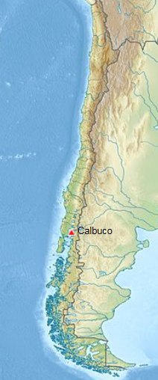
Volcano Pilot, Calbuco, Chile
After 43 years of quiescence, Calbuco began erupting on 22 April 2015, with very little warning.
Large amount of ash, significant impact on air traffic on Chile and Argentina. Ash tracked and was communicated to VAAC Buenos Aires
Several 1000s people were evacuated from villages closest to Calbuco .
Other interferograms constrain the deformation to have started no more than 1.5 days before the eruption, and to have lasted no more than 1 day.
Partner agencies: SERNAGEOMIN (Chile); Buenos Aires Volcano Ash Advisory Center (Argentina); University of Bristol (UK); Cornell University (USA); NOAA (USA)
Notes:
Preliminary model of the deflation indicates that the source is located about 5 km SW of the volcano’s summit at a depth of 9.3 km beneath the surface, with a volume changes of ~0.045 km³. This source geometry and strength is consistent with recordings from a tiltmeter located 4 km W of the volcano.
SAR data used to characterize co-eruption surface deformation, and to constrain the location of the magma body that fed the eruption.

Slide 20
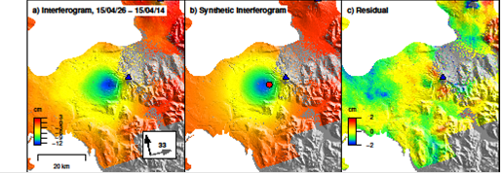
Volcano Pilot, Calbuco, Chile
Observed (left), modeled (center), and residual (right) deformation at Calbuco from a Sentinel-1a interferogram spanning April 14–26, 2015. Deformation can be approximated by a source at ~9 km depth beneath the volcano’s west flank.
Observatorio Volcanológico de Los Andes del Sur (OVDAS) used this source model to validate their tilt meter records

Slide 21
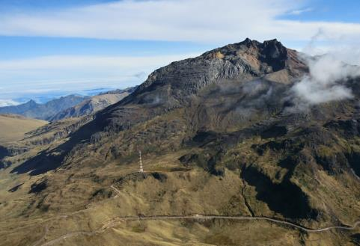
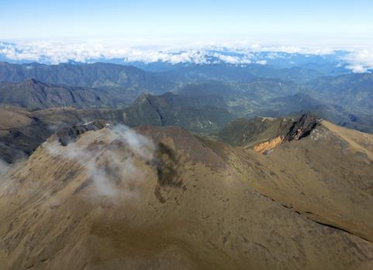
Volcano Pilot, Chiles –
Cerro Negro de Mayasquer
Chiles- Cerro Negro are volcanoes on the Ecuador-Colombian border, with no historical activity
Since September 2014, thousands of small earthquakes every day – but no changes at the surface.
As there have been no historical eruptions, ground based monitoring is limited:
-> satellite data are critical
Chiles
Cerro-Negro
photos: Instituto Geofisico, Ecuador

Slide 22
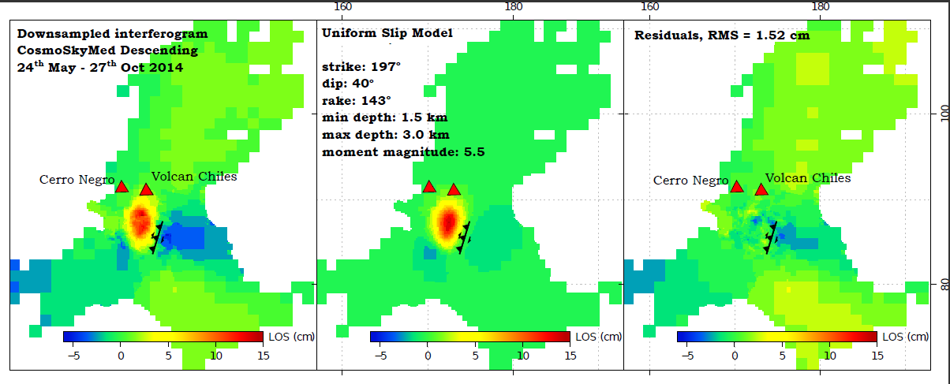
Volcano Pilot, Chiles –
Cerro Negro de Mayasquer
Deformation Best-fit fault plane solution Residuals
The deformation detected using InSAR has so far been primarily associated with a larger (M5.6w) earthquake on the 22nd October 2014. This earthquake result in maximum displacements of 15 cm towards the satellite in a region SW of Chiles volcano.
The majority of deformation can be explained by oblique slip on a fault at depths ~1.5-3 km. Civil Defense in Colombia ordered the evacuation of 12,000 people.
Notes:
The majority of deformation can be explained by oblique slip on a fault at depths ~1.5-3 km dipping WNW. The orientation of this fault aligns well with faults mapped from regional topographic structures.

Slide 23
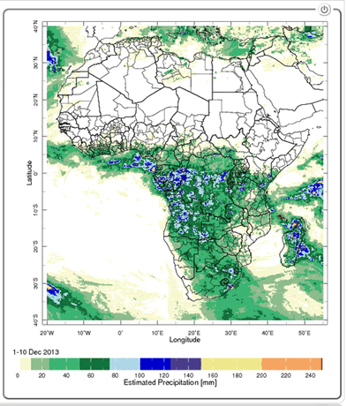
Management of Mosquito-borne Diseases
Malaria and meningococcal meningitis epidemics: recurring problems in Africa
Risk for malaria transmission increases:
Average temperature between 18°C and 32°C
Average precipitation is greater than 80mm
Average relative humidity is greater than 60%
Estimated Precipitation
From SERVIR, NASA’s
Earth Science
PI: Pietro Ceccato,
Columbia UniversityTeam
Combined use of satellite observations and
performing models can provide accurate
predictions to local populations
Notes:
78% of events are infection diseases; 17 % are due to climate events (floods, droughts)

Slide 24
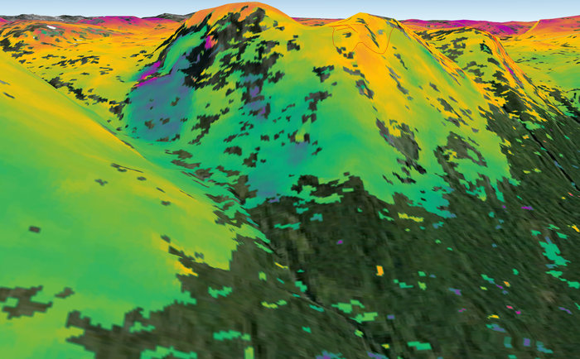
Landslide Risk Monitoring
‘Interferometric’ image showing surface deformation of a landslide in the municipality of Kåfjord in Troms county, Norway.
  Sentinel-1A radar scans from 23 Sep. and 30 Aug. 2014
In 24 days, the ground moved about 1 cm.

Slide 25
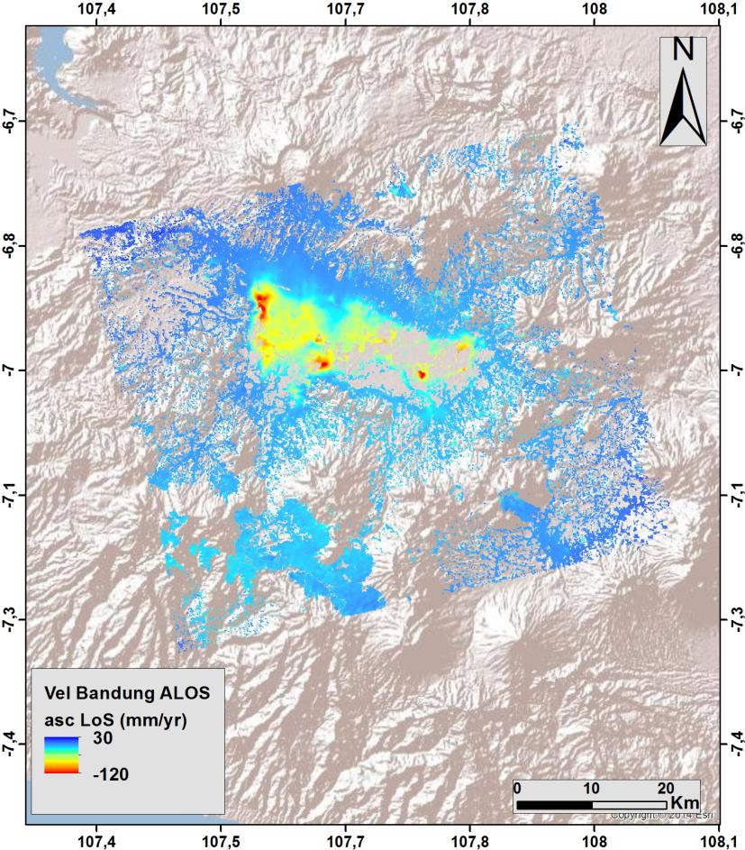
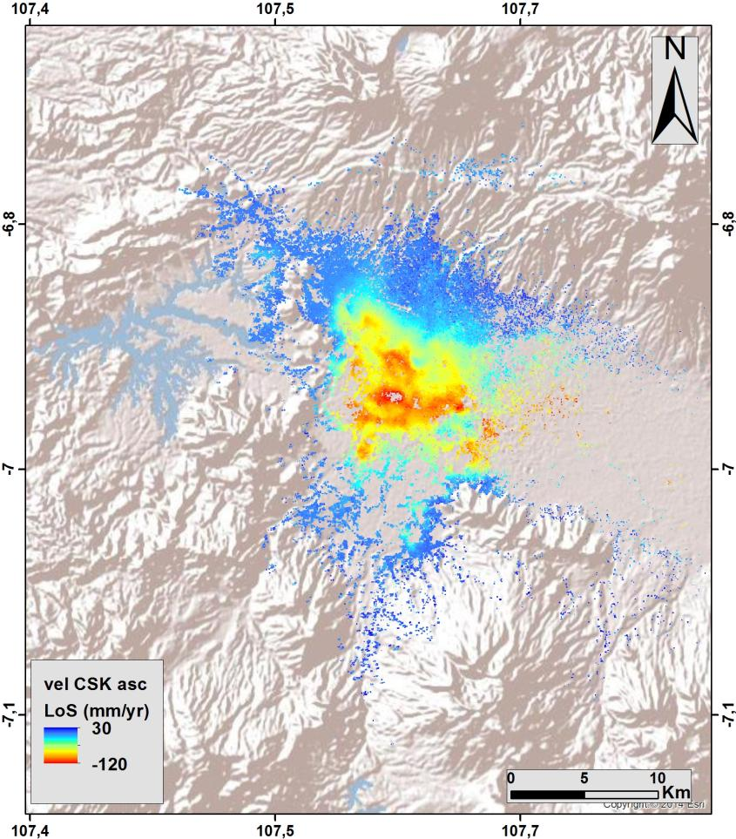
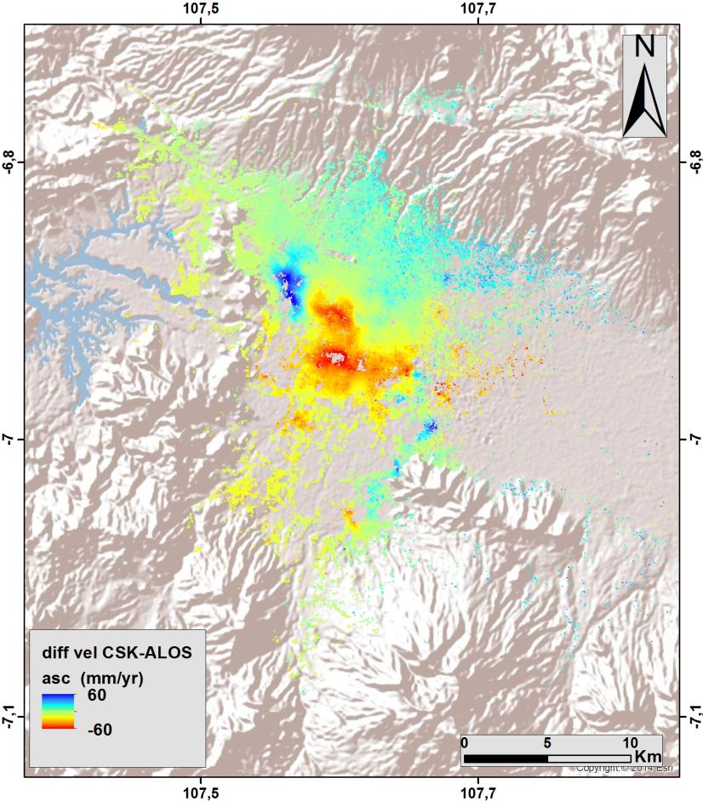
Flood Modelling and subsidence in
South-East Asia
ALOS ascending (2007-2011)
CSK ascending (2013-2015)
Difference (CSK-ALOS)
(red = increased rate of subsidence)
Notes:
Using ALOS and CSK data, INGV calculated the changing rate of subsidence (2007-2015) in an urban flood plain in Bandung, Indonesia, with a view to improving risk assessment for long-term flood projections (RASOR Project).

Slide 26
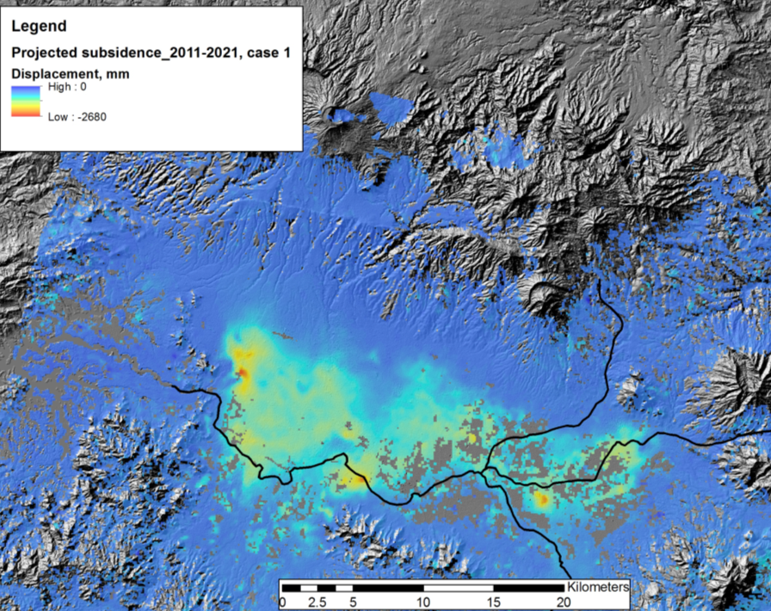
Flood Modelling
- Subsidence Projection
Other Activities:
Consultations on new pilot
products with UN, World Bank, and ICRC
Asian Disaster Preparedness
Center (ADPC, Bangkok
Thailand) to setup instance of
flood modeling and monitoring
processing and distribution
software installed under
cooperation with SERVIR and
USAID Oct-Nov 2015
Projected total subsidence by 2021 of up to 2.2 m along main drainage areas.
© INGV
26
Notes:
RASOR project showing subsidence impact on flood hazard in the Bandung area in West Java, Indonesia.

Slide 27
Thank You!
ivan.petiteville@esa.int
andrew.eddy@athenaglobal.com

