Slide 1
Communicating the success of the pilots
Committee on Earth Observation Satellites
Stéphane Chalifoux, WGD Chair Andrew Eddy, WGD Secretary
WGD#8, Buenos Aires, Argentina
September 4-8, 2017

Slide 2
How to report success?
Publication on web site. Each pilot lead to provide ½ page general public summary and then a link to more detailed information.
Current target is 2 web stories a year (could do more).
Publication of articles in specialized scientific journals.
Presentations at international meetings.
Glossy ‘pilot report’ highlighting pilot results, as a preparation of the pilot successor strategy for 2017.
Strengthen linkage with international organizations (UN, GEO, WB…)

Slide 3
CEOS Disaster Website
By the end of the summer, review of the Disasters pages
From a structure perspective
From a text perspective
From a contact perspective
Web stories:
RO (October 2017)
TBD, Landslide? (March 2018)
TBD, Geohazard Lab? (October 2018)

Slide 4
GP-STAR
Global Partnership on Space Technology Applications for Disaster Risk Reduction (GP-STAR)
Support the implementation of the Sendai Framework for Disaster Risk Reduction 2015-2030
Chair: Mexican Space Agency
Co-Chair: Disaster Management Center Government of Sri Lanka
Name of Working Group | Sendai framework component | Members
“Cancun”: Preparation of GP-STAR side event, including brochure, fact sheets and GP-STAR web page, for Global Platform Session Cancun, Mexico 2017 | All | GEO, UN-SPIDER, DMC-SL, ISPRS (tbc), IWG-SEM, CEPREDENAC, AEM
Volcanos (tbc) | Priority 1 | DLR, CEPREDENAC, CEOS (tbc), GEO POs (tbc), ISPRS (tbc)
Droughts | Priorities 1 and 4, global targets and indicators | DMC-SL, IWMI, UNCCD, WMO, CNE-DR, ESCAP, ZFL UniBONN , ISPRS (tbc), GEO POs (tbc), UNU-EHS
Sand and dust storms | Priorities 1 and 4 | UNCCD, WMO (tbc), NDRCC (tbc), SDIM (tbc), ISA –Iran (tbc), UN-SPIDER, ISPRS (tbc)
Tsunami | Global targets and indicators | Tohoku University, MMAF-Indonesia, Sentinel Asia, UN-SPIDER, GEO, ISPRS (tbc)
Flood | Priorities 1 and 4, global targets and indicators | IWMI, IWG-SEM, Sentinel Asia (tbc), DMC-SL, CNE-DR, GEO POs (tbc), CEOS (tbc), EC [DG-JRC, COPERNICUS] , DLR (tbc), WMO, UNCCD

Slide 5
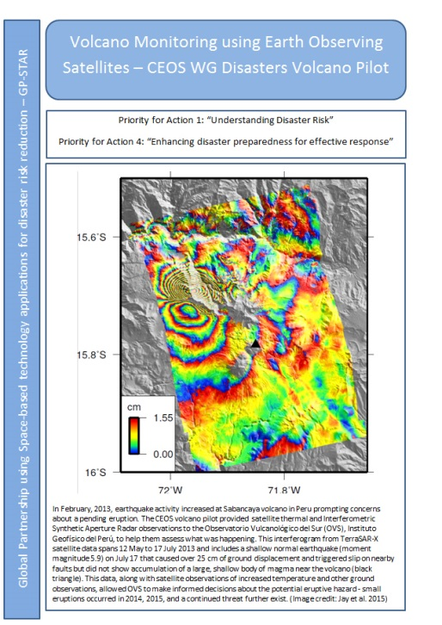
GP-STAR
Global Partnership on Space Technology Applications for Disaster Risk Reduction (GP-STAR)
WGDisasters contribution:
GP-STAR Meetings and Website
Volcanoes WG (fact sheet)
Floods WG
Special events
GP-STAR side event at the Global Platform for Disaster Risk Reduction meeting in May 2017, organized by The United Nations Office for Disaster Risk Reduction.

Slide 6
Communications and Outreach
Conferences
- New Dimensions for Natural Hazards in Asia conference, 4-8 February in the Philippines
- Fifth global Understanding Risk Forum! May 14-18, 2018 in Mexico City
Meetings
- TBD

