Slide 1

GEO/LEO/SAR Flood Pilot Proposal
Committee on Earth Observation Satellites
David Green (NASA), Andrew Molthan (NASA) and Mitch Goldberg (NOAA)
2020 WGDisasters Meeting
Virtual Discussion
9 – 13, March 2020

Slide 2

Co-Leads and Introductions
Dr. Mitch Goldberg, NOAA/NESDIS
  NOAA’s Chief Scientist for Low Earth Orbiting Satellites and formerly the Chief of the NESDIS Satellite Meteorology and Climatology Division
  Leads the NESDIS Satellite Proving Ground program to improve NOAA services through facilitated collaboration for product developers and end users
Dr. Andrew Molthan, Marshall Space Flight Center
  Research Meteorologist at NASA Marshall, collaborates with NASA’s Disasters Program to help the disasters community use NASA data and tools
  Past experience in the use of numerical weather prediction, GEO/LEO remote sensing, and SAR

Slide 3
GEO / LEO Progress and Pilot Concepts
2019 CEOS Plenary – WGDisasters proposed expanding CGMS flood pilot to include SAR, focus on urban and coastal flooding and bring in more CEOS participation.
GEO/LEO and WGDisasters see opportunities for collaboration:
  Work with community of partners to document needs and requirements for effective water extent and flood mapping
  Share information about techniques, methodologies, methods of product dissemination and best practices
  Identify a small number of impactful flood events with known, rich volumes of GEO/LEO and complementary SAR data
  Identify additional past cases and new, unfolding cases emphasizing availability of multi-frequency and new SAR missions

Slide 4
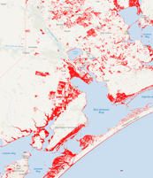
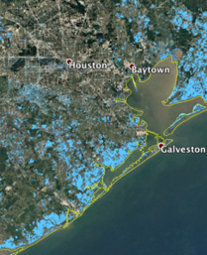

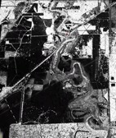
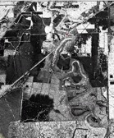
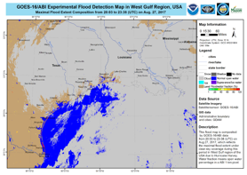
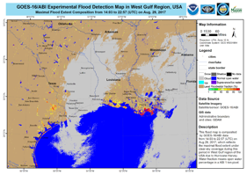
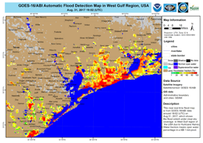
Combined Value of LEO/GEO and SAR
Charter/RadarSat-2 Flood Map
Sentinel-1 JPL/ARIA
Sentinel 1A
ARIA Flood Proxy Map
(Hurricane Harvey)
increased flooding from 9/1-2
Multi-agency collaborations around remote sensing response to Harvey
ALOS-2 JPL/ARIA
9/1/17
9/2/17
August 23
8/26
8/27
8/28
8/29
8/30
8/31
September 1
←UAVSAR Flights→
9/4

Slide 5
Combined Value of LEO/GEO and SAR
Charter/RadarSat-2 Flood Map
Sentinel-1 JPL/ARIA
Sentinel 1A
ARIA Flood Proxy Map
(Hurricane Harvey)
SAR provides cloud and under-vegetation views of water, but often with additional data latency and infrequent repeat passes: constellation approaches are highly valuable!
increased flooding from 9/1-2
Multi-agency collaborations around remote sensing response to Harvey
ALOS-2 JPL/ARIA
9/1/17
9/2/17
August 23
8/26
8/27
8/28
8/29
8/30
8/31
September 1
←UAVSAR Flights→
9/4

Slide 6
Combined Value of LEO/GEO and SAR
Charter/RadarSat-2 Flood Map
Sentinel-1 JPL/ARIA
Sentinel 1A
ARIA Flood Proxy Map
(Hurricane Harvey)
SAR provides cloud and under-vegetation views of water, but often with additional data latency and infrequent repeat passes: constellation approaches are highly valuable!
increased flooding from 9/1-2
Multi-agency collaborations around remote sensing response to Harvey
ALOS-2 JPL/ARIA
9/1/17
9/2/17
August 23
8/26
8/27
8/28
8/29
8/30
8/31
September 1
←UAVSAR Flights→
9/4
LEO/GEO provide routine coverage, limited by cloud cover – their combination provides multiple opportunities to revisit and reassess!

Slide 7
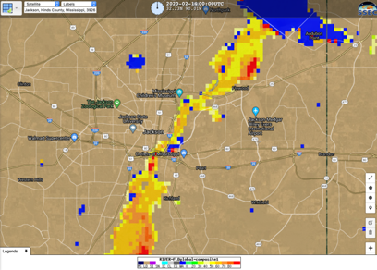
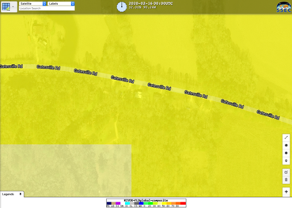
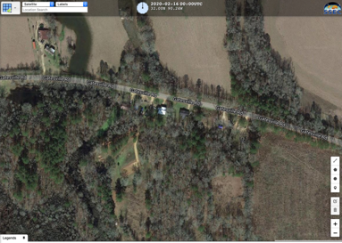
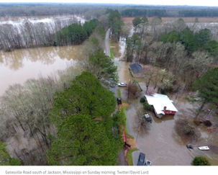
Additional Need: Ground Truth Validation
Feb 16,
2020
An Example
Of Ground Truth

Slide 8
Proposed Pilot Objectives
Objective A
  Solicit input from CEOS partnering agencies and participants on current and upcoming efforts to map water and flood extent from diversity of LEO/GEO and SAR contributions
Objective B
  Capture underlying requirements and future needs to sustain and improve upon these capabilities.
Objective C
  Explore ideal combination of LEO/GEO/SAR flood mapping outputs, using representative regional events of interest to partners.
  Develop and document best practices for combining and sharing flood information from multiple platforms with diversity in sensor, spatial/temporal resolution, etc.

Slide 9
Proposed Pilot Deliverables
Objective A
  Document requirements, current and future needs for remote sensing in LEO/GEO and SAR to sustain and advance water and flood extent mapping capabilities.
Objective B
  Develop and share information online to aggregate sources of water extent and flood mapping information
Objective C
  Demonstrate and document best practices for combining LEO/GEO and SAR flood extent mapping

Slide 10
Proposed Next Steps
Discuss concept of WGDisasters Flood Pilot among potential partners, suggest revisions and refined direction
Create portfolio of the flood community – document remote sensing requirements, data formats, and ancillary data across optical and SAR platforms
Identify water extent and flood mapping capabilities and techniques throughout CEOS agency efforts
Create a CEOS Flood Portal to share documentation on requirements and capture capabilities for flood detection along with related forecasting and analysis websites.
Use case studies to explore best practices for combining LEO/GEO and SAR information from multiple spatial/temporal resolutions
Share lessons learned on mapping capabilities and combined LEO/GEO and SAR in partnership with WGCapD

Slide 11
Questions / Group Discussion

