Slide 1
Geohazards Lab
Committee on Earth Observation Satellites
Theodora Papadopoulou, Philippe Bally, ESA
Michael Foumelis, BRGM
CEOS WGDisasters-13
Pasadena, California
09 – 13 March 2020

Slide 2
GeoHazards Lab Initiative
Geohazards Lab:
A platform with federated resources to provide data access and an online processing and e-collaboration environment to exploit EO data to assess geohazards and their impact
Supports and complements the CEOS WG Disasters activities (on-going pilots, follow-on activities and the RO), GSNL and users from the broader geohazards community.
Maximize use of EO techniques and cloud processing by the EO expert community
Achieve acceptance of EO products by the non-EO scientific community and decision makers
Landslide Pilot
Seismic Hazards Demonstrator
Volcano Demonstrator
Geohazards Lab
Recovery Observatory
CEOS WG Disasters

Slide 3
CEOS Pleiades users agreement - Data order/delivery Procedure
ESA and CNES reached an agreement:
CEOS-Pleiades users can now access via GEP any existing (or newly requested) Pleiades images stored on GEP
A CEOS user submits a Pleiades data request form to isis-pleiades@cnes.fr , provided the request is approved by the thematic CEOS Demonstrator/Pilot lead*
CNES checks that the entity/public institution to which belongs the « User » has signed the SCA
If 2 is OK, CNES asks Airbus to acquire/produce the image
Airbus informs the user and the platform operator for the delivery of the images by FTP
The dataset is made available on the platform by the platform operator
The platform operator grants access to all CEOS-Pleiades users and the Pleiades lisence is signed (electronically if possible) before each download
The dataset is shown on the catalogue for all platform users; no processing/download is permitted but any user can see the (metadata) catalogue of imagery.
*Leads responsible for Pleiades data requests
Landslides: Jean-Philippe Malet
Seismic: Theodora Papadopoulou, Stefano Salvi
Volcano: Michael Poland
RO: Hélène Deboissezon

Slide 4
CEOS Pleiades users agreement - Data access via GEP
Once the SCA is signed by ESA, CEOS Pleiades users will be able to access Pleiades imagery on GEP following the procedure below:
The user visits: https://geohazards-tep.eu/ and logs in with his/her account.
Thematic leads are kindly requested to provide a list of CEOS Pleiades users including their emails.
ESA check with CNES the list of entities who have signed the SCA
The user opens the Thematic Apps tab and selects one of the available Thematic Apps e.g. EO Services for Landslides Analysis.
Under the tab EO data the user selects Pleiades.
After selecting the preferred Pleiades image(s), the user, depending on his/her rights on the platform, can visualize/download/process the available Pleiades images.
In order for an individual to join the CEOS-Pleiades-Users group, the entity/public institution that they belong to must have signed an SCA with CNES.
Currently, if a CEOS Pleiades user has not signed the Pleiades license for an image that he/she is about to download/process, the user will be asked by the GEP operator to sign the license by email.
A new functionality shall be implemented: when clicking the Download button, a user that hasn’t previously signed the Pleiades license will be prompted to sign it online.
Privileges of CEOS Pleiades users concerning the download and processing of Pleiades imagery, as well as visualization, download and sharing Protected and Derived products have been predefined and agreed between CNES and ESA.

Slide 5
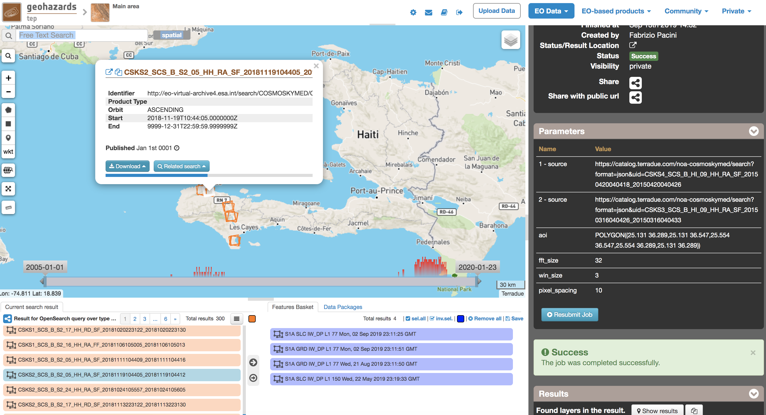
Cosmo-SkyMed data on GEP
ASI contributes to the Geohazards Lab by making available CEOS and GSNL Cosmo-SkyMed datasets through GEP.
The totality of GSNL data are available through GEP (on-going process to remove any duplicated data)
CEOS Haiti RO data are available on GEP
CEOS Seismic and Volcano pilots’ data to be integrated
Two processing chains available on GEP for processing Cosmo-SkyMed Stripmap data (SNAP CSK and SBAS Stripmap).
AOI/Supersite | CSK data on ESA archive | Frame
Ecuador | 27 | GSNL
Campi Flegrei | 524
Hawaii | 1090
Iceland | 1924
Iran | 116
Marmara | 563
Nepal | 657
San Andreas | 446
South Andes | 702
Taupo | 246
Virunga | 885
Haiti RO | 300 | CEOS

Slide 6
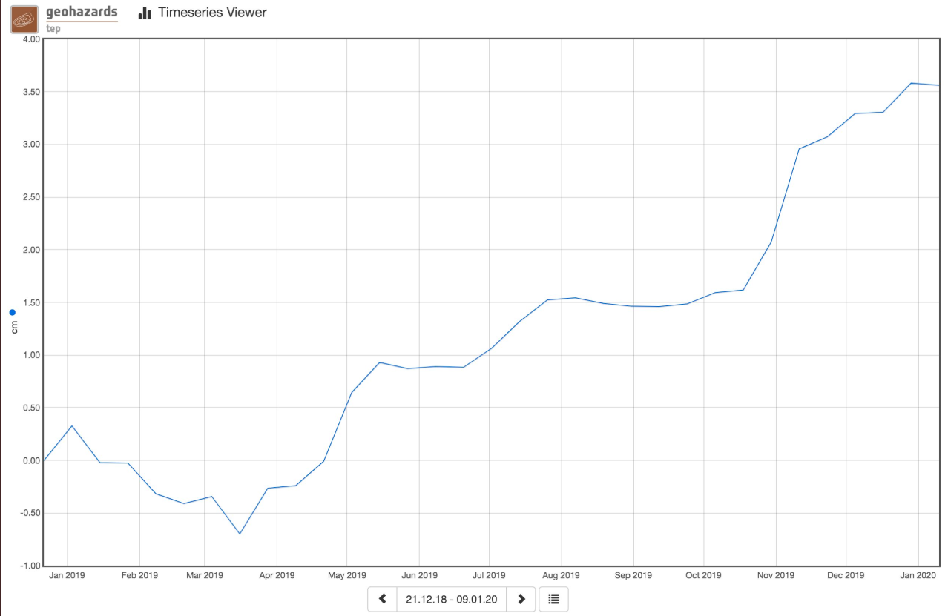
GEP Examples of results - Taal Volcano case

Slide 7
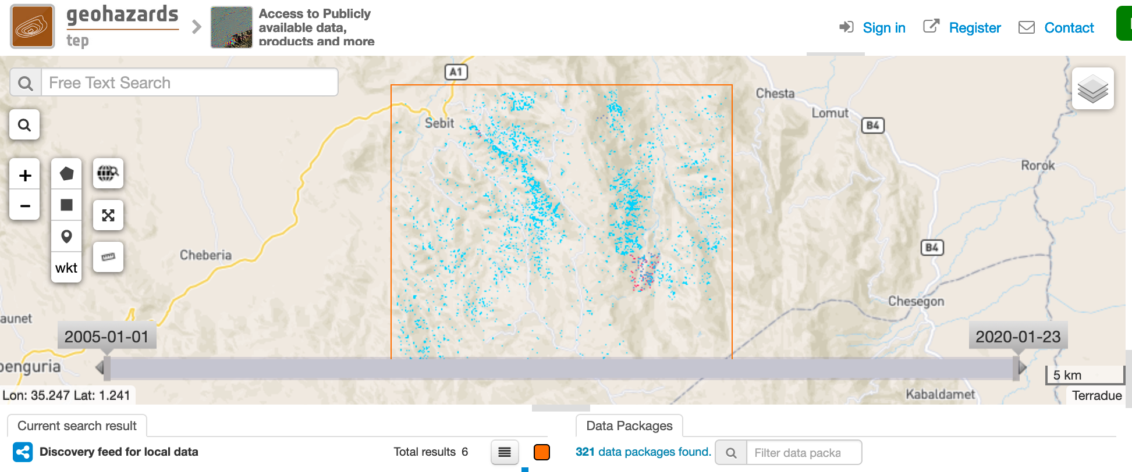
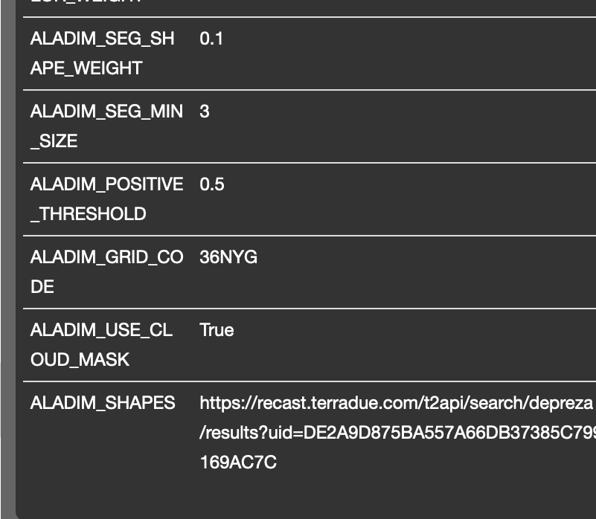
GEP Examples of results - Landslide rapid detection in Kenya 2019
Red: landslide sample
Blue: landslide detection
ALADIM rapid landslide detection algorithm using
Sentinel-2 (ALADIM-S2)
Pleiades (ALADIM-VHR)
joint work of CNRS/EOST and UNOSAT
(with support of CNES and ESA)

Slide 8
Animate & Communicate Scientific Results

Slide 9
Outreach and Capacity building Q4 2019 – Q1 2020
Demo & training on GEP services performed at:
MDIS Workshop, France (October 2019): SNAP-StaMPS PSI service
SUAD University, UAE (November 2019)
RSSAC, Greece (February 2020)
GLab presentation at:
MDIS Workshop, France (October 2019)
RSSAC, Greece (February 2020)
Presentations based on scientific results generated on GEP at MDIS Workshop in France (October 2019)
CEOS webpage updated
Paper (published): Monitoring geohazards using on-demand and systematic services on ESA’s Geohazards Exploitation Platform, IGARSS 2019
GEP Blog posts and tweets
Upcoming:
GLab presentation at FRINGE 2020 (abstract to be submitted)

Slide 10
Geohazards Lab – Reporting on CEOS Work plan Milestones
Objective | Projected Completion Date | Background Information
DIS-20: Pursue the standardization of geohazards EO-products | Q2 2020 | Identify a framework for standardization of geohazards related EO-products to achieve acceptance by the EO community and decision makers
Taking into account that there are currently initiatives working on InSAR standards such as EPOS, EGMS, CEOS WGD, the intention is to prepare a list of common standards with the purpose to adopt them on GEP.

Slide 11
GEP - Way forward Network of Resources
Single access point for:
Resource tier providers (ICT Providers hosting collocated EO data)
Platform service providers (built on top of a resource tier provider)
Addressing
Self-funded user: Any user world wide requiring for any reason Resource Tier or Platform Services (e.g. Science, Development, Pre-commercial and Commercial) who funds the consumption themselves;
Sponsored user: (Science, Development, Pre-commercial) by ESA and other entities via Announcement of Opportunity
Sponsorship upon application (evaluation depends on project merit on a scientific and engineering viewpoints, schedule adequacy to complete the project and achieve positive results etc.)
NoR Portal to onboard GEP in Q1-Q2 2020
Detailed procedure to be communicated to current and future GEP users shortly.

Slide 12
Conclusion
Pleiades data users agreement between ESA and CNES: Pleiades data access via GEP
The totality of GSNL and CEOS RO Cosmo-SkyMed datasets available via GEP
GEP services are being used by the broader geohazards community
Promotion and capacity building: presentations in International conferences and workshops; training sessions organized in Europe and Asia; CEOS webpage updated; a paper published; upcoming: FRINGE 2020
Way forward: GEP to be onboarded on Network of Resources

Slide 13
Thank you
Geohazards Lab:
Philippe Bally, ESA philippe.bally@esa.int
Michael Foumelis, BRGM m.foumelis@brgm.fr
Theodora Papadopoulou, ARGANS Ltd. c/ ESA tpapadopoulou@argans.co.uk
Floriane Provost, ESA floriane.provost@esa.int

