Slide 1
Recovery Observatory (RO) Pilot Haiti Hurricane Matthew RO Status and Next Steps Presentation to WGD #13 March 11, 2020 A Collet, H de Boissezon, C Proy, CNES Jens Danzeglocke, DLR Deodato Tapete, Francesca Cigna , ASI Jean Philippe Malet, CNRS / EOST Enrico Ponte, CIMA Andrew Eddy, RO Secretary with contributions of CNIGS, Copernicus, WB Haiti
Committee on Earth Observation Satellites

Slide 2
Outline
Haiti Recovery Observatory Pilot
Progress since last WGD meeting
Capacity building
Legacy planning and wrap-up
Conclusion

Slide 3
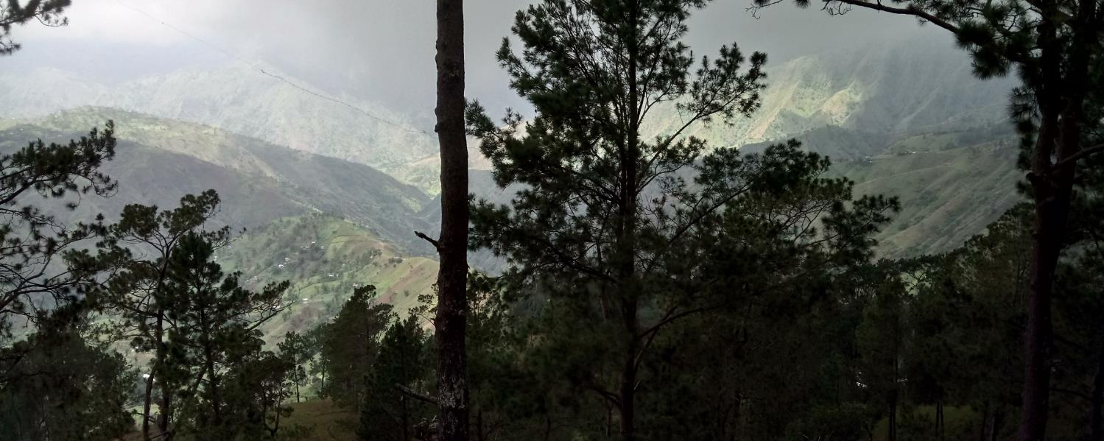
RO Haïti Status Overview
Hurricane Matthew
in Haïti
Oct 4th 2016
A Reminder of Haiti’s diversity
Triggering of the RO by CEOS Chair - December 22, 2016
Mission #1 to Haiti - end January 2017 Definition of activities in Haiti
…
Mission #5 to Haiti 10 – 14 Dec 2018 technical review, training
Mission #6 to Haiti - May 2019 3th User Workshop (PàP + Jérémie)
Sept 2019 – Dec 2019 : troubled period but some work progress however

Slide 4
Key elements since Last WGD mtg
Riots in Haiti canceled the capacity building mission scheduled last December
Finalization of the Mid Term Evaluation Report
New Copernicus Risk and Recovery Mapping activation : EMSN063
Focus on Capacity Building (Internships, Trainings)
Links with WB Haiti post Matthew projects on agriculture: Les Cayes (ended) and Nippes (ongoing)
Links with IADB Haiti projects on environment: Parc Macaya /Ground Movement (on going)
Continued engagement of space agencies (ASI, CNES, DLR, ESA, NASA, NOAA) for data provision and value adding products (NOAA available for health products elaboration)

Slide 5
RO Thematic Products
Les Produits
 | Product | Key user | CEOS | Sat. Data
 | Buildings Mapping | CIAT / Planning Ministry | CNES/SERTIT, Copernicus EMS R&R | Pléiades, WorldView-3
 | Terrain Motion Change Detection | BME / URGeo | ASI, CNES/EOST | COSMO-SkyMed, Pléiades, Spot 6/7, TerraSAR-X
 | Watershed / Flood | ONEV / Agriculture Ministry | ASI/CIMA Foundation | Pléiades, COSMO-SkyMed
 | Agriculture | Agriculture Ministry | Copernicus EMS R&R | Sentinel-2, Spot 6/7, GeoEye-1, WorldView-2
 | Macaya Park Monitoring | ANAP / ONEV / Environment Ministry | Copernicus EMS R&R, CNES/SERTIT | Spot 6/7
 | Environmental Impact | ONEV / Environment Ministry | Copernicus EMS R&R | Sentinel-2, Spot 6/7, Pléiades, WorldView-2
 | Land Use | All | CNIGS, CNES | Sentinel-2
Vector Borne Disease risk | Health Minister/ OMS | NOAA | L8, Images NOAA + statistic needs
Air pollution | ONEV / Ministère Santé | NASA | S5P Tropomi on going discussion
Notes:
Rencontre avec le min de la Sante Haïtien. Courier officiel pour recup stats d’occurrence des maladies (dengue….)
Air pollution: meeting RO / NASA fait et mise en contact avec le CIAT et délégation européenne . Echange en cours

Slide 6
RO Timeline
01
Opening
Today
Du RO Haïti par le CEOS
Q1 2020
22/12/2016
05
REX
02
ROOP
03
G-RO
04
Evaluation
Feedback
Q3 2020
Du RO Haïti par le CEOS
First meeting
RO Haïti
Q3 2017
Q3 2018
Q4 2019
Disaster
Ouragan Mathieu Haïti
04/10/2016
M2
Workshop 1 (PàP)
M4
Workshop 2 (PàP, Cayes)
M6
Workshop 3 (PàP, Jérémie)
M8
Closing workshop
29 Mai – 2 Juin
8 - 11 Mai
26 Avr - 4 Mai
Q2 : PàP, Jérémie
M1
First contacts
M3
Technical Review
M5
Training and Revue
M7
Landuse Training
31 Jan – 3 Fev
5-8 Dec
10-14 Dec
Q2
Q4
Q1
Q2
Q3
Q4
Q1
Q2
Q3
Q4
Q1
Q2
Q3
Q4
Q1
Q2
Q3
Q4
2017
2018
2019
2020
RO post Matthew
Definition and
Implementation
RO post Matthew
Commissionning
RO post Matthew Operations
Lessons learnt for G-RO
RO legs
G-RO concept

Slide 7
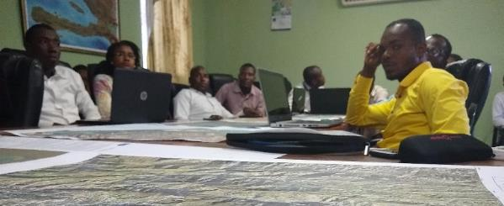
Capacity Building 2020
Links with WB Haiti post Matthew project: Agricultural resilience in Nippes
January Training of two Haitian partners (CNIGS) in Montpellier (France) at CIRAD on Land Use
January – April 4 Internships ongoing at CNIGS (work with CNES/SERTIT)
Urbanization of agricultural areas: issues and challenges in Jérémie
Analysis of the mutation of agricultural areas: Dame Marie and Jérémie
Analysis of the dynamics of woodland cover and coastal erosion: Dame Marie
March – August 1 Internship by a Haitian student in France on Land-Use :
"Characterization of land use in an agricultural environment in the Dame-Marie sector (Haiti) by the application of the Moringa chain".
Links with IADB Haiti projects : Macaya Park / Ground Movement
March / April Training of two Haitian partners (CNIGS) in Italy at ASI with IADB & Macaya Park input (more info on ASI section)

Slide 8
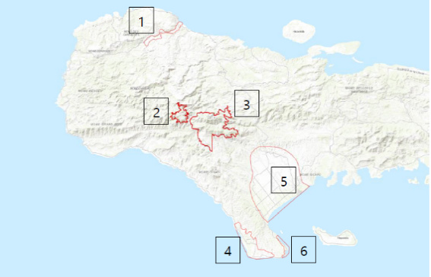
Copernicus EMS RRM
EMSN 051 “ Environment” (2018)
Area : Macaya Park, Port Salut, Les Cayes, Jérémie, Pointe Abacou and Costal line.
Agricultural activities
Coastal Line evolution
Macaya Park classification and monitoring forest damage
Mangrove monitoring
CNIGS/CIAT/ONEV have asked for two other RRM activations mid 2019 on two products, through EU delegation : Activation EMSN 063 launched in January 2020
Result expected beginning of April 2020.
Agricultural monitoring
Macaya Park land use map and wooden areas monitoring

Slide 9
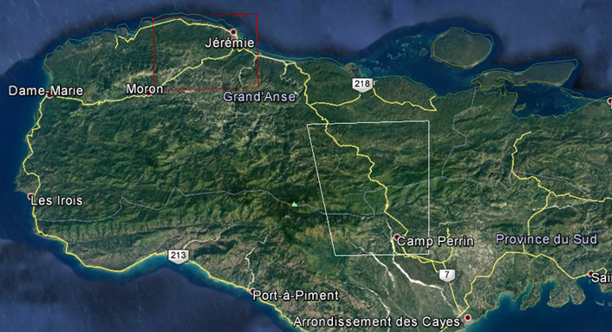
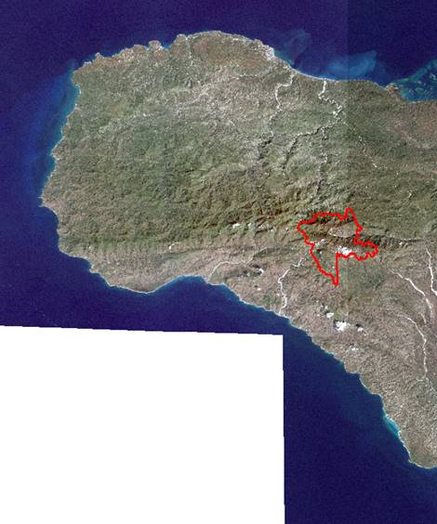
CNRS EOST / CNES
EOST RO activities on landslide mapping: EOST/CNES
On going Landslide Inventory on whole optical RO archive over 2 main areas

Slide 10
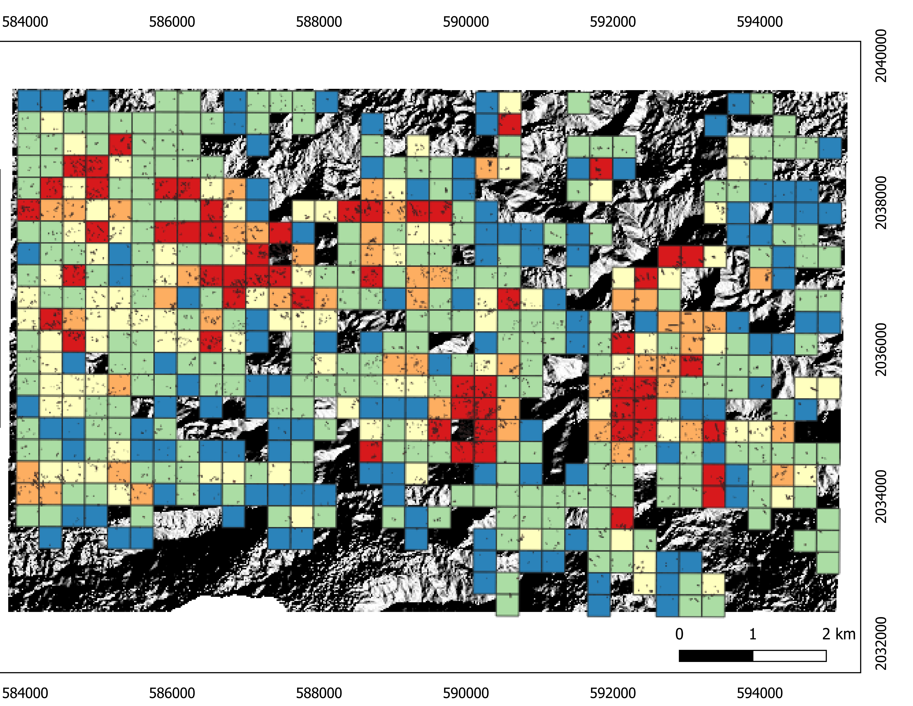
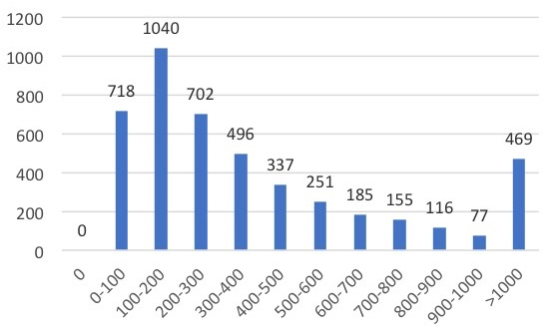
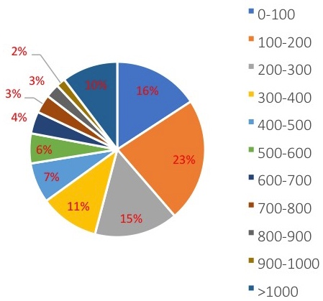
POST-MATTHEWS EO DERIVED LANDSLIDE INVENTORY: FROM INVENTORY TO SUSCEPTIBILITY MAP
Previous works: ALADIM derived inventory from SPOT6/7 images and aggregated indicators
Landslide density (over 1 km2 mesh)
[0.0 – 0.1[
[0.1 – 0.4[
[0.4 – 0.7[
[0.7 – 0.9[
[0.9 – 1.0]
Number of landslides: > 7000
Landslide surface: 4km²
Landslide size (m²)
Landslide size (m²)

Slide 11
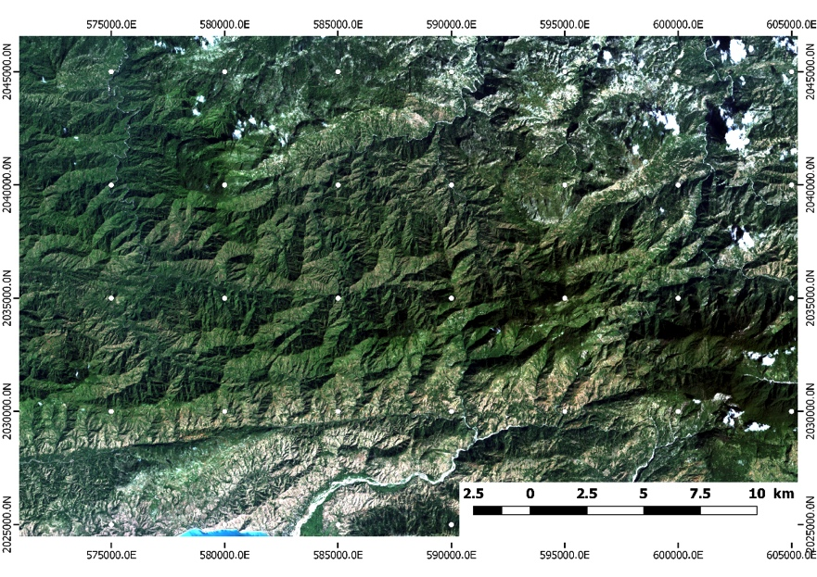
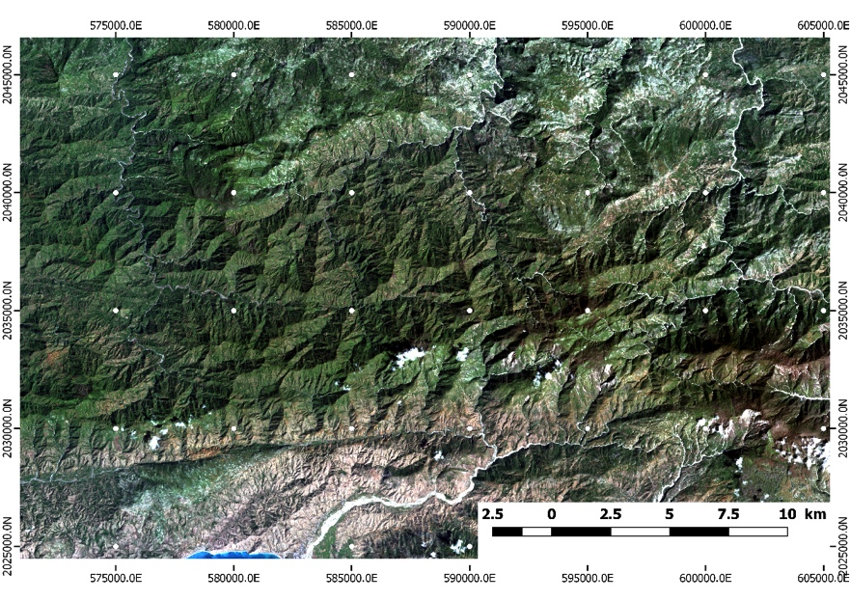
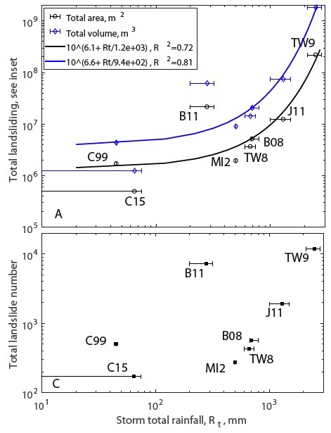
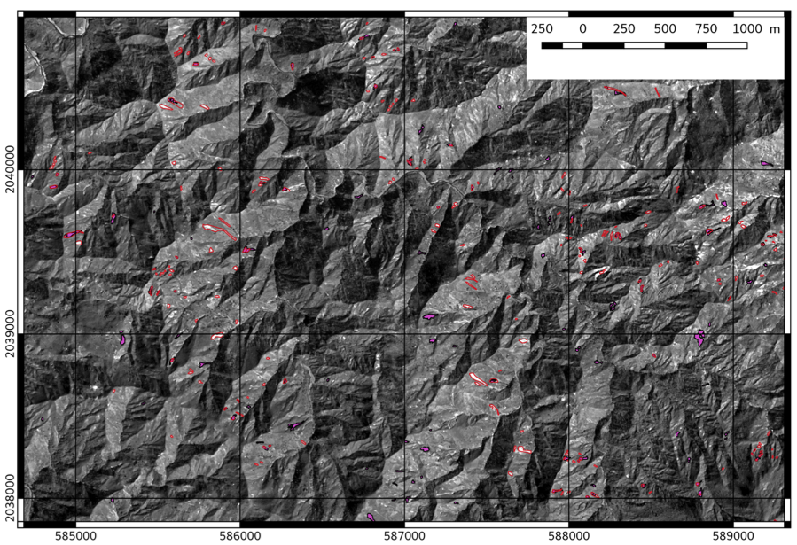
POST-MATTHEWS EO DERIVED LANDSLIDE INVENTORY: FROM INVENTORY TO SUSCEPTIBILITY MAP
Les Anglais cordillera – SPOT 6
Previous works: scaling laws – rainfall pattern vs. landslide size
Les Anglais cordillera – SPOT 7
Landslide properties and rainfall properties (ex. of recent extreme rainfall)
Space-based inventory from ALADIM

Slide 12
POST-MATTHEWS EO DERIVED LANDSLIDE INVENTORY: FROM INVENTORY TO SUSCEPTIBILITY MAP
Project 2020: sponsored by CNES
Provide a final version quality controlled of the optical derived landslide inventory for the full Spot6/7 coverage
Compare the optical derived landslide inventory to InSAR detection (based on the processing by ASI)
Propose a landslide susceptibility model (eg. a map presenting the possible spatial occurrence of landslides) for the region using a Random Forest classifier, and few exploratory variables (relief, geology, landcover)
Train Haitian users on Aladim/GEP and on the susceptibility modelling

Slide 13
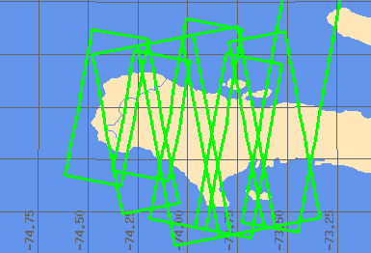
DLR – TerraSAR data
There are 13 TerraSAR-X coverages of the whole area :
Ascending + Descending orbit
4 full coverages in 2019, one more between Dec 2019 and Feb 2020
The 14th coverage starts in March 2020.
There are 170 scenes available on the TSX Supersites Portal of DLR: https://code-de.org/download/tsx-supersites/Haiti/ (access for registered science users)
Notes:
Les italiens ont récupéré les donnés

Slide 14
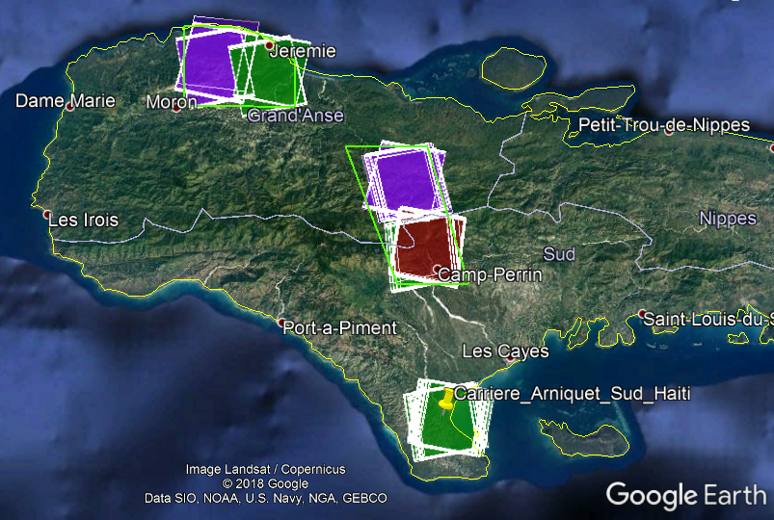
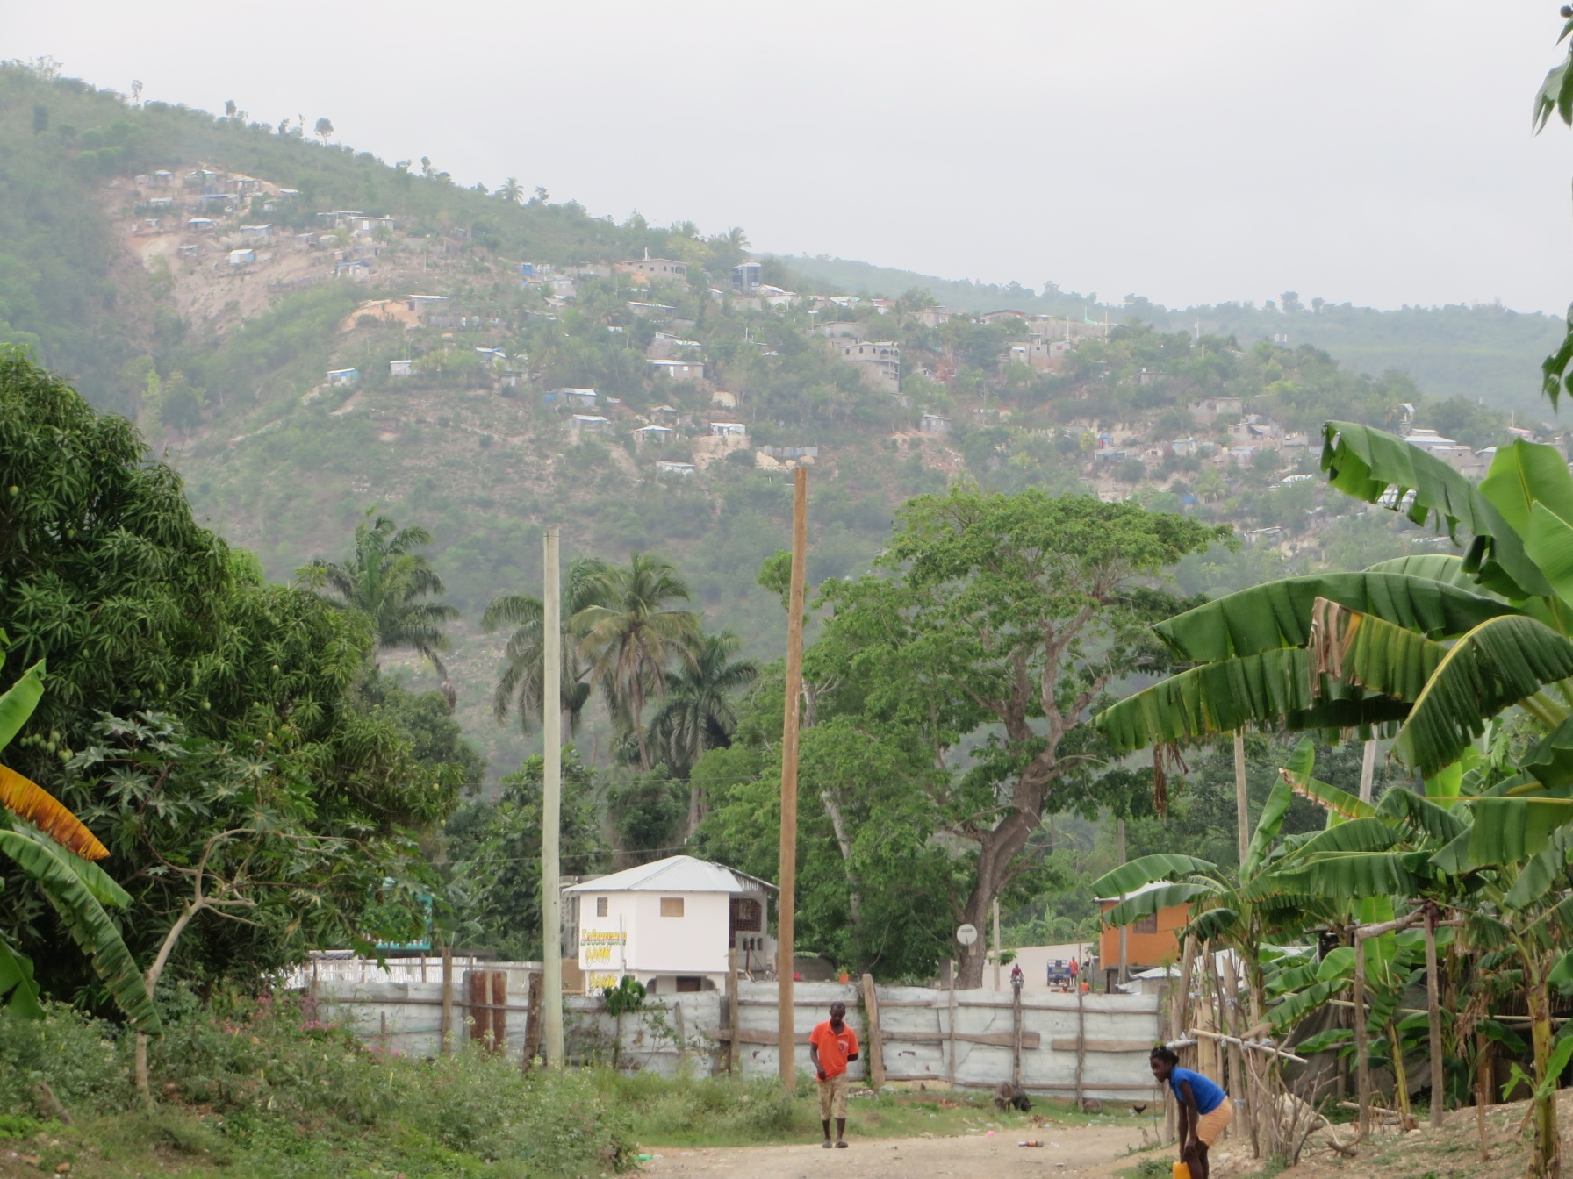
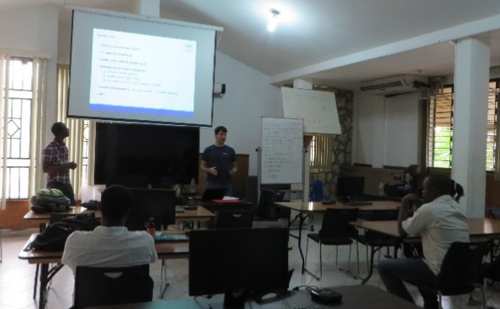
ASI – Terrain motion products
ASI’s scientific goal → To develop experimental scientific products tailored to obtain useful information on ground stability and motions for target areas of the RO
Satellite data analysis and ground truth activities
COSMO-SkyMed acquisition campaign with VHR SAR over 3 hotspots (Jeremie, Camp-Perrin, Carriere Arniquet), started in Dec 2017
X-band SAR change detection using COSMO-SkyMed and TerraSAR-X
Sentinel-1 data processing with ESA GEP hosted services, to create interferograms, amplitude change and coherence maps
Technical mission in Haïti in Apr-May 2019 (field checks, data validation, discussion with stakeholders)
COSMO-SkyMed SpotLight
Capacity building
Apr-May 2019: scientific seminars on SAR data and applications held at LNBTP-Haïti during field mission
Mar-Apr 2020: visit of 2 CNIGS staff members in ASI in Rome, to learn how to process Sentinel-1 data in GEP
Upcoming dissemination
Jun-Jul 2020: presentations at IGARSS and FRINGE 2020

Slide 15
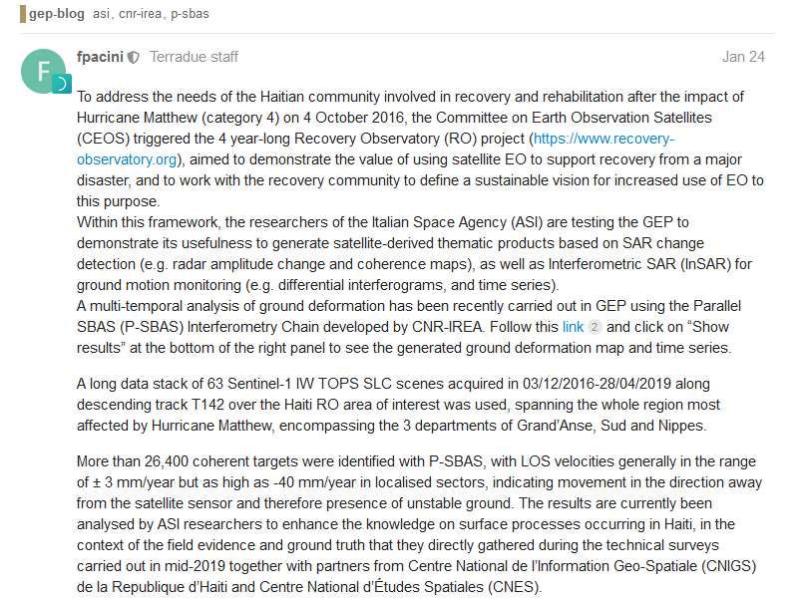
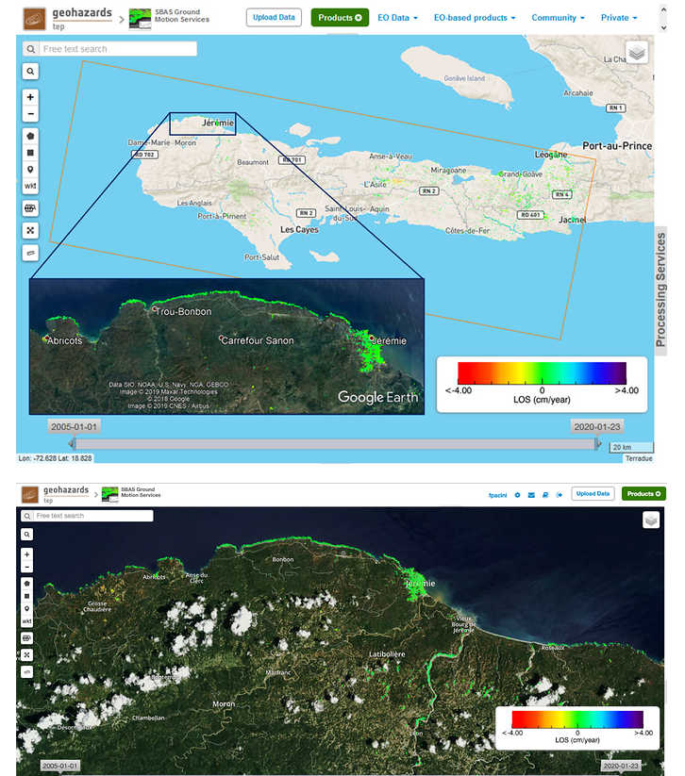
ASI – Terrain motion products
Dissemination via ESA GEP Blog
“Observing surface deformation in Haiti after Hurricane Matthew with Sentinel-1 in GEP”
https://discuss.terradue.com/t/observing-surface-deformation-in-haiti-after-hurricane-matthew-with-sentinel-1-in-gep/845

Slide 16
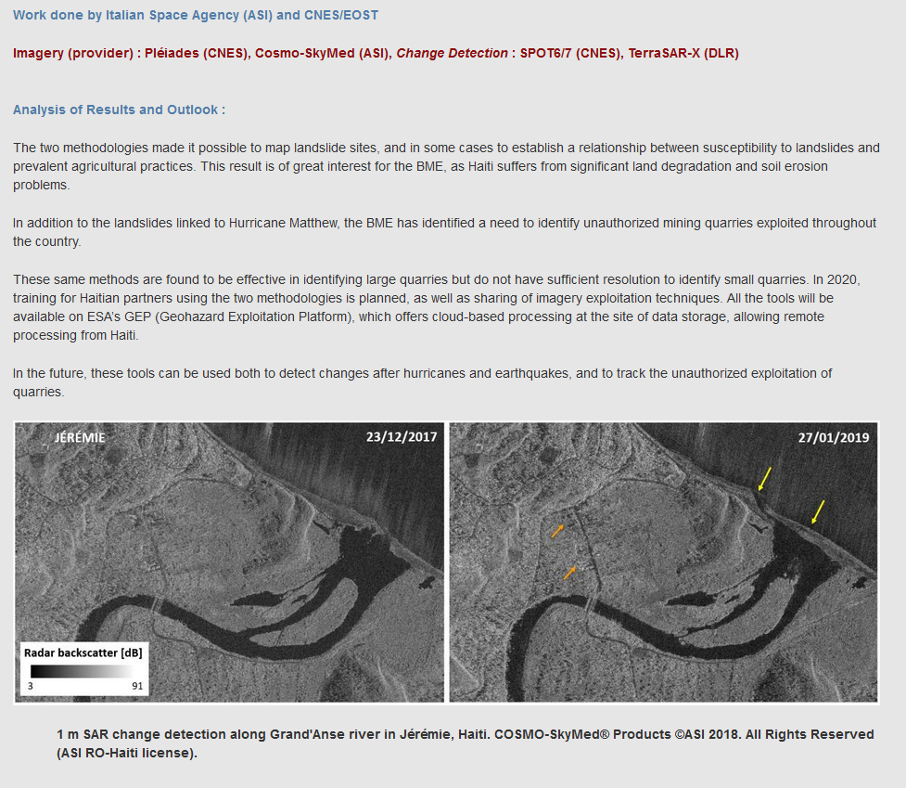
ASI – Terrain motion products
Dissemination via RO website

Slide 17
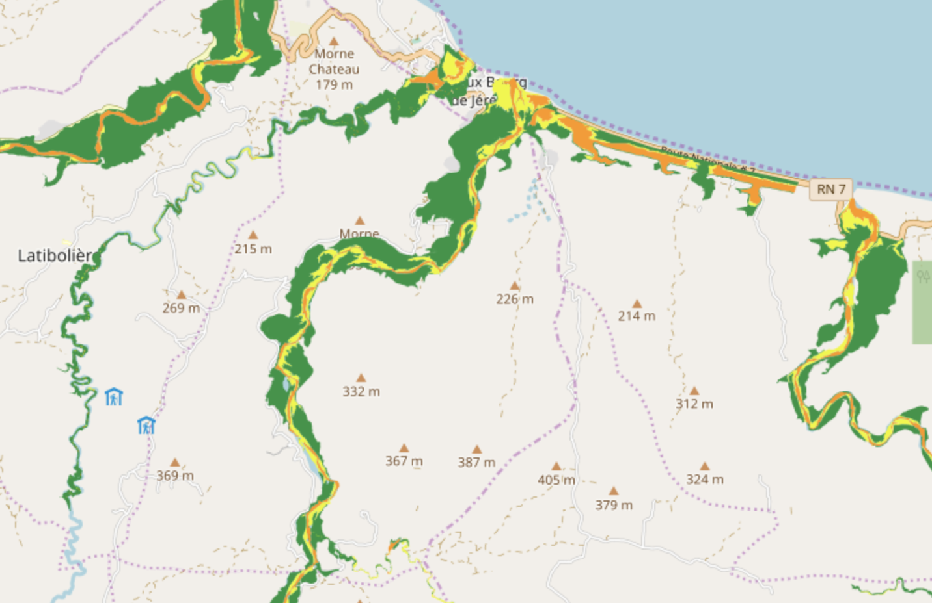
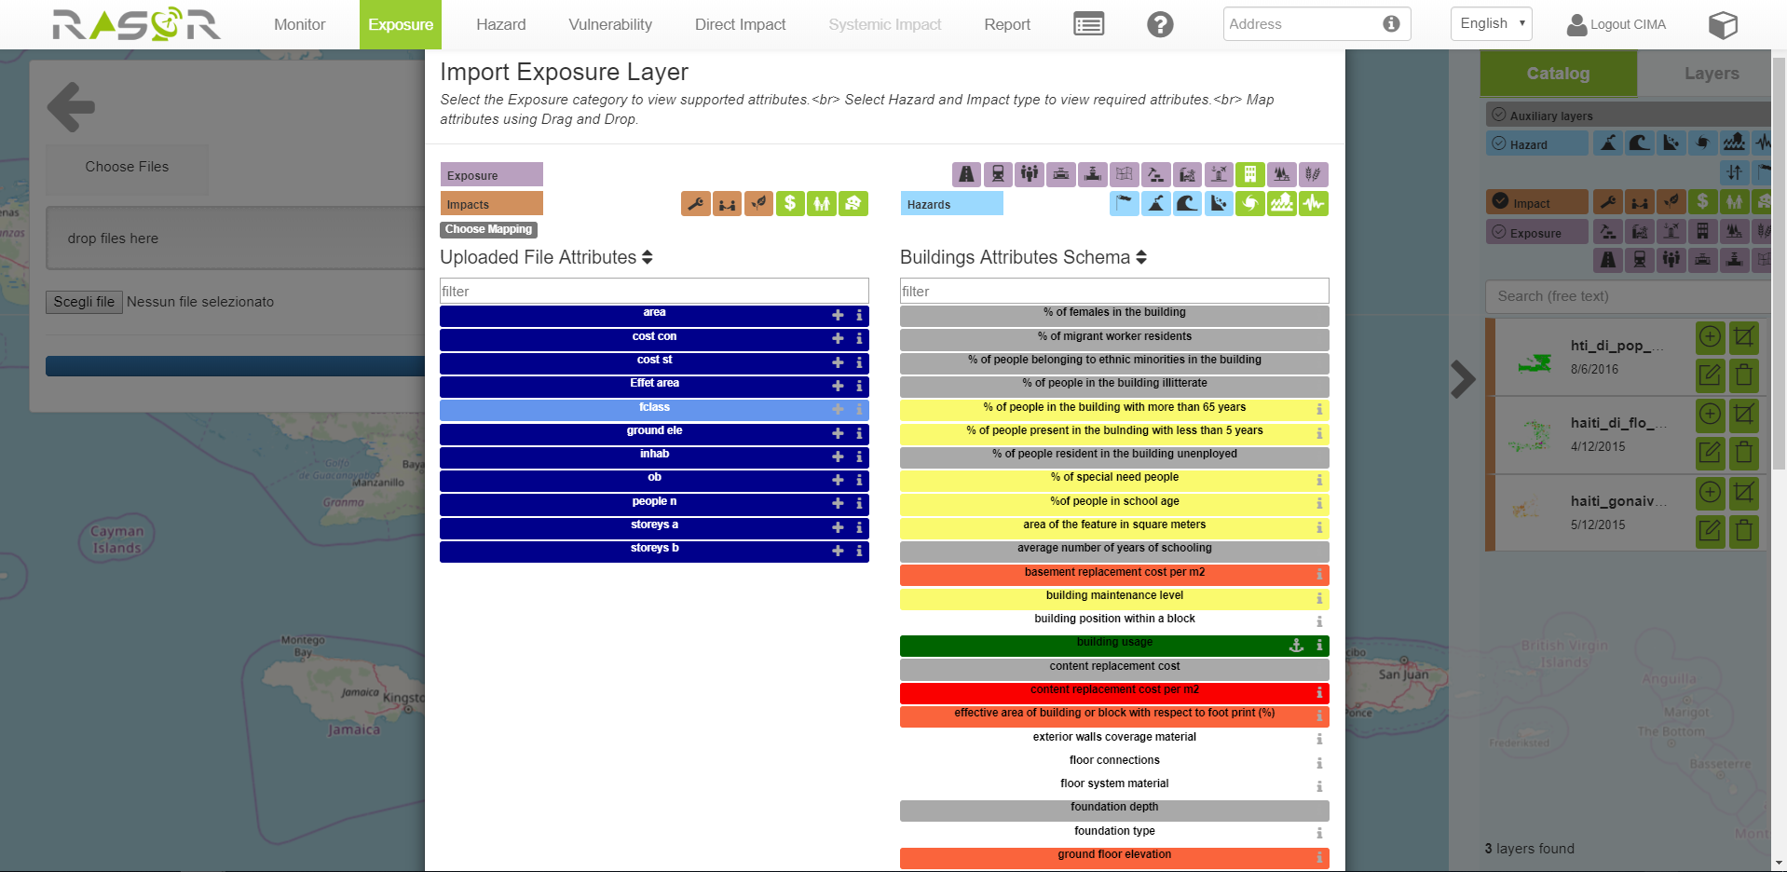
CIMA – RASOR Training
The training expected in April will cover 3 main components:
1.
Hazard:
Uploading and generating new hazard layer
2.
Exposure and vulnerability:
Uploading different exposure shapefile and associating specific RASOR attributions and different vulnerability curves
3.
Impact evaluation:
Generating impact reports and extrapolating the most relevant results

Slide 18
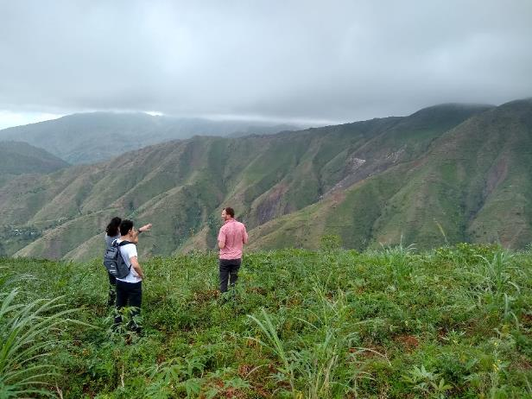
Planned events in 2020
Training at ASI and CIMA (RASOR) for 2 CNIGS experts
Link with EOST using ALADIM on GEP and discuss methodologies
To be rescheduled
Training Session end of May
Training for Land Use Land Cover from S2 data based on IOTA2 tool
The IOTA2 chain should be completely understood by the Haitian team
After this training they should be able to operate IOTA2 S2 chain by themselves Planned : LULC map made by Haitian at the end of training
=> Following previous training made at CIRAD and ASI/RASOR
Extra : Charter PM training

Slide 19
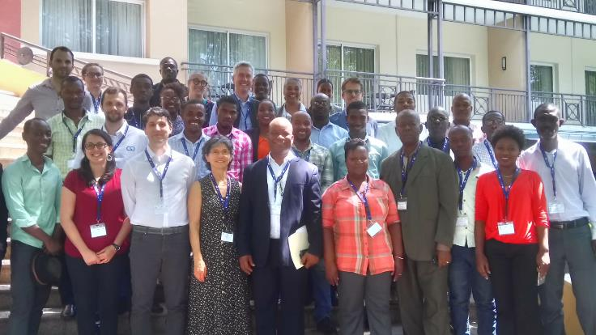
User Workshops #4
June 2020
First week of June 2020 :
Opening of the 2020 cyclonic season
High level presentation of RO achievements
Final User Workshops in Jérémie & Port-au-Prince
RO products analysis and last delivery
Haiti RO closure preparation
Lessons learned
RO Legacy preparation
Steering Committee # 6

Slide 20
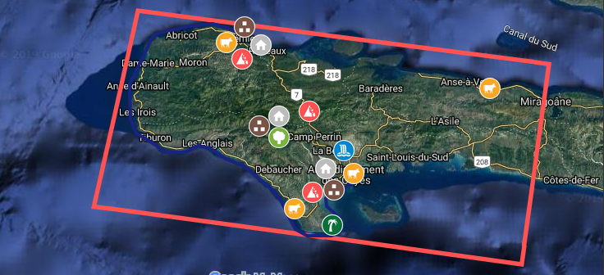
Project tasks in 2020
Development plan for Thematic products regularly updated with Haitians
8 New Optical images since September : Pléiades (being integrated on GEP)
Integration into the Web server of new products (25) and experience feedback from Value Adders

Slide 21
Legacy Considerations
RO Pilot ends in 2020 – presentation to CEOS plenary Q4 2020
RO legacy in Haiti will consist in EO data and products database and capacity building with Haitian organizations:
Discussion with CNIGS to determine how RO database can be transferred to HaitiData.org
Significant work is being performed to ensure success is consolidated – Effort underway to identify specific projects which could fund follow-on efforts that build on RO success:
National Environmental System Indicators (SIE) with UNEP
Resilient agriculture projects with WB in Nippes and Les Cayes
Forestry and Environment (mangrove) projects with IADB
Lessons learned for scalable and replicable RO

Slide 22
Conclusions
Troubled period in Haiti delayed the capacity building roadmap. However due to our strong links with WB projects and Haitian community, Haitians partners have benefited from training in Europe and will continue to do so with ASI and CIMA. So it does not affect the final planning for the moment.
In this final phase of Capacity building the last product are not forgotten and Copernicus EMS063 will respond to the last request from previous workshop (from several mayors).
The next mission will be focused on high-level and decision makers final workshops, as well as outreach linked to the cyclonic season opening.

Slide 23
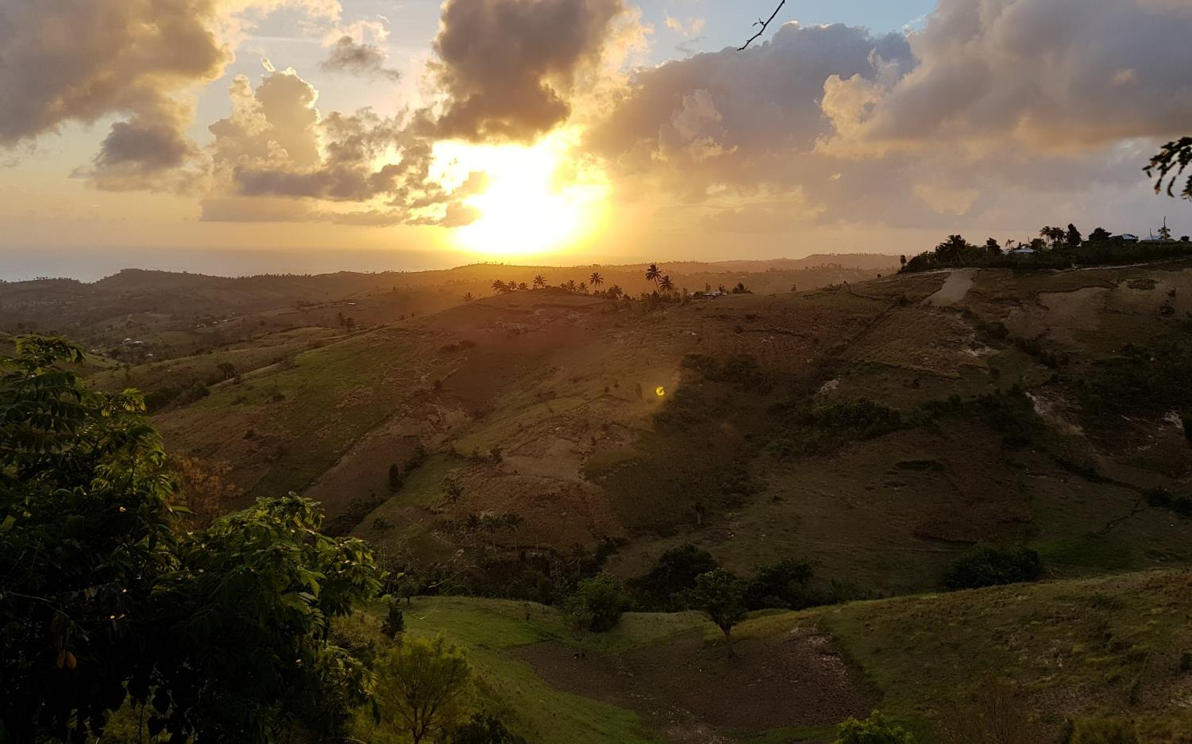
Thank you
Merci
Mesi

