Slide 1
GEO-DARMA Update and Status WG Disasters 13 10 March, 2020 – Teleconference Ivan Petiteville, Chair, GEO-DARMA SC Andrew Eddy, Secretary, GEO-DARMA SC
Committee on Earth Observation Satellites

Slide 2
GEO-DARMA Phases
Concept phase completed for all regions.
Prototyping phase underway:
1 project approved (Asia – GD-1 SERVIR Mekong
Several projects under development/in consolidation in Asia, Africa and Latin America/Caribbean.
Iterative process: new projects welcome anytime within identified DRR priorities from concept phase.
if extra resources and funding
identified
18
36
Notes:
GEO-DARMA approved by GEO Programme Board fall of 2016
GEO-DARMA aims rto offers improved access to satellite data in support of risk management initiatives.

Slide 3
Regional Assessments
and Projects
Regional assessments provide consensus on regional priorities
Regional DRR priorities serve as filter for project selection, along with other criteria (ease of implementation, resources, impact/benefits, scalability, etc)
New projects reviewed by SC for coherence with regional assessments. SC recommends projects for implementation.

Slide 4
Overview - Proposed Projects
Criteria for Further Development
For each project, champion presents:
Alignment with regional priorities as identified in regional assessments
Ease of implementation
Ability of CEOS and other data providers to meet needs
Resourcing (finance, in-kind contribution, maturity of project development)
Benefits (cost benefits, societal benefits,…

Slide 5
GEO-DARMA – Recent Progress
RSAT-2 data request submitted for GD-1 SERVIR Mekong
Discussions with ESCAP - UNGGIM on new project proposal (tied to SDG monitoring and developing standard data collection practices integrating statistics and geospatial data)
Circulation of PRIDE proposal (RCMRD, Africa) to identify funding partners
Agreement in principle to work with UNDRR Americas, CDEMA, CEPREDENAC and Andean Community on Regional Assessment for Latin America/Caribbean. Discussions held around two potential projects to be developed in 2020

Slide 6
Projects – Overview (1/2)

Slide 7
Projects – Overview (2/2)

Slide 8
UN-GGIM Collaboration in Asia Pacific for SDG monitoring
ESCAP designated Secretariat of the UN-GGIM-AP since Nov. 2018.
ESCAP is working on integrating geospatial information with statistics and other ground data for resilience building and sustainable development.
ESCAP received fund from China and Russian Federation on developing common data format for integrated geospatial information and land account and SDG monitoring.
Interest at ESCAP to develop partnership with GEO-DARMA for spatial component.
Proposal to be developed 2020.

Slide 9
Next Steps
SERVIR Mekong/Myanmar NRT Flooding (GD1): need to set up data access (CEOS and ADPC discussion)
RADARSAT data request submitted for four historical events from 2019; no data was available; new request with more events submitted February 2020.
New projects being developed: new projects coming forward, require AOIs, data needs, etc.
ESCAP projects at various sages of development (definition, consolidation, seeking funding) – more input expected spring 2020
RCMRD project requires funding
CEPREDENAC and CDEMA working with AmeriGEO and NASA to develop new proposals in LAC region
Proposals can be received at any time and are reviewed against regional assessments by SC
Project proposals will be consolidated in April (1 ESCAP, 2 AmeriGEO) and presented to GD SC and WGD.

Slide 10
Thank you!
ivan.petiteville@esa.int
andrew.eddy@athenaglobal.com

Slide 11
Steering Committee (SC)
Terms of Reference
Governing body for GEO-DARMA
Provides strategic leadership and governance oversight.
Has delegated authority of the project partners or contributors to make decisions that are in accord with the objectives, approach and scope of the project.
Makes key policy decisions.
Guides the Objectives and implementation of the GEO-DARMA Projects.
Ensures effective oversight through receiving regular reports and reviewing the results of project evaluations.
Meets by teleconference several times a year and in person once a year.
Takes decisions by consensus.
Supported by Secretariat provided by European Space Agency consultant.

Slide 12
LAC Regional Assessment
Results (1)
Latin America/ Caribbean
- Single draft prepared for regional review by CDEMA, CIMH, UNDRR/Americas, UNEP/Americas, Andean Community, CEPREDENAC, and AmeriGEO, based on Regional Action Plan for Sendai Implementation priorities | 1 Strengthen disaster risk information systems through supporting national multi-hazard systems, disaster risk mapping initiatives, traditional knowledge, and methodologies for calculating economic, cultural and social losses from extensive and intensive disasters. 2 Strengthen of monitoring and recording of potential and existing disaster risks, with specific focus on historical record-keeping to inform future actions. 3 Strengthen systems and mechanisms for sharing disaster risk assessment guidance, best practices and methodologies across regions and sectors, promoting open access to data where applicable and as appropriate. 4 Promote comprehensive studies and integral evaluations on multi-hazard disaster risk, including climate change projections, and the identification of regional research priorities. 5 Promote the implementation of education programs and the use of disaster risk information, including by working with media outlets, as appropriate, for understanding disaster risk at all levels of society. | GD role: satellite EO can be a valuable source of disaster and risk information for all phases of the disaster cycle. GD can facilitate access and provide free data to demonstrate prototype systems. GD role: satellite EO can help establish libraries of past events to inform future decision making. GD role: satellite EO can help establish libraries of past events to inform future decision making. GD role: satellite EO is a critical component to applying global systems on a regional and national scale over large areas. Prototype systems could be developed and proposed through GD. GD role: satellite EO provides high-level synoptic information useful in promotion and awareness campaigns.
Notes:
New partners added to CDEMA and UNDRR/UNEP Americas – Andean Community, CEPREDENAC

Slide 13
LAC Regional Assessment
Results (2)
Latin America/ Caribbean
- Single draft prepared for regional review by CDEMA, CIMH, UNDRR/Americas, UNEP/Americas, Andean Community, CEPREDENAC, and AmeriGEO, based on Regional Action Plan for Sendai Implementation priorities | 6 Strengthen dialogue, cooperation and sharing of knowledge on disaster risk reduction and management among decision makers, planning entities, scientific, academic and technological communities, civil society organizations, volunteers and other relevant actors, in accordance with respective mandates and priorities. 7 Strengthen disaster risk management strategies, governance and mechanisms and their evaluation at appropriate levels. 8 Enhance of capacity building programs and cooperation on disaster risk management and governance. 9 Foster multi-stakeholder and multi-national exchanges through sharing of experiences and best practices for integrating actions in DRR in all areas, including climate change adaptation, and sustainable development spheres. 10 Encourage regional studies on best practices concerning financial instruments for disaster risk transfer and management. | GD role: satellite EO is a neutral, objective source of information about risk and disasters, building consensus among a broad range of partners in DRR. GD role: satellite EO as input to monitoring systems can improve the elaboration of DRR strategies. GD role: capacity building tied to EO data exploitation is a key component of GD. GD role: no specific role foreseen. GD role: several organizations have developed parametric insurance tools that use satellite EO as an objective trigger for payouts, most recently in Southeast Asia. GD can be a mechanism to acquire data if a separate programme is established to set up the financial instrument for risk transfer.

Slide 14
LAC Regional Assessment
Results (3)
Latin America/ Caribbean
- Single draft prepared for regional review by CDEMA, CIMH, UNDRR/Americas, UNEP/Americas, Andean Community, CEPREDENAC, and AmeriGEO, based on Regional Action Plan for Sendai Implementation priorities | 11 Enhance and mobilize investment in DRR, including through multiple sources and funding such as public and private partnerships, multi-lateral institutions and other means of cooperation. 12 Promote the sharing of best practices on the continuity of vital services taking into consideration all-hazards, as appropriate and applicable. 13 Strengthen the coordination, collaboration and participation of Member States, communities, regional and international organizations, civil society organizations, volunteers and other stakeholders, in disaster preparedness, response, and recovery, within the scope of respective mandates and priorities. 14 Promote the exchange of post-disaster recovery knowledge and best practices that incorporate the perspective of building back better to protect communities and their livelihoods. | GD role: no specific role foreseen. GD role: no specific role foreseen. GD role: no specific role foreseen. GD role: satellite EO has recently been showcased as a key tool for supporting recovery and building back better, notably in the context of the Haiti Recovery Observatory, following Hurricane Matthew. GD may be a mechanism to establish more systematic exploitation of satellite EO after major events.

Slide 15
LAC Regional Assessment
Results (4)
Latin America/ Caribbean
- Single draft prepared for regional review by CDEMA, CIMH, UNDRR/Americas, UNEP/Americas, Andean Community, CEPREDENAC, and AmeriGEO, based on Regional Action Plan for Sendai Implementation priorities | 15 Strengthen knowledge sharing and exchange of experiences on urban and rural development plans that take into consideration disaster risk with the aim of enhancing planning tools such as building codes and master plans. 16 Develop and share best practices and strategies to improve integrated multi-hazard early warning systems, disaster risk information systems, monitoring networks, and exploring ways for stronger linkages among scientific and technical agencies, communities, and decision makers. | GD role: no specific role foreseen. GD role: satellite EO is increasingly recognized as a critical tool in most integrated multi-hazard systems and a simple means of harmonizing data across diverse user bases. GD can provide easier access to data and facilitate the set-up of demonstrator systems.

Slide 16
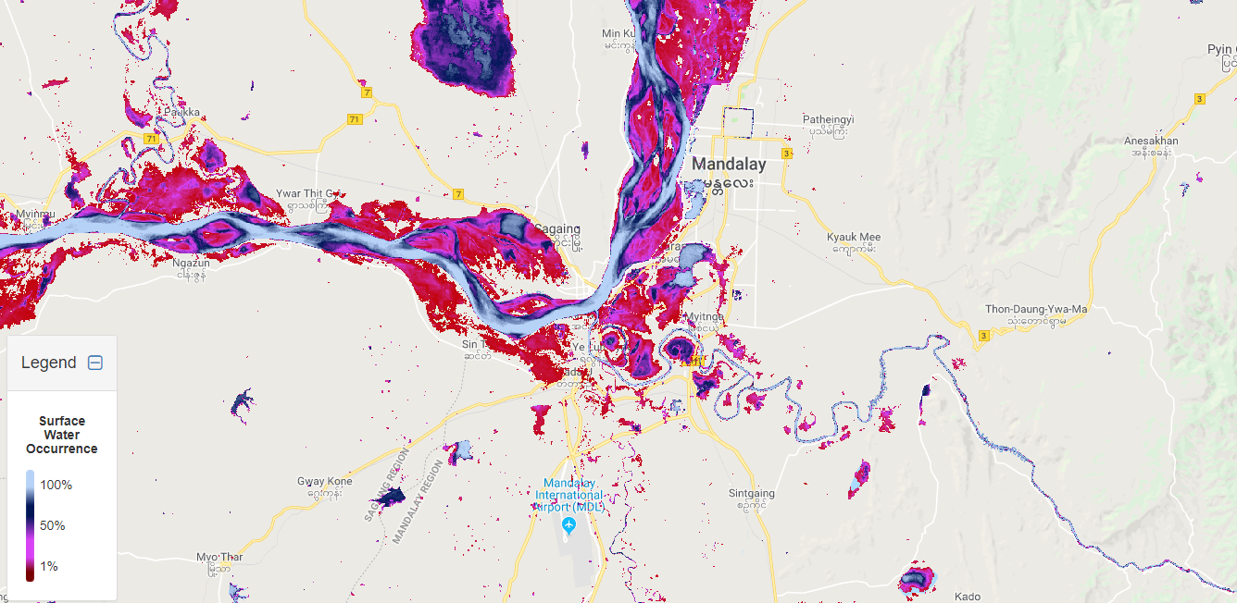
Summary of DRR Priorities
Asia
Geospatially identify hazards, vulnerability, exposure;
Provide EO-based early warning and prediction;
Response supported through impact assessments, damage assessments and informed planning/delivery of humanitarian relief;
Support and monitor reconstruction efforts to ensure resilience;
Data access, quality and sharing;
Technical capacity;
Usable tools and models;
Land use and land cover mapping and monitoring;
DRM, especially EWS for droughts and flooding;
Agricultural monitoring and food security;
Climate change adaptation and mitigation.
Notes:
Flood hazard in Mandalay, Myanmar

Slide 17
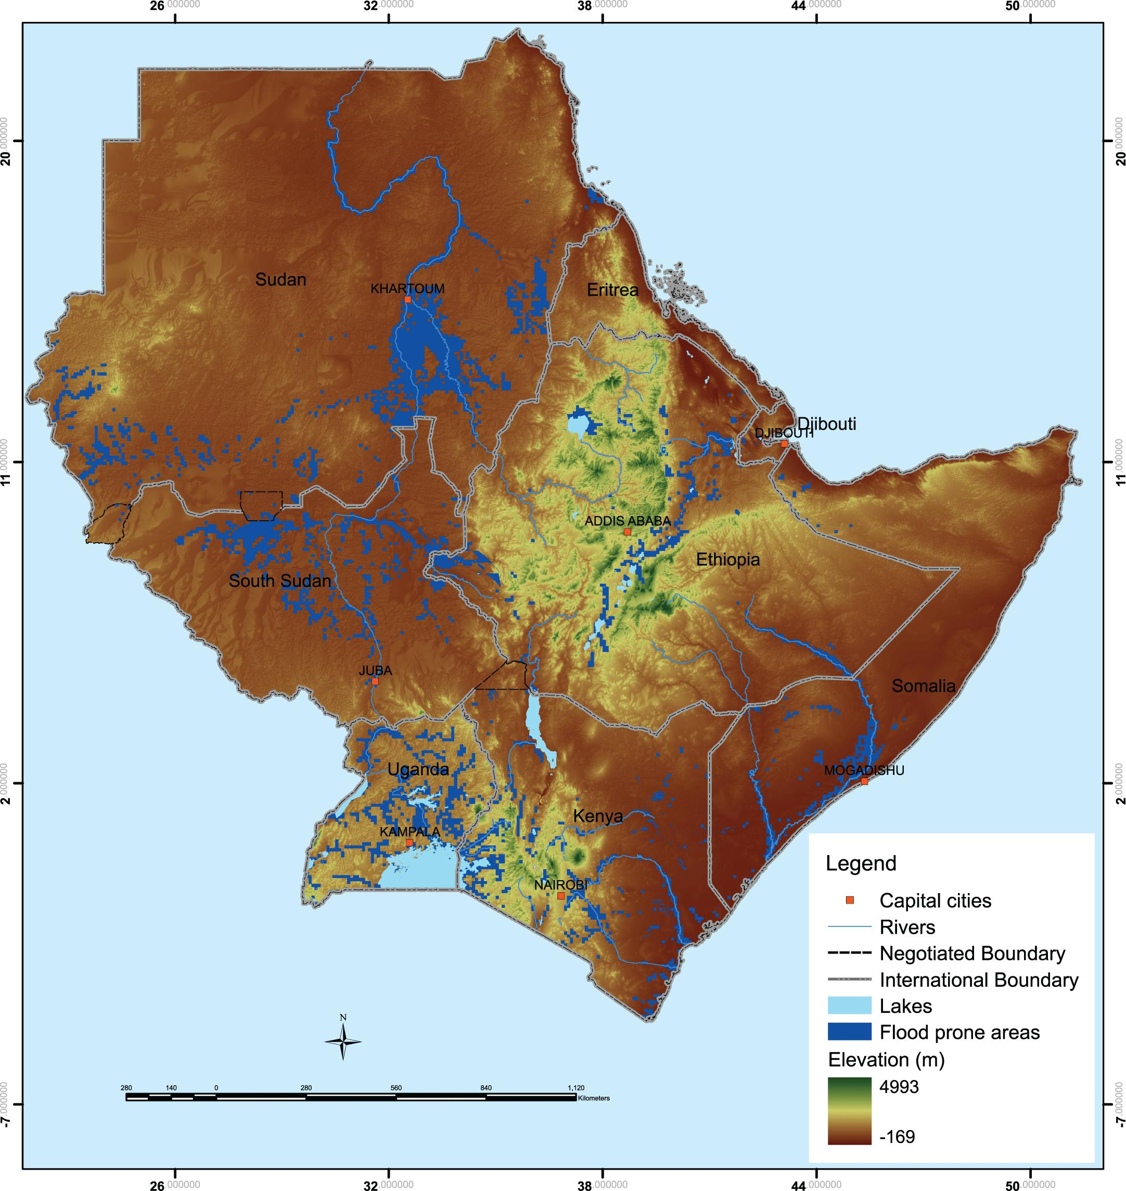
Summary of DRR Priorities
Africa (1/2)
Key hazards: drought, floods, landslides, diseases, and seismic and volcanic hazards (atlas produced 2013);
Hazard mapping, disaster monitoring, and early warning system establishment (esp. drought);
Impact of disasters on livelihoods (e.g. vector-borne disease);
Climate change and disaster vulnerability assessments and adaptation (focus on social vulnerability);
Food security;
Hazard mapping and risk assessment (geo, hydro-met, climatological, and technological hazards);
Early warning/alert and tracking of natural hazards, including flood, drought and landslides;
Notes:
IGAD drought product

Slide 18
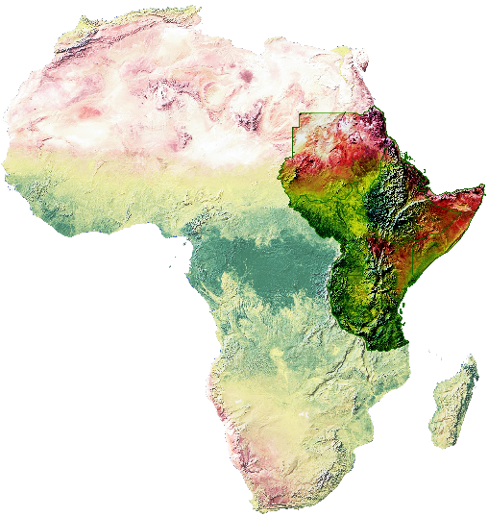
Summary of DRR Priorities
Africa (2/2)
Disaster response and support for Crisis Mapping/Damage Assessment involving risk knowledge, technical monitoring, and early warning service, dissemination, and preparedness about hazards, vulnerabilities and risks, their nature and effects, early warning and risk reduction;
Sub-regional and trans-boundary risks identification and assessments, through development and use of EO data and tools;
Facilitate contingency planning activities at regional/national levels and consolidating National disaster risk information which includes natural hazards, vulnerabilities, and climate change risk; maintain Regional Risk Map;
Develop, strengthen and operationalize mechanisms for partnership with private sector, CSOs, and volunteer groups.
Notes:
EO-based map of Africa

