Slide 1
Agency report
roscosmos
Tamara Ganina
Deputy Chief of Prospective Development Dep.
WGISS-39
JAXA, Tsukuba, Japan
May 11–15, 2015

Slide 2
LAST NEWS in Russian Space Industry
At the beginning of the year in Russian space industry
reconstruction process started. Now most of government and commercial organizations including JSC “Russian Space Systems” were included in United Rocket and Space Corporation.
The formation of this system will be finalized to 2020.
We also have a new Head of
Russian Federal Agency (Roscosmos) – Igor’ Komarov
In march our government approved the new version of law on
space activities. This document confirms free access for all users to Russian satellite data with 30 meters resolution and more. We are also ready to start commercial distribution high resolution data for all customers.
Notes:
Research Center for Earth Operative Monitoring
JSC Russian Space Systems – Operator of the Russian Remote Sensing Space Systems
B.51, h.25 Dekabristov Str., Moscow, 127490, Russia
Tel: +7 (495) 925-04-19
E-mail: ntsomz@ntsomz.ru
www.ntsomz.ru

Slide 3
Russian EO Missions
Launched in 2014
Meteor-M 2, Resurs-P 2
This year (2015)
Resurs-P 3, Kanopus-V 2, Electro-L 2
Planning in 2016
Meteor-M 2-1, Meteor-M 2-2, Electro-L 3

Slide 4
INFORMATION CAPABILITIES OF OPERATIVE RUSSIAN SATELLITE CONSTELLATION
Satellite /Characteristics | Resurs-DK | Meteor-M |  |  | Elektro-L | Kanopus-V |  | Resurs-P
Launch Date | 15.06.2006 | 18.09.2009 (№ 1) 19.06.2014 (№ 2) |  |  | 20.01.2011 | 22.07.2012 |  | 25.06.2013 (1) 26.12.2014 (2)
Active Lifetime | 3 years | 5…7 years |  |  | 10 years | 5…7 years |  | 5 years
Swath Width (km) | Geoton 28.3 – 47.2 / 8 – 16km** | KMSS* |  | MSU-MR* | MSU-GS* Entire disk of the Earth | PSS | MSS | Geoton | GSA* | ShMSA
 |  | MSU-100 | MSU-50
 |  |  |  |  |  |  |  |  |  | VR | SR*
 |  | 900 | 900 | 2800 |  | 23 | 20 | 38 | 25 | 97 | 441
Spatial Resolution (m): Panchromatic (PAN) Multispectral (MS) | 1 / 2.8** 2–3 / 3–5** | - 60 | - 120 | - 1000 | In visible region – 1000 In IR region – 4000 | 2.5 - | - 12 | 1 3 | - 30 | 12 23.8 | 60 120
Spectral Bands | 4 | 3 | 3 | 6 | 10 | 1 | 4 | 8 | 96 | 6 | 6
Revisit Period (days) | 6–10 | 2 |  |  | 15–30 minutes | 4–16 |  | 3–4
** before / after September 2011
* Open access data
Satellite / Thematic Tasks | Cartography | Ecological Monitoring | Infrastructure Object Monitoring | Data Support of Environmental Management | Natural Resources Monitoring | Monitoring of Man-Made and Natural Disasters
Resurs-DK | 1:10,000 and smaller | + | + | + | + | +
Meteor-M | 1:500,000 and smaller | + | - | + | - | +
Kanopus-V | 1:25,000 and smaller | + | + | + | + | +
Elektro-L | - | - | - | + | - | Large-scale +
Resurs-P | 1:10,000 and smaller | + | + | + | + | +

Slide 5
ROSCOSMOS GEOSERVICES
Since 2010
Roscosmos Geoportal
From 2016
Basic EO Data Products Bank
In process
Open EO Data Portal

Slide 6
International Cooperation
Operational services
Experience exchange
Research projects
Data distribution
International Charter
on Space and
Major Disasters –
since 2013
Working Group on
Information Systems
and Services –
since 2013
Working Group on
Calibration
And Validation –
since 2010
Framework programs
of European Commission,
GMES (COPERNICUS) –
since 2000
Since 2011
ERS-2 data –
2000 – 2004
International
Global monitoring
Aerospace System –
since 2011
In 2014 Roscosmos and JSC “RSS” organized WGISS-38 meeting.
In 2015 Roscosmos and JSC “RSS” organized two-day Russian–ASEAN workshop “Practical use of remote sensing technologies for socio-economic purposes”.
And in spring 2016 Roscosmos with JSC “RSS” are going to organize International charter on Space and Major Disaster Secretariat meeting
Group on Earth Observations –
since 2004
Coordination Group for
Meteorological
Satellites -
since 2003

Slide 7
EARTHQUAKE MONITORING PROJECT
This innovation project using satellite data can use for examines some problems of prediction earthquakes.
The basis of the methodology used the concept of seismotectogenesis (Doda L.N.), which is a combination of geophysical patterns and corresponding methods for calculating the parameters of possible earthquakes: the date, location and magnitude.
Particular attention is paid to the cloud and the magnetic characteristics of a possible earthquake.

Slide 8
CONCEPT OF SEISMOTECTOGENESIS:
GEOPHYSICAL PATTERNS
In average earthquakes take places on the 14 or 21 day (predict date of earthquake) after geoeffective phenomena on the Sun (coronal mass ejections or solar flares);
The spread of the seismogenic process is directed along the projection on the geoid of the most perturbed set of the geomagnetic field flux tubes, i.e. earthquakes occur at the intersection of seismomagnetic meridians and plate boundaries (predict zone of epicenter of earthquake) when there are save up to release of elastic energy potential of stress and strain;
The connection of the magnitude of earthquakes and the maximum length of seismic clouds has been discovered near activated seismic place (predict intervals of magnitude of earthquake).

Slide 9
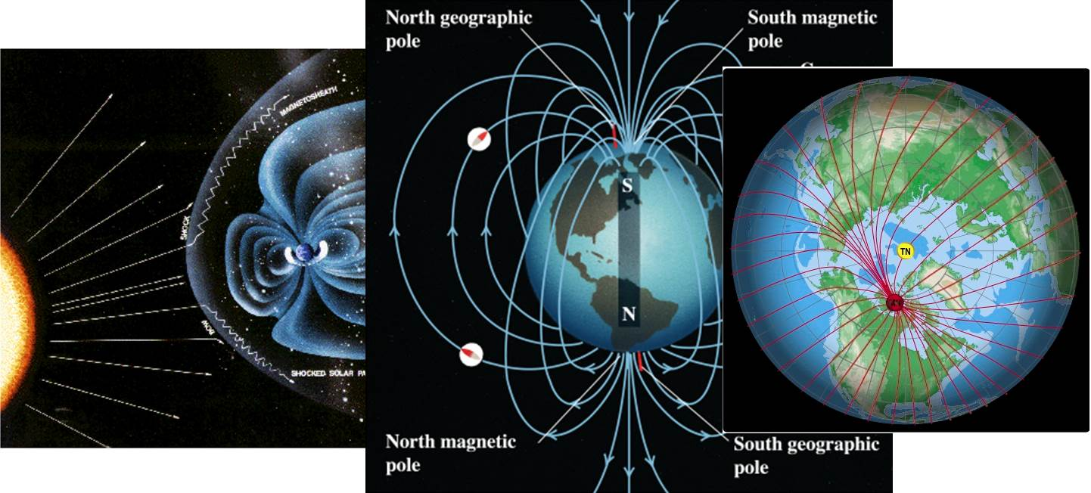
CONCEPT OF SEISMOTECTOGENESIS:
seismomagnetic merridians
Magnetic precursors of earthquake. Found that the most likely potentially seismically dangerous zones are the intersection of the projections on the geoid is disturbed geomagnetic flux tubes with plate boundaries.

Slide 10
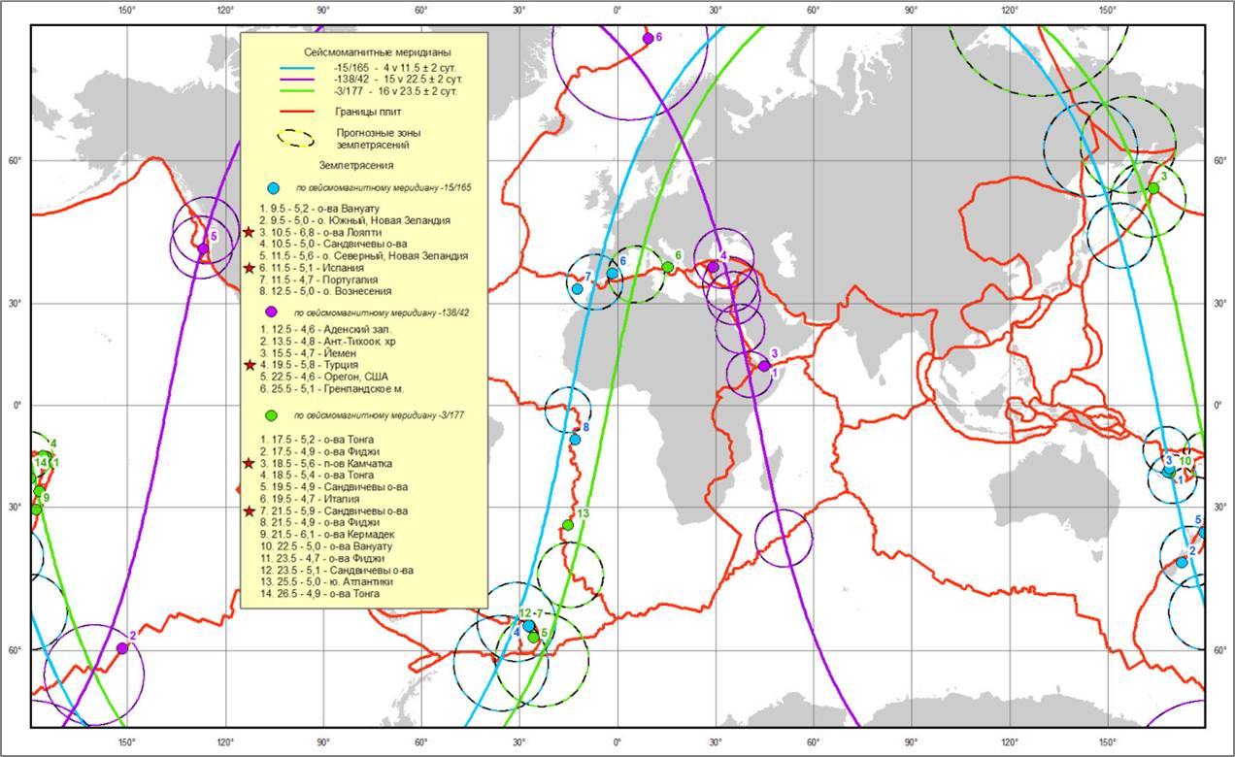
CONCEPT OF SEISMOTECTOGENESIS:
seismomagnetic merridians

Slide 11
CONCEPT OF SEISMOTECTOGENESIS:
Cloud precursors of earthquake. On activated section of the plate boundaries, blocks or faults under certain conditions begin to develop specific clouds that have the same contours of such boundaries and visible on satellite images in a variety of structures. Such cloud developing certain limit extent, and then destroyed. In this case, for the entire period of a few hours, they are fixed on space in the places of occurrence and are not involved in the process of moving air masses.
SEISMIC CLOUDS

Slide 12
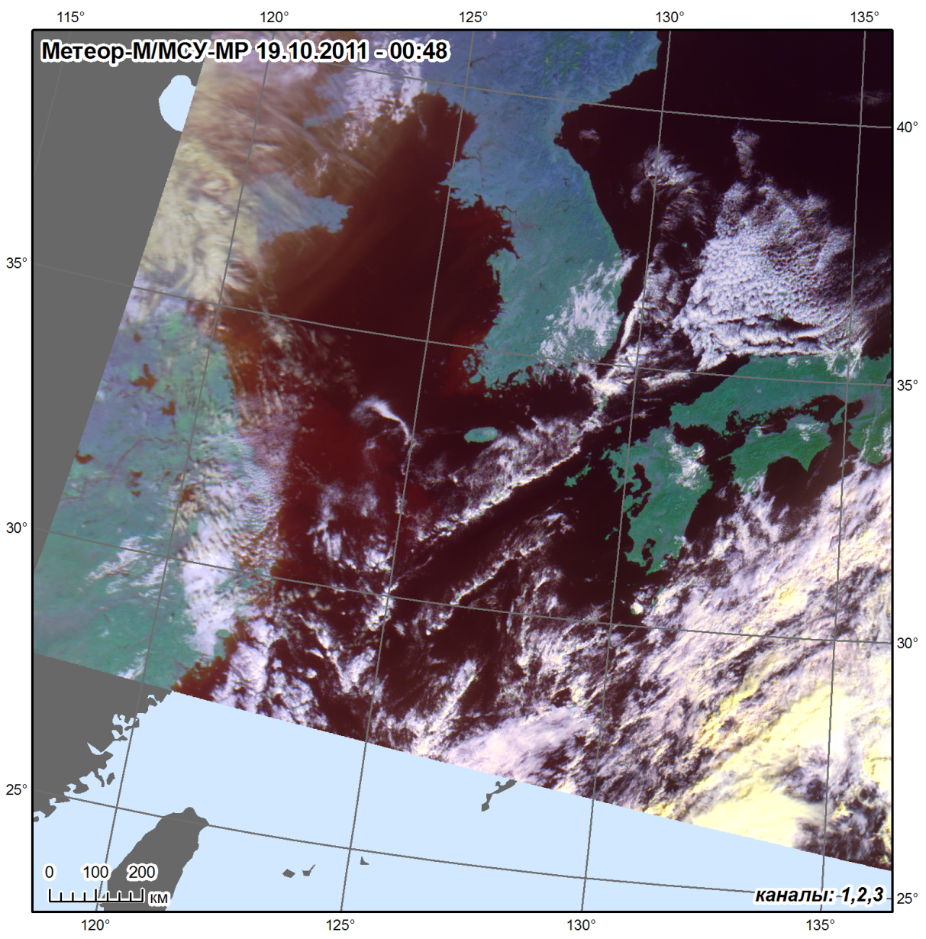
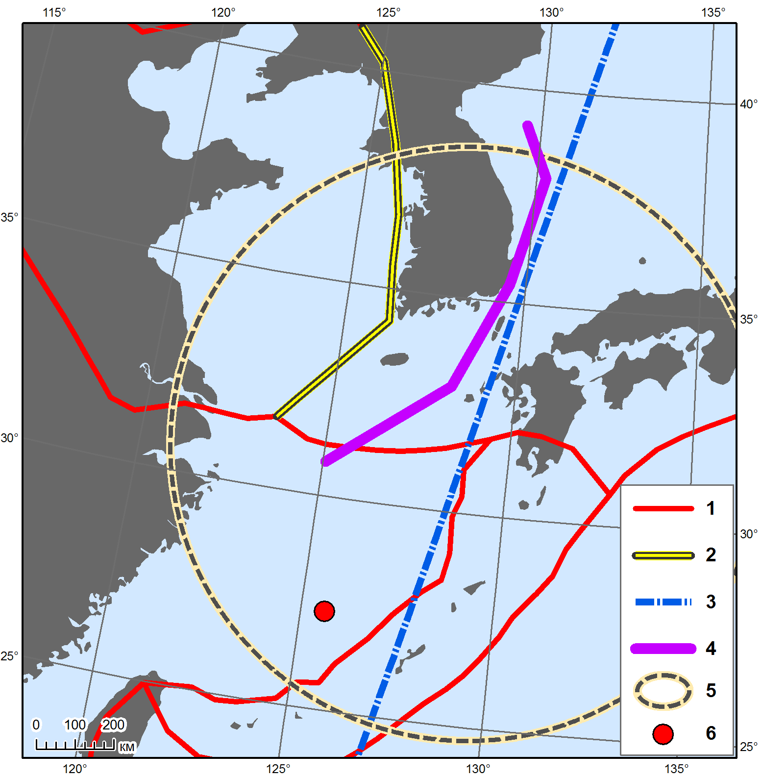
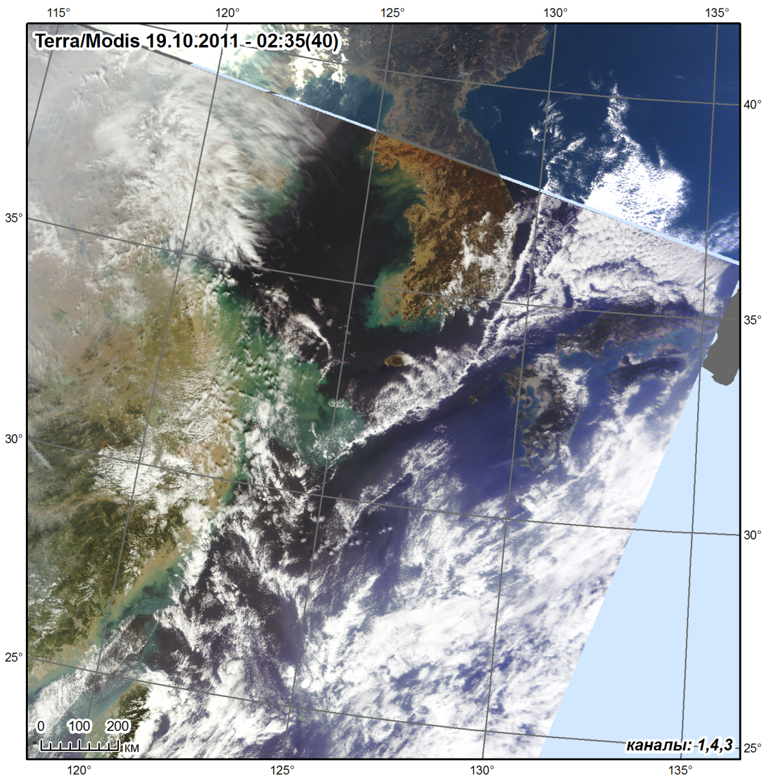
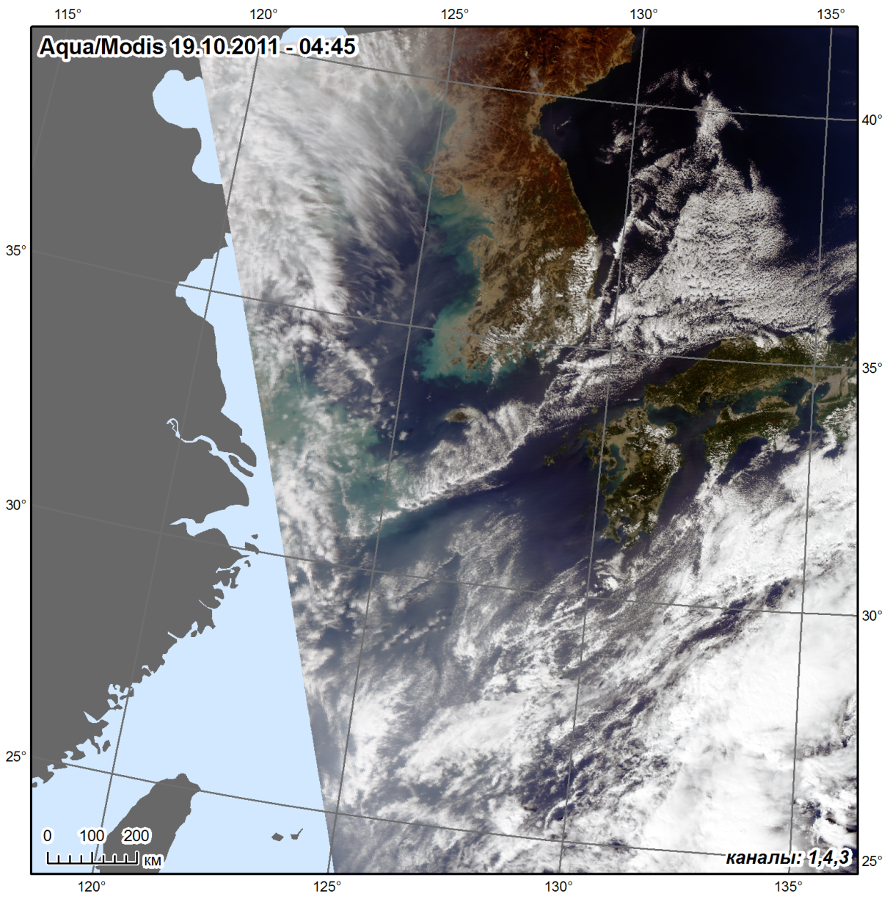
CONCEPT OF SEISMOTECTOGENESIS:
SEISMIC CLOUDS

Slide 13
THE RESULTS OF TEST SEISMIC MONITORINGS AREAS
MAY 2012 – NOVWMBER 2013
1
Seismic monitoring experiments at Japanese and Kamchatka test areas
eight confirmed seismoGRAPHIC WAS registered AT the Russian Expert Council for earthquake prediction DURING THIS PERIOD OF TIME
May 19-20, 2012
Honshu Island
(М 5.9/6.4)
Forecast – May 4
June 17, 2012
Honshu Island
(М 6.4)
Forecast – June 15
June 24, 2012
Kamchatka Peninsula
(М 6.1)
Forecast – June 15
July 20, 2012
Kamchatka Peninsula
(М 6.1/5.8)
Forecast – July 6
August 14, 2012
Okhotskoe Sea
(М 7.7)
Forecast – July 31
December 7, 2012
Honshu Island
(М 7.3)
Forecast – December 3
May 24, 2013
Okhotskoe Sea
(М 8.3)
Forecast – May 20
October 25, 2013
Honshu Island
(М 7.1)
Forecast – September 9
2
The analysis of destructive earthquakes signs
August 11, 2012
Iran
(М 6.4/6.3)
August 27, 2012
Salvador
(М 7.3)
November 7, 2013
Guatemala
(М 7.4)
September 24, 2013
Pakistan
(М 7.7)
3
During 2012 – 2013 we produced 39 thematic products at 7 seismic areas of the Earth

Slide 14
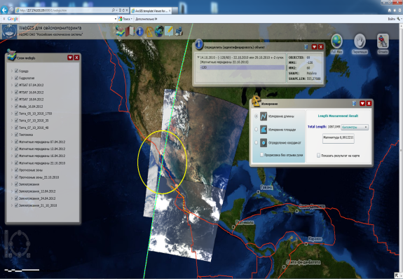
GIS FOR EARTHQUAKE MONITORING:
MAIN COMPONENTS
Databank
Measurements
Web-Portal
Satellite Monitoring
Analytical Information
Earth Observation
Geophysics measurement
Statistical Information
Visualization Tools
Low-key Analysis Tools
Mapping Tools
…
In-situ Data

Slide 15
GIS FOR EARTHQUAKE MONITORING:
Architecture
User
Web browser
Silverlight plugin for browser
Algorithm was development in C#,
markup in XAML
Windows Server
Data
Silverlight project
(CMS function)
Requests
ArcGIS Server
Database Access Interface ArcSDE
Data
Requests
PostgreSQL Database Management System

Slide 16
GIS FOR EARTHQUAKE MONITORING:
DATA
Gravimetric measurements obtained by the Tula State University (Russia)
Proton measurements carried out by the Cosmo-tectonics school of distance education (Russia) and the Chieti University (Italy)
Electro-telluric measurements made by Kakioka Magnetic Observatory (Japan) and Athens University (Greece)
Space images received with the help of Russian and foreign metrological and EO satellites (Meteor-M, Terra, Aqua, etc.)
Measurements of Earth rotation parameters performed by Earth Orientation Center, Paris Observatory (France)
Geophysical supervision over the Sun made by Russian and foreign observatories (X-ray radiation, flares, integrated indicators of Earth geomagnetic field responses to Sun radiation, parameters of solar wind and interplanetary magnetic field, etc.)

Slide 17
GIS FOR EARTHQUAKE MONITORING:
THEMATIC STRUCTURE
Digital Maps / Databases
World Map
EO Data – Images
(Elektro-L, Meteor-M, Meteosat, Terra etc.)
Environmentally hazardous facilities
(Nuclear power plants, chemical facilities etc.)
Synoptic
(wind direction and strength)
Hydrological
(water consumption)
Demographic
(population in urban areas, population density)
Seismic
(earthquakes and their parameters)
Climatic
(wind direction and frequency)
Geomagnetic
(indices of geomagnetic activity)
Geological
(plate boundaries and faults, seismic zoning)
Ground-based sampling
(samples of water, air)
Analytical Tools
User Web-Portal

Slide 18
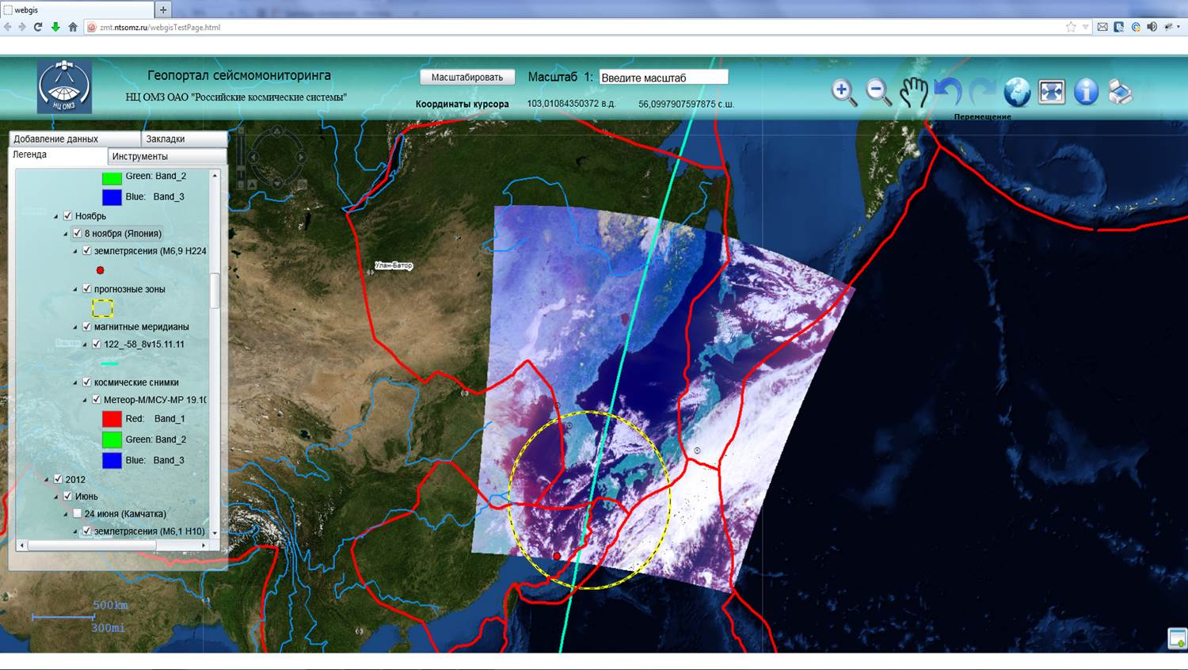
GIS FOR EARTHQUAKE MONITORING:
PORTAL
Developed new tools and service solutions to users Web-GIS “Seismomonitoring”

Slide 19
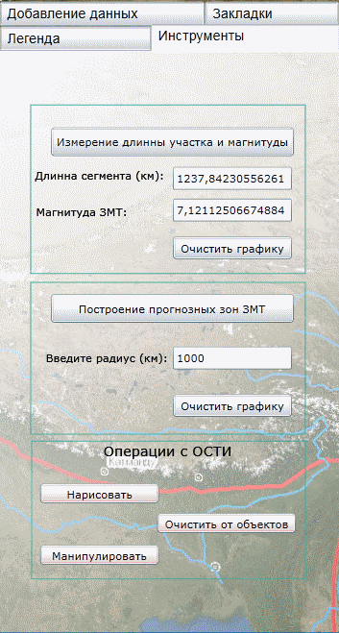
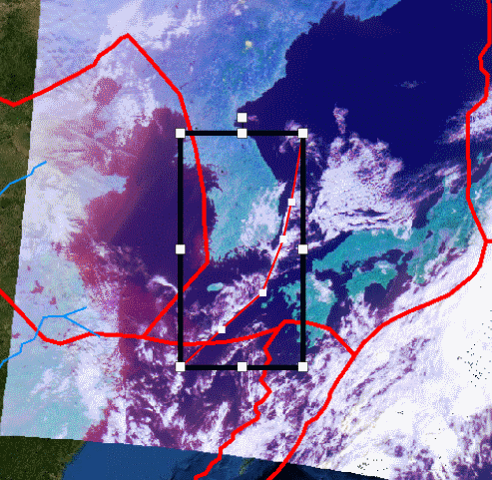
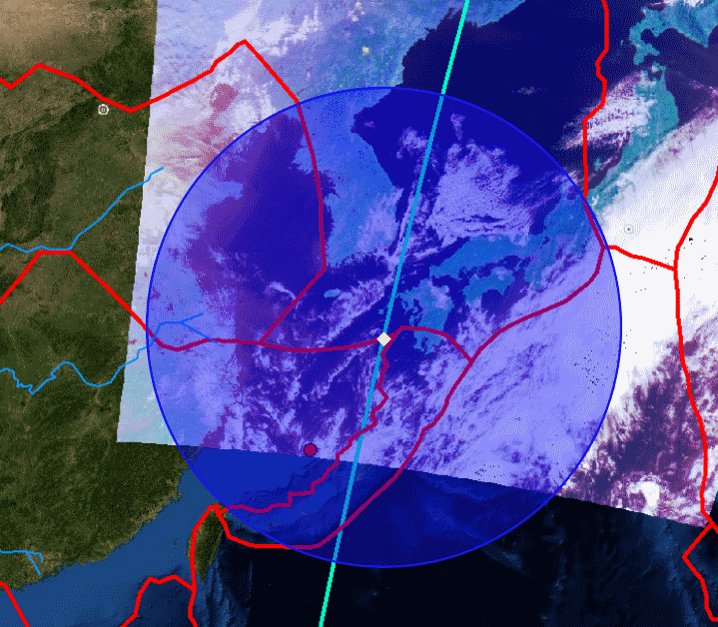
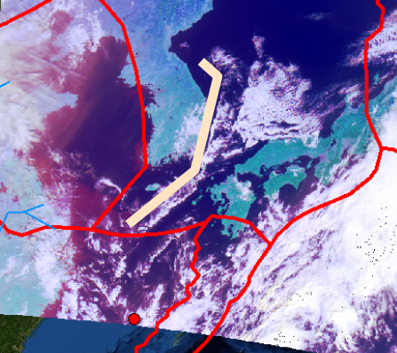
GIS FOR EARTHQUAKE MONITORING:
PORTAL
The process of tracing
the seismic clouds
Construction of predict zones
1
3
Measurement of the length of the
cloud structure and calculation of magnitude
Final data product
4
2
1
2
3

Slide 20
WGISS-39
JAXA, Tsukuba, Japan, May 11–15, 2015
Notes:
Research Center for Earth Operative Monitoring
JSC Russian Space Systems – Operator of the Russian Remote Sensing Space Systems
B.51, h.25 Dekabristov Str., Moscow, 127490, Russia
Tel: +7 (495) 925-04-19
E-mail: ntsomz@ntsomz.ru
www.ntsomz.ru

