Slide 1

Liaison’s Report on GSDI Association
An update on selected activities since WGISS-38
Source: ESA ESRIN
again with some examples from EUROGI and HUNAGI
Dr. Gábor Remetey-Fülöpp
Secretary-general, HUNAGI

Slide 2
Outline
GSDI Updates
GSDI Regional level member activities Example: EUROGI
GSDI National-level member activities Example: HUNAGI
Conclusions

Slide 3
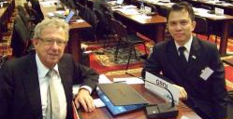
GSDI Updates (1)
Former GSDI President Prof. Bas Kok passed away
Prof.Bas Kok and Pakorn Apaphant at GEO V in Bucarest
  Former President Abbas Rajabifard and GSDI President David Coleman attended the full UN-GGIM meeting in Beijing in October, 2014
  Roger Longhorn has ben appointed as Secretary-general of GSDI Association. His coordinates are:
rlonghorn@gsdi.org
http://gsdi.org
Skype: ralonghorn
LinkedIn: https://www.linkedin.com/in/rogerlonghorn
GSDI LinkedIn:
http://www.linkedin.com/groups/GSDI-Association-3794985

Slide 4

GSDI Updates (2)
High-level cooperation with learned societies of
the geospatial world
  MoU-based cooperation with ICA, ISPRS.
  Ongoing preparation with OGC. Planned: ISDE
The current members of the JBGIS are the Presidents or equivalent officers of:
Global Spatial Data Infrastructure Association (GSDI)
International Association of Geodesy (IAG)
International Cartographic Association (ICA)
IEEE Geoscience and Remote Sensing Society (IEEE-GRSS)
International Federation of Surveyors (FIG)
International Geographical Union (IGU)
International Hydrographic Organization (IHO)
International Map Industry Association (IMIA)
International Steering Committee for Global mapping (ISCGM)
International Society for Photogrammetry and Remote Sensing (ISPRS)

Slide 5
GSDI Updates (3)
  GSDI Activities in Marine (Coastal and Sea) spatial Data Infrastructure include
Active participation in the IHO’s Marine SDI Working Group (http://www.iho.int/srv1/index.php?option=com_content&view=article&id=483&Itemid=370&lang=en) 4-6 March in London. Meeting report from the tech meeting available. The draft workplan mention GSDI explicitly and GSDI Secretary-general Roger Longhorn has specific between 2015-2018. Highlights from the new workplan include:
a) Focus on capacity building with adoption of a new Marine/Coastal SDI Training Syllabus (which GSDI also introduced at its workshop in Cape Town on 21 April and will include in the workshop on 30 May in Lisbon post-INSPIRE Conference),
b) Identifying and promoting national and regional best practice in implementing Marine/Coastal SDIs,
c) Extending and updating IHO Publication MSDI C-17 (the IHO's introductory document on Marine SDI – already available) and incorporating relevant parts of C-17 into the GSDI SDI Cookbook wiki,
d) Continuing work on development of the new IHO sponsored S-100 series of hydrographic and marine information standards (in which our member OGC also are playing an important role as so many of their specifications affect work in the marine/coastal realms, especially relating to EO, sensor webs, big data issues, etc.).

Slide 6
GSDI Updates (4)
GSDI expert Joep Crompvoets gave a keynote presentation and moderated a discussion at the IHO-sponsored ‘Marine SDI Open Forum’ meeting on 3 March in London. GSDI member Esri (Rafael Ponce made a presentation on Marine GIS while Hugo de Groof of EC DG Environment also made a keynote presentation on how INSPIRE data themes will support development of marine/coastal SDIs in European coastal states.
GSDI role on the UNESCO Intergovernmental Oceanographic Commission (IOC) IODE International Coastal Atlas Network (ICAN) Project should be mentioned, This project builds on and supports the Coastal/Marine SDI work, where Roger Longhorn serves on the Steering Group. http://www.iode.org/index.php?option=com_content&view=article&id=335&Itemid=100065)
Successful completion of the ‘GSDI Marine/Coastal SDI Capacity Building Workshop’ on 21 April in Cape Town, South Africa – a full-day workshop conducted between the ICAN meeting (19-20 April) and CoastGIS 2015 Conference (22-24 April) – agenda available – attendance was 34 people from various African governmental and academic institutions.

Slide 7
GSDI Updates (5)
GSDI was asked to run a Round Table Discussion on Open and Big Data at the Defense Geospatial Intelligence Conference in London (January 2015)
GSDI participation at the 4th GEO Workshop on “Concepts, Technologies, Systems and Users of the Next GEOSS,” organised by the GEOSS Science and Technology Stakeholder Network (STSN) in Norfolk VA (March, 2015) http://www.gstss.org/2015_Norfolk_4th as follows
  Session summarized the results of the previous GEOSS 3rd Workshop on “Navigating Sustainability on a Changing Planet”
  At the AIP-8 Kick-off Meeting chaired by OGC Interoperability progrem Bart De Lathouwer , GSDI introduced the recent results (survey and study) in the field of Marine (Coastal and Sea) Spatial Data Infrastructures – relates services. AIP-8 CFP
  GSDI emphasized the concept Internet of Spaces/Locations among IoTs at the breakout-session chaired by Bob Chen of CIESIN
  GSDI took part of the GEOSS descriptive logo initiative - related meeting
  GSDI participated the GEOSS Implementation Group discussion
GSDI contributed to the EU BYTE Project “The Big data roadmap and cross-disciplinarY community for addressing socieTal Externalities” www.Byte-project.eu at a brainstorming workshop in Vienna on 13 April, 2015 participated by GEO experts and GEO Sec Osamu Ochiai

Slide 8
GSDI Updates (6)
GSDI-GIKNET (Geographic Information Knowledge Network of GSDI) http://www.giknet.org
GSDI-IGS (International Geospatial Society) http://www.igeoss.org/
SDI Regional Newsletters, GSDI & IGS Global News (edited by Roger Longhorn) GSDI home page http://www.gsdi.org/newsletters
Publications http://www.gsdi.org/publications
GSDI expert Doug Nebert of USGS, former team member of the “GEOSS Recommendations for Community Portals” in the GEOSS Common Infrastructure framework, Editor of the SDI Cookbook passed away in a plane crash
Dissemination and promotion:
GEO Apps Development Call in GEOSS Architecture Implementation Project framework
http://www.gsdi.org/node/1382
  www.hunagi.hu/G/pub/Globalis/CFP8GEOSSAIPCALL.pdf

Slide 9

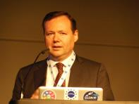


GSDI Regional level member activities
Example: update on EUROGI
Activities related to the Earth Observation
www.eurogi.org
    2nd EUROGI imaGIne Conference hosted by DDGI, supported by ESA and DLR
      Berlin, 8-9 October, 2014 with Intergeohttp://www.imagine2014.eu/about-imagine-2014/
    COPERNICUS and the Big Geospatial Data Challenge
    Final Workshop of Market-Pull-Pack Germany Supported by ESA and EUROGI
      http://www.imagine2014.eu/about-imagine-2014/
    Policy papers on hot issues prepared for the Geospatial World Forum/INSPIRE 2015 Conf
    Discussed topics includes:
        Open Data
        Internet of Things
        Big and Linked Data
        Urban & Regional Development
        The promotion of SMEs in the GI/GT sector and
        the use of GI/GT in the wider SME sector
Roberto Viola DG Connect
EU’s champion for Open data and
Data driven economy policy

Slide 10
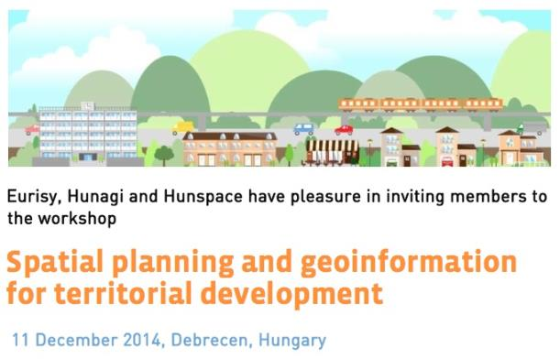
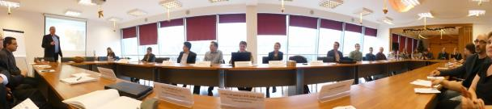

GSDI National-level member activities
Example: HUNAGI (1)
EO/GI: REGIONAL STAKEHOLDERS INVOLVEMENT
EURISY Regional event supported by HUNAGI and HUNSPACE. Debrecen 11 December 2015
http://www.eurisy.org/event-spatial-planning-and-geospatial-services-for-regional-development_26/outline-programme
-This end-user focused event offered excellent opportunity to discuss how innovative geoinformation services based on satellite imagery and/or satellite navigation can help regional administrators to improve their public services and make better informed decisions.
HUNAGI invitation was accepted by JRC DRDSI, Debrecen University, and Centropa. As follow on action, Dept of Physical Geography of the Debrecen University was invited by ESA to a Meeting held in Prague.

Slide 11
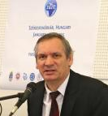
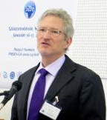
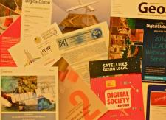
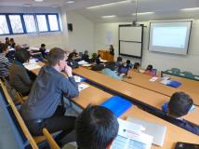
GSDI National-level member activities
Example: HUNAGI (2)
International Conference
IGIT 2015, Székesfehérvár, January , 2015
Topic: Integrated geo-spatial information and its application to land and environment monitoring
Host: Óbuda Egyetem Faculty of Technology, Institute of Geoinformatics (member of HUNAGI)
Participated GEO Sec, ITC, RADI,Beijing, also by HUNAGI
Developments and applications discussed include water management, environmental investigations
HUNAGI’s contribution:
advocating GEOSS benefits and leveraging technologies, awareness raising and dissemination
Dr. Tamás Jancsó
organiser
GEO Sec
Representative
Douglas Cripe PhD

Slide 12

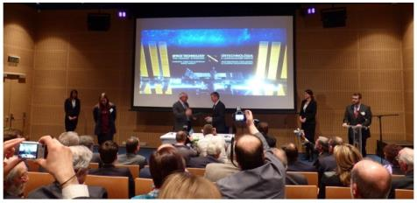
GSDI National-level member activities
Example: HUNAGI (3)
  Hungary became 22nd Full Member of ESA
HUNAGI has a seat in the National Space Council
Hung. Space Office’s Dir. Dr. Előd Both became R+D Director at OOSA
New Director of HSA is Dr Fruzsina Tari since November, 2014
Hungarian Space Office is founder member of HUNAGI (1994)
Hungary 's accession agreement with ESA was signed on 24th February 2015. During the office period of DG J.-J- Dordain the number of full members of ESA increased from 15 to 22. The ceremony followed by a series of presentations including HUNAGI in the Palace of Arts, Budapest
Jean-Jacques Dordain DG, ESA and Ákos Kara, State Secretary MoNational Development
HUNAGI was invited as governmental
delegation member to meet the French
Space Industry representatives of the
Toulouse area. Director dr. Zoltán Zboray of FÖMI took part on behalf HUNAGI

Slide 13
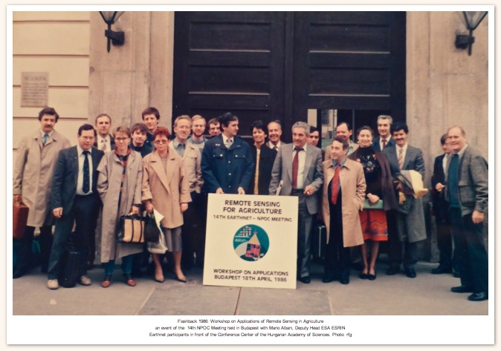
GSDI National-level member activities
Example: HUNAGI (3)
  Hungary became Full Member of ESA – A Flashback 1986
ESA EARTHNET Meeting hosted by MoA and FÖMI first time in outside of EEA
Workshop on Remote Sensing for Agriculture Hung. Academy of Science
Photo: Remetey

Slide 14
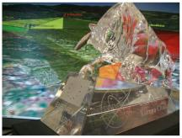









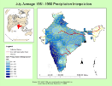
GSDI National-level member activities
Example: HUNAGI (4)
Involvement in the NASA WWEC 2015
NASA World Wide Europa Challenge 2015
Deadline: June 1, 2015. Details:
Evaluation by international board (JRC, FAO, NASA etc)
    NASA WWEC 2015 Award Ceremony for university teams and professionals at the 2nd FOSS4G Europe Conference, Como, July , 2015
    Submitted Applications (as of 15 May)
eurochallenge.como.polimi.it
The Crystall Bull Prize
GeoSim Cloud-based 5D-
Geovisualization University of Denver
Global Earthquake
Forecast System Trillium Learning & Kodiak Island
Borough District
ZEUS Easy Track Krisztián Fehér
wwwOSM Web World Wind –
OpenStreetMap Trilogis srl
wGlobe: Interactive
Visualization/Analysis
of Spatial Data State University of
New York at Buffalo
Wildfire
Management Tool also with Web Version EMXSYS
Navigational
Knowledge
Extraction from
Crowd Trajectories Univers. of Nottingham
Steady-State
Water Rise 4D Visualization International Institute of
Information Technology,
Hyderabad
LiDAR Data
Visualization
and Analysis University of Kansas

Slide 15
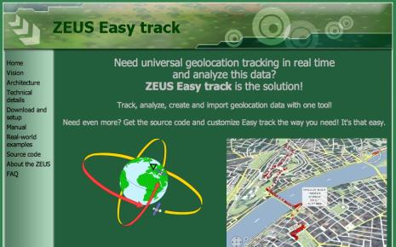
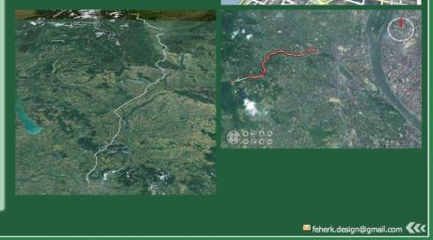
GSDI National-level member activities
Example: HUNAGI (5)
Innovative development by individual member
Result of a 4 man-year development
Vision: ZEUS Easy track's goal is to give
the possibility to everyone to create
custom, universal real-time tracking
and analyzis systems for nearly no
extra cost.
Potential app areas, which can be
Supported include - transport, - public traffic - law enforcement,- defence - disaster management, - logistics - traffic analysis,- airplane tracking - sports and outdoor activities - remote supporting activities.
Features: opensource, website
contains manual, detailed info on
architecture, real-world examples,
Download and setup, sourcecode
http://feherkrisztian.magix.net/public/easy/vision.html

Slide 16

GSDI National-level member activities
Example: HUNAGI (6)
Promotion of EO-Related API Calls
MYGEOSS
MYGEOSS" CALL ANNOUNCEMENT on smart mobile or web-based applications to inform European citizens on the changes affecting their local environment
March 18-April 30
DG JRC 2015 http://digitalearthlab.jrc.ec.europa.eu/mygeoss/call.cfm
    SMEs, start-ups, entrepreneurs, students and everyone with a brilliant idea is welcome to join and submit their entries from 15 April to 13 July 2015 at www.copernicus-masters.com.

Slide 17


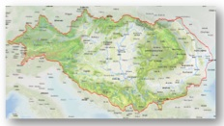
GSDI National-level member activities
Example: HUNAGI (7)
HUNAGI- JRC DRSDI link
EU MacroRegional Strategies Baltic (2009), Danube (2011), Adria-Ionian (2014), Alpes
Danube Region strategy
Danube Region Data Service Infrastructure (1700+ datasets so far)
Danube Community
Danube-Net
National coordinator in Hungary: MoFA
Priority Areas with Hungarian co-coordination:
PA2: Sustainable energy –with Chech Republic
PA4: Water quality –with Slovakia
PA5: Environmental risk –with Romania
www.jrc.ec.europa.eu
http://danube-region.eu/
http://drdsi.jrc.ec.europa.eu
CONNECT
PROTECT
PROSPERITY
REINFORCE
DRDSI expert network
14 countries,100 M population
Courtesy of Antal Ferenc Kovács dr.
EC JRC DRDSI Danube_Net

Slide 18
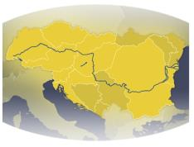
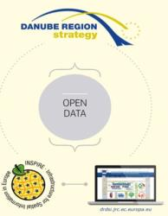
GSDI National-level member activities
Example: HUNAGI (8)
JRC DRDSI Data Platform
DRDSI platfom – http://drdsi.jrc.ec.europa.eu
in development, access to over 1700 datasets in the Danube region
Regional, cross-border, thematic concepts
Themes linked to Priorities and Nexi
Linked to national data infrastructures and INSPIRE
European, regional projects
Enhancing harmonization of data and services
Spatial and non-spatial data
Community platform
Data and data services
Source: JRC DRDSI
Courtesy of Antal Ferenc Kovács dr. EC JRC DRDSI Danube_Net

Slide 19

GSDI National-level member activities
Example: HUNAGI (9)
HUNAGI- DRDSI links established
A) CONNECTING THE DANUBE REGION
1. A mobilitás és a multimodalitás fejlesztése (1a) Navigation (1b) Road, rail transport | “ Multimodal terminals in Danube harbors” “ Competitive, high speed passanger transport between major cities”
2. Sustainable energy | “EU2020 climate and energy goals”
3. Culture and tourism | „Green tourism services”
B) PROTECTING THE ENVIRONMENT
4. Restore and protect water qulity | „Water management plans for partial catchment areas”
5. Managing environmental risks | „Flood risk management”
6. Protect biodiversity | „To reduce the spread of invasive alien species”
C) BUILDING PROSPERITY
7. Knowledge society | „Broadband internet”
8. Entreprise competitiveness | „Reinforce IP activity”
9. Human resource competences | „Contribute to EU2020 education strategy“
D) STRENGTHENING THE DANUBE REGION
10. Institutional cooperation | “ Reduce bureaucracy”
11. Promote security tackle organized and serious crime | „ Efficient institutional cooperation ”
Courtesy of Antal Ferenc Kovács dr. EC JRC DRDSI Danube_Net

Slide 20

GSDI National-level member activities
Example: HUNAGI (10)
35th Anniversary of the Hungarian space flight
Start of Bertalan Farkas’ spaceflight was on 26 May 1980. One of his task was Earth observation
Anniversary Ceremony will take place at the Budapest University of Technology on 26th May, 2015 followed by a seminar devoted to the development related to his research domains. Under the auspices of Dr. Miklós Seszták, Minister, Ministry of National Development
One of the follow-on action was to establish the FÖMI Remote Sensing Centre. The institute performs today EO and GI-based services on operational basis having significant economic and societal benefits. Today FÖMI is a major stakeholder in the EO and GI-related programmes.
Bertalan Farkas

Slide 21
Conclusions
Interoperable spatial data infrastructures and related services are enabling tools for EO applications
GSDI and its Regional and Country level members are playing active role not only serving and supporting EO applications, but also providing awareness raising and user feedbacks by arranging international networking, regional projects, conference sessions, thematic workshops and promoting challenges from local to regional in EO.
The Danube Region Data Service Infrastructure project offers excellent opportunities to investigate the feasibility to launch a ESA-supported pilot, with the aim of the establishment of a Danube Data Cube based on WGISS experiences but with the feature of cross-border environment. A draft note on this vision will be submitted to Mirko Albani of ESA ESRIN after 20 May 2015

Slide 22
Acknowledgements
GSDI related updates/contact:
Roger Longhorn
Secretary-General, GSDI
Editor, GSDI & IGS Global Newsletter
rlonghorn@gsdi.org, http://gsdi.org
NASA WWEC 2015-related updates/contacts:
Patrick Hogan, NASA Ames RC, Moffet Field
patrick.hogan@nasa.gov
Prof.Maria.A. Brovelli, Politecnico Milano at Como
maria.brovelli@polimi.it
Giuseppe Conti, Trilogis Spa.
Giuseppe.Conti@trilogis.it
EUROGI related updates/contact:
Simon Vrečar, Secretary General EUROGI
simon.vrecar@eurogi.org www.eurogi.org
Danube Region Digital Reference Data
Antal Ferenc Kovács dr.
EC JRC Danube_Net

Slide 23


Thank you for your attention!
Photographs taken: Japan Space Museum, ESA ESRIN, internet

