Slide 1
The NASA Earth Observing System Data and Information System (EOSDIS)
WGISS 39
Andrew Mitchell, Assistant Project Manager
NASA Earth Science Data & Information Systems (ESDIS) Project

Slide 2
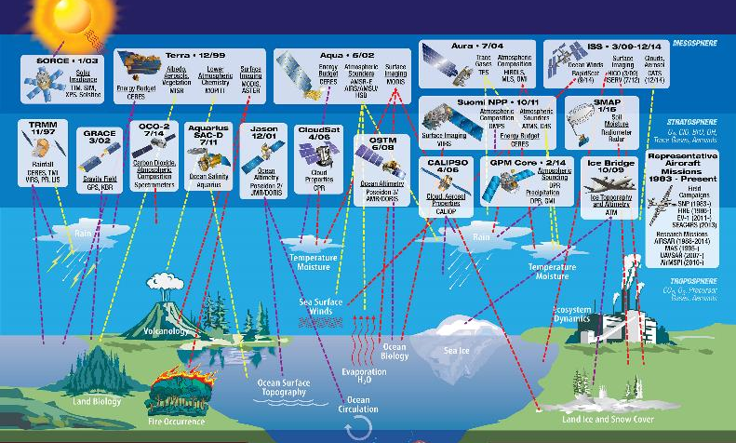
Earth Science Measurements
Data sources include on-orbit assets, airborne, field campaigns, near-real time data, and ancillary

Slide 3
Role of EOSDIS
“Advance Earth system science to meet the challenges of climate and environmental change.” -- 2011 NASA Strategic Plan
NASA’s Earth Science Data Systems directly support this objective by providing end-to-end capabilities to deliver data and information products to users
NASA’s Earth Science Data Policy promotes usage of data by the community
No period of exclusive access
Data available at no cost to all users on a non-discriminatory basis, except where agreed upon with international partners
EOSDIS provides:
Interoperable Distributed Data Archives
Science Data Processing
Data Management
On-Line Data Access Services
Earth Science Discipline-Oriented User Services
Network Data Transport to distributed System Elements

Slide 4
Earth Science Data Operations
Mission Operations
Science Operations
Flight Operations,
Data Capture,
Initial Processing,
Backup Archive
Data
Transport to
Data Centers/
SIPSs
Science Data Processing,
Data Management,
Interoperable Data
Archive, and Distribution
Distribution
and
Data Access
Data
Acquisition
EOSSpacecraft
Tracking and Data
Relay Satellite
(TDRS)
Research
Education
Value-Added
Providers
Infra-
structure
(Search,
Order,
Distribution)
White Sands
Complex (WSC)
EOS Data Operations
System (EDOS)
Data Processing
Interagency
Data Centers
EOSDIS
Data Centers
Earth
System Models
Direct
Broadcast
(DB)
International
Partners
EOS Polar
Ground Stations
EOS Operations
Center (EOC)
Mission Control
NASA
Integrated
Services
Network
(NISN)
Mission
Services
Instrument Teams
and Science
Investigator-led
Processing Systems
(SIPSs)
Decision Support
Systems
Direct Broadcast/
Direct Readout
Stations

Slide 5
Earth Science & Data Systems
Applications
C. Dobson
Socioeconomic
Data & Applic-
ations Center
Astro-
physics
SAR Systems
C. Dobson
Applied
Science
L. Friedl
ASF SAR
Data Center
Application Scientists
NASA Headquarters
Science Mission
Directorate (SMD)
J. Grunsfeld
Helio-
physics
Program Scientist for EOS
L. Tsaoussi
Land Processes
W. Turner
Research
J. Kaye
Land
Processes
DAAC
Earth
Science
M. Freilich
Program Scientists
Program Executive for Operating Missions
C. Yuhas
Earth Surface
and Interior
J. LaBrecque
Flight
Programs
S. Neeck
(Acting)
Crustal
Dynamics
DIS
Planetary
Program Executive for
Earth Science Data Systems
K. Murphy
Atmospheric
Dynamics
R. Kakar
..
.
Global
Hydrology
Resource Center
..
.
Goddard Space
Flight Center
(GSFC)
C. Scolese
400
420
Upper Atmosphere
Research
K. Jucks
423
Flight
Projects
G. Morrow
Earth
Science
T. McCarthy
Earth Science
Data and Information System (ESDIS) Project
D. Lowe
GSFC Earth
Sciences DISC
500
430
Atmospheric
Radiation
H. Maring
Appl. Eng.
&
Technology
Planetary
Science
Atmospheric
Sciences
Data Center
Science
Operations
Management
J. Behnke
Drew Kittel
Data Center
Operations
440
L1 and Atmos. Data
TBD
600
Astro-
physics
L1 Atmosphere
Archive & Distri-
bution System
Sciences
&
Exploration
Cryosphere
Science
T. Wagner
..
.
Terrestrial
Ecology
D. Wickland
Ocean Biology &
Biogeochemistry
P. Bontempi
Physical
Oceanography
E. Lindstrom
National Snow
and Ice Data
Center
..
.
Ocean Biology
Processing
Group
Physical
Oceanography
DAAC
ORNL
DAAC
02/26/2014

Slide 6
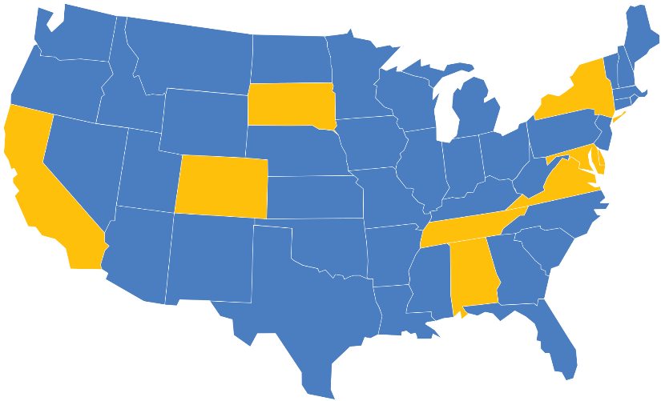
National Aeronautics and Space Administration
Discipline-oriented Distributed Active Archive Centers
(DAACs)
ASF SDC
SAR Products,
Sea Ice,
Polar Processes,
Geophysics
SEDAC
Human Interactions,
Land Use,
Environmental
Sustainability,
Geospatial Data
LP DAAC
Surface
Reflectance,
Land Cover,
Vegetation Indices
GES DISC
Global Precipitation,
Solar Irradiance,
Atmospheric Composition
and Dynamics,
Global Modeling
NSIDC DAAC
Snow and Ice,
Cryosphere,
Climate Inter-
actions, Sea Ice
PO.DAAC
Gravity, Sea Surface
Temperature, Ocean
Winds, Topography,
Circulation & Currents
CDDIS
Space Geodesy,
Solid Earth
OBPG
Ocean Biology,
Sea Surface
Temperature
LaRC ASDC
Radiation Budget,
Clouds, Aerosols,
Tropospheric
Chemistry
MODAPS/
LAADS
MODIS Level-1
and Atmosphere
Data Products
GHRC DAAC
Hydrologic Cycle,
Severe Weather Inter-
actions, Lightning,
Atmospheric
Convection
DAACs ingest, archive, process and distribute data to users.
ORNL DAAC
Biogeochemical
Dynamics,
Ecological Data,
Environmental
Processes
www.nasa.gov

Slide 7
National Aeronautics and Space Administration
Science Investigator-led Processing Systems
Measurements of Pollution in the Troposphere (MOPITT)
Ocean Data Processing System
(OCDPS)
MODIS Adaptive Processing System (MODAPS)
High Resolution Dynamics Limb Sounder (HIRDLS)
Solar Radiation and Climate Experiment (SORCE)
Ozone Monitoring Instrument
(OMI)
Geoscience Laser Altimeter System (GLAS)
Microwave Limb Sounder (MLS)
Clouds and the Earth's Radiant Energy System (CERES)
Stratospheric Aerosol and Gas Experiment (SAGE III)
Active Cavity Radiometer Irradiance Monitor (ACRIM)
Tropospheric Emission Spectrometer (TES)
Advanced Microwave Scanning Radiometer for EOS (AMSR-E)
Lightning Imaging Sensor (LIS)
SIPSs perform forward processing of standard products, and reprocess data to incorporate algorithm improvements.
www.nasa.gov

Slide 8
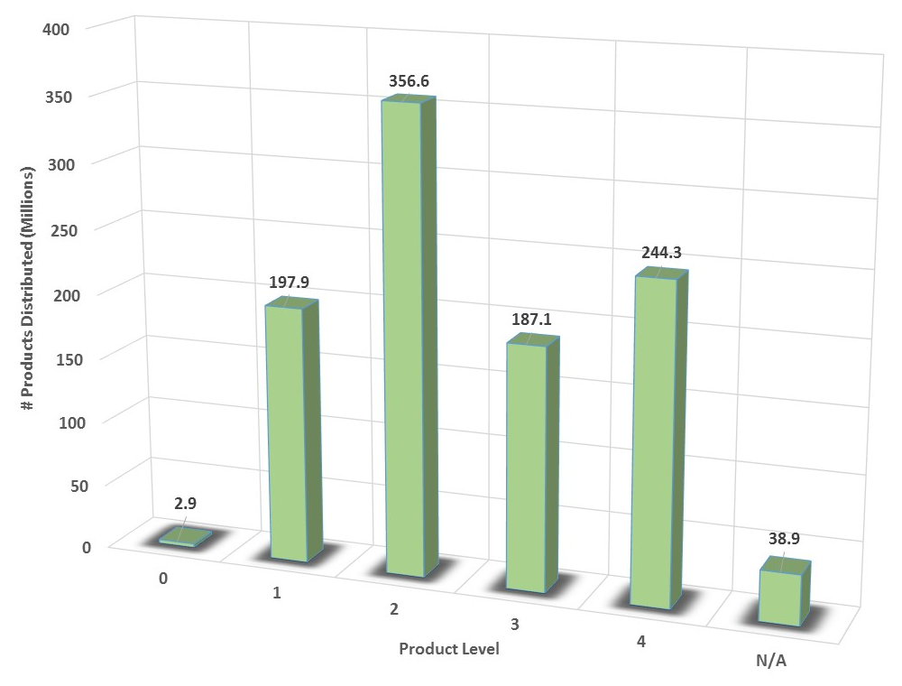
Support for a variety of parameters
EOSDIS data products are processed at various levels ranging from Level 0 to Level 4.
Level 0 products are raw data at full instrument resolution.
At higher levels, the data are converted into more useful parameters and formats.
All EOS instruments must have Level 1 products. Most have products at Levels 2 and 3, and many have products at Level 4.
Products are formatted for use by the discipline community
While use of standard formats is required by NASA, multiple formats still present issues to usage/interoperability
Individual files can have up to 800+ variables within a single file
FY14 EOSDIS Number of Data Products Distributed by Product Level

Slide 9
Yearly Data Files Distributed by Product Level
Showing the increase in interest in higher level products over the years.

Slide 10
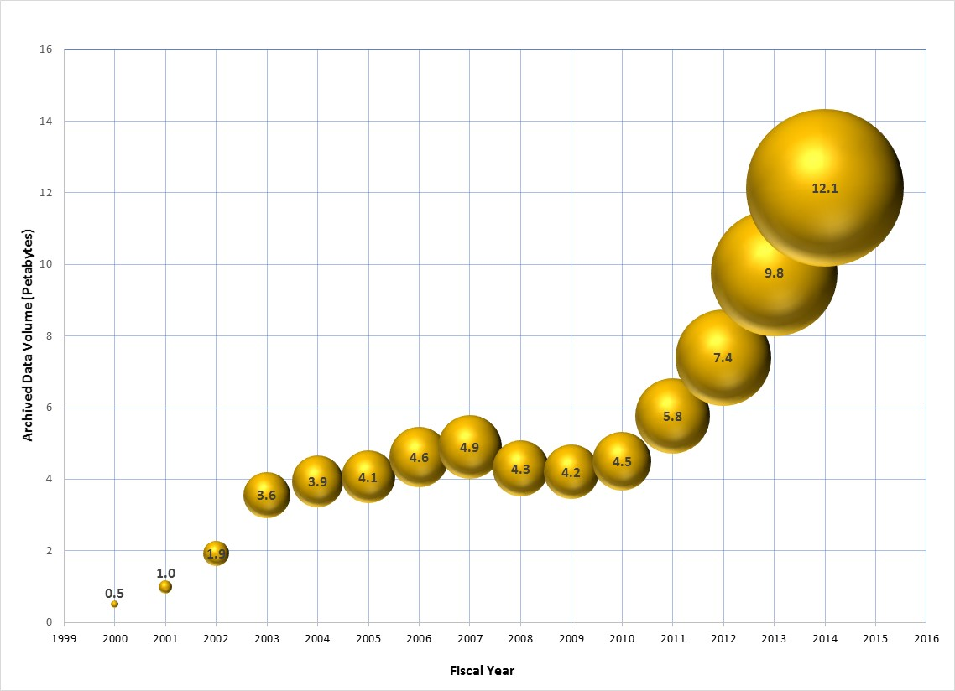
Volume changes
As data is acquired and reprocessed the collection both grows and shrinks
Multi-year datasets need to be summarized/evaluated over long time series
Products range in size from kb to 1 GB
Total EOSDIS Accumulated Data Archive Volume (Petabytes) 15 years of Earth Science data
Addition of
AQUARIUS and ICEBRIDGE
products
Addition of
ALOS PALSAR & UAVSAR products
Landsat-7 Data
Migrated from
LPDAAC to USGS
Addition of SNPP CERES&OMPS
Deletion of
MODIS
Collection 4
Products
TERRA
AQUA
ICESat
AURA
MEASURES 2006
Notes:
A petabyte is a lot of data:
1 PB is 20 million four-drawer filing cabinets full of text
1 PB is 13.3 years of HD-TV video
1.5 PB is the size of 10 billion photos on Facebook

Slide 11
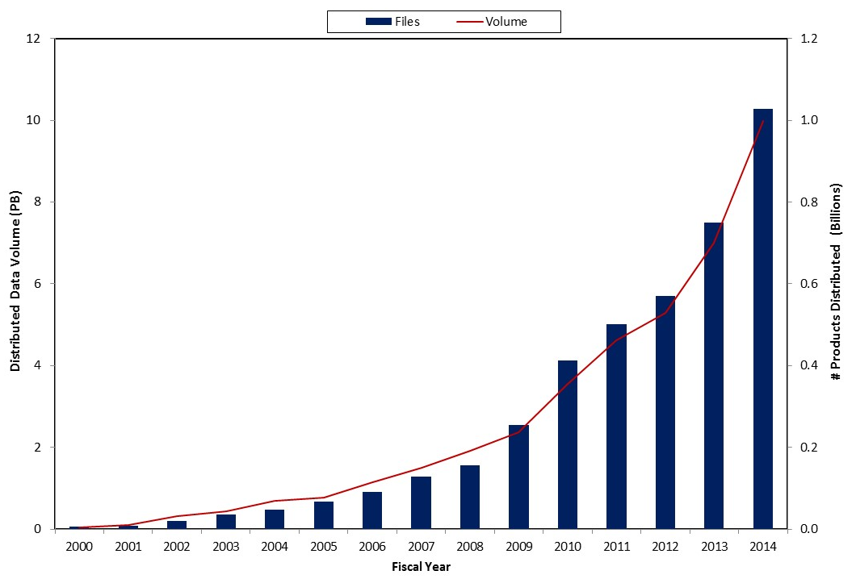
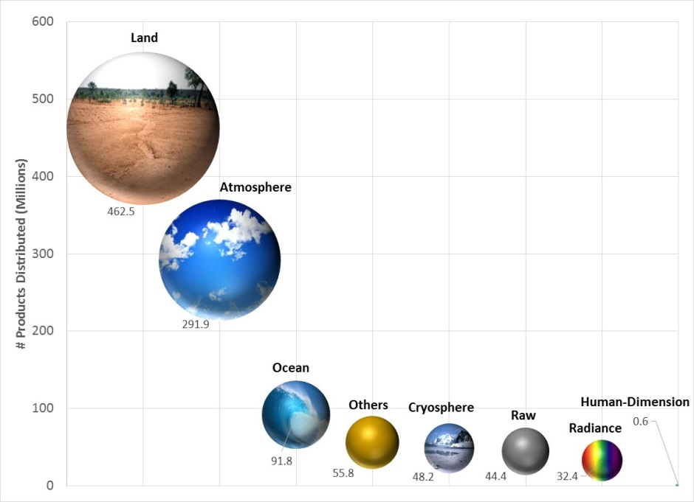
Velocity of data ingest and distribution
FY2014 Number of Products Distributed by Discipline
EOSDIS Yearly Total Data Volume (PB)
and Number of Products (Billions) Distributed to End Users
Notes:
Velocity of data ingest and distribution increases
Other Products whose discipline was not available or not applicable including some of the ancillary data

Slide 12
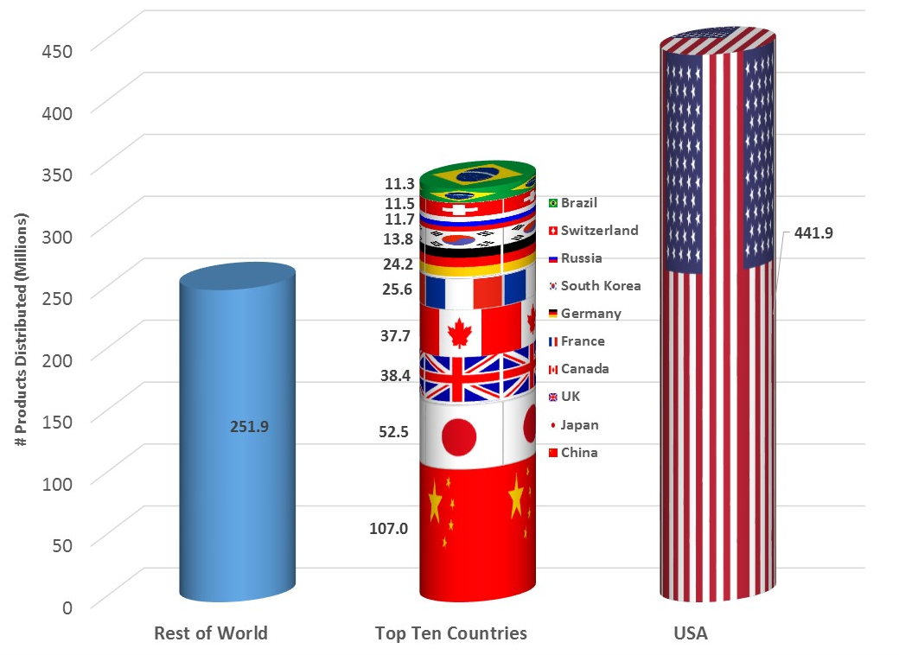
EOSDIS Distribution is World-wide
FY2014 EOSDIS Number of Data Products Distributed by Country

Slide 13
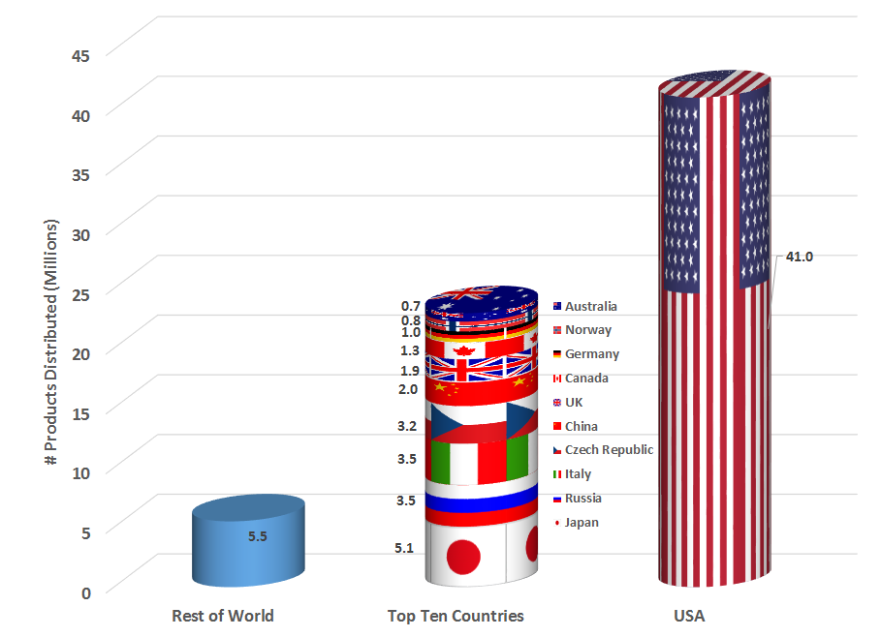
NASA FY14 Near Real-Time Distribution
NASA’s Land, Atmosphere Near real-time Capability for EOS (LANCE) system distributed over 900, 000 GB of Earth Observation data in FY14 in support of application users interested in monitoring and analyzing a wide variety of natural and man-made phenomena.

Slide 14
Process Improvement
Requirements collection to allow interactive participation
Tools like JAMA allow many to be involved in the requirements definition phase
Shortens the time to review and roll-out new design and development
Integrate directly into test phase
EOSDIS capabilities and feature development is prioritized through DAAC User Working Groups (science experts) and input from community data system programs (e.g., Earth Science Data Systems Working Groups)
User registration systems will allow closer communication with users
Improve business models to enable change
Sharing and reuse to reduce development costs
Use of common COTS across program where applicable: Kayako

Slide 15
Infrastructure Improvements
Improve network connectivity throughout EOSDIS
Expanded use of agile and continuous integration techniques by each center/system
Provide centralized location for software and system development
Continuous integration of new technology
Potential to leverage alternatives to supplement current system access, e.g.:
Cloud service provides sophisticated governance, access control, and resource provisioning (and billing), allowing projects to spin up small, developmental instances then scale to large parallel processing models if desired – then tear everything down when done.
On demand resources for analysis and processing
Enable sophisticated data access and service scenarios

Slide 16
Common Metadata Repository - CMR
CMR API
Designed to improve the discovery and access of NASA data, CMR will provide a single source of unified, high-quality, and reliable Earth Science metadata while merging the inventories of ECHO (EOS Clearing House) and GCMD (Global Change Master Directory) / IDN (International Directory Network). CMR will be the authoritative management system for all metadata of EOSDIS data holdings.
Services UMM-S
CMR Catalog
Visualization UMM-V
Global Change Master Directory (GCMD) / International Directory Network (IDN)
NASA DAACs
Service Invocation
CMR API
CMR Catalog
CMR API
CMR Catalog
WGISS Integrated Catalog (CWIC)
Collections UMM-C
Granules UMM-G
Non-NASA US Data Providers
International Data Providers
Earth Data Search
Client (EDSC)
CMR Catalog
CMR also provides a metadata model that documents vital elements that may be represented across various metadata formats and standards and unify them through core fields useful for data discovery and service invocations.
Unified Metadata Model UMM
Reverb
CMR API

Slide 17
EOSDIS User Registration System - Earthdata Login -
The Earthdata Login provides a single mechanism for user registration and profile management for all EOSDIS system components (DAACs, Tools, Services). Earthdata Login also helps the EOSDIS program better understand the usage of EOSDIS services to improve user experience through customization of tools and improvement of services.
Standardized Method of Metrics Collection & Reporting
User Demographics and Access Patterns
Enable Status Change Notifications to Users
By access pattern, data product, application, etc.
Establish Framework for Future Capabilities
User Tailoring, Customized Views, Saved Queries, Order Management
* Required Fields

Slide 18
Earthdata Login for NASA services
Earthdata Login is being implemented by NASA DAACs, subsystems and related services for the following capabilities:
Downloading science data files from HTTP, HTTPS and FTP services.
Web services and tools allowing access to science data files (e.g. OPeNDAP, Web Coverage Services, analysis tools, DAAC-unique ordering tools).
Online collaboration and comment tools (e.g. Wikis, Forums, Code Repositories).
Other tools and services that currently have optional or required user registration.
Registration is NOT required:
Read-access to Web pages and documentation.
Data discovery services such as Reverb, Earth Data Search Client (ESDC), Global Change Master Directory keyword services, CMR and DAAC unique search clients.
Note: This portion of the policy applies up until the point where science data downloads are performed or write operations such as saving search parameters, inputting or updating metadata records are performed.

Slide 19
Vision 2020 - Aspiration of Capabilities
Discovery and Access | Usage
Machine Level Discovery and Access for all data. Seamless Cross-agency Discovery. Dataset Selection Guidance based on fitness for purpose. Metadata Naming Conventions for Variables, Platforms, Instruments, Resolution… Virtual Collections oriented around science problems. | Intelligent Tool Catalogs suggest tools to work with the data. Publications are linked to data and tools that allow interactions with the data. Automatic Mobile Data and Processing to achieve optimal performance. Quantitative Quality for all data. Reproducibility of research results with high precision. Documentation is Concise, Comprehensive and Consistent for all data variables. Capacity Building mechanisms for people with limited literacy in science, technology, and/or English. Data Analysis at Scale over any arbitrarily defined area. Dataset Upgrading for high-value datasets to fully support rich capabilities.
Integration
NASA data can be combined with data from other agencies and nations. Combining Tools and Services within the community is easy. Enable sharing of any scientific resource.
Notes:
explicit references in the notes page?
Discovery and Access
Usage
Integration

Slide 20
EOSDIS Mission Support
CY
2014
2015
2016
2017
2018
2019
2020
EOSDIS
GPM
OCO-2
SMAP
SAGE-III
DSCOVR
CYGNSS
ICESat-2
GRACE FO
Sentinel 1A
ISS-RapidScat
7/29/14 (Level 1)
9/2/14 (Level 2/3)
7/2/14
1/1/15
1/31/15
7/31/15
9/30/16
3/30/16
8/8/15
2/11/15
4/28/17
10/28/16
7/27/17
1/27/18
8/1/17
2/1/18
6/1/15
9/20/14
2/1/15
Launch Readiness Date
Launch
Planned Data Release
Data Released

