Slide 1
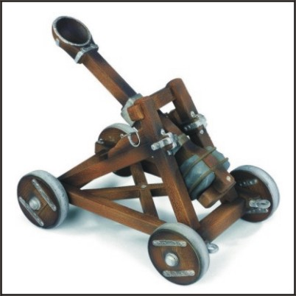
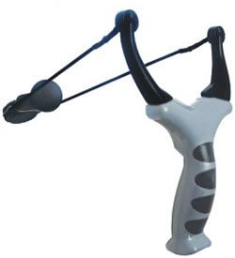
UK Space Agency Report on Satellite Applications Catapult (new UK Technology Innovation Centre)
Presentation to
WGISS39
Japan, May, 2015
Wyn Cudlip UKSA/GeoSeren
wcudlip@geoseren.com

Slide 2
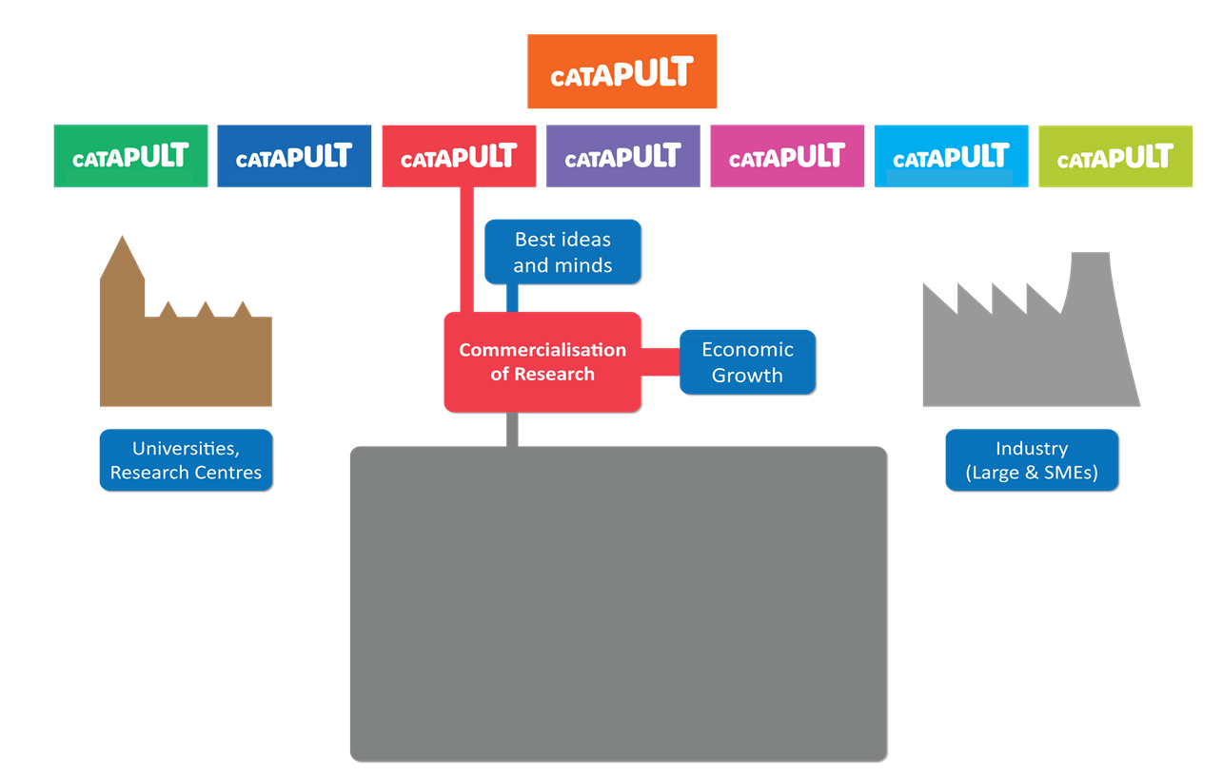
The Catapult Network
The Catapult
ORE
HVM
TS
CDE
CT
FC
Easy access to world-leading technology, expertise and science
Stimulating collaborative, business led R&D
Delivering contract research for business and government
Platforms and services to accelerate business realisation
Provide a coalescing force for the sector
Pioneering, Agile, Collaborative, Entrepreneurial

Slide 3
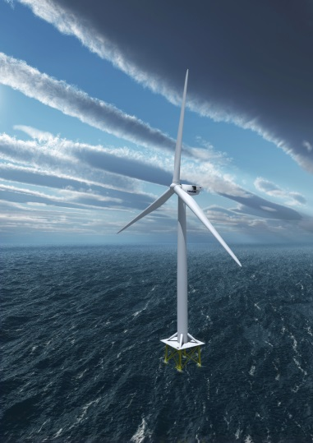
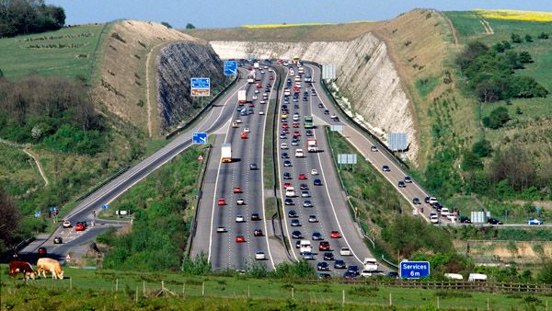
The Catapult Network
Big Data -> CEMS
M2M -> Satcomms and IoT
Connected Digital Economy
Platforms, Technologies, Routes to Market
Satellite Components of Solutions, Test Cases
Satellite Applications
User Requirements, Ideas, Routes to Market
New Solutions
Off-Shore Wind Resource Mapping
Wind and Wave Forecast and Monitoring
Communications and Positioning
Transport Infrastructure Monitoring
Maritime Emergency Response
Automated Vehicles
Communications and Positioning
Off-Shore Renewable Energy
Future Cities
Transport Systems
Urban Planning inc Heat islands
Monitoring Building Usage
Precision Farming
Notes:
One of seven independent centres, part-funded by the Technology Strategy Board
Driving economic growth through commercialisation of research
Is a not for profit Research and Technology Organisation
Business-focused technology and innovation centre that makes world-leading technical capability available to businesses to solve their technical challenges
Provides
Access to world-leading technology & expertise
Reach into the knowledge base for world-class science
Capability to undertake collaborative R&D projects with business
Capability to undertake contract research for business
Strongly business-focused with a professional delivery ethos
Create a critical mass of activity
Skills development at all levels
It is all about
Closing the gap between conception and commercialisation.
How businesses can get to market sooner - and more effectively
Connecting the innovation landscape.
Helping companies to find the best answers, expertise and help
Provide facilities and expertise to lower barriers to innovation.

Slide 4
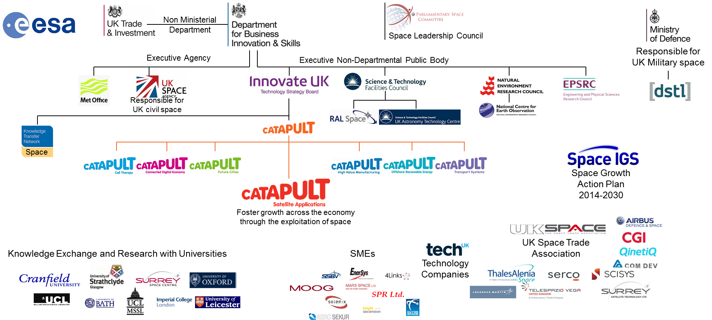
Relationship with other organisations
A new world-leading network of technology and innovation centres
Bridge the gap between businesses, academia, research and government
Long-term investment to transform the UK’s ability to create new products and services
Open up global opportunities for the UK and generate sustained economic growth

Slide 5
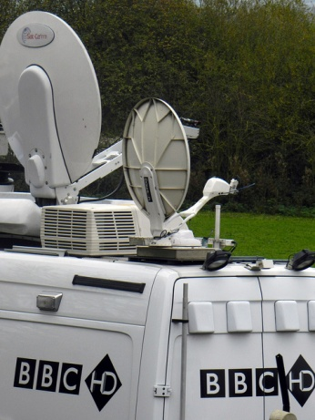
Stakeholders
Stakeholder Engagement
Idea Generators
(Key Stakeholders)
Customers
Networkers
Funders
SatApps Catapult
End Users
Other Catapults
Suppliers
Centres of Excellence
Notes:
• Range of stakeholders
Connecting SMEs with end users produces applications that solve real problems and therefore have market potential.
• Catapult-facilitated communication between stakeholders enables better understanding, speeding up development process and lowering risk of failure.
Our consultation fora process supports engagement with new sectors and transition of new concepts through to development of new solutions.
Please engage?

Slide 6
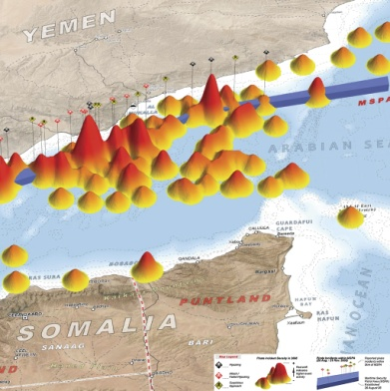
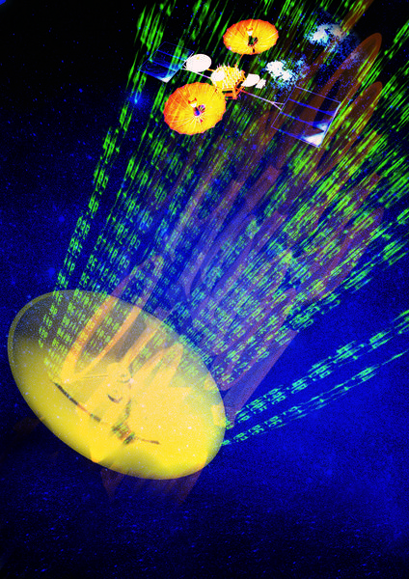
Engagement
Delivery Model
Other Industries
ESA ARTES
Space Industry
EU FP7, H2020
Commercial Services
Collaborative Programmes
UK Space Agency
UK National Programmes
Other Government
Non-EU, US, India, South Korea
Core Grant
TSB
Notes:
Three ways of working:
Contracting research with partners such as UKSA, members of the Space Industry, Other Industries, etc.
Collaborative work both within the UK and internationally.
Self-funded projects supported by the Technology Strategy Board core grant.

Slide 7
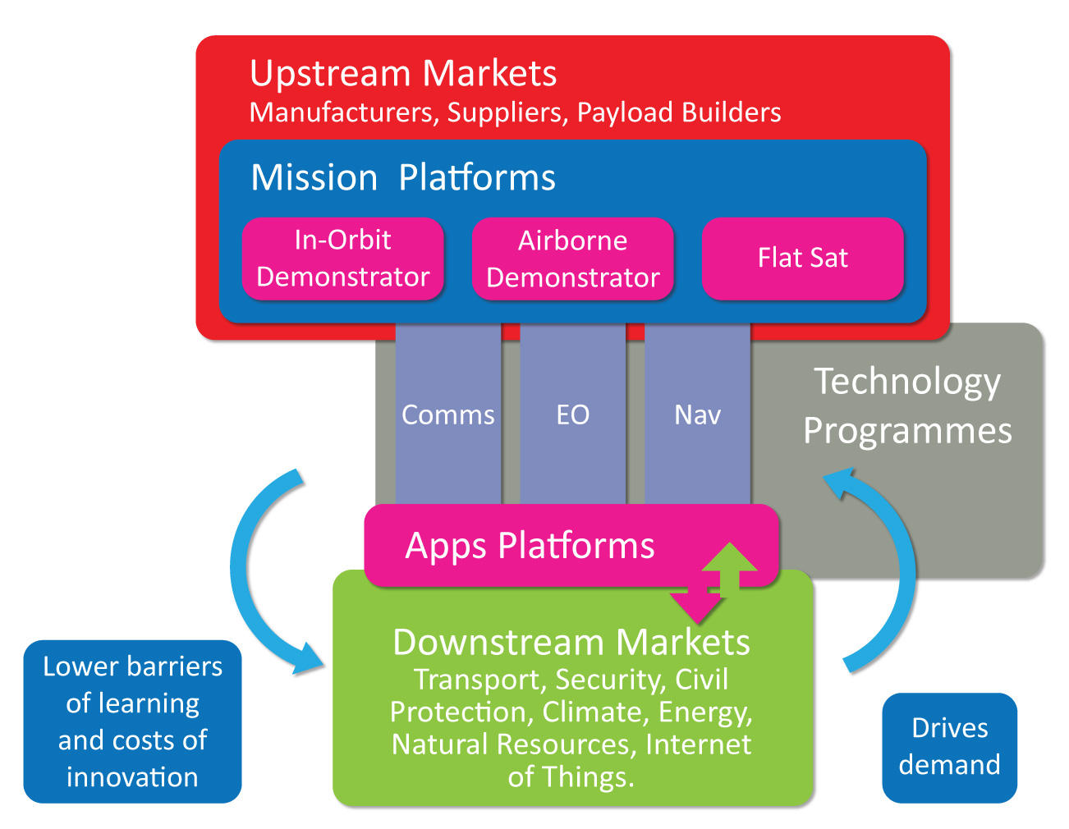
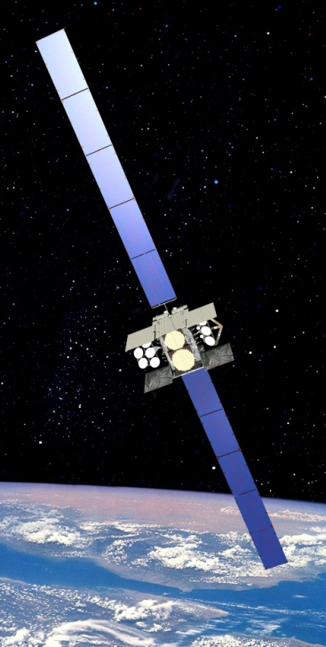
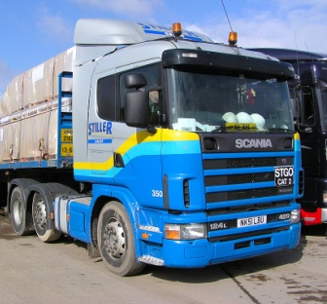
Overview
Notes:
By.....
Providing end-to-end infrastructure that enables systems
prototyping and service demonstrations – both mission platforms and application development platforms.
Provide access to in-orbit test facilities & expertise
to operate demonstration satellites
Integrate satellite and terrestrial data sources to
demonstrate viability of new applications
Facilitate access to existing satellite infrastructure,
communication networks & data sources
It lowers barriers of learning and cost of innovation in the upstream and drives demand in the downstream.
The first downstream markets we are focussing on are transport, security and civil protection; climate energy and natural resources and internet of things. Important to connect satellite applications with downstream markets.
Strong case-study evidence that many of the major
downstream success stories grow from the upstream
(technology push, sector knowledge, cluster effect, skills
availability….)
The Catapult aims to bring the upstream and downstream
communities together to create the “virtuous circle” of
applications pull and technology push.

Slide 8
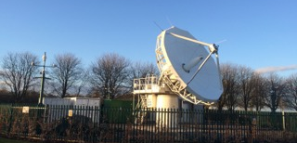
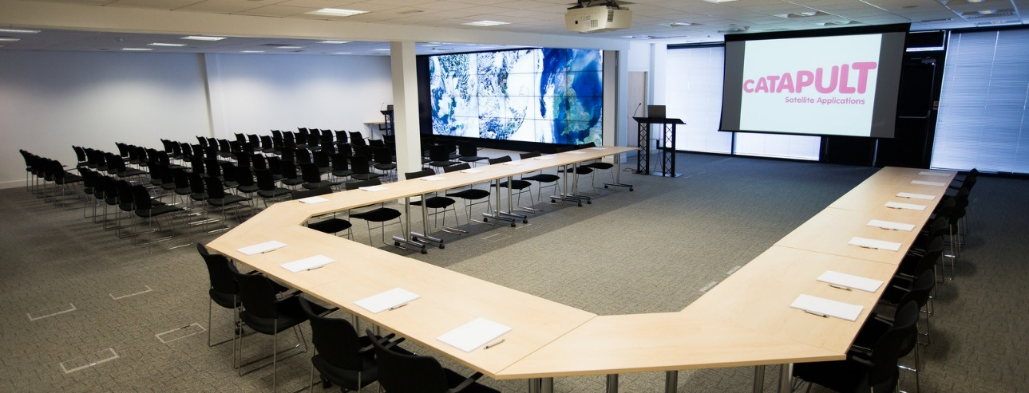
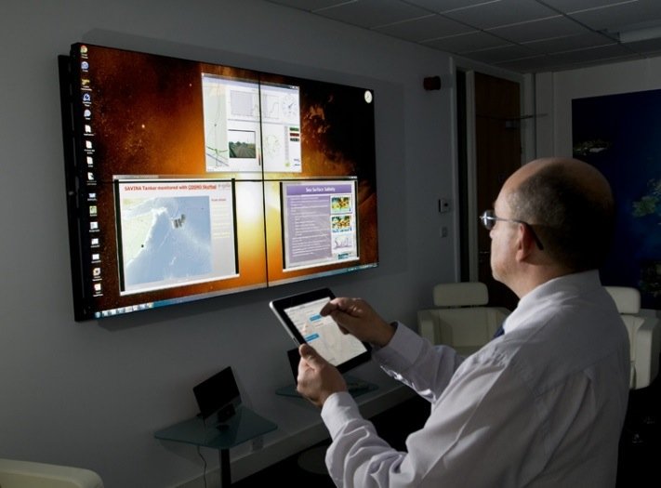
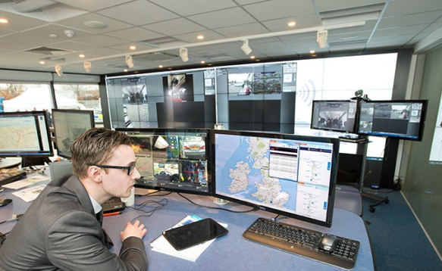
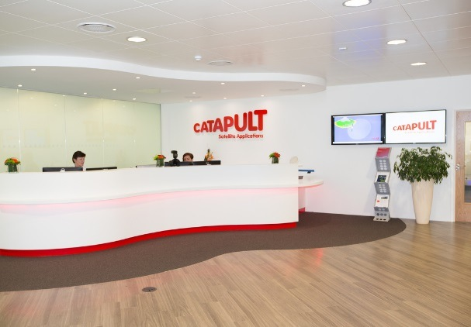
Excellent Facilities
Establishing world class facilities

Slide 9
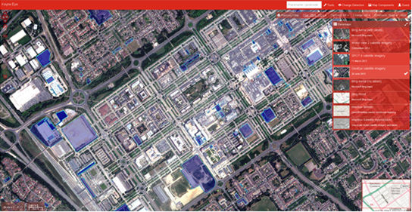
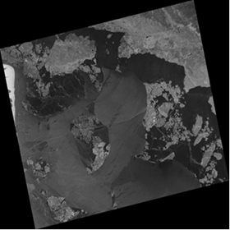
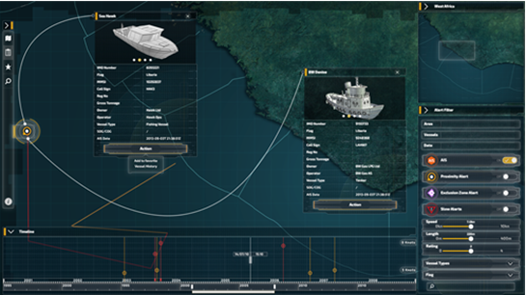
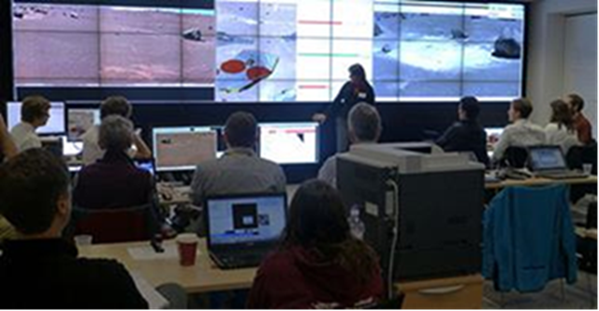
Activities and Projects

Slide 10
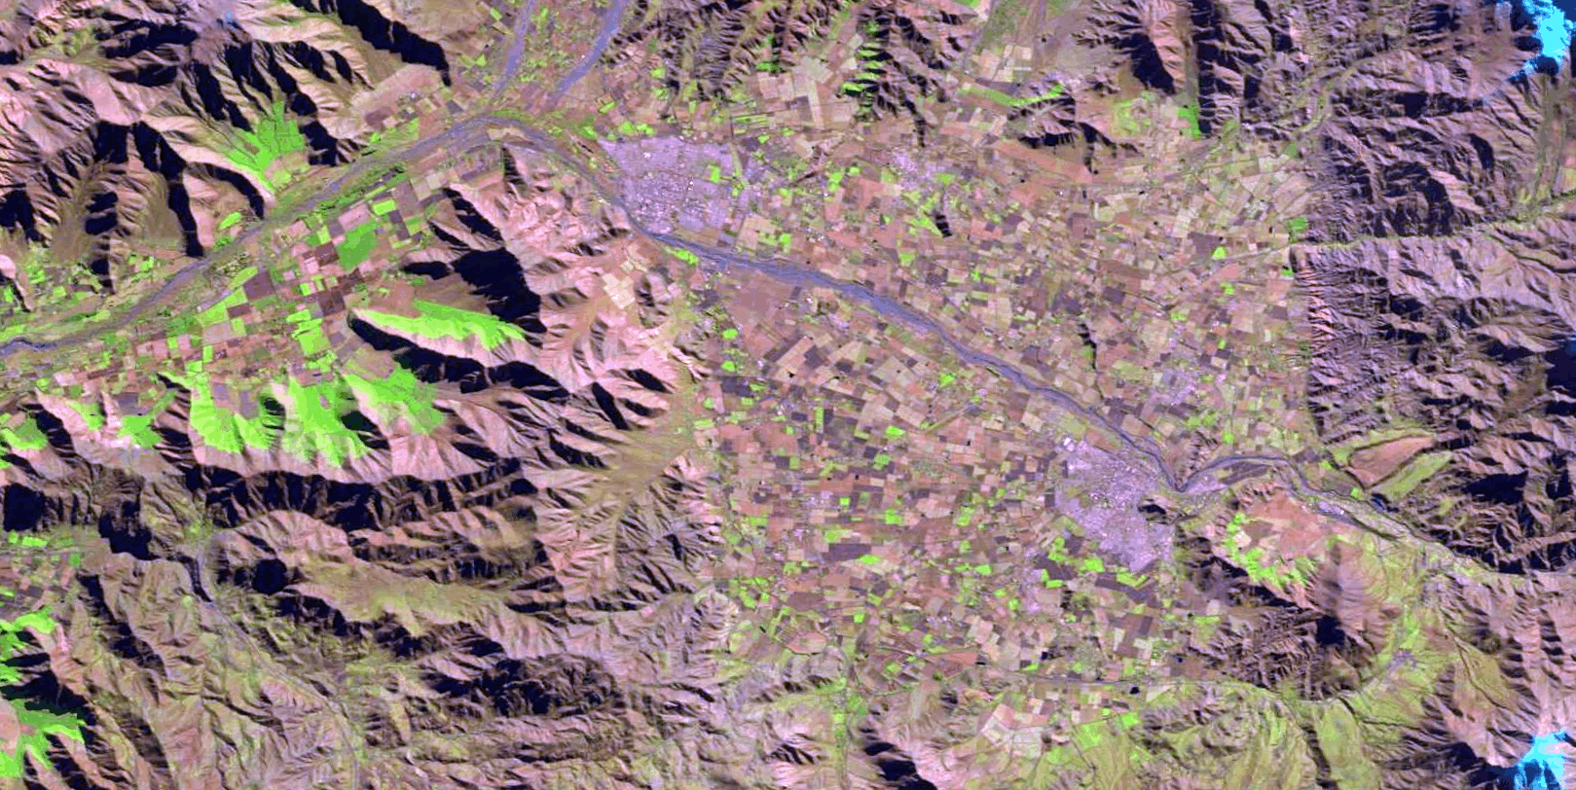
LURA Project Overview
Animation of Landsat8: Los Andes Area in Chile
July 2013 to July 2014

Slide 11
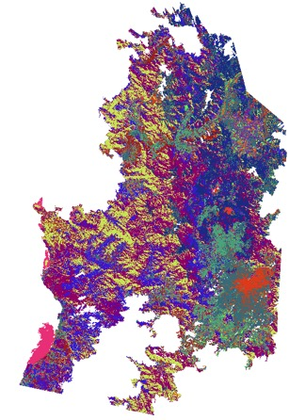
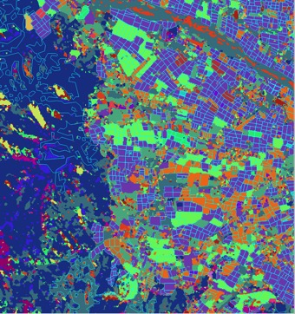
LURA Project Overview
Image Classification using Landsat 8

Slide 12
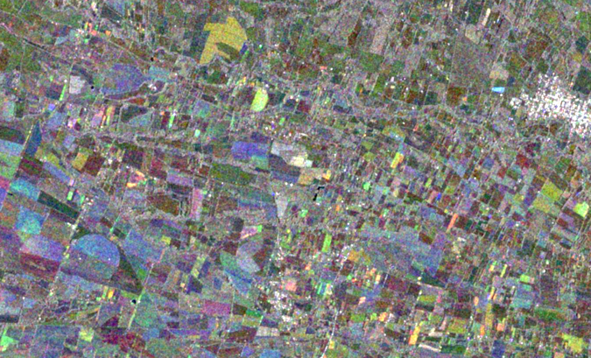
LURA Project Overview
Sentinel-1 Close up near San Ignacio near Chillan (Concepcion)
Good differentiation of different crops in multi-temporal image.
Image creation not affected significantly by cloud
Notes:
Works through cloud.

Slide 13
UK Collaborative Ground Segment for Sentinel data – funded by
UK Space Agency

Slide 14
Thank you.you!

