Slide 1
Invitation to Harwell for WGISS 40
Presentation to WGISS39
Japan, May 2015
Wyn Cudlip UKSA/GeoSeren
wcudlip@geoseren.com

Slide 2
Invitation
UK Space Agency is pleased to host WGISS 40 at Harwell in the UK
Location: Satellite Applications Catapult
Dates:
From Monday 28th September 2015
To Friday 2nd October 2015

Slide 3
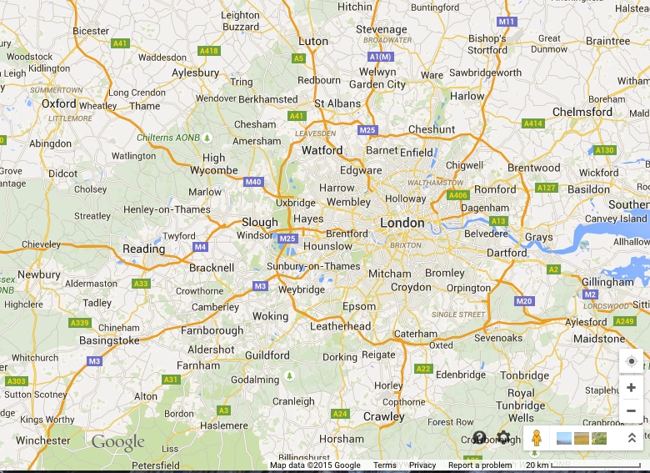
Where is Harwell?
In the middle of nowhere…
Stanstead Airport
Luton Airport
Harwell
Heathrow Airport
Gatwick Airport

Slide 4
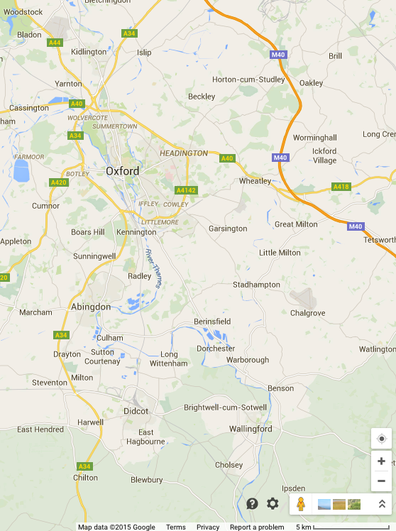
Near Oxford
Harwell Oxford Campus

Slide 5
Oxford…
http://www.oxfordcity.co.uk

Slide 6
Transport
Unfortunately, Harwell is difficult to get to.
(86km from Heathrow Airport, 115km from London)
Easiest to get to by hire car. Journey time ~1 hr
(unless staying in Oxford hotel)
Pre-arranged Taxi is possible (recommended) – cost ~£50
(Catapult can help co-ordinate arrival times)
Train also possible: from Airport to Paddington Station (London)(£15); then to Didcot or Oxford (£30); then Taxi (£15 – £5)
Or, from Heathrow Airport, RailAir coach to Reading Station (£10) and train to Didcot or Oxford Station (£14), then Taxi….

Slide 7
What is at Harwell?
Not a lot!
Apart from 3000 people working in a high-tech business park.

Slide 8
Harwell Oxford Campus
New ESA ECSAT Centre
Satellite Applications Catapult
Diamond Synchrotron Source
RAL Space
ISIS
Neutron & Muons
Central Laser Facility

Slide 9
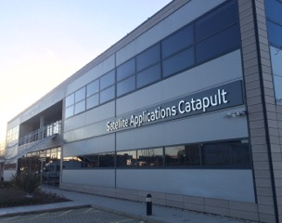
Meeting Location
Sentinel Receiving Dish

Slide 10
Meeting Agenda
Monday to Friday – usual WGISS Stuff
Tuesday – Sentinel Workshop…. Half-day? (different room)

Slide 11
Finally
Registration will open at end of May.
Will recommend a hotel in Oxford.
Plus other local hotels
I look forward to seeing you there!

