Slide 1

WGISS Infrastructure Project (WISP) Report
Martin Yapur (martin.yapur@noaa.gov)
Anne Kennerley (anne.kennerley@noaa.gov)
Tsukuba, Japan
May 11, 2015
Committee on Earth Observation Satellites

Slide 2
Support Team
Lead
  Martin Yapur (martin.yapur@noaa.gov)
Team
  Anne Kennerley (anne.kennerley@noaa.gov)
  Kim Holloway (kim.e.holloway@nasa.gov)
  For any technical CEOS server requests, contact: it@ama-inc.com

Slide 3
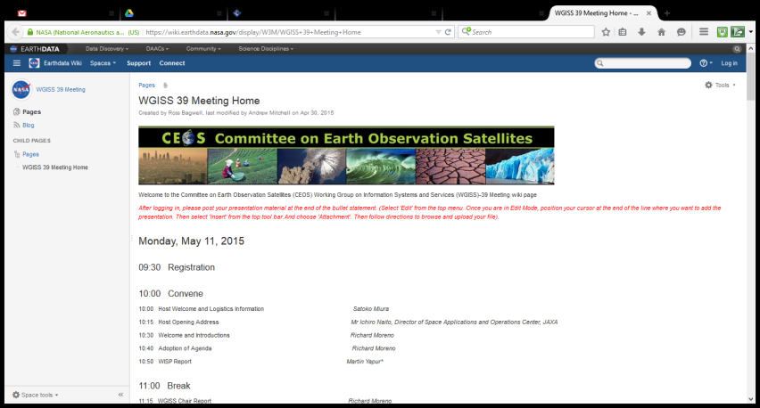
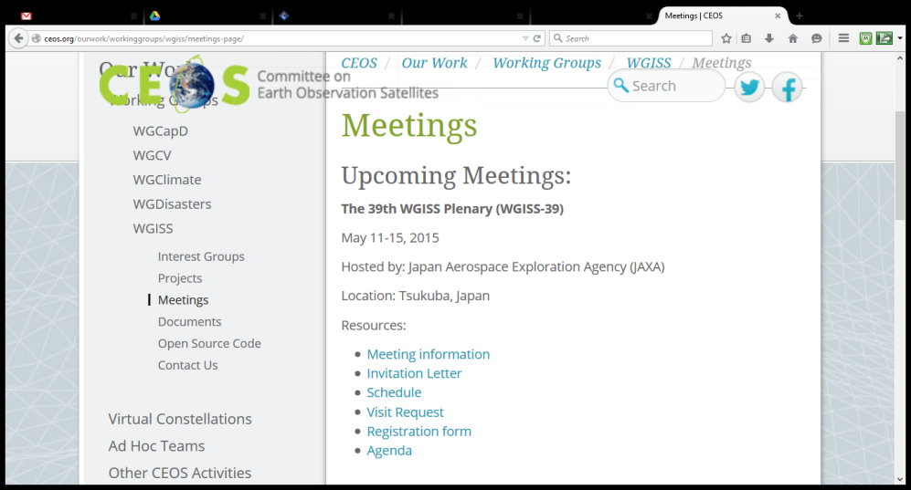
WGISS-39 Presentations
The link to the wiki where presentations
are/can be loaded is here:
https://wiki.earthdata.nasa.gov/display/
W3M/WGISS+39+Meeting+Home
All the presentations will be migrated to the Google drive for viewing/
archiving after the conference. They will also be accessible from the
agenda on the WGISS page.

Slide 4


File Formats
Presentations
  Date_Time_Title (ie. 5.15_10.35_WISPREPORT)
  Remember to submit your presentation
  BEFORE YOU START!
Methods
  Email
  Please email Michelle to mvpievgrass@gmail.com
    and Anne to anne.kennerley@noaa.gov
WGISS Infrastructure Services (WISP)

Slide 5
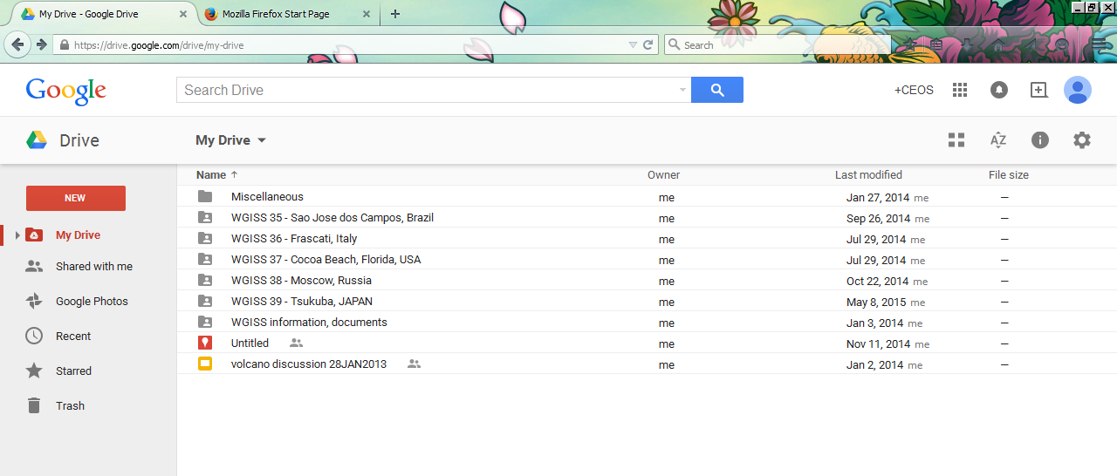
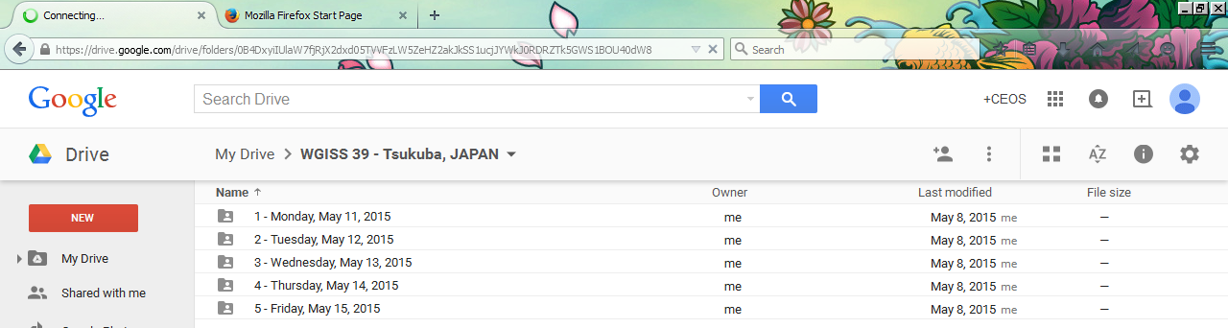
Meeting Docs. &
Archive
  Request past presentations and archives to Anne Kennerley (anne.kennerley@noaa.gov)

Slide 6
Recent Activities
Updates of existing webpages to coordinate with the new look of the CEOS website
Creation of new pages for FedEO project and Open Source Code
Organization/upload of documents to the new Document Management System for archival
Continual updates of the mailing lists

Slide 7
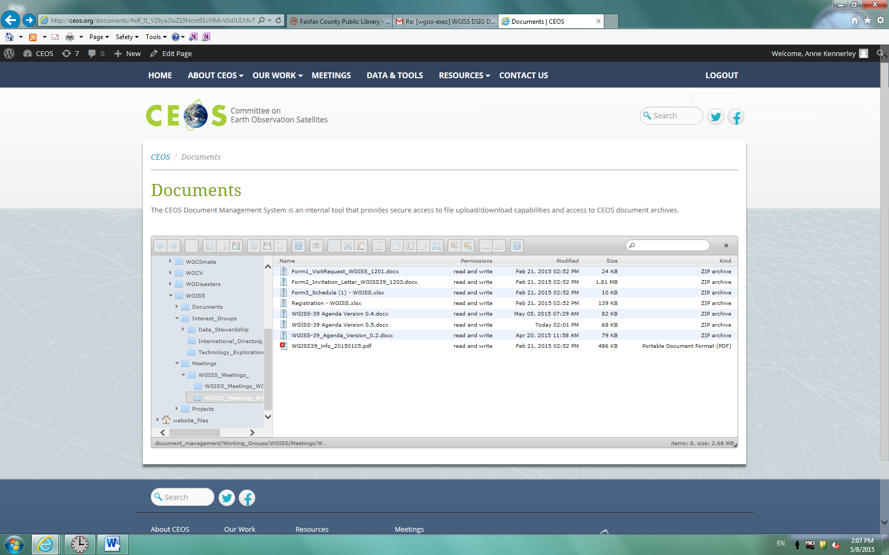
Document Management
System

Slide 8
The Future of WISP
WISP seeks your support to:
Continue managing the main content of the WGISS website and the mailing lists
Generate and support outreach materials

