Slide 1
GEO Strategic Plan 2016-2025: Implementing GEOSS and GEO Work Programme 2016 Report from GEO Workplan Symposium
WGISS#39
Tsukuba (JAPAN), 11-15 May 2015
Mirko Albani, ESA

Slide 2
What’s new?
Unique value defined
Strategic Objecives refined
GEOSS better described
Core Functions refined; targets & indicators added
Implementing Mechanisms consolidated
SBAs revised
Work Programme developed further;
Governance Programme Board added Legal status analyzed
Resources indicative scale;
specific contributions

Slide 3
Unique Value
GEO must clarify its unique value proposition
improve the quality, timeliness, range and availability of Earth observations
facilitate the development of efficient, sustainable solutions to environmental societal challenges
broker combinations of actors to understand Earth system processes and respond to societal challenges
GEO does more than build GEOSS
Uniqueness of GEO is in its convening power

Slide 4
Strategic objectives
GEO value must be made clear to policy-makers
Three Strategic Objectives in the Areas of Action – Advocate, Engage, Deliver
Encompass major GEO achievements and success
Data Sharing Principles / Data Management Principles
Flagship Initiatives
Communities
Advocate
Engage
Deliver
High level message on what GEO strives for
Evolution, not revolution

Slide 5
GEOSS
Need to clarify what GEOSS is and what GEO‘s role is
Observation and Information Systems
GEO implements central components, based on clear high-level principles
Name principles for central GEOSS components: openness, effectiveness, flexibility, adaptability, sustainability, reliability
One simple description of GEOSS
GEO’s role is enabling GEOSS

Slide 6
Advocate
Core Functions for
Data Sharing
Data Management
Gap analyses
Best practices for citizen science
Radio frequency protection

Slide 7
Engage
Core Functions for
Creating partnerships
Resource mobilization
Creating visibility and awareness
Broadening the user bases
Capacity building
Promoting EO use in development activities

Slide 8
Deliver
Core Functions for
Operating common elements of GEOSS
Documenting data quality & provenance
Maintaining a knowledge base
Conducting implementation pilots
Incubating services through initiatives

Slide 9
Implementation Mechanisms
Need for appropriate processes and simple structures for effective and efficient implementation
Defined four Implementation Mechanisms
GEO Community Activities
GEO Initiatives
GEO Flagships
GEO Foundational Tasks
Clear understanding of how GEO implements its actions
Expectations and process clarified
Handle diversity of actions effectively

Slide 10
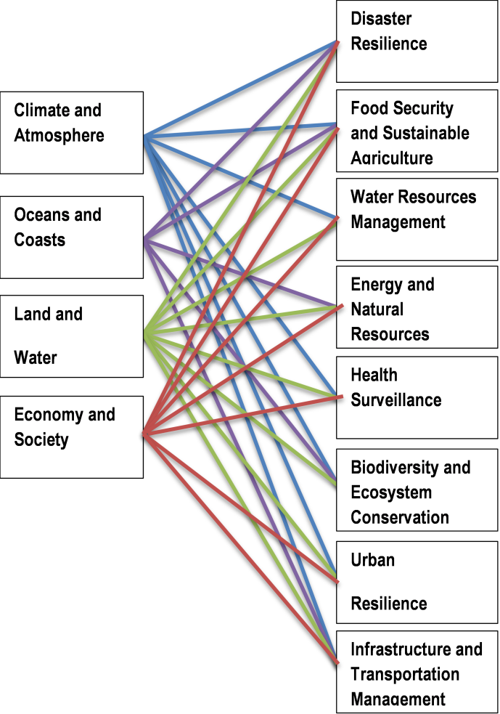
Revised SBA
Current SBA did not fully enable coordination and user-engagement
Application-oriented SBA proposed – to be discussed further

Slide 11
Work Programme
Need to prioritze actions and match ambition to resources
3-year Work Programmes, transitional Work Programme for 2016
Include all GEO action, decide on priorities
Discuss and agree in GEO Programme Board
Include indicative resource planning
Work Programme concept developed further
Community input needed, including here
Notes:
Explain difference between Foundational Tasks and rest
Longer presentation on this next day.

Slide 12
Governance
Governance needs to clearly support implementation needs
Evolve ExCom for more equitable participation
Expand to 15 seats plus 3 PO observers
Enable rotation of Co-Chairs
GEO Programme Board to discuss implementation
Include PO and Members
Nominate PO observers in ExCom
Establish GEO as independent legal persona
Form follows function
GEO Programme Board to oversee Work Programme
Notes:
Mention Advisory Boards

Slide 13
Resourcing
Address lack of resources at all levels, but remain voluntary
Commitments maintained as voluntary
Support for use of an indicative scale of contributions, ideally multi-year
Commitments to be specified for Flagships and Initiatives
Resource allocations specified in Work Programme
Mechanisms suggested to strengthen reliability of resourcing in voluntary context of GEO

Slide 14
Introducing the GEO Work Programme

Slide 15
Work Programme Structure
GEO Foundational Tasks
GEO Flagships
GEO Initiatives
GEO Community activities
Resources summary
Implementation Mechanisms
Notes:
Structured by type of activity, treating each differently.
(tbc with Giovanni)

Slide 16
GEO Foundational Tasks
Implements or supports GEO Core Function
Clear relevance to Strategic Objectives
Detailed description in Work Programme
Resourced from GEO Trust Fund, Member- or PO-commitments
Central to GEO‘s own activities
Usually strong GEOSEC role
Often in the „Advocate“ or „Engage“ Area of Action.
→ GEO Portal, Data Sharing Principles, Frequency Protection, …

Slide 17
GEO Flagships
Substantial, mature activity of global or regional scope;
Aims to provide information service or product pre-operationally or as pilot;
Flagship Implementation Plan
Multi-national stakeholder group;
Alignment with political priorities;
Clear relevance to GEO’s Strategic Objectives.
→ GFOI, GEO-GLAM, GEO-BoN, …

Slide 18
GEO Initiatives
Activity of global or regional scope;
Aims to develop or demonstrate prototype information service or product;
Implementation Plan,
Multi-national stakeholder group,
Clear relevance to GEO’s Strategic Objectives
→ Blue Planet, Cold Regions, Great Lakes, …

Slide 19
GEO Community Activities
Objective shared by a group of interested partners,
Multi-national stakeholder group or scope,
Relevance to GEO’s Strategic Objectives
→ Global Land Cover, Urban Observations, EO for Mineral Resources, …

Slide 20
Key differences: Purpose
Flagship | Pilot or pre-operational service (common GEO priority)
Initiative | Prototype service (common GEO priority)
Community Activity | Test or demonstrate applications (shared interest of specific community
Foundational Task | Implement selected, often enabling functions

Slide 21
Key differences: Originator
Flagship | Members, Participating Organizations
Initiative | Members, Participating Organizations
Community Activity | GEO Community
Foundational Task | GEOSEC

Slide 22
Key differences: Steering and oversight
Flagship | Dedicated Steering Board
Initiative | Dedicated Steering Board
Community Activity
Foundational Task | GEO Programme Board

Slide 23
Key differences: Reporting to GEO
Flagship | Coordinator
Initiative | Coordinator
Community Activity | GEOSEC to best knowledge
Foundational Task | GEOSEC
Mandatory Contributions to GEO Activities Report

Slide 24
Work Programme: Process
Interest by Members/PO
Updated draft
Final Draft (GEOSEC)
GEO Programme Board
1st draft (GEOSEC)
Adoption (Plenary)
iterative

Slide 25
Work Programmes
Work Programme 2016 (transitional)
Work Programme 2017-2019
Work Programme 2020-2022
Work Programme 2023-25
Generally 3-year Work Programmes
Notes:
Highlight also the difference in process for WP2016 in the absence of the Programme Board

Slide 26
What‘s new?
GEO Work Plan | GEO Work Programme
Overview on ongoing activities Report on progress and plans | Presents planned actions for adoption
by Task and components | by Implementation Mechanism
GEO Community | Member/PO interest, requirements for achieving GEO Targets, community wisdom
List of Task participants | Specified contributions
by Plenary | by Plenary following Programme Board recommendation
Prepared by GEOSEC community poll | Prepared by GEOSEC with GEO Programme Board
Nature
Structure
Input
Commitment
Acceptance
Process
Notes:
Further docs will come from MinWG

Slide 27
Draft 2016 Work Programme

Slide 28
Background
This initial draft has been compiled by the GEO Secretariat and it has been drafted to comply with the structure suggested by Annex B of the draft “GEO Strategic Plan 2016-2025: Implementing GEOSS”, issued by the IPWG in March 2015.
The content of the Plan is based on
the inputs received by the current GEO Tasks Teams, provided through a template (Annex 1) that the Secretariat circulated in mid March, complemented by the Secretariat
a preliminary analysis of the Foundational tasks necessary to implement all the GEO Core Functions identified in the new Strategic Plan, performed by the Secretariat.

Slide 29
Table of Contents
1 | Introduction
2 | Executive Summary
3 | Overall Planning and main deliverables
4 | Candidate Foundational Tasks
5 | Community Activities
6 | Candidate GEO Initiatives
7 | Candidate GEO Flagships
8 | Resources Summary

Slide 30
Candidate Foundational Tasks
Core function | CANDIDATE FOUNDATIONAL TASKS |  |  | Ref. to current Tasks/Components
D | FT | 1 | GCI Operations (including GEONETCast and access to Knowledge) | IN-03-C2
D-A | FT | 2 | Data Management Principles definition and Implementation | IN-02-C2
D-E | FT | 3 | Knowledge Base development and maintenance | NEW
D | FT | 4 | GEOSS Development (Includes CL-01-C2: Accelerated Implementation of the Global Climate Observing System) | IN-01-C1, IN-01-C2, IN-02-C2, IN-03-C1, IN-04-C1, IN-04-C2, IN-05-C1, CL-01-C2
D-A | FT | 5 | Advances in data sharing and implementation of the GEO Data Sharing Principles | ID-01-C1
D.A.E | FT | 6 | Systematic determination of user needs, observational gaps and resources to fill them. | NEW
A | FT | 7 | Definition of global perspectives on observations continuity planning and investments | NEW
A-E | FT | 8 | Establish GEO as global authority on the value of Earth observations in decision-making | NEW
A-E | FT | 9 | Promote the role of EOs and GEO in the post-2015 agenda and UN Conventions | NEW

Slide 31
Candidate Foundational Tasks
Core function | CANDIDATE FOUNDATIONAL TASKS |  |  | Ref. to current Tasks/Components
A | FT | 10 | Radio-frequency protection | IN-01-C4
A-E | FT | 11 | Communication and Engagement | ID-04-C2
E | FT | 12 | GEO decision processes, supporting tools, documentation, preparatory activities | NEW
E | FT | 13 | Monitoring and Evaluation | NEW
E | FT | 14 | Promoting establishment of CoPs and supporting their activities | NEW ID-04-C1
E-D | FT | 15 | Capacity Building coordination | ID-02
E | FT | 16 | Mobilize resources and coordinate their use in support of GEO activities | ID-05
E | FT | 17 | Promote the development of citizens’ observatories | NEW
A-E-D | FT | 18 | Socio-economic value of EO’s | NEW

Slide 32
Community activities
C | 1 | Global Land Cover SB-02-C1, C2, C3
C | 2 | Land Cover for Africa SB-02-C4
C | 3 | Global Urban Observation and Information SB-04
C | 4 | Extension and Improvement of the Climate Record CL-01-C1
C | 5 | Access to model data in GEOSS part of CL-01-C4
C | 6 | Strengthen collaboration between GEO and GFCS part of CL-01-C4
C | 7 | EO data and mineral resources part of EN-01 (Includes also the SB-05-C2, Impact Monitoring System for Geo-Resource Exploration and Exploitation)
C | 8 | Foster utilization of Earth observation remote sensing data for all phases of Disaster Risk Management DI-01-C5
C | 9 | Integrated Water-cycle Products and Services WA-01-C1
C | 10 | GEO Water Quality WA-01-C5
C | 11 | Water Cycle Capacity Building WA-01-C6

Slide 33
Candidate GEO Initiatives
I | 1 | Ocean and society - Blue Planet SB-01
I | 2 | GEO Geohazard Supersites and Natural Laboratories (GSNL) DI-01-C2
I | 3 | Global Wildfire Information System DI-01-C4
I | 4 | EO data and renewable energies part of EN-01
I | 5 | GEO Great Lakes Activity (currently part of WA-01-C1)
I | 6 | Global Drought Information System (GDIS) WA-01-C2
I | 7 | Information Services for Cold Regions WA-01-C3

Slide 34
Candidate GEO Flagships
F | 1 | GEOGLAM-Global Agricultural Monitoring and Early Warning AG-01
F | 2 | GEOBON-Global Biodiversity Observation (GEO BON) BI-01
F | 3 | GFOI Global Forest Observation Initiative SB-03-C1
F | 4 | Global Ecosystem Monitoring EC-01 (new proposal)
F | 5 | Global Observing System for Mercury and PoPs, new proposal based on HE-02-C1 and C2
F | 6 | Global Carbon Observation and Analysis System, new proposal based on CL-02-C1

