Slide 1


The basic Earth OBSERVATION DATA PRODUCTS BANK
Tamara Ganina
Deputy Chief of Prospective Development Dep.
WGISS-39
JAXA, Tsukuba, Japan
May 11–15, 2015

Slide 2
Content
Concept and Properties of Basic EO Data Products (BP)
Hierarchy of Basic EO Data Products Categories
Objective and Benefits of Basic EO Data Products Bank (BBP) Generation
Definition and technological model of BBP
BBP components:
Resource Administration;
Archiving & Cataloging;
BPs Generation;
BPs Verification;
BPs Distribution.
BBP Information Interoperation and Access to Basic Products Bank
2

Slide 3
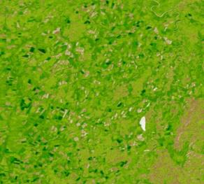
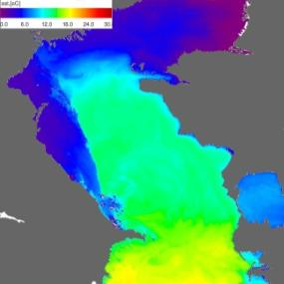
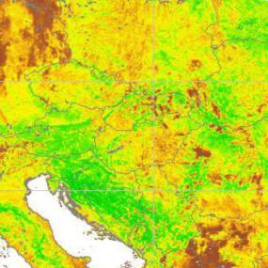

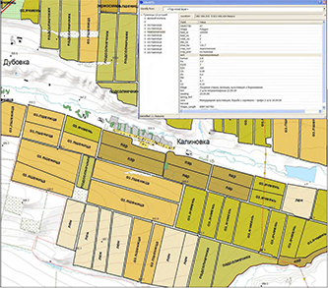
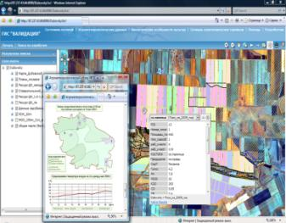
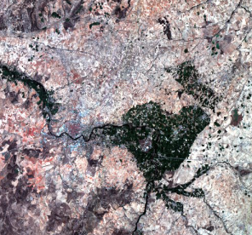
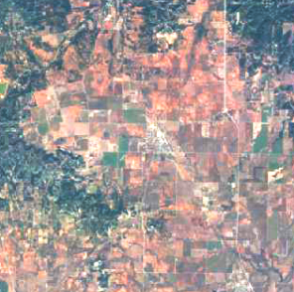
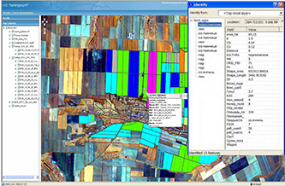
Concept of Basic EO Data Product
EO Data Products of Standard Processing Level (L1C, L1D CEOS)
Thematic GIS –
Results of BPs Interpretation
Basic EO data products provide the basis for multipurpose thematic interpretation for solving the tasks of interagency and regional customers with no use of additional measuring material
3

Slide 4
Properties of Basic EO Data Products
Today the BPs are datasets from which the different characteristics of regions, phenomena, and/or objects observed may be derived. They allow:
Monitoring long-term variability of objects under control
Constructing maps of remote data-retrieved geophysical parameters
Comparing data from various sources of satellite observations
Validation of remote data-retrieved geophysical parameters describing physical objects
Acquiring source and reliable data needed for models of various phenomenon and process development
4

Slide 5
Hierarchy of Basic EO Data Products Categories
5
Notes:
Basic EO Data Product of Standard Level Processing 1C (1D) CEOS
Primary Basic Product MSI: Spectral Radiance, MSE GSI: Spectral Radiance, MSE RLI: Amplitude Image, Coherence Image
Secondary Basic Product Spectral Induces Thematic Masks
Single-Purpose Physical Quantities
Spectral Induces
Thematic Masks
Single-Purpose Physical Quantities
Composites

Slide 6
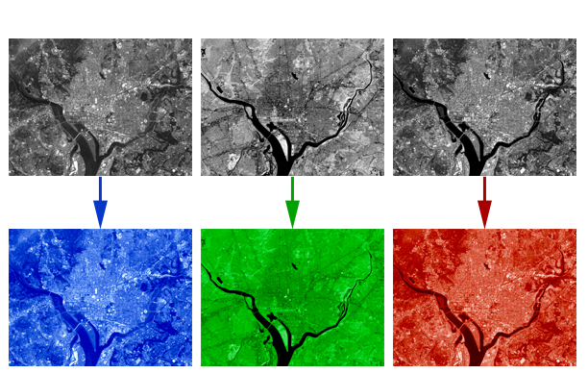
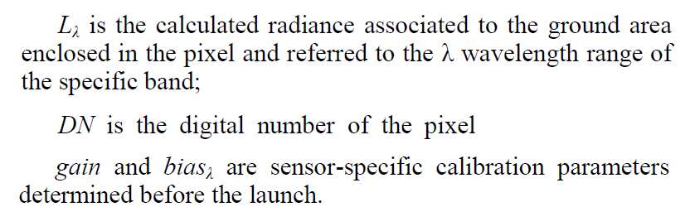

Primary BPs
Primary BP is a product of standard processing level 1C(1D) CEOS in at-sensor physical quantities
6

Slide 7
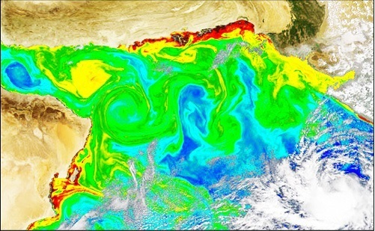
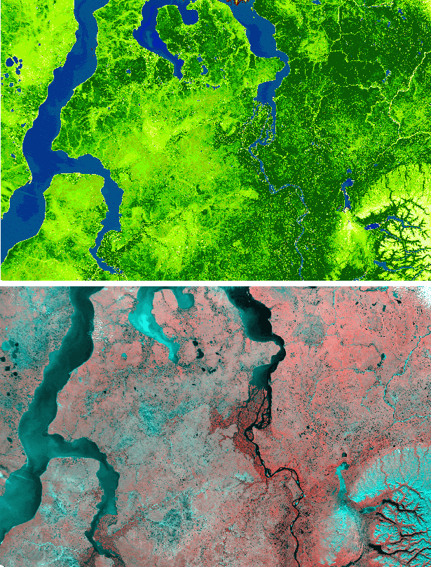

Secondary BPs
Secondary BP is a result of special processing primary product given in derived physical (or pseudo physical) quantities
Chlorophyll-A Concentration, mg/m3
Vegetation Indices
(pseudo physical quantities)
7

Slide 8
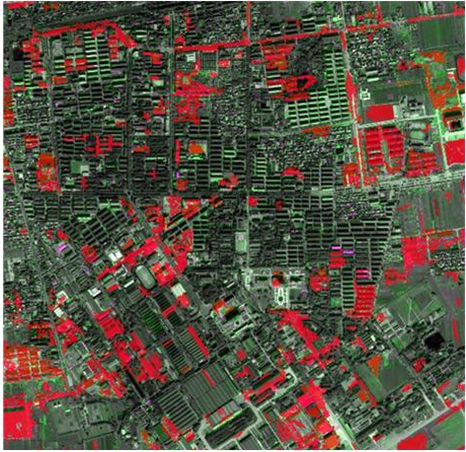
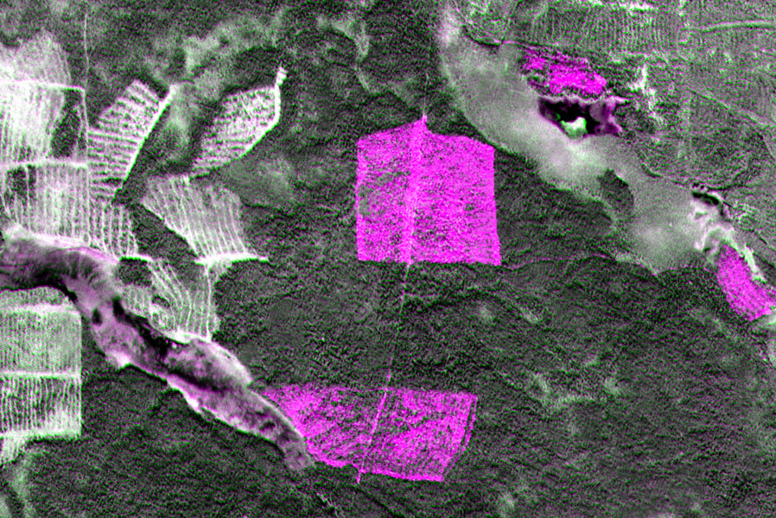
Composites
Composite is a three-band (or two-band) image formed based on primary basic products for the same region acquired at different dates and/or from different sensors
Change detection for multi-date imagery
Anomalies detection using
multiple sensor data
8

Slide 9
BBP: Objective and Benefits
Objective
The use of raw data from the Russian in-orbit satellite constellation for addressing socio-economic problems has several disadvantages now. The main one is that the agencies need to develop the technologies of basic data product generation autonomously and many times at the expense of budget funds. The establishing of the BBP will solve this problem
Benefits
A federal public BBP will provide the agency-level and regional systems with multipurpose source data to solve the thematic tasks of space monitoring without the need for developing and operating the relevant technologies by themselves
9

Slide 10
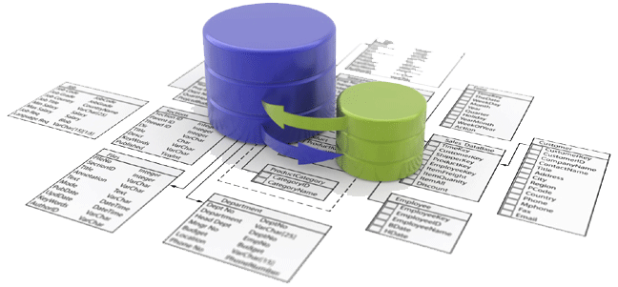



BBP as a WEB-service
Archive of Primary BPs
Generation of Secondary BPs and Composites
bbp.ntsomz.ru
External
users
10

Slide 11


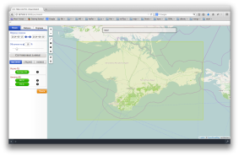
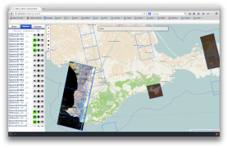

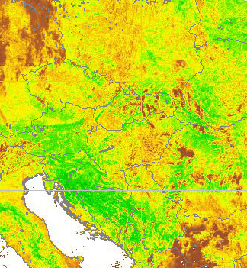
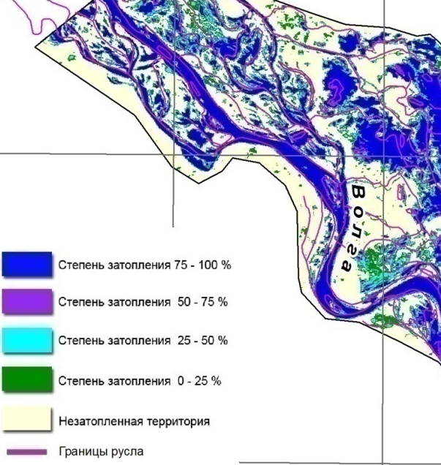
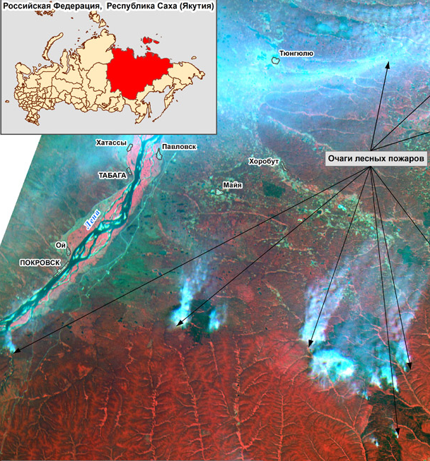
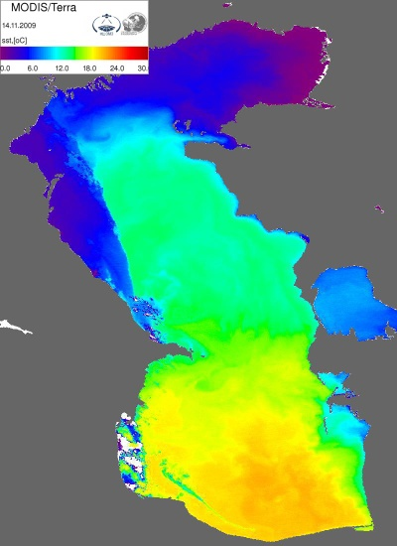






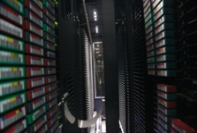


BBP Components
BP Generation
BP Distribution
4 software applications for basic products generation
flow data processing server
Ready orders Server
bbp.ntsomz.ru
Administration Resource
Distributed system
(Map/Reduce model)
Archive & Database
Centralized control based on Vmware vSphere
Communication Server for Regional segments
metadata
Oracle DB cluster
BP Verification
Archive Server
Desktop workstation
(ENVI, Erdas)
Master data downloaded from foreign archives
Long-term archive
(2114 Tb)
Primary basic
products
11

Slide 12
BBP Components Distribution by Segments
Central Segment (Moscow)
BP Generation
BP Distribution
Resource Administration
Archive & Database
BP Verification
Regional Segment (Zheleznogorsk)
Regional Segment (Khabarovsk)
Resource Administration
(Local subcomponent)
Resource Administration
(Local subcomponent)
Local Data Archive
BP Generation
Local Data Archive
BP Generation
12

Slide 13
BBP Resource Administration
BP Generation
BP Distribution
Resource Administration
Archive & Database
BP Verification
13

Slide 14
Programming Model for Resource
Administration Software
The Map/Reduce programming model provided the scaling:
At level of establishing new regional segments;
At level of creating new subsystems for data processing (tasks of new types).
Features:
Sockets using for messaging between the components via TCP/IP;
Cross-Platform compatibility at Worker level (WinNT/*nix)
14

Slide 15
Central and Regional Segment Interaction Using Resource Administration Software Modules
15
Notes:
Central Segment
Regional Segment

Slide 16
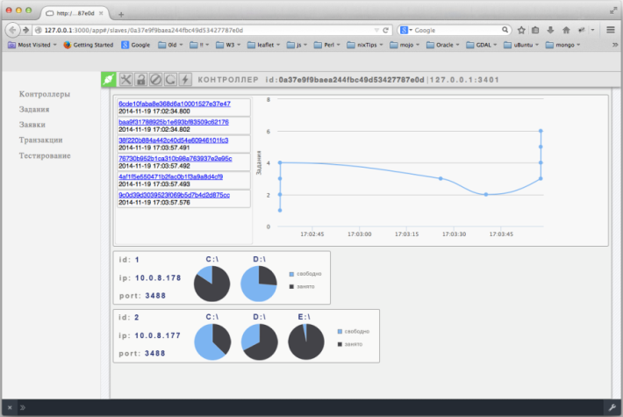
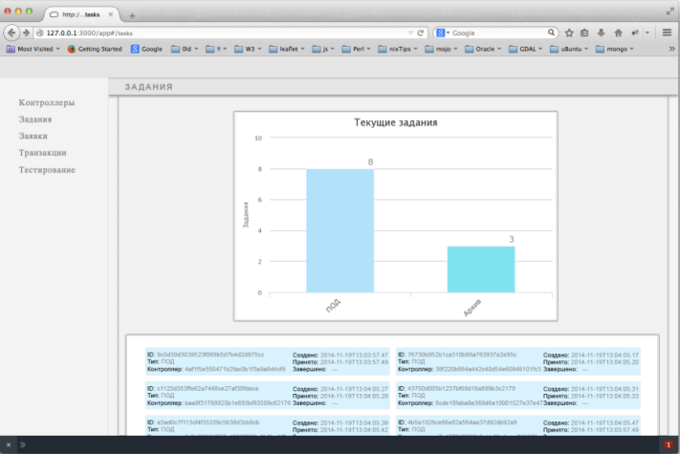
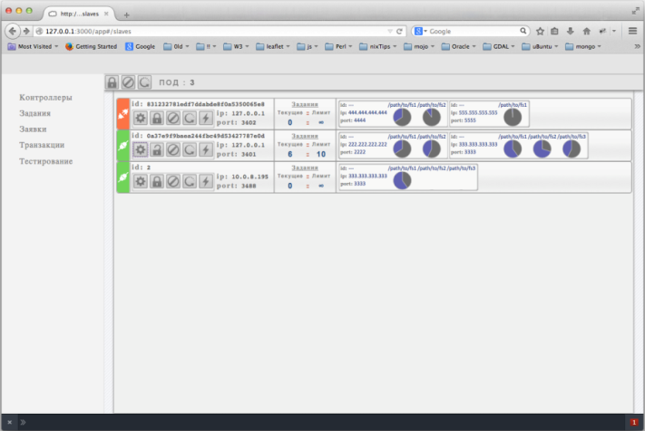
Dispatcher Module
Module Functioning Mechanism:
Acceptance of new requests (through the interaction with Database)
Generation of “tasks” list based on the request
“Tasks” distribution to controllers
Visualization of the request execution and virtual machine condition
Reception of the accomplished “tasks” from Controller type modules
Distribution of the request completion messages to Basic Product customers
16

Slide 17
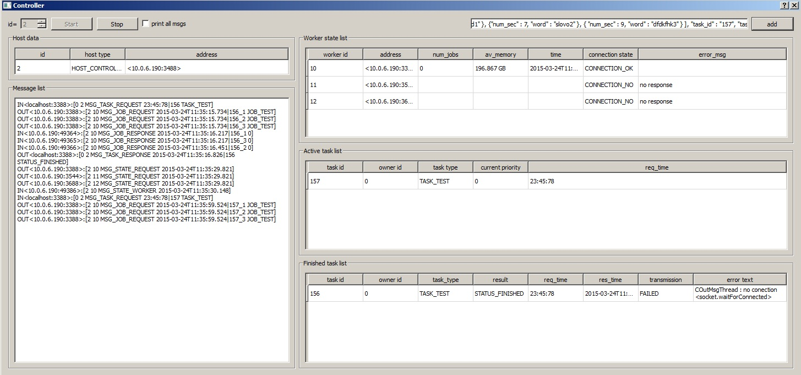
Controller Module
Module Functioning Mechanism:
Acceptance of new “tasks” from Dispatcher module
Generation of task-based “job” list
Distribution of “jobs” to appropriate Worker type modules
Reception of Worker type module state messages
Passing of virtual machine condition to Dispatcher type module
Passing of accomplished tasks to Dispatcher module
17
Notes:
Key buttons to start/stop Controller work
Message window of incoming/outgoing messages
ZKIPPOD active program window
Executed task window
Current task window

Slide 18
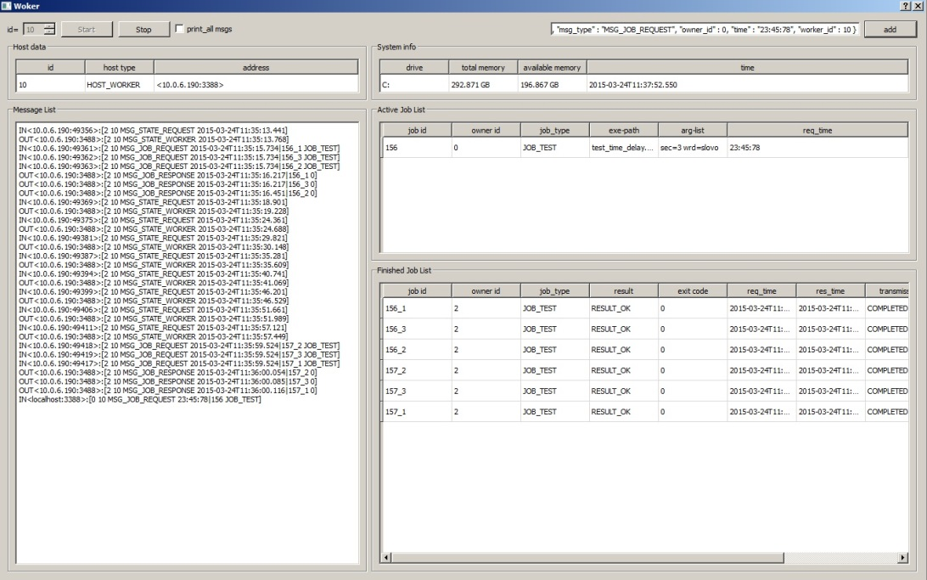
Worker Module
Module Functioning Mechanism:
Acceptance of new “jobs” from the Controller module
Start of appropriate “jobs” as the console-applications
Waiting for the “job” execution
Transfer of status messages to Controller type module
Transfer of accomplished “job” message to Controller type module
18
Notes:
Buttons to start/stop ZKIIPOD
Message window of incoming/outgoing messages
Window of current tasks being executed by ZKIIPOD
Executed task window
Message window of available memory state

Slide 19
Soft- and Hardware Tools for BPs Archiving & Cataloging
BP Generation
BP Distribution
Resource Administration
Archive & Database
BP Verification
19

Slide 20
Principles and Approaches to Database Development
The object model containing the semantic network of object categories and stored procedures of various type model is developed
The set of object model relation classes and types using Metadata Profile of Integrated GeoData Bank (government standard) is generated
The model realizes the virtual generic object using a common surrogate key (end-to-end object identification) whereby the integrated table of many-to-many relations with the capability of extending the relation type set with no programming is implemented
The status model common for all object classes is implemented
A unified set of housekeeping data input attributes is implemented. It is universal for all object classes (data on record generation date, customer generated the record, and customer changed the record and record status)
Dealing with geospatial data using standard facilities of storage, request generation and analysis of location data incorporated into Oracle DBMS is arranged
20

Slide 21
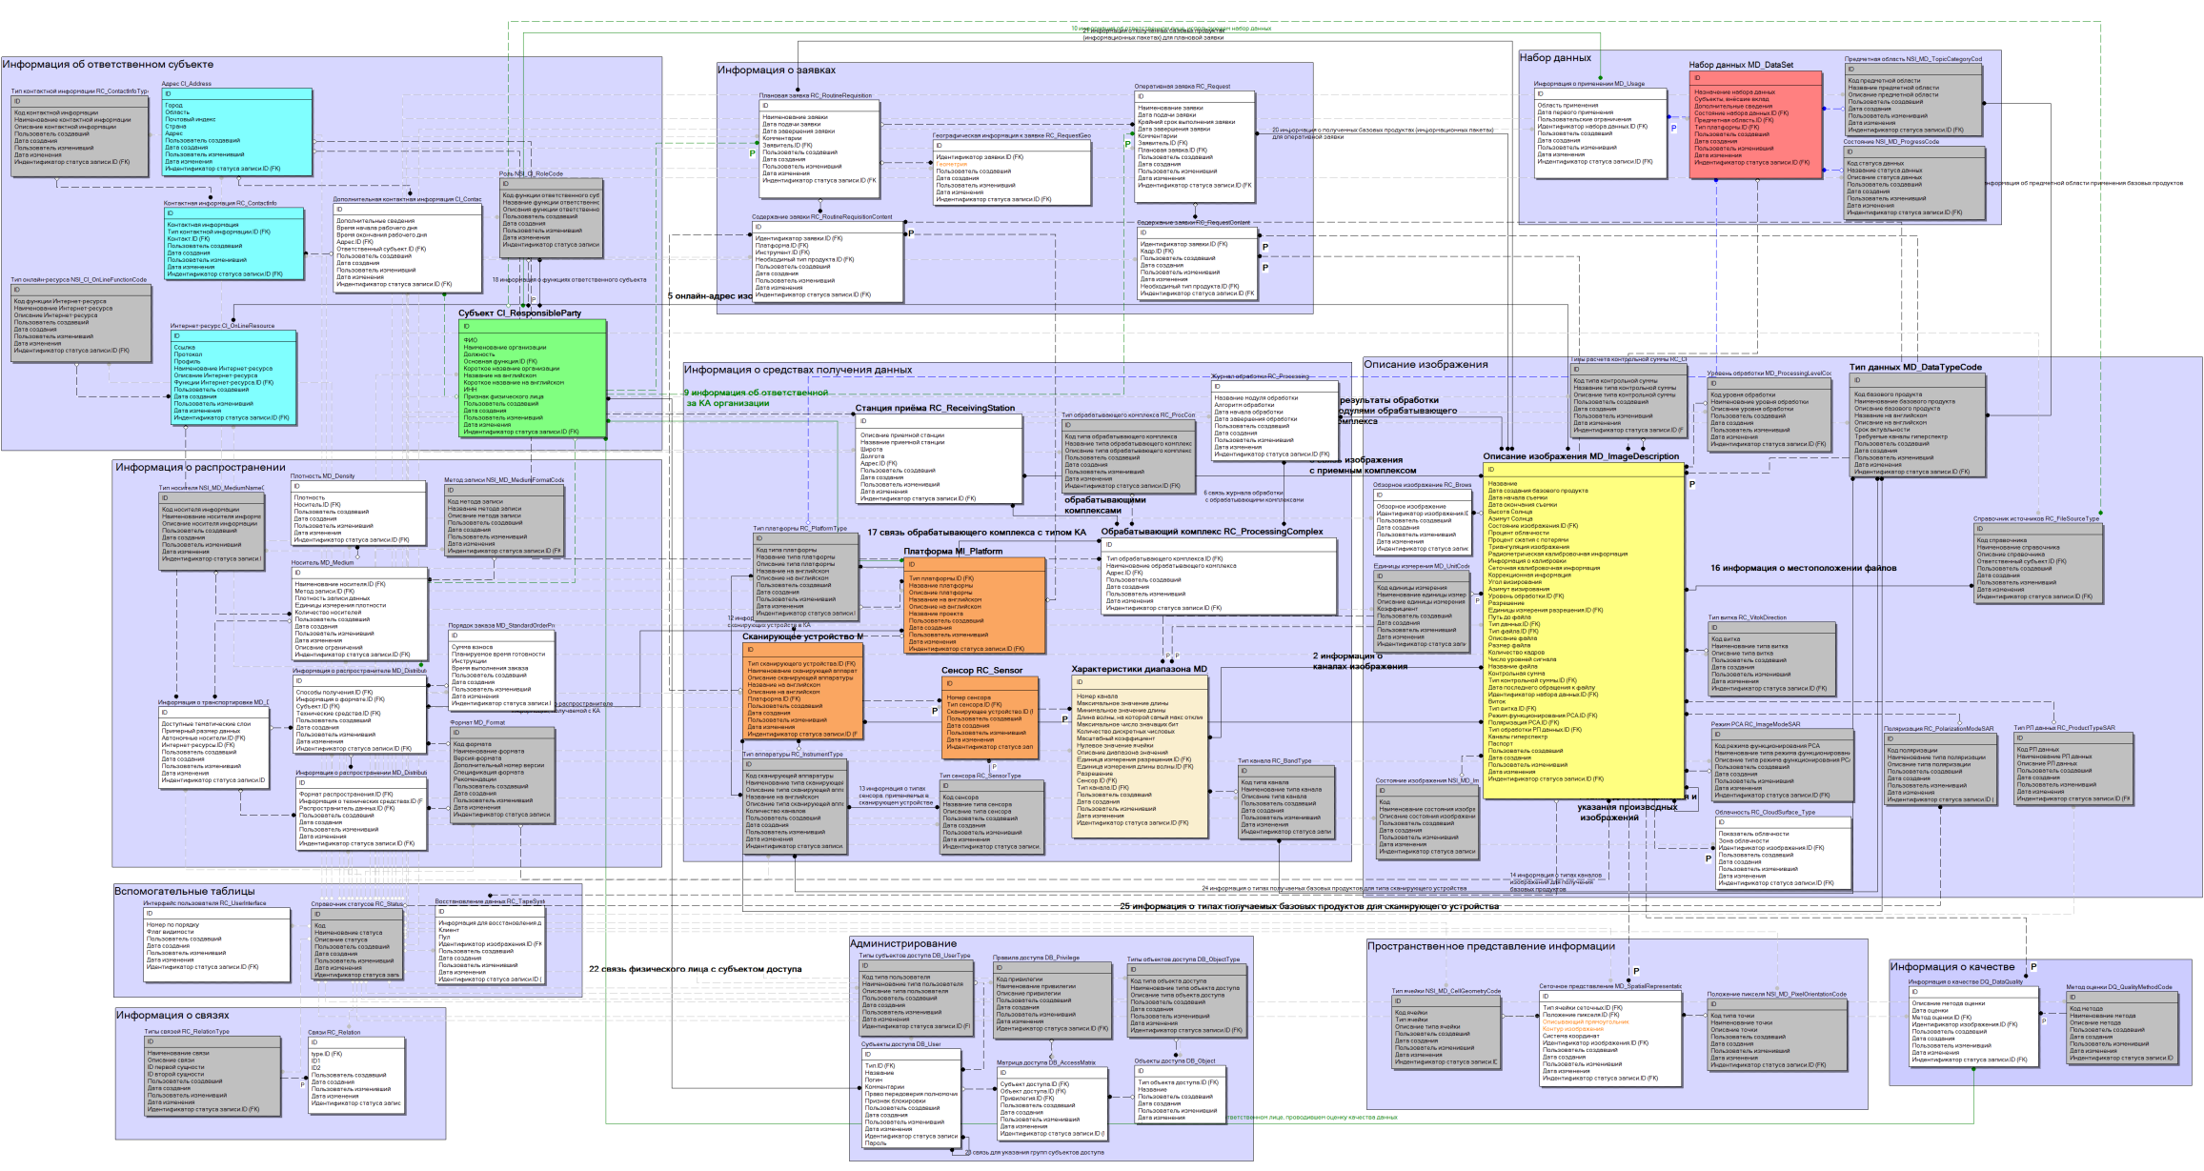
General View of Information-Logical Model
BBP Database
Information-Logical Model includes ~80 tables, ~300 procedures, 25 connection types, generating ~3.000.000 connections
21

Slide 22
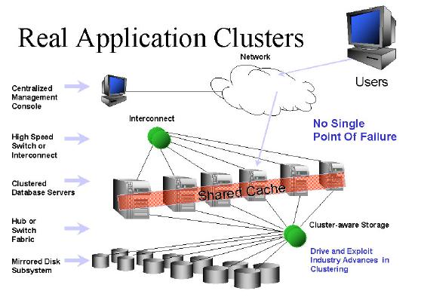
Fault-Tolerant Cluster of BBP Database
Advantages of Oracle
Real Application Clusters
Oracle Real Application Clusters (RAC) technology allows Oracle DBMS to execute any applications on independent server cluster through merging their processor power to provide fault tolerance, linear scalability, and high availability
High degree of system availability
Scalability
Serviceability
Generality for application software
Information system developed using cluster soft- and hardware as well as single-Oracle developer DBMS facilitates tuning and technical support
22
Notes:
Public network
In-house cluster network
Independent computers/cluster nodes
Shared data repositories

Slide 23
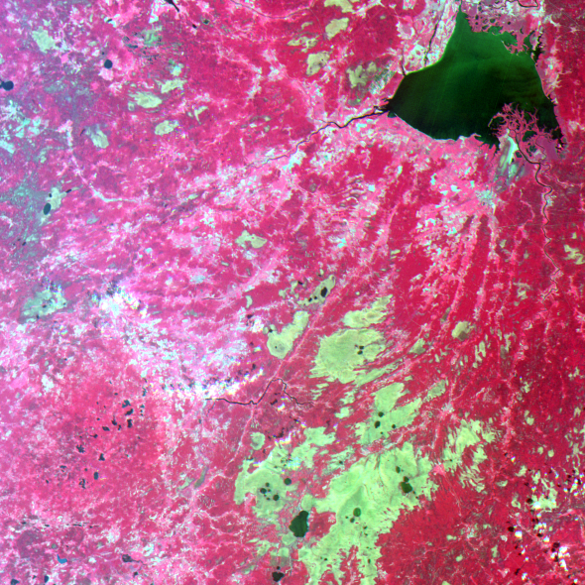
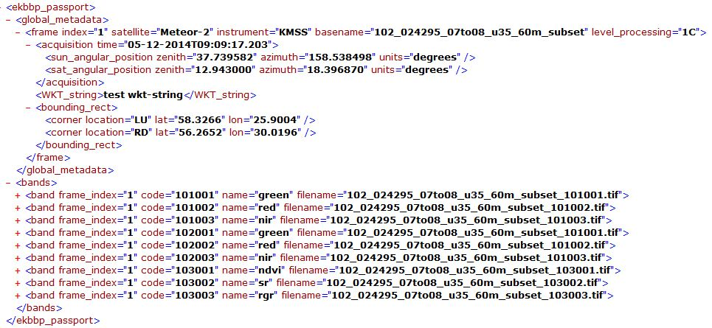
Unified Presentation of Primary Basic EO Data Products in BBP Archive
Raster Data:
1. Presented in cartographic projection
2. Tiff presentation format
3. 16-bit data presentation
Passport Details:
1. EO satellite description
2. Sensor description
3. Frame metadata
4. Raster data description
ZIP Archive
23

Slide 24
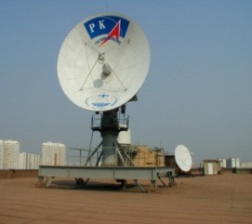

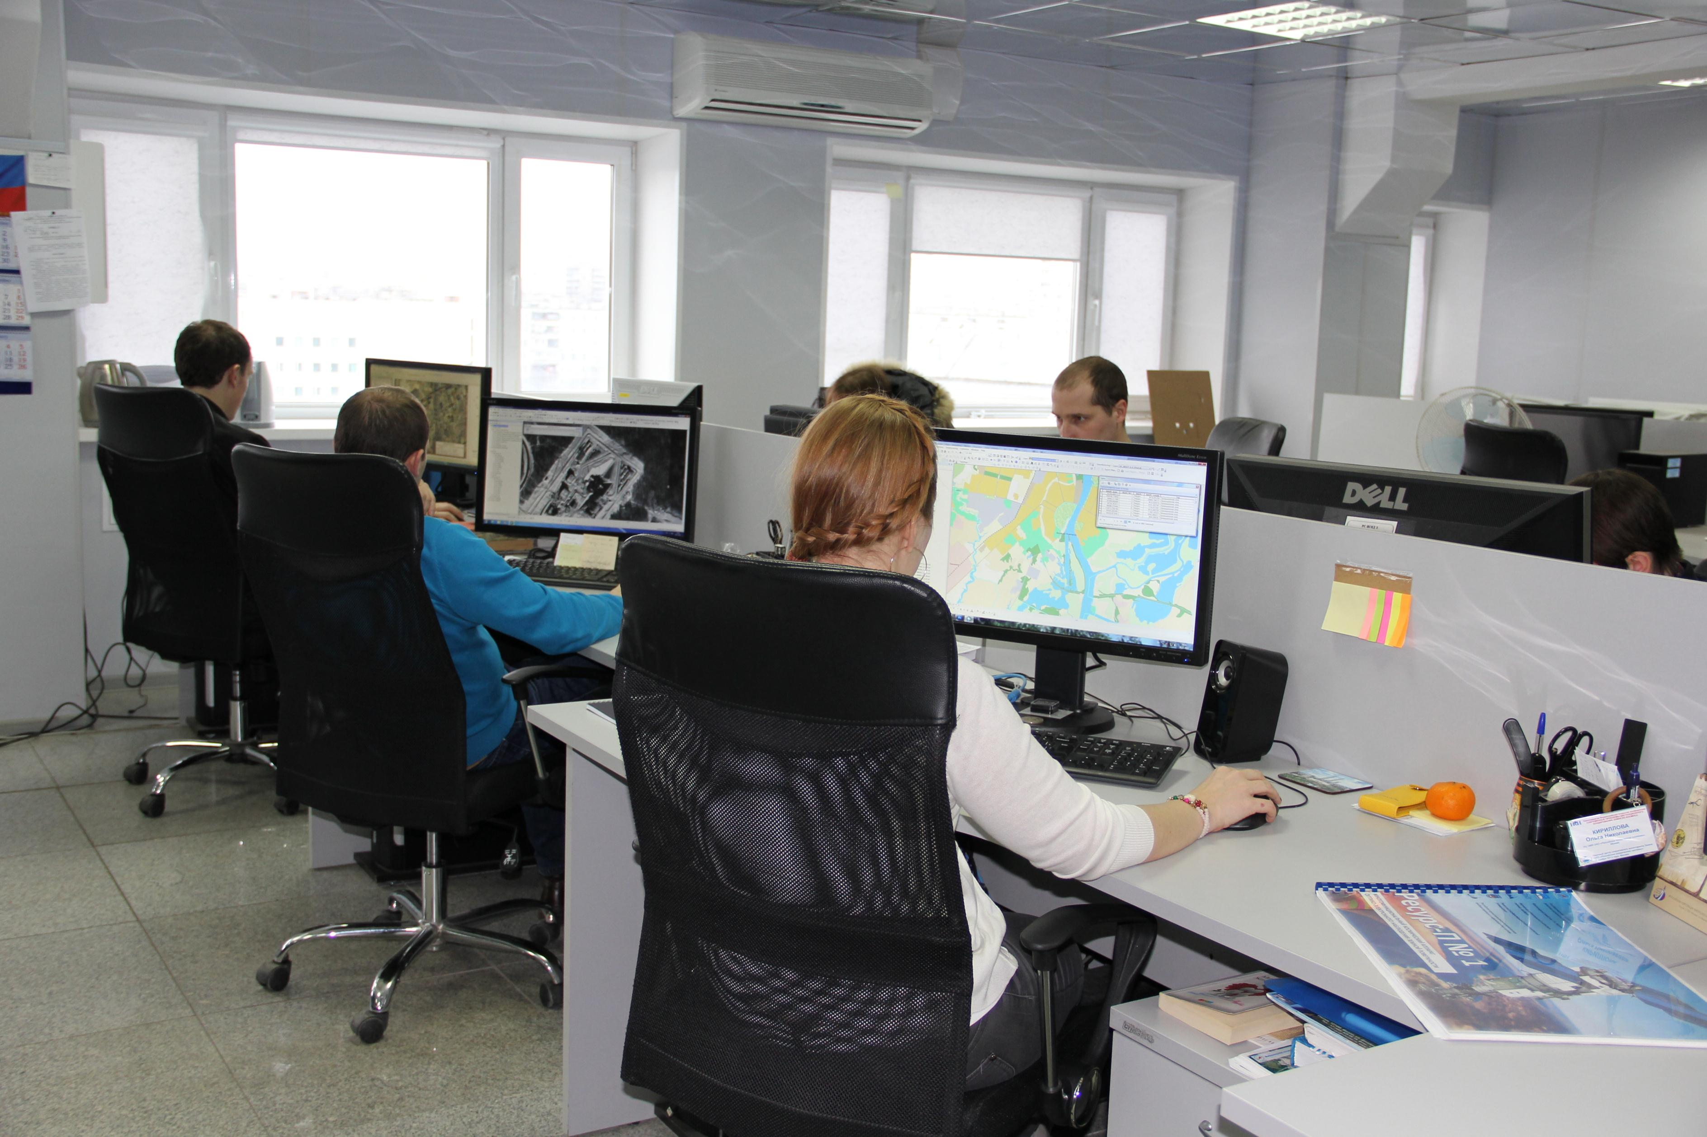

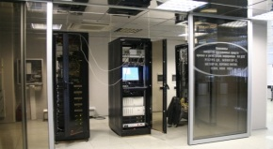
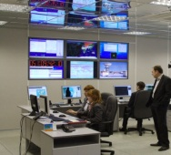
Archiving Contour for Standard Products Derived from Russian EO Satellites Data
Receive and unpack of primary EO satellite data
Automatic/Interactive processing of primary EO satellite data
L1B
L1C
(L1D)
Archive & Database
metadata
Oracle DB cluster
BBP Format
Archive Server
Primary BPs
Converter in BBP format
Long-term archive
(2114 Tb)
24

Slide 25
Soft- and Hardware Tools for BPs Archiving & Cataloging
BP Generation
BP Distribution
Resource Administration
Archive & Database
BP Verification
25

Slide 26
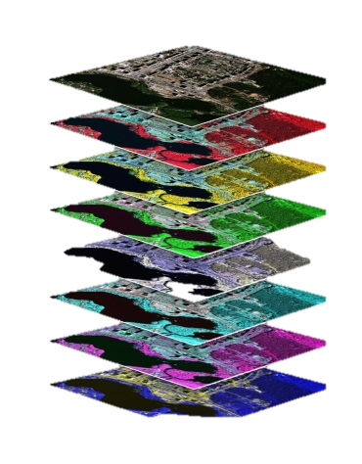
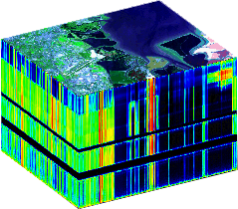
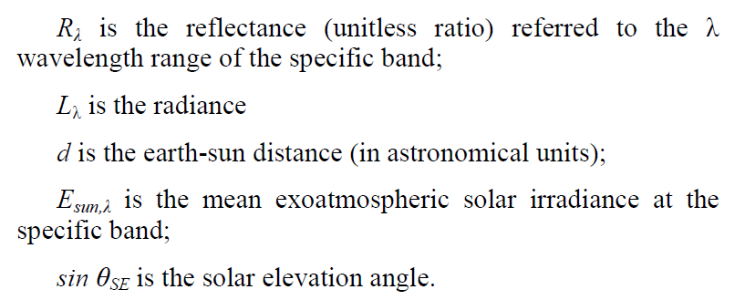
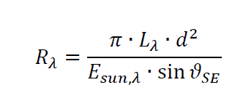
Secondary BPs for Optical Imagery: Top-of-Atmosphere Reflectance Images
Hyperspectral
imagery
~100-300 bands
Multispectral
imagery
~ 3-10 bands
26

Slide 27
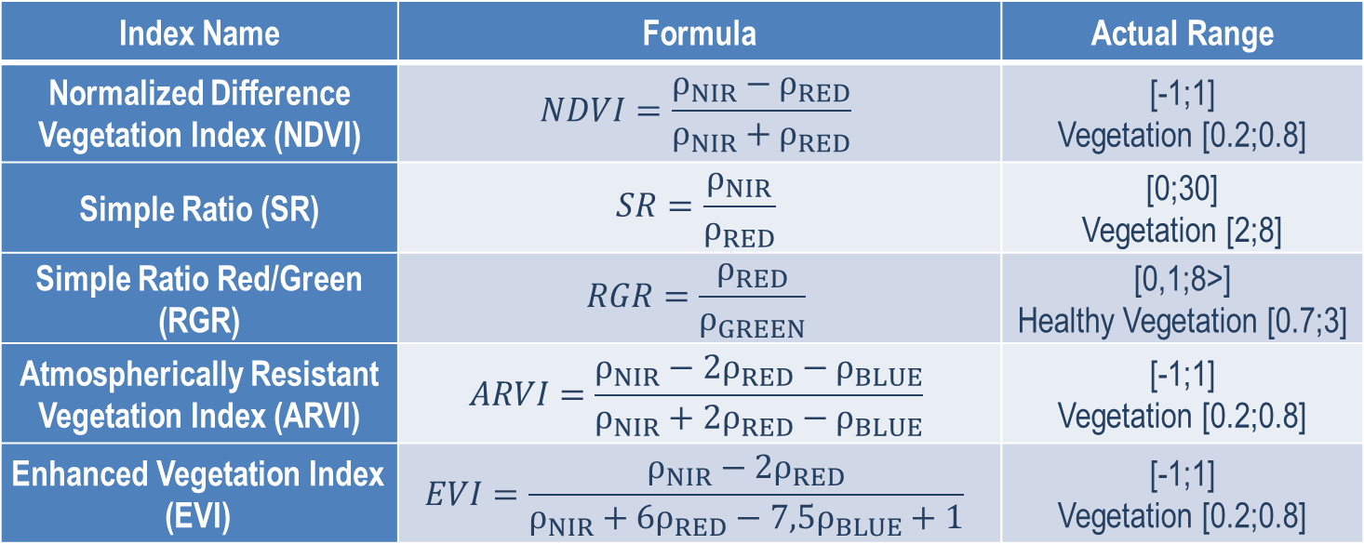
Secondary BPs for Multispectral Imagery: Index Images
Satellite | Sensor | Actual bands
Meteor-M2 | KMSS | R, G, B, NIR
Resurs-P1 | SHMSA | R,G,B, NIR
Kanopus-V1 | MSS | R,G,B
Landsat-8 | OLI | R,G,B,NIR
Index Name | Formula | Actual Range
Normalized Difference Vegetation Index (NDVI) | $$NDVI=\frac{ρ_{NIR}−ρ_{RED}}{ρ_{NIR}+ρ_{RED}}$$ | [-1;1] Vegetation [0.2;0.8]
Simple Ratio (SR) | $$SR=\frac{ρ_{NIR}}{ρ_{RED}}$$ | [0;30] Vegetation [2;8]
Simple Ratio Red/Green (RGR) | $$RGR=\frac{ρ_{RED}}{ρ_{GREEN}}$$ | [0,1;8>] Healthy Vegetation [0.7;3]
Atmospherically Resistant Vegetation Index (ARVI) | $$ARVI=\frac{ρ_{NIR}−2ρ_{RED}−ρ_{BLUE}}{ρ_{NIR}+2ρ_{RED}−ρ_{BLUE}}$$ | [-1;1] Vegetation [0.2;0.8]
Enhanced Vegetation Index (EVI) | $$EVI=\frac{ρ_{NIR}−2ρ_{RED}}{ρ_{NIR}+6ρ_{RED}−{7,5ρ}_{BLUE}+1}$$ | [-1;1] Vegetation [0.2;0.8]
27

Slide 28
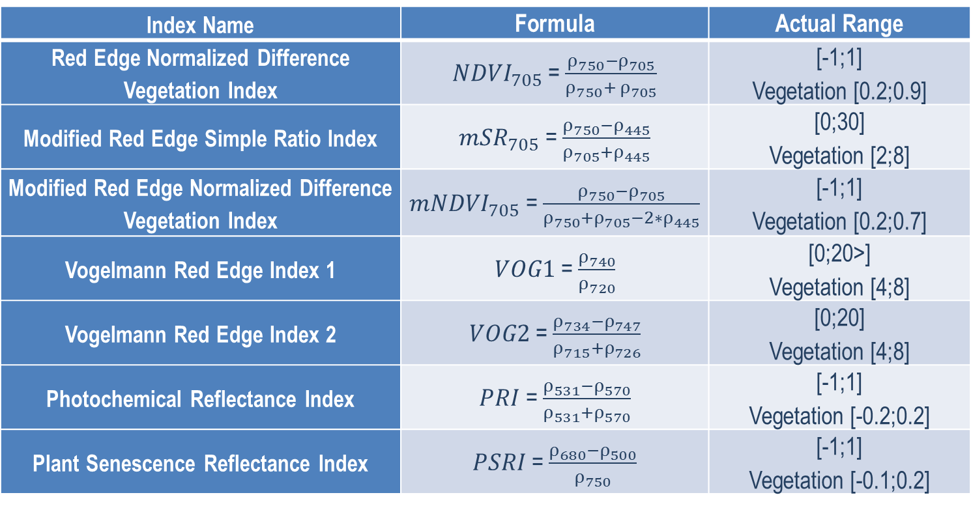
Secondary BPs for Hyperspectral Imagery: Index Images
Satellite | Hyperspectral sensor
Resurs-P1 | GSA
EO-1 | Hyperion
Index Name | Formula | Actual Range
Red Edge Normalized Difference Vegetation Index | ${NDVI}_{705}$ = $\frac{ρ_{750}−ρ_{705}}{ρ_{750}+ ρ_{705}}$ | [-1;1] Vegetation [0.2;0.9]
Modified Red Edge Simple Ratio Index | ${mSR}_{705}$ = $\frac{ρ_{750}−ρ_{445}}{ρ_{705}+ρ_{445}}$ | [0;30] Vegetation [2;8]
Modified Red Edge Normalized Difference Vegetation Index | ${mNDVI}_{705}$ = $\frac{ρ_{750}−ρ_{705}}{ρ_{750}+ρ_{705}−2∗ρ_{445}}$ | [-1;1] Vegetation [0.2;0.7]
Vogelmann Red Edge Index 1 | $VOG1$ = $\frac{ρ_{740}}{ρ_{720}}$ | [0;20>] Vegetation [4;8]
Vogelmann Red Edge Index 2 | $VOG2$ = $\frac{ρ_{734}−ρ_{747}}{ρ_{715}+ρ_{726}}$ | [0;20] Vegetation [4;8]
Photochemical Reflectance Index | $PRI$ = $\frac{ρ_{531}−ρ_{570}}{ρ_{531}+ρ_{570}}$ | [-1;1] Vegetation [-0.2;0.2]
Plant Senescence Reflectance Index | $PSRI$ = $\frac{ρ_{680}−ρ_{500}}{ρ_{750}}$ | [-1;1] Vegetation [-0.1;0.2]
28

Slide 29
Secondary BPs: Ecological monitoring of water objects
Satellite | Sensor | Actual bands
Meteor-M2 | KMSS | R, G, B, NIR
Resurs-P1 | SHMSA | R,G,B, NIR
Kanopus-V1 | MSS | R,G,B
Product Name | Physical Quantities
Normalized Intensity of Water Surface for wavelengths 412, 443, 488, 531, 555, 667 μm | Wt·m⁻²·μm⁻¹·sr⁻¹
Chlorophyll-A Mass Concentration | μg·l⁻¹
Mineral Suspended Matter Concentration | μg·l⁻¹
Light Reduction Diffusive Factor for wavelengths 412, 443, 488, 531, 555, 667 μm | m⁻¹
Roiliness index (Depth of Seccji Disk Visibility) | m
Coccolithophora flowering area | -
Dissolved Organic Carbon Mass Concentration | mgsec·l⁻¹
Luminance of Water Surface | -
Intagrated Light Reduction Diffusive Factor | -
29

Slide 30
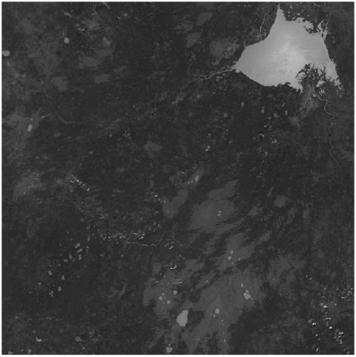
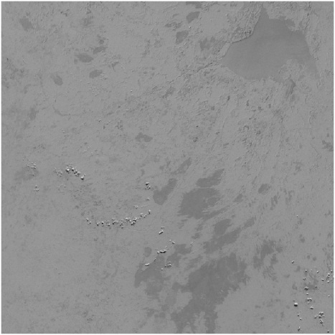
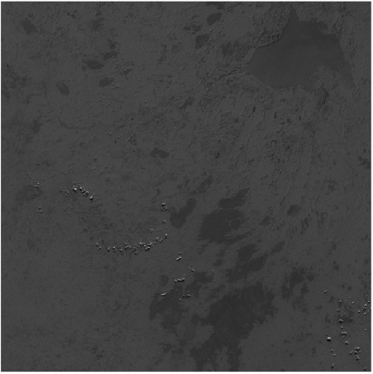
Example of Secondary BP
Ratio Green Red
NDVI
Simple Ratio
30

Slide 31
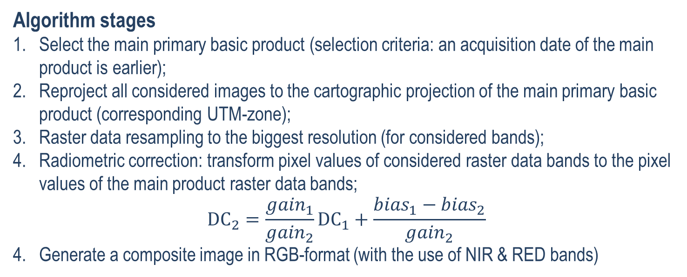
Generation of Two-Band Multi-Date Composite
Algorithm stages
Select the main primary basic product (selection criteria: an acquisition date of the main product is earlier);
Reproject all considered images to the cartographic projection of the main primary basic product (corresponding UTM-zone);
Raster data resampling to the biggest resolution (for considered bands);
Radiometric correction: transform pixel values of considered raster data bands to the pixel values of the main product raster data bands;
$${DC}_{2}=\frac{{gain}_{1}}{{gain}_{2}}{DC}_{1}+\frac{{bias}_{1}−{bias}_{2}}{{gain}_{2}}$$
Generate a composite image in RGB-format (with the use of NIR & RED bands)
Bands | Primary BP₁ | Primary BP₂ | Composite
R | NIR₁ | NIR₂ | Red₂
G | - | Red₂ | NIR₂
B | - | - | NIR₁
31

Slide 32
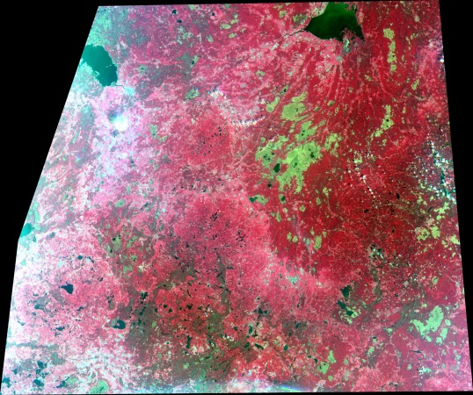
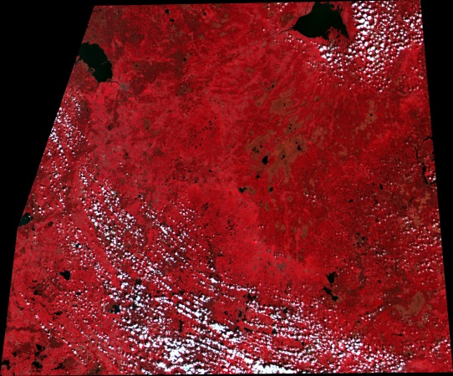
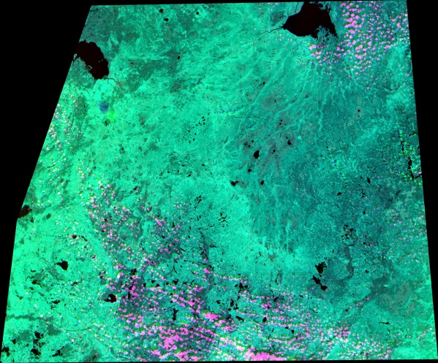
Example of Composite Image
Meteor-M1 KMSS (22/06/2012)
Terra MODIS (25/06/2012)
Composite Passport Details:
1. EO satellites description
2. Sensors description
3. Frames metadata
4. Composite image bands description
RGB-composite image
32

Slide 33
Soft- and Hardware Tools for BPs Archiving & Cataloging
BP Generation
BP Distribution
Resource Administration
Archive & Database
BP Verification
33

Slide 34
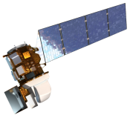
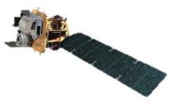



Archiving Contour for Standard Products derived from Foreign Satellites EO Data
Data from Foreign Satellites
Foreign Data Archive
Landsat 8
Landsat 7
EO-1
Terra / Aqua
Internet
Archive & Database
metadata
Oracle DB cluster
Archive Server
BBP Format
L1C (L1D)
Primary BPs
Server Downloads Foreign Satellite Data
Long-term archive
(2114 Tb)
Converter in BBP format
34
Notes:
PAS SI Development of Basic Product verification techniques
VEGA-Constellation – information services family for satellite monitoring of biosphere

Slide 35





Example of Multispectral Imagery Verification Technique
Terra MODIS
(25/06/2012)
Meteor-M1 KMSS
(22/06/2012)
Reference Data
Data to be verified
Raster Data Histogram
Matching and Correction Parameters Estimation
35

Slide 36



Secondary BP Calculation Using Verification Results
Secondary BP for Reference Data
Derived from Landsat 7 data
Secondary BP Generated before Verification
Derived from Meteor-M1 data
Secondary BP Generated after Verification
Derived from Meteor-M1 data
36

Slide 37
Soft- and Hardware Tools for BPs Archiving & Cataloging
BP Generation
BP Distribution
Resource Administration
Archive & Database
BP Verification
37

Slide 38
Block-Diagram of Distribution Component
User Interface Module
WEB-API of Back-End Component
Order Generation Service
Service of PB Search by Criteria
Request State Monitoring Service
BP Delivery Service
BBP Catalog (Oracle DBMS)
38

Slide 39

Web-Interface of BP Distribution System
39

Slide 40





BBP Information Interoperation
Satellite
Services
Centers
BASIC PRODUCTS BANK
www.bbp.ntsomz.ru
VEGA Satellite Service
Russian Integrated Bank of Geo-Information Data
VEGA-Science
VEGA-PRO
ROSCOSMOS GEOPORTAL
www.gptl.ru
VolSatView
System for Remote Monitoring of Volcanic Activity of Kamchatka and the Kurile Islands
Sea To Sea
Satellite Service of World Ocean Monitoring
40

Slide 41






Access to BBP
Personal access with the use of interface tools for catalog products searching and making an order, the order state monitoring and downloading of the generated products
Subscription access (without Web-browser using) in accordance with the regulations specifying the requirements for products and means of access to them by main federal consumers – agencies and regional authorities
41

Slide 42

WGISS-39
JAXA, Tsukuba, Japan, May 11–15, 2015
Notes:
Research Center for Earth Operative Monitoring
JSC Russian Space Systems – Operator of the Russian Remote Sensing Space Systems
B.51, h.25 Dekabristov Str., Moscow, 127490, Russia
Tel: +7 (495) 925-04-19
E-mail: ntsomz@ntsomz.ru
www.ntsomz.ru

