Slide 1
Next Generation Application Platform (NGAP)
Andrew Mitchell
WGISS-39
Tsukuba, Japan
Monday, May 11, 2015

Slide 2
As with most new ‘cool’ technologies, it is natural for innovative and cutting edge thinkers to want to be the first to implement a technology in their system. However, moving to quickly can sometimes lead to the scenario where you have a Solution looking for a Problem.

Slide 3
Back to the Basics: Problem Solving Loop
1. Identify the problem
2. Explore and research solutions
5. Evaluate the product
4. Develop and test
3. Select the best ideas

Slide 4
Problem: Resource Allocation of Application Deployments
Initial Platform Setup
Property
Configuration
Initial Application Setup
Networks
Infrastructure Processes (e.g. Security Plans)
Ongoing Maintenance & Operations
Patching
Monitoring
Failover / Backups
Scaling
Each application deployment (re)creates this process and they all deal with the same core problems.
Current application deployment can be time-consuming and expensive to scale, and maintain.

Slide 5
Research Ideas: How to provide cross cutting resource management ?
NASA set out to perform a Trade Study that investigates a scalable, flexible application platform solution that offers the cost benefits of hardware consolidation with the safety and security of application sandboxing and resource management.
Property
Procurement of property can take a couple months
Configuration
Setting up VM’s requires a team of system administrators, developers and database administrators.
Infrastructure Processes (e.g. Security Plans)
Heavily reliant on 3rd party approvals.
Networks
Initial network setup and network changes to make an application available for access can take a week to occur.
Patching & Monitoring, Failover / Backups, Scaling
Analysis of monitoring logs and patching takes several hours per week, every week. Failover and Backups are only implemented for applications with a high availability need.

Slide 6
Select the Best Ideas: Use shared resources
Initial Platform Setup
Property
Initial Application Setup
Infrastructure Processes (e.g. Security Plans)
Ongoing Maintenance & Operations
Patching
After investigating COTS solutions and down selecting to the best fit that meets NASA’s fault tolerance, monitoring, metric, and security demands, the result of this investigation was to provide a cloud-based Platform-as-a-Service for ESDIS applications. .
Configuration
Networks
Monitoring
Scaling
Backups/Failover

Slide 7
Develop and Test: The Next Generation Application Platform (NGAP )
Currently developing a prototype small scale implementation (private and public cloud) of a highly available, scalable platform that can host future NASA Earth science data system services.
The beta release of the NGAP will run in NASA’s Computing Services Service Office (CSSO) General Purpose Managed Cloud Environment (GP-MCE). It will also be integrated with NASA’s Earthdata Code Collaborative (ECC) to allow for builds and releases.

Slide 8
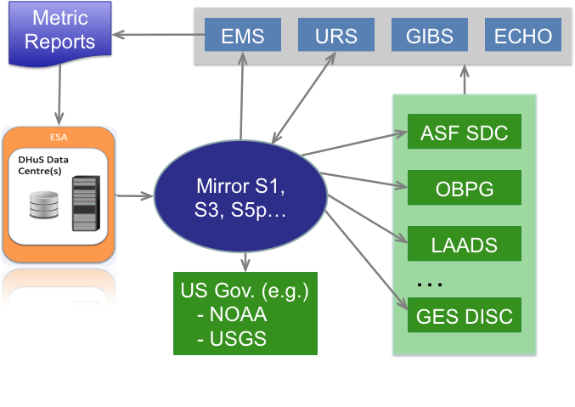
NASA Sentinel Mirror Leveraging Existing EOSDIS Capabilities
To serve US scientists, NASA is developing a data mirror archive for Sentinel 1, 3, 5P. in the U.S.
Single network interface relieves bandwidth load on European networks
Long term archival and end user distribution by DAACs (e.g. Sentinal-1 by ASF DAAC).
Provides metric reports back to the EC/ESA on product distribution and usage
Leverages entire suite of NASA’s EOSDIS capabilities including capturing and reporting metrics on distribution and usage of Sentinel products by U.S. scientists

Slide 9
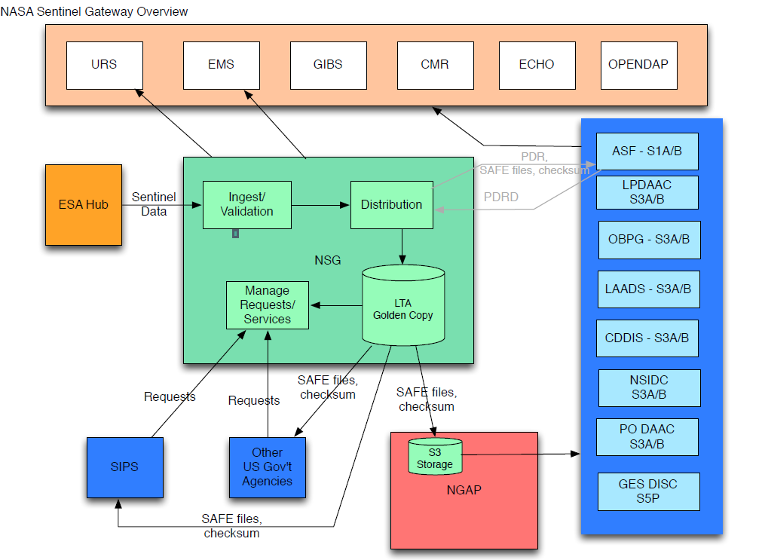
NASA Sentinel Gateway - NSG
Sentinel Gateway Target
—————————
* Ensure the reliable archive of the golden copy of Sentinel data at GSFC
* Distribution to the appropriate DAAC(s)
* Make that data available in AWS S3 storage. The approach will not be limited to AWS but that is assumed to be our initial target to support NGAP.
DRAFT

