Slide 1

Federated Earth Observation (FedEO) Status
CEOS WGISS Meeting #39
11 – 15 May, 2015
Tsukuba, Japan
Hosted by JAXA
M.Albani, P.Mougnaud, A.Della Vecchia (ESA)
Yves Coene (Spacebel)

Slide 2
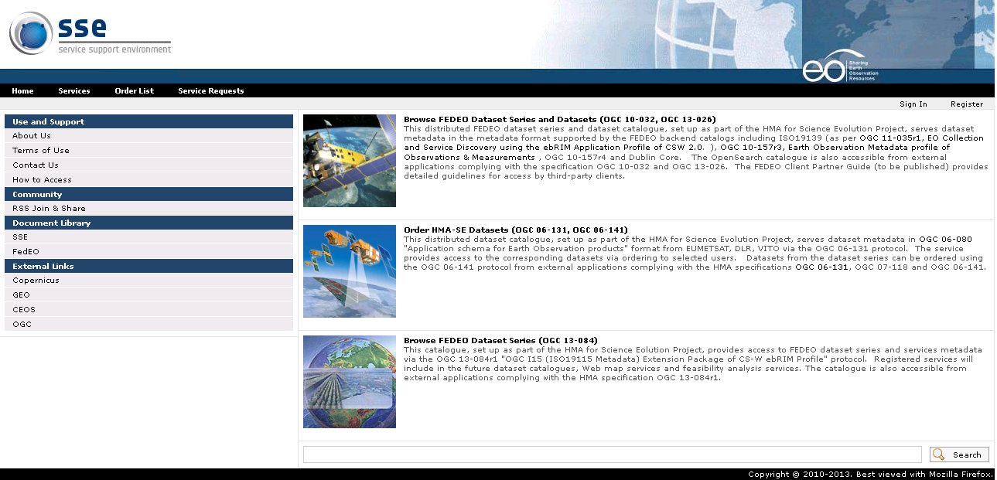
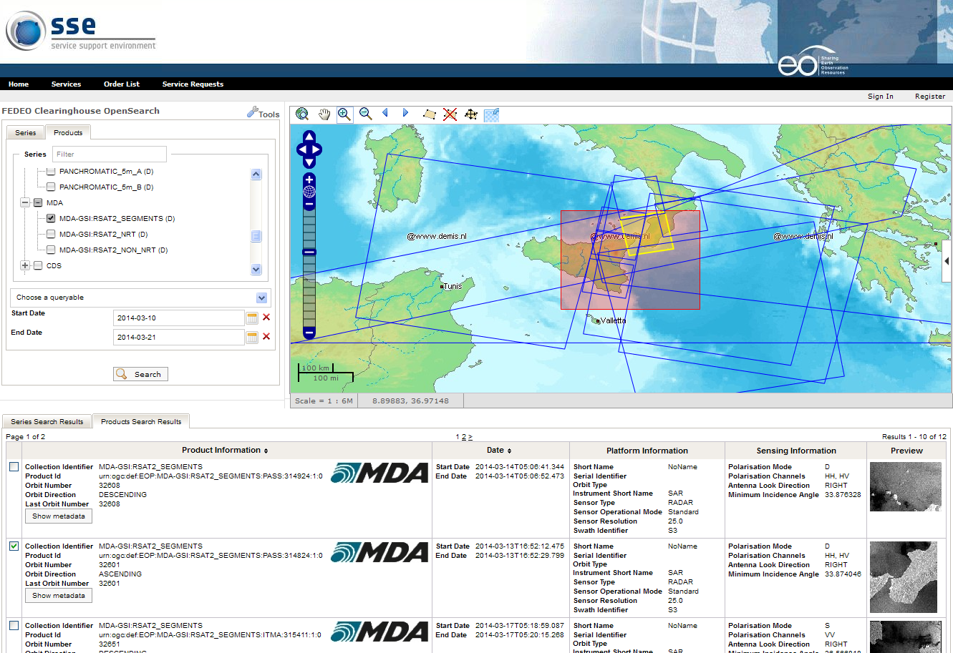
FedEO: Federated Earth Observation Gateway System
Provides brokered discovery, access and ordering capability to European & Canadian EO missions data based on HMA standard interfaces
Implements the OpenSearch OGC (and other) interfaces for an increased number of discoverable and accessible EO data collections, and for interfacing with CEOS Community Catalogues and Clients
Notes:
Ordering implemented for DLR, EUMETSAT

Slide 3

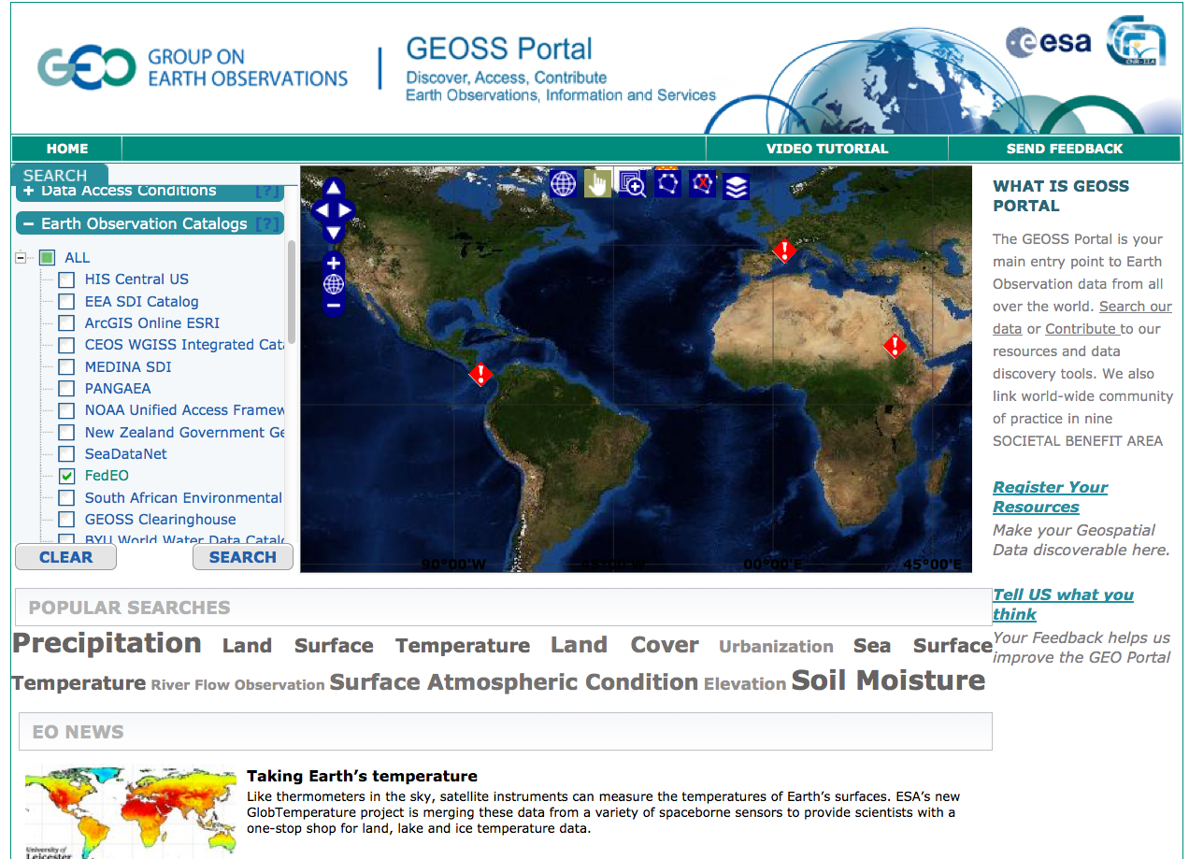
High Level Concept – Scenario 1
European Data in the International Context
EO Clients (e.g. Web Portals)
CEOS Community Portals
GEO Web Portal
DAB Broker
1
2
FedEO
CWIC
2
Data discovery,
access and ordering depending on agreement and interfaces (e.g. HMA, OpenSearch)
1
2
European Scientific Catalogues
& Services
EUMETSAT
CNES
ESA Missions
DLR, VITO
OTHERS

Slide 4
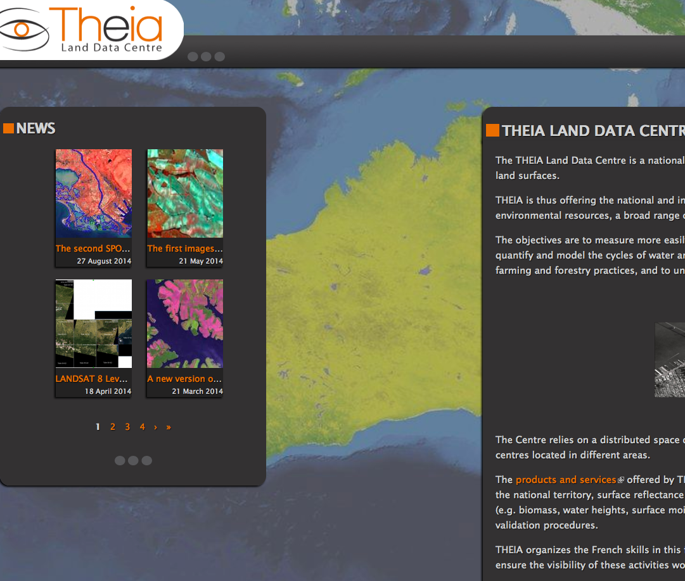
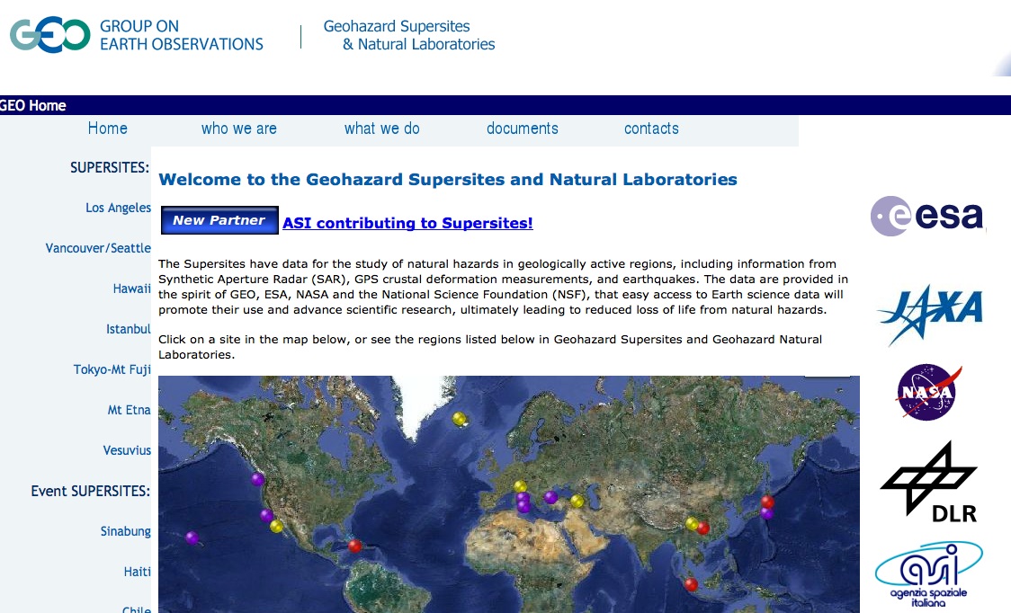
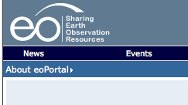
High Level Concept – Scenario 2
European Users and projects to European and non-European EO data
European EO Clients (e.g. Web Portals)
Data discovery,
access and ordering depending on agreement and interfaces (e.g. HMA, OpenSearch)
FedEO
CWIC
European Scientific Catalogues
& Services
Non European Scientific Catalogues
& Services
EUMETSAT
CNES
NOAA
ISRO
ESA Missions
DLR, VITO
NASA
USGS
OTHERS
OTHERS

Slide 5
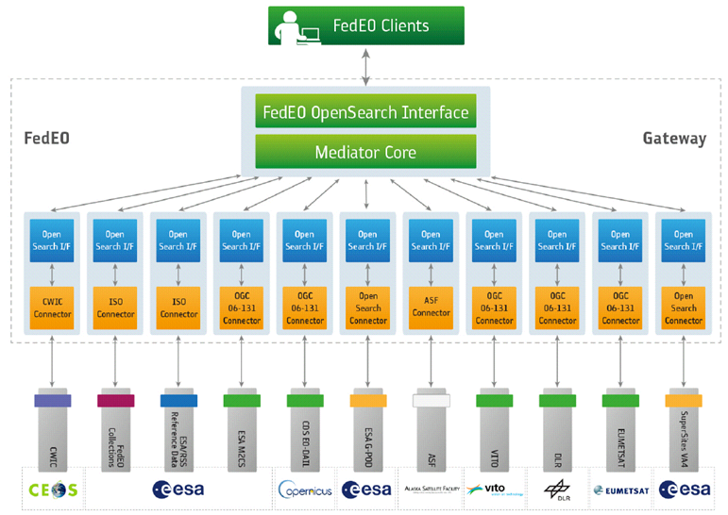
FedEO Current Brokered Architecture
Data discovery,
access & ordering depending on agreement and interfaces (e.g. HMA, OpenSearch)
Scientific Catalogues
& Services

Slide 6
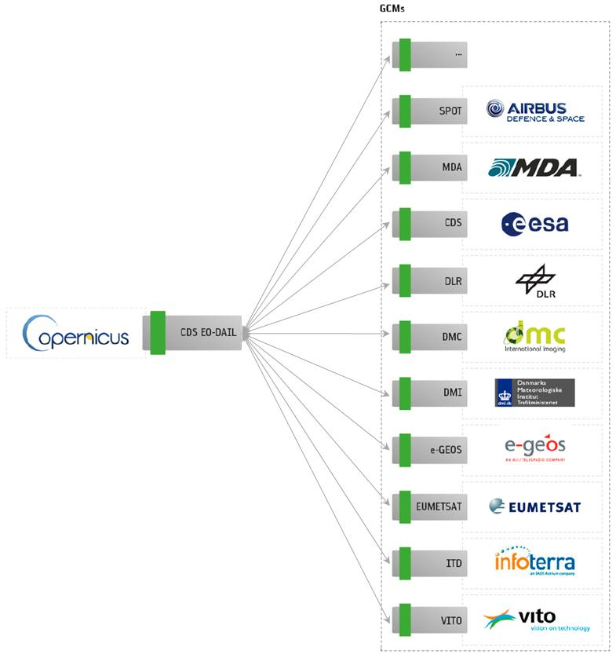
FedEO Back-end Connections
Backend Connectors supporting:
  OGC 06-131 (CSW EOP EP)
  OGC 10-032 (OpenSearch)
  OGC 07-045 (CSW ISO AP)
  OGC 07-038 (CSW CIM EP)
  OGC 13-084 (CSW I15 EP)
  CWIC
  ASF
No impact on EO-DAIL or restrictions on CCMs data visibility
No data access/ordering through DAIL towards FedEO (Copernicus licenses)

Slide 7
FedEO Operational Environment
European EO Clients (e.g. Web Portals)
Demo Client
http://services-test.eoportal.org/web/guest/fedeo-demo-services
FedEO@ESA is the operational instance with an associated Service Level Agreement
FedEO@ESA
Catalogues connected to FedEO@ESA can be either:
Fully operational (preferred/recommended)
Demo but representative ones (i.e. some data collections)
Catalogue owners are responsible for the level of service they offer, but ESA maintains contact to obtain the best service
(European) Scientific Catalogues
& Services
EUMETSAT
CNES, NASA
ESA Missions
DLR, VITO
OTHERS …

Slide 8
FedEO Test/Developmnet Evironment
Test / Development GUI @ SPB
FedEO@SPB is the test/development instance:
New features, evolutions and enhancements
Interface tests with new catalogues from (new) FedEO partners
Catalogues connected to FedEO@SPB are mainly testing instances (i.e. for integration)
Joint activities with partners to perform integration tests
Transfer to operations once developments and/or new catalogues integration tests are completed
FedEO@SPB
(European) Scientific Catalogues
& Services for test
CNES-THEIA
JAXA
EUMETSAT (order)
OTHERS …

Slide 9
FedEO Current Operational Set-up
FedEO end-point/component on Interoute Cloud including hot back-up and test platforms; development platform at Spacebel.
  Link on Cloud: http://fedeo.esa.int
Info on Opensearch implementation available at: http://fedeo.esa.int/opensearch/readme.html (Main)http://geo.spacebel.be/opensearch/readme.html (Test)
FedEO accessible for demos and administration through a dedicated Client Portal: http://services-test.eoportal.org/web/guest/fedeo-demo-services
  SSE Portal implementation (Primary Client) under TTO
  Future migration into ESA eoPortal
ESA RSS/SSE Team in charge of FedEO Routine Operations: SLA based on working hours (not 24/7)

Slide 10
Two Step Search
In alignment with CEOS and GEO approaches
FEDEO
1 collection search
2 product search
FEDEO Collection Catalog
Product catalogues
ISO Collection metadata

Slide 11
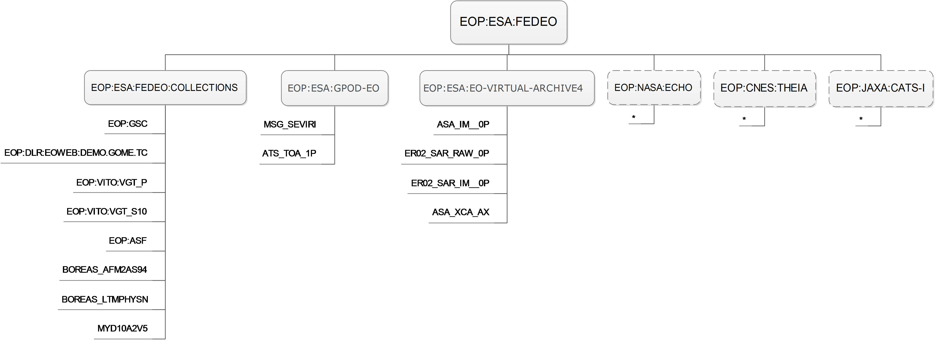
Current FedEO two steps based search
Two step search approach:
  Step 1: search dataset series (currently parallel search in 3 catalogs - see below)
  Step 2: search datasets inside the selected dataset series
In progress
Includes ASF, M2CS, CSCDA, CWIC etc. dataset series metadata

Slide 12
Future Metadata Handling in FedEO: Collection search
Collection Search
ISO
OSDD
FedEO OpenSearch
OSDD
OSDD
OSDD
OSDD
OSDD
ISO
FedEO
I15
GPOD
VA4
ISO
ISO
ISO
synch (gscda)
CSCDA
Synch
OTHERS
ISO
OTHERS
@ESA
IDN
ECHO
synch/convert (fedeo/cwic)
OSDD is collection-specific.
Notes:
Filling FedEO I15 with metadata at collection level which are currently missing and synch with databases where these are available.
Synch/copy of IDN-CWIC entries
Direct access to ECHO
VIRTUAL COLLECTIONS CAN BE CREATED TO ALLOW CLIENTS TO ACCESS ONLY A SUBSET OF THE COLLECTIONS (e.g. DAB not to access CWIC stuff otherwise we have duplication with CWIC). eoPortal only to access ESA plus European plus e.g. NASA.

Slide 13
Metadata Handling in FedEO: Collection search
FedEO I15 (hosted/prepared on-behalf):
  M2CS collection metadata
  CSCDA collection metadata (import – labelled "cscda")
  ASF collection metadata
  CWIC collection metadata (sync – labelled "cwic")
  ESA ScienceHub Sentinel1
  Science Catalogs
    EUMETSAT collection metadata (import)
    VITO collection metadata (import)
  DISSHARM collection metadata
Live Access:
  ESA G-POD
  ESA VA4
Notes:
"Import" means one-time operation of metadata provided by ESA or 3rd party data provider as metadata is not updated (very low update frequency).
"Sync" means that software is provided to allow FeDEO Operator to synchronise with the remote catalog and import copies of the metadata which are updated to be (1) valid wrt applicable ISO scheme and (2) be "importable" in the I15 EP implementation.
When no "import" or "sync" is indicated, this means that metadata were created ad-hoc with the information available

Slide 14
Metadata Handling in FedEO Granule search
INDERS
Granule Search
INDEX
DISSHARM LDS
EOP O&M
ISO
DC
OSDD
Synch
FedEO OpenSearch
EOP O&M
SMOS
M2CS
GPOD
VA4
DISSHARM
SciHub
CDS DAIL
ISO
FedEO OpenSearch
DC
@ESA
CCM
CWIC
VITO
DLR
EUM
CNES
ASF
CCM
…
JAXA
CATS-I
ROSCOSMOS
SPIRIT
SPOT
NASA ECHO
…
…
OSDD is collection-specific and will exploit (ISO/Atom) collection metadata such as
temporal extent (<dc:date>) and sensorType if available.

Slide 15
Relation/interfaces with CWIC & IDN
  Current relation with CWIC/IDN:
    Metadata of collections harvested from IDN and copied by FEDEO Import Utility (B3.1) in EOP:ESA:FEDEO:COLLECTIONS (I15) catalog.
    Metadata labelled with « cwic » keyword.
    Product metadata available through FEDEO using parentIdentifier=original CWIC dataset ID or via two-step search.
      http://fedeo.esa.int/opensearch/request?parentIdentifier=EOP:ESA:FEDEO&uid=BOREAS_AES_UPL2
      http://fedeo.esa.int/opensearch/request/?httpAccept=application/atom%2Bxml&parentIdentifier=MYD10A2V5&startDate=2002-01-01T00:00:00Z&endDate=2003-01-01T00:00:00Z&startRecord=1&maximumRecords=10
    Collection metadata will be found if parentIdentifier is either EOP:ESA:FEDEO:COLLECTIONS or EOP:ESA:FEDEO or absent.
    Should be avoided that CWIC information is counted by GEODAB in FEDEO statistics. Similar issue may arise if NASA ECHO collections would be counted. Currently only found if parentIdentifier is EOP:NASA:ECHO.

Slide 16
FedEO OpenSearch Implementation
Currently OpenSearch access to:
  HMA Catalogs supporting OGC 06-131
  CWIC catalogs
  Virtual Archive 4 and G-POD
  Science Hub
  M2CS and LDS-DISSHARM
Implemented:
  OGC 10-032r8 Geo and time Extension
  OGC 13-026r5 Extension for Earth Observation

Slide 17
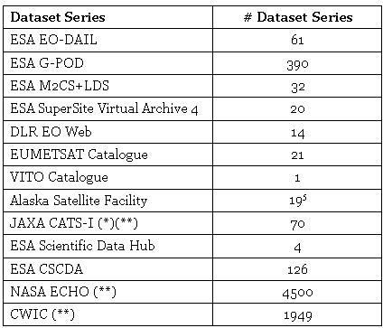
FedEO Statistics (April 2015)
In addition CWIC collections discoverable & accessible

Slide 18
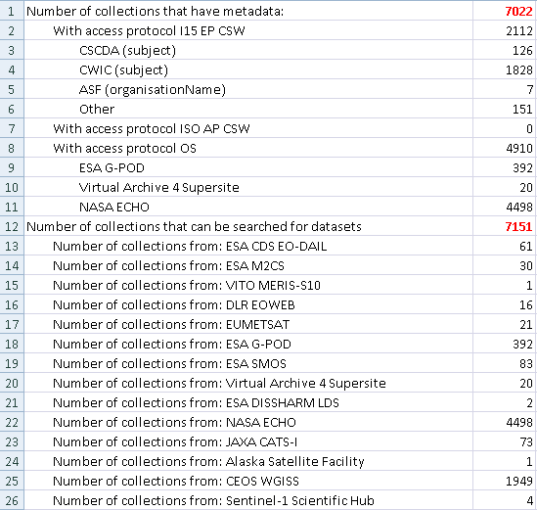
WGISS#39 Japan
Collections accessible through FedEO (28/04/2015)

Slide 19
Work performed - Harmonisation
Harmonisation Collection Metadata format (OGC 11-035r1)
Harmonisation Product Metadata format (OGC 10-157r4)

Slide 20
Work performed – Collection Metadata
Additional Collection Metadata in EOP:ESA:FEDEO:COLLECTIONS
  Has positive effect on #collections that support 2-STEP search in FedEO.
535

Slide 21
EO Collections discovery/access in GEOSS via FedEO

Slide 22
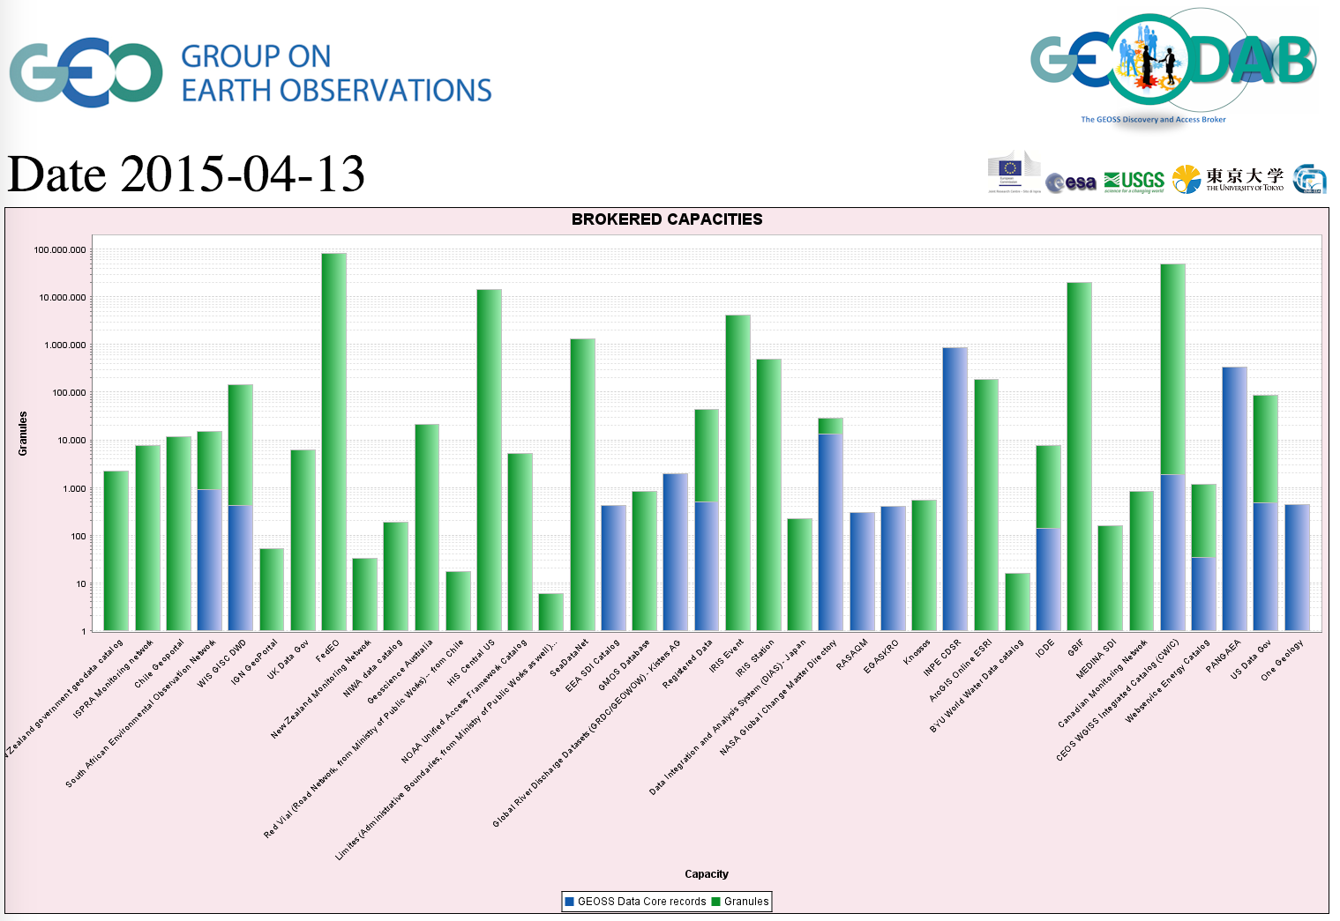
GEO Discovery and Access Broker Statistics
FedEO

Slide 23
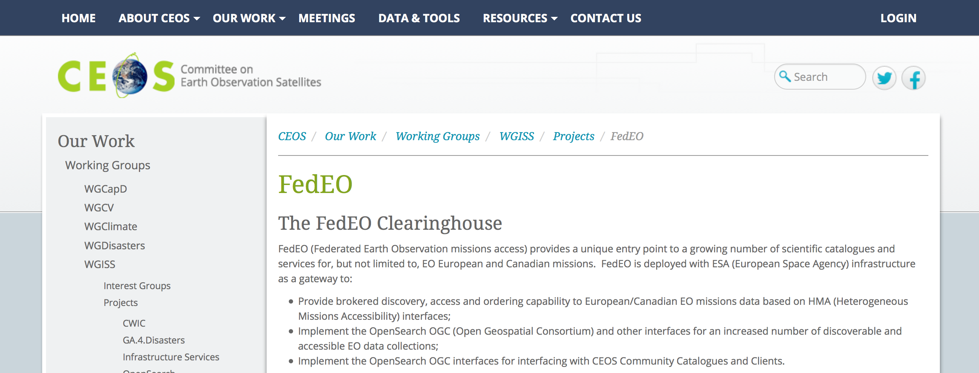
FedEO on WGISS Web Site and contacts
Contacts at ESA:
FedEO Operations Team: giancarlo.rivolta@esa.int
FedEO Population/Tests: andrea.della.vecchia@esa.int, Yves.coene@spacebel.be
FedEO Evolutions: philippe.mougnaud@esa.int
HMA standardisation: pier.giorgio.marchetti@esa.int
Coordination and international cooperation: mirko.albani@esa.int

Slide 24
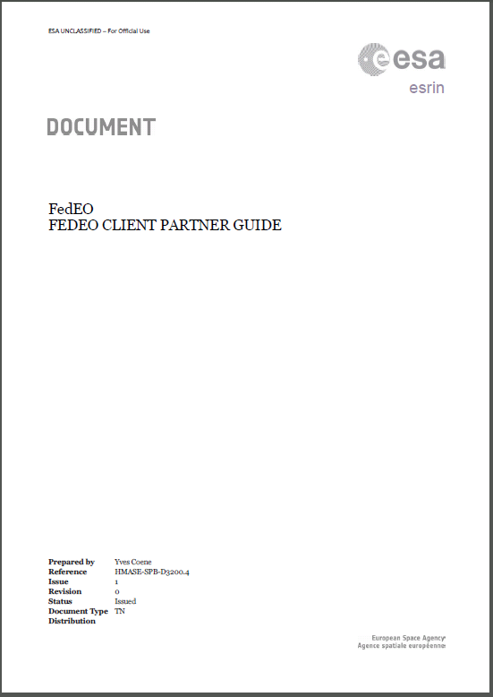
FedEO Client Partner Guide
  General description of the FedEO environment and its relation to other systems
  Details about the FedEO query interface based on OpenSearch (e.g., principles, the search parameters, search response format, etc ...)
  Description of two cases: one starting from a dataset series catalogue, and a second one accessing immediately the dataset catalogue
  Details on the catalogue connectors and how their corresponding dataset series and dataset metadata can be discovered

Slide 25
FedEO Data Partners Guide:
How to be accessed by FedEO (1)
  Information for organisations joining FedEO as metadata and data provider: full guide on web site
Step-1 - Implement one of the following standard interfaces (for dataset search):
OGC 06-131 (CSW EOP EP)
OGC 10-032 (OpenSearch) and/or OGC 13-026 (OpenSearch)
OGC 07-045 (CSW ISO AP), e.g. GeoNetwork (open-source)
OGC 07-038 (CSW CIM EP)
OGC 13-084 (CSW I15 EP)
Other API (over HTTP) can be considered on a case by case basis as well as other metadata (EOP O&M, EO GML, ISO19139, Dublin Core, .CSV, …) and response formats (Atom - preferred, RDF, …)

Slide 26
FedEO Data Partners Guide:
How to be accessed by FedEO (2)
Step-2 – Send endpoint to ESA FedEO team for integration. Please provide:
Examples of successful search requests (area / time period)
List of supported search parameters if different from formal (OGC) specification
List of proposed identifiers for each proposed dataset series (collections): e.g. EOP:MYORGANISATION:XXX-YYY
Optional: mechanism to discover list of allowed dataset series identifiers automatically
Parameter to be used to pass dataset series identifier (e.g. parentIdentifier) in request

Slide 27
FedEO Data Partners Guide:
How to be accessed by FedEO (3)
Step-3 – Provide ISO 19139 Metadata file for each of the proposed collection identifiers EOP:MYORGANISATION:XXX-YYY including temporal and geographical coverage.
Can be created with support of the ESA FEDEO team (e.g. through answers to a questionnaire). Sample metadata files can be provided as well.
Step-4 – ESA FEDEO team provides test endpoint (OpenSearch) for organisation XXX to preview their OpenSearch I/F.
Optional steps: agree keywords to be added to collection metadata as per agreed thesaurus,… Federated authentication (SSO).

Slide 28
FedEO future activities and Demo

Slide 29
Ongoing/future Activities:
FedEO Consolidation & Population
Consolidation of FedEO Concept/Scenarios as part of the ESA and European EO Ground Segments
Consolidation of interfaces with existing European catalogues and addition of new catalogues, e.g.:
  Extend number of downloadable collections from ESA DISSHARM LDS accessible through FedEO
  Extend number of orderable collections (OGC 06-141) with EUMETSAT and DLR
  Provide access to CNES THEIA 2.0 when available.
Population of FedEO Collection Metadata Catalogue for ESA and European Missions
Consolidation of access from GEO DAB Broker, tests with non-European catalogues
    Collaboration/interoperability/interfacing with CWIC, NASA ECHO

Slide 30
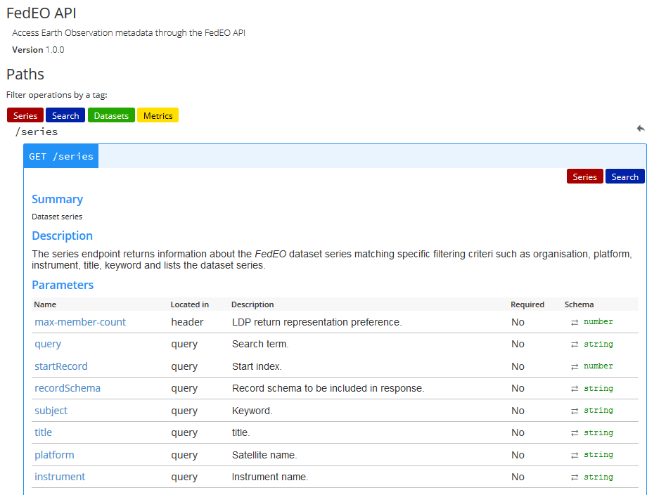

RESTful interface - Discovery
Content negotiation
  Atom,
  HTML
  +
Resource extension

Slide 31
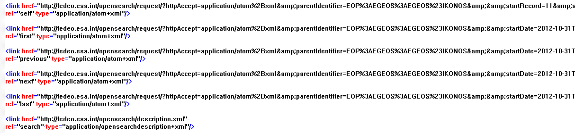
Extend HATEOAS for ordering
Hypermedia as the Engine of Application State
  Standardised Media types
  Standardised Link Relations <link rel=“…”> (RFC 5988)
    ‘first’, ‘previous’, ‘self’, ‘next’ and ‘last’ : Navigation
    ‘search’ : Two step search
    ‘enclosure’ : Product download
    ‘order’ : Product order page or ordering capabilities (OGC 06-141) or OSDD (OGC 13-042)
      type="text/html"
      type="application/vnd.ogc.oseo.capabilities.response_xml" (TBC).
      type="application/opensearchdescription+xml"

Slide 32
RESTful interface - Ordering
Provide OGC 13-042 RESTful interface for ordering as facade to existing OGC 06-141 SOAP interfaces.

Slide 33
RESTful Interface – Linked Data
Provide (experimental) W3C Linked Data Platform
interface, http://www.w3.org/TR/ldp/
Content negotiation
  RDF/XML
  Turtle
  JSON-LD
HTTP Methods
  GET
  HEAD
  OPTIONS

Slide 34
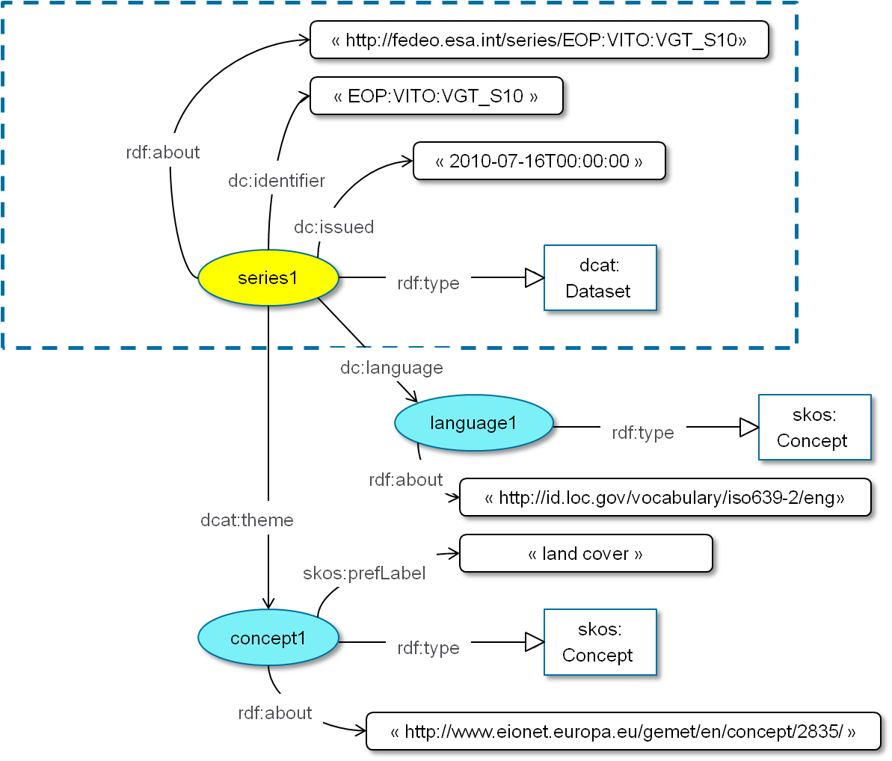
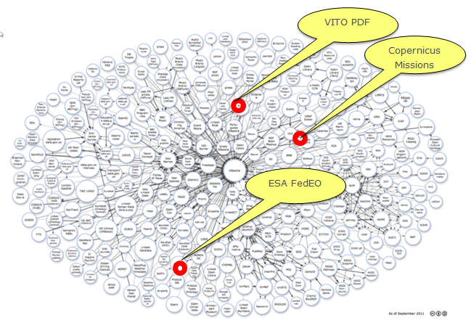

Linked Data - Data Model
Linked Data access to EO dataset
series and EO dataset metadata
using W3C LDP interfaces
EO Metadata Discovery with Linked Data
possibly to be proposed as OGC Paper.

Slide 35
Linked Data
instrument1
skos:
Conceptt
rdf:type
rdf:about
«http://gcmdservices.gsfc.nasa.gov/kms/concept/
1c53d85e-3792-4081-9748-192fd3140aa6»
skos:prefLabel
"The SENTINEL-1 mission is the European Radar Observatory for the Copernicus joint initiative of the European Commission (EC) and the European Space Agency (ESA). …"
"SENTINEL-1 C-SAR"
skos:definition
"SENTINEL-1"
skos:prefLabel
platform1
skos:
Conceptt
rdf:type
rdf:about
"http://gcmdservices.gsfc.nasa.gov/kms/concept/
c7279e54-f7c1-4ee7-a957-719d6021a3f6"
skos:inScheme
"http://gcmdservices.gsfc.nasa.gov/kms/concepts/
concept_scheme/platforms"

Slide 36
Improved Search responses
Faceted Search
  “allowing users to explore a collection of information by applying multiple filters” (*)
  E.g. provide links to (dataset series) results per group (e.g. FedEO, CWIC, ECHO, VA4, GPOD, CSCDA etc.) or other classification.
  Can be integrated in Atom-based responses using rel=« »:
    Advertise number of items (if known): thr:count=123 (http://www.ietf.org/rfc/rfc4685.txt)
    Other approaches at http://www.feedbooks.com/api/facets and http://opds-spec.org/specs/opds-catalog-1-1-20110627/#Facets.
  Addressed in OASIS searchRetrieve specifications.
(*) http://en.wikipedia.org/wiki/Faceted_search

Slide 37
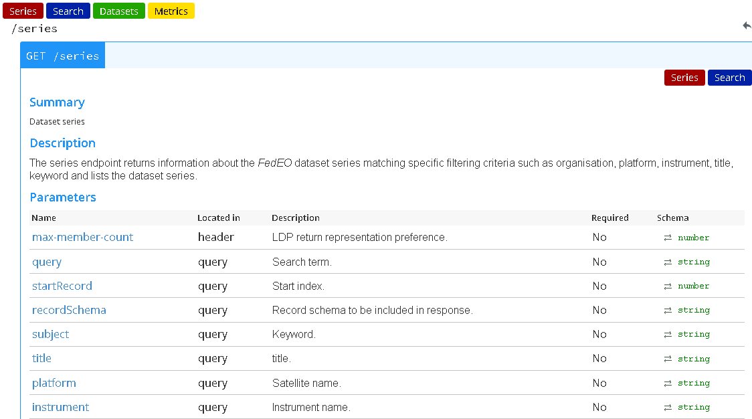
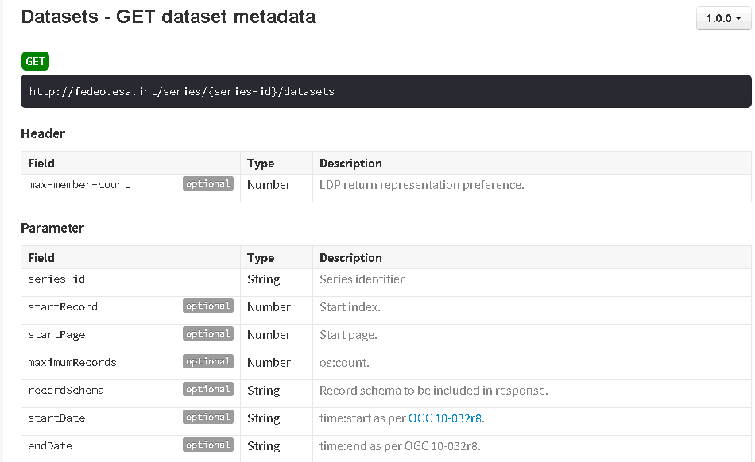
API Documentation
Update FedEO Client Partner Guide with additional capabilities.
Make available online API documentation with examples. Technology being considered:
  Swagger (http://swagger.io/), RAML (http://raml.org/)
  W3C Hydra, ApiDoc (http://apidocjs.com/)

Slide 38
DEMO Slides

Slide 39
Overview
Demo Architecture
SmartHMA Client
SSE and EO Portal Clients
  Examples two-step search
    With download
    With order
  Integration with Science Hub Sentinel-1
Web Browser Client -> fedeo.esa.int
  Partial integration with JAXA CATS-I
  Integration with Science Hub Sentinel-1
Interoperability with NASA CwicSmart client

Slide 40
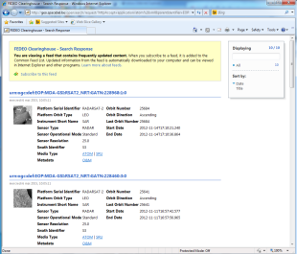
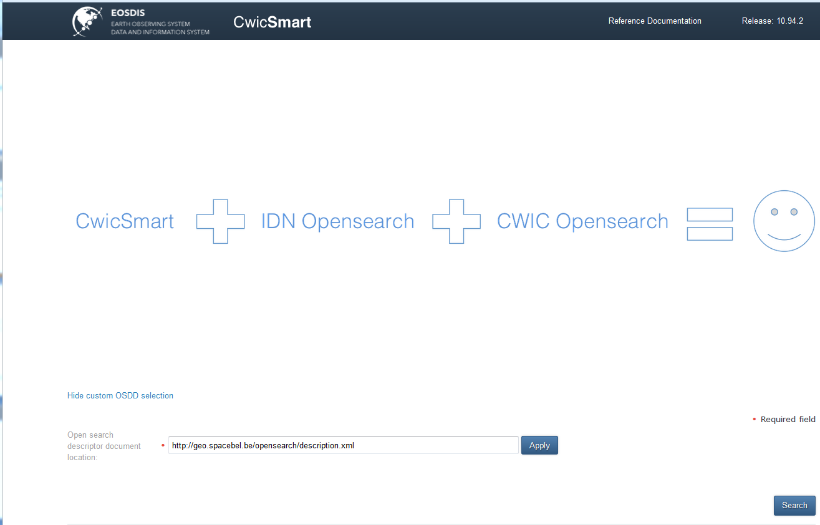
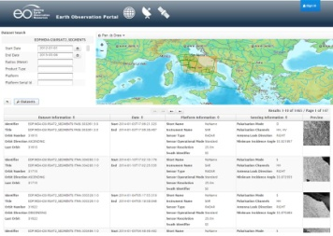
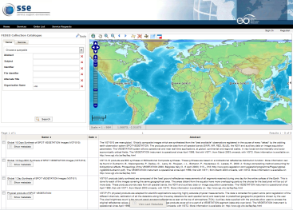
FedEO Collection search
Collection Search
ISO
OSDD
FedEO OpenSearch
OSDD
OSDD
OSDD
OSDD
OSDD
ISO
FedEO
I15
GPOD
VA4
ISO
ISO
ISO
synch (gscda)
CSCDA
Synch
OTHERS
ISO
OTHERS
@ESA
IDN
ECHO
synch/convert (fedeo/cwic)
OSDD is collection-specific.

Slide 41
FedEO Granule
search
INDERS
Granule Search
INDEX
DISSHARM LDS
OSDD
EOP O&M
Synch
FedEO OpenSearch
EOP O&M
SMOS
M2CS
GPOD
VA4
DISSHARM
SciHub
CDS DAIL
ISO
FedEO OpenSearch
DC
@ESA
CCM
CWIC
VITO
DLR
EUM
CNES
ASF
CCM
…
JAXA
CATS-I
ROSCOSMOS
SPIRIT
SPOT
NASA ECHO
…
…
OSDD is collection-specific and will exploit (ISO/Atom) collection metadata such as
temporal extent (<dc:date>) and sensorType if available.

Slide 42
Work performed – Collection Metadata
Additional Collection Metadata in EOP:ESA:FEDEO:COLLECTIONS
  Has positive effect on #collections that support 2-STEP search in FedEO.
535

Slide 43
Overview
Demo Architecture
SmartHMA Client
SSE and EO Portal Clients
  Examples two-step search
    With download
    With order
  Integration with Science Hub Sentinel-1
Web Browser Client -> fedeo.esa.int
  Partial integration with JAXA CATS-I
  Integration with Science Hub Sentinel-1
Interoperability with NASA CwicSmart client

Slide 44
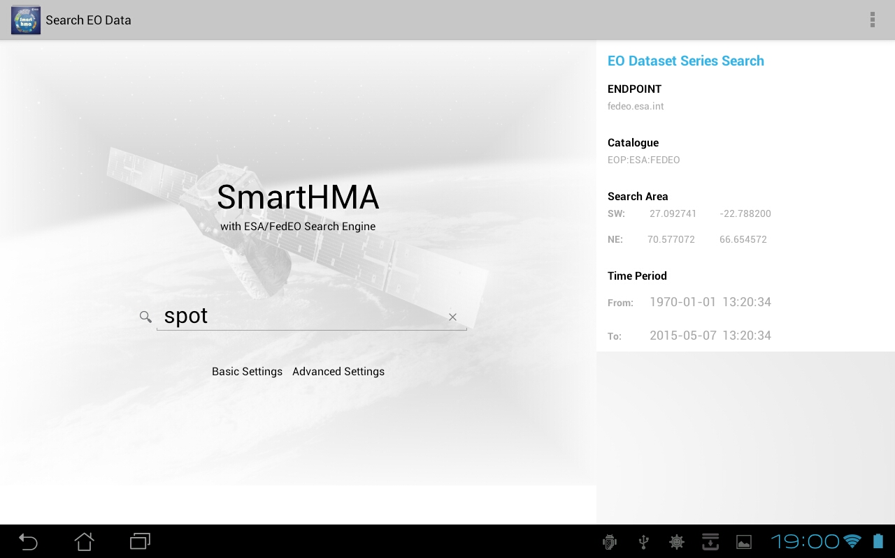
SmartHMA Android Client
Open-source Android Client
  WASAT (Poland)
  http://sourceforge.net/projects/smarthma/
SmartHMA screen shots
courtesy Daniel Zinkiewicz

Slide 45
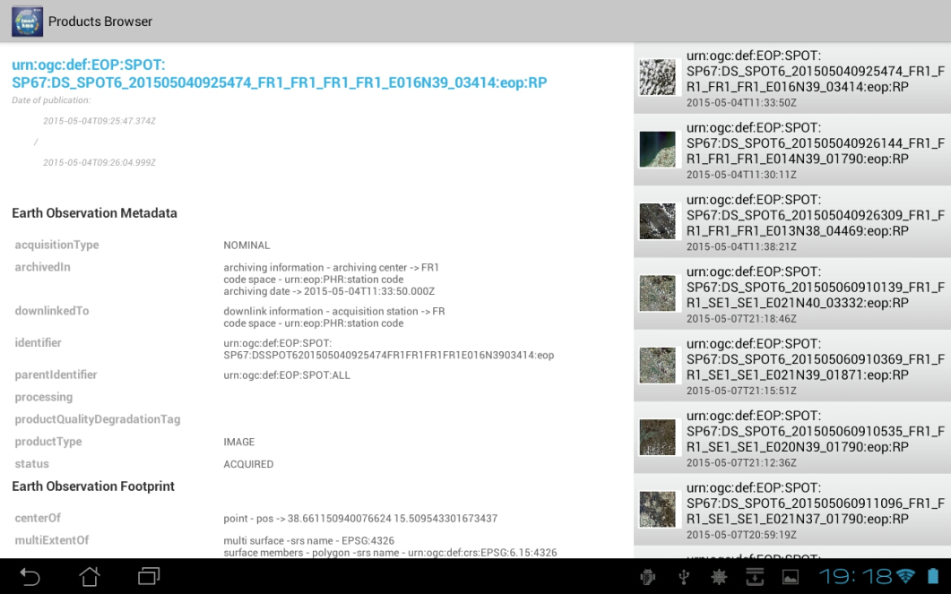
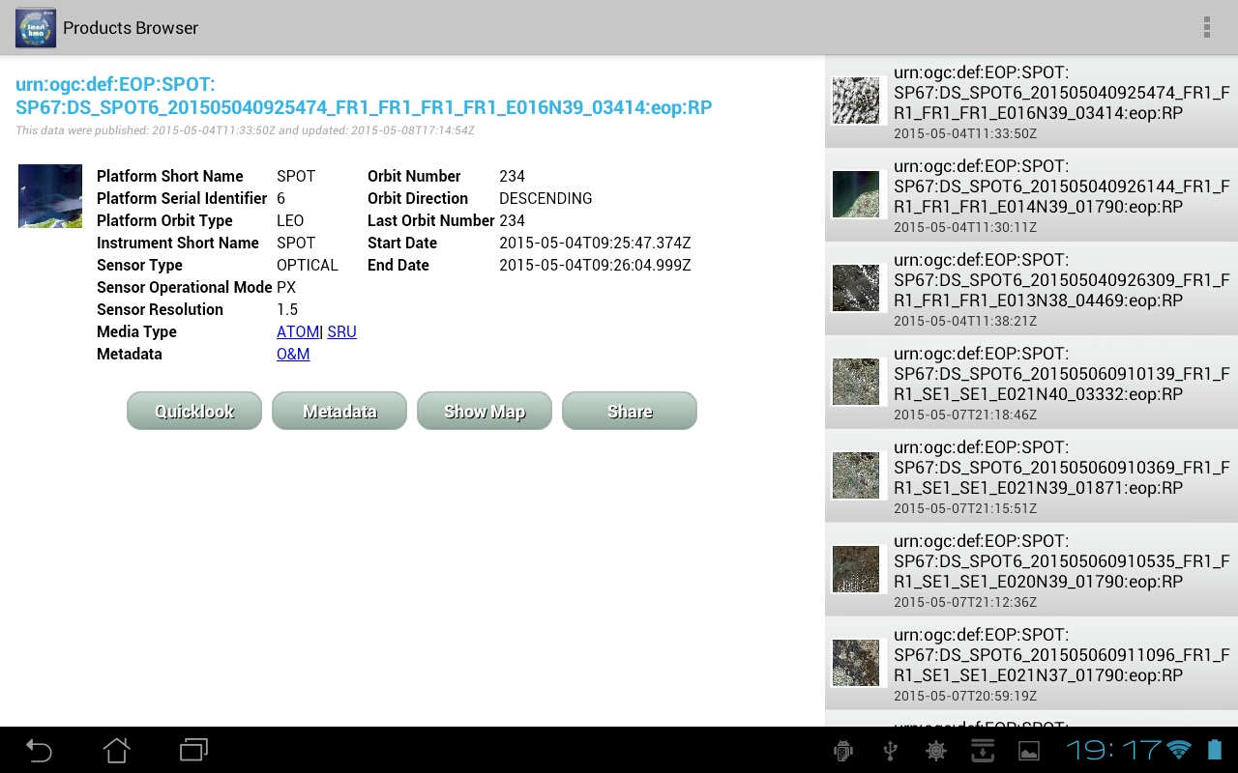
SmartHMA Android Client

Slide 46
Overview
Demo Architecture
SmartHMA Client
SSE and EO Portal Clients
  Examples two-step search
    With download
    With order
  Integration with Science Hub Sentinel-1
Web Browser Client -> fedeo.esa.int
  Partial integration with JAXA CATS-I
  Integration with Science Hub Sentinel-1
Interoperability with NASA CwicSmart client

Slide 47
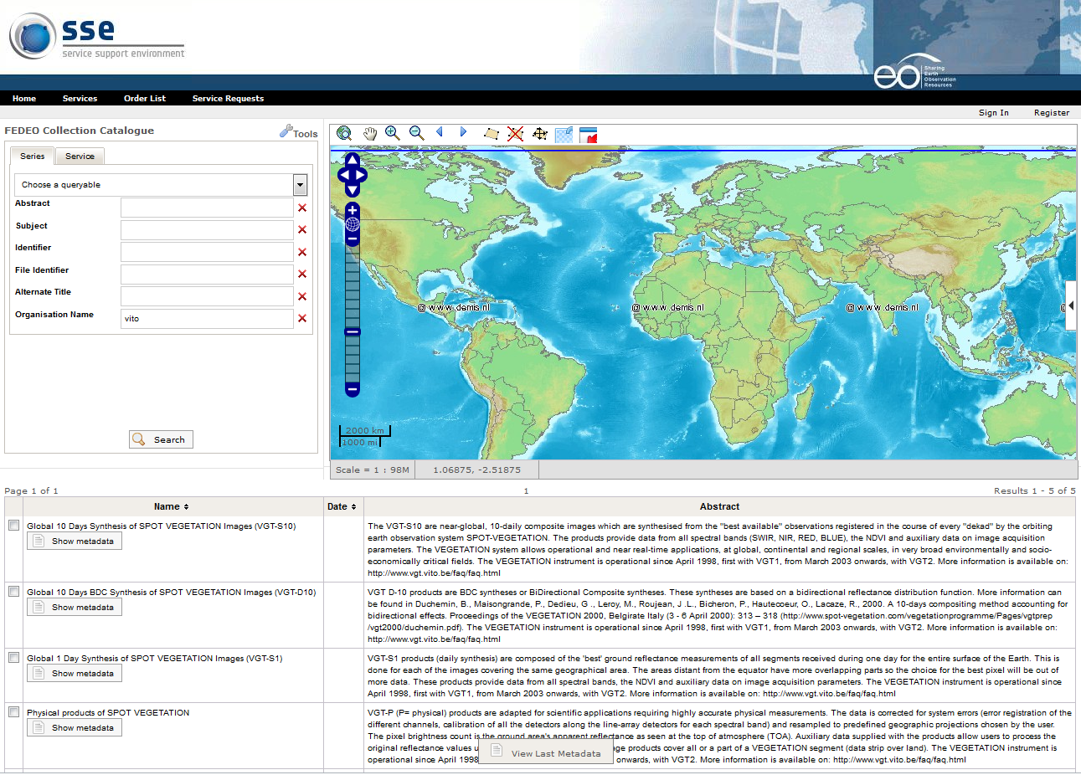
SSE Portal Client(s)

Slide 48
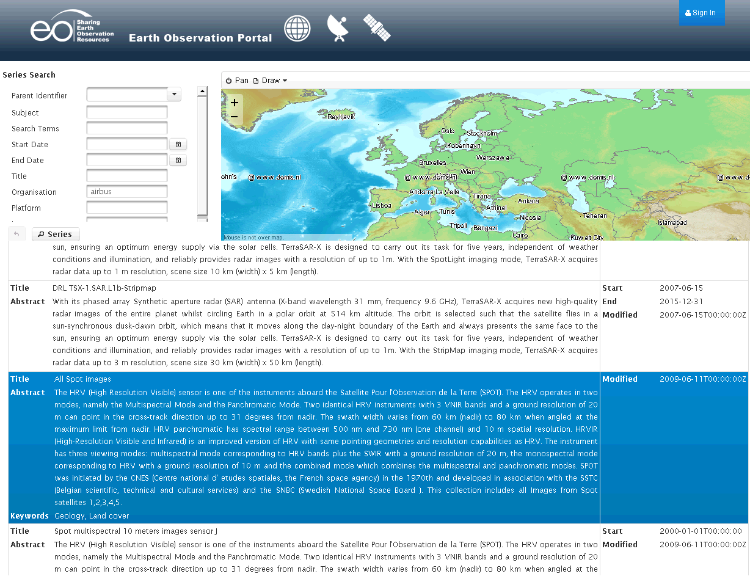
SPOT Series Search

Slide 49
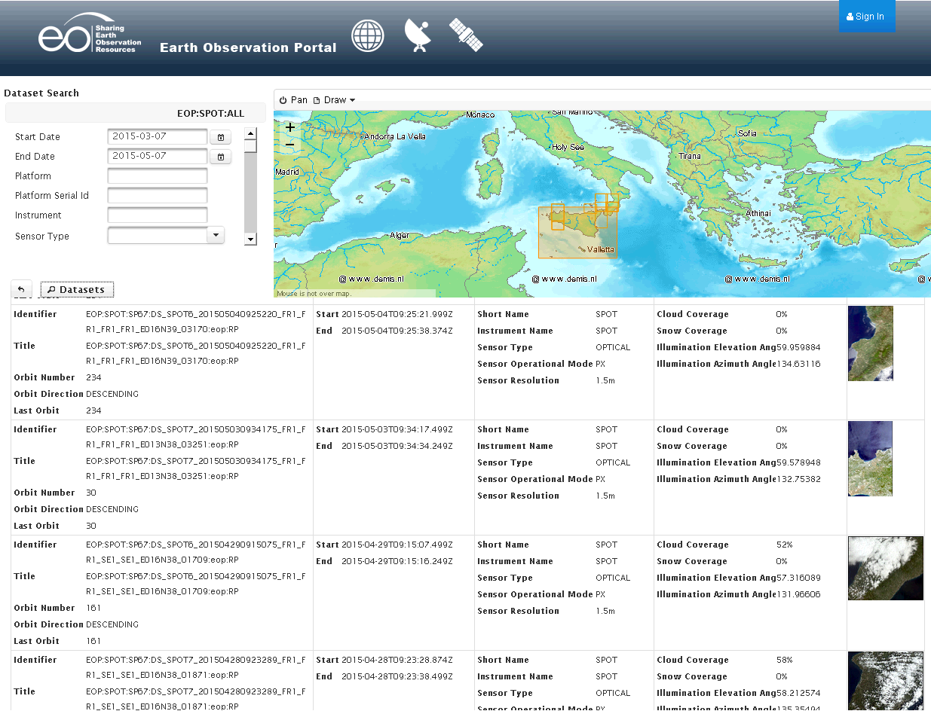
SPOT Dataset Search

Slide 50
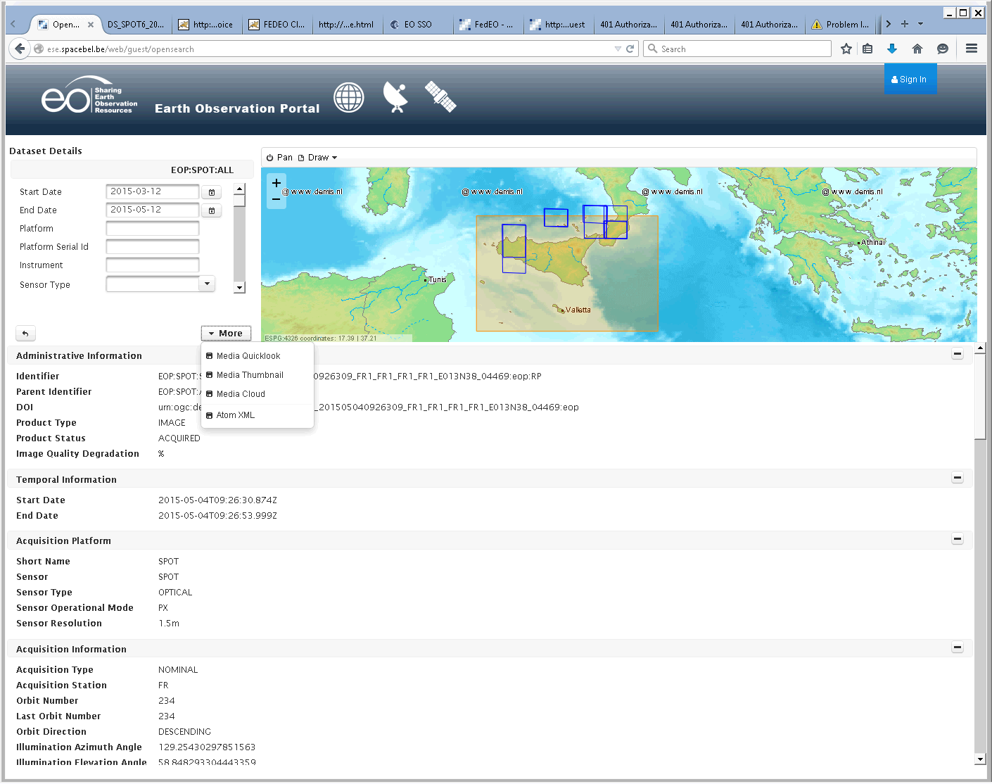
SPOT Dataset Details

Slide 51

SPOT Dataset Details
GUI extracts info from Atom entry:
  <atom:link rel="enclosure" href="…" />
  <atom:link rel="order" href="…" />
  <media:content medium="image" type="image/jpeg" url=…><media:category scheme="http://www.opengis.net/spec/EOMPOM/1.0">QUICKLOOK</media:category></media:content>
  <atom:link rel="alternate" href="…" />

Slide 52
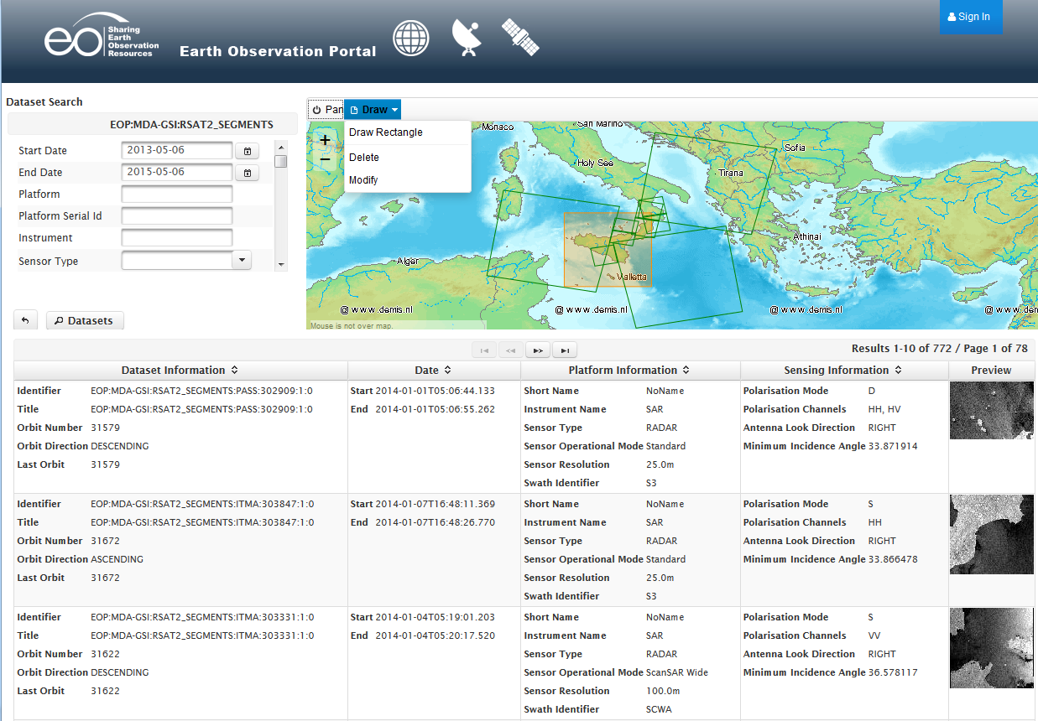
MDA Dataset Search

Slide 53
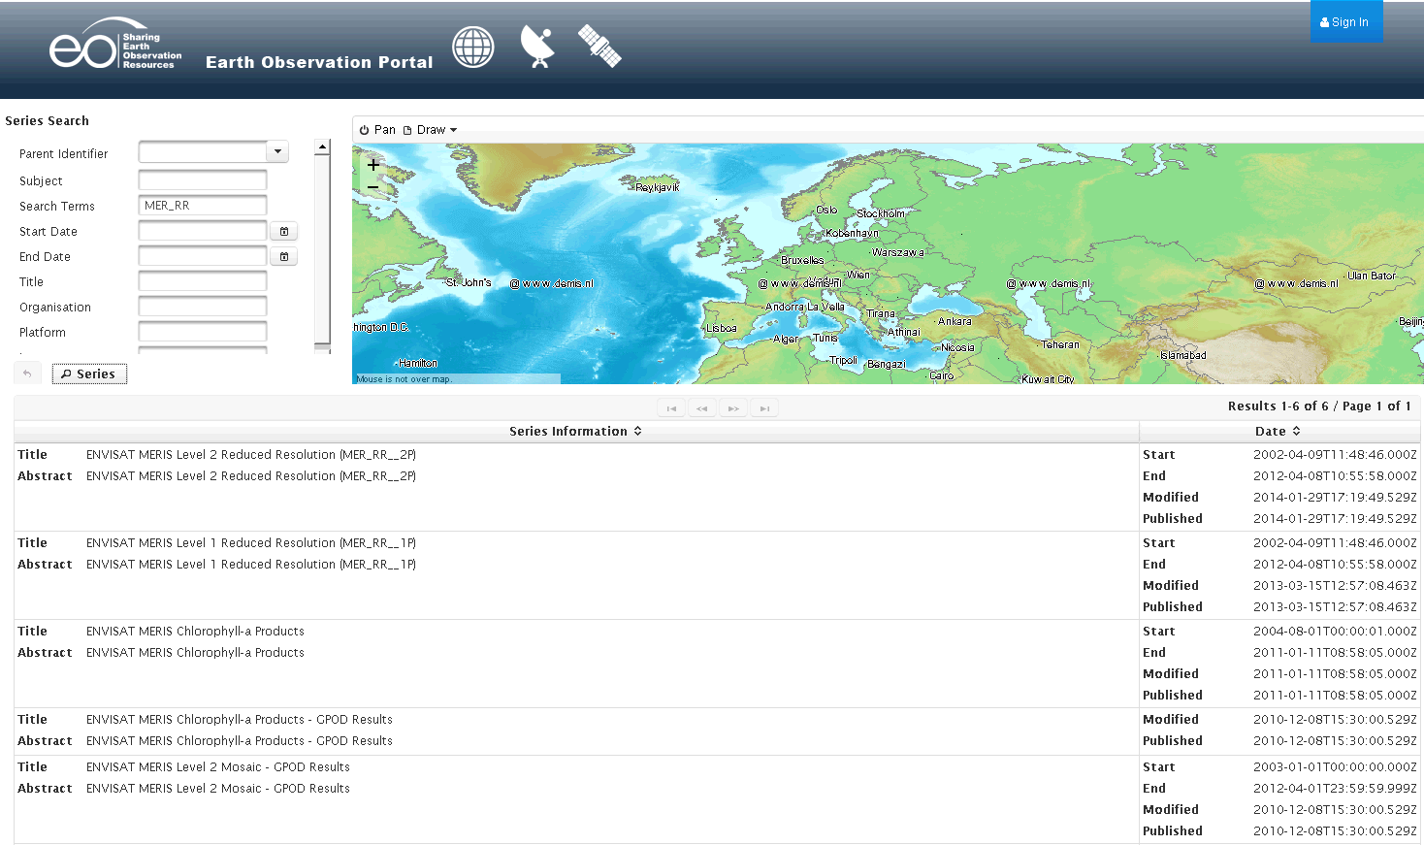
G-POD Series Search

Slide 54
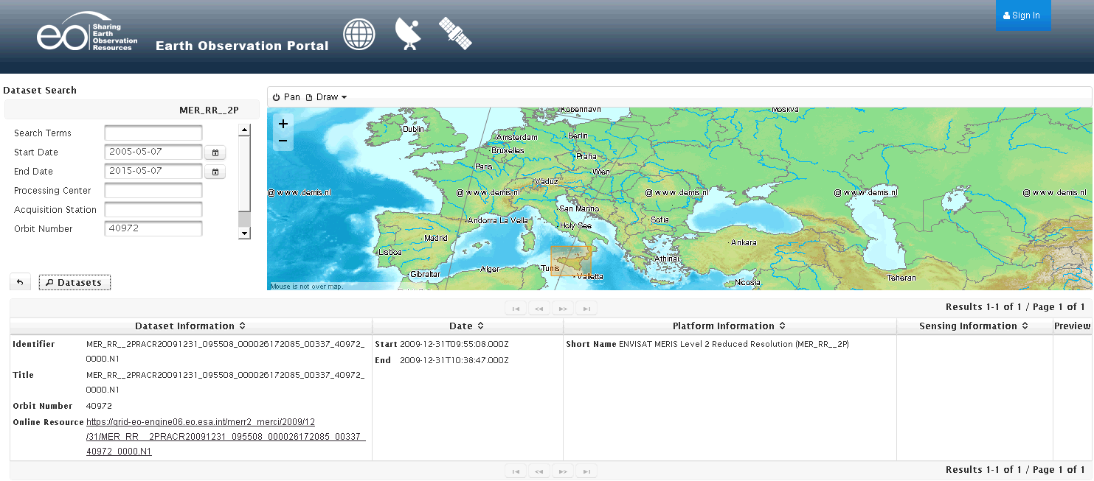
G-POD Dataset Search
GPOD

Slide 55
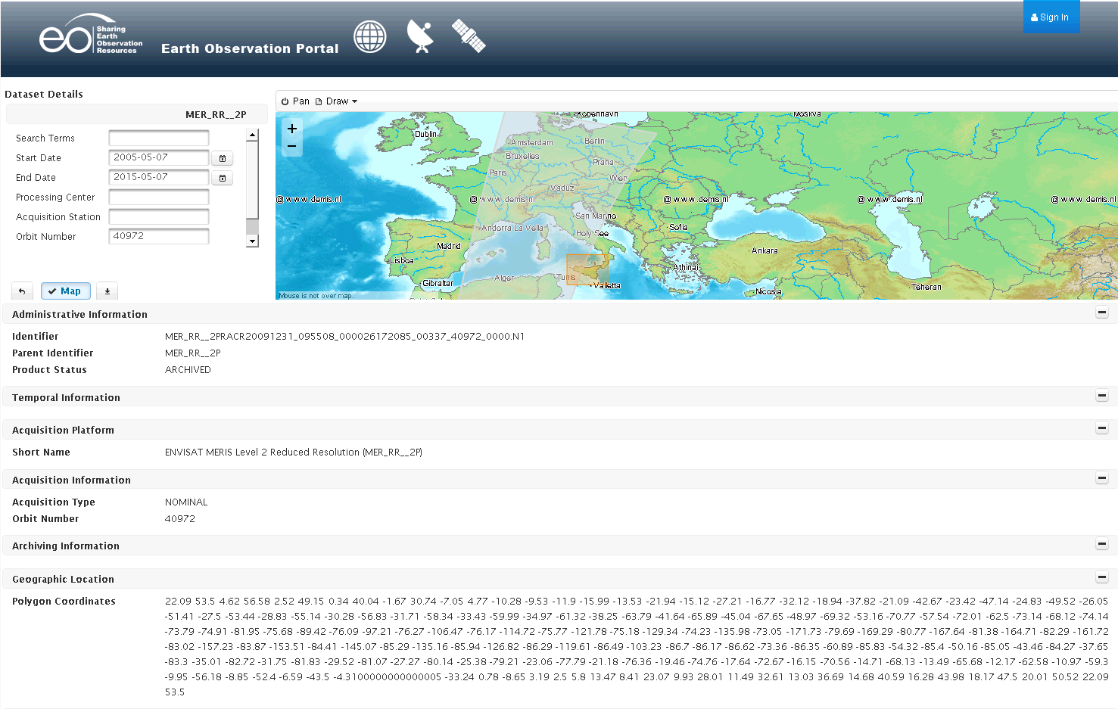
G-POD Dataset Details / (Download)
Button allowing
for Product Download

Slide 56
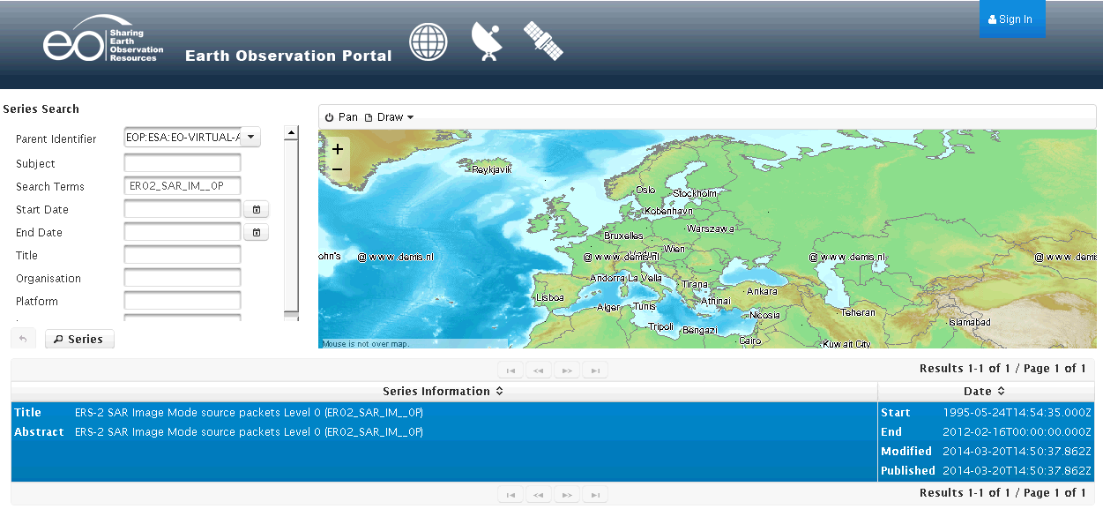
VA4 Series Search

Slide 57
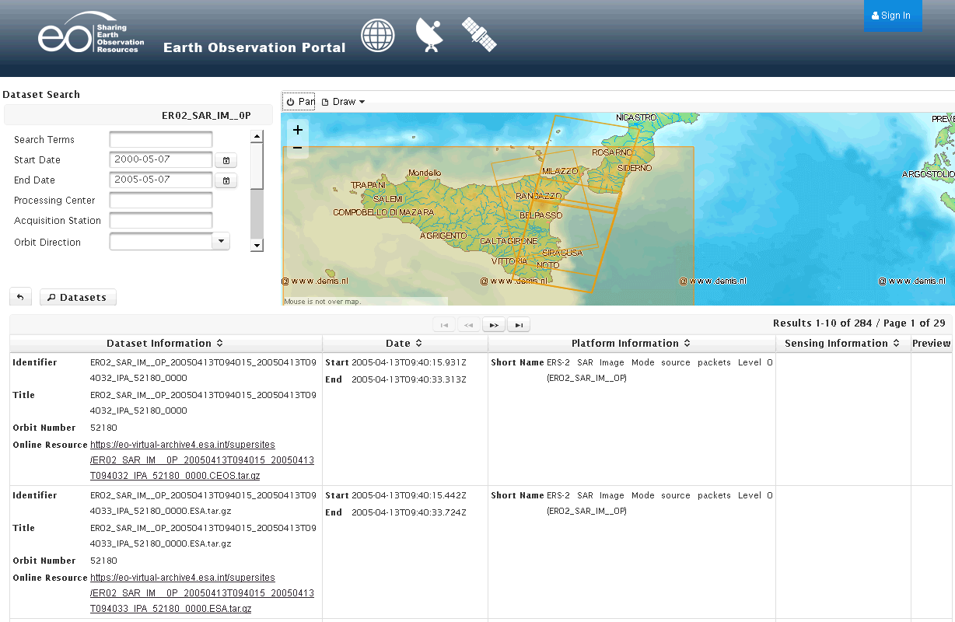
VA4 Dataset Search

Slide 58
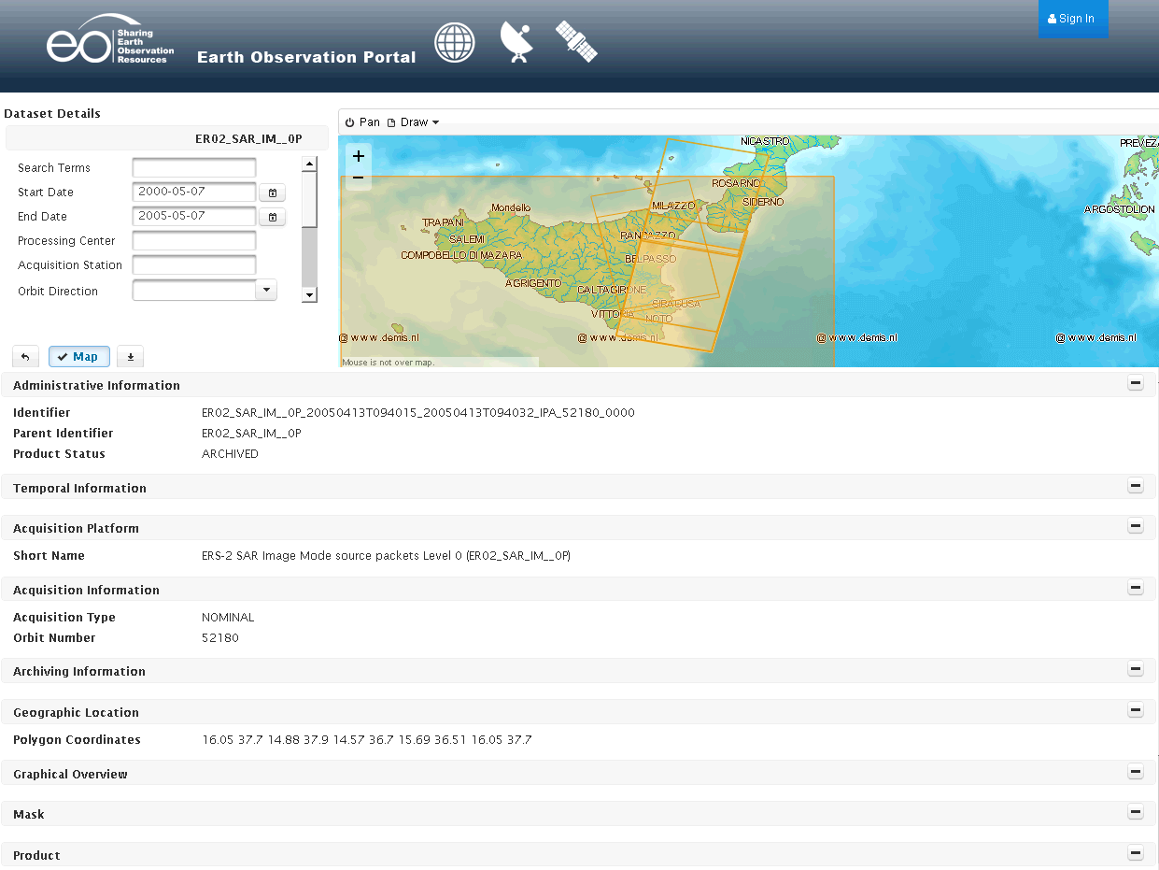
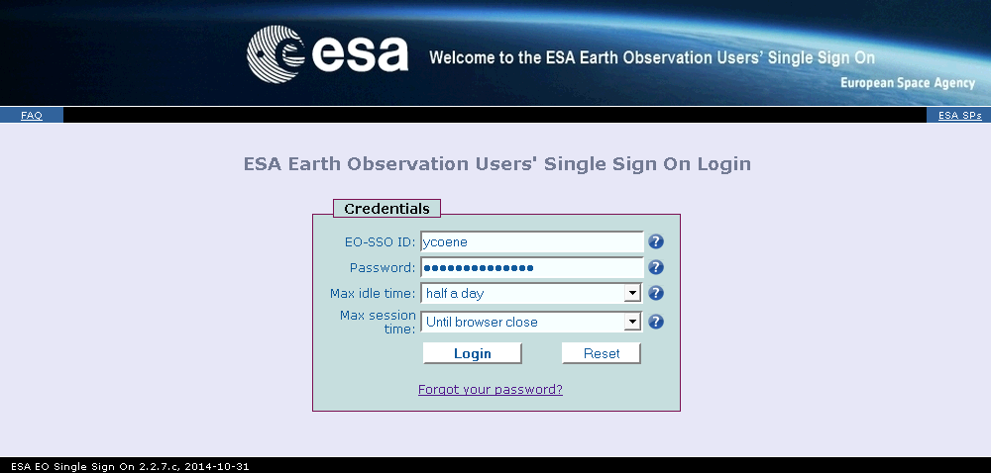
VA4 Dataset Details / Download

Slide 59
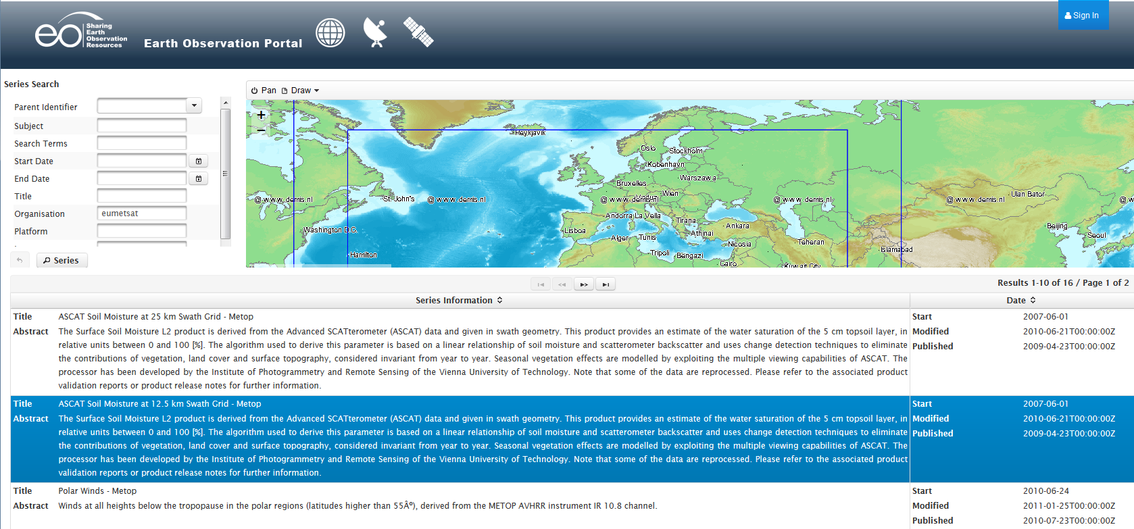
EUMETSAT Series Search

Slide 60
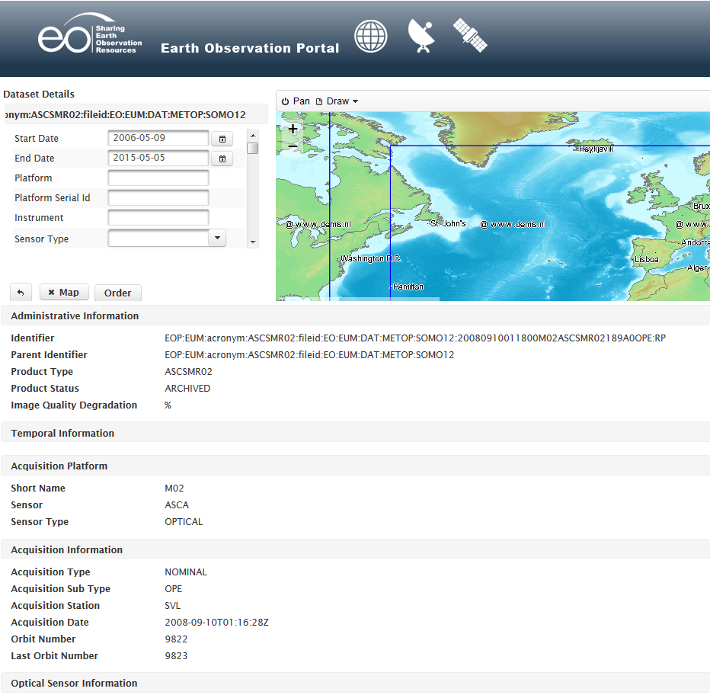
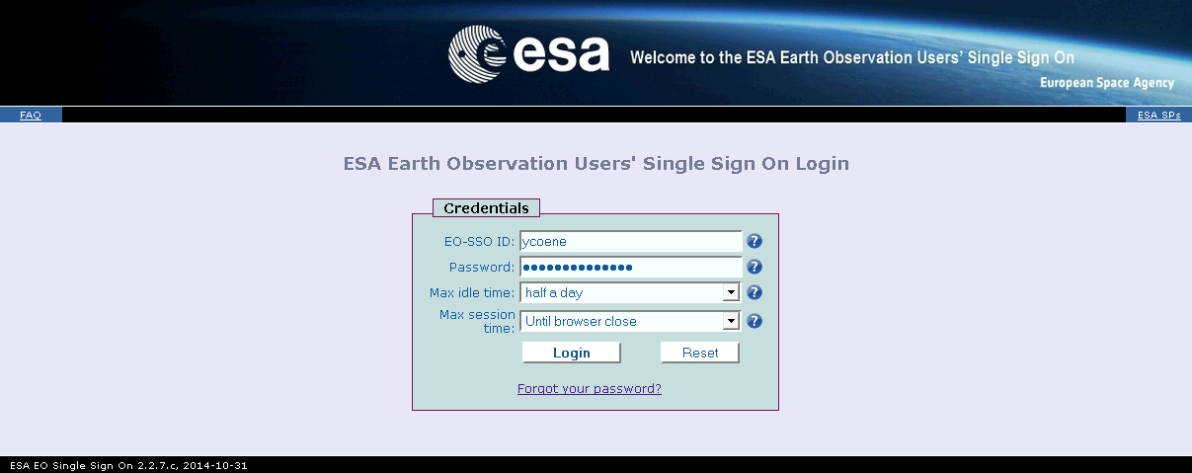
EUMETSAT Dataset Details / Order
Button allowing
for Product Order

Slide 61
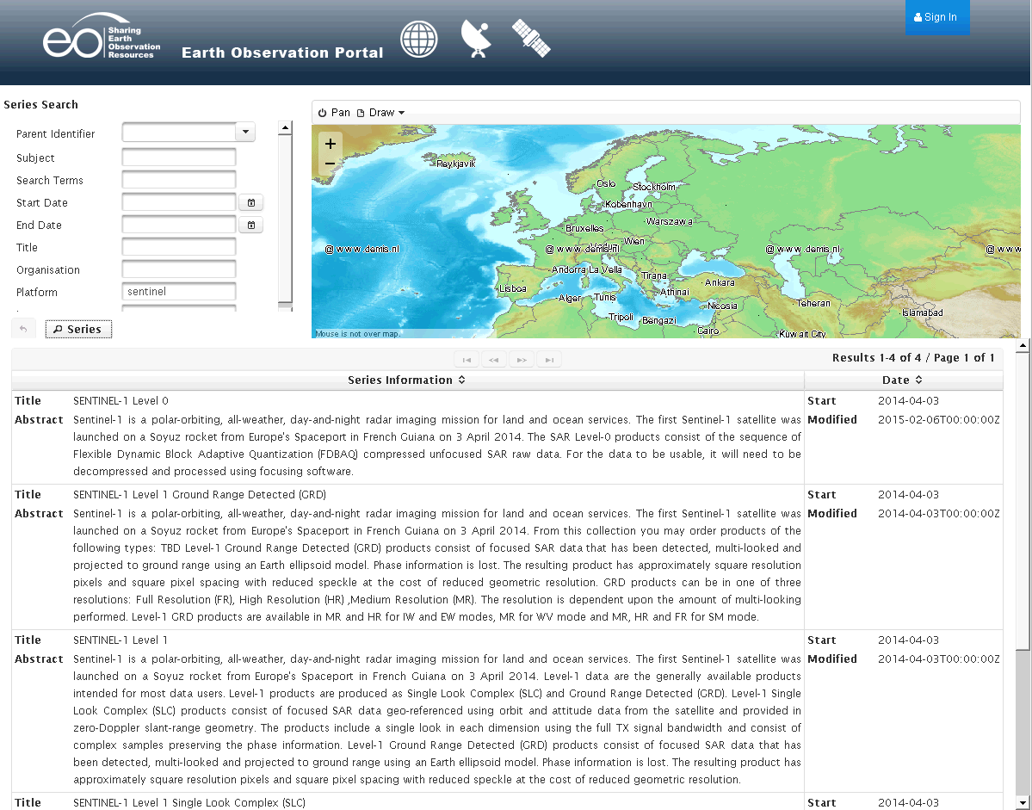
Science Hub Sentinel-1 Series Search

Slide 62
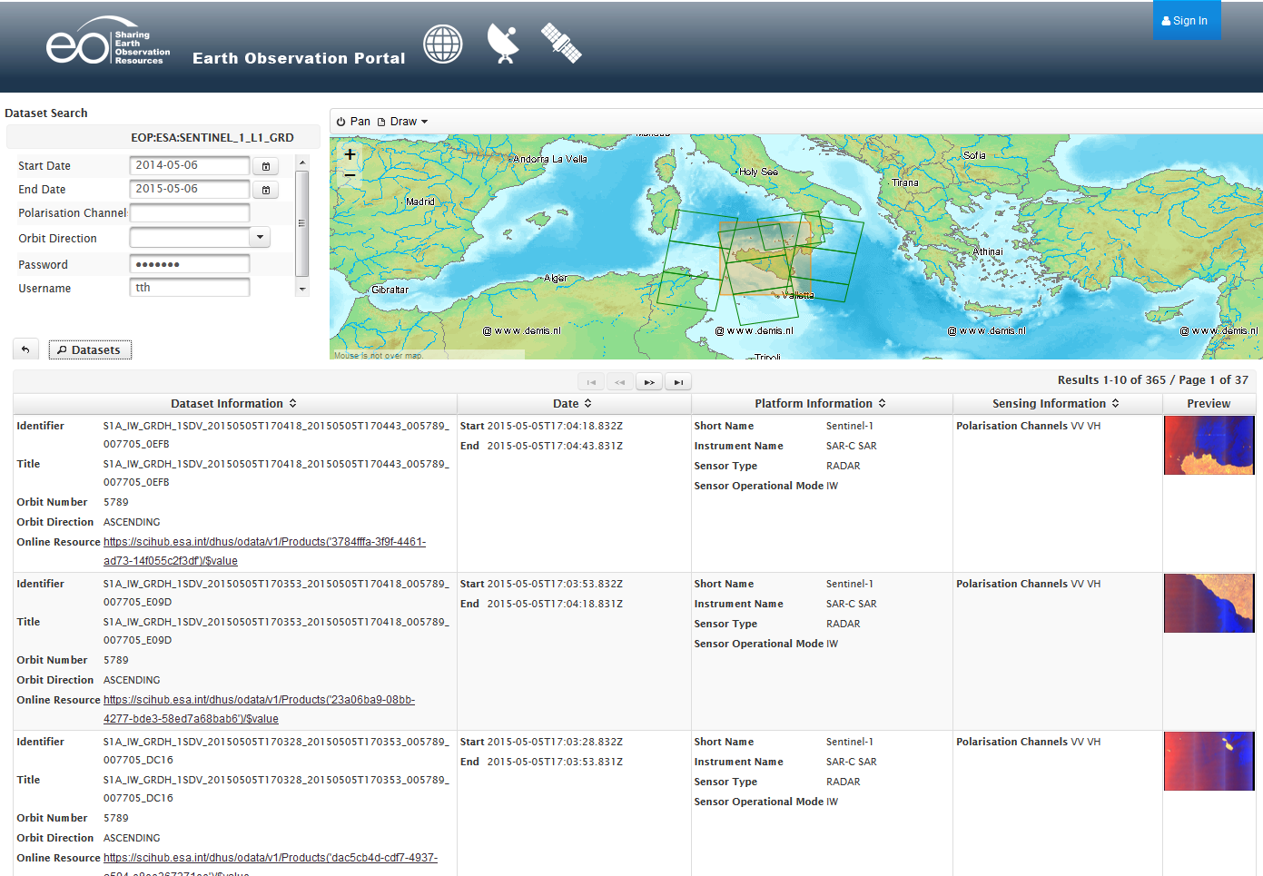
Science Hub Sentinel-1 Dataset Search

Slide 63
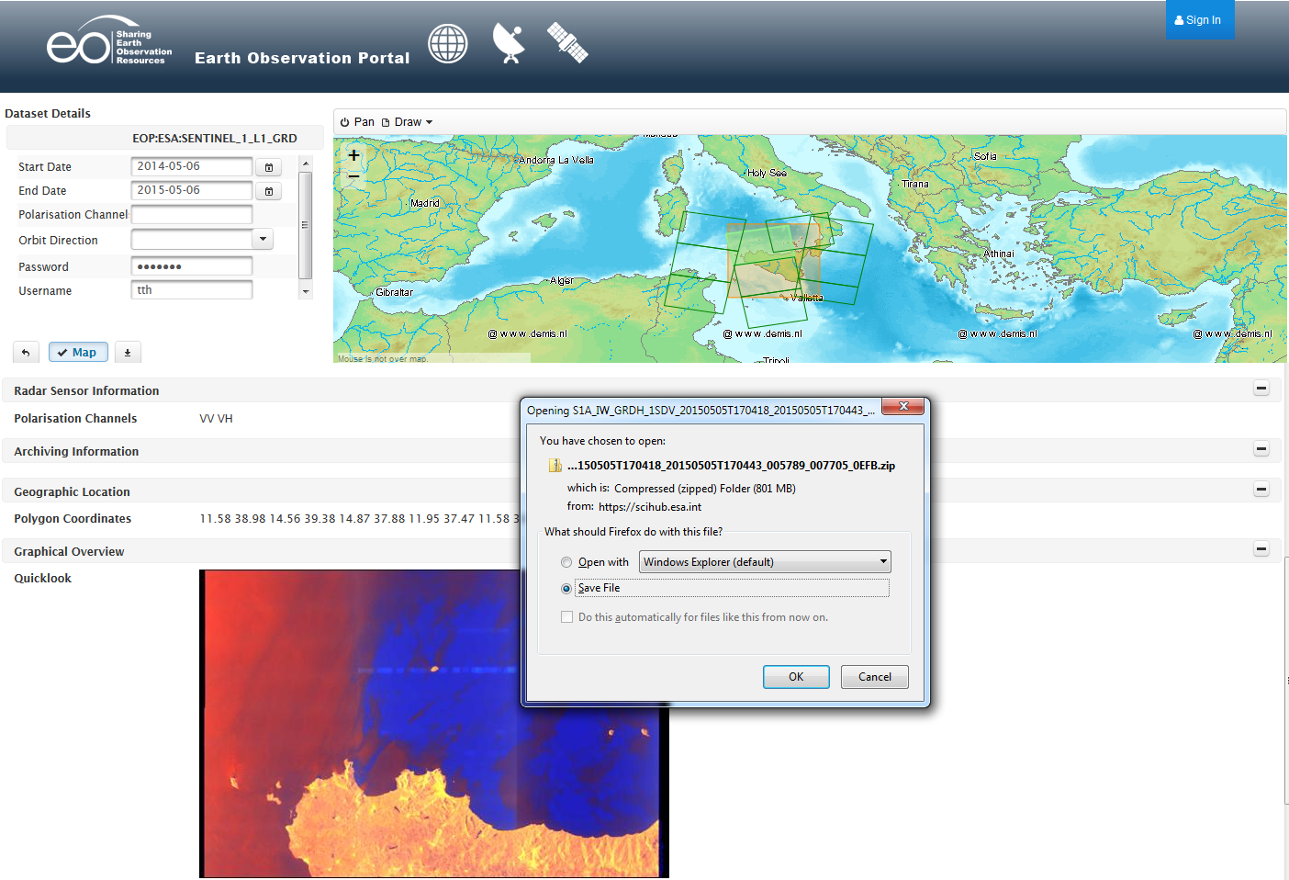
Science Hub Sentinel-1 Dataset Download

Slide 64
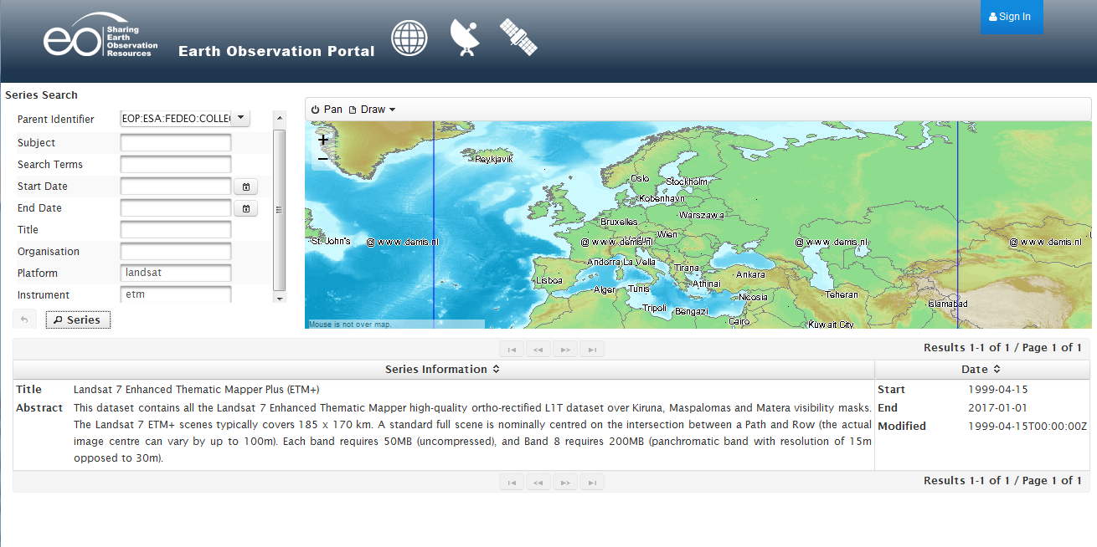
LDS-DISSHARM Series Search

Slide 65
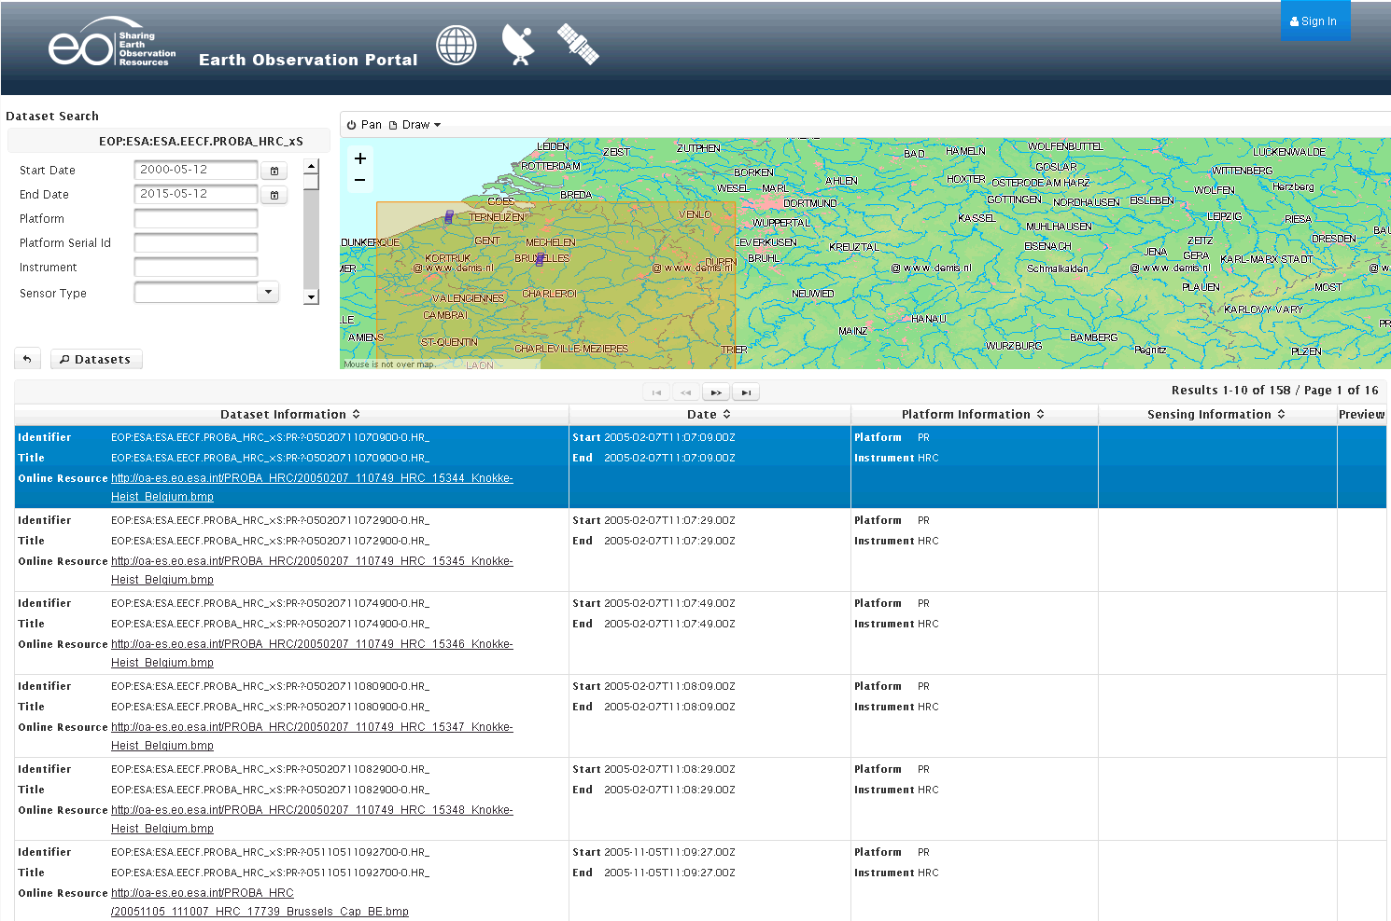
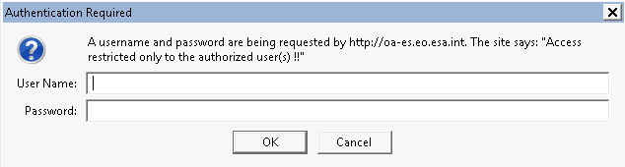
M2CS Dataset Search / Download

Slide 66
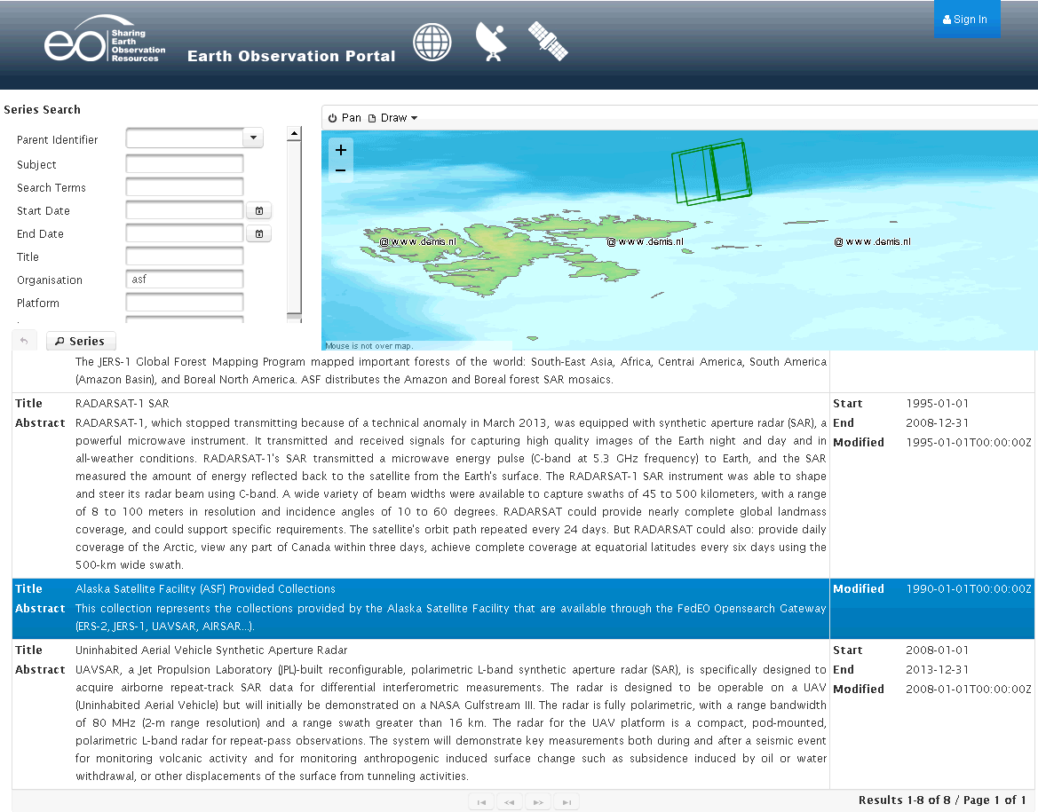
ASF Series Search

Slide 67
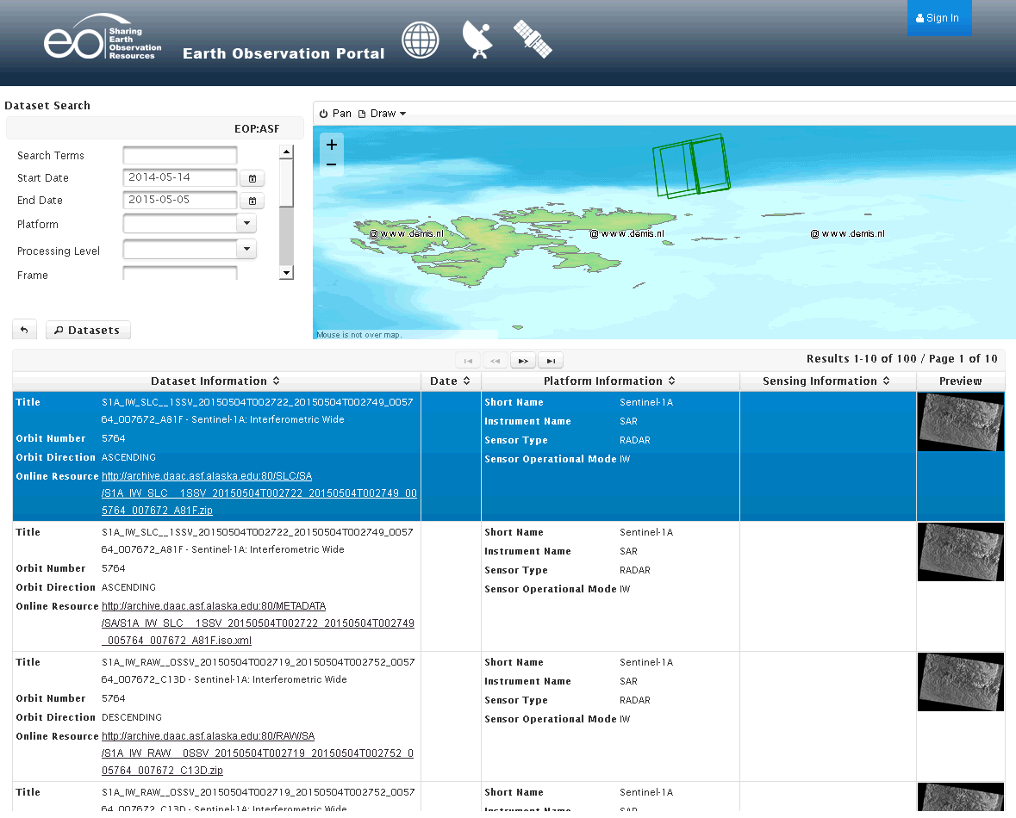
ASF Dataset Search

Slide 68


ASF Dataset Details/ Download

Slide 69
Overview
Demo Architecture
SmartHMA Client
SSE and EO Portal Client
  Examples two-step search
    With download
    With order
  Integration with Science Hub Sentinel-1
Web Browser Client -> fedeo.esa.int
  Partial integration with JAXA CATS-I
  Integration with Science Hub Sentinel-1
Interoperability with NASA CwicSmart client

Slide 70
JAXA CATS-I
Series Search
  Integration underway.
Dataset Search
  http://fedeo.esa.int/opensearch/request/?httpAccept=application/atom%2Bxml&parentIdentifier=ALOS_PALSAR&startDate=2006-10-10T00:00:00&endDate=2006-10-14T00:00:00&orbitDirection=Descending&polarisationChannels=HH&maximumRecords=10
Notes:
Further work:
Integrate CATS-I dataset series search (became available very late)
Align values of parameters with OGC 13-026r5 (i.e. enumerations expected by server are different)
Access to download ?

Slide 71

JAXA CATS-I Dataset Search

Slide 72
Sentinel-1
http://fedeo.esa.int/opensearch/description.xml?parentIdentifier=EOP:ESA:SENTINEL_1_L1_GRD
http://fedeo.esa.int/opensearch/request?platform=sentinel
https://fedeo.esa.int/opensearch/request/?httpAccept=application/atom%2Bxml&parentIdentifier=EOP:ESA:SENTINEL_1_L1_GRD&orbitDirection=ASCENDING&polarisationMode=HH&startDate=2015-01-01T00:00:00Z&endDate=2015-01-02T00:00:00Z&username=uuu&password=xxxxxx
password={wsse:Password}
username={wsse:Username}
xmlns:wsse="http://docs.oasis-open.org/wss/2004/01/oasis-200401-wss-wssecurity-secext-1.0.xsd"

Slide 73

Sentinel-1
Notes:
Further work: support additional OGC 13-026r5 queryables.

Slide 74
Overview
Demo Architecture
SmartHMA Client
SSE and EO Portal Client
  Examples two-step search
    With download
    With order
  Integration with Science Hub Sentinel-1
Web Browser Client -> fedeo.esa.int
  Partial integration with JAXA CATS-I
  Integration with Science Hub Sentinel-1
Interoperability with NASA CwicSmart client
  http://testbed.echo.nasa.gov/cwic-smart/

Slide 75

CwicSmart access to FedEO
FedEO top-level OSDD

Slide 76

CwicSmart access to FedEO

Slide 77

CwicSmart access to FedEO

Slide 78



Slide 79
More info:
  http://ceos.org/ourwork/workinggroups/wgiss/projects/fedeo/
Questions ?

