Slide 1
WGISS-39 IDN Report
Michael Morahan
CEOS WGISS-39 Spring Meeting
Japan Aeronautics Exploration Agency (JAXA)
Tsukuba, Japan
May 12, 2015

Slide 2
Outline
WGISS38 Action Item Review
  Action item WGISS-38-9
  Action item WGISS-38-10
Upgraded IDN Site DEMO
Continuity of Support for IDN
  Maintain continuity of CEOS/GEOSS Services (Near-Term)
  Maintain continuity of DIF format/content
  IDN records would eventually move to the CMR

Slide 3
Outline
GCMD Keyword Status and Plan
  Release Version 8.1 (Land Surface and Atmosphere)
  Release Version 8.2 (Atmosphere, Ecosystem, and Terrestrial Hydrosphere)
  Version 8.3 (Water Vapor, Water Quality/Chemistry, and Ecosystems)
Unified Metadata Model – Collections (UMM-C) Upgraded
  Background information
  Developed DIF-10 to support for UMM-C Compliance
  Summary list of benefits for using DIF10
  DIF10.1 Translators
IDN Metrics

Slide 4
WGISS38 Action Item Review
Action item WGISS-38-9: “Yves Coene (ESA) to check whether the SKOS description of satellite and missions is in the IDN”
Response: GCMD/IDN opened up the KMS SKOS API (dynamic search) without authentication:
    Platform example:
    http://gcmdservices.gsfc.nasa.gov/kms/concept/80eca755-c564-4616-b910-a4c4387b7c54
    Instrument example:
    http://gcmdservices.gsfc.nasa.gov/kms/concept/2878f334-35dc-47a7-a3ae-8c5da1adccd3
    Science Keyword example:
    http://gcmdservices.gsfc.nasa.gov/kms/concept/6a426480-c58f-4b6b-8e35-0975b7f6edb5
Notes:
Benefits to moving to DIF10 and QA value.
UMM-C standard for !SO referenced in the UMM-C Doc.

Slide 5
WGISS38 Action Item Review
Action item WGISS-38-10: “Andy Mitchell (NASA) to review the use of the term DOI in the IDN DIF metadata field to determine if it is appropriate to use PI instead.”
Response: GCMD/IDN has updated the DIF (version 10) schema to use the appropriate Persistent Identifier:
  DIF₉ Dataset_DOI examples:
<Dataset_DOI>ark:68059/27666ebcdcf35e04eb87602da5b3a5ab</Dataset_DOI>
<Dataset_DOI>doi:10.5067/ICESAT/GLAS/DATA125</Dataset_DOI>
<Dataset_DOI>hdl:68059/27666ebcdcf35e04eb87602da5b3a5ab</Dataset_DOI>
  DIF₁₀ Proposed PersistentIdentifier example:
<PersistentIdentifier>
<Type>DOI</Type>
<Identifier>10.5067/ICESAT/GLAS/DATA125</Identifier>
</PersistentIdentifier>
<PersistentIdentifier>
<Type>ARK</Type>
<Identifier>68059/27666ebcdcf35e04eb87602da5b3a5ab</Identifier>
</PersistentIdentifier>
Notes:
Benefits to moving to DIF10 and QA value.
UMM-C standard for !SO referenced in the UMM-C Doc.
DIF₉ Dataset_DOI field is available for metadata providers to use now. PersistentIdentifier field will be available with the public release of DIF₁₀. (In review by the CMR group.)
Details:
If providers use the DIF₉ format; they should use the Persistent Identifiers prefix (doi:, ark:, or others) in the field syntax with the url.
If DIF₁₀ is used; the provider can select the Persistent Identifier prefix and populate the identifier url with a fixed set of supported identifier types (DOI, ARK).
DIF₉ data properly encoded is forward compatible with DIF₁₀ as the DIF₉->DIF₁₀ translators can correctly migrate the data.

Slide 6
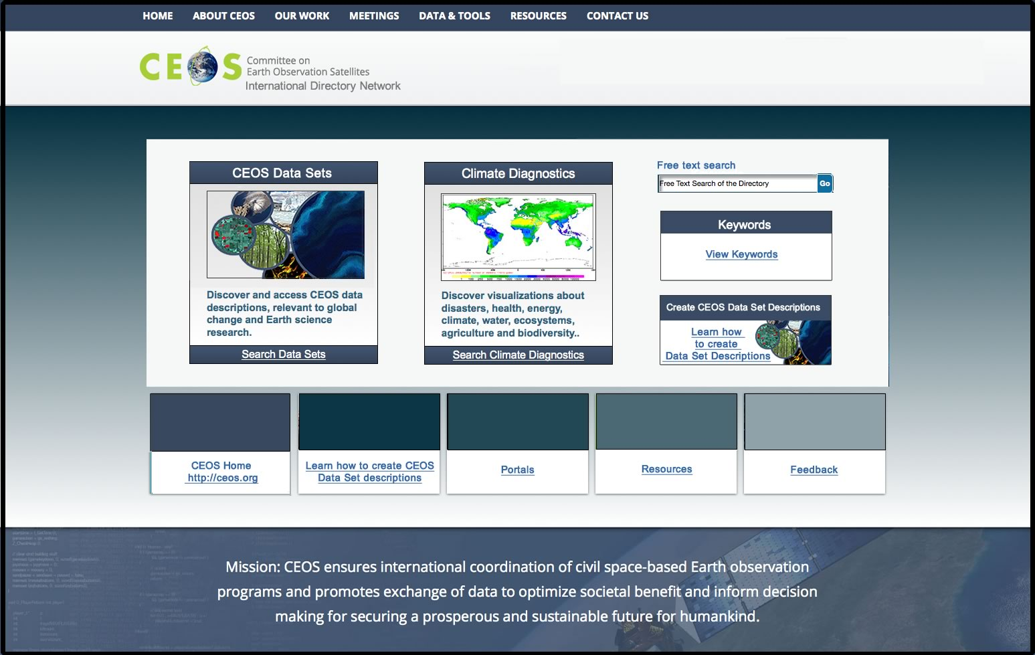
Upgraded IDN Site
Aim: Incorporate current look/feel GCMD search to improve navigation
Demo - http://idn.ceos.org/

Slide 7
What to include
Recommendations: What datasets to include
  Include CEOS Agencies
  Include the CEOS Agency Associates
  Include datasets sponsored by CEOS
Recommendations: What Portals to include
  Include CEOS Agencies
  Include the CEOS Agency Associates
  Include non-CEOS Agency portals that have datasets sponsored by CEOS?

Slide 8
CEOS agencies that have IDN portals
CEOS Agency members: ESA, JAXA, EOSDIS, NOAA
CEOS Agency Associate members: GOFC, UN, CEOP
CEOS Other Agencies that have CEOS data:
  WWF (World Water Forum)
  AMD
  ANTABIF
Recommendation: remove portals that have been incorporated in the past, but are not CEOS affiliated:
  GISD
  Human Health and Disease Portal
  Human Health and Disease Portal Services

Slide 9
Continuity of Support for IDN
CEOS/GEOSS Services
  IDN portals
  CWIC (records, members, QA, metadata mappings)
  Discovery of CWIC records (OpenSearch or CSW servers).
    OpenSearch server
    CSW server for GEOSS services
  Deploy GEODataCore tags on request from agencies
Maintain continuity of DIF format/content
  Support DIF 9 for IDN partners
  DIF format evolution (In parallel with UMM-C)
  Work with IDN partners to ensure high quality DIF content
IDN records would eventually move to the CMR
  Transition IDN (CEOS) metadata records into the CMR (by the end of the year)
  Support QA of CEOS and other non-NASA metadata in the CMR
Notes:
* consider question "will IDN providers be expected to migrate from DIF9 to DIF10?

Slide 10
GCMD Keyword Status and Plan
Science Keyword Release Version 8.1 (Land Surface and Atmosphere) (March 26)
  Changes are new/updated Land Surface and Atmosphere keywords (246 new keywords and 10 updated keywords).
  Posted announcement to GCMD/IDN listserv and website (http://gcmd.nasa.gov/learn/keyword_release.html).
Version 8.2 (Atmosphere, Ecosystem, and Terrestrial Hydrosphere)
  Document proposed changes by September 2015
  Submit to NASA ESDIS standards office (ESO) for review by October 2015
  Aim to release by March 2016
Version 8.3 (Water Vapor, Water Quality/Chemistry, and Ecosystems)
  Document proposed changes by April 2016
  Submit to ESO for review by May 2016
  Aim to release by October 2016
Further Releases are TBD – on 6 month cycle
Notes:
General background
Why and UMM-C
Summary list of benefits for using DIF10
Discuss and questions

Slide 11
Unified Metadata Model – Collections
(UMM-C)
Background information
  Used by the NASA EOSDIS community as a guide during metadata generation for the Common Metadata Repository (CMR)
  Takes into account existing collection metadata formats (DIF, ECHO, ISO 19115-2).
Developed DIF-10 to support for UMM-C Compliance
    DIF-10 Changes
      Additional required fields
      New fields
      Addition of enumerations for specific fields
Notes:
General background
Why and UMM-C
Summary list of benefits for using DIF10
Discuss and questions

Slide 12
    DIF-10 Changes:
    Additional required fields
Entry ID
Entry Title
Summary
Science Keywords
Platform
Platform/Instrument
Temporal Coverage
Spatial Coverage
Project
Organization
Related URL
Metadata Standard Name
Metadata Standard Version
Metadata Creation Date
Product
Previously not required in the GCMD/IDN DIF
Notes:
General background
Why and UMM-C
Summary list of benefits for using DIF10
Discuss and questions

Slide 13
    DIF-10 Changes:
    New enumeration fields
SpatialCoverageType
Organization_Type
PlatformType
Duration_Unit
PersistentIdentifierType
MetadataAssociationType
MetadataAssociationType
PhoneType
Metadata Standard Name
Metadata_Version
Metadata Creation Date
ProductFlag
ProductLevelId
Previously not in the GCMD/IDN DIF
Notes:
General background
Why and UMM-C
Summary list of benefits for using DIF10
Discuss and questions

Slide 14
    DIF-10 Changes:
    New fields
Field Name | Field Definition
Version | The version identifier of the data set.
Version_Description | A brief description of the differences between one data set version and another version.
Metadata_Association | Describes the metadata associated with the instance of a data set; i.e., the name and other details of input data, data sets associated (in science data terms) with the instance and/or data sets dependent on the collection.
Metadata_Dates | A union of the DIF metadata event date fields with the three ECHO event time fields.
Additional_Attributes | Parameters which further describe the data represented in each granule within a collection.
Product_Level_Id | The product identifier of the data collection.
Collection_Data_Type | Identifies non-science-quality products.
Product_Flag | Specifies the product type of the data.

Slide 15
Summary list of benefits for using DIF10
UMM-C compliance for the Common Metadata Repository.
  Allows easy of metadata record ingest into the new repository
Developed with ISO in mind.
  Help maps ISO fields to the DIF
New Fields to describe the datasets
  AdditionalAttribute
  ProductLevelId
  Version
Restructured existing fields to better describe the datasets
  Platform > Instrument > Sensor hierarchy
  PersistentIdentifier
  Spatial_Coverage
Notes:
General background
Why and UMM-C
Summary list of benefits for using DIF10
Discuss and questions

Slide 16
DIF10 Translators
What it does:
  Converts DIF-9 to DIF-10, DIF-10 to DIF-9, ECHO-10 to DIF-10
  Fills in missing required UMM-C fields where possible
How it works:
  Implemented in Adapter Framework (not XSLT conversion)
  Supports file-based “dropbox” capability (GUI in the works)
Notes:
Other DIF10 Tool: QAtool CrossWalk

Slide 17
IDN Metrics
IDN Site
March 2014 – April 2015
Total Visits: 36,233
Average Visits per day: 85
Average Visits per month: 2,587
Total Page Views: 74,591
Average pages viewed per day: 175
Notes:
NetInsight

Slide 18
IDN Usage by Continent

Slide 19
IDN Usage by Country
Top 10 Countries:
United States
India
China
Republic of Korea
Canada
6) Great Britain
7) Iran
8) Australia
9) Germany
10) Italy

Slide 20
User Access: Production CSW Service
March 2014 – April 2015
Total Visits: 30,128
Average Visits per day: 70
Total Page Views: 1,596,580
Average Page Views per day: 3,747
20
Notes:
From gcmdsrv1

Slide 21
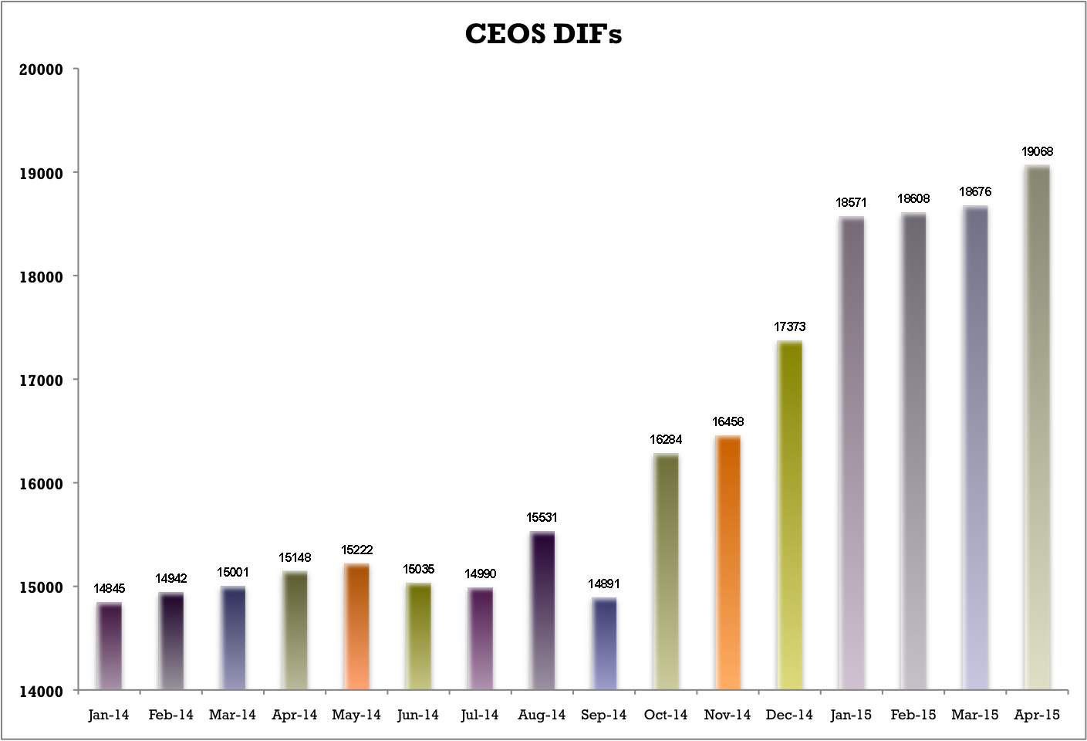
Number of IDN Metadata Records

Slide 22
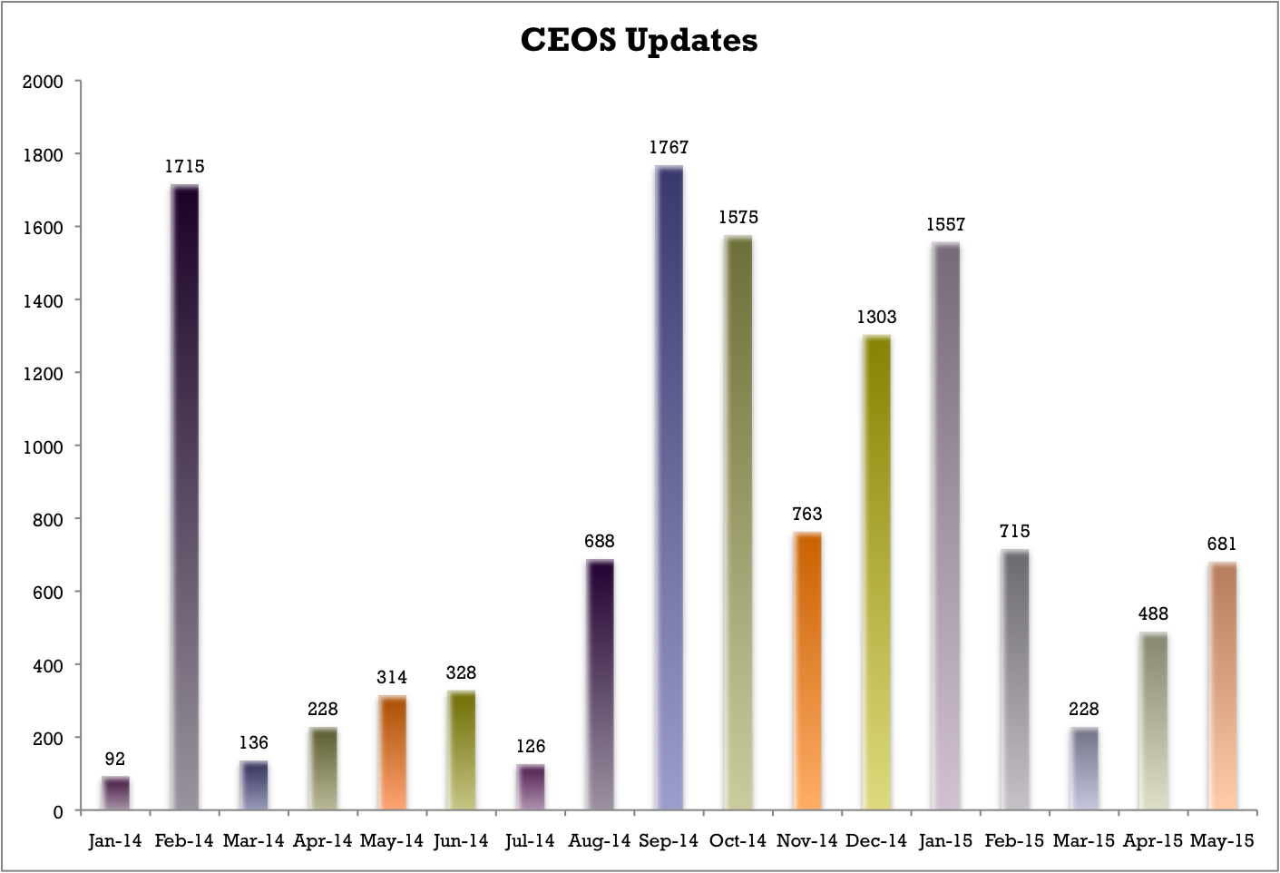
Number of IDN Records Updated

Slide 23
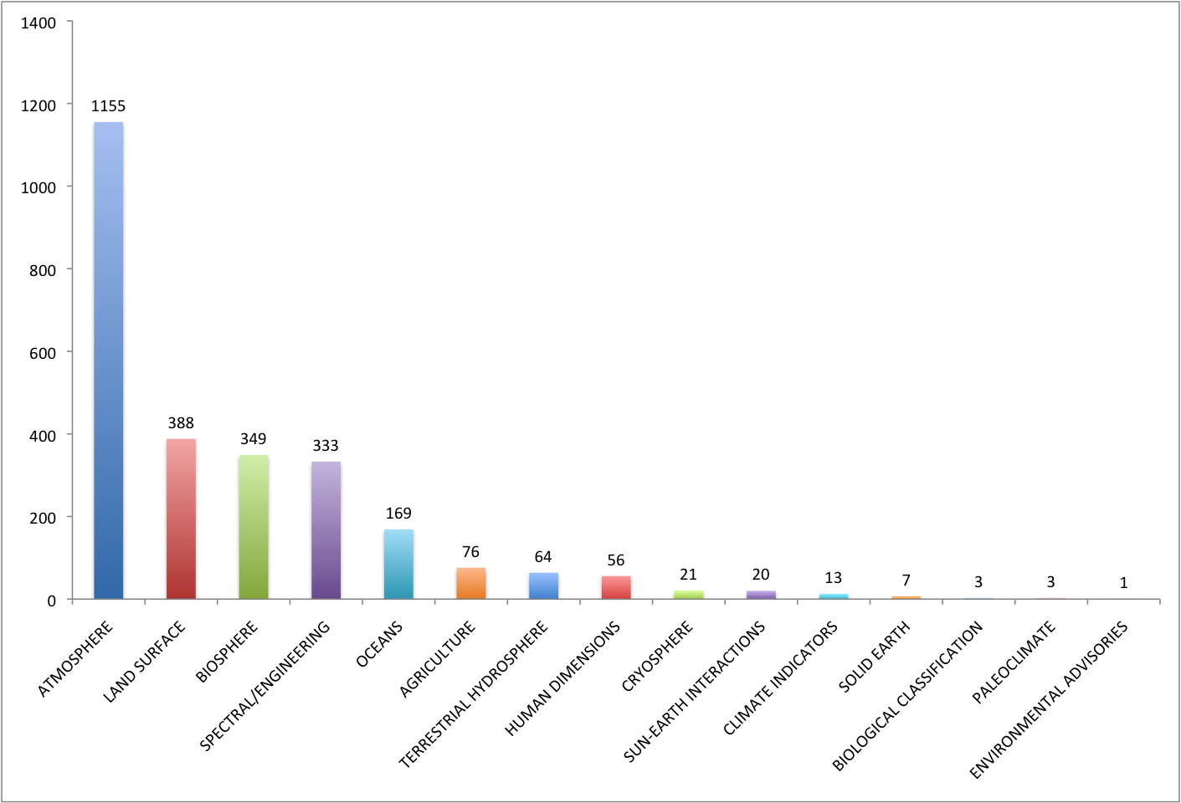
Current CWIC Data Sets by Topic

Slide 24
DIF Break Down of the GCMD
Other*
8034
CEOS
19,334
NASA
6358
Other DIFs (Antarctic Master Directory (AMD),
USDA, National Science Foundation (NSF))

Slide 25
US GEO/GEOSS Metrics
(Updated April 1, 2015)
US GEO Data Core Contributions by Agency:
Centers for Disease Control and Prevention (CDC) | 18
Department of Homeland Security (DHS) | 8
National Oceanic and Atmospheric Administration (NOAA) | 5788
Department of Defense (DOD) | 142
Department of Energy (DOE) | 346
Department of the Interior (DOI) | 2051
Department of State (DOS) | 15
Department of Transportation (DOT) | 23
Environmental Protection Agency (EPA) | 164
National Aeronautics and Space Administration (NASA) | 4433
National Science Foundation (NSF) | 1618
Smithsonian Institute (SI) | 46
U.S. Department of Agriculture (USDA) | 710
Total ISO-19115 Metadata Records in CSW Server: 28108
ISO-19115 Metadata Records Tagged as GEOSSDataCore: 12994
(+15 INPE & +1 JAXA Metadata Records)
Notes:
Last Day of Harvest was May 3

Slide 26
IDN Statistics Page link
Stats:
    CEOS DIF counts
    CEOS DIFs by Parameters
    CEOS DIFs by Source_Name Bucket (Platform Type)
    CEOS DIFs by IDN_Node
    CEOS DIFs by Data Center
http://idn.ceos.org/idn-resources/stats_ceos_dif_count.pdf
Notes:
Last Day of Harvest was May 3

Slide 27
Stay Connected
Email notifications (Send email to gsfc-gcmduso@mail.nasa.gov to sign up)
  docBUILDER: News and downtime notifications on metadata authoring tool (ceos-idn-docbuilder@lists.nasa.gov)
  Interoperability Forum: Release announcements and proposed changes to DIF and SERF (ceos-idn-interop@lists.nasa.gov)

Slide 28
  Questions
  Michael.P.Morahan@nasa.gov

