Slide 1
GEO and GEOSS Infrastructure – current state and future
Osamu Ochiai
GEO Secretariat
CEOS/WGISS, Tsukuba, Japan
May 11-15, 2015

Slide 2
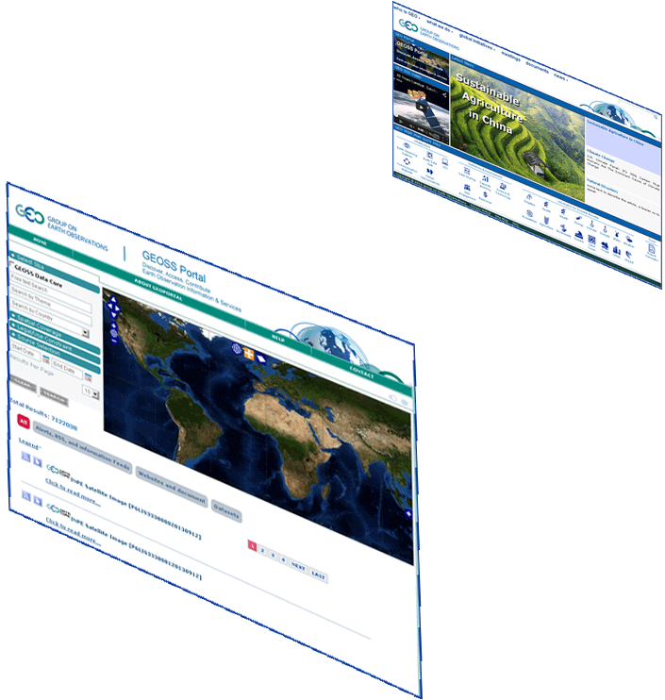
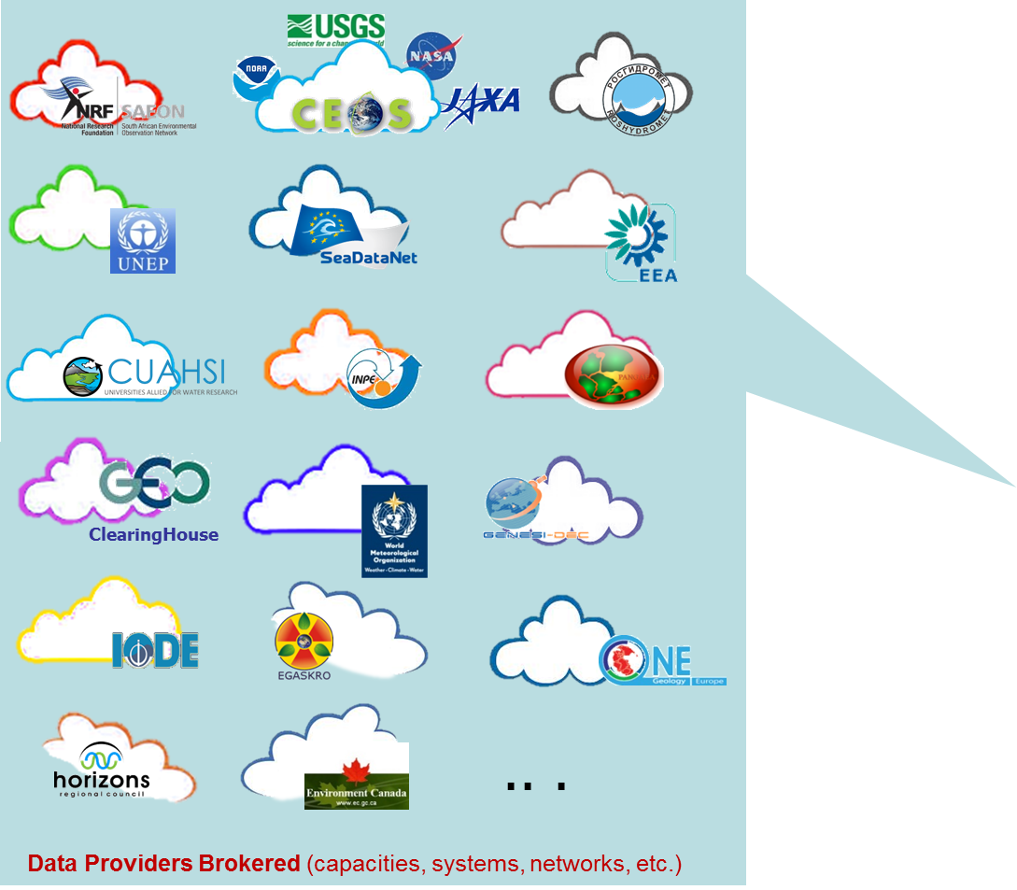
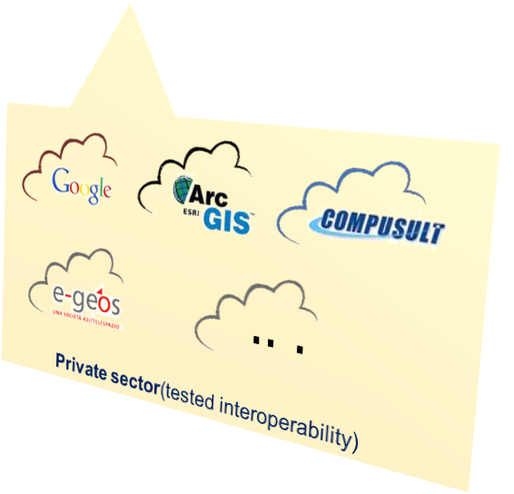
Enabling System of Systems
GEOSS Portal
GEO Home Page
GEO DAB
GEO Discovery & Access Broker
Notes:
Added GEOSS Clearinghouse, IDN, and CWIC, moved NOAA, added JAXA
2

Slide 3
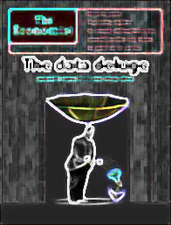
GEOSS Assets
About 38 brokered data providers
.. .
Publish
More than 41 Million accessible resources (mix of data collections and datasets)
.. .
Contain
.. .
More than 174 Million assets
(mix of satellite scenes, raingage, streamgage records, etc.)
Resources
Notes:
It will be important to demonstrate the accuracy of these numbers. We have had difficulty tracking the source of large reported numbers in the past and verifying that they were actually accessible. The phrase “potentially Discoverable” should be defended in the demo.
3

Slide 4
Introduction of the Brokering approach

Slide 5
GEOSS Assets
FedEO
CWIC
reporting.geodab.eu

Slide 6
GEOSS Portal
Major functional and layout improvements of main components
Data Discovery through Collections & Granules
Data Access Preview and Download (as is) and/or Transformation
Display of geoRSS feed on the Map's home page
Contextual help
User Registration

Slide 7
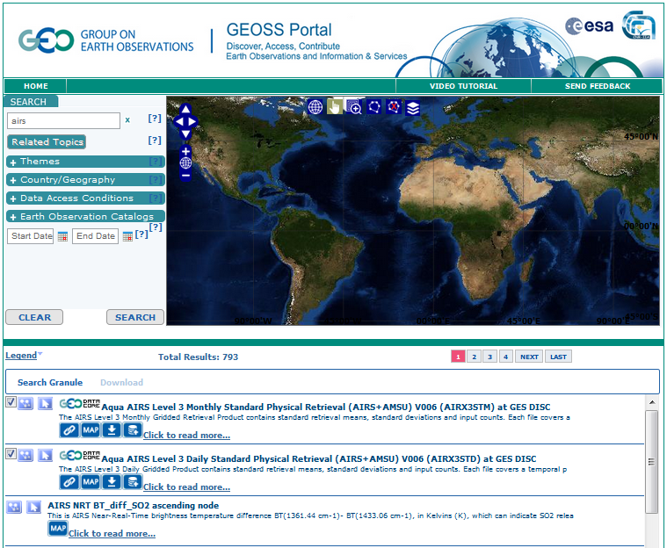
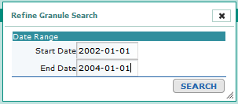

Slide 8
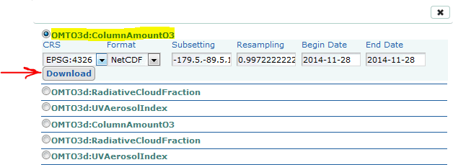
Data Access Improvement - Transformation
The GEOSS Portal allows users selecting a set of data from different data sources.
Via the Web Service exposed by the GEO DAB (Sub-set,Format conversion, CRS transformation and Data Interpolation), the user is able to define a common grid.
The selected data are downloaded
according to the defined common grid
Spatial Extent
Temporal
Extent
File
Format
Spatial Resolution
Coordinate Reference System

Slide 9
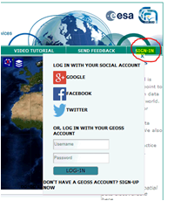
User Registration
User are now able to sign in the GEOSS Portal using existing social credential or log in with a newly created account

Slide 10
New Functionalities Implemented
New Standards/Protocol Supported by the DAB:
ESRI Map Server
Grads Data Server
CKAN
DCAT
BCO-DMO
IRIS Services (Event, Station)
Hydro Server/HIS Central profiler
New GBIF REST API
HTTP-GET implementation of CSW/ISO
Generic Web Accessible Folder for shape files
New Functionalities implemented by the DAB and/or the GWP:
User authentication
Usage statistics
Performance Metrics
JavaScript APIs
Discovery Result Refinement

Slide 11
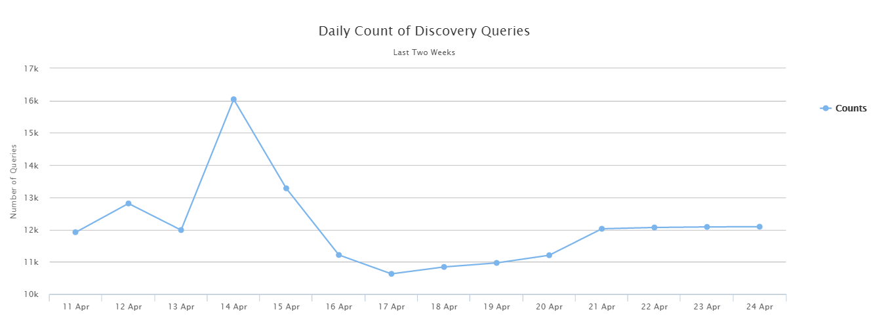
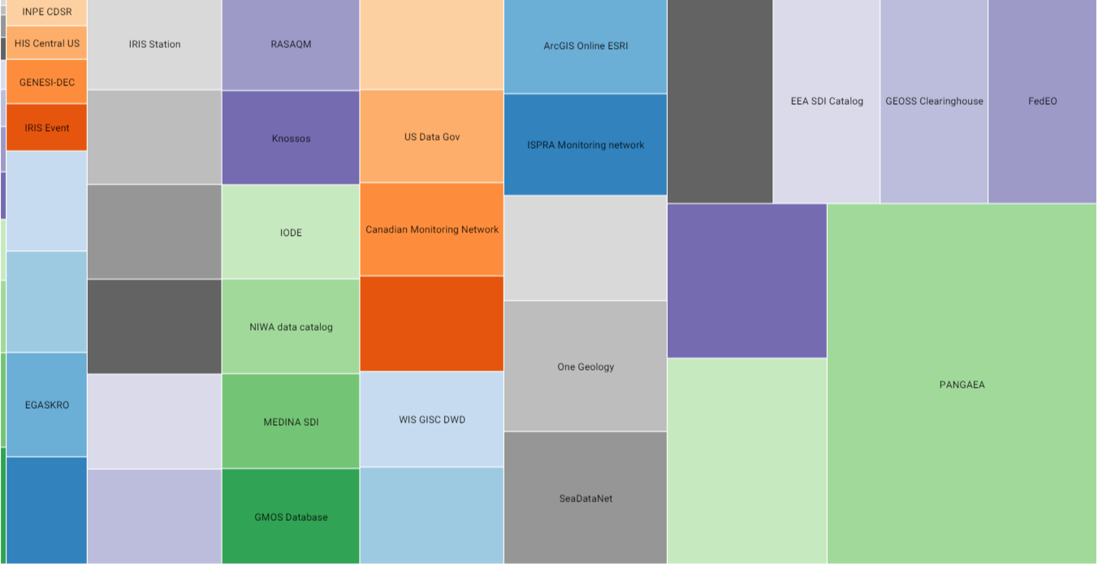
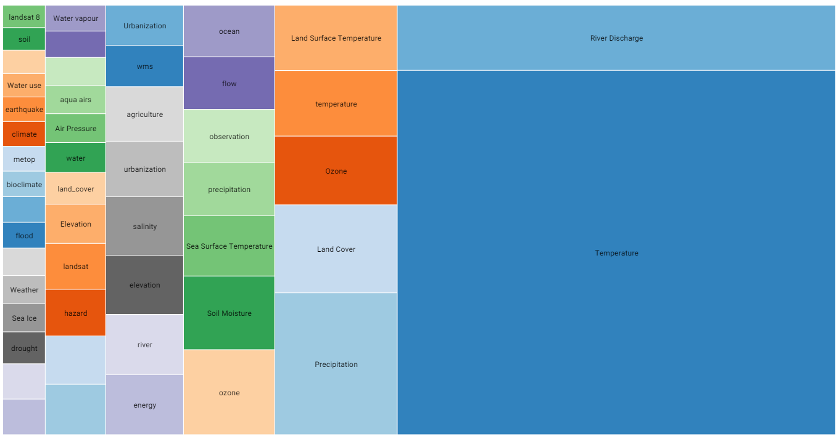
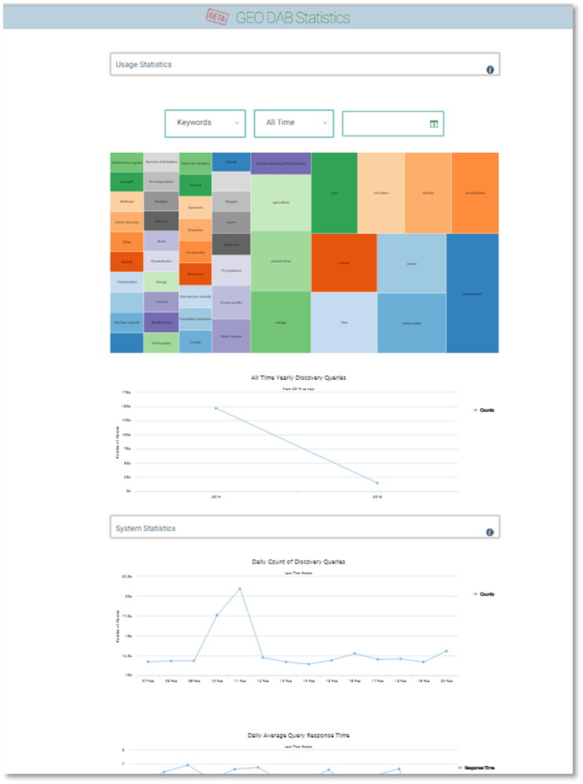
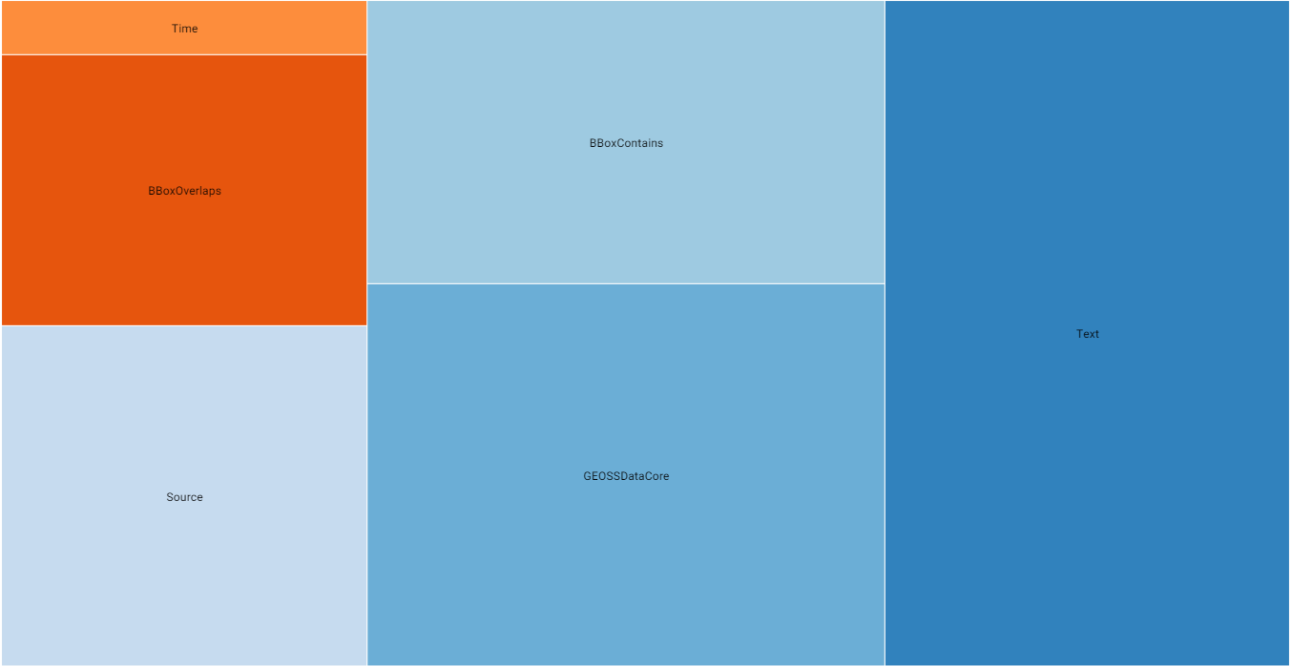
GCI (GEO DAB) Usage Statistics
2014: more than 410 thousands
First 4 months 2015: more than 150 thousands
Last two weeks: around 12 thousand per day
Monitor and assess the GCI/GEO DAB Usage*
All Time
Yearly
Monthly
Daily
Temperature
River Discharge
Precipitation
Lan Cover
…. .
PANGAEA
GRDC GEOWOW
CEOS WGISS
FedEO
EEA SDI
…. .
Number of Discovery Queries finalized
Most Searched Keywords
Most Searched Data Sources
Most Used Query Constraints:
Single constraint
Complex constraint
Keyword
GEOSS Data-CORE
BBOX
… .
* Only User’s requests contribute to the statistics

Slide 12
Data providers in 2015 and beyond
Providers under coordination
In-test: FP7 GEOCARBON, IGN, FAO
In discussion: UNEPLive, China, UK.GOV, GOSIC
Brokered Providers ongoing work needed
WMO/WIS, US Data Gov, DIAS/Japan
Private Sector providers
Pre-Ops: ESRI ArcGIS Users, Digital Globe
In test:e-GEOS CSM
In future: Microsoft, StormCenter, Blackbridge,
Potential providers in future
Copernicus, India, Russia, AfriGEOSS,
Priority influenced by input from SBA

Slide 13
Data providers to be brokered in 2015
Criteria for prioritization:
Key/Targeted datasets from SBA community (identification and engagement)
Big and Government data providers including private sector
Data providers willing to contribute to, and to get benefit from, GEOSS

Slide 14
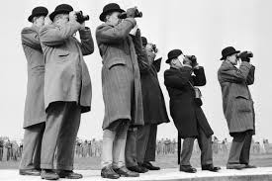
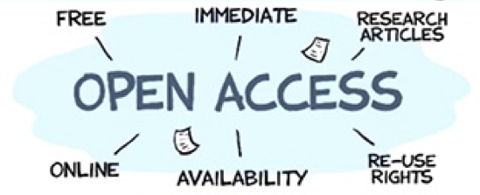
Discoverability
Accessibility
Preservation
Curation
Usability
Five
Data
Management
Principles
The value of each EO is maximized through data life-cycle management, including five foundational elements.
Discoverability
DMP-1 Data and all associated metadata will be discoverable through catalogues and search engines, and data access and use conditions, including licenses, will be clearly indicated.
Accessibility
DMP-2 Data will be accessible via online services, including, at minimum, direct download but preferably user-customizable services for visualization and computation.

Slide 15
Usability
DMP-3 Data will be structured using encodings that are widely accepted in the target user community and aligned with organizational needs and observing methods, with preference given to non-proprietary international standards.
DMP-4 Data will be comprehensively documented, including all elements necessary to access, use, understand, and process, preferably via formal structured metadata based on international or community- approved standards. To the extent possible, data will also be described in peer-reviewed publications referenced in the metadata record.
DMP-5 Data will include provenance metadata indicating the origin and processing history of raw observations and derived products, to ensure full traceability of the product chain.
DMP-6 Data will be quality-controlled and the results of quality control shall be indicated in metadata; data made available in advance of quality control will be flagged in metadata as unchecked.

Slide 16
Preservation
DMP-7 Data will be protected from loss and preserved for future use; preservation planning will be for the long term and include guidelines for loss prevention, retention schedules, and disposal or transfer procedures.
DMP-8 Data and associated metadata held in data management systems will be periodically verified to ensure integrity, authenticity and readability.
Curation
DMP-9 Data will be managed to perform corrections and updates in accordance with reviews, and to enable reprocessing as appropriate; where applicable this shall follow established and agreed procedures.
DMP-10 Data will be assigned appropriate persistent, resolvable identifiers to enable documents to cite the data on which they are based and to enable data providers to receive acknowledgement of use of their data.

Slide 17
DMPTF Next Steps
DMPTF will prepare implementation strategies for discussion at GEO-XII Plenary.

Slide 18
Some GEO Work Plan Outcomes
Outcome: Audience feedback provided constructive feedback for sustaining existing GEOSS Services and to support our evolving 2025 GEOSS Vision and Infrastructure.
Key Messages:
Stakeholders
Understand needs of stakeholder groups
Deliver high end products (indicators, information)
Data
Need to address key Data Services: - Data Access and Use - Data Integration - Data Reliability
Infrastructure
System of Systems
Improve Communication & Participation
Support Real-time collection
Community Portal Alignment
SBA link & integration to infrastructure team
Build on existing but evolve to meet new needs
From data to information products - Additional new Sources of data
We need to work together as a community for GEOSS Success
In the coming months we will continue to work with the community to develop an acceptable and achievable vision & architecture
Notes:
Alignment
GEOSS Definition and GCI distinction
GEOSS Contributor/Collaborator model is foundational to GEOSS Success
GEOSS
Agreement today : We need to work together.
Better understand
What we want to do?
What future we want?
You can create it.
Data and information are needed to support the future we want to create
System of system not centralized and monolithic
Based on stronger connection to GEOSS users (e.g. flagships/initiatives, anc thematic communities)
Need to improve communication and clarity of message
Increase interaction and integration with GEO Implementation Mechanisms (e.g. Community Activities, Flagships, Initiatives, foundational tasks), users, stakeholders
Use 2016 as a transitional period for the foundational task
Develop and test a framework/structure to support strong coordination
We need to work together as a community for GEOSS Success
Alignment
GEOSS Definition and GCI distinction
GEOSS Contributor/Collaborator model is foundational to GEOSS Success
GEOSS
Agreement today : We need to work together.
Better understand
What we want to do?
What future we want?
You can create it.
Data and information are needed to support the future we want to create
System of system not centralized and monolithic
Based on stronger connection to GEOSS users (e.g. flagships/initiatives, anc thematic communities)
Need to improve communication and clarity of message
Increase interaction and integration with GEO Implementation Mechanisms (e.g. Community Activities, Flagships, Initiatives, foundational tasks), users, stakeholders
Use 2016 as a transitional period for the foundational task
Develop and test a framework/structure to support strong coordination
We need to work together as a community for GEOSS Success
Our goal was to engage the community – alignment and direction
Takeaway:
We need a framework for delivery that includes partnership, participation, shared coordination and communication.
We haven’t defined what that will look like at this time. This engagement was helpful to understand your issues and concerns provides a good foundation for our continuing work
Some of the key themes identified
Framework for Success
Some Guiding Principles for GEOSS
Coordination
Linkage
Facilitation
Cooperation
Communication
Feedback loop
Shared Meaning
Shared Direction – on the same sheet of paper, sync
Clarify terms
Alignment
GEOSS Definition
Closure on GCI
Sustain the contribution model
Boundaries

Slide 19
GEOSS Actions for the 2016 Work Programme
Priorities
Sustainment of ongoing Maintenance & Operation of GEOSS Infrastructure
Support GEOSS Research & Development Strategic Activities & Objectives
Support the Advancement of Data Sharing & Management Principles
Starting Interaction and integration with GEO Implementation Mechanisms and Users
Continue efforts on development of a 2025 Service Delivery Framework
Leverage best practices – Pilot, Prototype & then Implement for success
Success Criteria
Demonstrable value of GEOSS for GEO community and beyond
Notes:
2016 Transitional Year
R&D
Service Delivery Framework - GEOSS Framework for delivery that includes enhanced partnership, participation, shared coordination and communication
GEOSS Infrastructure Concept of Operations (ConOps)
GEOSS Infrastructure Terms and Definitions
GEOSS Infrastructure Stakeholder engagement, end-user requirements
GEOSS Infrastructure Participation and Integration into GEO program priorities and activities

Slide 20
Expectations to WGISS
Welcome contributions from more space agencies
Welcome implementation on going technology evolution (Processing, Integration, Analysis, Knowledge base, etc) with use cases (community services/portals) – e.g., GEO-BON
Welcome inputs to the post 2015 GEOSS Vision and Architecture

Slide 21
Mexico Ministerial and GEO-XII
GEO Week
9-13 November 2015
Mexico City
www.earthobservations.org

