Slide 1
CEOS Open Search Developer Guide
Achieving a robust and interoperable Open Search implementation
WGISS-39
Doug Newman (NASA EOSDIS – Raytheon)
This work was supported by NASA/GSFC under Raytheon Co. contract number NNG10HP02C.

Slide 2
Why two CEOS documents?
CEOS Best Practices
how to implement an Open Search implementation for an earth science data provider
CEOS Developer Guide
client and server focus
how to link two providers together via two-step
handbook for CWICSmart, IDN and CWIC system
Notes:
What if we could leverage an OSDD and two-step to provide enough information to a client so that if can generate a UI from that information alone?
Could we provide levels of UX support in CWICSmart based on each level of compliance
Base specification
Parameter specification
OGC specifications
ESIP Best Practices
CEOS Best Practices
CEOS developer guide
And if we could do that what does it tell us about the choices we made for the API?

Slide 3
What is the development guide?
Originally a set of guidelines for
Interoperability of IDN and CWIC Open Search APIs
Programmatic construction of a user interface to the IDN and CWIC OpenSearch APIs
It is now a set of guidelines for
General earth data Open Search API interoperability
Enabling the use of CWICSmart as a client to your Open Search API
Client and server development for Open Search
Built on top of the CEOS Open Search Best Practices document

Slide 4
Specifications, Best Practices & Guidelines
CEOS Developers Guide
ESIP Best Practices
CEOS Best Practices
OGC 10-032r8 – Geo and Time ext.
OGC 13-026r5 EO products ext.
Open Search Relevancy extension
Open Search Parameter extension
Open Search Geo extension
Open Search Time extension
Open Search Specification 1.1 draft 5
Notes:
The lineage of adherence is described here for the CEOS Best Practices. Note: relevancy and parameter extensions are optional
The CEOS developers guide is compliant with all below it and adheres to ESIP guidelines also

Slide 5
In detail
Conform to the Open Search Specification
Conform to the relevancy and parameter extensions
Conform to the OGC extensions
Take pertinent ideas from ESIP best practices
Spatial (MBR) extents for all
Add our own recommendations
Make best attempt at coercing clients to provide client ids
Extend ESIP ‘two step’ idea to link IDN dataset -> CWIC granule searching
Embrace hypermedia - HATEOAS
Navigation by ‘first’, ‘prev’, ‘self’, ‘next’ and ‘last’
Media types
Relevance
Utilizing the parameter extension for better clarity of service
Temporal (Dublin Core) extent representation
Propagation of parameters from collection to granule resource
Notes:
Base, spatial and temporal extensions
Tailoring to Earth Data needs
Two step searching
Our stuff
Identification where possible (you’d like to know who is using your data right?)
Extend 2-step to cross provider borders
Be more restful and tell the client how to navigate
Put the good stuff at the top
Better describe your search parameters
Easiest to interpret
Took 1 month to establish between ECHO, CWIC and IDN.

Slide 6
Searching
HTTP GET cwic.wgiss.ceos.org/opensearch/dataset/descriptor_document.xml
Open Search Descriptor Document
HTTP Response
ID
ID
Spatial Extent
Spatial Extent
HTTP GET Request
Temporal Extent
Temporal Extent
keyword = air temperature
Metadata Link
Metadata Link
bounding_box = 39.1 -96.6 39.1 -96.6
Search Link
Search Link
start_date = 2013-11-13T00:00:00Z
Data Link
Data Link
HTTP GET cwic.wgiss.ceos.org/opensearch/datasets.atom?searchTerms=modis
Notes:
Get OSDD
Formulate search
Perform search
Analyze results
THE OSDD IS ALL YOU NEED TO FORMULATE A SEARCH

Slide 7
Two-step searching
Parent OSDD
Child OSDD
HTTP GET Request
HTTP GET Request
HTTP Response
HTTP Response
Parent ATOM Feed
Child ATOM Feed
Atom Entry 1
Atom Entry 2
Atom Entry 1
Atom Entry 2
Metadata Link
Metadata Link
Metadata Link
Metadata Link
Search Link
Search Link
Search Link
Search Link
Data Link
Data Link
Data Link
Data Link
Documentation Link
Documentation Link
Documentation Link
Documentation Link
Notes:
Get OSDD
Formulate search
Perform search
Analyze results
Drill down on interesting data with second search. GOTO 1
The control of the linkage between the parent and child is under the control of the implementer and not a specification. This allows the implementer freedom to uniquely describe a collection as they see fit.
THE OSDD IS ALL YOU NEED TO FORMULATE A SEARCH
THE SEARCH LINK IS ALL YOU NEED TO DRILL DOWN ON A COLLECTION

Slide 8
In action
Notes:
CWIC has decided to use the OpenSearch protocol for discovery. Partnered with IDN for their metadata holdings as we did when we used CSW

Slide 9
CwicSmart overview
https://api.echo.nasa.gov/cwic-smart
A Programmatic OpenSearch Client
Any Open Search implementation that conforms to the
CEOS Developer Guide* can be queried using CwicSmart
* Conforming to base OpenSearch spec gives reduced feature set
Notes:
We wanted to achieve two things with CWICSmart
Demonstrate how easy it can be to write a client for OpenSearch
Demonstrate how valid our Best Practices were by developing a client with no a priori knowledge of an interface other than the specifications it conforms to.
BONUS: Provide a client for Earthdata OpenSearch implementations that do not conform to the CEOS Best Practices

Slide 10
CwicSmart - home

Slide 11
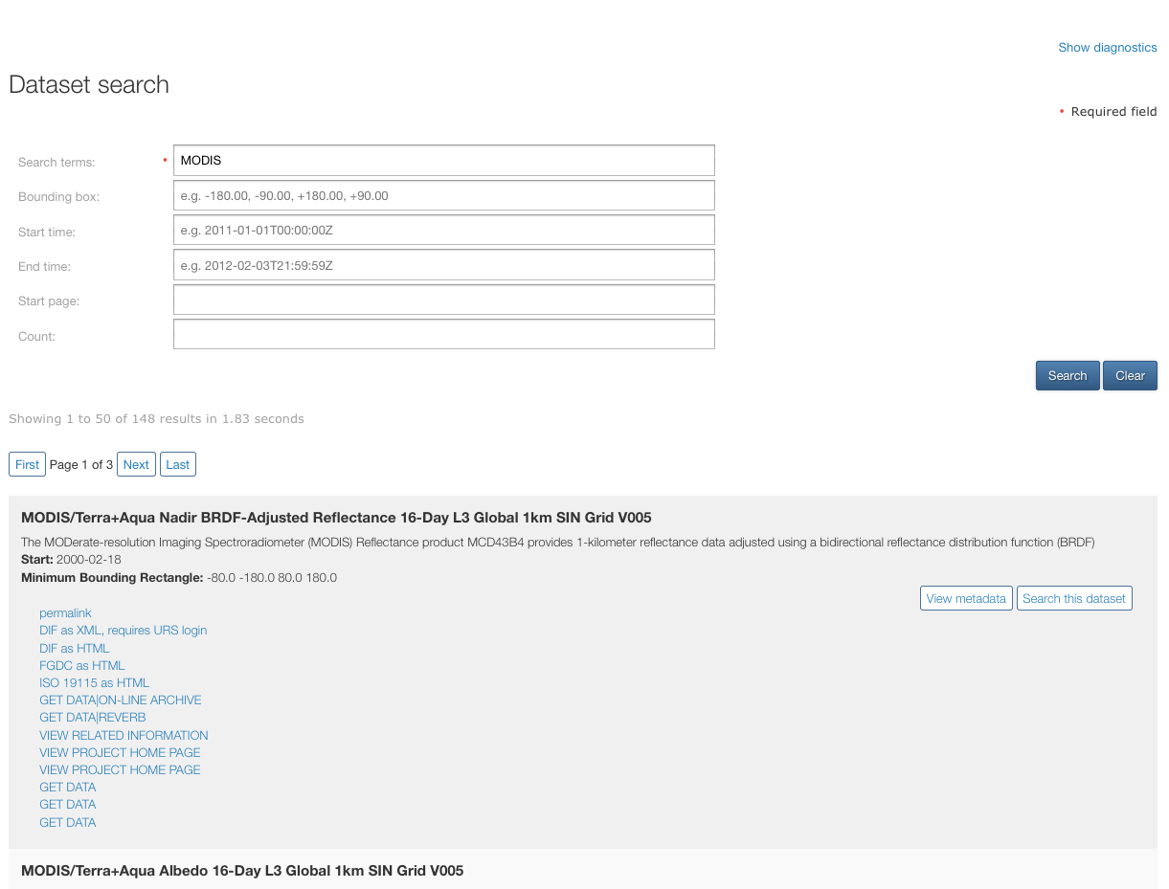
CwicSmart – dataset search
<link rel="next” type="application/atom+xml" href="http://gcmd.gsfc.nasa.gov/KeywordSearch/OpenSearch.do?searchTerms=MODIS&amp;Portal=cwic&amp;clientId=cwicsmart&amp;count=50&amp;
startPage=2"/>
<Url type="application/atom+xml"
template="http://gcmd.gsfc.nasa.gov/KeywordSearch/OpenSearch.do?
searchTerms={searchTerms}&geoBox={geo:box?} &Portal=cwic&amp;clientId=cwicsmart">
<parameters:Parameter name="searchTerms" value="{searchTerms}"/>
<parameters:Parameter name="geoBox" value="{geo:box}" minimum="0" maximum="1"/>
</Url>
<link rel="search" type="application/opensearchdescription+xml" title="CEOS WGISS Integrated Catalog (CWIC)" href="http://cwic.wgiss.ceos.org/opensearch/datasets/MCD43B45/osdd.xml?clientId=cwicsmart"/>
Notes:
We use the OSDD to dynamically render a html form. Using the template and the parameter extensions we can determine whether a parameter is mandatory, it’s type, it’s bounds and whether it is a ‘core’ parameter like searchTerms.
The user submits the form and we present the results.
We use HATEOAS to generate links for traversing through the results. NEW: In the absence of such links we use elements mandated by the base OS specification.
We use search links within the entries to provide ‘Search this <resource>’ links that perform two-step searches. In this case we are ‘searching this dataset’

Slide 12
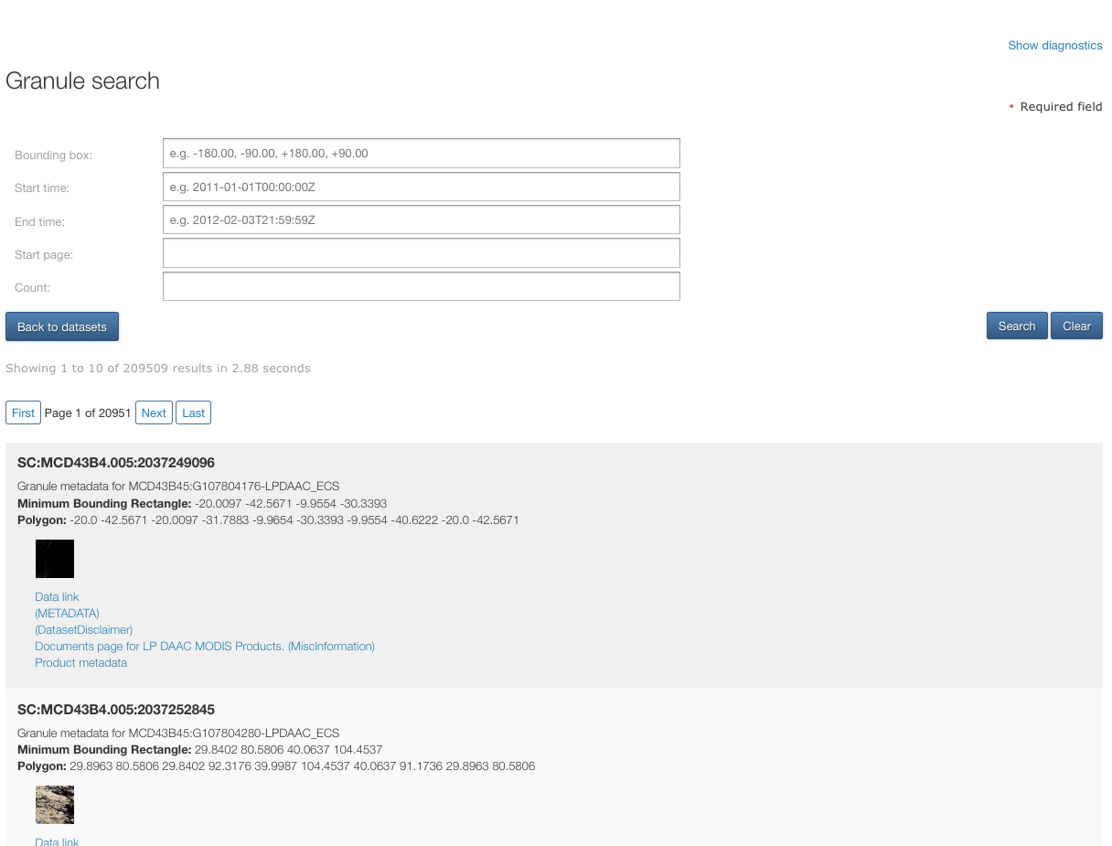
CwicSmart – granule search
<link href="http://e4ftl01.cr.usgs.gov//WORKING/BRWS/Browse.001/2006.09.29/BROWSE.MCD43B4.A2000049.h14v10.005.2006269064726.1.jpg" hreflang="en-US" rel="icon" title=" (BROWSE)" type="image/jpeg"/>
<Url type="application/atom+xml" template="http://cwic.wgiss.ceos.org/opensearch/granules.atom?datasetId=MCD43B45&amp;geoBox={geo:box?}&amp;clientId=cwicsmart"> <params:Parameter name="geoBox" value="{geo:box}" title="inventory which has a spatial extent overlapping this bounding box" minimum="0"/> <params:Parameter name="timeStart" value="{time:start}" title="inventory which has a temporal extent containing this start time" minimum="0" minInclusive="2000-02-18" maxExclusive="2014-06-16"/> <params:Parameter name="timeEnd" value="{time:end}" title="inventory which has a temporal extent containing this end time" minimum="0" minExclusive="2000-02-18" maxInclusive="2014-06-16"/> </Url>
<link href=“foo.hdf" hreflang="en-US" rel=”enclosure" title=”Data Link" type=“application/x-hdf"/>
Notes:
Again we parse the OSDD to generate an HTML form to enable the user to perform a search against a child resource (in this case granules pertaining to the dataset they are searching on).
All shared parameters are propagated to this search form. For example, bounding box. The OSDDs tell us whether they are ‘the same’
The user submits the form and we present the results.
We use HATEOAS to generate links for traversing through the results.
We use icon links within the entries to render browse thumbnails to the user
We use ‘enclosure’ links within the entries to allow the user to download a resource (granule in this case)

Slide 13
Using other APIs
Notes:
Main barrier was not having HATEOS links for result set traversal.
Pagination using
page/index no.
Total number of results
Results per page
Found problems related to result set traversal with every OS implementation we tried. Actively working with FEDEO, Mirador and HyDRO to resolve these issues.

Slide 14
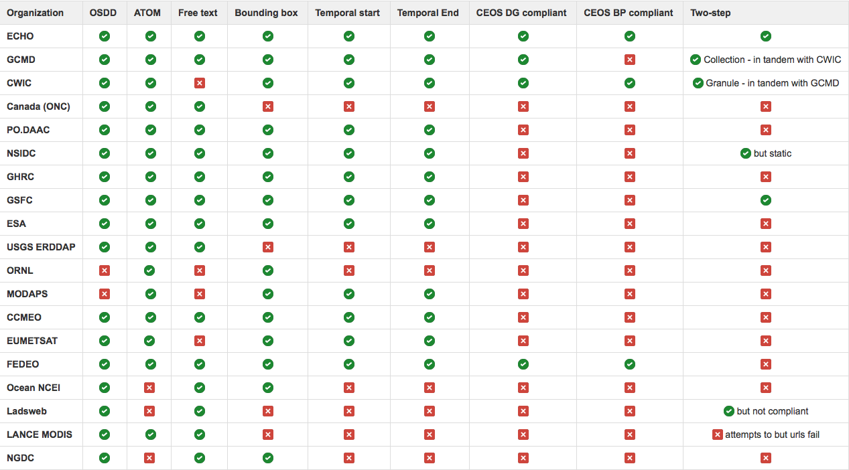
Compliance

Slide 15
In conclusion…
Code your OS service to the CEOS Developer Guide to gain a
ready-made client*
simple gateway into the CWIC system
Code your OS client to the CEOS Developer Guide to gain a
gateway into the IDN/CWIC aggregation of providers
We need to get a lot more compliance boxes checked
* Pending open-sourcing

Slide 16
Where is it?
http://ceos.org/document_management/Working_Groups/WGISS/Projects/CWIC/OpenSearch/CEOS Open Search Developer Guide.docx

Slide 17
Questions?

