Slide 1
CWICSmart
A programmatically-derived user interface for Open Search implementations
WGISS-39
Doug Newman (NASA EOSDIS – Raytheon)
This work was supported by NASA/GSFC under Raytheon Co. contract number NNG10HP02C.

Slide 2
What is CWICSmart?
Client for IDN and CWIC Open Search
Client for any CEOS Open Search Developer Guide compliant implementation
Client for any CEOS Open Search Best Practices compliant implementation
Client for any Open Search specification compliant implementation

Slide 3
CwicSmart - home

Slide 4
CwicSmart – dataset search
Notes:
We use the OSDD to dynamically render a html form. Using the template and the parameter extensions we can determine whether a parameter is mandatory, it’s type, it’s bounds and whether it is a ‘core’ parameter like searchTerms.
The user submits the form and we present the results.
We use HATEOAS to generate links for traversing through the results. NEW: In the absence of such links we use elements mandated by the base OS specification.
We use search links within the entries to provide ‘Search this <resource>’ links that perform two-step searches. In this case we are ‘searching this dataset’

Slide 5
CwicSmart – granule search
Notes:
Again we parse the OSDD to generate an HTML form to enable the user to perform a search against a child resource (in this case granules pertaining to the dataset they are searching on).
All shared parameters are propagated to this search form. For example, bounding box. The OSDDs tell us whether they are ‘the same’
The user submits the form and we present the results.
We use HATEOAS to generate links for traversing through the results.
We use icon links within the entries to render browse thumbnails to the user
We use ‘enclosure’ links within the entries to allow the user to download a resource (granule in this case)

Slide 6
Using other APIs

Slide 7
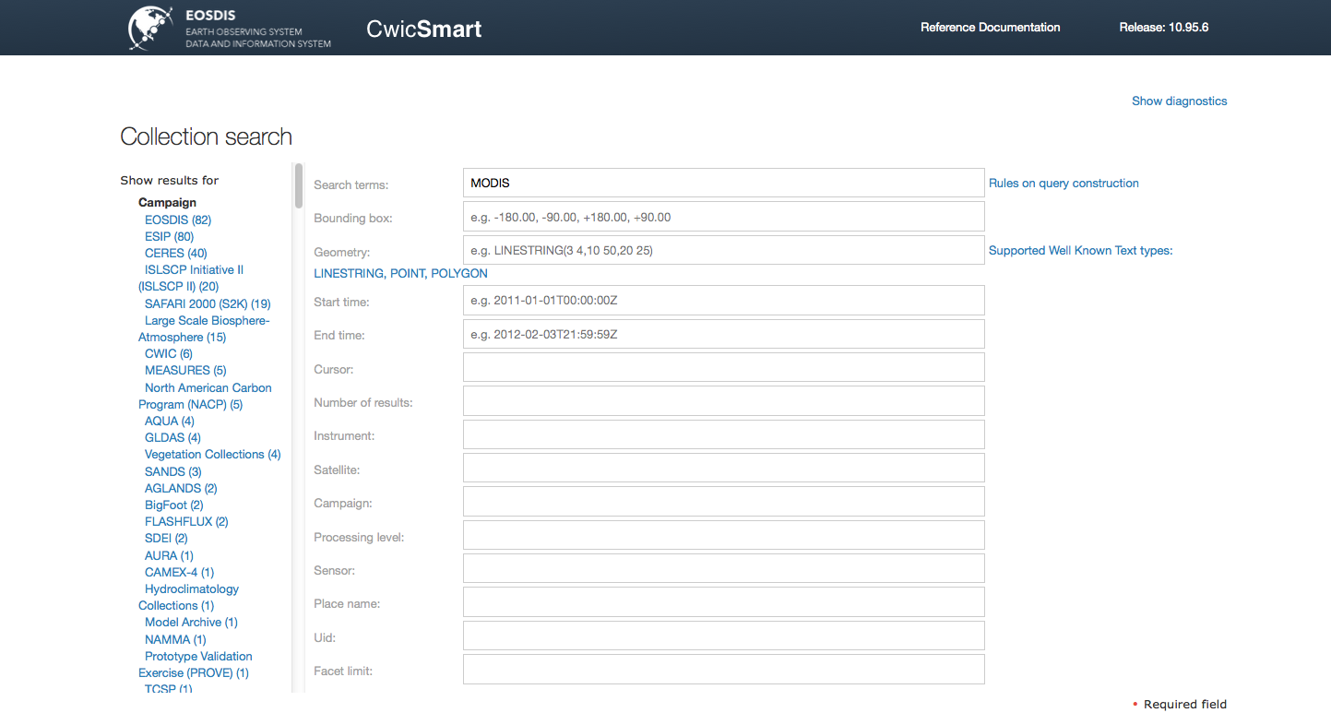
Facets
http://www.opensearch.org/Community/Proposal/Specifications/OpenSearch/Extensions/SRU/1.0/Draft_1
Notes:
Via the SRU specification: http://www.opensearch.org/Community/Proposal/Specifications/OpenSearch/Extensions/SRU/1.0/Draft_1

Slide 8
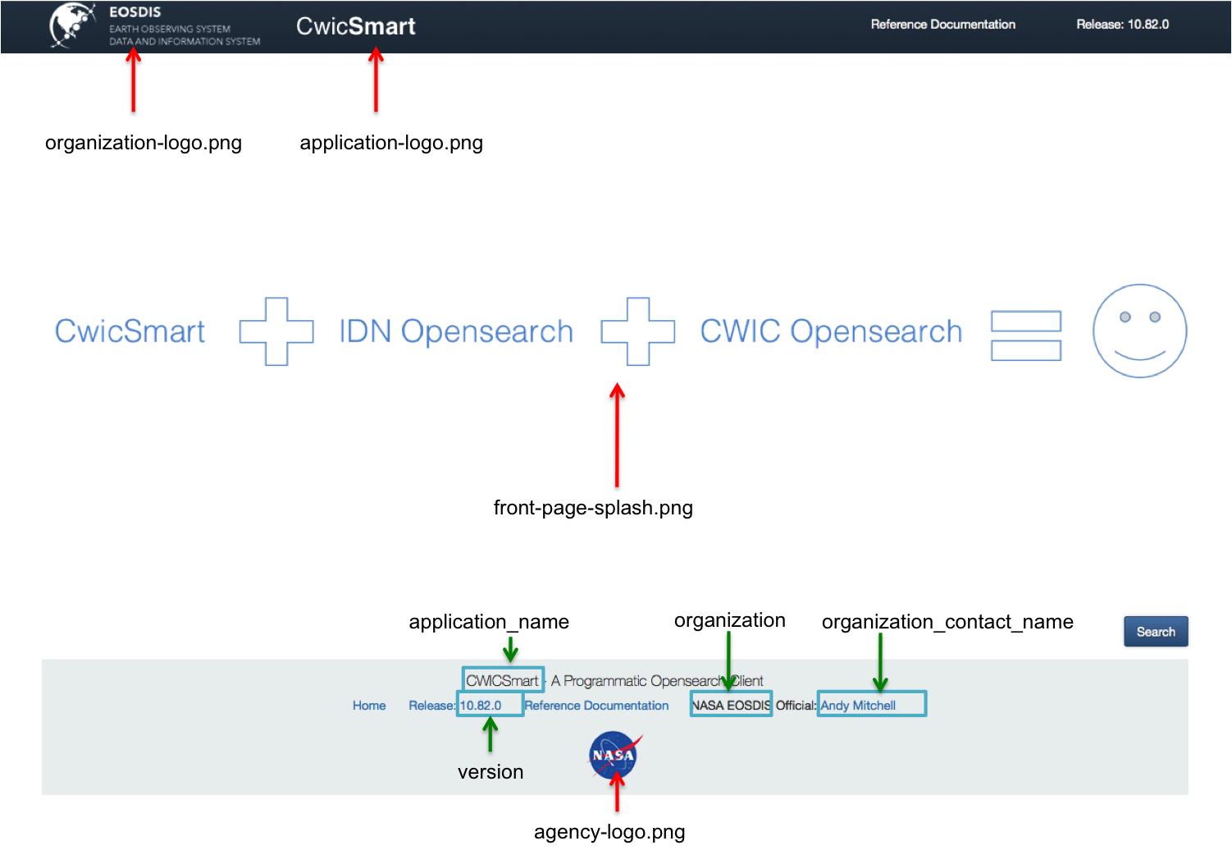
Re-badging
Notes:
CWICSmart code is on the Earthdata Code Collaboratory
Will be mad public at some point soon in the future
Simple Ruby On Rails application
Instructions available to replace default assets with custom ones

Slide 9
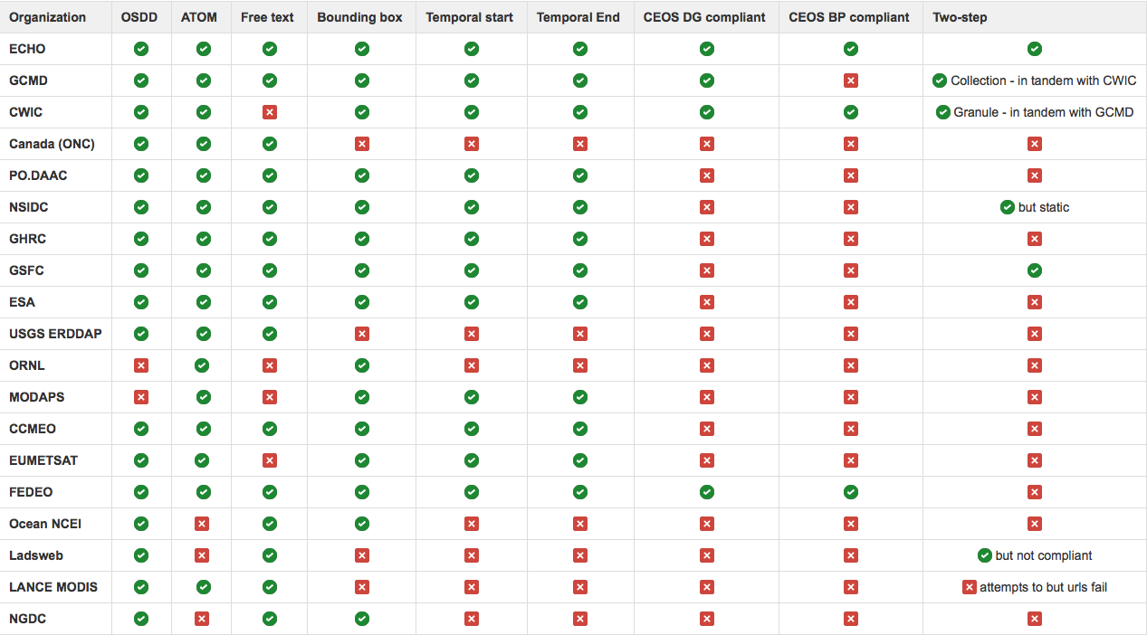
Compliance

Slide 10
In conclusion…
CWICSmart can be used to query any Open Search implementation with varying degrees of user experience:
BEST – CEOS Developer Guide compliant
Better – CEOS Best Practices compliant
Good – OGC extension compliant
Fair – Open Search specification compliant
CWICSmart will soon be open-sourced to allow providers to re-badge the application to their needs

Slide 11
Where is it?
https://api.echo.nasa.gov/cwic-smart

Slide 12
Questions?

