Slide 1
CEOS Water Portal
Overview and Status Update
WGISS-39
Tsukuba, Japan
JAXA Shinichi SEKIOKA
RESTEC Kaori Kuroiwa

Slide 2
Contents
Overview (just a reminder…)
Updates
  New Architecture Development
Future Plan
Demo
Notes:
.

Slide 3

1. Overview
1.1 Concept
CEOS Water Portal is ;
  A distributed data system component of DIAS (Data Integrated Analysis System)-Program
  To provide “Easy to Access” service to users
  To provide access to a whole variety of hydrological data and water relevant data scattered over the world
  To connect the existing components like data centers, scientists and wide users.
Multiple types of data are available such as;
  In-situ data
  Satellite data
  Model output data
Notes:
2

Slide 4
1. Overview
1.2 Services
  Dataset Search
    Category Search/Map Search
    Connecting to 11 data centers and 2 catalog broker system
  Dataset Access
  (Depend on the Server side function,
  ex. OPeNDAP server)
      Data Subset (time, variables)
      Data Download/Format conversion (NetCDF, ascii, GRIB (Modeloutput only))
  Sharing Use Case
    Use Case registration/browsing

Slide 5
Visitors & Users
New CEOS water portal site has been available from May 12th,2015.
Registration User is around 290.
2014
2015

Slide 6








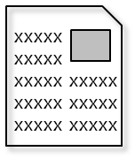
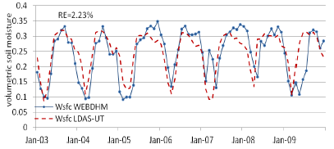
1. Overview
1.3 Goal
Data, use case, etc
Useful information
Data centers
(All over the world)
interface
non-Water Data (DEM)
In-situ data
Various Users
In-situ data
e.x.) river administrators
CEOS
Water Portal
In-situ data
Satellite data
Facilitate communications among communities
Users (researchers)
input
Model calculation
Model Output Data
Analysis
Register a Use case

Slide 7

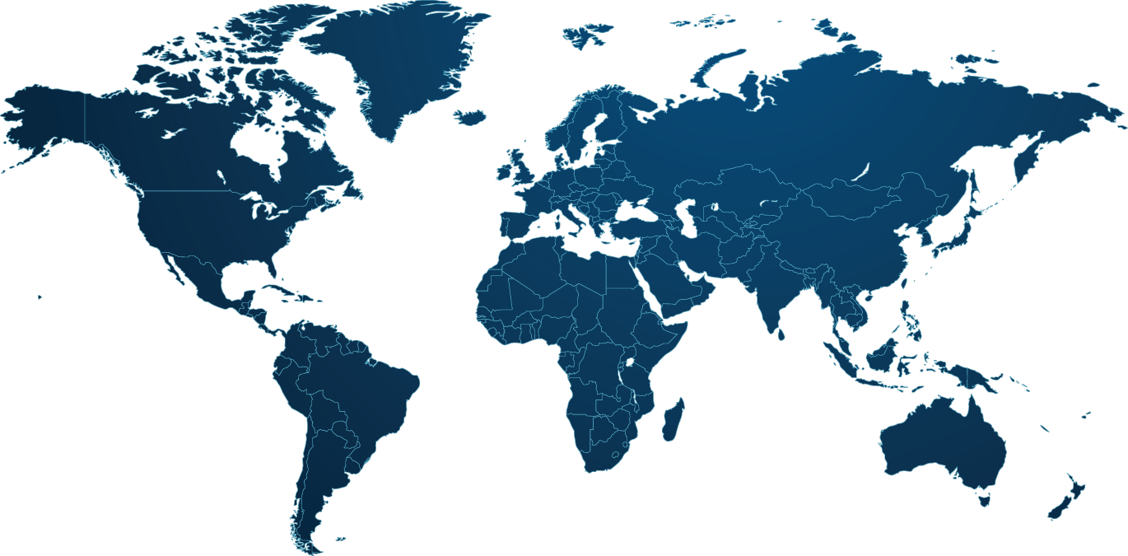













1. Overview
1.4 Data Partners
GEMS/Water
In-situ data
NASA/ORNL
IN-situ (FLUXNET) data
NASA/JPL (PO.DAAC)
Satellite Data
NOAA /ESRL
In-situ(GPCC ) data
NASA/GSFC
Satellite Data
NOAA /NCDC (New)
In-situ data
Search
Download
Use Case Registration/Browsing
CEOS
Water Portal
NCAR
In-situ data
Users
MPI
Model Output data
NASA/ECHO
Satellite data
In-situ data
Model Output data
In-situ data
Satellite data
GLOWASIS
Satellite data
Model Output data
GEO DAB (New)
In-situ data
CUAHSI
In-situ data

Slide 8
1. Overview
1.5 Available Data List (1/2)
Data Partners | Data Types | Variables | Server type | Server Locations
CEOP | Satellite | PR, TMI, AMSR, AMSR-E, MODIS,GLI, SSMI, VISSR | Hyrax | University of Tokyo (Japan)
 | Model (MOLTS) | surface pressure, skin temperature, precipitation amount in hour, brightness temperature surface, specific humidity, u-component of wind, v-component of wind, etc | THREDDS | MPI (Germany)
 | Model(Gridded) | Air pressure, surface air pressure, air temperature, precipitation rate, snowfall amount, etc | Jblob | MPI (Germany)
 | In-situ | Surface Meteorological and Radiation Data Set Flux Data Set Soil Temperature and Soil Moisture Data Set Meteorological Tower Data Set | http link | NCAR (USA)
AWCI | Model(MOLTS) | surface pressure, skin temperature, precipitation amount in hour, brightness temperature surface, specific humidity, u-component of wind, v-component of wind, etc | THREDDS | MPI (Germany)
 | In-situ | Precipitation amount, River discharge, River water level, etc | Hyrax | University of Tokyo (Japan)
NASA | Satellite | Airs level 3 data | Hyrax | NASA (GSFC)
NOAA (GPCC) | In-situ | Precipitation data | THREDDS | NOAA (USA)

Slide 9
1. Overview
1.5 Available Data List (2/2)
Data Partners | Data Types | Variables | Server type | Server Locations
NASA | Satellite | GRACE Level 3 data | THREDDS | NASA/JPL(PO.DACC)
FLUXNET | In-situ | FLUX data Fluxes of carbon dioxide, water vapor, and energy exchange, etc | THREDDS | NASA (ORNL DAAC)
GEMS/Water | In-situ | Instantaneous Discharge , Dissolved Oxygen , Temperature, etc | WFS | GEMS/Water (CANADA)
GLOWASIS | Satellite Model(Gridded) | Precipitation, Air temperature | THREDDS | Deltares (Netherland)
ECHO Broker Service | In-situ Satellite Model | Various types of data via ECHO broker | OpenSearch | NASA（GSFC)
CUAHSI | In-situ | precipitation, humidity, discharge, oxygen, etc | REST/WaterML2, WaterOneFlow/WaterML1 | CUAHSI (USA)
GEO DAB/ GRDC | In-situ | River Discharge via GEO DAB | OpenSearch | GEO
NOAA/NCDC | In-situ | Air temperature, Precipitation, Air Pressure | THREDDS | NOAA/NCDC
(NEW)

Slide 10
2. Updates
New Architecture Development
Purposes
Less time and labors on adding data partners
Integrated operation flow (search -> download)
Easier operation

Slide 11











New System Architecture
1
CWP Catalog Management Component
Operation Flow
CEOS Water Portal
(CWP)
Client Component
Dataset
Dataset level catalog CMP
(GI-Cat)
1
→
2
→
3
Detail
- DIF
Data Centers
CWP Catalog Broker CMP
(GI-Cat)
2
New Partners and updates for some datasets
Granule
Legacy catalog CMP
-CEOP Gridded Model
-CUAHSI Europe
-GEMS/Water
-CEOP MOLTS
-AWCI MOLTS
-CEOP Satellites (~2013)
Harvest
(Automatic registration & updates)
OPeNDAP Server
-NASA AIRS
-NASA GRACE
-NOAA
-GLOWASIS
-FLUXNET
ISO19115/19139
-AWCI In-situ
Users
Search
Broker Service & Catalog Service
1
2
(External)
New Data Centers
ISO-19115/19139
OPeNDAP
W*S
OpenSearch, etc
DAB
NASA
ECHO
CUAHSI
HIS
Download
3
Data Access
Subset(html) or File
@each data center
File
Other than OPeNDAP
Catalog
Interface
OpenSearch
WaterOneFlow (WOF)
CSW (view detailed catalog)
Data Access
HTTP files
OPeNDAP

Slide 12
3. Activity plan in FY2015
Integrated with DIAS Catalog system
  Develop the common dataset level catalog database
  Use GI-cat software
Changing the User Authentication Function
  SSO among DIAS
  DIAS will take over the Water portal system operation at FY2016.

Slide 13
4. Demonstration
New CEOS Water portal

