Slide 1
Status Update of Digital Object Identifiers for NASA EOSDIS data
May 2015
Andrew Mitchell
WGISS - 39

Slide 2
Outline
DOI Registration Status
ESDIS DOI Process
Recommendations to NASA Data Centers

Slide 3
DOI Submission Request Options
1. Reserve: The Data Provider submits a request to ESDIS to reserve DOIs for EOSDIS products until those products are ready for DOI registration. ESDIS requires that each product be identified with a minimal set of descriptive information (metadata) for initial review. Upon review, ESDIS assigns a DOI with a unique identifier to each product. This DOI is kept in “Reserve” status in the database and on the ESDIS Wiki website until all metadata required for DOI registration is collected. No landing page is necessary to reserve a DOI with ESDIS.
2. Register: The Data Provider submits a request to ESDIS to assign DOIs to EOSDIS data products for registration with EZID* for public access. Before ESDIS can register DOIs with EZID, all mandatory metadata describing the data product must be present, including the DOI landing page URL. Once the DOI is reviewed by ESDIS for completeness, the DOI is assigned a unique identifier (if not already reserved) and “Registered” with EZID for immediate public access.
*EZID – An application built using open sourcing components
that allows the creation and management of unique, long-term identifiers

Slide 4
Status of Monthly Submitted DOIs

Slide 5
Status of DOIs Submitted by Providers
NASA Data Provider

Slide 6
DOI Workflow for NASA DAACs
Step 3: Fill the New/Update Form
(check examples on the wiki)
Step 1: Visit ESDIS DOI wiki Website
(https://wiki.earthdata.nasa.gov/display/DOIsforEOSDIS/
Step 2: Download DOI Submission Form (https://wiki.earthdata.nasa.gov/display/DOIsforEOSDIS/DOI+Submission+Form/
Step 4: Submit Form to ESDIS
(ESDIS Contact Team)
Data Provider
Communicate Information to the Provider
Step 5: Review of DOI Information
Step 6: Process DOI Information
Step 7: Reserve/Register/Update DOI Information
Step 8: Post Information on the ESDIS wiki website
ESDIS DOI Team

Slide 7
ESDIS DOI Registration Metadata
DOI Mandatory Metadata for Registration
Identifier (DOI Name)
Creator Name (Principal Investigators, Data Center)
Title (Data Product Title)
Publisher (Agency Distributing the data)
Publication Year (Year since when the data has been available)
URL (Web Page - Landing Page)
DOI Additional Information Required by ESDIS
Data Provider Reference (Short Name)
Mission/Program name
Instrument/Project Name
DOI Information Provider
Contact Name
Contact Email
Landing Page Agency
Contact Name
Contact Email

Slide 8
DOI Process
Example: AMSR-E/Aqua L1A Raw Observation Counts Version 3
Assign Unique DOI
DOI Name: 10.5067/AMSR-E/AMSREL1A.003
DOI Name: 10.5067/AMSR-E/AMSREL1A.002
DOI Title: AMSR-E/Aqua L1A Raw Observation Counts Version 3
Creator: Japan Aerospace Exploration Agency
Distributor: NASA DAAC at the National Snow and Ice Data Center
Year: 2011
URL: http://nsidc.org/data/amsrel1a/versions/3
Develop Metadata
Develop Landing Page (Web Page)
Register with Service Provider
http://ezid.cdlib.org/

Slide 9
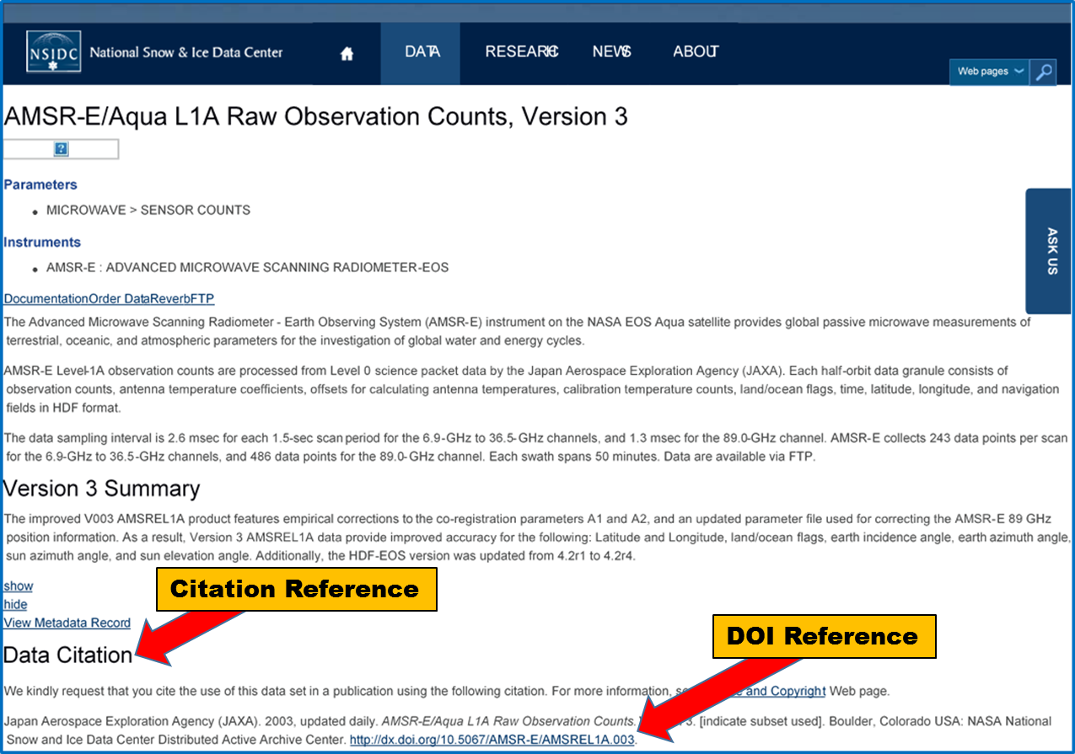
AMSR-E/Aqua L1A Version 3
Landing Page

Slide 10
Citation Examples with DOI Reference
Japan Aerospace Exploration Agency (JAXA). 2003, updated daily. AMSR-E/Aqua L1A Raw Observation Counts. Version 3. [indicate subset used]. Boulder, Colorado USA: NASA National Snow and Ice Data Center Distributed Active Archive Center. http://dx.doi.org/10.5067/AMSR-E/AMSREL1A.003.
NASA Land Processes Distributed Active Archive Center (LP DAAC). ASTER Level 2 Surface Radiance Product (TIR) . USGS/Earth Resources Observation and Science (EROS) Center, Sioux Falls, South Dakota, 2001. http://dx.doi.org/10.5067/ASTER/AST_09T.003
.

Slide 11
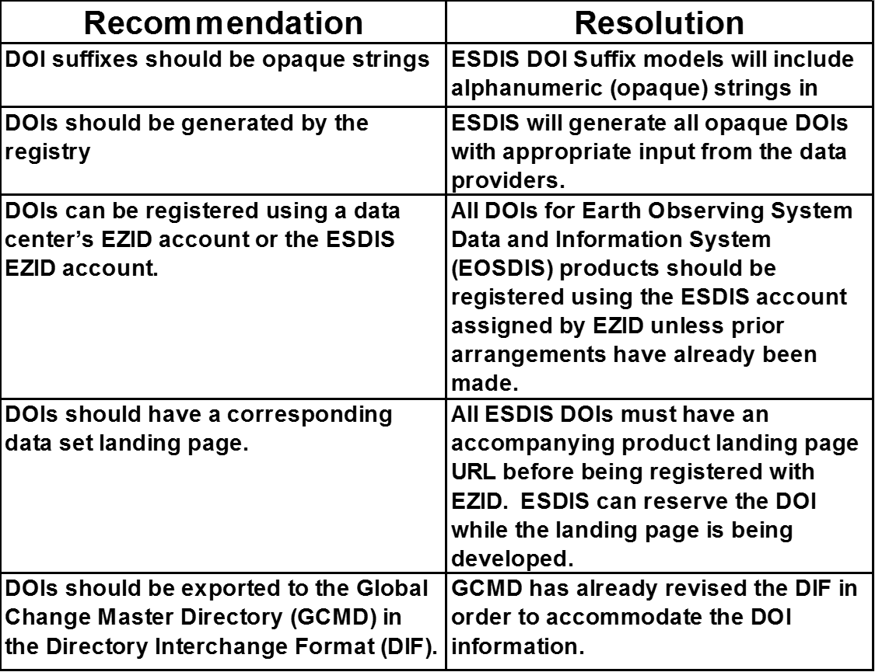
Recommendations to EOSDIS DAACs

Slide 12
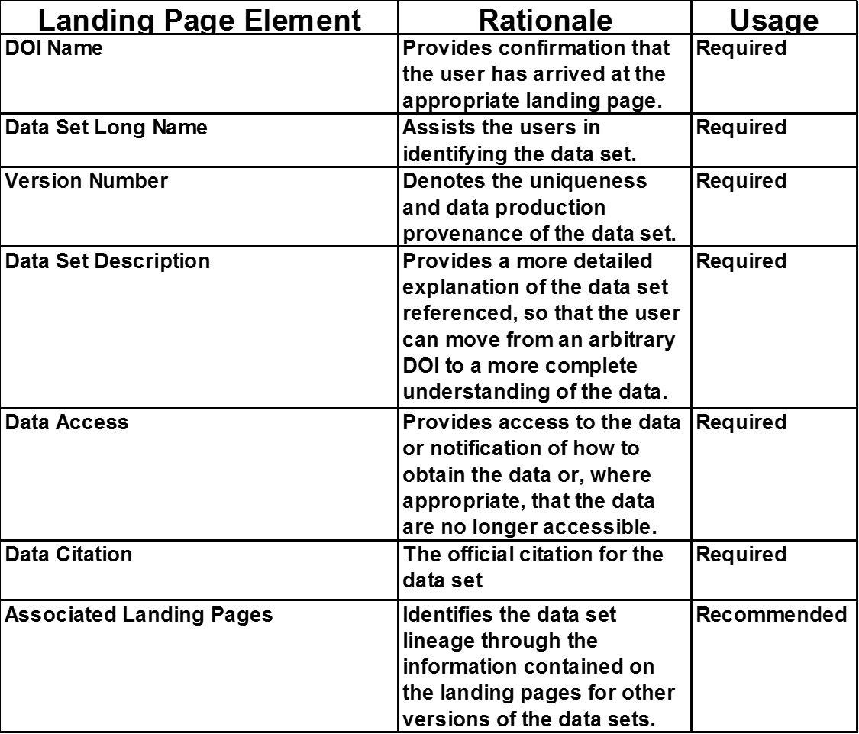
Recommendations: DOI Landing Pages

Slide 13
Additional Information
ESDIS DOI Public Wiki
https://wiki.earthdata.nasa.gov/display/DOIsforEOSDIS/Digital+Object+Identifiers+%28DOIs%29+for+EOSDIS

