Slide 1
GEO Community Portals Ken McDonald/NOAA CWIC Session, WGISS–39 May 13, 2015

Slide 2
Topics
Short Report on GEO Work Plan
Recent Work Plan Symposium
Infrastructure Implementation Board Meetings
Update GEO Community Portal Activity
Description and Scope
Community Portal Paper
Community Input
Summary and Discussion of Relationship to WGISS Activities

Slide 3
GEO Work Plan Symposium
Review progress of current tasks
Infrastructure Tasks
Institution and Development Tasks
Information for Societal Benefits Tasks
Discuss proposed GEO Strategic Plan 2016-2025: Implementing GEOSS
Areas of Action: Advocate, Engage, Deliver
Implementation Mechanisms: Community Activities, GEO Initiatives, GEO Flagships, Foundational Tasks
Propose tasks to accomplish the goals of the Strategic Plan

Slide 4
GEO Infrastructure Implementation
Focus of the Infrastructure Implementation Board (IIB) is the development of the GCI components and associated processes
Observation/Concern from the WPS:
Limited utilization of GEOSS and the GEOSS Common Infrastructure (GCI) by the communities it is intended to support
Need to focus more on data access
Two existing mechanisms in place to address the concern
Architecture Implementation Pilots
Community Portal Activity

Slide 5
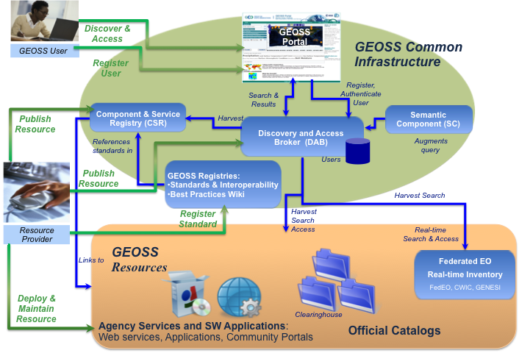
GEOSS Common Infrastructure
GCI Role in GEOSS
GCI key components:
Component and Services Registry (CSR)
Discovery and Access Broker (DAB)
GEOSS Portal
Clearinghouse functions fully provided by DAB
Under development
Revised component and services registration process
User registration process
Missing in diagram are contributions of community components

Slide 6
Rationale for Community Portals
As good and necessary as the GEOSS Portal is, communities still wish to develop their own interface to relevant data and services
Provides visibility to their particular program
Supports integration of EO and non-EO data
Enables integration of specialized community services (e.g. helper applications, data processing, sensor webs, model webs…)
Ideally Community Portals will utilize GCI for discovery and access of GEOSS resources
GCI can enable CPs to present a community-specific view of GEOSS data, services, standards, etc.
Communities will need assistance
GCI documentation, recommendations, best practices, tutorials, etc.

Slide 7
Community Portal Role in GEOSS
GEOSS
Community View of
GEOSS Resources

Slide 8
Evolving Scope of CP Activity
Originally limited to Community Portals/Clients
Understand the general needs of communities that are developing portals to GEOSS services
Show how GCI can address those needs
Provide instruction and assistance in utilizing the GCI components
Scope broadened to look at range of possible interactions between GCI and Community Infrastructures
Allows GCI to better leverage community capabilities
Promotes closer engagement of user communities in sustaining and enhancing GEOSS

Slide 9
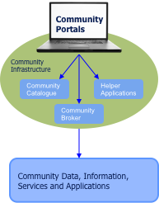
Community Systems Role in GEOSS
GEOSS
Link to/from GEOSS Portal
Community View of
GEOSS Resources
GCI Access to
Community Infrastructure
Enables Integration of
GEOSS and non-GEOSS
Registered Resources
Register Community Resources as Appropriate

Slide 10
Community Portal Recommendations Document Contents
Outreach
Introduction/Purpose/Scope
Community Objectives
GCI Description/Capabilities
Demonstrate benefits of active GEOSS participation
Instruction
Tutorials
Recommendations
Structured around each of the potential interfaces
Examples

Slide 11
Going Forward
Community Portal Activity
Closer engagement with community activities
Architecture Implementation Pilots
Other GEO community initiatives
GEO Initiatives/Flagships
Start to assemble recommendations based on community experience
WGISS – CWIC - FedEO
Do we have same concerns with respect to community engagement?
Should we more actively engage with GCI, GEO SBAs?
Do we need a WGISS-Smart client or is DAB sufficient?

