Slide 1
Osamu Ochiai Scientific and Technical Expert GEO Secretariat CEOS WGISS Harwell, UK 28 September 2015
GEO Secretariat report
GEO Strategic Plan 2016-2025
New GEO Work Programme

Slide 2
GEO Strategic Plan 2016-2025
based on a presentation by Toshio Koike (IPWG Member)

Slide 3
Strategic Plan 2016-2025: Implementing GEOSS
Reference Document
Part A: Strategy
Part B: Implementation
GEOSS Description
GEOSS Data Sharing Principles
GEOSS Data Management Principles
Core Functions
Implementation Mechanisms
GEO Work Programme Development
V2.2 has been issued in July
Next version to be circulated by 29 September

Slide 4
Part A: Strategy
Vison for GEO
- to envision a future wherein decisions and actions for the
benefit of humankind are informed by coordinated,
comprehensive and sustained Earth observations.
GEO’s Mission
- to connect the demand of decision-makers with the supply of
data and information
- to unlock the power of Earth observations
GEO’s Value
Convening Power
- to assemble and coordinate expertise from across different
disciplines and communities

Slide 5
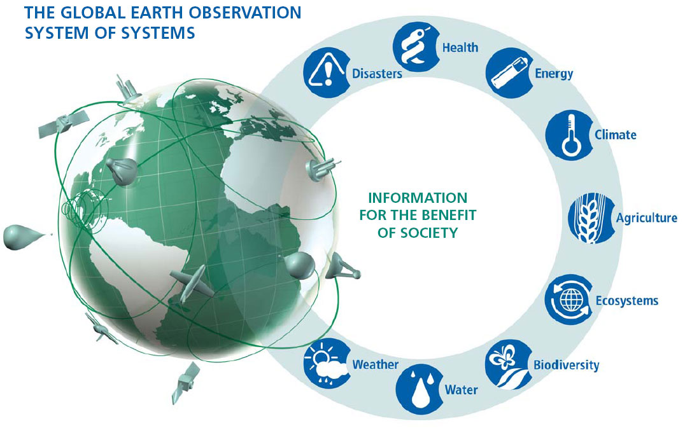
Part A: Strategy
Societal Benefit Areas
Biodiversity and Ecosystem Sustainability
Disaster Resilience
Energy and Mineral Resources Management
Food Security and Sustainable Agriculture
Infrastructure and Transportation Management
Public Health Surveillance
Sustainable Urban Development
Water Resources Management
Climate change and its impacts, are cross-cutting and connect with several the SBAs.

Slide 6
Part B: Implementation
To implement the Strategy identified in Part A,
GEO will leverage the successes of its first decade.
GEO has:
advanced international sharing and interoperability;
fostered substantial collaboration by creating new global
initiatives and supporting vital regional initiatives;
advanced new Earth observation efforts by creating new, user-driven networks and projects.

Slide 7
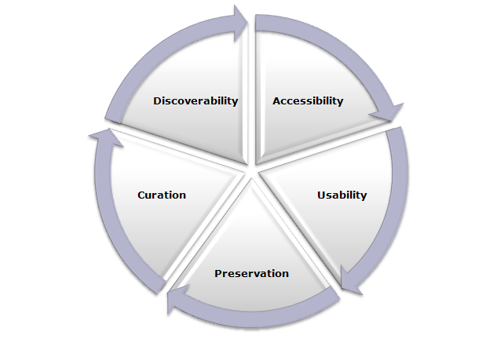
Part B: Implementation
To implement the Strategy identified in Part A,
GEO will leverage the successes of its first decade.
GEO will implement Data Sharing Principles:
by making data, metadata and products available as part of the GEOSS Data-CORE without charge or restrictions on reuse;
by making metadata, data and products available with minimal restrictions on use and at no more than the cost of reproduction and distribution;
by making metadata, data and products available with minimum time delay.
GEO will implement Data Management Principles:
by focusing on discoverability, accessibility, usability,
preservation and curation.

Slide 8
Part B: Implementation
Core Functions
Identifying user needs and addressing gaps in the information chain
Sustaining foundational observations and data
Fostering partnerships and mobilize resources
Advancing GEOSS and best practice in data management and sharing
Implementing sustained global and regional services
Cultivating awareness, building capacity and promoting innovation
Essential for realization of Strategic Objectives
Accompanied by specific, measurable and achievable targets

Slide 9
Part B: Implementation
Implementation Mechanisms
Notes:
GEOSS is a global distributed system, including satellite observation systems, Global in situ networks and systems, And local and regional in situ networks.
GEOSS will deliver the benefits of EO to both data & information providers and consumers world wide.

Slide 10
GEO Work Programme

Slide 11
Introduction on Work Programme
The GEO 2016 transitional Work Programme is the first of the new GEO decade 2016-2025.
It is being developed in parallel with the new Strategic Plan in order to have the necessary tool in place to ensure continuity to GEO actions in 2016.
It bridges the first and the second GEO decades, it ensures continuation of current activities and inclusion of new ones.

Slide 12
Introduction on Work Programme
Transitional Work Programme 2016
Its development is coordinated by the GEO Secretariat in consultation with the the GEO IPWG under the guidance of the GEO Executive Committee during 2015.
“Regular” 3-year Programmes 2017-19, 2020-22 and 2023-25
The Work Programme is drafted by the GEO Secretariat based on inputs from GEO Members, Participating Organizations, and the GEO Community at large.
Through an iterative process, it is reviewed and further developed by the GEO Programme Board, which ensures alignment with the priorities of GEO Members and Participating Organizations, identifies resource commitments by GEO Members and Participating Organizations, and recommends it to GEO Plenary for approval.

Slide 13
Activities total number
Community Activities | 33
GEO Initiatives | 20
Foundational Tasks | 18
TOTAL | 71
ALL Current Societal Benefit Areas are addressed

Slide 14
Community Activities - Current List (1)
CA-01 | Global Land Cover
CA-02 | Land Cover for Africa
CA-03 | Access to model data in GEOSS
CA-04 | Strengthen collaboration between GEO and GFCS
CA-05 | TIGGE (Thorpex Interactive Grand global Ensemble) evolution into a Global Interactive Forecast System (GIFS)
CA-06 | EO data and mineral resources (Includes also the, Impact Monitoring System for Geo-Resource Exploration and Exploitation)
CA-07 | Integrated Water-cycle Products and Services - Overall coordination
CA-08 | Water Vapor and Clouds (and Aerosol and Precipitation)
CA-09 | Precipitation
CA-10 | Evapotranspiration (and Evaporation)
CA-11 | Soil Moisture
CA-12 | River Discharge
CA-13 | Groundwater
CA-14 | GEO Water Quality
CA-15 | Water Cycle Capacity Building
CA-16 | Global Drought Information System (GDIS)
CA-17 | GEO Great Lakes Activity

Slide 15
Community Activities - Current List (2)
CA-18 | Water Cycle Integrator (WCI)
CA-19 | E2E Water Indicators
CA-20 | EartH2Observe
CA-21 | Total Water Prediction: Observations Infrastructure (new-US)
CA-22 | Linking water tasks with wider societal benefit areas and the post-2015 global development framework
CA-23 | Space and Security
CA-24 | Earth Observation in Cultural Heritage documentation
CA-25 | Africa Global-scale Geochemical Baselines for mineral resource and environmental management: Capacity-building phase
CA-26 | Towards Chinese tsunami mitigation system under GEO framework
CA-27 | Foster Utilization of Earth Observation Remote Sensing and In Situ Data for All Phases of Disaster Risk Management (new-CEOS)
CA.28 | Global Flood Risk Monitoring (new-US)
CA.29 | Using Geospatial Data to Identify and Monitor Ecosystem Service and Track in a Natural Capital – Ecosystems Accounts Framework (new-US)
CA-30 | Harmful Algal Bloom (HAB) Early Warning System (new-US)
CA-31 | For Global Mangrove Monitoring (new-US)
CA-32 | Research Data Science Summer Schools (new-CODATA/RDA)
CA-33 | Building capacity for Forest Biodiversity in Asia and the Pacific Region (new-Indian Institutions)

Slide 16
GEO Initiatives – current List
GI-01* | GEOGLAM-Global Agricultural Monitoring and Early Warning
GI-02* | GEOBON-Global Biodiversity Observation (GEO BON)
GI-03* | GFOI Global Forest Observation Initiative
GI-04* | Global Observing System for Mercury and Persistent Pollutants
GI-05* | Global Carbon Observation and Analysis System
GI-06 | Reinforcing engagement at regional level: AfriGEOSS for Africa
GI-07 | Ocean and society - Blue Planet
GI-08 | GEO Geohazard Supersites and Natural Laboratories (GSNL)
GI-09 | Global Wildfire Information System
GI-10 | EO data and renewable energies
GI-11 | Information Services for Cold Regions
GI-12 | Integrated Information Systems for Health (Cholera, Heat waves)
GI-13 | Integration of Methods for Air Quality and Health Data, Remote Sensed and In-Situ with Disease Estimate Techniques (new US)
GI-14 | GECO: the GEO Global Ecosystem Initiative
GI-15 | GEO-GNOME Initiative: GEO Global Network for Observation and information in Mountain Environments
GI-16 | GEO-DARMA = Data Access for Risk Management (new-CEOS)
GI-17a | Global Urban Observation and Information
GI-17b | Global Human Settlement indicators for post-2015 international frameworks
GI-18 | GEO and SDGs. EOs role in providing support to countries in achieving SDGs and in defining and monitoring the associated indicators.
GI-19 | AmeriGEOSS (new)
GI-20 | GEO Global Water Security (GEOGLOWS) new-US
* Proposed as GEO Flagship

Slide 17
Foundational Tasks – current List
GD | GEOSS Development and GCI Operations
GD-01 | Advancing GEOSS Data Sharing principles
GD-02 | GCI Operations (including access to Knowledge)
GD-03 | Global Observing and Information Systems (new) (includes systems like WIGOS. GCOS; …. And reference datasets)
GD-04 | GEONETCast Development and Operations
GD-05 | GEOSS satellite Earth Observation Resources (includes advocacy for continuity)
GD-06 | GEOSS non-space based Observation Resources (includes inclusion of citizens’ observatories) (includes advocacy for continuity)
GD-07 | GCI Development (includes development of Data Management guidelines)
GD-08 | SBAs processes: Systematic determination of user needs / observational gaps
GD-09 | Knowledge Base development
GD-10 | Radio-frequency protection
GD-11 | Utilization of Communication Networks
CD | Community Development
CD-01 | Capacity Building coordination
CD-02 | Reinforcing engagement at national and regional level
CD-03 | Assess the benefits from EOs and of their socio-economic value
SO | Secretariat Operations
SO-01 | Management and Support
SO-02 | Communication and Engagement
SO-03 | Monitoring and Evaluation
SO-04 | Resources Mobilization

Slide 18
GD3: Global Observing and Information Systems (includes systems like WIGOS. GCOS; …. And reference datasets)
General description
The GEOSS as a ‘system of systems’ will proactively link together existing and planned observing and information systems around the world, foster interoperability, and support the development of new systems where gaps currently exist. In this regards, the task will provide various coordination opportunities in order to advocate new systems, to strengthen existing and planned systems and also to encourage integrating and linking different systems.
2. Implementation approach, respective responsibilities
The task will be coordinated by the Secretariat.
a. Contributors (WMO, GCOS, GEO members)
i. Improve integration different Observation systems by defining metadata of Observation systems contributing to GEOSS (e.g., WIGOS, GCOS, GOOS, GGOS)
ii. Sustain and improve existing operational Information systems contributing to GEOSS (e.g., WMO Information System (WIS), OneGeology, IRIS)
iii. Make efforts to implement the GEOSS Data Sharing Principles.
iv. Make efforts to ensure interoperability with GEOSS and GCI.
v. Develop data model for each system, implementing the GEOSS Data Management Principles.
vi. Maintain and improve the operational network diversities such as satellite based, ground based and internet.

Slide 19
GD3: Global Observing and Information Systems (includes systems like WIGOS. GCOS; …. And reference datasets)
GEO Secretariat
i. Overarching coordination in particular to support cross linkages in different communities and to support GEOSS Data Sharing Principles, Data Management Principles and interoperability with GEOSS and GCI.
ii. Inventory Global Earth observation systems
iii. Identify potential gaps, duplications and synergies;
3. Planned activities and outputs for 2016
1. Resume coordination and consultations with Global Observing and Information Systems.
2. Produce a document describing GEO plans to support existing Systems and facilitate development of new ones, including their connection with GCI
3. Produce a report on “Inventory of Global Earth observation and information systems” with identifying potential gaps, duplications and synergies

Slide 20
GD07: GCI Development (includes development of Data Management guidelines)
General description
Define and maintain the GCI evolution strategy and architecture based on documented and emerging user requirements, and analysis of evolving landscape in technology and production/consumption of EO data products and services. Undertake R&D activities, in collaboration with public, private, and voluntary sectors, to develop and test new functionalities, solutions, and components needed to support the achievement of GEO Strategic Plan objectives and user needs. Develop documentation and training material needed to support transition from development to operations of identified new components and solutions.
Implementation approach and respective responsibilities
This task will be implemented by a GEOSS Development Working Group (GDWG), which will include major contributors. The GEO Secretariat will support the GDWG and ensure that its activities are fully supportive of the current needs of the Portal and common components.
a. Contributors (JRC, USGS, CNR, ESA, OGC, IEEE)
i. Define and maintain of the GCI evolution Strategy and Architecture based on documented and emerging user requirements, and analysis of evolving landscape in technology and production/consumption of EO data products and service
ii. Develop and test new functionalities, solutions, and components
iii. Develop Data Management Guidelines and best practices
iv. Implement subsequent Architecture Implementation Pilot Projects on yearly basis (AIP-9 in 2016), to test solutions and to promote the use of GEOSS data to develop products and services
v. Support the advance of the GEOSS interoperability through the Standards and Interoperability Forum (SIF)
vi. Engage the GEO community through guidelines and tutorials that explains the utilization of the GEOSS and the GCI.
vii. Continue to develop the Community Portal Recommendations paper that provides best practices, examples and lessons-learned to promote and facilitate communities’ use of the GCI and assist them in contributing their capabilities to GEOSS.

Slide 21
GD07: GCI Development (includes development of Data Management guidelines)
b. GEO Secretariat
i. Overarching coordination
GCI Requirements consolidation and update
3. Planned activities and outputs
1. Consolidate/update a document “Evolution of GCI functionalities and architecture” for GEO-XII Plenary approval
2. Develop and integrate the new functionalities to ensure access to the Knowledge base being developed.
3. Continue to improve GCI performance in response to user feedback and GEO activities needs
4. Report results on AIP - 9
5. Develop Data Management Guidelines and Best Practices
6. Finalize and publish the documentation that reflects current GCI configuration
7. Organize a GEOSS Interoperability Workshop
8. Publish new guidelines and tutorials in the Best Practices Wiki

Slide 22
GEO WP 2016 Development timeline
September 29 | Version 4.0, as a GEO-XII Plenary document
November 11-12 | GEO-XII – inputs from Delegations, including pledges on 2016 contributions to GEO trust fund (a driver to scope Foundational tasks)
Dec 15 | Version v5 – Final (incorporating Plenary decisions)

Slide 23
GEOSS Common Infrastructure

Slide 24
Introduction of the Brokering approach

Slide 25
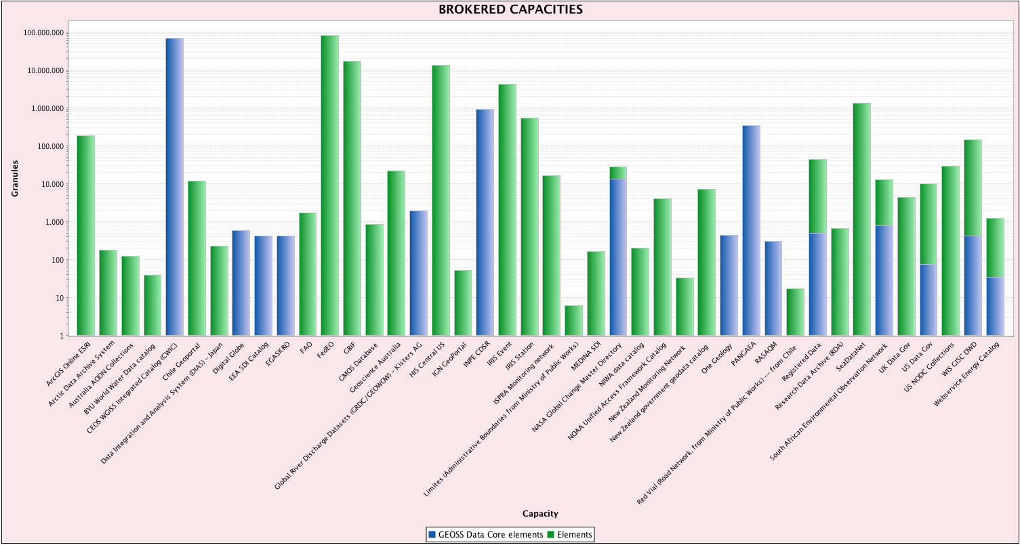
CEOS Resources
CWIC
70M Granules
All GEOSS Data-CORE
FedEO
82M Granules
No GEOSS Data-CORE

