Slide 1


Recovery Observatory
Committee on Earth Observation Satellites
Richard Moreno
CNES – WGISS chair
WGISS-40
Harwell – United Kingdom
28th September – 02nd October 2015

Slide 2
The concept
Committee on Earth Observation Satellites

Slide 3
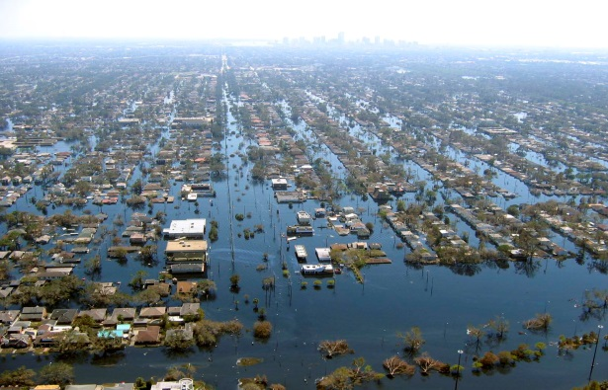
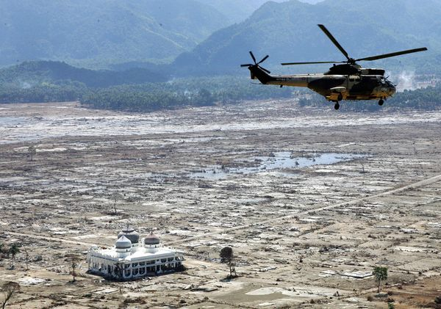
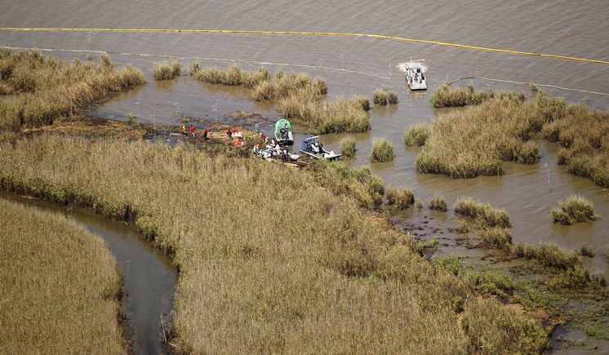
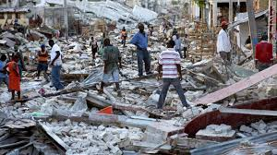
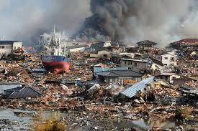
Recovery Observatory – major disasters
Indonesian Tsunami
2004
Hurricane Katrina
2005
Deepwater Horizon
2009
Haiti Earthquake
2010
Tohoku Tsunami
2011
Photo credits: www.nationalgeographic.com; www.mediamythalert.com; www.tampabay.com; www.manongeo.wordpress.com; www.japansociety.org.uk.

Slide 4



Recovery Observatory – the idea
Disaster (weeks)
Recovery(years)
Response
Recovery Observatory
  Space agencies already organize the emergency response after disasters (International Charter) …
  … But have little or no coordination for the post-crisis part of the disaster management cycle
A CEOS initiative (Working Group Disaster, WG currently led by CNES)
  Triggered through lessons learned by CNES from Kal-Haiti project (precursor of a Recovery Observatory) after 2010’s earthquake in Haiti

Slide 5
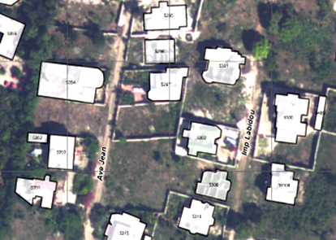
Figure 1:Jacmel buildings classification
Recovery Observatory – Objective
  Demonstrate the value of using satellite Earth Observations to support Recovery from a major disaster:
    Assessment of damages, reconstruction planning, reconstruction monitoring
  Establish institutional relationships between CEOS and stakeholders from the international recovery community.
    World Bank : Global Facility For Disaster Reduction and Recovery (GFDRR),
    United Nations : Development Programme (UNDP) Environment Programme (UNEP)
    Gouvernemental and non- gouvernemental organisations Red Cross/Red Crescent Societies (IFRC) Office for the Coordination of Humanitarian Affairs (OCHA)
  Promote innovation around high-technology
  applications to support recovery.
Jacmel buildings classification

Slide 6
Figure 1:Jacmel buildings classification
Recovery Observatory – Objective
  Demonstrate the value of using satellite Earth Observations to support Recovery from a major disaster:
    Assessment of damages, reconstruction planning, reconstruction monitoring
  Establish institutional relationships between CEOS and stakeholders from the international recovery community.
    World Bank : Global Facility For Disaster Reduction and Recovery (GFDRR),
    United Nations : Development Programme (UNDP) Environment Programme (UNEP)
    Gouvernemental and non- gouvernemental organisations Red Cross/Red Crescent Societies (IFRC) Office for the Coordination of Humanitarian Affairs (OCHA)
  Promote innovation around high-technology
  applications to support recovery.
Jacmel buildings classification

Slide 7
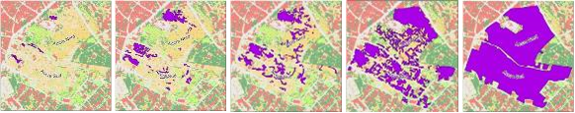
Recovery Observatory : Rationale
  Duration of a RO instance ≈ 3 years
  Plan coordinated acquisitions to support:
    Damage assessment (built areas, natural resources);
    Reconstruction planning;
    Reconstruction monitoring;
  Install a DotCloud instance (collaborative web IT workspace) to share products and user data
Monitoring of grouping of people and camps

Slide 8
WGISS implication
Committee on Earth Observation Satellites

Slide 9
Recovery Observatory : Planning
  End 2013 - Proposal from the CEOS Recovery Observatory Oversight Team (ASI, CNES, ESA, JAXA, NASA)
  13/02/2014 – proposal from WGISS to contribute to the development of the Recovery Observatory
  18/03/2014 – participation to WG disaster meeting in Paris to discuss on the project
  20/03/2014 – presentation of the project in WGISS37 (Florida) meeting
  11/07/2014 – kick-off with THALES & AKKA companies
  WGISS38 (Russia) & WGIS39 (Japan) : technical discussions with our technical support AKKA
  01/01/2015 – Delivery of the 1st version of the Recovery Observatory
  15/08/2015 – Delivery of the complete version of the Recovery Observatory

Slide 10
Recovery Observatory : WGISS
  Good example of cooperation between two CEOS working groups
    WG Disasters and WGISS
  WG Disasters has participated to the design and to the development of the Recovery Observatory
  The schedule was tight, but Recovery Observatory has been developed on time
    The planning is the one that was presented in WGISS37

Slide 11
Main features of what has been developed
Committee on Earth Observation Satellites

Slide 12
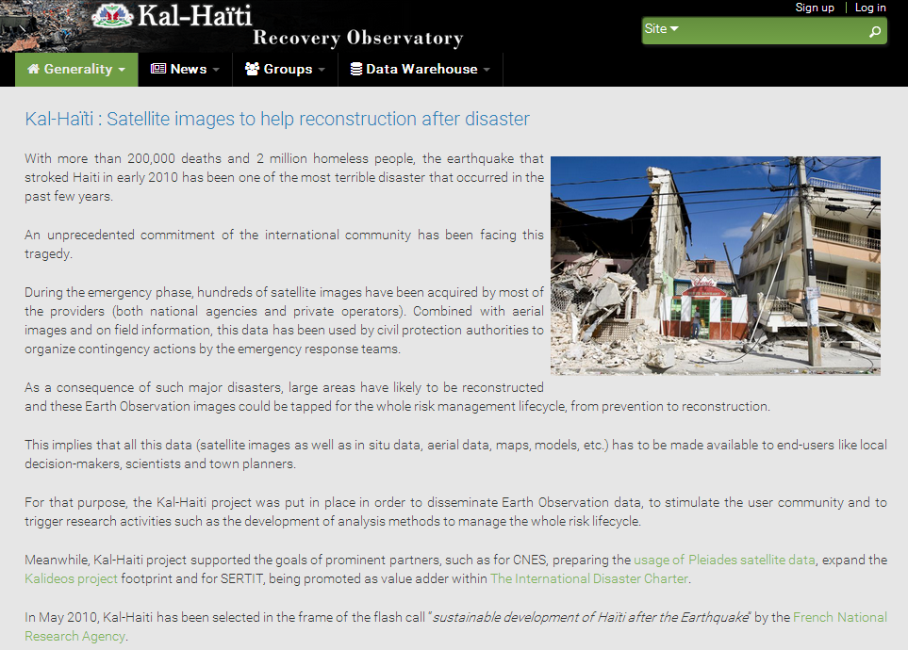
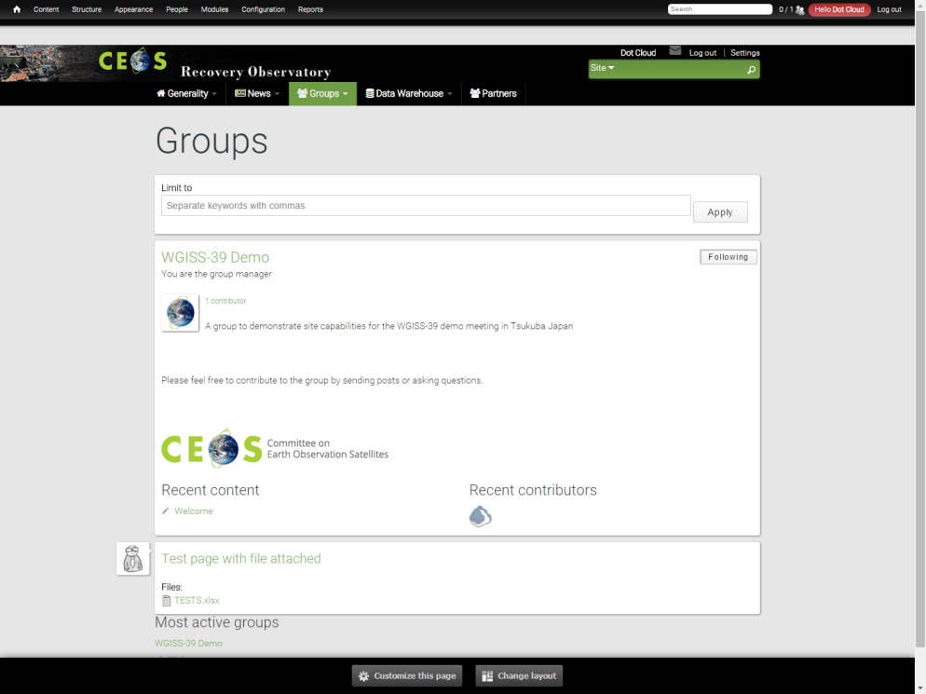
Public Web portal features
  Editorial content
    Project presentation
    General News & events
    Fed by webmaster
    License management
  Collaborative groups
    To allow users to post information & data
    within groups
    To provide security management
      Private groups
      Semi private groups
      Public groups

Slide 13
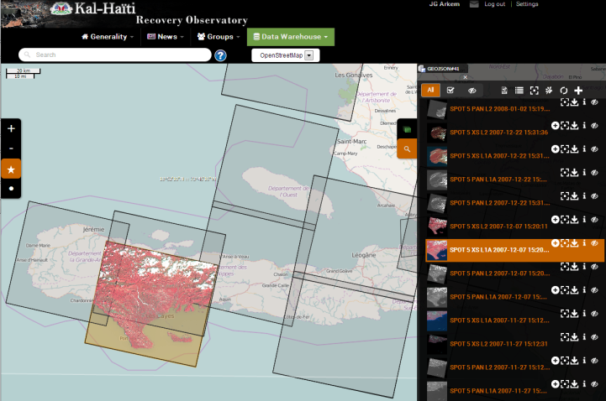
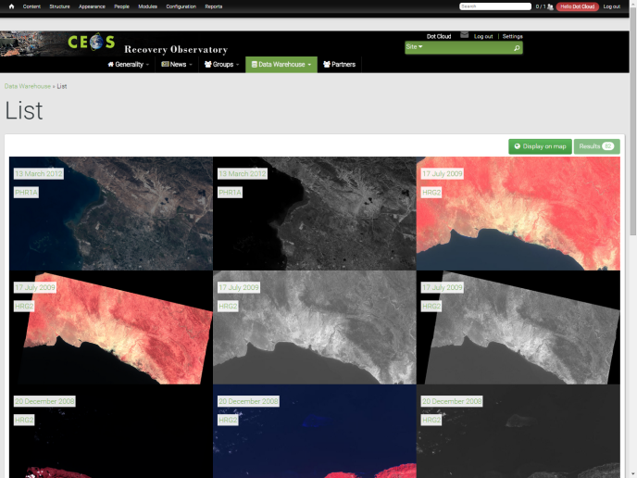
Public Web portal features
  Map with products footprints
    Full resolution products displayed on the map
    Product download
  List of available products
    List of products ordered by date of acquisition
    Product download
    Product details with metadata , quicklook
    and footprint
  Multi criteria search form

Slide 14
Design and COTS
Committee on Earth Observation Satellites

Slide 15




Technologies & COTS
  Main technologies
    PHP
    Java (Spring, Spring Boot, Spring MVC)
    HTML5, CSS3, JavaScript, OpenLayers
  COTS
    Drupal 7 with Acquia Commons
    PostgreSQL & PostGIS
    MapServer, GDAL, RESTo, iTag
    (map display backoffice)
    Mapshup (map display frontoffice)

Slide 16
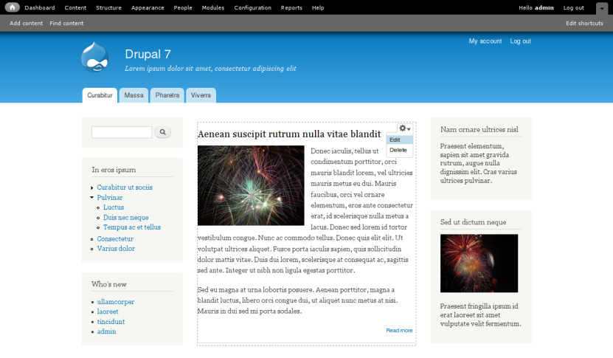
Drupal CMS
Drupal - CMS
  Open source Content Management System written in PHP
  Core with basic features
    User account
    Menu
    Page customization
    System administration
  Large number of available plugins
  to extend the core
    Available on Drupal.org
  Fully customizable with themes

Slide 17
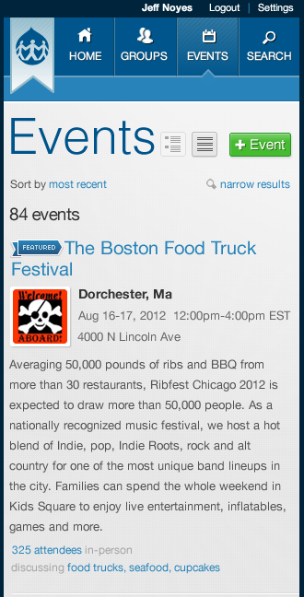
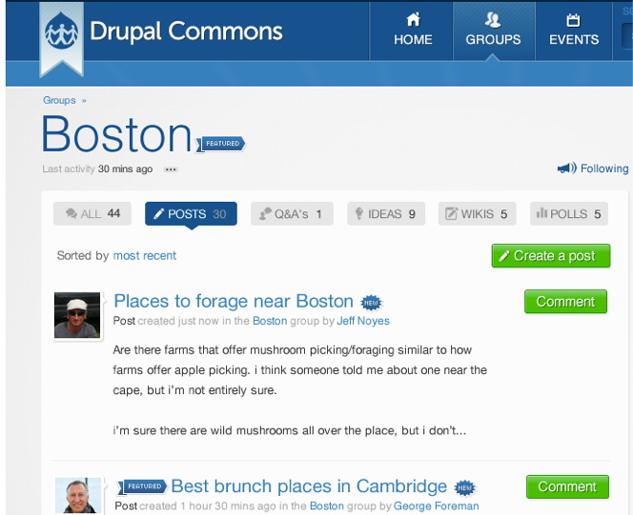
Acquia Commons : collaborative plugin
  Developed by the creators of Drupal (Acquia)

Slide 18

Mapshup

Slide 19
Drupal / RESTo integration
  RESTo stores the products + metadata
    Product download licenses rights are defined in RESTo.
  Drupal stores the articles and documents.
  Interaction RESTo ↔ Drupal
    Shared user session
    Imagery products stored as content item in Drupal as well
    Multi criteria search form allowed by Drupal GUI
    Search results : easy navigation from the list view (Drupal) and map view (Mapshup/resto)

Slide 20
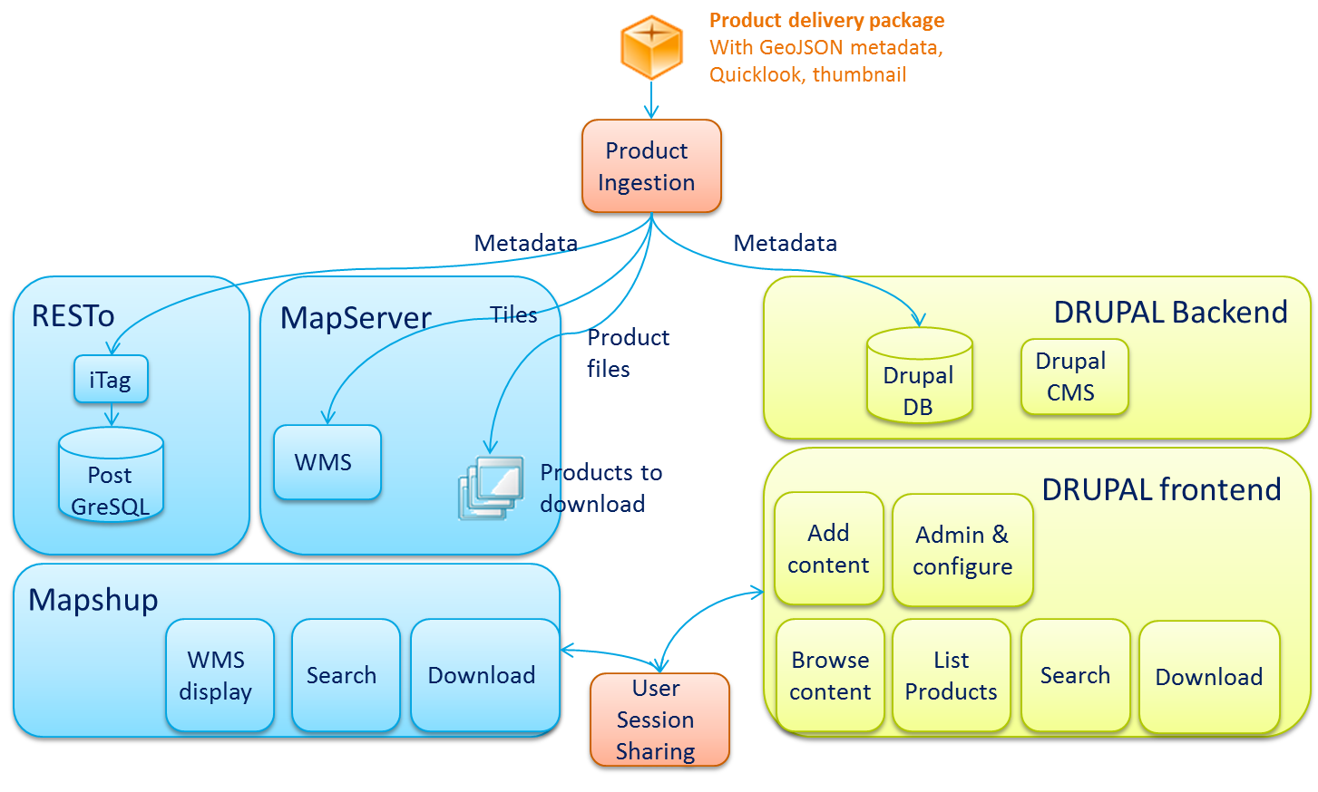
DotCloud Architecture

Slide 21
Product ingestion
  An “Ingestion Unit” is a set of products to be added in the database
  Consists of a ZIP file containing :
    A metadata.json (with metadata of all products)
    The list of Product Archives
      Full Product
      Thumbnail
      Quicklook

Slide 22
Current and future enhancements
  After this first version, other functional improvements will have to be done :
    new data formats have to be added like TerraSAR-X, Landsat 8, Sentinel 2, Spot 6/7, Sentinel-1, Alos-2, US VHR sensors, etc.)
    automatic harvesting of external OpenSearch catalogues
    to other data types such as digital images taken from a smartphone or a camera with GPS location, user documents related to a toponym, etc.

Slide 23
Postface (before demo)
  Whatever the functionalities, the success of the first instance of the recovery observatory will heavily rely on a person with the dedicated task to animate and trigger the discussions, and to feed the group contents on a regular purpose.
  Users will contribute and visit the group board on a regular process only if there is a steady activity in it

Slide 24
DEMO
Committee on Earth Observation Satellites

