Slide 1
CEOS WGISS-40
COSMO-SkyMed Ground Segment
& other Ground Segment Developments
Richard Lowe – Group Manager, EO Systems & Operations

Slide 2




Telespazio VEGA UK Ltd
1978 - VEGA formed
1992 - Listed on the London Stock Exchange
2008 - VEGA De-listed from the Stock Exchange – upon acquisition by Finmeccanica
2010 - VEGA Space introduced as a subsidiary of Selex Systems Integration
2011 - Ownership of VEGA Space Ltd transferred within Finmeccanica to Telespazio
2012 – Renamed Telespazio VEGA UK Ltd

Slide 3
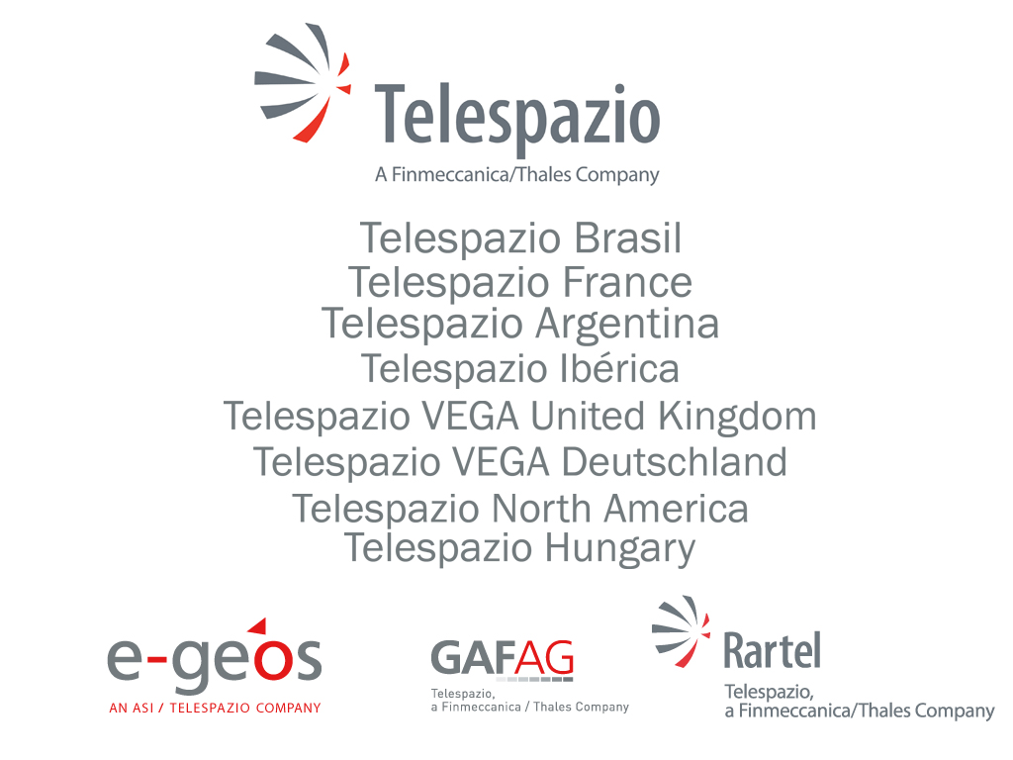





 | Telespazio VEGA UK | Telespazio | Finmeccanica
Revenue | €22m | €562m | €17,218m
Employees | 140 | 2,500 | 67,400
33%
67%
67%
33%

Slide 4
COSMO SkyMed Ground Segment

Slide 5
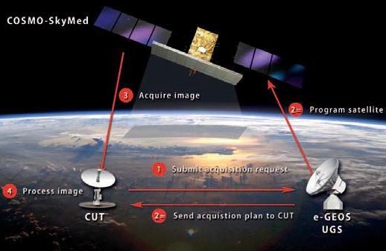
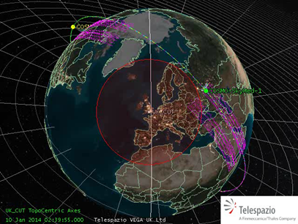
UK COSMO-SkyMed Ground Station
The UK’s first Customer User Terminal (“CUT”) for
COSMO-SkyMed
  UK-Italian space agency bilateral collaboration
  Near Real Time data and services to UK
  Provides services to wide range of government and commercial sectors
  Flood mapping, oil spill detection, vessel detection, extreme weather event impact assessment
  Operations centre at Telespazio VEGA
  Emergency satellite image tasking facility
  Unique near real time coverage of transatlantic shipping routes
  COSMO-SkyMed: Radar satellites can image in all weather, day and night
  Unique four Satellite constellation for unparalleled revisit frequency and coverage

Slide 6
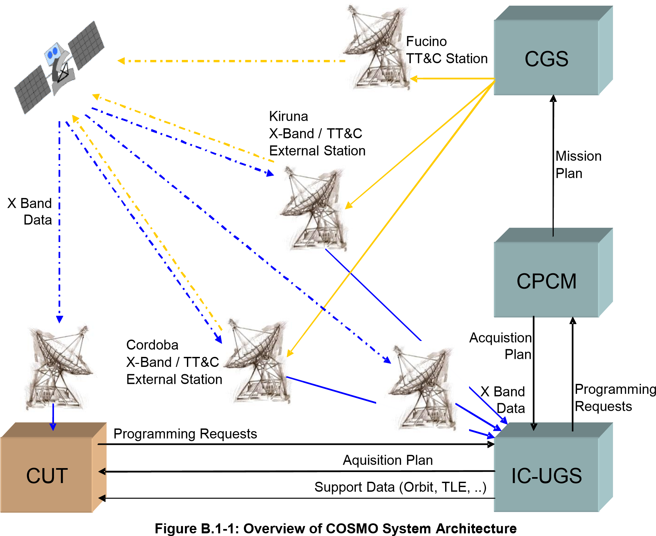
Collaboration & Effective Investment
UK CUT is a successful collaboration involving:
  Telespazio VEGA UK
  Satellite Applications Catapult Centre
  Rutherford Appleton Laboratory
  e-GEOS
  UK Space Agency
  Italian Space Agency
Built on existing infrastructure and COTS systems
CORSAIR programme currently open in UK for R&D access to data
Chilbolton
Harwell & Luton
Harwell & Luton

Slide 7
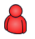
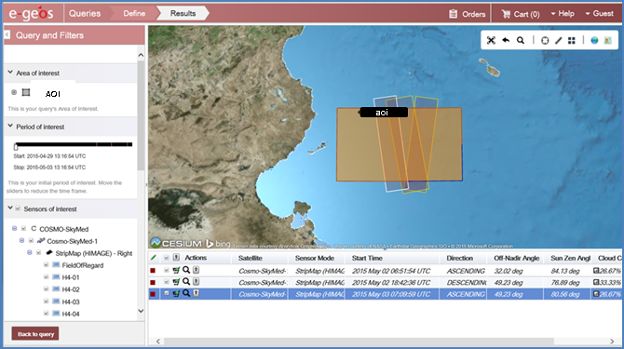
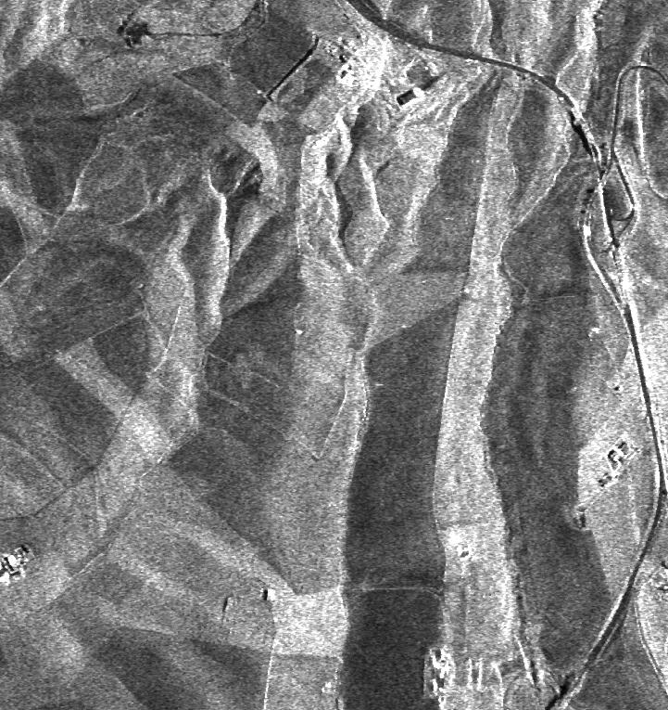
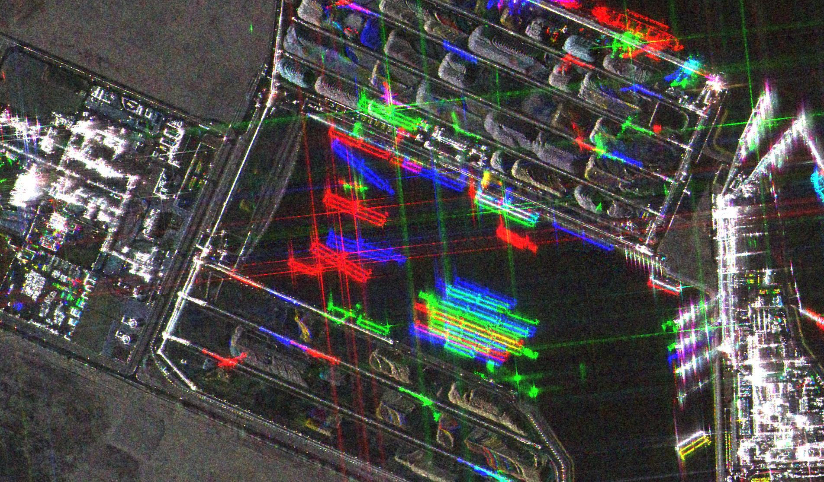
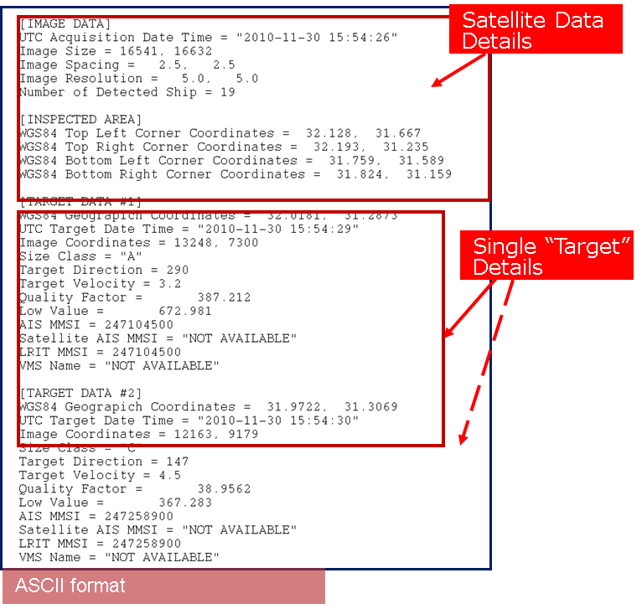
The GEOStation – Production Workflow
Acquisition planning
G-USI
(COSMO Planning)
Collection manager
Acquisition
Plan
Data Collection
COSMO User Terminal (CUT)
+ other terminals
Station operator
Satellite
Data
Image
processing
G-Core
(Advanced processing)
Processing expert
Value-Added
Image Product
Image
exploitation
Application Platforms
Application expert
Report
Map
Product
Delivery
G-Distribution
Final User

Slide 8
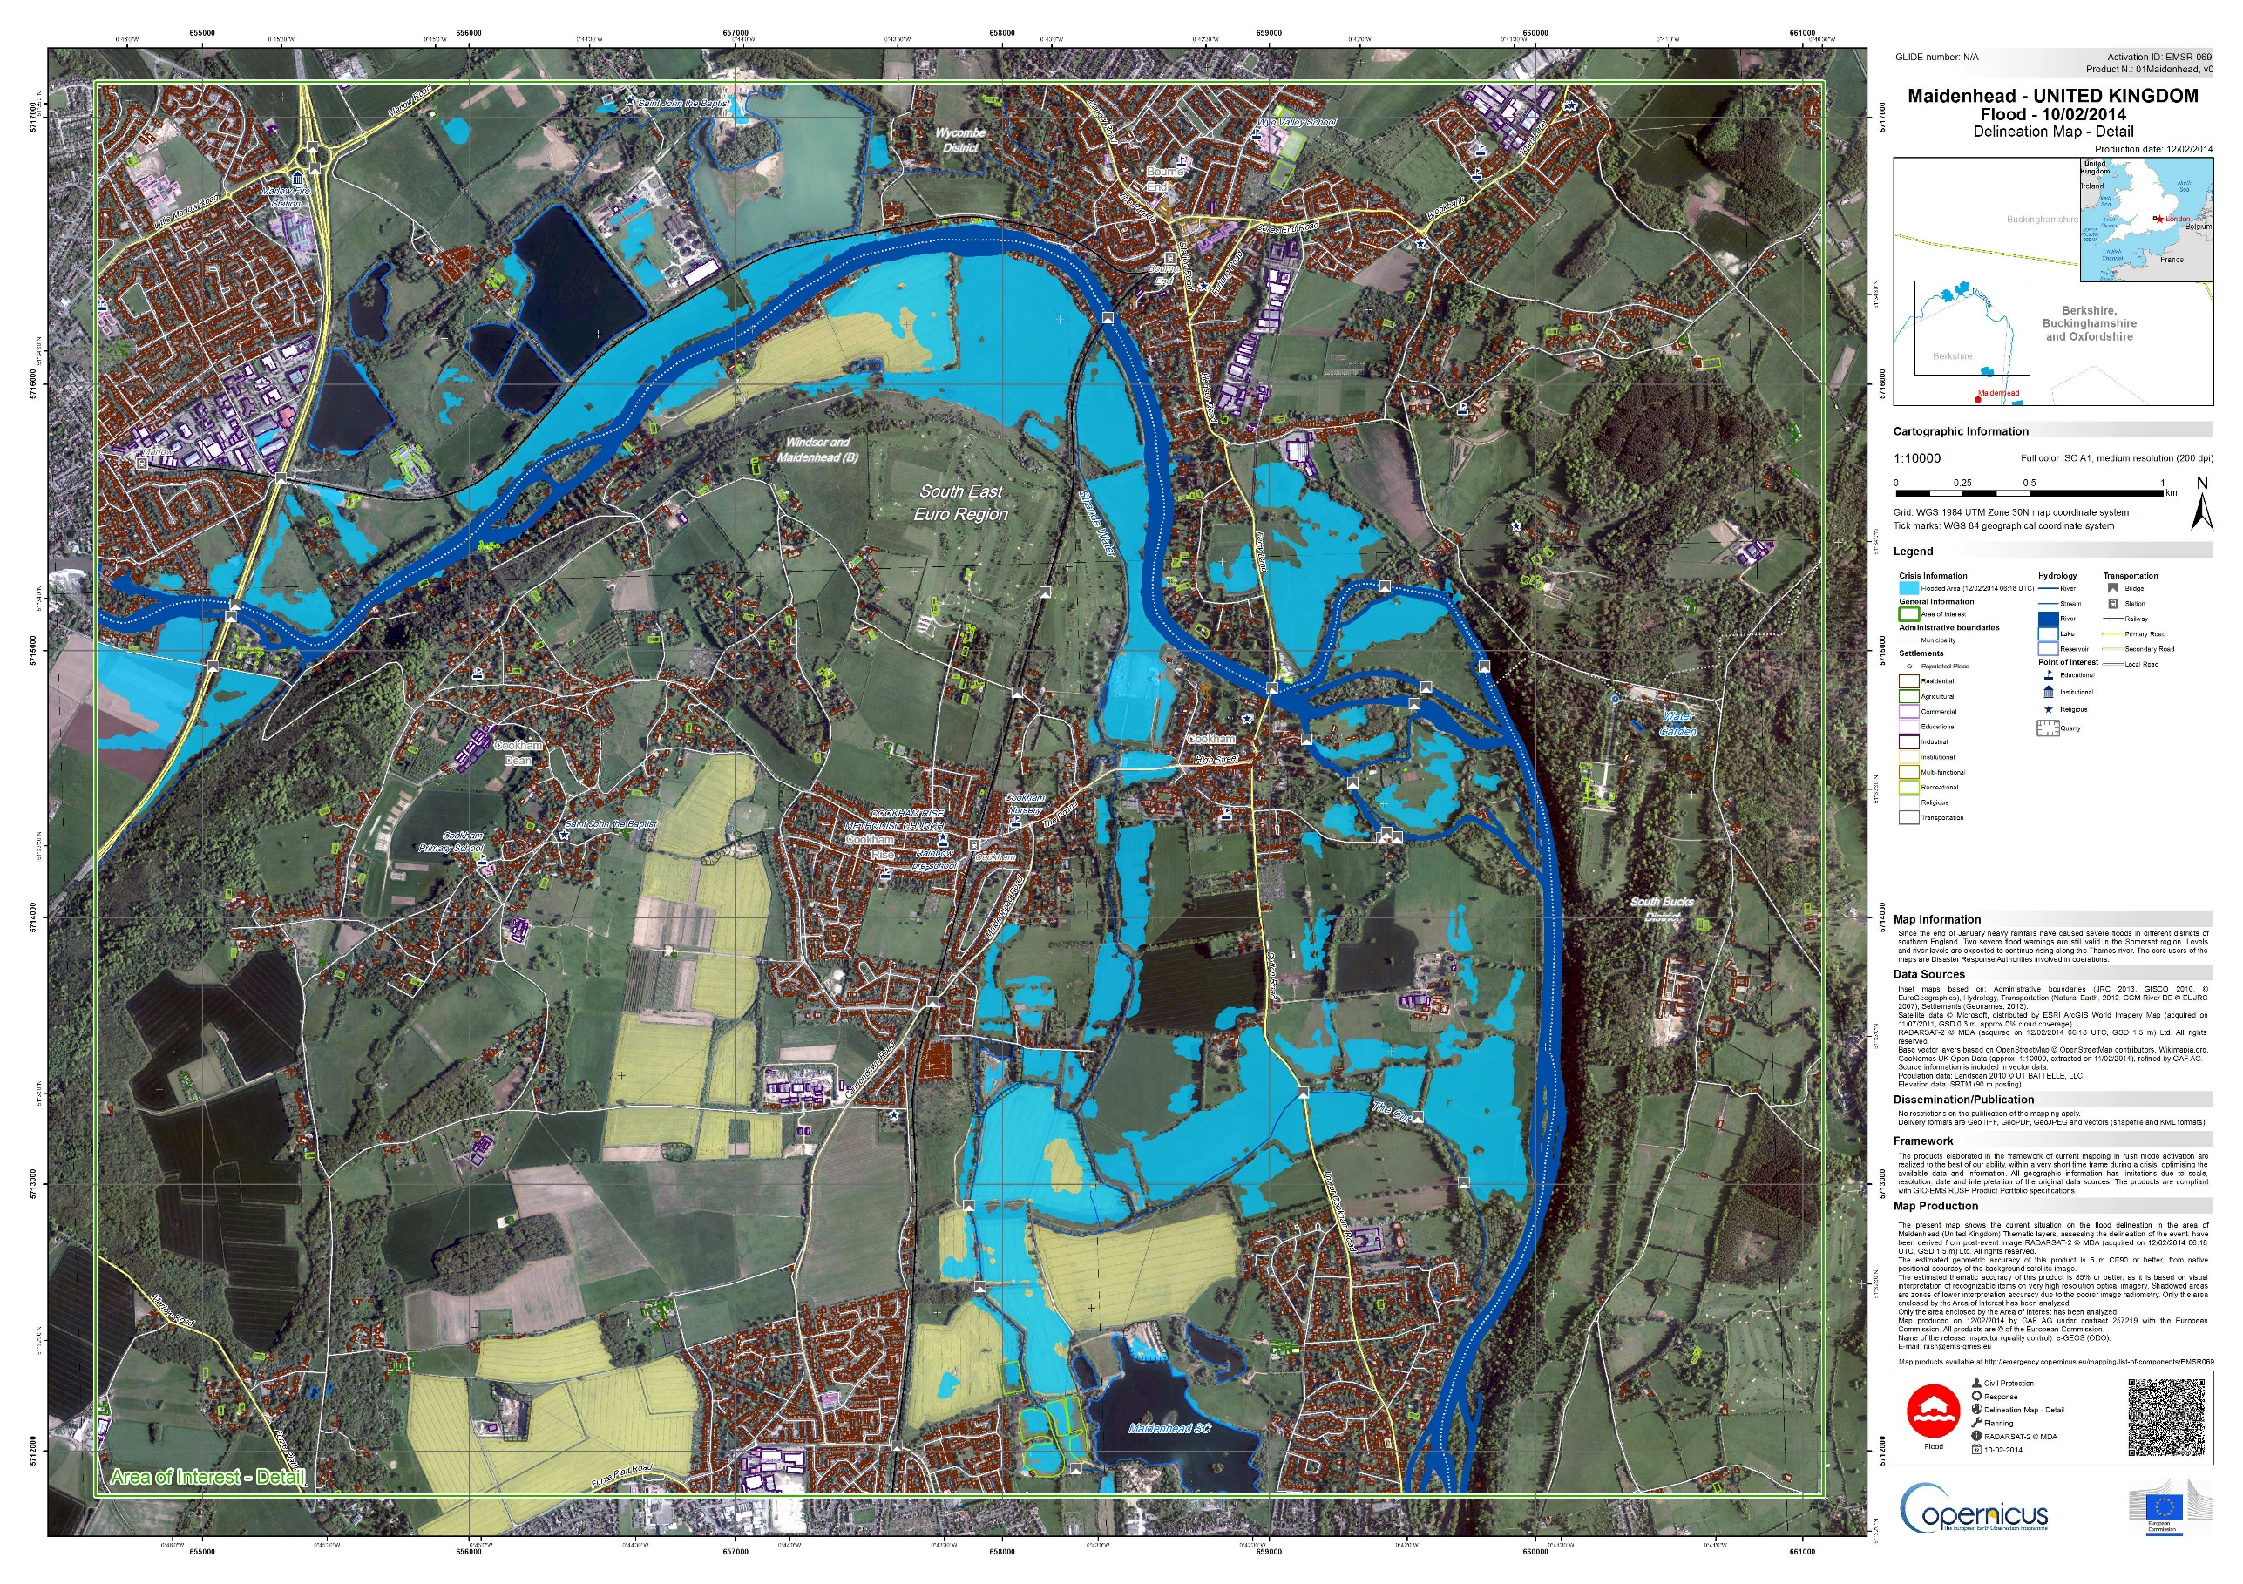




Disaster extent
Settlements
Transportation
Hydrology
Archive image
Damage Assessment Maps
Post event situation
Flooded field database
Delivery time: 3 hours after EO data avail.
Agriculture

Slide 9
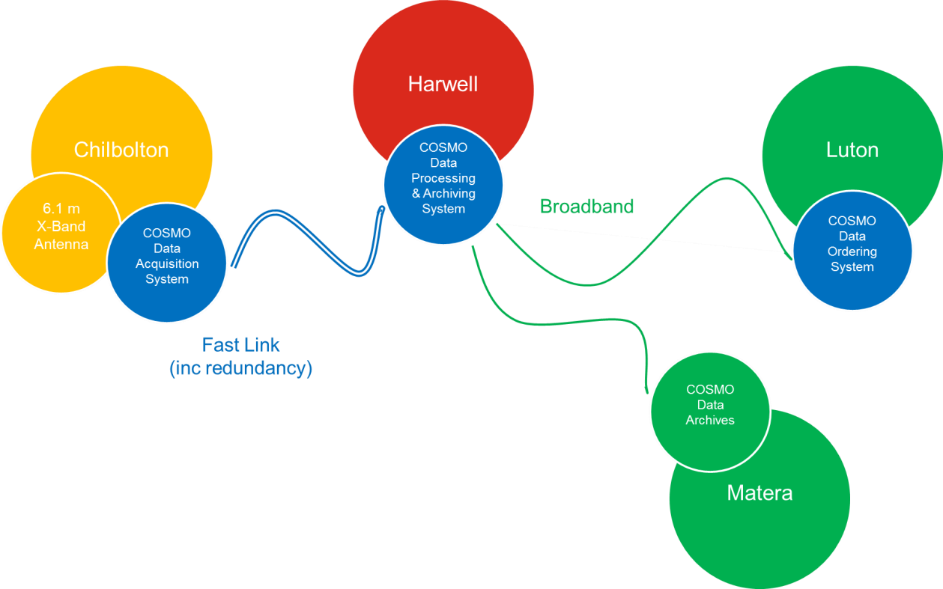
UK COSMO-SkyMed Ground Station
Catapult
RAL Space
Telespazio Vega
Fast Link (inc redundancy)
R&D Data Distribution – from Harwell
Commercial Services (inc. data) – from Luton
Fast link supports future Ground Segment capability development between Harwell and Luton for any mission (e.g. Sentinels, Cosmo, other SAR missions, etc)
CSK Mission (Italy)

Slide 10
Other Ground Segment Developments

Slide 11
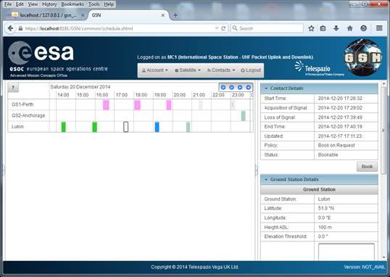
Emerging Ground Segment
  CUBESATs are a fast expanding area that is served poorly by existing Ground Segment infrastructure:
  Low cost; Short missions; Large Constellations; Limited on-board size and power; …
Collaborative Ground Station Networks
  On a much larger scale than existing networks (e.g. ESTRACK). 100’s-1000’s of low cost sites, dynamically shared across hundreds of missions
  Simple, fast, dynamic on-line sharing / brokering of station availability and mission support
  TVUK has developed GSN Web System
  ESA / ESOC as early customer (screenshot)

Slide 12
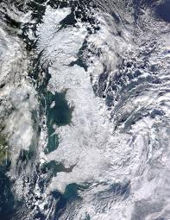


EO Ground Segment
Beyond PDGS + TT&C
  A fully integrated EO capability must ensure:
  Mission data quality – giving reliable, traceable data for the end user
  Accessibility – tailored to user communities and their needs
  (for data / products / information / analysis / services)
Examples:
Quality – e.g. ESA Earth Explorer missions (plus Envisat & partner missions)
  Instrument Data quality Evaluation and Analysis Service (IDEAS+)
  Addresses: (Re)Processing Quality; Processor implementations; Cal/Val R&D
  Europe-wide consortium of 20+ expert organisations (TVUK prime)
Accessibility – e.g. ESA Climate Change Initiative (CCI)
  CCI Data Access Portal gives free access to managed Climate Variable data sets (E.g. SST, Ocean Colour, Ice, Aerosols, etc.)
  Encourages user uptake; requires (and develops) expertise across full EO value chain
  Hosted in Harwell on CEDA-JASMIN system (TVUK prime)
Harwell & Luton

Slide 13
UK Ground Segment Engagement
Telespazio VEGA UK
GSN
UK National
Infrastructure
CubeSats
Shared Ground Systems
Downstream
Upstream
e.g. COSMO-SkyMed CUT
e.g. Catapult CCSDS FOS
ESA Programmes
e.g. GSN Web Collaboration Service
Data Quality Management
Data Dissemination
Systems & Operations
e.g. Earth Explorers;
ESA data from JAXA, NASA missions…
e.g. CCI Data Portal (hosted at Harwell);
Sentinel User Uptake
e.g. Sentinel PDGS’s

