Slide 1
Collection Management
Simon Oliver
CEOS WGISS40

Slide 2
Outline
Background
Sources of Change
Elements of the solution
Business processes
Tools

Slide 3
Background
We are now reprocessing data collections in weeks rather than years – hasn’t be a problem before but now is because of the processing power we have available
Collections were an evolution before
No or minimal provenance
No version control of ancillary inputs and software
No updating or confirmation of currency of ancillary inputs
Not enough information to manage collections
Not feasible to keep multiple collection versions i.e. Petabyte-scale collections (but maybe we can recreate the processing environment)
Not able to recreate instances of systems because we don’t trap information required to do this

Slide 4
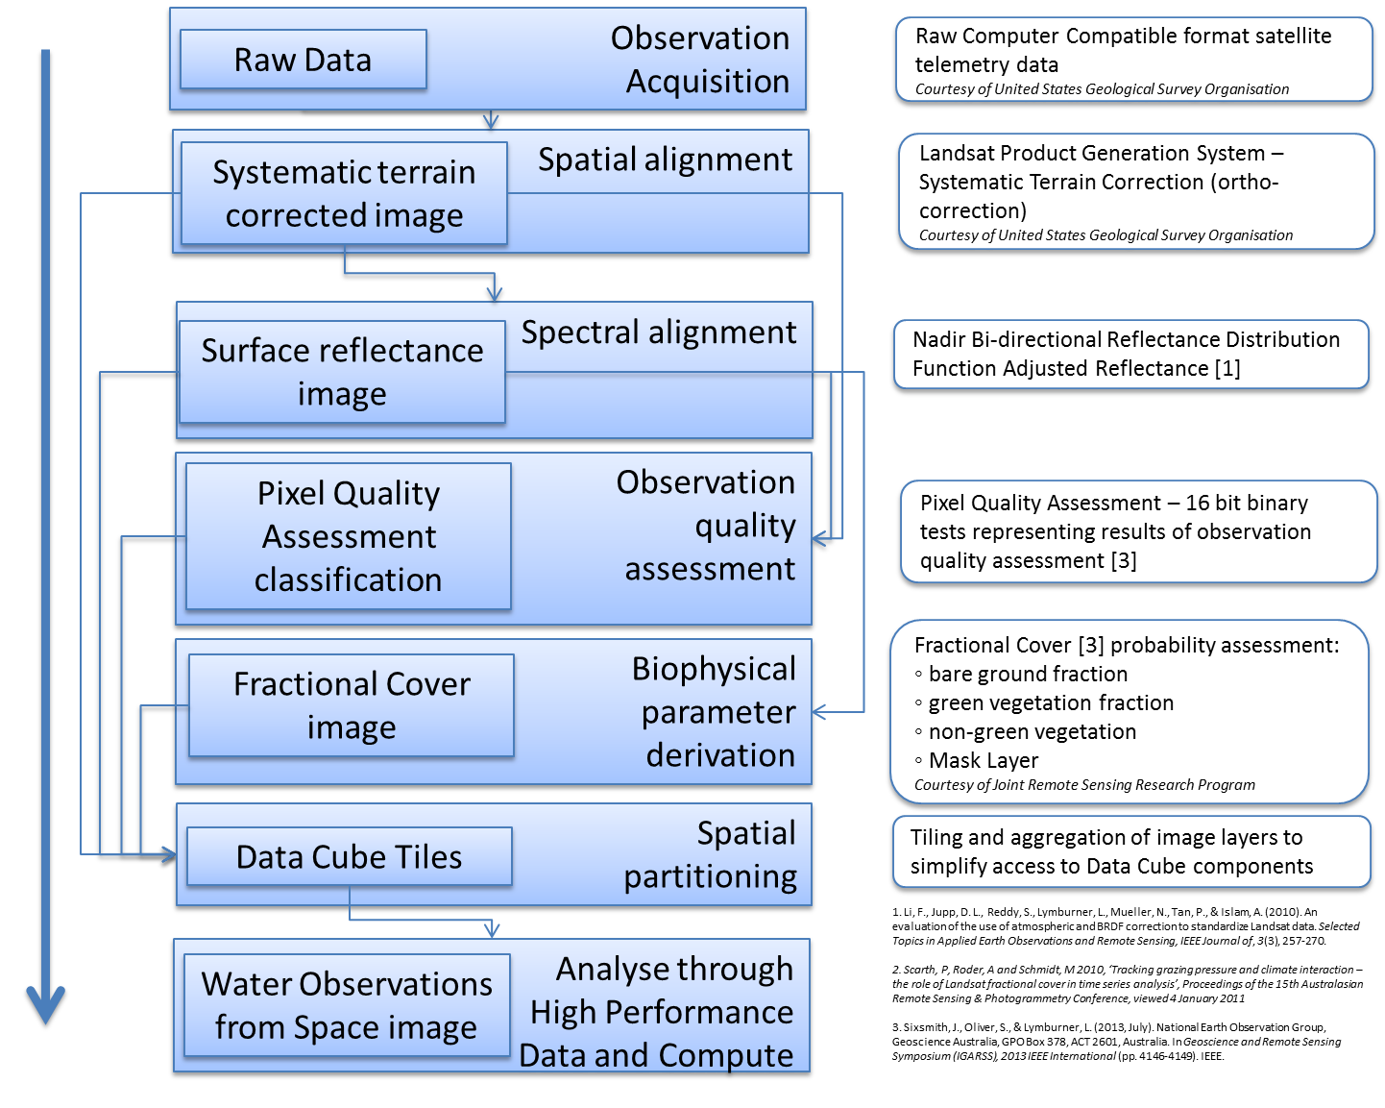
AGDC production workflow
Notes:
Additionally, a solid scientific approach to data processing is essential:
Taking the data to comparable quality assured measurements
Adapting software systems for embarrassingly (massively) parallel processing, enabling quality assurance, building code workflows that allow processes to be iterated and improved / experiments – this is where workflows are important (I will discuss in a minute how we are tackling this)

Slide 5
An example of what we had
It’s not good enough
GANBARv3.00.00-dev – this is hardcoded!
/mnt/gluster/cen-jm-prod14/work/721043/MCD43A1.2012.009.aust.005.b09.500m_0459_0479nm_brdf_par_fgeo.hdf
Local production location
Can’t tell if it’s the latest version
We don’t know when this file was retrieved from the source

Slide 6
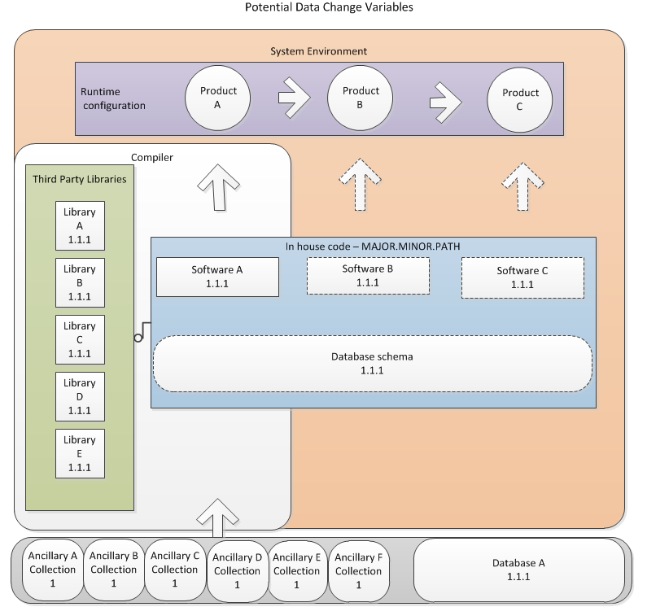
Analysis of potential sources of change
Ancillary data version update
Change in geometric base (i.e. image chips used in rectification)
Correction parameter update
Improved Terrain Model
Database schema update
Database content update
Software update
Software library update
Configuration change (command line configuration)
Runtime environment
Operating System
Processor architecture
Network distribution, if using parallelization
Build configuration
Compilation options
Change in data model or output format

Slide 7
Support systematic fault finding at reception
From acquisition first file write - Ground station
· Antenna
· Channel
· Demodulator used
· Demodulator software and configuration file version
· Data Quality

Slide 8
What we need to do
Systematic and consistent application of component version control
No changes to production systems without approval
Common deployment across instances and platforms (ensuring consistent versioning)
Prevent uncontrolled production changes
Request for Change (RFC) procedures include universal rollout of updates – not isolated
Adopt Business process controls on:
Collection versioning with software and underlying dependencies
Proposing and agreeing on a configuration to feed into a new collection
Major software releases
Control of “production outputs” – i.e. locking down these repositories to selected users
High quality, consistent metadata about variables used in the generation of data products
Recording of system parameters at run time

Slide 9
Elements of the solution
Towards repeatable pipeline production processes
System Snapshot as part of Production Rollout
Version Control EVERYTHING – software and data
Automated retrieval of ancillaries and update
Provenance reporting for process based on version controlled inputs and outputs
Provenance analysis (relating entities)
Workflows for automation
Patch and reprocess with workflow
Relating this to business managers – iterations cost, cumulative issues and thresholds, expert advice

Slide 10
Business processes
Controlled change: Opportunity to make use of RFC (Request for Change) processes (enterprise software release processes) to stamp collections with versions – based on informed business decisions on the SCOPE and SIGNIFICANCE of a proposed change
Change may be software update, ancillary upgrade, change in system library etc.
MAJOR.MINOR.PATCH
MAJOR = New collection. i.e. Upgrade
MINOR = Update to an aspect of the collection
PATCH = insignifiant change (data not modified)

Slide 11
Scenarios

Slide 12
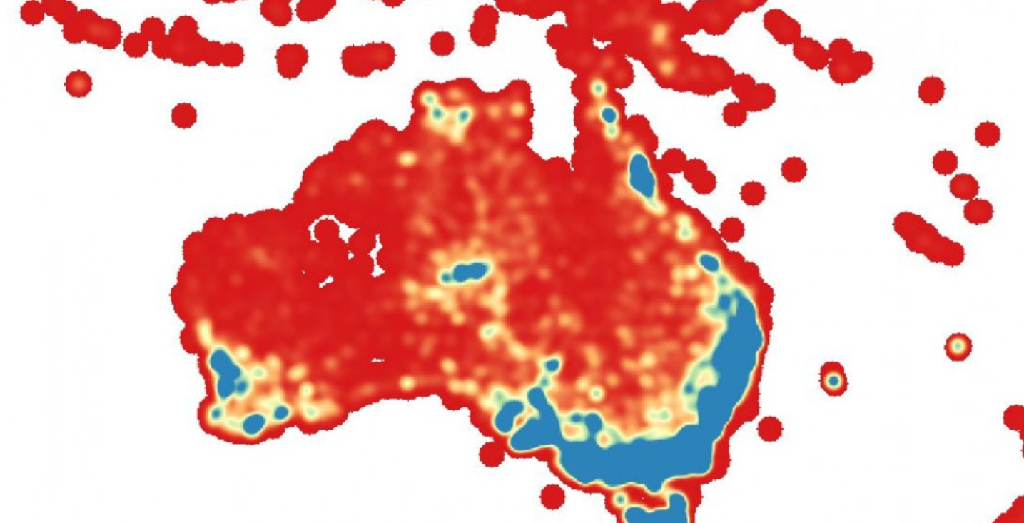
Scope and Significance - threshold
Assisting business decisions – when to initiate a reprocess

Slide 13
Version controlled System Snapshot
Why?
To enable reproduction of a processing event when the system that created an output and the output itself no longer exist
But Why? Litigation scenarios which require reproduction of a product from a superseded collection
Options
Capture the entire processing environment on release to production (VM..)
CDE http://www.pgbovine.net/cde.html
Capture the construction process and the dependencies for the creation
Version controlled Puppet Script and it’s libraries (assuming a barebones linux install)

Slide 14
LPGS CDE snapshot example
Generate a “cde-package-PBS2” through PBS HPC LPGS processing
[lpgs@raijin3 LS8]$ more LS8_PBS_run_cde_2
#!/bin/bash
#PBS -P v10
#PBS -q normal
#PBS -l walltime=24:00:00,ncpus=8,mem=16384MB
#PBS -me
#PBS -M lan-wei.wang@ga.gov.au
cd /projects/v10/PinkMatter/LPGS
source profile
/g/data/v10/projects/HPC_LPGS_testing/LS8/cde -o /g/data/v10/projects/HPC_LPGS_testing/LS8/cde-package-PBS2 landsat_processor /g/data1/v10/projects/HPC_LPGS_testing/LS8/landsat_order_template_mod_lanwei.xml
Copy the “cde-package-PBS2” back to a Vanilla Dev VM at GA
[lwang1@lanwei-ss-dev cde_test]$ ls -l
drwxrwsrwx. 3 lwang1 gemd 4096 Aug 15 14:50 cde-package-PBS2
Run .cde and we can generate the same L1T output
[lwang1@lanwei-ss-dev LS8]$ pwd
/data/cde_test/cde-package-PBS2/cde-root/g/data1/v10/projects/HPC_LPGS_testing/LS8
[lwang1@lanwei-ss-dev LS8]$ ./landsat_processor.cde landsat_order_template_mod_lanwei.xml

Slide 15
Puppet scripts and version control dependencies
Enabling rebuild of environment from version controlled components
Assume vanilla Linux install
Version control the Puppet Script and Dependencies
This is the lightweight alternative but deprecation and obsolescence of build components/dependencies must be assumed

Slide 16
Version Control
Repositories that are easy to recreate and those that are not
Originally considered BOAR https://code.google.com/p/boar/
Git-annex https://git-annex.branchable.com/ can do the same job (stores symbolic links, not checked in though)
Git can provide a common interface for version control of code and data

Slide 17
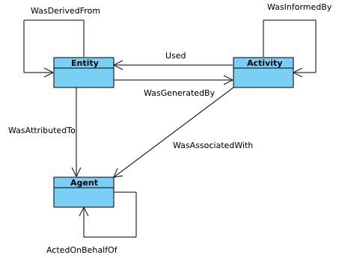
What is provenance?
Provenance is information about entities, activities, and people involved in producing a piece of data or thing, which can be used to form assessments about its quality, reliability or trustworthiness.
Introducing PROV
Entity ~ data
Activity ~ Surface Reflectance Correction
Agent ~ Landsat processor version x
PROV core structures

Slide 18
PROMS
A restful web service responding to HTTP POST and GET requests
Provenance traces can be found by querying the PROMS' various query endpoints. These endpoints are:
database command line interface - most basic;
RESTful API - general purpose, main, interface;
SPARQL endpoint - only relevant for provenance traces expressed in an RDF ontology such as PML-P or PROV-O.

Slide 19
Reporting provenance
Sumatra API (one option) http://neuralensemble.org/sumatra/
a tool for managing and tracking projects based on numerical simulation and/or analysis, with the aim of supporting reproducible research.
System, Algorithm and Data provenance
Code
Code dependencies
Algorithm
Inputs and Outputs
Versions

Slide 20
Sumatra example outputs snippet
"label": "20140723-132113",
"version": "ca11bf387ae73618fca188a142649788510192d6",
"stdout_stderr": "/short/v10/sao547/nbar/sumatra/Data/work_LS5_TM_OTH_P51_GALPGS01-002_098_078_19920417_1\n/short/v10/sao547/nbar/sumatra/Data/output_LS5_TM_OTH_P51_GALPGS01-002_098_078_19920417_1\n/short/v10/sao547/nbar/sumatra/Data/L1_DONE/1992-04/LS5_TM_OTH_P51_GALPGS01-002_098_078_19920417_1\n",
"repository": {
"url": "/home/547/sao547/code/sumatra",
"type": "GitRepository",
"upstream": null

Slide 21
Sumatra example outputs snippet
"executable": {
"path": "/apps/python/2.7.6/bin/python",
"version": "2.7.6",
"name": "Python",
"options": ""
},
"parameters": {
"content": "input = \"/short/v10/sao547/nbar/sumatra/Data/L1_DONE/1992-04/LS5_TM_OTH_P51_GALPGS01-002_098_078_19920417_1\"\nwork = \"/short/v10/sao547/nbar/sumatra/Data/work_LS5_TM_OTH_P51_GALPGS01-002_098_078_19920417_1\"\nnbar_root = \"/short/v10/sao547/nbar/sumatra/Data/output_LS5_TM_OTH_P51_GALPGS01-002_098_078_19920417_1\"\nsumatra_label = \"20140723-132113\"",
"type": "SimpleParameterSet"

Slide 22
Managing collections through provenance - Luigi and Provenance
Luigi from Spotify:
Workflow execution
Dependency tree based
Similarities to PROV model:
Parameter - Task - Target
Comparable breakdown to ~PROV
Entity - Activity – Agent - Entity
Towards a self healing collection!

Slide 23
Version Control
PROMS
Workflow component
SnapShot
Luigi
PV
PV
PV
PROCESS
INPUT
OUTPUT
PV
D
PV
OS

Slide 24
Ancillary / Data Retrieval
System Workflow
p
PROMS
A
Version Control
L0
p
LPGS
p
L1
FC
EO Processor
p
p
p
p
PQ
p
p
NBAR
DataCube Injector
p
p
DataCube
p
p
p
DataCube API
System Snapshot
p
Ancillary / Data Retrieval
WoFS
EO Processor
DataCube Injector
DataCube API
LPGS

Slide 25
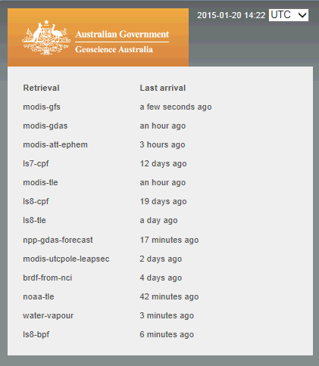
Implementation
Automated ancillary retrieval and version update

Slide 26
Initial implementation – appended lineage YAML
id: ecbb6a36-55c5-11e5-8787-005056bb5f37 ga_label: LS8_OLITIRS_NBAR_P54_GALPGS01-002_112_079_20140126 ga_level: P54 product_type: nbar_brdf ……. lineage: machine: {} source_datasets: ortho: id: 5cf41d98-eda9-11e4-8a8e-1040f381a756 ga_label: LS8_OLITIRS_OTH_P51_GALPGS01-002_112_079_20140126 …
lineage: algorithm: name: LPGS version: 2.4.0 parameters: {} machine: {} ancillary: bpf_oli: name: LO8BPF20140127130115_20140127144056.01 bpf_tirs: name: LT8BPF20140116023714_20140116032836.02 cpf: name: L8CPF20140101_20140331.05 rlut: name: L8RLUT20130211_20431231v09.h5 source_datasets: satellite_telemetry_data: id: 4ec8fe97-e8b9-11e4-87ff-1040f381a756 ga_label: LS8_OLITIRS_STD-MD_P00_LC81160740742015089ASA00_116_074_20150330T022553Z20150330T022657 lineage: machine: hostname: rhe-jm-dev01.dev.lan runtime_id: 4bc6225c-e8b9-11e4-8b66-1040f381a756 type_id: nemo-jobmanager-packager version: 2.4.0 uname: 'Darwin rhe-jm-dev01.dev.lan 14.3.0 Darwin Kernel Version 14.3.0: Mon Mar 23 11:59:05 PDT 2015; root:xnu-2782.20.48~5/RELEASE_X86_64 x86_64' source_datasets: {}

Slide 27
Challenges
Making this part of the business process
A common framework for code development
Incorporating workflow, provenance, version control in all of our code
Version control EVERYTHING
Code, inputs, data, outputs, configurations, system snapshots-
Enabling PROMS-O compliant reporting
Formulating scripts to analyse provenance
Deciding on the level of granularity for provenance capture
…to mention a few

Slide 28
Project Progress
In production refactor - workflow components have been broken down to enable fine-scale provenance capture. Desired granularity of provenance may be abstracted from this.
Potential tools have been identified
Lots to do…

Slide 29
Thank you
Simon Oliver

