Slide 1

NASA WWEC 2015
3rd World Wind Europa Challenge for apps using NASA’s open source platform
Source: NASA
M.A.Brovelli (PoliMiComo), P.Hogan (NASA), G.Remetey-Fülöpp (Hunagi)
All Members, Scientific Committee, WWEC 2015

Slide 2
Outline
Open source platform for analysis and visualisation
WWEC – a flashback
The WWEC 2015
Beyond WWEC 2015
Conclusions and Acknowledgements

Slide 3
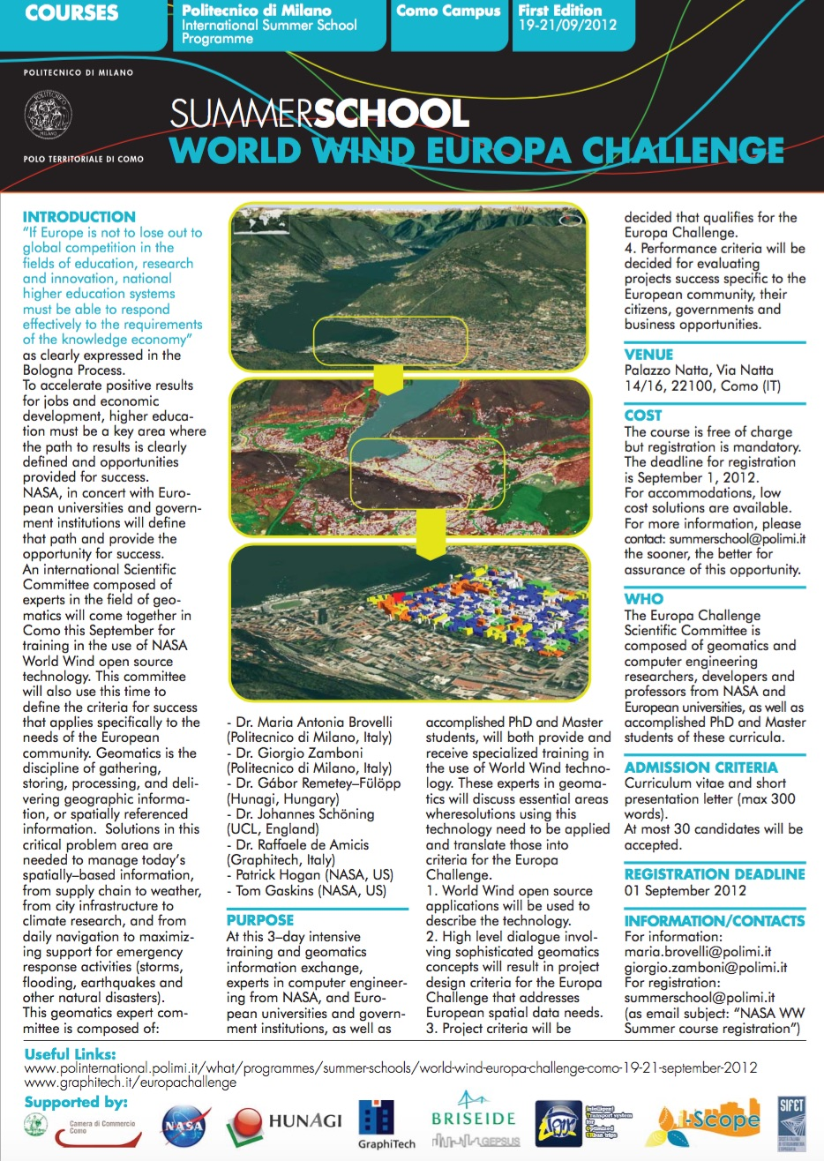

NASA WWEC – a flashback
The start
Summer School in Como, 2012 Hosted by PoliMiComo Prof. Maria A. Brovelli
Setting the specifications and rules for WWEC with experts and students from all over the world N. (N.B. Hungary was represented by 6)

Slide 4
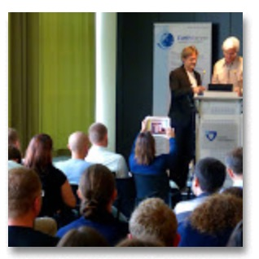
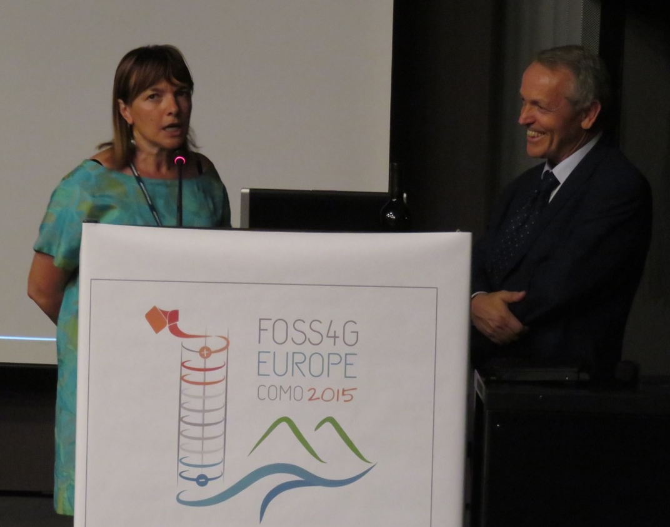
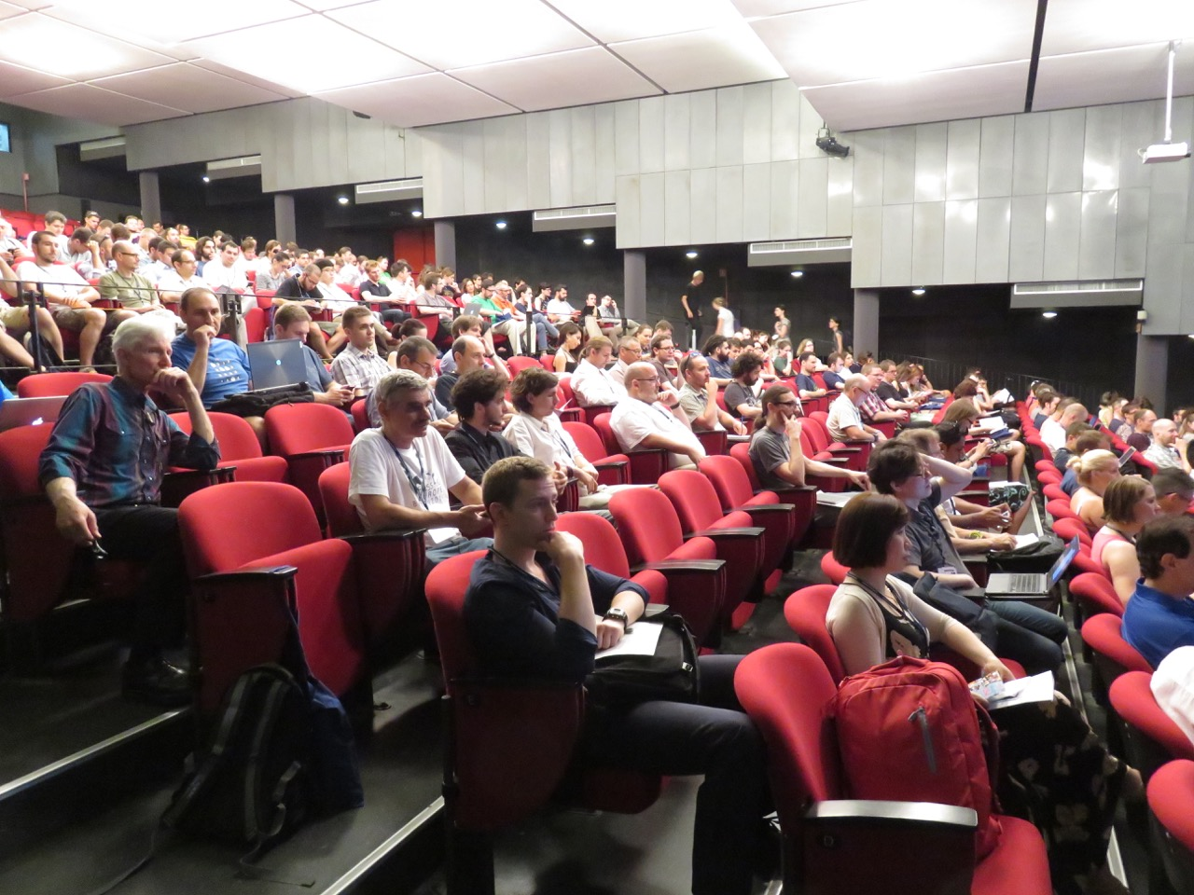
NASA WWEC – a flashback
Yearly award ceremonies
1st WWEC in 2013 INSPIRE Conference, Florence
(over 600 participants)
2nd WWEC in 2014
1st FOSS4G Europe
Conference in Bremen
(at Jacobs University with over 250 participants)
3rd WWEC in 2015
2nd FOSS4G Europe Conference in Como (at Politecnico Milano Como Campus with over 400 participants)
(FOSS4G=Free and
Open Source Software
for Geospatial)

Slide 5
The NASA WWEC 2015
Evaluation criteria with max scores allocated
Sophistication: Level of difficulty, number of functions, data accessibility, degree of challenge to data analysis. 20
Performance: Given the amount of data being digested and viewed, in 3D and more intensely in 4D, does the performance appear effective at delivering that data? The more data being managed, the more impressive the program’s ability to deliver it, i.e., 4D > 3D alone. 20
Intuitive, efficient, allowing control over data selection, time series, etc. 20
Website: Documentation sufficient and effective. 20
Idea: How compelling is the application purpose? Do you see the application providing significant value to the community being served? 10
Outreach: Any coordination with other University departments, outside agencies or the actual user community? 10

Slide 6
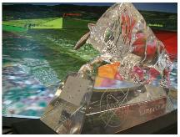









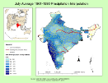
NASA WWEC 2015
Roadmap
NASA World Wind Europa Challenge 2015
Deadline: June 1, 2015. Details:
Evaluation by international board (JRC, FAO, NASA etc)
    NASA WWEC 2015 Award Ceremony for university teams and professionals at the 2nd FOSS4G Europe Conference, Como, July , 2015
    Submitted Applications (as of 15 May)
eurochallenge.como.polimi.it
The Crystall Bull Prize
GeoSim Cloud-based 5D-
Geovisualization University of Denver
Global Earthquake
Forecast System Trillium Learning & Kodiak Island
Borough District
ZEUS Easy Track Krisztián Fehér
wwwOSM Web World Wind –
OpenStreetMap Trilogis srl
wGlobe: Interactive
Visualization/Analysis
of Spatial Data State University of
New York at Buffalo
Wildfire
Management Tool also with Web Version EMXSYS
Navigational
Knowledge
Extraction from
Crowd Trajectories Univers. of Nottingham
Steady-State
Water Rise 4D Visualization International Institute of
Information Technology,
Hyderabad
LiDAR Data
Visualization
and Analysis University of Kansas

Slide 7
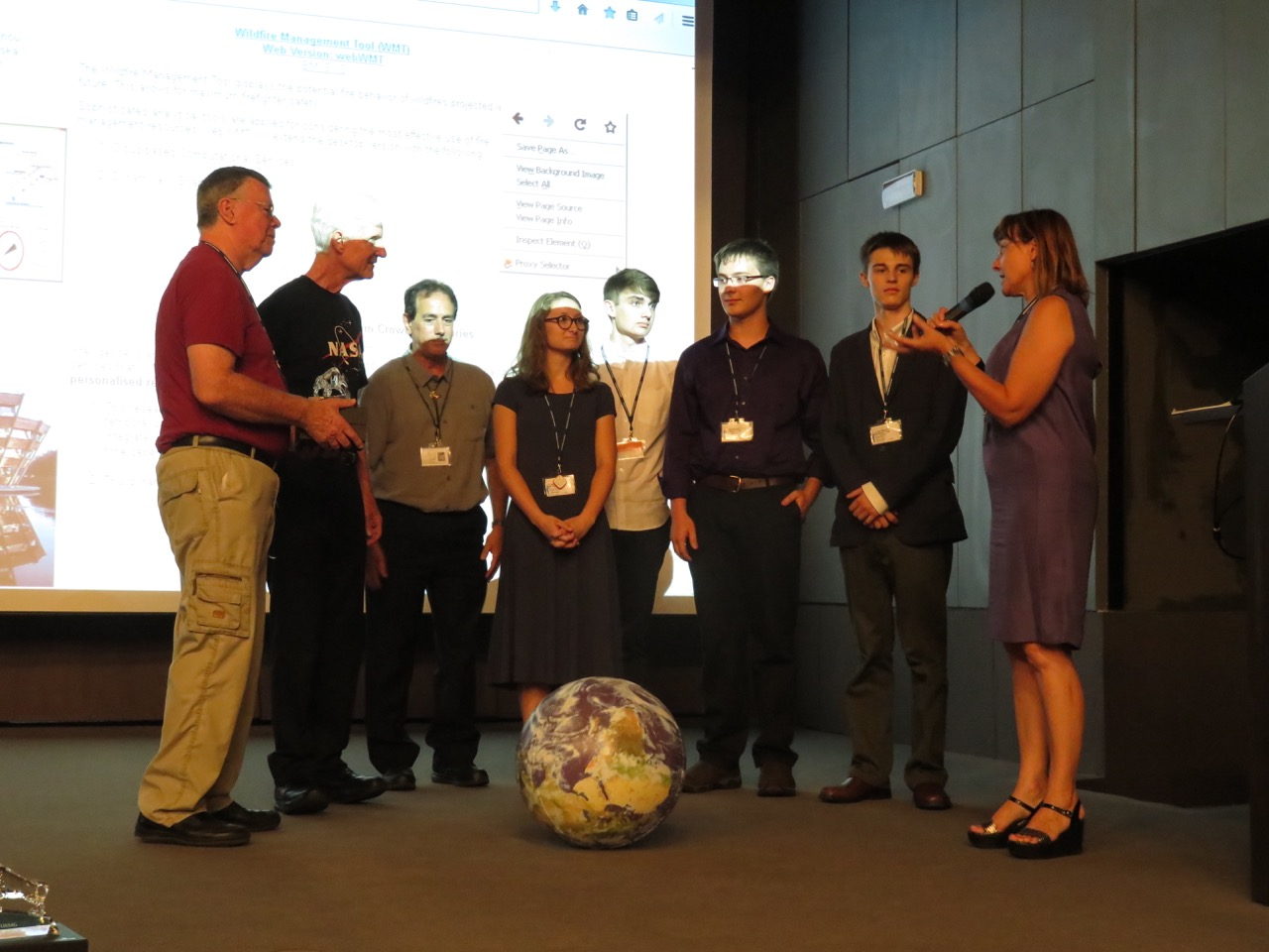
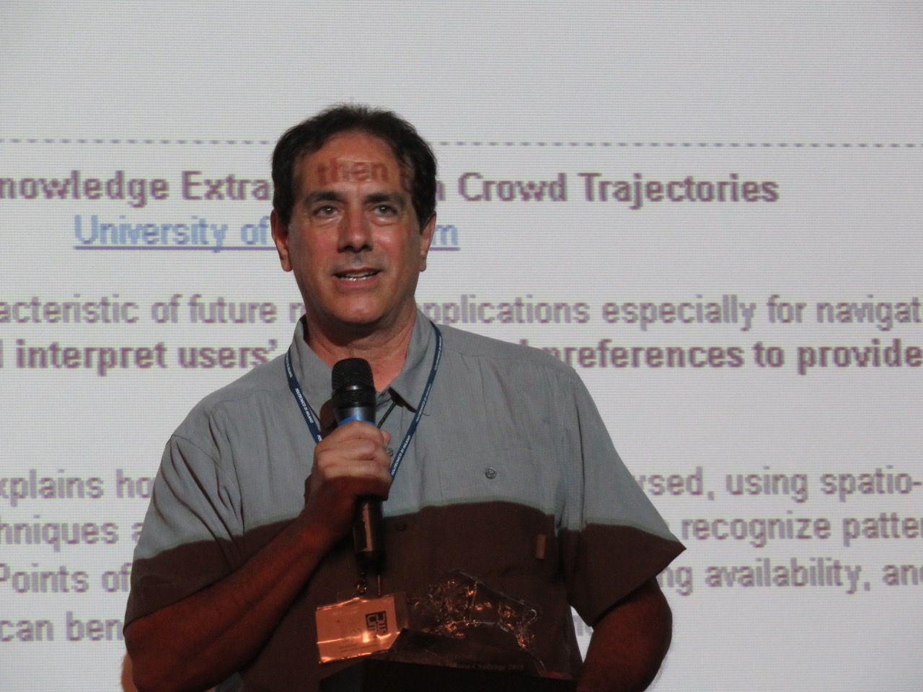

Winner of the WWEC 2015
First Prize in Academic Track
Kodiak High School, Alaska
Educator: Ron Fortunato
Kodiak High School’s own site :
http://www.edlinesites.net/pages/America_Bridge_Project/Europa_Challenge
The open hardware and software Global Earthquake Forecast System they generated and are ready to share, is there providing live data, http://gefs.trilliumlearning.com/ It identifies earthquakes several hours to a couple days before the event. Including identifying the location of the earthquake’s hypocenter at depth, all before it happens. www.aWorldBridge.com

Slide 8
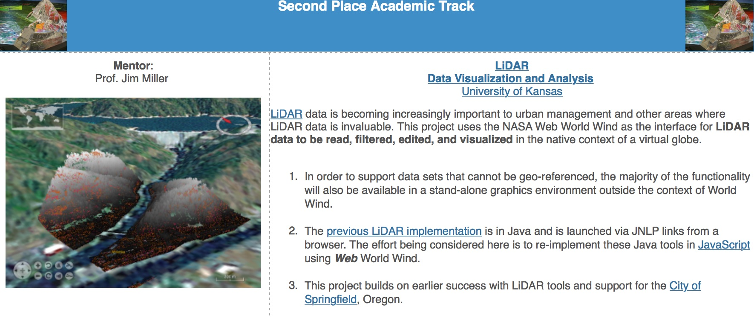
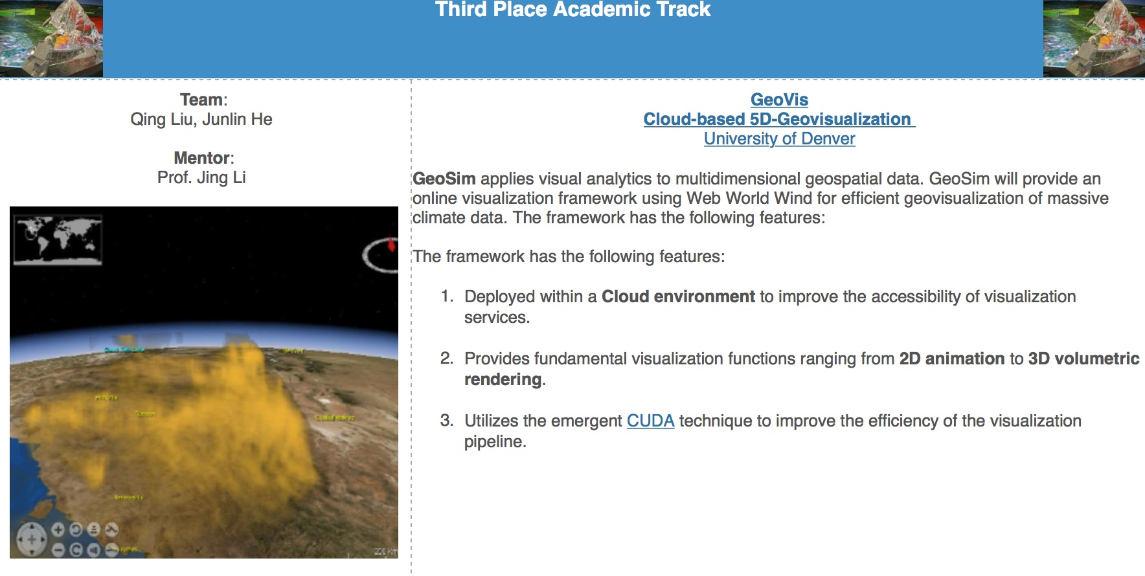
Winners of the WWEC 2015
In Academic Track

Slide 9
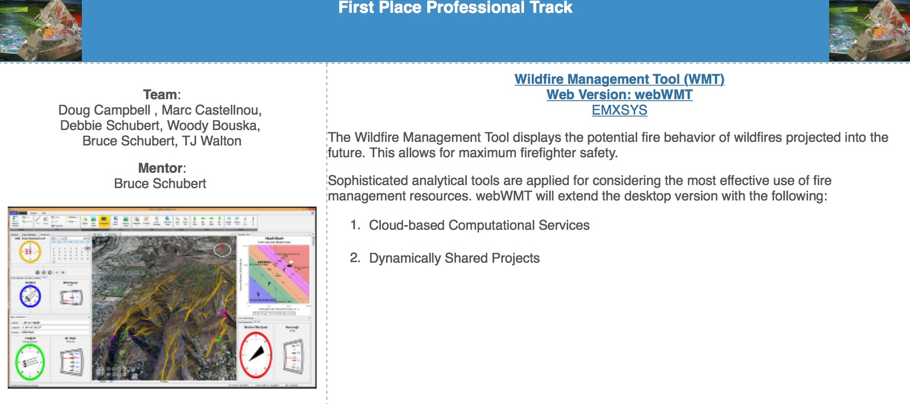
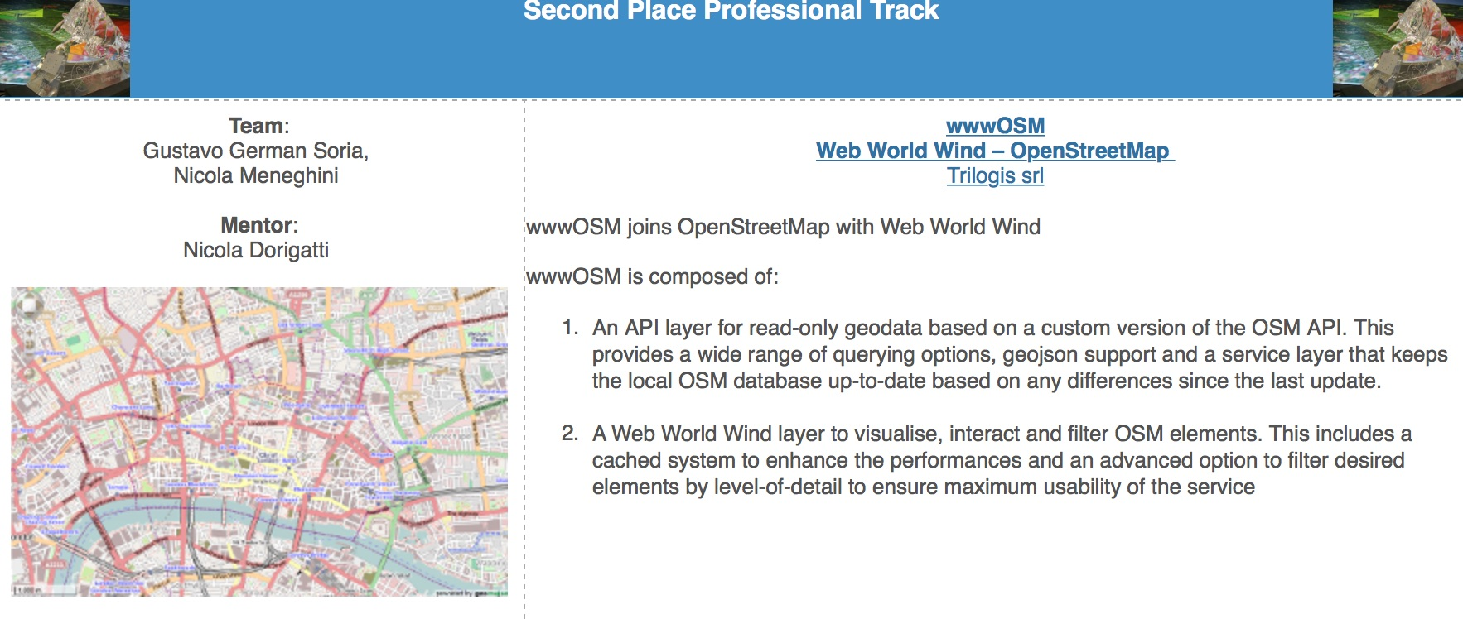
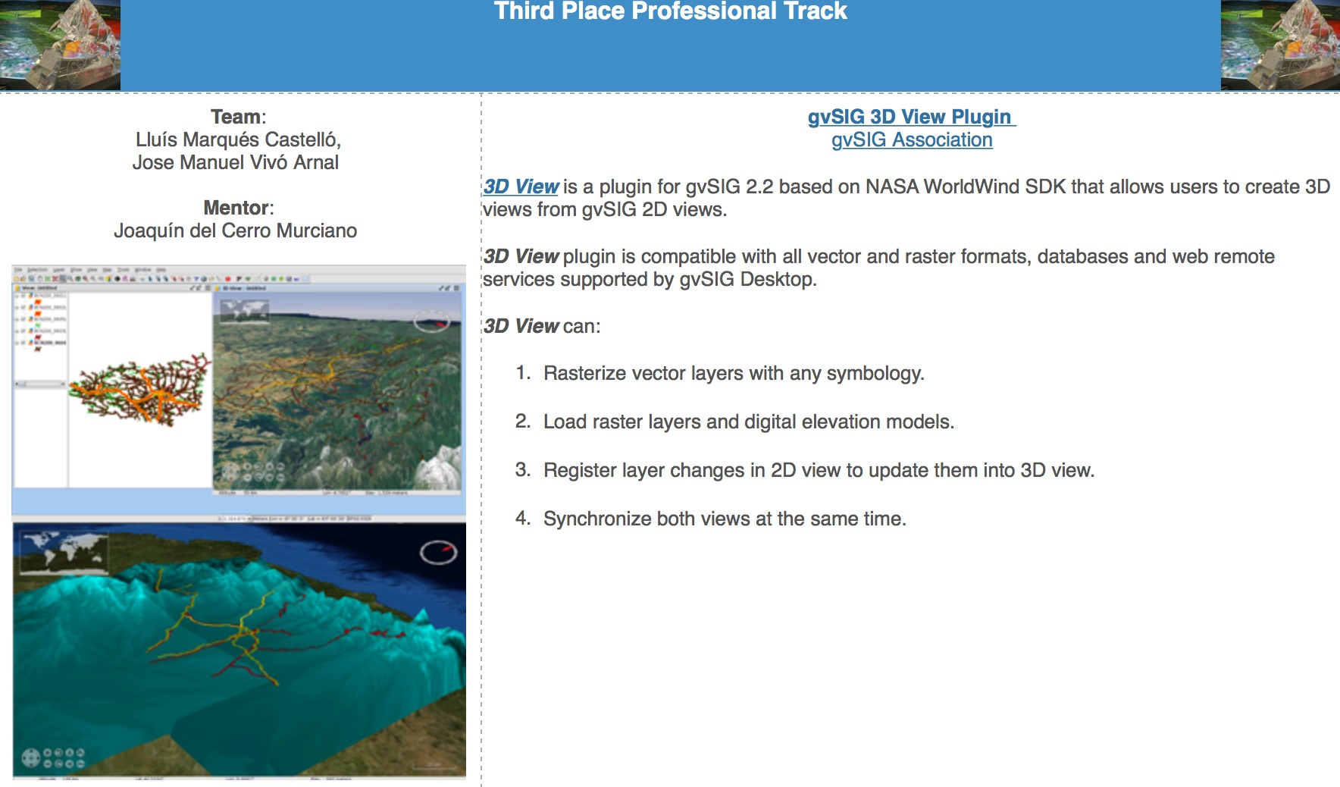
Winners of the WWEC 2015
Professional Track

Slide 10
NASA World Wind
A sound open-source base for development and apps
The 2009 NASA software of the year award
Prime developer Tom Gaskins, sole-author of the bible on computer graphics over 20 years ago, actually two of them (at a 1,000 pages each) http://www.oreilly.com/pub/au/280.
The developing team at NASA ARC is very experienced
Capable to work on every platform: .NET, Java, Android, iOS, and now the most work will go into the JavaScript web version.
Many US Government agencies use WorldWind, particularly the Air Force. And the US Federal Aviation Agency (FAA)has standardized on WorldWind, they are using WWj now but plan to begin using WebWorldWind next. http://worldwind.arc.nasa.gov/temp/faa/NESAT3DDemo.mp4

Slide 11
Beyond WWEC 2015
Commitments for WebWorldWind worldwide
Recently two European and one Australian government
agencies are standardizing on WebWorldWind
In Europe
The EU’s ‘big data portal’ effort, www.EarthServer.eu
E.G. JACOBS UNIVERSITY
The European Weather Forecast Service, www.ecmwf.int
.
To be mentioned: the European Space Agency Two full-time developers now embedded In the NASA team, to advance KML GeoJSON, analytic surface, annotations, etc. (Pier Giorgio Marchetti is also involved) https://www.linkedin.com/in/piergiorgiomarchetti
In Australia
Australia Nat'l Computational Infrastructure, www.nci.org.au
.

Slide 12
Beyond WWEC 2015
Commitments for WebWorldWind worldwide
At United Nations Institutions
Per their request, meeting with the UNOSAT lead, Dr. Einar Bjorgo, at ESRIN mid-October regarding their interest in WebWorldWind www.unitar.org/unosat.
Similar purpose but separate meeting has already been arranged with UNECE regarding their interest in WebWorldWind.
The UN FAO has a version of WorldWind Android installed on several hundred ToughPads that operate in the field throughout North Africa to track locust activity as part of www.fao.org/ag/locusts/
There will be a WebWorldWind Workshop at the ESA/ESRIN www.EOScience20.org meeting in Frascati October 15 as part of the Hackathon, with the World Wind Chief Architect and Lead Developer. It is a great (and free) opportunity to learn more about WebWorldWind
Looking for new government agencies as partners/users. Their interests are maximally served. (Patrick Hogan, Project Manager, NASA ARC)

Slide 13
Beyond WWEC 2015
Wide range of best practices, basic applications
Here are a couple very basic demo ‘apps’:
http://188.166.37.211:8089/examples/GeoJSON.html
http://188.166.37.211:8088/examples/AnalyticalSurface.html
http://worldwind.dimaestro.cz/index.html
And more examples here:
http://webworldwind.org/examples/
Example for how easy it is to deliver data (time series included):
Using http://worldwindserver.net/webworldwind/apps/Explorer.html
then copy this URL to “Add new server”:
http://apps.ecmwf.int/wms/?token=MetOceanIE
Keep this CORS issue in mind as you leverage WMS-compliant servers:
http://webworldwind.org/developers-guide/common-problems/

Slide 14
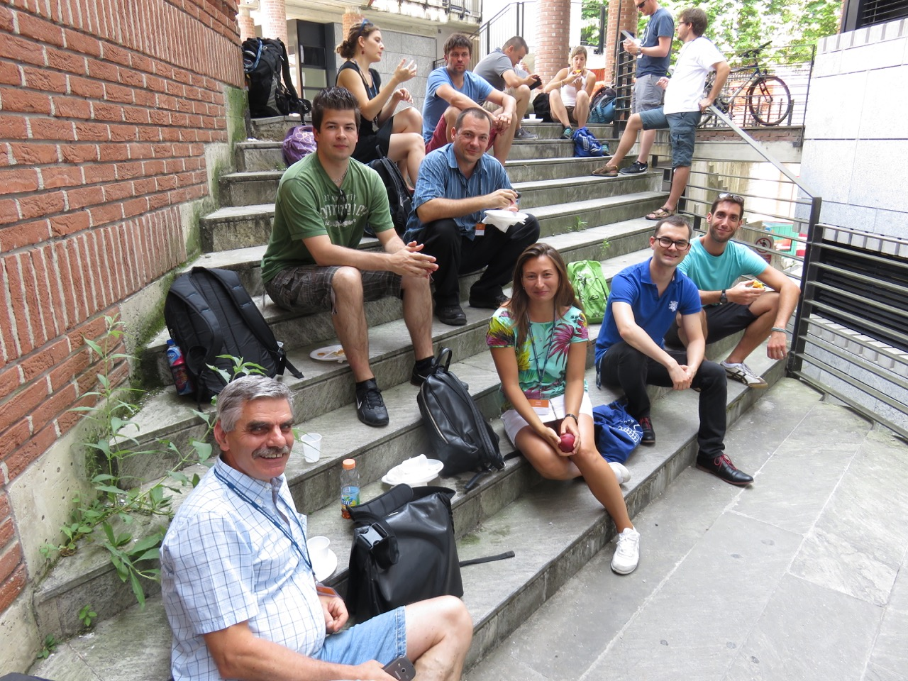
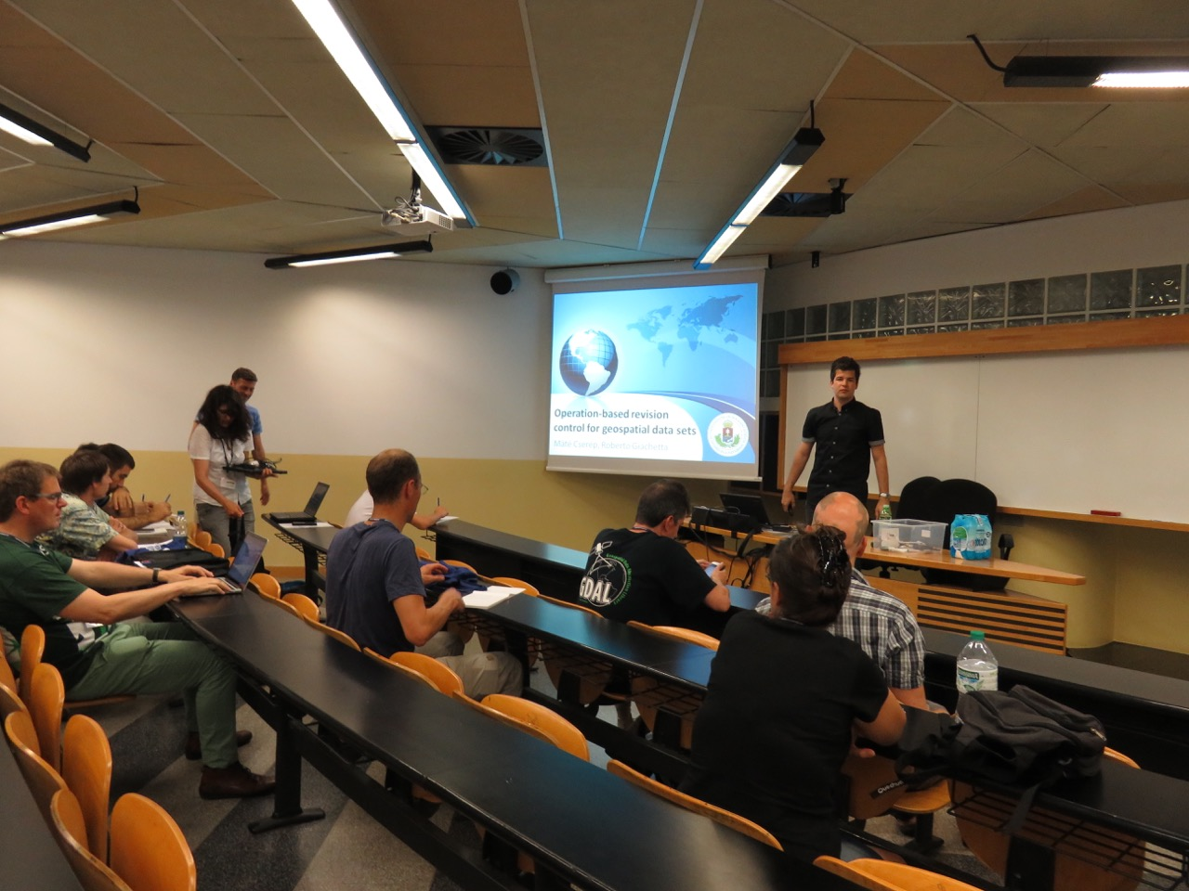
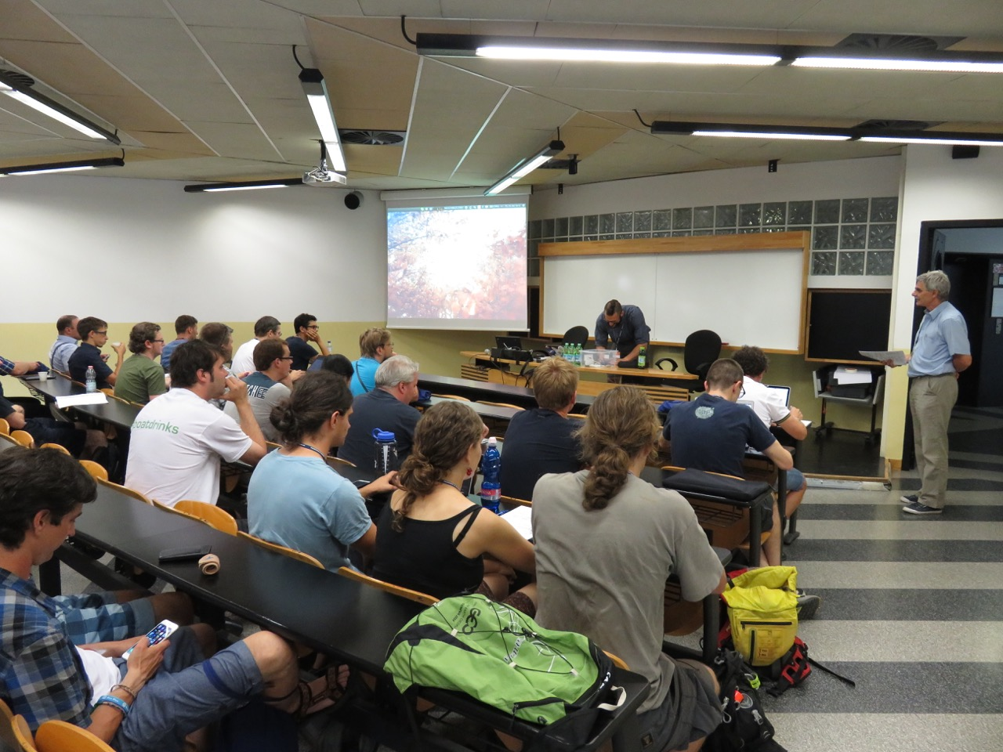
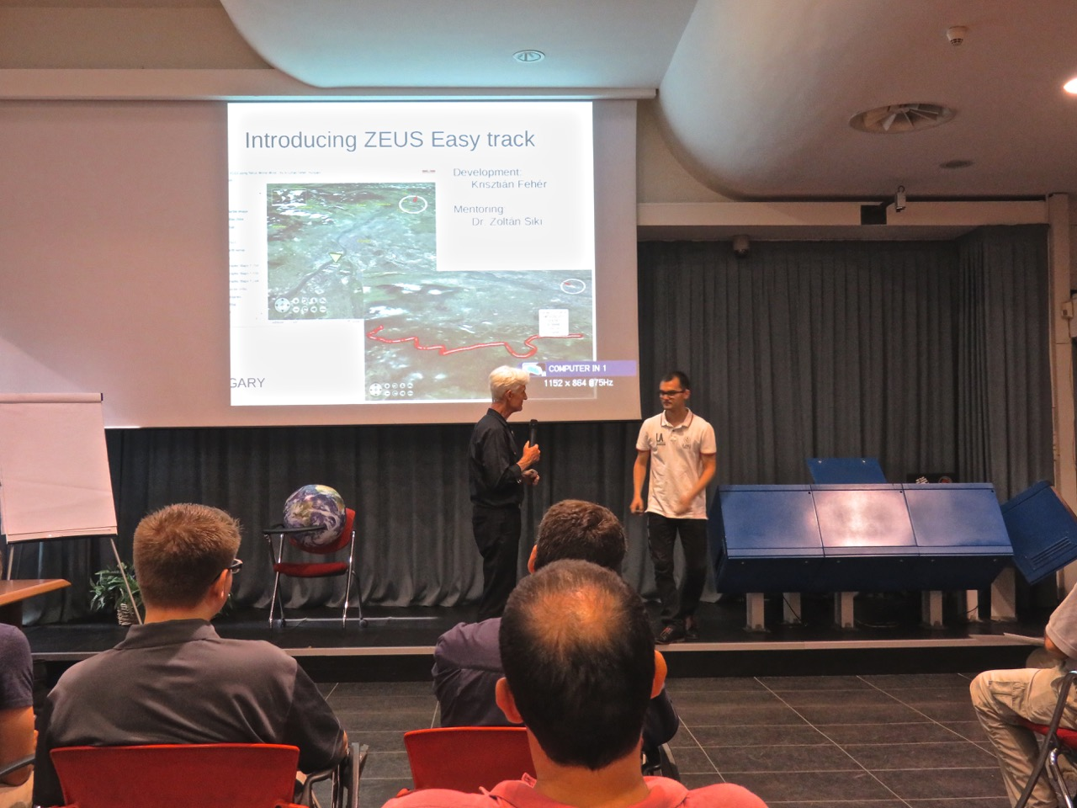
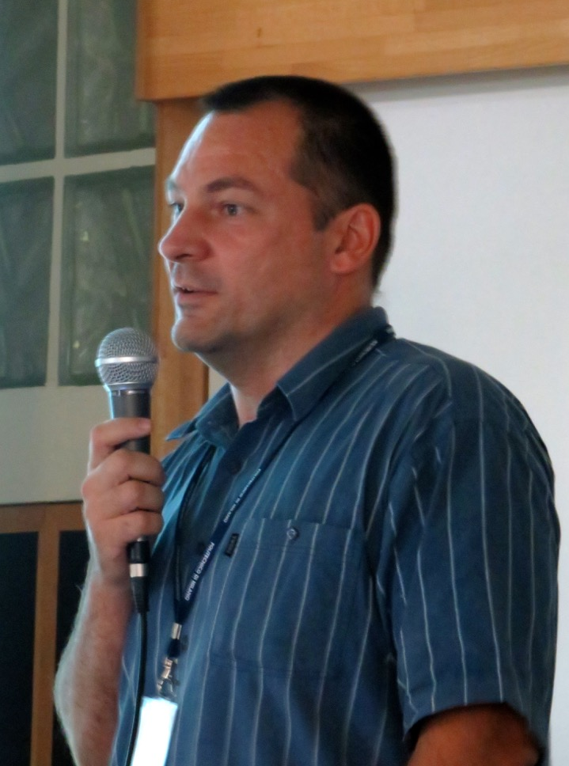


Beyond WWEC 2015
Open source in Hungary
Showcase at the
2nd FOSS4G Europe Conference in Como
Hungary was represented by academic institutions (M. Cserép of ELTE, E. Wirth and Z.Siki of BME), NGO (G. Remetey of HUNAGI) private sector (Cs.Sándor, G.Márta of ViaMap Ltd) and governmental organisation (A. Olasz and K.Takács of FÖMI), one expert from OVF and B. Simó of MFGI
Annual FOSS4G.HU Meeting foss4g.hu
Department of Geodesy and Surveying
Budapest University of
Technology and Economics
November 27, 2015
For more information: siki.zoltan [at] epito.bme.hu
Open source tools used for RS/EO: GRASS and QGIS are supported by OSGeo, ORFEO is still in OSGeo incubator stage
Hungarian
Presenters included
M.Cserép
Z.Siki
K.Fehér,
K.Takács

Slide 15
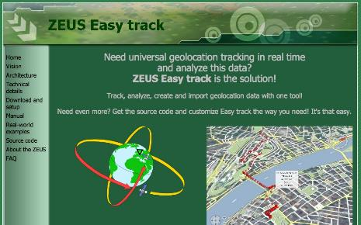
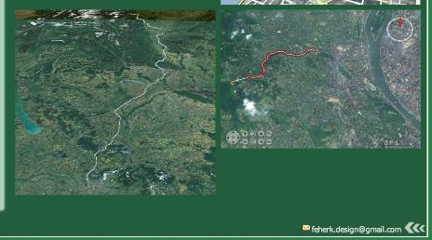
HUNAGI member presented at the WWEC 2015
ZEUS Easy Track by Krisztián Fehér
Result of a 4 man-year development
Vision: ZEUS Easy track's goal is to give
the possibility to everyone to create
custom, universal real-time tracking
and analysis systems for nearly no
extra cost.
Potential app areas, which can be
Supported include - transport, - public traffic - law enforcement,- defense - disaster management, - logistics - traffic analysis,- airplane tracking - sports and outdoor activities - remote supporting activities.
Features: opensource, website
contains manual, detailed info on
architecture, real-world examples,
Download and setup, sourcecode
http://feherkrisztian.magix.net/public/easy/vision.html

Slide 16
Conclusions
Why industry and government especially, should be moving ahead with WorldWind?
WebWW: a competitive platform for innovative solution
  e.g. if combined with JRC’s energy evaluation tools, European cities could make the most of JESSICAhttp://ec.europa.eu/regional_policy/index.cfm/EN/funding/special-support-instruments/jessica/
  Capable for proposals serving MYGEOSS, also known as GEOSS Data-CORE element: https://ec.europa.eu/jrc/en/news/mygeoss-first-call-innovative-apps-environmental-and-social-domains, http://digitalearthlab.jrc.ec.europa.eu/mygeoss/index.cfm

Slide 17
Acknowledgements
Patrick Hogan, NASA Ames RC, Moffet Field
patrick.hogan@nasa.gov
Prof.Maria.A. Brovelli, Politecnico Milano at Como
maria.brovelli@polimi.it
Marco Negretti WWEC Website Manager (PoliMiComo)
Dr. Zoltán Siki, Budapest Univrsity of Technology and Economics

Slide 18

Thank you for your attention!

