Slide 1
WGISS-40: IDN Report
Michael Morahan
WGISS-40 Fall meeting / Harwell, United Kingdom
2015-10-01

Slide 2
Outline
WGISS-39 Action Item Review
  Action WGISS-39-19 and WGISS-39-19
IDN Usage/Metrics
Continuity of Support for IDN
What’s Changing in the IDN

Slide 3
WGISS-39 IDN Action Items
Action WGISS-39-18: IDN Interest Group to reword the phrase “create CEOS dataset” to “Collaborate with IDN” on the Beta IDN website by WGISS-40. Completed
Revised Phrase Box Link

Slide 4
WGISS-39 IDN Action Items
Action WGISS-39-19: IDN Interest Group to identify alternate terminology for the term “portals” used on the Beta IDN website by WGISS-40. Completed
Removed Portal Reference
Removed Portal Reference

Slide 5
IDN Site
August 2014 – August 2015
 | Counts | % year difference
Total Visits | 35,556 | +26.36%
Average Daily Visits | 90 | +28.29%
Average Monthly Visits | 2,735 | +22.37%
Total Views | 73,765 | +21.59%
Average Daily views | 186 | +21.57%
Notes:
CEOS IDN Web Sites: Executive Dashboard August 1, 2014 - August 31, 2015

Slide 6
IDN Usage
August 2014 – August 2015
CSW Usage
 | Counts | % year difference
Total Visits | 16,944 | -61.06%
Average Daily Visits | 42 | -61.47%
Total Views | 1,186,406 | -28.52%
Average Daily views | 2,995 | -28.54%
OpenSearch (CWIC) Usage
*First year in Production
OpenSearch (CWIC)* | Counts
Total Visits | 14,900
Average Daily Visits | 37
Total Views | 41,848
Average Daily views | 105
6
Notes:
Get last % different

Slide 7
IDN Usage by Continent
August 2014 – August 2015
Number of Visits (Total Visits=35,556)
3715
6480
8960
1478
1085
1492
*Not able to identify 12346 visitors
7
Notes:
Asia, North America, Europe, Africa, South America, Australia

Slide 8
IDN Usage by Country
August 2014 – August 2015
Top 10 Countries:
1. United States
2. India
3. Korea, Republic of
4. China
5. Canada
6. Iran
7. United Kingdom
8. Australia
9. Russian Federation
10. Indonesia
8
Notes:
From gcmdsrv1

Slide 9
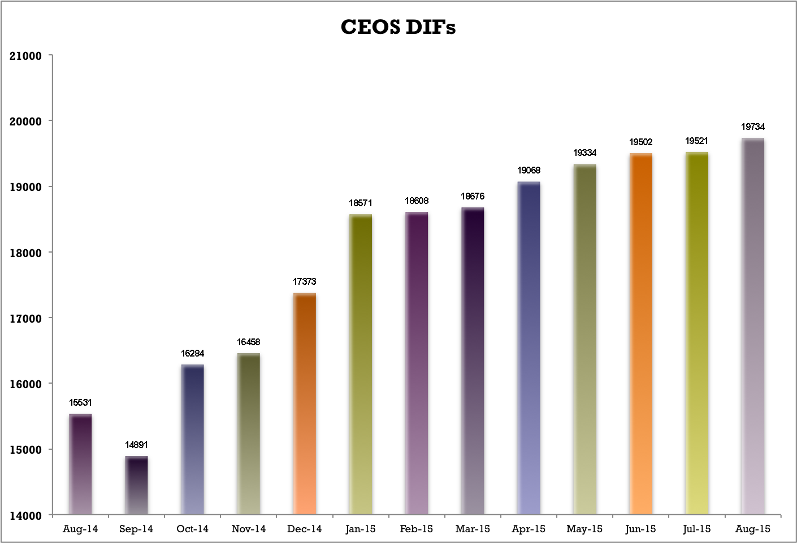
Number of CEOS Metadata Records
27.06% increase for the year
DIFs
Months

Slide 10
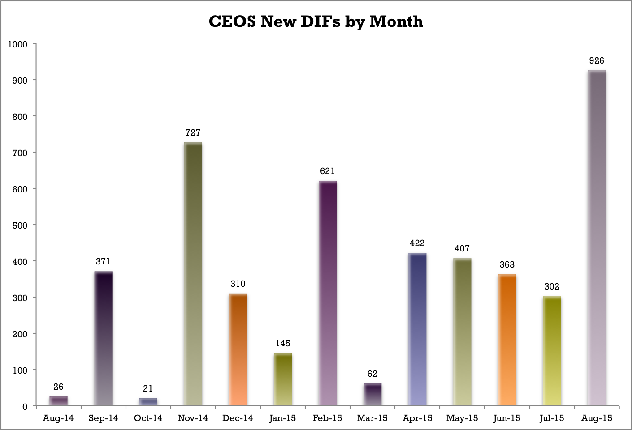
Number of New IDN Metadata Records
DIFs
Months

Slide 11
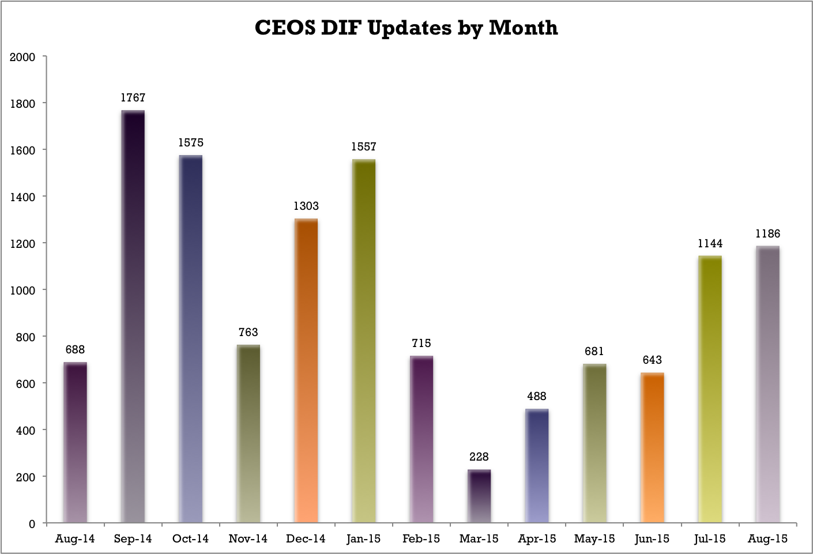
Number of IDN Records Updated
DIFs
Months

Slide 12
IDN Statistics Page
Stats:
    CEOS DIF counts
    CEOS DIFs by Parameters
    CEOS DIFs by Source_Name Bucket (Platform Type)
    CEOS DIFs by IDN_Node
    CEOS DIFs by Data Center
http://idn.ceos.org/idn-resources/stats_ceos_dif_count.pdf
Notes:
Last Day of Harvest was May 3

Slide 13
Continuity of Support for IDN

Slide 14
Continuity of Support for IDN
No Changes (during Common Metadata Repository (CMR) transition):
  Keyword Management System (KMS)
  Catalog Services for the Web (CSW)
Notes:
* consider question "will IDN providers be expected to migrate from DIF9 to DIF10?

Slide 15
GCMD Planned Keyword Releases
Science Keyword Release | Science Keyword Topics | Date
Version 8.1 | (Land Surface and Atmosphere) | (March 2015)
Version 8.2 | (Atmosphere, Ecosystem, and Terrestrial Hydrosphere) | March 2016
Version 8.3 | (Water Vapor, Water Quality/Chemistry, and Ecosystems) | September 2016
*Send proposed changes for 8.3 by April 16
Notes:
General background
Why and UMM-C
Summary list of benefits for using DIF10
Discuss and questions

Slide 16
IDN Beta Site: “Sort” Options
New Sort Options

Slide 17
What’s Changing in the IDN

Slide 18
How IDN will work with the CMR
IDN records would eventually move to the CMR
  Transition of metadata records to the CMR (by November 2015)
  Support QA of CEOS and other non-NASA metadata in the CMR
Notes:
* consider question "will IDN providers be expected to migrate from DIF9 to DIF10?

Slide 19
  Transition: GCMD APIs to CMR APIs
Changes (November 2015):
Decommissioned API: | Switch to the following:
Metadata Web Service (MWS) API | CMR Search API
GCMD OpenSearch | CMR OpenSearch
Notes:
Other DIF10 Tool: QAtool CrossWalk

Slide 20
  New CMR Provider IDs
All 31 CEOS Members and 24 Associate Members will be assigned their own Provider_ID for Metadata Search/Ingest for CMR.
Notes:
Other DIF10 Tool: QAtool CrossWalk

Slide 21
Summary list of benefits for using DIF-10
UMM-C compliance for the Common Metadata Repository.
Additional compatibility with ISO
New Fields to describe the datasets
  AdditionalAttribute
  ProductLevelId
  Version
Restructured existing fields to better describe the datasets
  Platform > Instrument > Sensor hierarchy
  PersistentIdentifier
  Spatial_Coverage
DIF-10 Documentation: http://gcmddemo.gsfc.nasa.gov/DocumentBuilder/defaultDif10/guide/index.html
Notes:
General background
Why and UMM-C
Summary list of benefits for using DIF10
Discuss and questions

Slide 22
DIF-10 Translator
What it does:
  Converts DIF-9 to DIF-10
  Fills in missing required UMM-C fields where possible
If you are interested in using the translator, please contact GCMD/IDN User services: gsfc-gcmduso@mail.nasa.gov or Michael.P.Morahan@nasa.gov
Notes:
Other DIF10 Tool: QAtool CrossWalk

Slide 23

docBUILDER-10 Beta
Performs same functionality as docBUILDER-9
  allows metadata authors to add (or modify) data set descriptions (DIFs)
Writes metadata to the new DIF-10 format, validates, generates QA reports, and submit DIFs directly to the CMR.
docBUILDER-10 Link:http://gcmddemo.gsfc.nasa.gov/DocumentBuilder/Home.do?MetadataType=7

Slide 24
New Features of docBUILDER-10
Enhanced inline QA Assessment of field content, syntax, verification of controlled keywords, and completeness using customized QA rules
Import and export metadata to and from the Common Metadata Repository (CMR).
More inline documentation with tool-tips
Supports the 8 new fields and 16 restructured fields for DIF-10

Slide 25
docBUILDER-10: Generation/Status Page

Slide 26
Stay Connected
If you want to read more
  Release announcements Archive link: http://idn.ceos.org/idn-resources/Interop/
  Connecting to the Available Services: http://idn.ceos.org/idn-resources/idn-resources/connect/services
Keep up to date
  docBUILDER: News and downtime notifications on metadata authoring tool (ceos-idn-docbuilder@lists.nasa.gov)
  Interoperability Forum: Release announcements and proposed changes to DIF and SERF (ceos-idn-interop@lists.nasa.gov)
  Email notifications (Send email to gsfc-gcmduso@mail.nasa.gov to sign up)

Slide 27
  Questions
  Michael.P.Morahan@nasa.gov

Slide 28
    DIF-9 fields now required in DIF-10
Entry ID
Entry Title
Summary
Science Keywords
Platform
Platform/Instrument
Temporal Coverage
Spatial Coverage
Project
Organization
Related URL
Metadata Standard Name
Metadata Standard Version
Metadata Creation Date
Product
Previously not required in the GCMD/IDN DIF
Notes:
General background
Why and UMM-C
Summary list of benefits for using DIF10
Discuss and questions

Slide 29
    DIF-10 Changes:
    New enumeration fields
SpatialCoverageType
Organization_Type
PlatformType
Duration_Unit
PersistentIdentifierType
MetadataAssociationType
MetadataAssociationType
PhoneType
Metadata Standard Name
Metadata_Version
ProductFlag
ProductLevelId
Notes:
General background
Why and UMM-C
Summary list of benefits for using DIF10
Discuss and questions

Slide 30
    DIF-10 Changes:
    New fields
Field Name | Field Definition
Version | The version identifier of the data set.
Version_Description | A brief description of the differences between one data set version and another version.
Metadata_Association | Describes the metadata associated with the instance of a data set; i.e., the name and other details of input data, data sets associated (in science data terms) with the instance and/or data sets dependent on the collection.
Metadata_Dates | A union of the DIF metadata event date fields with the three ECHO event time fields.
Additional_Attributes | Parameters which further describe the data represented in each granule within a collection.
Product_Level_Id | The product identifier of the data collection.
Collection_Data_Type | Identifies non-science-quality products.
Product_Flag | Specifies the product type of the data.

