Slide 1
GEO/CWIC Interactions Ken McDonald/NOAA CWIC Session, WGISS–40 October 1, 2015

Slide 2
Topics
GCI Status Overview
GEO Community Portal Activity
Review Purpose, Description and Scope
Update on Progress
Direct GEOSS Interactions with CWIC
Shared Lessons
Common Objectives
Similar Challenges
Opportunities

Slide 3
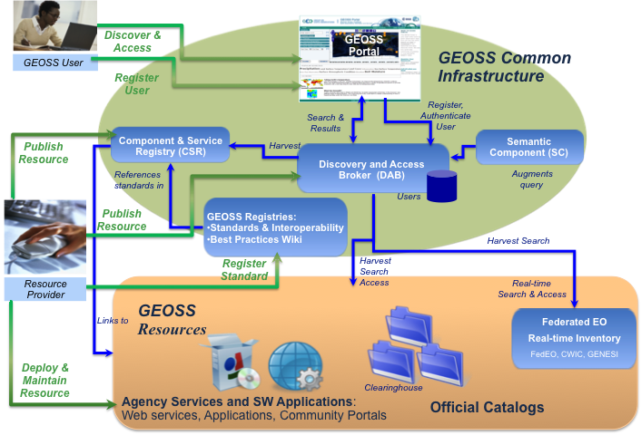
GEOSS Common Infrastructure
GCI Role in GEOSS
GCI key components:
Component and Services Registry (CSR)
Discovery and Access Broker (DAB)
GEOSS Portal
Clearinghouse functions fully provided by DAB
Development/evolution continues

Slide 4
GEOSS Status
GCI in place and operational
Content in CSR continually growing
DAB supports harvesting content and distributed search of large provider systems (CWIC, FedEO, etc.)
GEO Portal gives users path to discover and access all GEOSS holdings
Recognized concerns
Inconsistent registration process
Limited utilization of GEOSS and the GEOSS Common Infrastructure (GCI) by the communities it is intended to support
Initiatives underway to address concerns

Slide 5
GEOSS Going Forward
Greater focus on GCI operations
Regular GCI Provider telecons
Concentrated effort to refine registration process
GCI Providers will address future issues as they arise
Promote, encourage and enable GCI use
Architecture and Implementation Pilots (AIP)
Annual call for projects to implement applications that demonstrate capabilities of GEOSS
Community Portal Recommendations
Capture lessons learned and best practices from communities using the GCI
Construct recommendations to assist future users

Slide 6
Summary of CP Activity
Team composed of GCI Providers and Community Representatives (Water, Energy, Biodiversity…)
Originally limited to Community Portals/Clients
Provide community view of GEOSS resources
Complement capabilities of GEOSS Portal
Scope broadened to look at range of possible interactions between GCI and Community Infrastructures
Allows GCI to better leverage community capabilities
Promotes closer engagement of user communities in sustaining and enhancing GEOSS

Slide 7
Community Portal Role in GEOSS
GEOSS
Community View of
GEOSS Resources

Slide 8
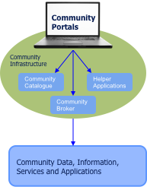
Community Systems Role in GEOSS
GEOSS
Link to/from GEOSS Portal
Community View of
GEOSS Resources
GCI Access to
Community Infrastructure
Enables Integration of
GEOSS and non-GEOSS
Registered Resources
Register Community Resources as Appropriate

Slide 9
Community Systems Role in GEOSS
GEOSS
Link to/from GEOSS Portal
Community View of
GEOSS Resources
GCI Access to
Community Infrastructure
Enables Integration of
GEOSS and non-GEOSS
Registered Resources
Register Community Resources as Appropriate

Slide 10
Community Portal Recommendations Document
Outreach
Introduction/Purpose/Scope
Community Objectives
GCI Description/Capabilities
Demonstrate benefits of active GEOSS participation
Instruction
Tutorials
Recommendations
Structured around each of the potential interfaces
Examples

Slide 11
Community Portals – Near Term Plans
Direct engagement with community projects
CEOS Water Portal
GEO Energy Portal
UNEP-Univ. of Geneva Project
GEO Biodiversity Observation Network (GEO BON)
AIP Projects
Harvest lessons from community experience
Identify problems with GCI that need to addressed
Build recommendations for future community efforts
Share feedback with GEO providers
Continue to update recommendations document
Publish journal article(s) to broaden interest
Start to assemble recommendations based on community experience
WGISS – CWIC - FedEO
Do we have same concerns with respect to community engagement?
Should we more actively engage with GCI, GEO SBAs?
Do we need a WGISS-Smart client or is DAB sufficient?

Slide 12
CEOS as a GEOSS Community
GEOSS
CEOS
Link to/from GEOSS Portal
IDN-
CWIC-FedEO
Clients
Community View of
GEOSS Resources
WGISS
Common
Infrastructure
IDN
CWIC
GCI Access to
Community Infrastructure
FedEO
Enables Integration of
GEOSS and non-GEOSS
Registered Resources
CEOS Agency Systems
Register Community Resources as Appropriate

Slide 13
GEO-WGISS Commonality
Similar objectives of respective efforts
Both building infrastructures to enable discovery, access and use of EO data
GEO has broad scope – all EO data
WGISS focus on satellite observations
Both have rich set of data providers
CEOS agencies through CWIC and FedEO are key GEOSS providers
Generic clients exist for both infrastructures
Provide common discovery and access services for all holdings
Better services possible with community client/portal support

Slide 14
GEO-WGISS Collaboration
Direct interactions – Work Together
As major GEOSS community brokers, IDN-CWIC-FedEO should provide feedback to GCI Providers
Access/performance issues should be addressed together
Especially important as systems become operational
Leverage experience/ideas – Learn Together
Both groups have similar issues concerning user authentication/authorization, results ranking, data quality, etc.
GEO Community Portal activity focused on broadening user base - WGISS might consider proactive approach (Collaborate with VCs, WGs, Develop client toolkit or reference implementation)

