Slide 1
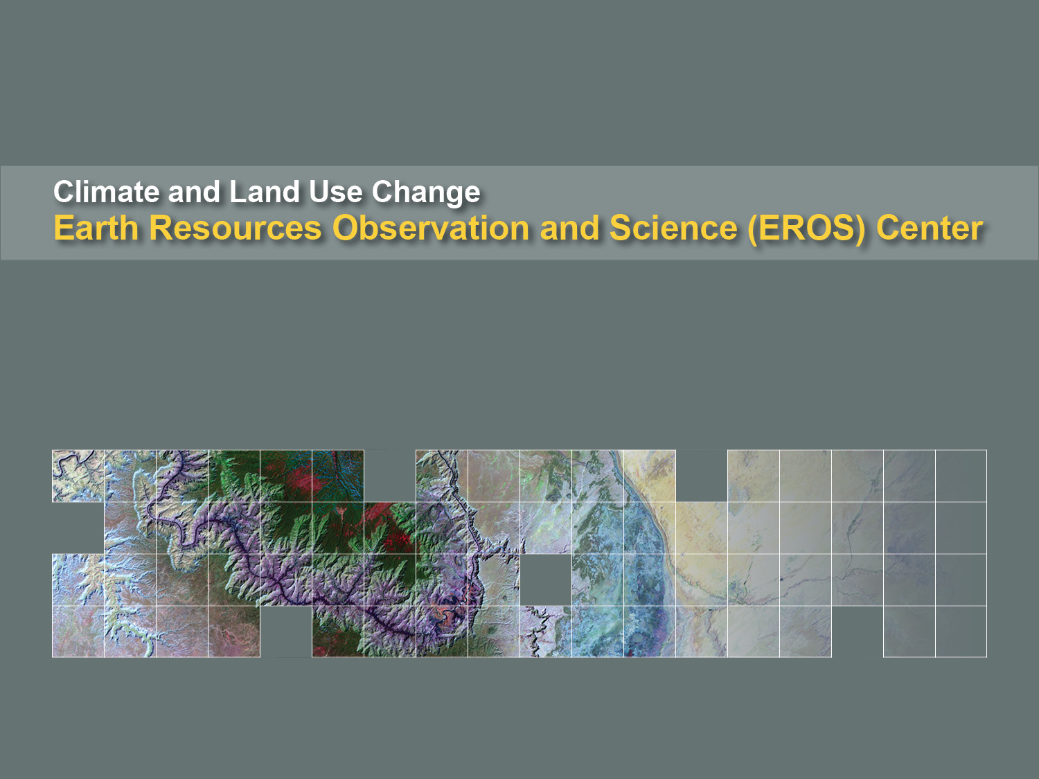
WGISS 40
CWIC Report
Kristi Kline
August 3, 2015
Kristi Kline
September 30, 2015

Slide 2
CWIC Server at EROS
Server more than 5 years old
  Plan to replace with newer system in next year
Security Issues
  Need to implement 2-factor authentication
  Move to different area of the network
    Behind additional firewall
    Security checks and easier management

Slide 3
Current Network

Slide 4
New Architecture

Slide 5
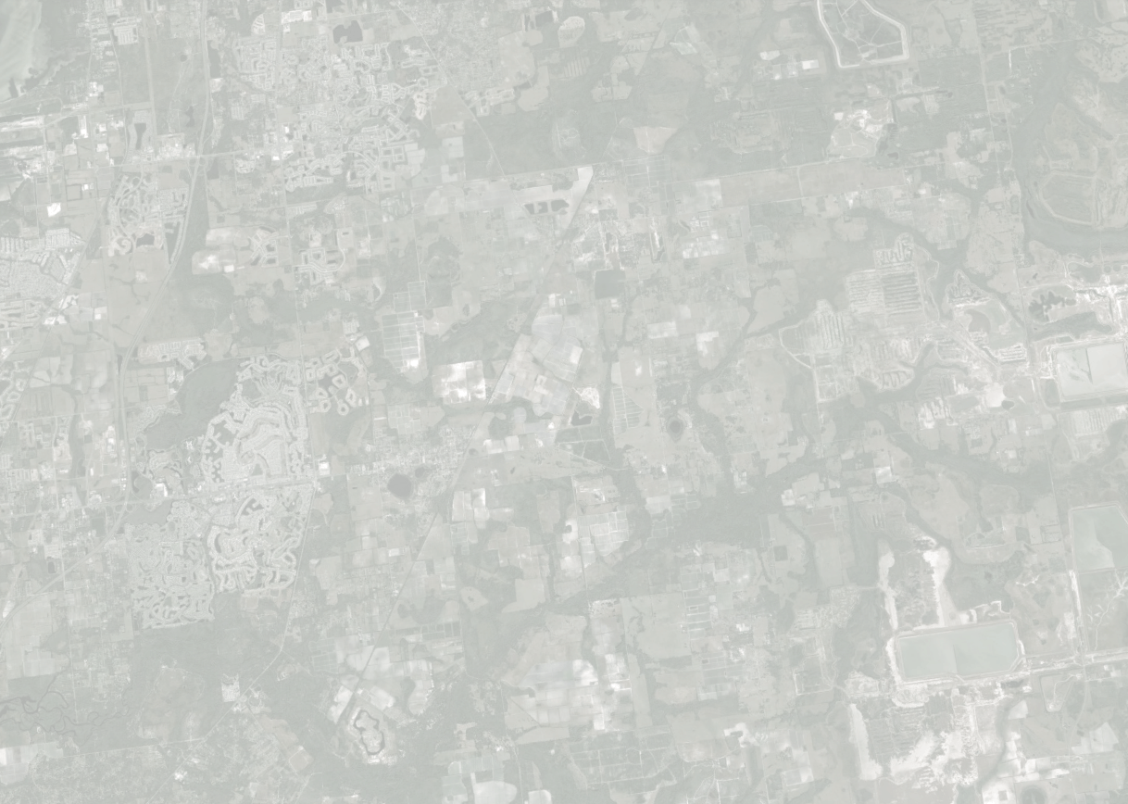

EROS Land-Change System
Concept for a Center-level system that exploits the Landsat archive
U.S. Department of the Interior
U.S. Geological Survey

Slide 6
EROS Land-Change System
Communications, applications services, outreach, and other user and stakeholder support
Analysis-ready Landsat data & derivatives
Assessments of land change (land-cover conversion, change in condition)
Continuous monitoring for change
Identified change

Slide 7
EROS Land-Change System
Communications, applications services, outreach, and other user and stakeholder support
Analysis-ready Landsat data & derivatives
Assessments of land change (land-cover conversion, change in condition)
Continuous monitoring for change
Identified change

Slide 8
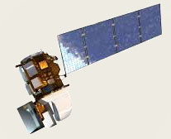
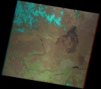
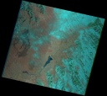

EROS Land-Change System
Analysis-ready Data
Single Scene Processes
Level 1
Surf. refl. / Surf. temp.
Corrections, adjustments, projections, tiles, stacks, masks, compositing are processed for the user.
Re-project to output space
Single Scene
Products
On-line Storage
Single Scene
Products
Multi-scene
Products
Multi-scene Processes
Compositing
Masking
Stacking
Other

Slide 9
Analysis Ready Data (ARD) for LCMAP
Key ARD Product Attributes
  Surface reflectance and brightness temperature
  QA bands with attributes for zero-fill, clouds, cloud shadow, cirrus (OLI only), snow/ice, terrain occlusion (OLI only), and radiometric saturation
  Albers Equal Area projection for conterminous U.S., Alaska, and Hawaii (see next slide)
  Data will be managed as tiles, not scenes, the dimensions of which are TBD
  Date range extends back to 1982 (Landsat 4 TM) through present (Landsat 8 OLI)
    “core’ temporal coverage is 1985 - 2015

Slide 10
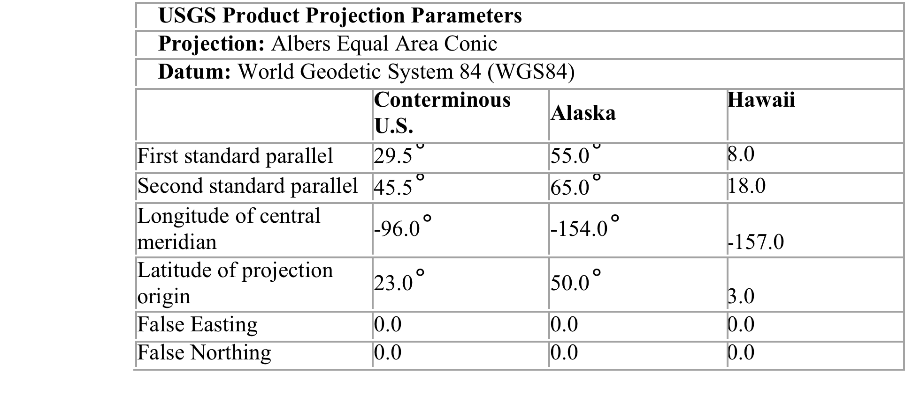
Albers Equal Area Projection

Slide 11
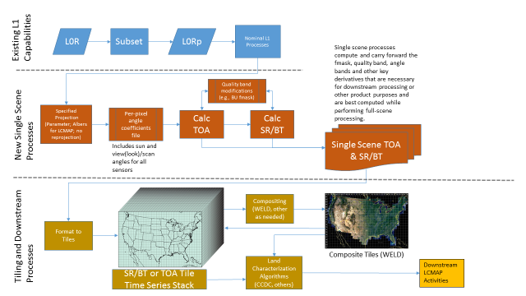
Notional Data Flow for LCMAP ARD

Slide 12
EROS Land-Change System
Communications, applications services, outreach, and other user and stakeholder support
Analysis-ready Landsat data & derivatives
Assessments of land change (land-cover conversion, change in condition)
Continuous monitoring for change
Identified change

Slide 13
EROS Land-Change System
Continuous Monitoring
Collection of algorithms to identify types and timing of abrupt and gradual change on a per-pixel basis
New: Incorporate pixel data from every available overpass to meet information requirements of a collection of algorithms that detect various forms of land change at various time-steps.
e.g.,
A continuous-monitoring algorithm that takes advantage of the full depth of the Landsat archive.
Developed by Boston University with support through the Landsat Science Team. Algorithm now under assessment at EROS via leveraged collaboration with BU.

Slide 14
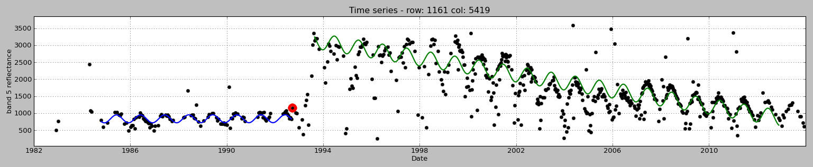
The spectral history of a pixel.
Gradual change
Landsat Band 5 observed reflectance per overpass
Reflectance (scale factor 0.0001)
1984 1986 1988 1990 1992 1994 1996 1998 2000 2002 2004 2006 2008 2010 2012
Date
Abrupt break in pattern of temporal sequence of reflectance levels
Model trajectory for estimated reflectance

Slide 15
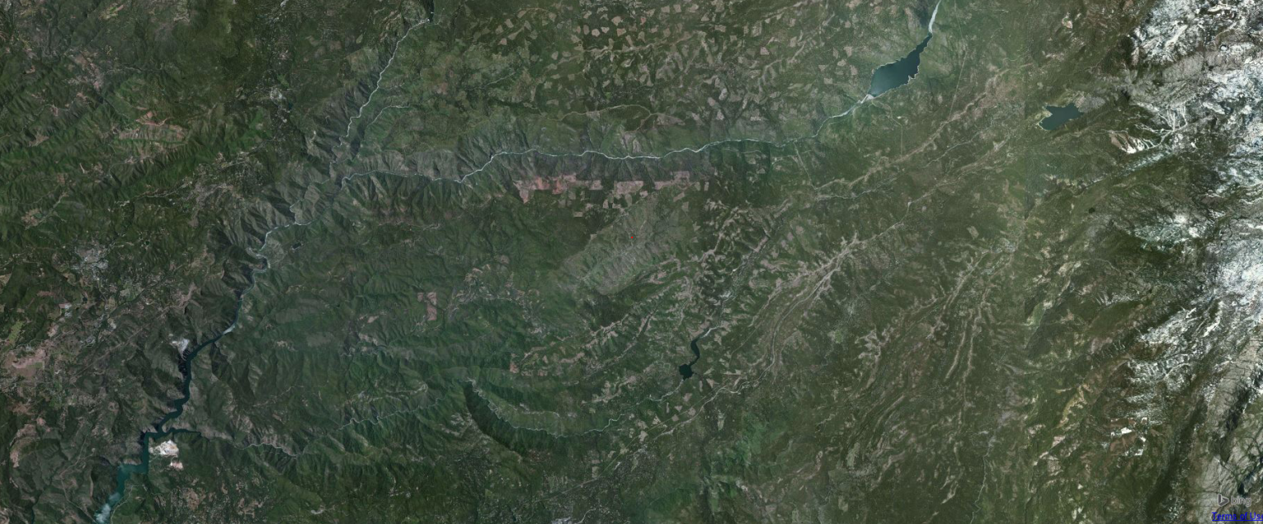
The spectral history of a pixel in Stanislaus National Forest, California
This pixel
from 1984 to 2013
Landsat Band 5
Reflectance (scale factor 0.0001)
1984 1986 1988 1990 1992 1994 1996 1998 2000 2002 2004 2006 2008 2010 2012
Date

Slide 16
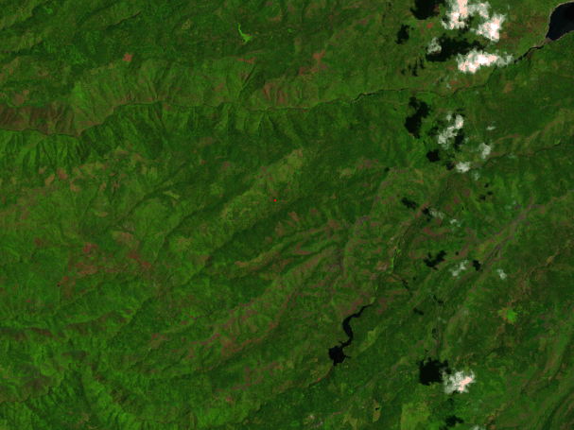
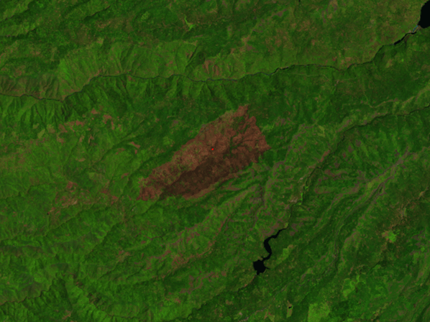
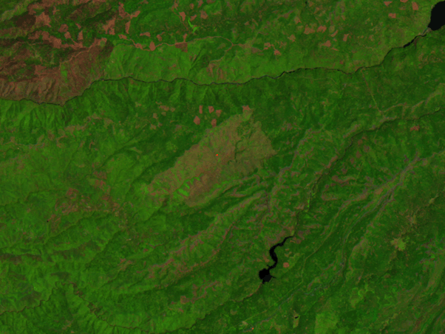
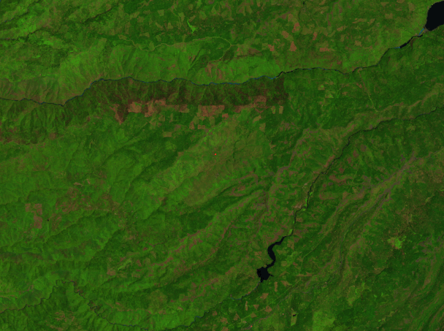
Pre-fire
Crop field
Year fire occurred
Post-fire recovery
Longer-term recovery
Landsat Band 5
Reflectance (scale factor 0.0001)
1984 1986 1988 1990 1992 1994 1996 1998 2000 2002 2004 2006 2008 2010 2012
Date

Slide 17
EROS Land-Change System
Communications, applications services, outreach, and other user and stakeholder support
Analysis-ready Landsat data & derivatives
Assessments of land change (land-cover conversion, change in condition)
Continuous monitoring for change
Identified change

Slide 18

EROS Land-Change System
Abrupt Change
Document Historical
Maps of thematic land cover/change
Maps of footprints of change
Maps of timing of change
etc.
Flag pixels identified as exhibiting change and document type, (New) timing, and duration of change.
Detect land change as it occurs
Maps of current land cover and recent change
Recent footprints of change
Gradual Change
Characterize land-cover condition; identify trends; cyclical phase shifts; other gradual change.
Maps of types, rates, locations, timing, and duration of gradual-change
Maps of phenological characteristics

Slide 19
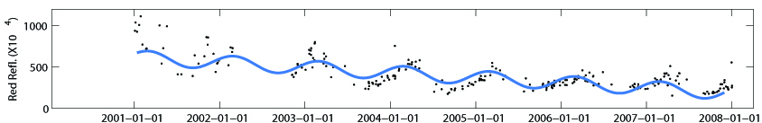
EROS Land-Change System
Continuous Monitoring
Collection of algorithms to identify types of abrupt and gradual change on a per-pixel basis
Abrupt Change
Intact forest
Thinning
Clearcut
abrupt change
Gradual Change
Post-disturbance revegetation

Slide 20
EROS Land-Change System
Communications, applications services, outreach, and other user and stakeholder support
Analysis-ready Landsat data & derivatives
Assessments of land change (land-cover conversion, change in condition)
Continuous monitoring for change
Identified change

Slide 21
EROS Land-Change System
Assessments
Syntheses of the geography of land change, land-change processes, characteristics, and consequences relevant to USGS stakeholders. Both scheduled standard and ad hoc topics should be conducted.
Produce cyclical and special-topic assessments of land change. New: Initiate annual “State of the Nation” reports on land change and institute targeted “stakeholder alerts.”
Annual land-change assessments (‘State of the Nation’ reports)
Topical assessments (current events, emerging issues, other high-interest topics)
Stakeholder alerts
Projections
Projected patterns of future land use, land cover, and/or land conditions that address potential interactions between current environmental characteristics and drivers of change (e.g., climate, socioeconomic, legislative).
Maps of trajectories of projected land change
Maps of likelihood of change
Maps of directions/intensities of change
Regional scenarios of change

Slide 22
EROS Land-Change System
Communications, applications services, outreach, and other user and stakeholder support
Analysis-ready Landsat data & derivatives
Assessments of land change (land-cover conversion, change in condition)
Continuous monitoring for change
Identified change

Slide 23

EROS Land-Change System
Communications, applications services, outreach, and other users and stakeholder support
Communications & outreach
Web-based access to all products
Web-based analysis portal
Applications support
New: Get answers without moving data!

Slide 24

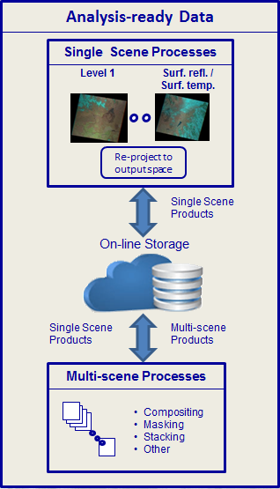
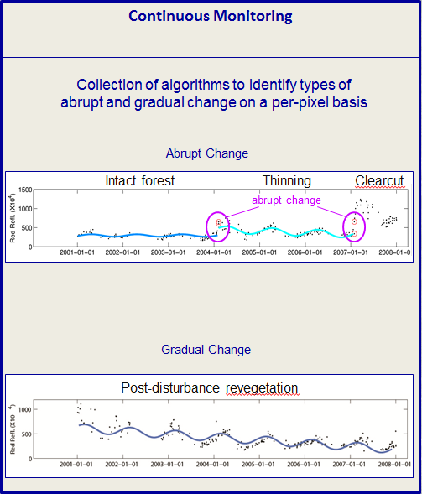
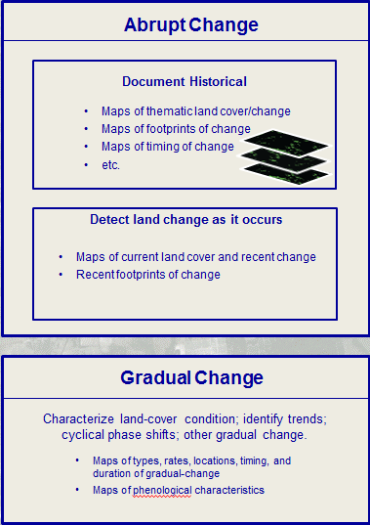
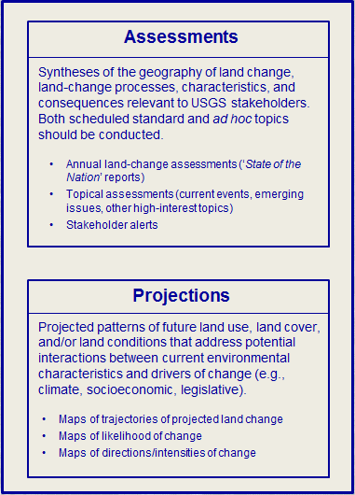

EROS Land-Change System
(connections and other important details)
Communications, applications services, outreach, and other users and stakeholder support
Communications & outreach
Web-based access to all products
Web-based analysis portal
Applications support
Continuous Monitoring
Spatial analyses of change
Information Warehouse and Data Store
Metadata
Land cover change/condition products
Outputs from assessments
Non-Landsat remote sensor data
Satellite data
Airborne
Non-Landsat rem. sens. prods.
DEMs & derivatives
Orthoimagery
Evapotranspiration
Vegetation phenology
Others
Ground-based data
Cal/Val data
Land cover accuracy/valid.
Others

Slide 25
EROS Land-Change System
(Example R&D opportunities)
Analysis
portal: get
answers, not data.
Communications, applications services, outreach, and other users and stakeholder support
Communications & outreach
Web-based access to all products
Web-based analysis portal
Applications support
R&D
Continuous Monitoring
Spatial analyses of change
Method
trade-offs
Multidimensional change visualization
Relations
between climate
and land-use change
Gradual-change algorithms.
External data
Information Warehouse and Data Store
Metadata
Land cover change/condition products
Outputs from assessments
Non-Landsat remote sensor data
Satellite data
Airborne
How to store pixel response histories
Non-Landsat rem. sens. prods.
DEMs & derivatives
Orthoimagery
Evapotranspiration
Vegetation phenology
Others
Ground-based data
Cal/Val data
Land cover accuracy/valid.
Others

Slide 26

Questions / Comments ?

