Slide 1
WGISS-41 and WGCV-40 Logistics Information
Canberra Australia, 2016
CEOS Working Group on Information Systems and Services (CEOS-WGISS) & CEOS Working Group on Calibration and Validation (CEOS-WGCV)

Slide 2
Welcome to Geoscience Australia
Australia’s national geoscience agency
Applying geoscience to Australia’s most important challenges
Focus areas:
Resources wealth
Community safety
Water resources
Maritime jurisdiction
Fundamental geographic information
National geoscience capability
Integrates:
Australia’s geological and geophysical survey
Australia’s land information and mapping group
Australia’s centre for remote sensing

Slide 4
WiFi
CEOS Working Group on Information Systems and Services (CEOS-WGISS) & CEOS Working Group on Calibration and Validation (CEOS-WGCV)

Slide 5
On-Site
Bathrooms – Across the foyer
Café – back of the foyer
Closed today – lunch provided
Library, foyer displays and education centre
Please visit!
GA TimeWalk
Emergency Procedure
Follow instructions of GA staff
Side Meeting Facilities
Contact Alla, Medhavy or Jono

Slide 6
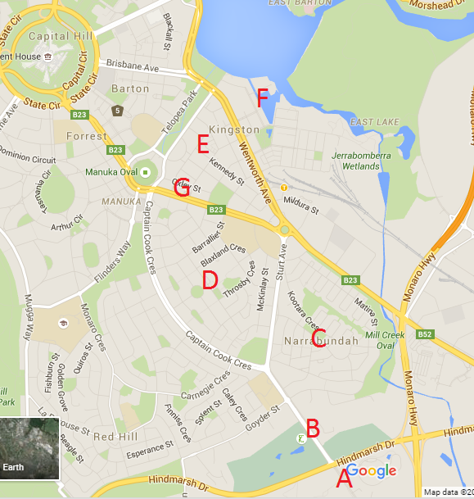
Local Area
Narrabundah Shops [C]
Walking distance
Chemist
Small supermarket
Restaurants - XO, La Cantina
Griffith Shops [D]
Griffith Vietnamese
Gryphons (Pub)
Kingston Shops [E]
Kingston Foreshore [F]
Many places (tonight)
Kingston Hotel (Pub) [G]
Lake Area
Jogging/Walking

Slide 7
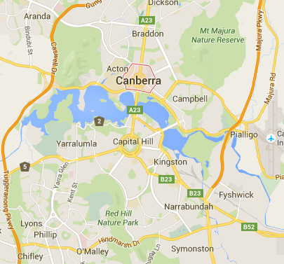
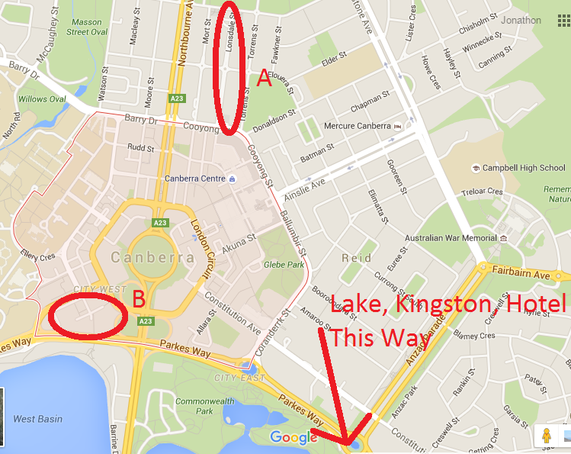
City
Lonsdale Street [A]
Restaurants (Lots)
Quirky Shops
Bentspoke Brewery
Wear Your Beard
New Action
Restaurants
Canberra Centre
Big Mall
C

Slide 8
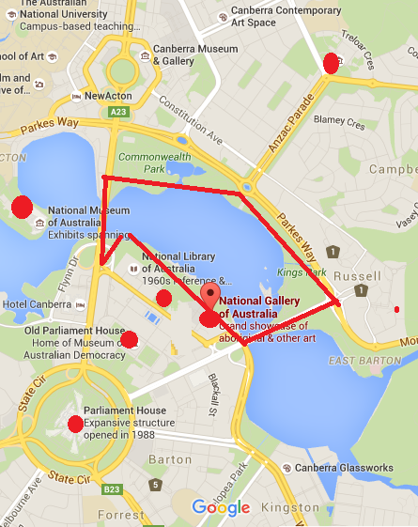
To Do
National Gallery
Portrait Gallery
National Museum
Australian War Memorial
Museum of Australian Democracy
Parliament House
5 km Walk/Run

Slide 9
Transport Options
Walk
Bit of a hike to some places
Taxi
Bus
If desperate
Ask us ☺

Slide 10
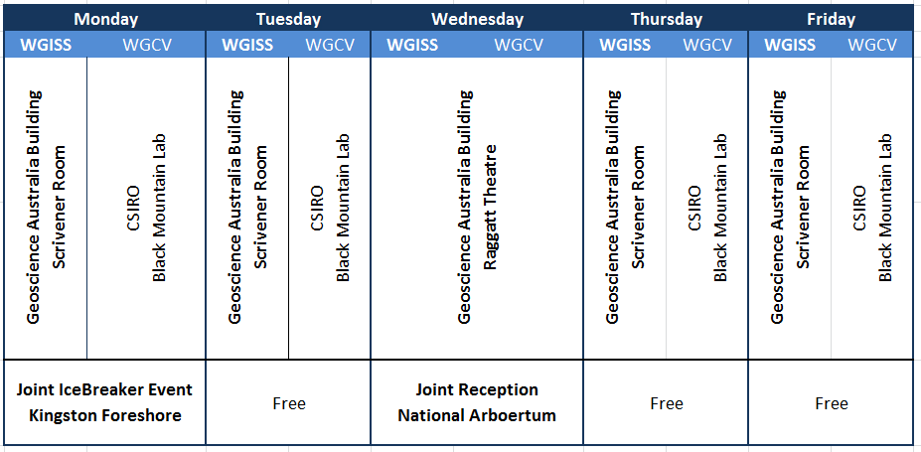
Week At A Glance

Slide 11
Monday:
Joint Ice Breaker Event held at Walt and Burley Restaurant on Kingston Foreshores – bus pick-up will be from your accommodation:
- 5:30pm University House and
- 5:45pm from Garden City
Cash bar and food sponsored by CSIRO
Delegates free to stay on for dinner or leave at own leisure
NB: no transportation arranged: therefore delegates will have to find their own way back to their accommodation
CEOS Working Group on Information Systems and Services (CEOS-WGISS) & CEOS Working Group on Calibration and Validation (CEOS-WGCV)

Slide 12
Tuesday:
Morning/Afternoon Tea supplied
Buy your own lunch- Café Rocco @ GA, Discovery Centre @ CSIRO
Free Evening - where to eat? Trip Advisor lists top eats in Canberra: https://www.tripadvisor.com.au/Restaurants-g255057-Canberra_Greater_Canberra_Australian_Capital_Territory.html Or ask a local!
CEOS Working Group on Information Systems and Services (CEOS-WGISS) & CEOS Working Group on Calibration and Validation (CEOS-WGCV)

Slide 13
Wednesday:
Group Photo at 10:20am at the front of GA building
Morning/Afternoon Tea supplied
Buy your own lunch- Café Rocco @ GA
GA Facility Tour @ 3:30pm meet in front foyer
Joint Cocktail Networking Event, sponsored by GA, held at National Arboretum – bus pick-up from GA at 5:30pm then delegates will be dropped at their accommodation from 9:15pm
CEOS Working Group on Information Systems and Services (CEOS-WGISS) & CEOS Working Group on Calibration and Validation (CEOS-WGCV)

Slide 14
Thursday:
Morning/Afternoon Tea supplied
Buy your own lunch- Café Rocco @ GA, Discovery Centre @ CSIRO
Tour of NCI facility, WGISS delegates bus pick-up @ 3:00pm from GA. WGCV walk to NCI facility.
CEOS Working Group on Information Systems and Services (CEOS-WGISS) & CEOS Working Group on Calibration and Validation (CEOS-WGCV)

Slide 15
Friday:
Morning/Afternoon Tea supplied
Buy your own lunch- Café Rocco @ GA, Discovery Centre @ CSIRO
Free Evening - where to eat? Trip Advisor lists top eats in Canberra: https://www.tripadvisor.com.au/Restaurants-g255057-Canberra_Greater_Canberra_Australian_Capital_Territory.html Or ask a local!
Head Home or Parrrrtaaay (Mirko).
CEOS Working Group on Information Systems and Services (CEOS-WGISS) & CEOS Working Group on Calibration and Validation (CEOS-WGCV)

