Slide 1




Committee on Earth Observation Satellites
WGISS Infrastructure Project (WISP) Report
Martin Yapur & Anne Kennerley
WGISS-41
Canberra, Australia
March 14, 2016

Slide 2

Support Team
Lead
  Martin Yapur (martin.yapur@noaa.gov)
Team
  Anne Kennerley (anne.kennerley@noaa.gov)
  Kim Holloway (kim.e.holloway@nasa.gov)
  Michelle Piepgrass (mvpiepgrass@gmail.com)
  For any technical CEOS server requests, contact: it@ama-inc.com

Slide 3
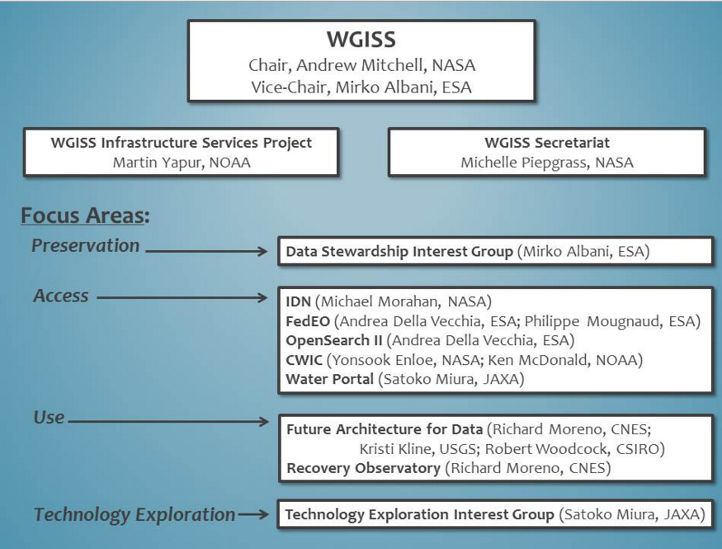
Who are we supporting?

Slide 4
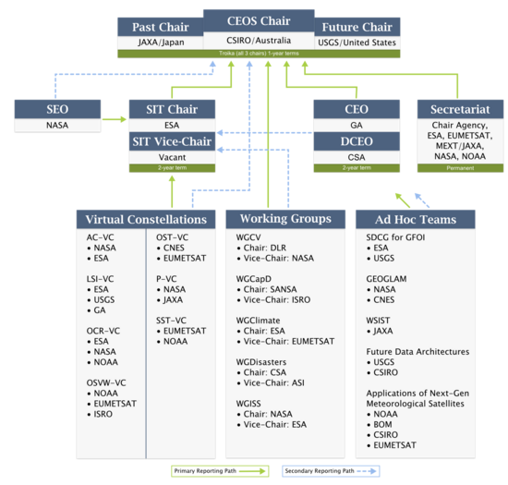

Who are we supporting?

Slide 5


WGISS-41 Presentations
Presentation Format:
  Date_Time_Title (ie. 03.14_09.30_WISPREPORT)
  ***Please use two digit format for month, day, hour, and minutes (example: March =03) and use underscores ***
Delivery Method
  Send email with presentation to
  Michelle at mvpievgrass@gmail.com
  Anne at anne.kennerley@noaa.gov
  Martin at martin.yapur@noaa.gov
  Andy at Andrew.E.Mitchell@nasa.gov

Slide 6
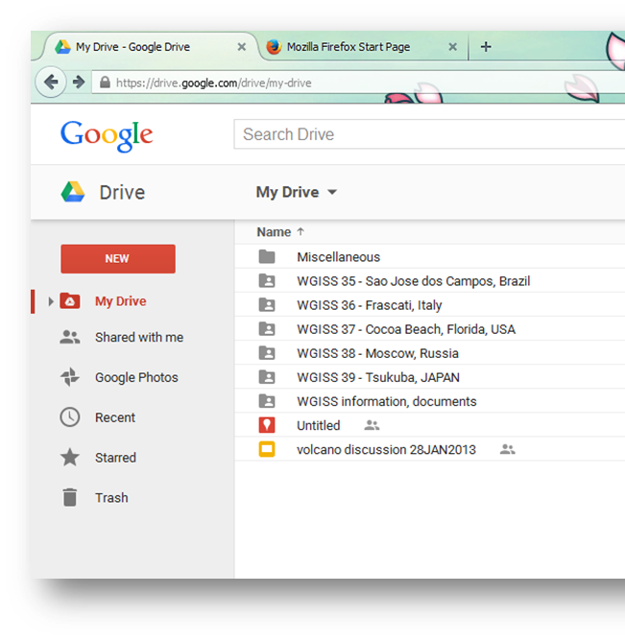
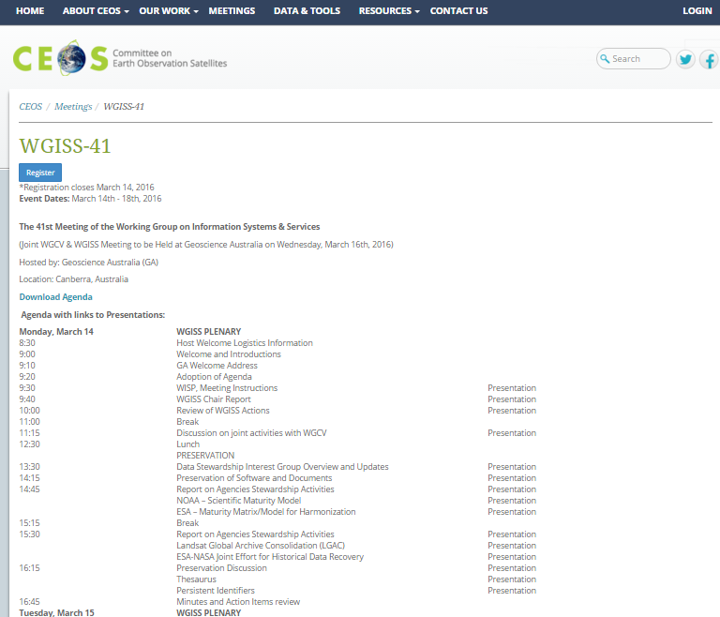
WGISS-41 Presentations
  Presentations will be directly linked to the agenda online
If files are too long, please let us know and we will use the CEOS-Google drive

Slide 7
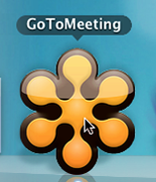
Web Conferencing
WGISS-41 Meeting Remote Participation
1. Please join my meeting.
https://global.gotomeeting.com/join/160468805
2. Use your microphone and speakers (VoIP) - a headset is recommended. Or, call in using your telephone.
United States: +1 (224) 501-3316
Australia: +61 2 8355 1034
France: +33 (0) 170 950 588
Germany: +49 (0) 692 5736 7207
Italy: +39 0 693 38 75 53
New Zealand: +64 4 974 7243
United Kingdom: +44 (0) 330 221 0097
Access Code: 160-468-805
Audio PIN: Shown after joining the meeting
Meeting ID: 160-468-805
WGISS Infrastructure Services (WISP)

Slide 8
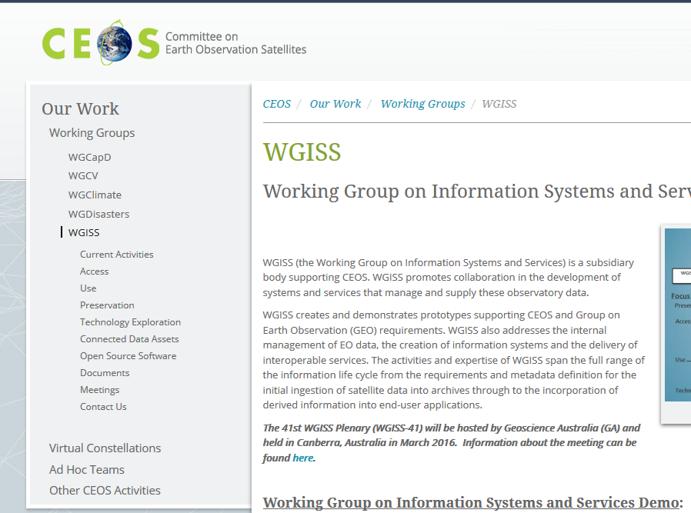
Recent Activity
Re-organization of the WGISS webpage
menu to communicate
WGISS functions
Continual upkeep of the
webpages and mailing lists
**If you have any additions or
deletions to the mailing list for your organization, please let Anne know (anne.kennerley@noaa.gov)

Slide 9


WISP Request
The WISP’s success depends on YOU to:
Keep us informed of any new or departing members so we can keep the mailing list
up-to-date
Let us know of any changes needed to the
WGISS webpages
Support our outreach activities

