Slide 1
“PRESERVATION DOMAIN”
Data Stewardship Interest Group
WGISS-41 Meeting - Canberra, (AUS)
14–18 March, 2016
Chair: Mirko Albani, European Space Agency

Slide 2
Background and Purpose
WGISS accomplishes its Data Preservation and Curation efforts through the Data Stewardship Interest Group (DSIG)
Purpose of the activities:
Enable the sharing of agency investigations, developments, experiences and lessons learned relating to EO data stewardship
Draft common cross-agency best practices or guidelines of data stewardship for possible adoption by WGISS
Sponsor technical exchanges and the conduction of Joint Activities and/or Pilot Projects on specific data stewardship topics
Establish and maintain a CEOS “Data Purge Alert” service
Contributing to GEO and Standardization activities

Slide 3
Scope
Activities focus on EO Data, Metadata, and Associated Knowledge:
Long-term archiving approaches, systems and media
Formats and Standards
Lifecycle concepts
Preservation, Valorization and Curation

Slide 4
Background - DSIG Activities (1)
Sharing Information & experiences during WGISS meetings:
Reporting from CEOS agencies about their investigations, developments, studies, and lessons-learned relating to EO data management and stewardship
Dedicated Sessions on specific topics
Drafting common cross-agency best practices or guidelines on data management and stewardship for possible adoption by WGISS:
Preservation Workflow
EO Data Generic Consolidation Process
Persistent Identifiers
Data Preservation Guidelines
Preserved Data Set Content
Purge Alert Procedure
Glossary of Acronyms and Terms
Purge Alert White Paper
Software & documents preservation
Appraisal Procedure
Archived data media transcription

Slide 5
Background - DSIG Activities (2)
Conducting Joint Activities and/or Pilot Projects on specific data stewardship topics
Contributing to GEO and Standardization activities through:
Specific tasks in the GEO Work-plan (Component GD-07.03 Development DMP Guidelines Implementation & Process) within Task GD-07 GCI Development and future GEO Work Programme.
Proposing WGISS best-practices as input to standardization bodies (e.g. OGC/CCSDS) when relevant.

Slide 6
DSIG sessions during this meeting
Overview and Updates
Preservation of Software and Documents
Session: Report on Agencies Stewardship Activities
Session on Preservation Topics Discussion:
Thesaurus;
Persistent Identifiers;

Slide 7
Data Stewardship Interest Group
Overview & Updates

Slide 8
Feedback from GEO
Work Programme &
Data Management Principles Task Force
DMP-TF

Slide 9
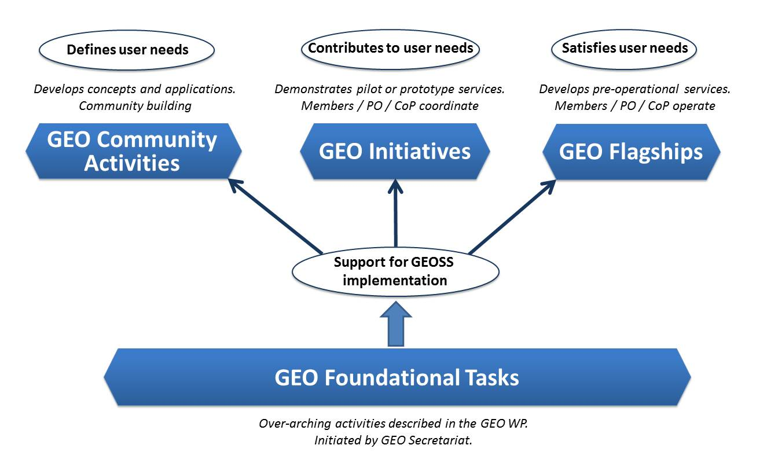
GEO 2016 Work Programme
Transitional Work Programme for 2016
“Regular” 3-year Programmes 2017-19, 2020-22 and 2023-25
Four types of GEO activities
Community Activities | 33
GEO Initiatives | 20
Foundational Tasks | 18
TOTAL | 71
ALL Current Societal Benefit Areas are addressed

Slide 10
Foundational Tasks – Current List
GD | GEOSS Development and GCI Operations
GD-01 | Advancing GEOSS Data Sharing principles
GD-02 | GCI Operations (including access to Knowledge)
GD-03 | Global Observing and Information Systems (new) (includes systems like WIGOS. GCOS; …. And reference datasets)
GD-04 | GEONETCast Development and Operations
GD-05 | GEOSS Satellite Earth Observation Resources (includes advocacy for continuity)
GD-06 | GEOSS in situ Earth Observation Resources (includes inclusion of citizens’ observatories) (includes advocacy for continuity)
GD-07 | GCI Development (includes development of Data Management guidelines)
GD-08 | SBAs processes: Systematic determination of user needs / observational gaps
GD-09 | Knowledge Base development
GD-10 | Radio-frequency protection
GD-11 | Utilization of Communication Networks
CD | Community Development
CD-01 | Capacity Building coordination
CD-02 | Reinforcing engagement at national and regional level
CD-03 | Assess the benefits from EOs and of their socio-economic value
SO | Secretariat Operations
SO-01 | Management and Support
SO-02 | Communication and Engagement
SO-03 | Monitoring and Evaluation
SO-04 | Resources Mobilization

Slide 11
GD-07 GCI Development – General Description
Define and maintain the GCI evolution strategy and architecture based on documented and emerging user requirements, and analysis of evolving landscape in technology and production/consumption of EO data products and services.
Undertake R&D activities, in collaboration with public, private, and voluntary sectors, to develop and test new functionalities, solutions, and components needed to support the achievement of GEO Strategic Plan objectives and user needs.
Develop documentation and training material needed to support transition from development to operations of identified new components and solutions.
GD07 – GCI Development
GD-07
GCI Development
(Includes Data Management Activities)

Slide 12
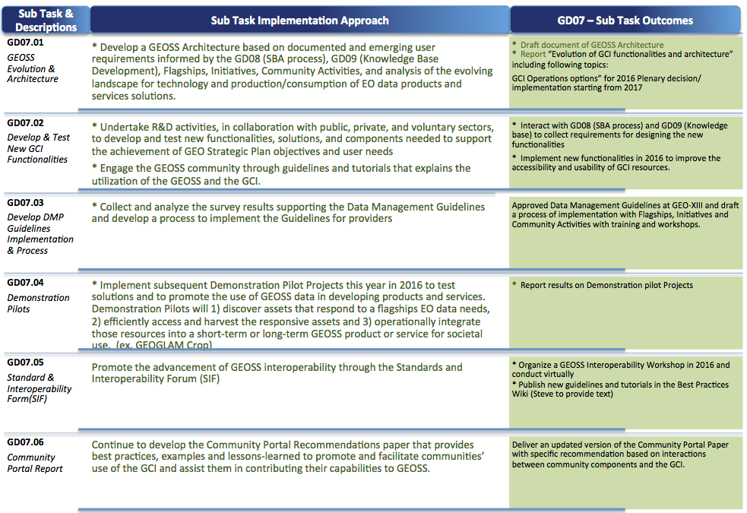
GD-07 Task Overview

Slide 13
GEO Key Milestone Dates
1st Program Board Mtg
Feb 2-3
* Work Program Symposium
May 2-4
* 2nd Program Board Mtg
3rd Program Board Mtg
Feb
Mar
May
Jul
Sep
Nov
35th ExCOM
March 8-9
36th ExCom
July TBD
37th ExCOM
Nov 8
GEO-XIII Plenary
Nov 9-10

Slide 14
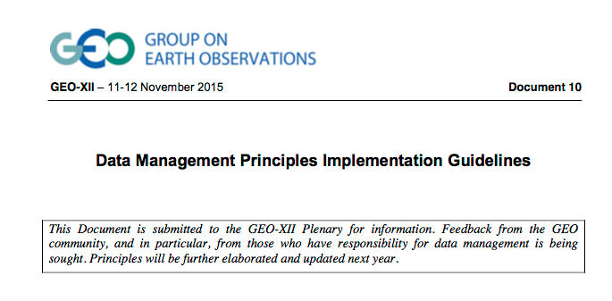
Data Management Principles Implementation Guidelines – Review Process
GEO-XII Plenary (11-12 Nov 2015): draft presented as information document.
Contribution from M.Albani and R.Moreno
Public review process started:
Online survey with deadline 15 March at http://www.earthobservations.org/survey_dmp_ig
Review process is led by IEEE (S. J. S. Khalsa)
GEO WP Symposium (2-4 May): Review updated draft
GEO Program Board (July): Review near-final draft
GEO-XIII Plenary (Nov): submitted for adoption
M.Albani & R. Moreno members of GD-07.03 task team
Other WGISS members encouraged to participate and contribute

Slide 15
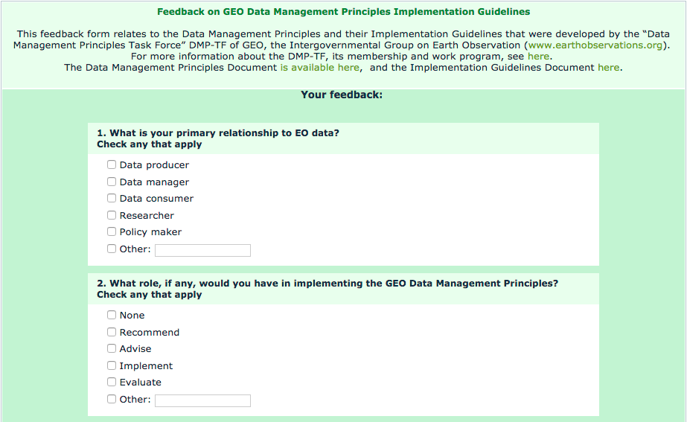
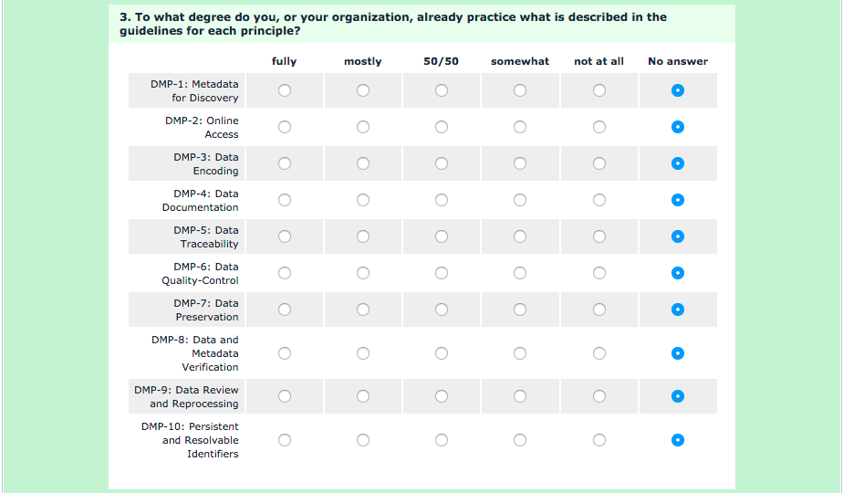
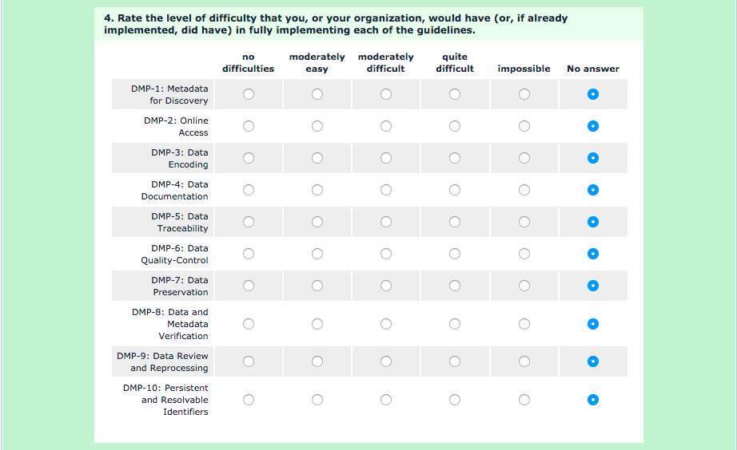
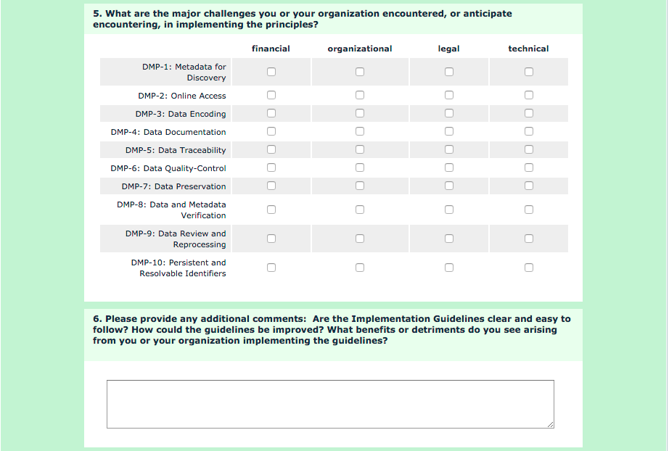
Data Management Principles Implementation Guidelines – Online Survey
Harmonised feedback will be provided by European Space Agencies in the frame of LTDP WG activities, e.g.:
Improvement of Data Quality Assurance aspects as only monitoring and assessment addressed
Include long term planning and knowledge preservation aspects
Include appraisal phase
WGISS members encouraged to submit comments.

Slide 16
Upcoming Conferences

Slide 17
Big Data From Space – BiDS’16
http://congrexprojects.com/2016-events/16m05/introduction

Slide 18
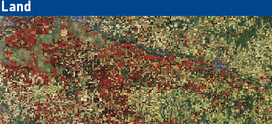
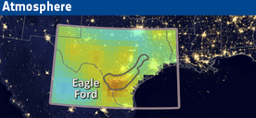
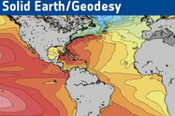
Living Planet Symposium 2016
Prague, Czech Republic
9-13 May 2016
http://lps16.esa.int/

Slide 19
Living Planet 2016 Data Preservation & Valorisation Session
Data Preservation & Valorisation Session organized
“Historical Data for the Continuous Record of our Planet: Valorise the Past to better understand the future”
Keywords:
Data Preservation, Long Time Data Series, Data Curation, Data Valorisation, Data Management, Data Stewardship and Multi-disciplinary Applications.

Slide 20
Living Planet 2016 Data Preservation Session – Oral Presentations/Posters
Title | Contribution Type | Authors | Satellites | ORDER in SESSION
The Scatterometer Instrument Competence Centre (SCIRoCCo): project’s activities and first achievements | Oceanography | Crapolicchio, Raffaele (1); Bigazzi, Alberto (2); Neyt, Xavier (3); Stoffelen, Ad (4); Wagner, Wolfgang (5); De Chiara, Giovanna (6) | ERS, Other | ORAL PRESENTATION
Offering long-term dynamic archives of data : a use case on ocean | Oceanography | Piollé, Jean-François (1); Fisher, Peggy (2) | ENVISAT, ERS | ORAL PRESENTATION
The need for long term SAR data preservation | Methodologies and Products | Prati, Claudio; Rocca, Fabio | ALOS, COSMO-SkyMed, ENVISAT, ERS, Other, RadarSat, Sentinel-1 | ORAL PRESENTATION
Long-term data records of Essential Climate Variables derived from AVHRR – pitfalls and promises | Land | Wunderle, Stefan (1); Hüsler, Fabia (1); Sütterlin, Melanie (2); Lieberherr, Gian (1); Neuhaus, Christoph (2); Albani, Mirko (3) | NOAA | ORAL PRESENTATION
The ALTS project: everything you always wanted to know about ATSR (but were afraid to ask) | Atmosphere | Casadio, Stefano (1,2); Burini, Alessandro (2,3); Dinelli, Bianca Maria (4); Castelli, Elisa (4); Papandrea, Enzo (4); Clarke, Hannah (5); Beaton, Alasdhair (5); Mackin, Stephen (6); Bojkov, Bojan (2) | ENVISAT, ERS | ORAL PRESENTATION
The LTDP ALTS Project – Contributing to the continued understanding and exploitation of the ATSR time series | Open Science 2.0 | Clarke, Hannah (1); Bojkov, Bojan (2); Casadio, Stefano (2,3); Davies, Gareth (3); Dinelli, Bianca-Maria (4); Mackin, Stephen (5) | ENVISAT | POSTER
Long Time Data Series | Methodologies and Products | Albani, Mirko | Historical Missions | INTRODUCTION SESSION & POSTER
Generating a nationwide ground motion baseline for the UK with ERS-1/2 and ENVISAT SAR archives: putting the plan into action | Hazards | Cigna, Francesca | ENVISAT, ERS | POSTER & Backup

Slide 21
iPRES 2016
http://www.ipres2016.ch/

Slide 22
iPRES 2016 - Topics
Preservation strategies and workflows
Migration; emulation; preservation planning, acquisition and ingest; preservation action, characterization, and access provision; risk analysis; audit, trust and certification; authenticity, security, and information/data quality
Digital preservation frameworks
Digital preservation requirements and implications for the system lifecycle: modeling, design, development, deployment and maintenance; business models, sustainability and economic viability
Infrastructure, systems, and tools
Intelligent and secure storage; system architectures and requirements, software and hardware dependencies, distributed and cloud-based implementations; preservation resources; content management, characterization, and processing tools
Domain-specific challenges
Preservation of cultural heritage, technical and scientific processes and data, engineering models and simulation, medical records, corporate processes
Case studies, best practices and novel challenges
Implementations; lessons learnt, preservation at scale; preservation of distributed and cloud based systems; cross-platform access services
Training and education
Building capacity in novel technologies and practices; curricula effectiveness; career management, etc.

Slide 23
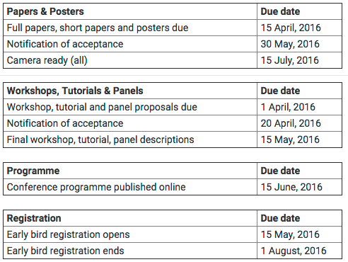
iPRES 2016 – Important dates
CEOS WGISS members are invited, if interested, to submit abstracts.

Slide 24
PV2017
Suggested Dates: Tues 7th – Thurs 9TH November 2017 2.5 days
Anticipated attendance: 70 - 200 people depending on level of marketing and response

Slide 25
CEOS Best Practices Status

Slide 26
Data Stewardship Best Practices Document Tree
Policy Documents
Individual organizations' policies (stewardship, access, ...)
EO Data Stewardship Cooperative Framework
Applied to
CEOS EO Space Data Sets
Data Purge Alert Procedure & White Paper
High level framework documents
Applied to
Technical Documents
Preservation Workflow
Glossary of Acronyms and Terms
General guidelines and best practices
Support
Guidelines and best practices on specific topics
Persistent Identifiers Best Practice
EO Data Preservation Guidelines
Preserved Data
Set Content
Associated Knowledge Preservation
…
Technical implementation procedures
EO Data Set Consolidation Process
…

Slide 27
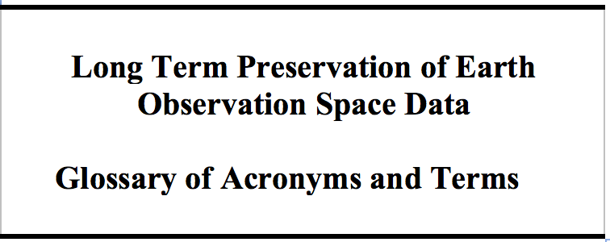
Documents “Almost Done” and “Working in Progress” – Glossary of Acronyms and Terms
Updated following review by members of:
ESIP Data Stewardship Committee;
NASA ESDSWG’s Data Preservation Practices Working Group;
Data Quality Working Group.
Comments Disposal
Final version circulated to WGISS-all.
Recommended for adoption today

Slide 28
Documents “Almost Done” and “Working in Progress” – Persistent Identifiers Best Practice
Document updated: added recommendation and use case scenarios for PID assignment to near real time products.
Final version v1.1 circulated to WGISS-all.
Recommended for adoption today
Notes:
[REC_12]
Based on user demand, in limited cases PIDs may be given to near-real-time products, but only if the data provider commits to archiving the product for at least 10 years or if a science-quality version of the near-real-time product is archived. The landing page should clearly state the limitations of the product, the data provider’s archiving commitment, and a link to the science-quality version if available.

Slide 29
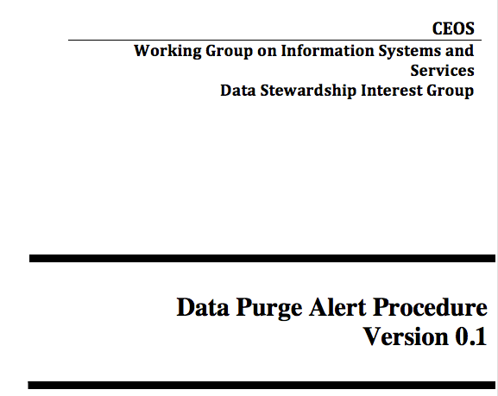
Documents “Almost Done” and “Working in Progress” – Data Purge Alert White Paper
DRAFT CIRCULATED FOR REVIEW

Slide 30
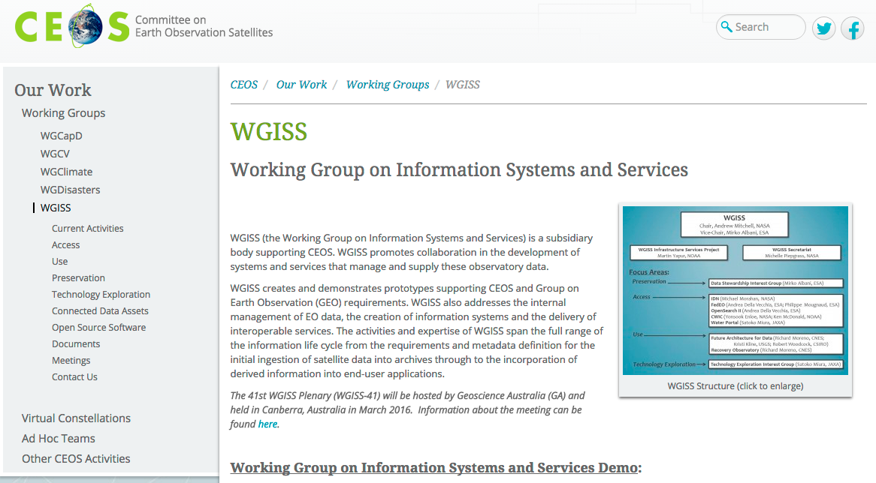
Data Purge Alert Web site: a proposal
Data Purge Alert
Documents
Meetings
Contact Us

Slide 31
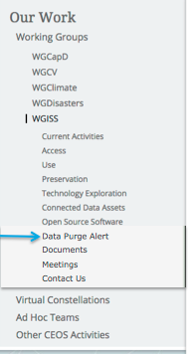
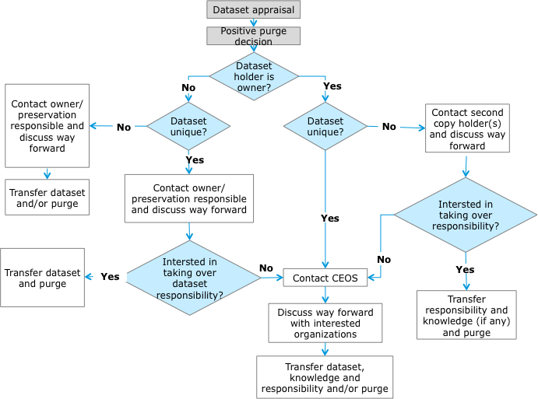
Data Purge Alert Web site
Data Purge alert
Data Purge Alert
Purpose
All organizations holding EO space data have the responsibility to assess the relative value of their data holdings and to preserve them for the long term. However, occasionally, an organization must make the decision to “purge” one or more datasets that could be important to help meeting the mission requirements of another agency. A Data Purge action permanently and irrecoverably removes all copies of an EO dataset held in an organization.
Scope
The “Data Purge Alert” procedure aims at preventing, or at least minimizing, the loss of EO space data. Organizations intending, for whatever reason, to purge an EO dataset have to apply the procedure (before purging the data) in order to inform other organizations, with the goal to trigger a possible transfer of preservation responsibility to another interested entity.
Purge Alert Procedure
More detailed information is available in the following document:
Data Purge Alert White Paper
Communication and Coordination
If no interested entity has been directly identified as indicated in the above procedure, WGISS Chair should be informed about the purging intention (see http://ceos.org/ourwork/workinggroups/wgiss/contacts/) with the following subject: <mission> Dataset to be purged and including a description of the case.
Active Purge Alerts
List of active purge alerts

Slide 32
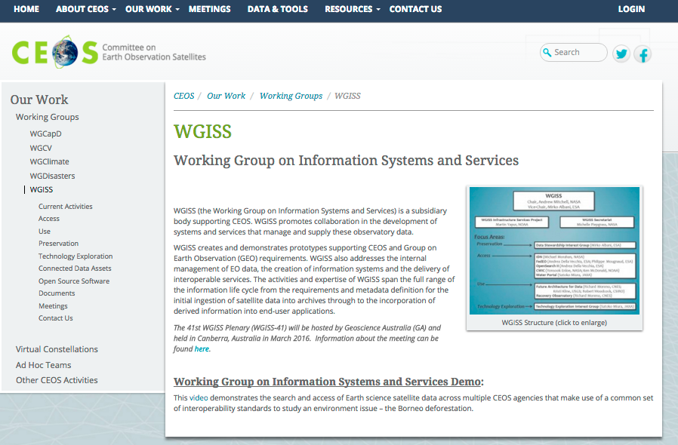
Data Purge Alert NEWS
In case of Purge Alert notification, the WGISS Chair will inform all CEOS Agencies Principals and publish a ”Purge Alert News” on the CEOS and WGISS web pages.
Main CEOS Web page: a flashing “News” word that links to the WGISS relevant web page
WGISS Web Page: http://ceos.org/ourwork/workinggroups/wgiss/preservation/

Slide 33
Data Purge Alert Procedure Status
Purge Alert Procedure endorsement at CEOS Plenary in Nov 2015
Finalization of Purge Alert White Paper and material needed to ensure visibility of Purge Alert Procedure on CEOS and WGISS Web Sites
Define approach to inform Commercial Data Owners of the existence of the procedure (data at highest risk, in particular old ones). Possibility for them to use the procedure.
TO BE DONE

Slide 34
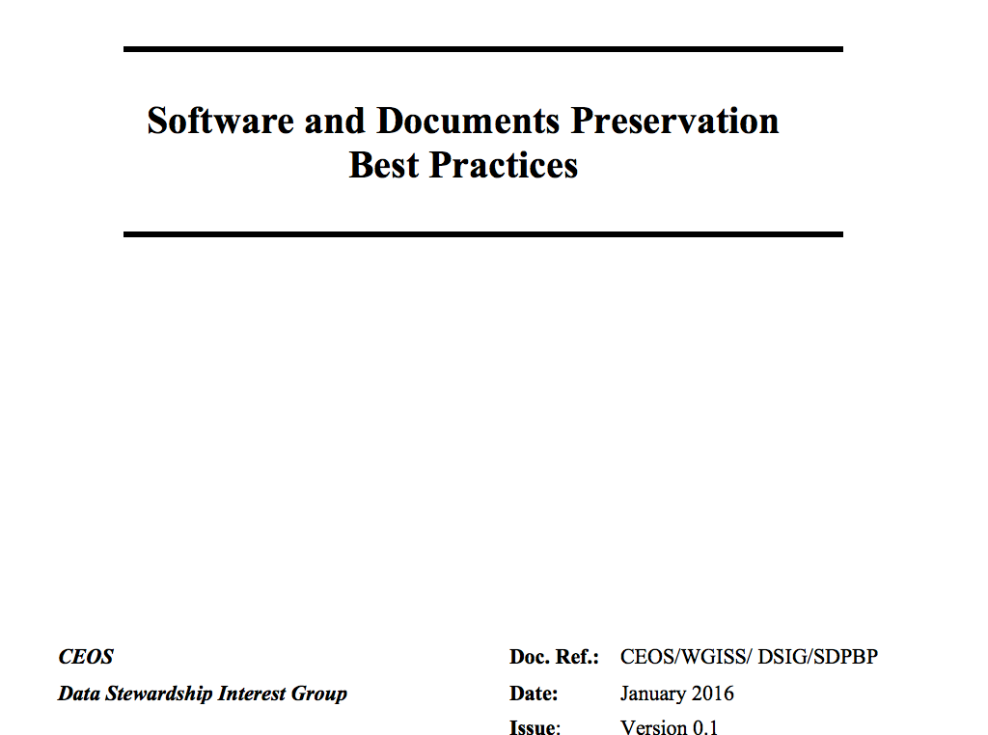
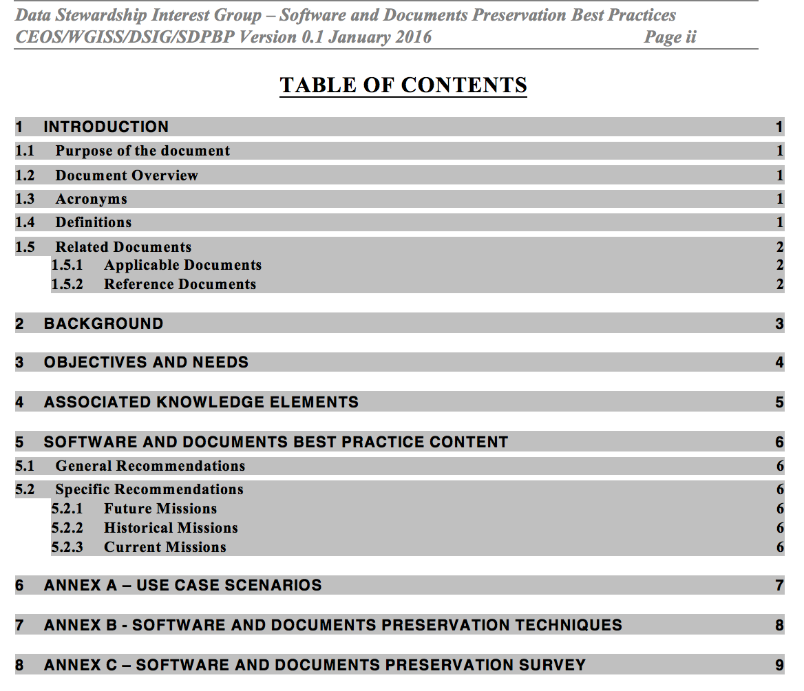
Documents “Almost Done” and “Working in Progress” – Software & Document Preservation
DEDICATED SESSION

Slide 35
Documents for adoption today
Assessment of Drafting Status and Discussion
Issue to DSIG for Review, comments and feedback
Final Presentation and Formal Approval
v
PID Best Practices
Glossary of Acronyms and Terms
v
Final Issue to WGISS
v
REVIEW
FINALIZATION
WGISS#40
WGISS#41
09/15
10/15
11/15
12/15
01/16
02/16
03/16

Slide 36
Future documents timeline proposal
Assessment of Drafting Status and Discussion
Issue to DSIG for Review
Comments & Feedback
Final Presentation and Formal Approval
& Assessment of New Drafting Status and Discussion
Comments & Feedback
Final Presentation and Formal Approval
Issue to DSIG for Review
v
v
v
v
v
v
Final Issue to WGISS
Final Issue to WGISS
v
v
REVIEW
FINALIZATION
WGISS#42
WGISS#41
REVIEW
WGISS#43
03/16
04/16
05/16
06/16
07/16
08/16
09/16
10/16
11/16
12/16
01/17
02/17
03/17
04/17
Data Purge Alert White Paper
Associated Knowledge Preservation

Slide 37
Document Management Table
Document name | Custodian | Document ID | File name | Current version | Date | Status | Planned release date
EO Data Preservation Cooperative Framework (DSIG Plan) | M. Albani, ESA | None | Presentations |  |  | Updated at each WGISS meeting | Q1/2016
Preservation Workflow | I. Maggio, ESA | CEOS/WGISS/DSIG/PW | Preservation Workflow | 1.0 | 03/2015 | APPROVED
EO Data Stewardship Glossary | I. Maggio, ESA | CEOS/WGISS/DSIG/GLOS | EO-DataStewardshipGlossary | 1.1 | 09/2015 | Under approval CEOS | Q1/2016
EO Data Preservation Guidelines | M. Albani, ESA | CEOS/WGISS/DSIG/EODPG | EO Data Preservation Guidelines | 1.1 | 09/2015 | APPROVED
EO Data Set Consolidation Process | R. Cosac, ESA | CEOS/WGISS/DSIG/GEODSCP | Generic Earth Observation Data Set Consolidation Process | 1.0 | 03/2015 | APPROVED
Preserved Data Set Content | R. Leone, ESA | CEOS/WGISS/DSIG/EOPDSC | EO Preserved Data Set Content | 1.0 | 09/2015 | APPROVED
Persistent Identifiers Best Practice | T. Christensen, DLR | CEOS/WGISS/ DSIG/PIDBP | CEOS Persistent Identifier Best Practices | 1.1 | 01/2016 | Under approval CEOS | Q1/2016
Data Purge Alert | M. Albani, ESA | CEOS/WGISS/DSIG/DPA | Presentation; to be published on WGISS web site. White paper | 0.1 | n/a | Update ongoing | Q1/2016

Slide 38
Thanks you for your attention !!!

Slide 39
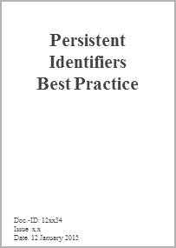
Data Stewardship Best Practices/Guidelines Drafting/Approval Cycle
Japan
USA
Brazil
Spaceborne Earth Observation
Europe
CEOS
Other
Spaceborne,
airborne, and in-situ Earth Observation
ESA LTDP Team and GSCB
LTDP WG
CEOS
CEOS-WGISS DSIG
GEO
DRAFT
?
?
NEEDS
OGC
CCSDS

Slide 40
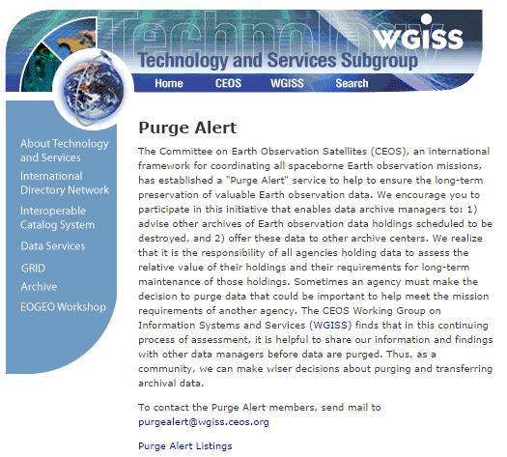
CEOS Purge Alert service
http://wgiss.ceos.org/purgealert/

Slide 41
APPRAISAL PROCEDURE
The data appraisal procedure consists in performing an assessment of an EO space data set under evaluation (for example in case of possible preservation discontinuing) through answering to a set of categorized questions extracted from the USGS EROS Appraisal Online Tool (http://eros.usgs.gov/government/ratool/) or from the CEOS online questionnaire http://wgiss.ceos.org/archive/index.html.
The list of questions should cover:
Mission relevancy
General policy (ISO Standard)
Physical properties (Media)
Metadata
Cost / benefit analysis.
When performing the appraisal, an appraisal report should be produced in order to properly document the different steps performed in the appraisal procedure and the final results. The appraisal report should be provided, in case of purge decision, to other data holders and archive owners together with a description of the data set when applying the data alert procedure.
A link to a template document containing the list of questions and to generate the appraisal report is provided hereafter: http://eros.usgs.gov/government/ratool/export.php?blank

Slide 42
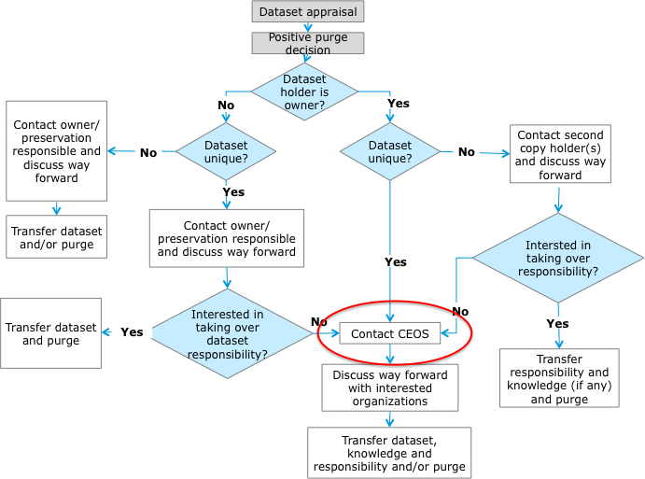
Purge Alert procedure: CEOS Involvement
“Purging organizations” to inform WGISS Chair (personal email contact) about purging intention when no interested entity has been directly identified.
WGISS Chair to:
Inform all CEOS Agencies Principals and publish a “Purge Alert News” on CEOS and WGISS web pages.
Put in contact “Purging organization” and “Interested Entities” which responded to the announcement.

Slide 43
Data Purge Alert – CEO
For activating the procedure:
Contact the CEOS Executive Officer (CEO) through the ad-hoc email (XXX);
The email should contain the following subject: <mission> Dataset to be purged and including a description of the case.
CEO will forward it to the mailing list containing all organizations;
Any interested agencies should respond within three months to start conducting negotiations/assessment with the alert initiator.

