Slide 1
NoSQL-influences in EO data exploration
Jeremy Hooke

Slide 2
Indexing our EO data
Notes:
Architecture of AGDC: Storage units & an index
We query the index to find relevant storage units.
Answers questions: What datasets do we have? Where did this dataset come from? What are we missing? & Real-time collection statistics.

Slide 3
The traditional relational approach
Version 1: A table for every entity, a column for every field.
Notes:
v1 index was a traditional relational design.

Slide 4
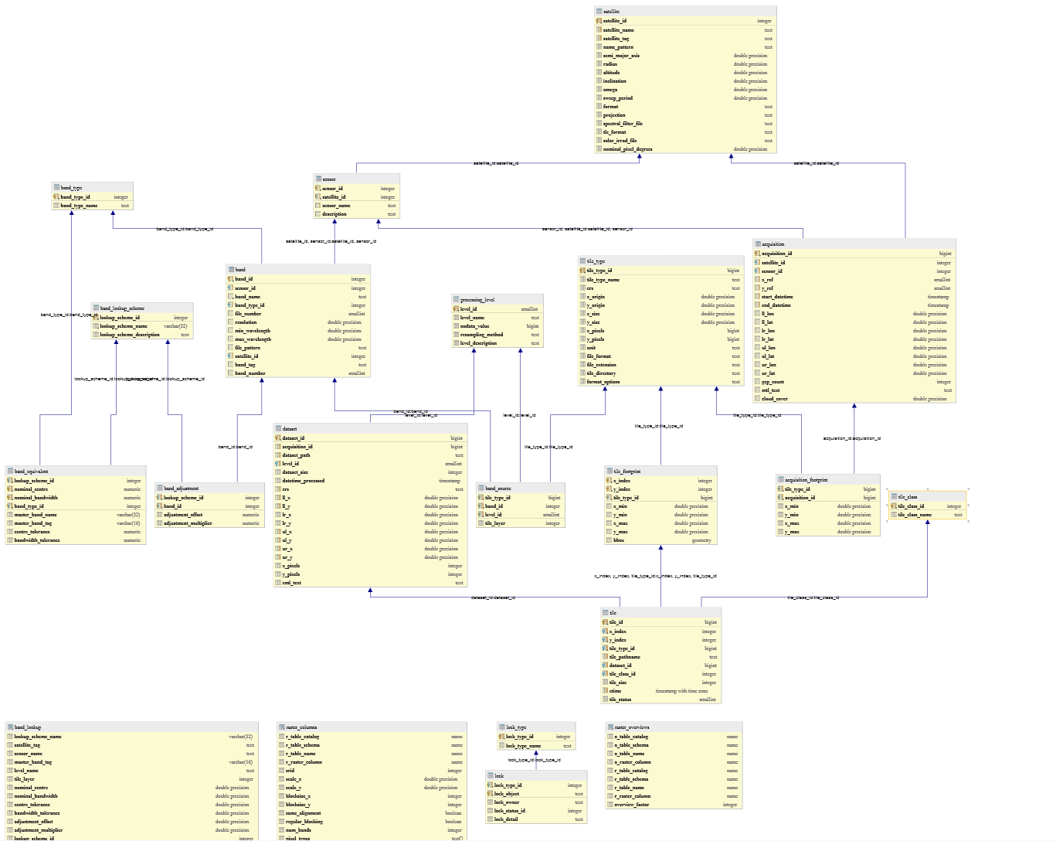
A table for every entity
A column for every field
Notes:
(exact details of schema not important)
But note that it was growing quite complex, and yet still needed to grow.
It didn’t yet track provenance information.
& had very few metadata fields: sensor/product specific fields were difficult (eg. Landsat path/row).
Not very extensible
Difficult to extend to new products and sensors: Adding additional metadata columns/tables requires a schema change
Different organisations would have different schemas: a pain for interoperability.
Other:
Columns for specific products will be null for every other product. End up with a lot of null columns. (field exists on every row even though it doesn’t apply to that dataset)
Queries contain many joins.
Requires code to map dataset info to the specific table schemas (and back again?).
With many new satellites & products this will get messier over time.

Slide 5
Composite Types & JSONB (documents)
PostgreSQL 9.4+
Notes:
Postgres introduced composite types several version ago.
One column can contain many values
And more recently, composite type JSONB

Slide 6
Supporting N-dimensions traditionally: two tables
ID | Product Type | Parent ID | ...
34 | ortho | 2
Dataset ID | Name | Value
34 | x | 123
34 | y | 45
34 | t | 543
select d.id, dim_x.value as x, dim_y.value as y, dim_t.value as t from dataset d
natural inner join dataset_dimension dim_x
natural inner join dataset_dimension dim_y
natural inner join dataset_dimension dim_t where dim_x.name = ‘x’ and dim_y.name=’y’ and dim_t.name = ‘t’ and d.type=’ortho’ and ..
Notes:
Need to use rows rather than columns
Two tables to represent the dynamic fields.
Complex, often unreadable queries: lots of joins
(it’s a simplified example: in real world is messier. Much more complicated queries, and we needed dimensions to support both ranges and scalars)

Slide 7
N-dimensions with composite types: one table
ID | Product Type | Parent ID | Dimensions
32 | ortho | 2 | { ‘x’: 123, ‘y’: 45, ‘t’: 543 }
select id,
dimensions->>’x’,
dimensions->>’y’,
dimensions->>’t’
from dataset
where type=’ortho’ and ...
Notes:
One table: no joins.
Query is more readable, understandable.
Data locality: entire dataset record stored together (can fetch without joins).
These fields can be used like columns in most cases: can index them, add constraints etc. But not (true) foreign keys.

Slide 8
A step further
id: f2d964bc-e63f-11e5-bee1-a0000100fe80
label: LS8_OLITIRS_OTH_P51_GALPGS01-032_115_076_20130723
product_type: ortho
product_level: L1T
size_bytes: 1809684853
platform:
code: LANDSAT_8
instrument:
name: OLI_TIRS
acquisition:
groundstation:
code: LGN
label: Landsat Ground Network
eods_domain_code: '032'
extent:
coord:
ul:
lat: -22.052155
lon: 113.114283
...
Notes:
We already have json-compatible metadata documents
Why not put them directly in the database as a JSONB column?
Then index and search the fields directly from it.
This simplifies the schema immensely: no separate tables or columns for every piece of metadata.
Easy to add custom fields for specific products, sensors.
Also simplifies the code: No converting from one metadata format to a variety of different tables and back again.
“One insert statement” to add a dataset, rather than populating many tables.
Multiple independent cubes can define their own products and still interoperate (identical schemas).
An example “full” Ortho dataset metadata of ours (with embedded source telemetry, which is a separate source dataset):
id: f2d964bc-e63f-11e5-bee1-a0000100fe80
label: LS8_OLITIRS_OTH_P51_GALPGS01-032_115_076_20130723
product_type: ortho
product_level: L1T
size_bytes: 1809684853
platform:
code: LANDSAT_8
instrument:
name: OLI_TIRS
acquisition:
groundstation:
code: LGN
label: Landsat Ground Network
eods_domain_code: '032'
extent:
coord:
ul:
lat: -22.052155
lon: 113.114283
ur:
lat: -22.089649
lon: 115.314013
ll:
lat: -24.130132
lon: 113.053974
lr:
lat: -24.17158
lon: 115.287779
from_dt: 2013-07-23 02:23:18
center_dt: 2013-07-23 02:23:34.366314
to_dt: 2013-07-23 02:23:50
grid_spatial:
projection:
geo_ref_points:
ul:
x: 98837.5
y: 7556287.5
ur:
x: 326062.5
y: 7556287.5
ll:
x: 98837.5
y: 7325712.5
lr:
x: 326062.5
y: 7325712.5
datum: GDA94
ellipsoid: GRS80
map_projection: UTM
orientation: NORTH_UP
resampling_option: CUBIC_CONVOLUTION
zone: -50
gqa:
abs_iterative_mean_residual:
x: 0.4732855442723554
y: 0.2255181015000974
acq_day: 2013-07-23
band: '6'
cep90: 23.859792900264242
colors:
blue: 317.0
green: 5807.0
red: 120.0
teal: 7385.0
yellow: 173.0
final_gcp_count: 13688
iterative_mean_residual:
x: 0.33397595241574124
y: 0.06208311708552504
iterative_stddev_residual:
x: 0.45028980753472203
y: 0.42161250718970644
mean_residual:
x: 0.33519340363337685
y: 0.06834697999710103
ref_day: 1999-07-25
ref_source: GLS_v1
residual:
x: 0.535682
y: 0.312071
stddev_residual:
x: 1.2243727570583645
y: 1.9009715956249842
browse:
full:
path: browse.fr.jpg
file_type: image/jpg
cell_size: 25.0
shape:
x: 9090
y: 9224
red_band: '7'
green_band: '5'
blue_band: '2'
medium:
path: browse.jpg
file_type: image/jpg
cell_size: 221.923828125
shape:
x: 1024
y: 1040
red_band: '7'
green_band: '5'
blue_band: '2'
image:
satellite_ref_point_start:
x: 115
y: 76
cloud_cover_percentage: 5.39
sun_azimuth: 37.95628766
sun_elevation: 36.99376912
sun_earth_distance: 1.015873
ground_control_points_model: 320
geometric_rmse_model: 4.785
geometric_rmse_model_x: 3.347
geometric_rmse_model_y: 3.42
bands:
'1':
path: product/LC81150762013204LGN00_B1.TIF
type: reflective
label: Coastal Aerosol
number: '1'
cell_size: 25.0
'10':
path: product/LC81150762013204LGN00_B10.TIF
type: thermal
label: Thermal Infrared 1
number: '10'
cell_size: 25.0
'11':
path: product/LC81150762013204LGN00_B11.TIF
type: thermal
label: Thermal Infrared 2
number: '11'
cell_size: 25.0
'2':
path: product/LC81150762013204LGN00_B2.TIF
type: reflective
label: Visible Blue
number: '2'
cell_size: 25.0
'3':
path: product/LC81150762013204LGN00_B3.TIF
type: reflective
label: Visible Green
number: '3'
cell_size: 25.0
'4':
path: product/LC81150762013204LGN00_B4.TIF
type: reflective
label: Visible Red
number: '4'
cell_size: 25.0
'5':
path: product/LC81150762013204LGN00_B5.TIF
type: reflective
label: Near Infrared
number: '5'
cell_size: 25.0
'6':
path: product/LC81150762013204LGN00_B6.TIF
type: reflective
label: Short-wave Infrared 1
number: '6'
cell_size: 25.0
'7':
path: product/LC81150762013204LGN00_B7.TIF
type: reflective
label: Short-wave Infrared 2
number: '7'
cell_size: 25.0
'8':
path: product/LC81150762013204LGN00_B8.TIF
type: panchromatic
label: Panchromatic
number: '8'
cell_size: 12.5
'9':
path: product/LC81150762013204LGN00_B9.TIF
type: atmosphere
label: Cirrus
number: '9'
cell_size: 25.0
qa:
path: product/LC81150762013204LGN00_BQA.TIF
type: quality
label: Quality
number: qa
cell_size: 25.0
lineage:
algorithm:
name: LPGS
version: 2.5.0
parameters: {}
machine:
hostname: rhe-proc-test23
runtime_id: 3bcaa518-e63c-11e5-bee1-a0000100fe80
software_versions:
eodatasets: 0.2.1
galpgs: 1.0.5
gqa: '0.4'
pinkmatter: 4.1.4009
uname: 'Linux rhe-proc-test23 2.6.32-573.12.1.el6.x86_64 #1 SMP Tue Dec 15 21:19:08 UTC
2015 x86_64'
ancillary:
bpf_oli:
name: LO8BPF20130723015554_20130723022542.01
uri: /g/data/v10/eoancillarydata/sensor-specific/LANDSAT8/BiasParameterFile/2013/07/LO8BPF20130723015554_20130723022542.01
access_dt: 2016-03-10 08:39:51
modification_dt: 2013-07-23 14:21:23
checksum_sha1: 6a1959d09869a2d54ecfafe5da809d281b3e1308
bpf_tirs:
name: LT8BPF20130723004941_20130723022635.01
uri: /g/data/v10/eoancillarydata/sensor-specific/LANDSAT8/BiasParameterFile/2013/07/LT8BPF20130723004941_20130723022635.01
access_dt: 2016-03-10 08:39:51
modification_dt: 2013-07-23 14:20:10
checksum_sha1: 792bea127684b910c43a1f3756a0a1e7671a7bb3
cpf:
name: L8CPF20130701_20130919.05
uri: /g/data/v10/eoancillarydata/sensor-specific/LANDSAT8/CalibrationParameterFile/L8CPF20130701_20130919.05
access_dt: 2016-03-10 08:42:44
modification_dt: 2014-02-04 09:14:31
checksum_sha1: b1a35b6c95d4c89695dead553102c29f908ab46a
rlut:
name: L8RLUT20130211_20150302v10.h5
uri: /g/data/v10/eoancillarydata/sensor-specific/LANDSAT8/RLUT/L8RLUT20130211_20150302v10.h5
access_dt: 2016-03-10 08:43:14
modification_dt: 2015-05-01 10:03:52
checksum_sha1: 8ee02c7000d2c7a1cd0ec486aa82b3174b8b3bb9
source_datasets:
satellite_telemetry_data:
id: 1e9baf82-5dbb-11e5-8594-ac162d791418
ga_label: LS8_OLITIRS_STD-MD_P00_LC81150750792013204LGN00_115_075-079_20130723T031913Z20130723T032040
ga_level: P00
product_type: satellite_telemetry_data
creation_dt: 2015-09-18 04:09:54.426726
size_bytes: 2288621040
checksum_path: package.sha1
platform:
code: LANDSAT_8
instrument:
name: OLI_TIRS
format:
name: MD
usgs:
interval_id: LC81150750792013204LGN00
acquisition:
aos: 2013-07-23 03:19:13.795000
los: 2013-07-23 03:20:40.038000
groundstation:
code: LGN
label: Landsat Ground Network
eods_domain_code: '032'
image:
satellite_ref_point_start:
x: 115
y: 75
satellite_ref_point_end:
x: 115
y: 79
bands: {}
lineage:
machine: {}
source_datasets: {}

Slide 9
Caveats: Validation
Notes:
Unlike traditional tables+fields, it’s entirely up to our own code to maintain the field structure. So we want to validate the documents that go in.
Postgres allows check constraints on fields inside documents, as with traditional schemas, so you can treat them similarly to traditional fields.
Or validate documents themselves with JSONSchema, which you may already have for your metadata.
Advantage of validating anywhere, not just in the DB.

Slide 10
Caveats: Types
Notes:
Limited to JSON datatypes, because we’re storing fields as JSON. But this is more than we had in the row-oriented example.
Eg. No date type. JSON documents typically store dates as ISO strings.
But we can use functional indexes. Eg. Index the date string as a parsed date, to efficiently query dates as dates, not as strings.

Slide 11
Caveats: Foreign Keys (and other features)
Notes:
Similarly, if we want foreign keys in our documents, our code has to manage it.
they’re not real foreign keys, they’re values that happen to be ids in other tables: Postgres doesn’t know they’re foreign keys.

Slide 12
Every choice is a trade-off
Notes:
So in general: the downside of all this flexibility is that the database itself is doing slightly less for us.
We’re volunteering to manage more concepts in our own code instead of the database.
This is a common pattern with “NoSQL” (or “Not-Only SQL”) ecosystem. As with everything, it’s a trade-off.
Postgres allows us to have a system that’s a hybrid: We can use traditional columns where the trade-off swings one way, and use flexible documents when they swing the other.

Slide 13
A hybrid approach
Notes:
Our hybrid approach:
Concepts defined by users (or non-developers): dataset metadata, sensor information, storage config
Inherently need to be flexible
are stored as JSONB documents
Concepts defined by the core developers: Concepts of dataset, storage unit, ids, relationships
ie. core architectural pieces of the system
Which are already fixed in the code.
are stored as traditional tables and columns
Despite flexibility, it seems to perform well: data locality, fewer joins.
The ballpark tens-of-millions of records we’re looking at are easy for Postgres on modern hardware.

Slide 14
This barely scratches the surface...
Provenance trees (feat. recursive queries)
Metadata types (feat. partial indexes)
Collections
Usability
Layering
Notes:
If time permits.
Provenance Trees
Another major change in this new version is ability to query provenance. We record unique IDs every time we process or receive a dataset. When creating a dataset we note the IDs of source datasets that went into it.
We also index datasets that aren’t accessible as data: eg. telemetry data, or historic datasets, as they’re referenced as source datasets.
Can then query, for example, for the tree of datasets that derived from a specific telemetry file, or all datasets that came from Antenna 1 of ASA (... when recorded).
If a new version of a CPF (Landsat calibration file) arrives, for example, we could query for the Orthos that were processed with the old version, and the entire tree of derived datasets derived from those Orthos (NBAR Surface reflectance, PQA, etc), to queue for reprocessing with the new calibration.
Metadata Types
Describes what we expect to see in the metadata
The metadata structure and fields expected for a type of dataset.
It’s sort of like a schema: we can use it to validate incoming datasets.
But primarily it’s a way to define what fields should be searchable/indexable and their types.
Eg. Add a Landsat metadata type that has Landsat path/row, calibration file versions etc.
When searching for Landsat, user can use path/row in their expressions.
We dynamically create indexes for each search field when a new metadata type is added.
And they only cover datasets of that type, not all datasets (partial indexes).
So we can support a new dataset type with custom fields just by adding a metadata type for it.
No schema changes required.
Importing data from outside Data Cube instances is much easier: we add their types along with their datasets.
Partial Indexes
Collections
Usability
Layering (other index backends)
Spatial Types

Slide 15
Questions

