Slide 1
Storage Structure and Efficient File Access

Slide 2
Overview
Efficiency aspects
Factors used for improving efficiency
Measures of efficiency
Physical aspects of the storage medium
Study area
Synthetic computation comparison test
Notes:
Factors; compression method, chunk sizes, other filters applied to compression
measures; process time, file size,

Slide 3
Efficiency aspects
Speed
Interactive user experience
Pixel profiles (spatial, spectral, temporal)
Quotas (inode, & storage):
RSA (Raster Storage Archive):
1 file per time-slice and spectral band
GA v0 & 1:
1 file per time-slice containing multiple spectral bands
GA v2:
1 file containing multiple time-slices of multiple spectral bands
Costs
Compute & storage (related to compression)
Notes:
A large driving force behind speed is the user experience during data exploration. GA is moving towards users being able to interactively interrogate and analyse data
The performance gain in terms of speed for both v0 & v1 over the RSA was immense

Slide 4
Measures of Efficiency
Creation times (computational costs)
Collection management strategies
Appending new data (version control, creation times)
Algorithm run times (computational costs)
largely dependent on disk I/O
Notes:
Improving efficiency can aid in collection management strategies

Slide 5
Physical aspects of the storage medium
Dimensional ordering (BSQ, BIL, BIP in the traditional 3D sense)
HDF5 chunking
Compression filters
filter options
fletcher32 (collection management)
shuffle (bit reorganisation)
scale offsets

Slide 6
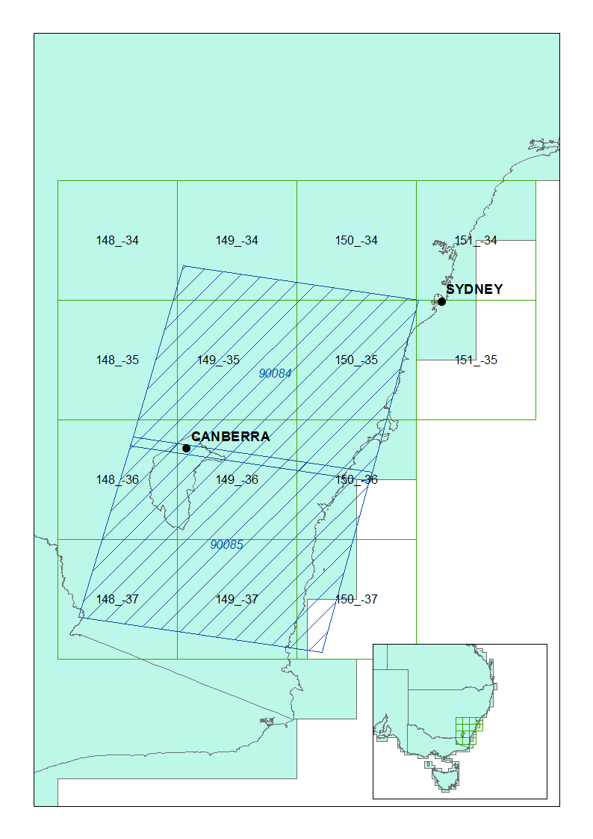
Region of Interest
2x WRS2 Path Rows; 90/84 & 90/85
Covers 14x 1ºx1⁰ cells of the Australian Reflectance Grid (ARG)
1 years worth of Landsat 5 data from 2008
Yields datasets containing partial image coverage as well as complete image coverage
Notes:
This coverage should test a variety of conditions; sparse, dense, as well as a variety of land-covers, which all will have some form of impact on compression

Slide 7
Factors
Compression algorithms
Deflate (gzip)
Levels: 1, 4, 8
LZF
Shuffle filter
HDF5 chunksize
Spatial (Square in shape)
50, 75, 100, 150, 200, 300, 400
Depth
5, 10, 20
Example chunk size (10, 200, 200) stored across the entire array dimensions which consist of (22, 4000, 4000)
Total number of combinations: 168
Cells: 14
Total number of files: 2352
Notes:
Depth (z-axis) chunks play a role in improving the efficiency of a user’s experience with querying and retrieving a temporal profile of a dataset

Slide 8
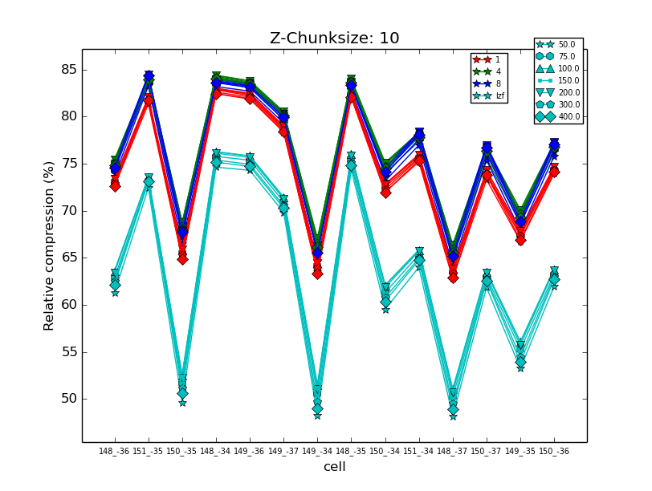
Effects across each cell
There will be variability!
Sparse arrays tended to compress well and vice versa for dense
149_-34 was the opposite. Spatial association of data???

Slide 9
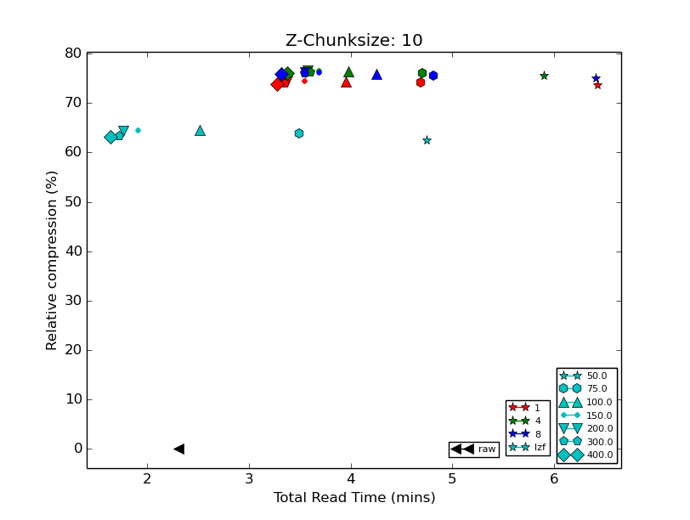
Read and compression efficiency
Large chunks, faster reads (but becomes more impacted by partial chunk reads)
Spatial chunks > 150 tended to lose their compression efficiency
Minor effects related to chunk sizes not being a factor of the total array dimensions. (larger file sizes, longer read times)
LZF vs Raw!!!
Notes:
Results averaged across each cell
Interesting to note is that the LZF compression resulted in faster read times than the raw data
Smaller chunk sizes resulted in slower read times
Chunks not a factor of the array dimensions (larger files, slightly longer read times)

Slide 10
Synthetic data simulations
Dimensions: (90, 4000, 4000); double precision (float64)
Chunksizes
Depth
2, 4, 8, 16, 32, 64
Spatial
128
Simulate appending newly acquired data (collection management)
Append single acquisition
Append multiple acquisitions at once
Dataset creation times
Synthetic algorithm computation time

Slide 11
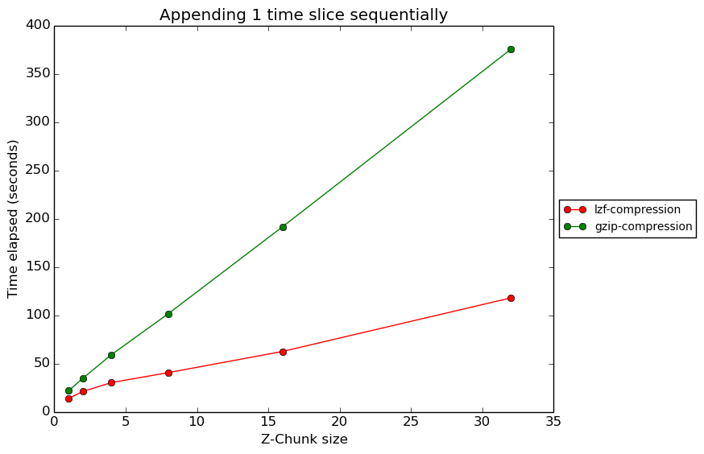
Dataset creation times (append)
GZip
25secs to 7mins
LZF
12secs to 2mins
Notes:
Each point represents a new file using a depth (z-axis) chunksize of ‘n’.

Slide 12
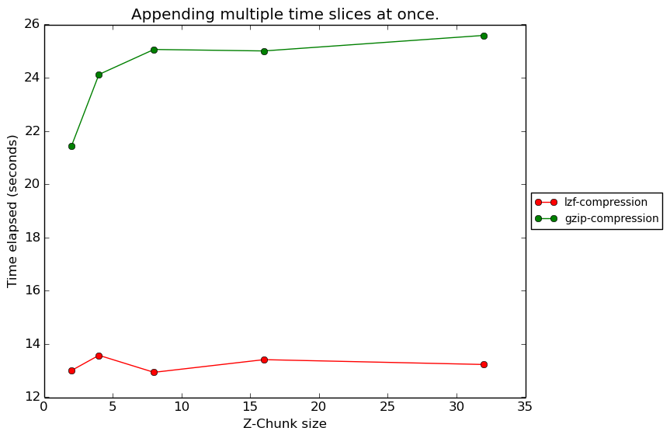
Dataset creation times (append in chunks)
Major improvement; Less re-reading
GZip
20-26 seconds
LZF
12-14 seconds

Slide 13
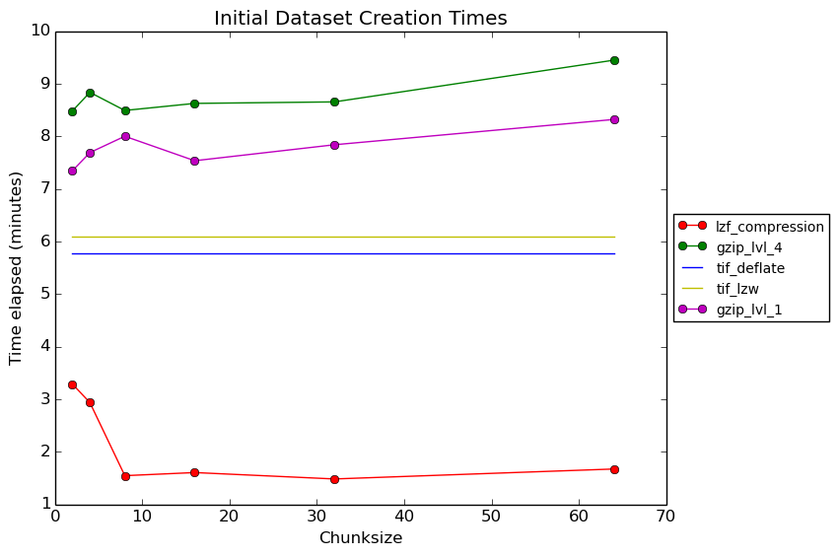
Dataset creation times (comparison)
Notes:
Datasets written using complete (depth/z-axis) chunks

Slide 14
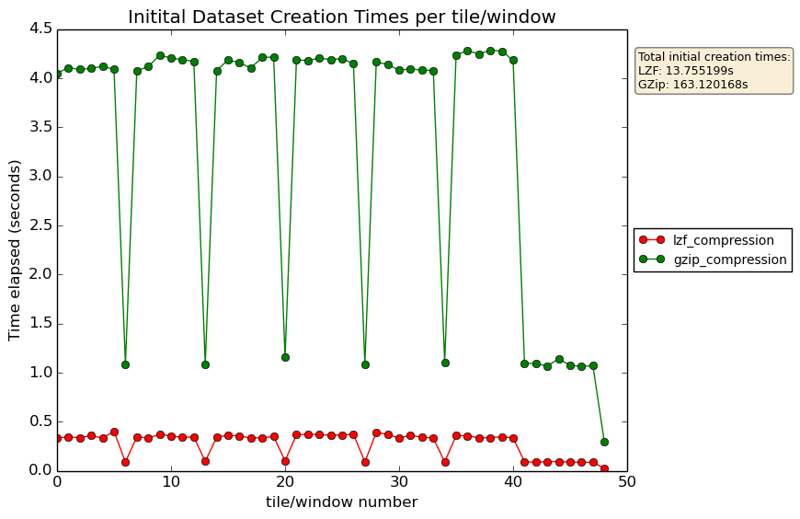
Dataset creation times (chunk factor affects)
Write a spatial block (eg 256x256) of data
Dips represent the edge of the spatial array dimensions (less data to write)
Notes:
4000x4000 spatial dimensions

Slide 15
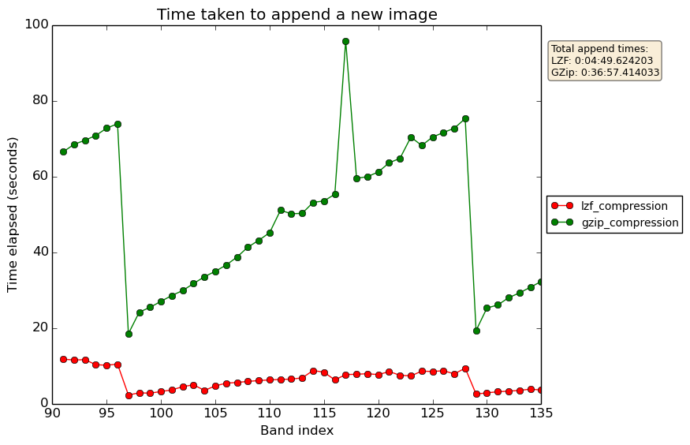
Dataset creation times (append, sequentially)
136 band image, chunks (32, 128, 128), appended sequentially
Each write needs to write each chunk collectively
Notes:
Appending sequentially you can see that the write times increase with each band index

Slide 16
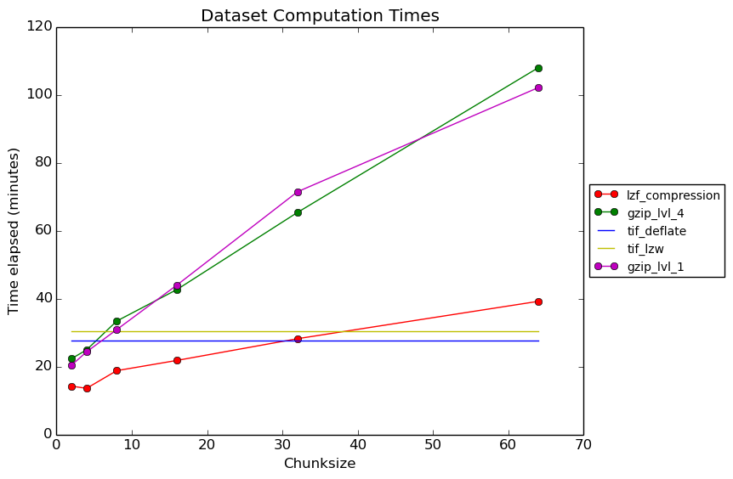
Synthetic algorithm process times (comparison)
result=log⁡(data)*√data- [x]
where:
data is a 3D array
x is a vector of averages (time point average)
Notes:
LZF was the only method comparable to the GTIff file. HDF5 suffered issues due to re-reading of the data.

Slide 17
Key points
Write in chunks that contain all data required
Aids in collection management in that a file could be aggregated when there is sufficient data required by the chunk dimensions
Your main type of analysis should determine how you chunk your data. If there isn’t then go for an in-between solution.
Large chunks can improve read times (but can also be a downside if you require less data than that returned by a chunk)
Notes:
GA currently has no products produced from algorithms requiring 4D data, so no point in reading 4D chunks to through away whole dimensions.
The v2 allows a user to configure the chunking sizes during the ingestion phase of a dataset

