Slide 1

CEO Report
Committee on Earth Observation Satellites
CEO Team
Marie-Josee Bourassa and Jonathon Ross
CEOS WEEK: WGISS-41 and WGCV-40
March 2016
Canberra, Australia

Slide 2
Topics
2016 Wrap-Up: Kyoto Plenary Outcomes
2016-2018 CEOS Work Plan
CEOS in the 2nd decade of GEO
SIT Chair Priorities and SIT-31
Sustainable Development Goals
CEOS Experts
Terms of Reference Updates
Other Relationships

Slide 3
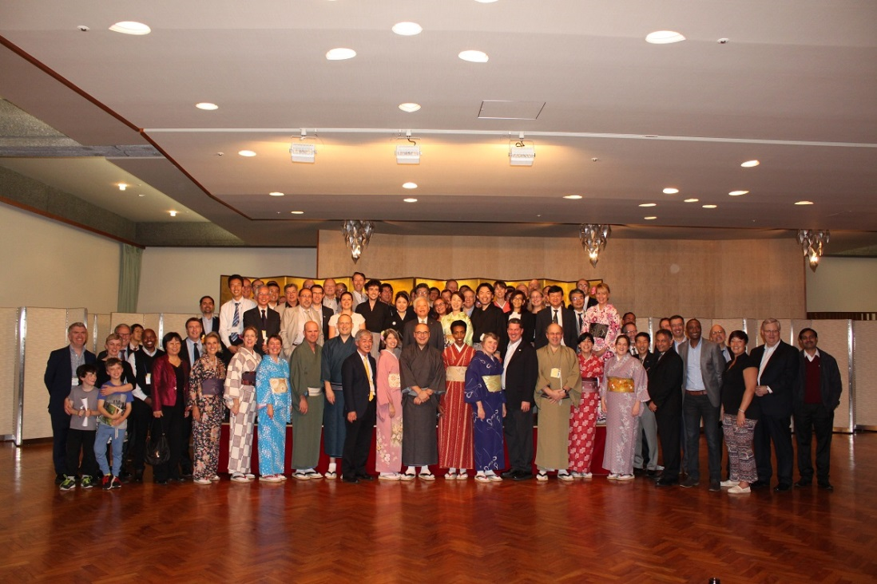
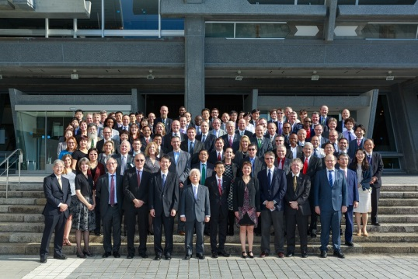
The 29th CEOS Plenary

Slide 4

Kyoto Statement
Applications
Significant progress but work to do
Engagement with GCOS and outcomes from Paris climate conference
New GCOS Implementation Plan
Sendai Framework
GEO-DARMA
Sustainable Development
Connecting with the statistics community
GEO
Engage to make the next decade a success!
Build on key successes like GFOI, GEOGLAM, AfriGEOSS, BluePlanet, Carbon and Water

Slide 5
Highlight Plenary Outcomes
Membership
Now includes Malaysia, Gabon and Mexico
Water
Endorsed CEOS Strategy for Water Observations from Space
Water Constellation Feasibility Study now in train
Disasters
Extended pilot activity to cover Landslides
Further support for super-sites
Agriculture and Forestry
Continued strong support for GFOI and GEOGLAM
Land Surface Imaging
Revitalised ‘virtual constellation’
‘Analysis ready data’ to capitalise on massive free data streams
Outreach
A CEOS Social Media Strategy

Slide 6
Chair Initiatives
Future data access and analysis architectures
Non-meteorological applications for
next generation geostationary satellites

Slide 7
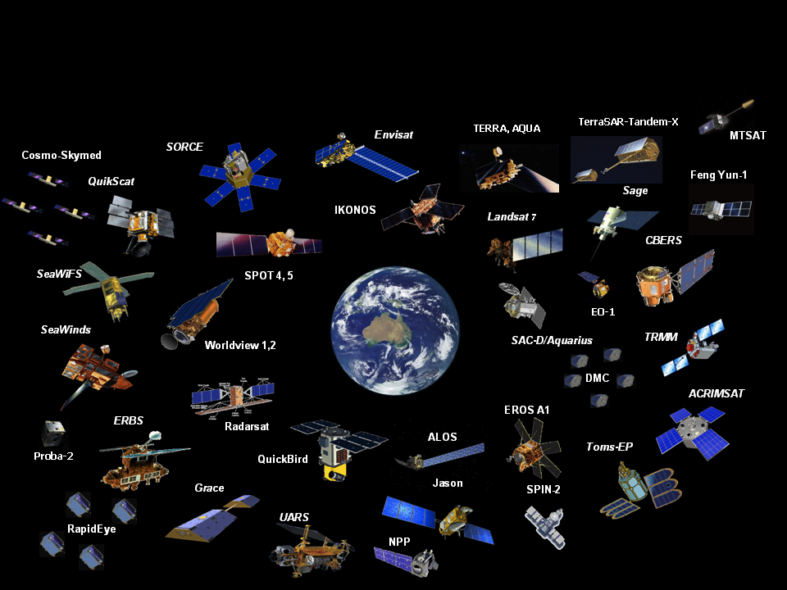
55 CEOS Agencies Operate 131 EO Satellites
(300+ sensors and measurements)
How do we help end-users discover and use data better?

Slide 8
Data Access and Analysis
The “Big Data” challenge
New Paradigm & Opportunities:
Integrated modelling of so called “big data”
    e.g. socio-economic with “science data”
Archive volumes
    Inhibit moving data to most end-users
    “Bring tools to the data”
Platform Technologies to enable easier use and collaboration
    Datacube, National Map
Sustainable approaches to archiving:
    Access issues especially in less developed countries are hampering global actions and treaties on climate change:
      loss of biodiversity, food security, water scarcity, disaster response, etc.
Notes:
The AGDC is an approach to meeting this challenge, and to create opportunities.
The Data Cube paradigm essentially transitions us to a situation where fundamental data about our Earth is ‘already there’ as infrastructure, in the same way as electricity and running water are
As well as the technical implications of such a paradigm, such as the need for investment in High Performance Computing and ‘spinning disk’ storage
This new paradigm brings with it implications for how data is stewarded at a national level
In a paradigm where the data needs to be ‘already there’ when a user goes to look for it, and where the potential to ‘mash up’ many different datasets and types of data is very real, a different approach to data management is essential

Slide 9
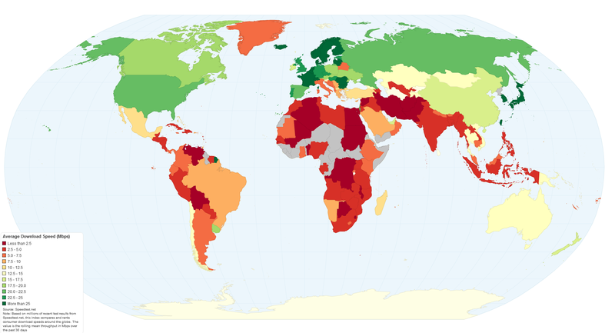
Data Access and Analysis
Global internet access speeds

Slide 10
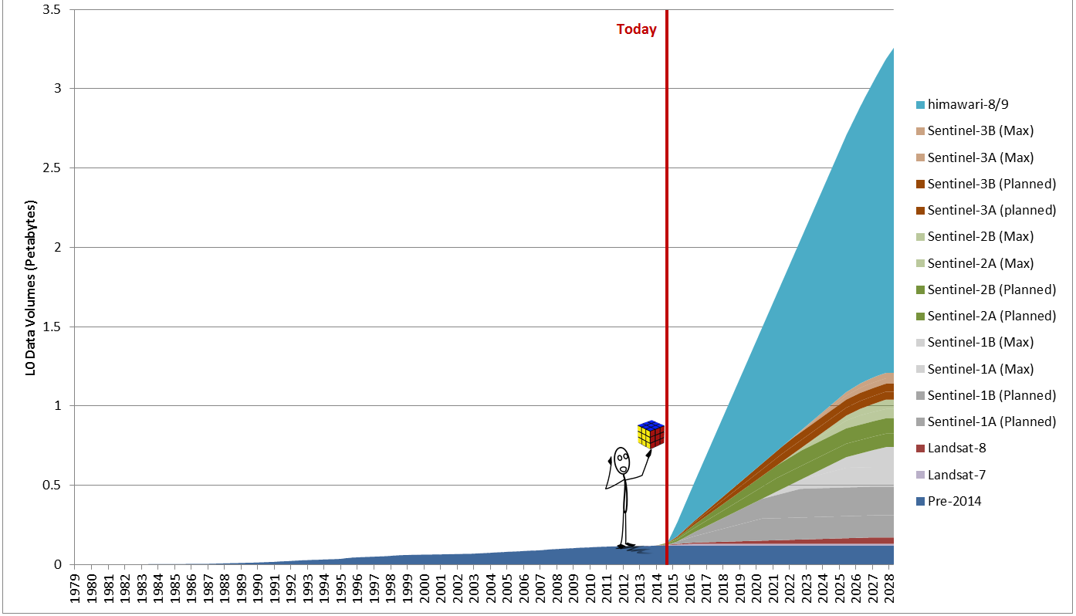
Data Access and Analysis
Next decade estimated
storage needs - Australia
Notes:
Here’s a rough estimate of the combined effect of variety, velocity and volume – and we’ve just arrived at the base of the mountain.

Slide 11
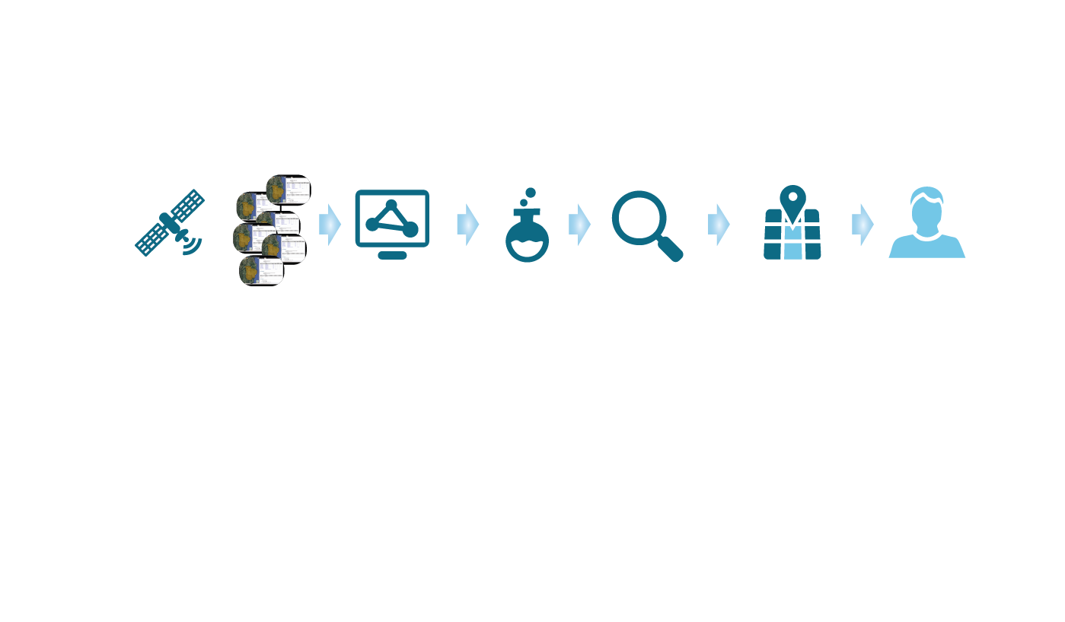
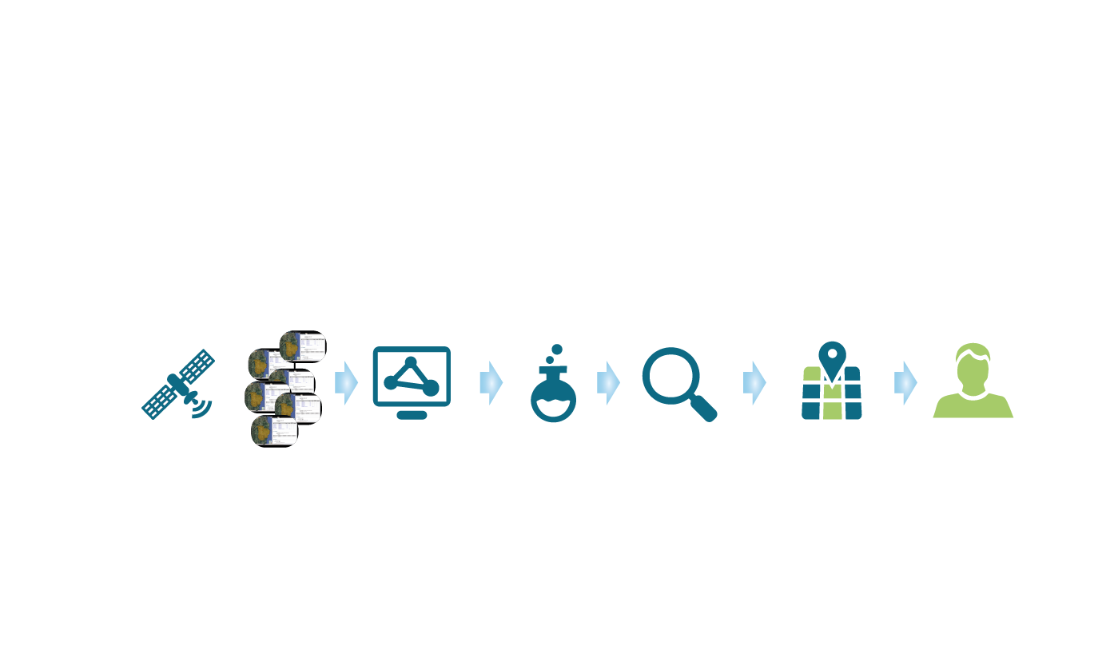
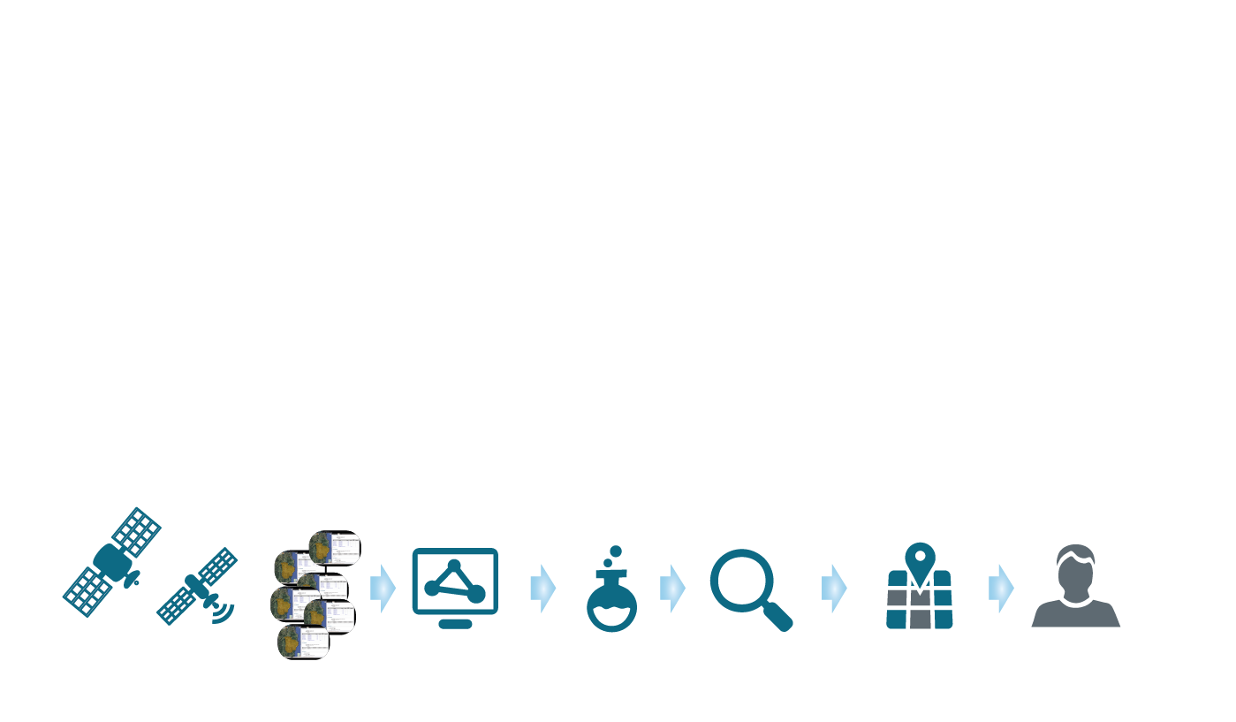
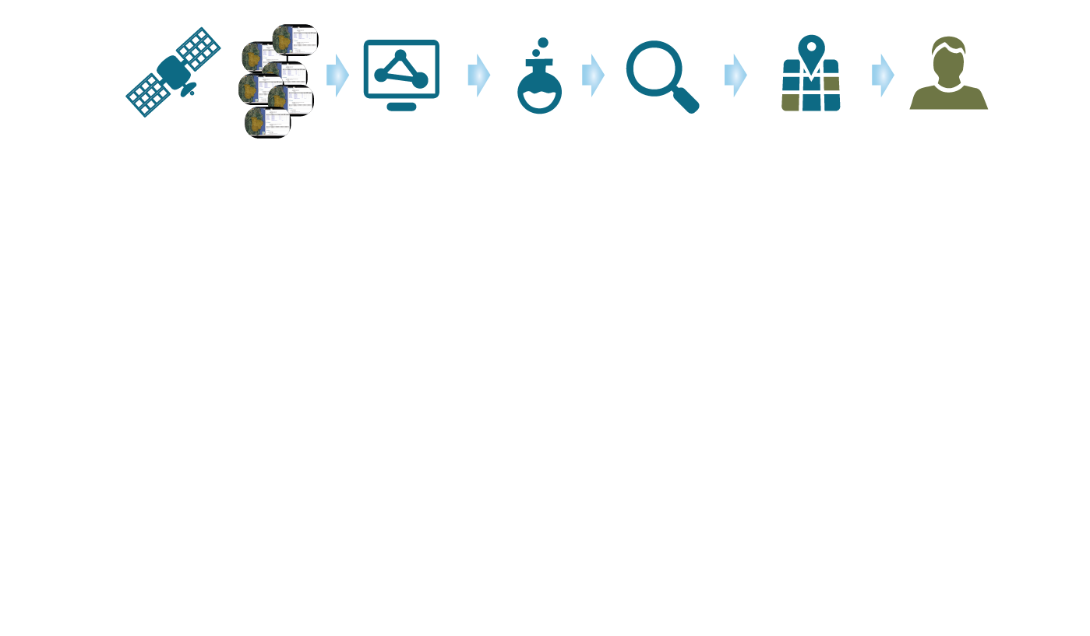
Data Access and Analysis
Traditional remote sensing product generation process
Notes:
Different users have different needs – though mostly the difference is in spatio-temporal region and feature extraction (analysis) choices. Most of the early parts of the pipeline are very similar (or often people don’t care so much about minor differences – that isn’t always the case though, people do like to choose their way).
In the AGDC approach all of that work that was duplicated, inefficient, ad-hoc, is taken care of and the data is made available as infrastructure, - just like electricity or water from a tap has multiple end uses, the supply side is simply “available for connection”.

Slide 12

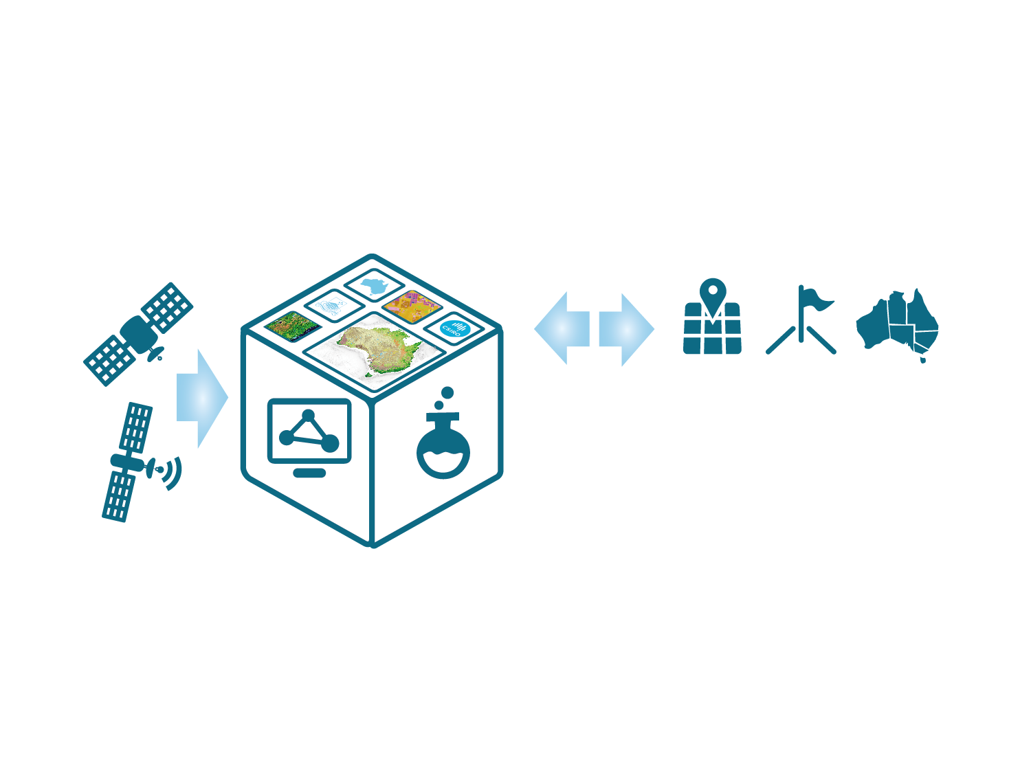

Data Access and Analysis
Integrated archiving
Notes:
The Data Cube makes comprehensive information about our Earth available as information infrastructure, supporting the digital economy, enabling downstream users, such as industry, to leverage it to create economic activity and employment
In this model, new data is proactively acquired and processed to further enhance the data cube, and users and the applications they develop can interact with the cube, rather than being passive recipients of ‘one off’ products … this type of interaction enables the answer to one question provided by EOS to trigger the next inquiry and so forth ...
The very large data is co-located with very large computing capacity at NCI – so the infrastructure is both data AND ANALYSIS. In effect, algorithms are sent to the AGDC.

Slide 13
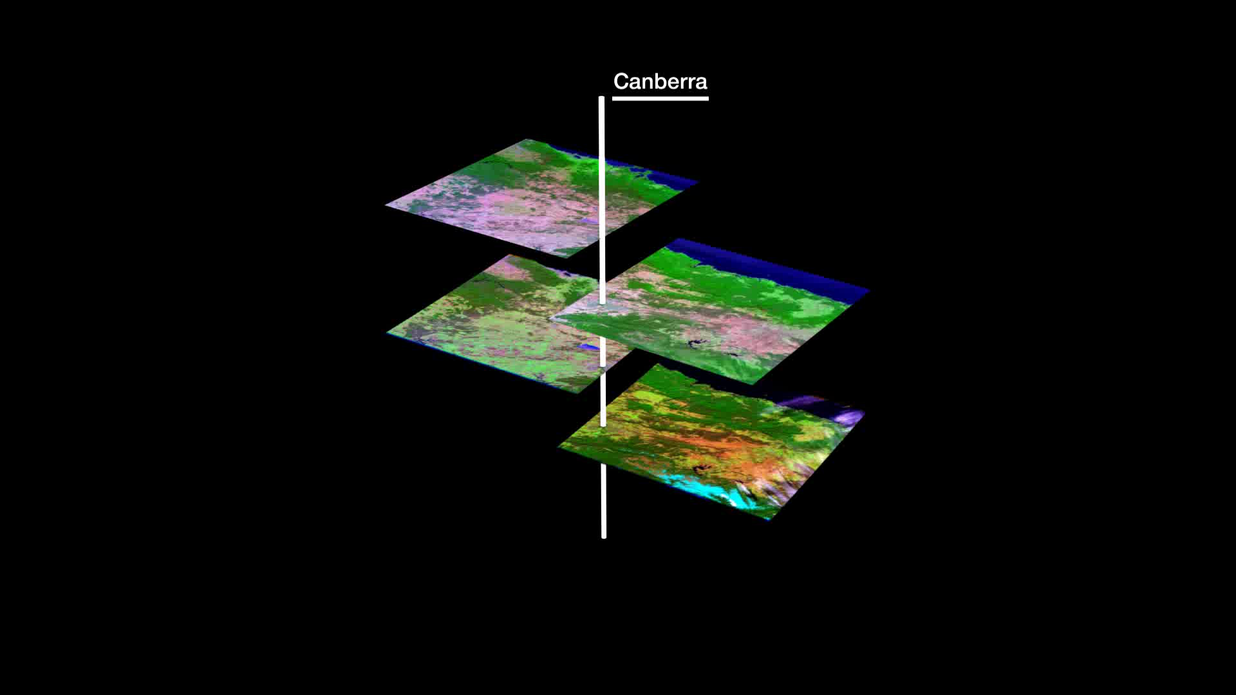
Data Access and Analysis
‘Cubing’ Landsat images
Notes:
Important points:
A distinction needs to be drawn between processed “working” data versus “raw” source observational data. Although potentially more accurate, source observational data is often less widely useful than processed products.
Working data needs to be calibrated and adjusted to a uniform standard for interoperability – this is what the AGDC contains.
Often have two satellites with different characteristics observing the same area in the same day, so daily detail isn’t enough, but also big gaps during cloudy periods.
Need to incorporate other sources of data for exact acquisition time (e.g. tide times, soil moisture, weather records) – used in calibration amongst other things
Need other on-ground observations to assist in interpreting surface colours.
The GA 25m Australian Reflectance Grid (ARG-25) product is an example of a dataset which has been processed to a suitable level. Without this level of processing, the individual scenes could not be combined seamlessly.
It is these challenges that the Australian Geoscience Data Cube is being developed by GA, CSIRO and NCI to address
Quite simply the Aim of the Data Cube is to remove as many technical barriers as possible to the use of this data, unlocking billions of dollars of value

Slide 14
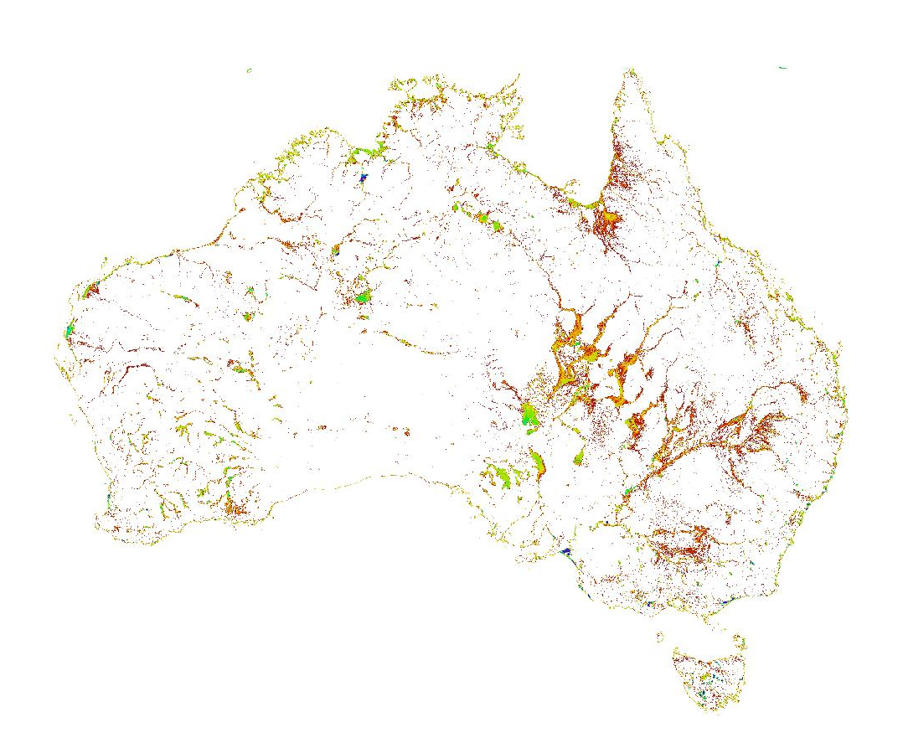




Data Access and Analysis
Continental surface water
Water detection
15 Years of data from LS5 & LS7(1998-2012)
25m Nominal Pixel Resolution
Approx. 133,000 individual scenes in ~12,400 passes
Entire archive of 1,312,087 tiles => 21x10¹² pixels visited
3 hrs at NCI (elapsed time) to compute
Notes:
But the Data Cube paradigm has enabled us to do not only undertake this analysis at a regional scale for the first time, it has in fact enabled us to scale this to produce a comprehensive national product
We can now analyse 15 years of data, across the country, representing every <n> square metres … in under 1 day.
Not only does this mean we can now for the first time produce this analysis once …
It means that we can produce it in an ongoing basis, enabling the production of updated information as new data becomes available, and enabling researchers to interact with the data iteratively to improve quality and try new ideas
And it means that, in future, industry and others can build value-adding products on top of this data by leveraging the services-based approach adopted
The important thing to note here is that, prior to the US opening the Landsat archive, GA charged $1000 per scene, which equates to $133M worth of data. Based on traditional data processing methods on original infrastructure, extracting and processing that data to the level in the AGDC would have taken around 8 years.

Slide 15
Data Access and Analysis
Study will highlight:
What are CEOS and related agencies doing today?
Lessons from the prototypes currently underway with the governments of Kenya and Colombia
Confirm issues and opportunities resulting from the trend towards Big Data, Analysis Ready Data
What issues will we need to work together on

Slide 16
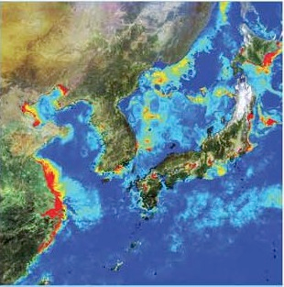



Enhanced, non-meteorological applications for next generation geostationary satellites

Slide 17
Non-meteorological applications
What are the opportunities for Members and Associates?
Greater spatial & spectral resolution
Greater temporal resolution
    more precise tracking of dynamic phenomena
Cross-calibration and synergies with Low-Earth Orbiting Satellites
Global coverage in virtual constellation mode provides ability to track global scale dynamics of various variables

Slide 18

Non-meteorological applications
Coverage
Full Disk
Interval : 10 minutes (6 times per hour)
Region 1
NE-JAPAN
Interval: 60 min. 10 min.
Region 2
SW-JAPAN
MTSAT
Himawari-8
Region 1 : JAPAN & Vicinity (North-East)
Interval : 2.5 minutes (4 times in 10 min)
Dimension : EW x NS: 2000 x 1000 km
Region 3
Target Area
Region 2: JAPAN & Vicinity (South-West)
Interval : 2.5 minutes (4 times in 10 min)
Dimension : EW x NS: 2000 x 1000 km
Region 3: Targeted Area
Interval : 2.5 minutes (4 times in 10 min)
Dimension : EW x NS: 1000 x 1000 km
Source: Kurino 2015, (JMA)
Notes:
18

Slide 19
Non-meteorological applications
Australian first cut
Ocean & Coastal Waters:
    Water-leaving radiance
    Total Suspended Matter
    Chlorophyll-a
    Flood plume mapping
    Algal bloom detection
    Sea Surface Temperature
  Atmospheric
    Aerosol optical depth (land)
    Aerosol type (land)
    Surface reflectance (land)
    BRDF
    Aerosol optical depth (land)
    Aerosol type (land)
    BRDF
    Cloud mask
    Aerosol optical depth (land)
    Angstrom exponent (land)
    Particulate Matter (PM10 and PM2.5) conversions of aerosol
  Atmospheric (cont.)
    Solar radiation
    SO2
  Land
    Shortwave downwelling radiation
    Surface reflectance (land)
    Land Surface Temperature & Emissivity
    Flood mapping – real-time
    Fire Hotspot mapping
    Burnt area mapping
    Normalised surface reflectance (terrain and BRDF corrected)
    Vegetation indices – daily composites comprised of all clear-sky pixels
    Evapotranspiration
    Land surface silicate Mineral particle size

Slide 20
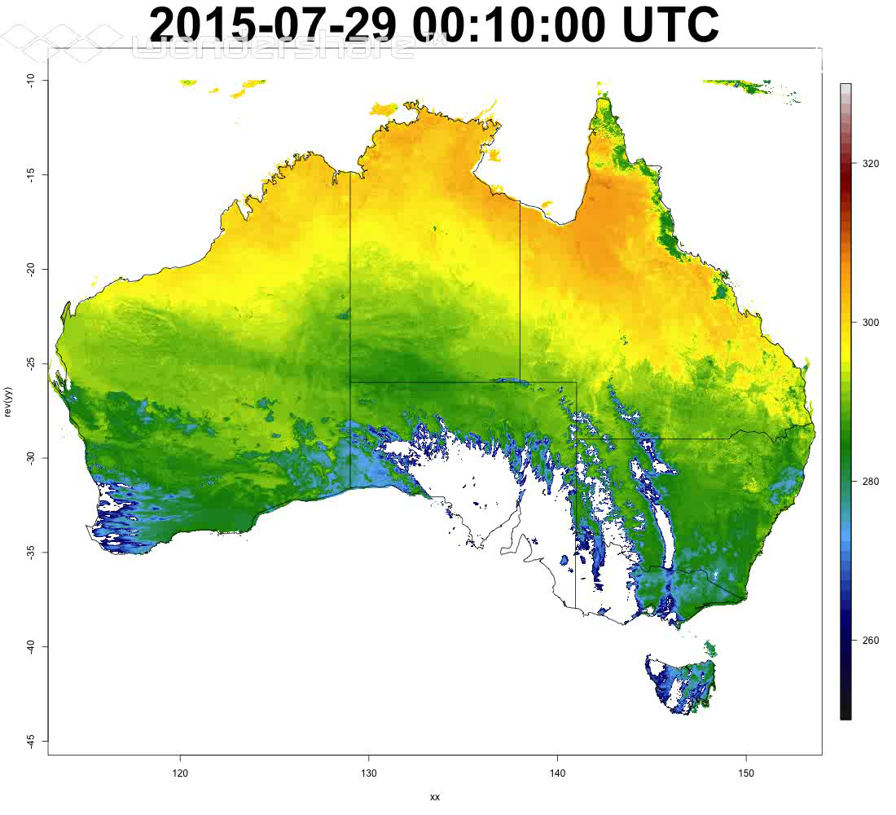
Non-meteorological applications Land-surface temperature

Slide 21
Non-meteorological applications
Study will highlight:
What are current plans in both applications and sensors
Assess and prioritise the various GEO and GEO-LEO combined applications and algorithms for coordination through CEOS
Lessons learnt from the early collaboration on non-met GEO algorithms resulting from the Japan-Australia bilateral efforts
Identify key issues and opportunities
What we do next

Slide 22
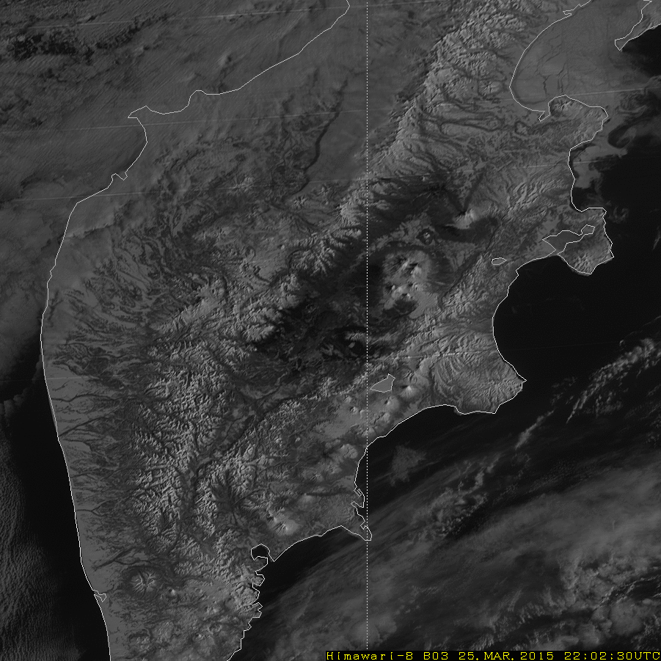
Thank you !!
Eruption of Mt. Shiveluch in Kamchatka
March 25, 2015
Footage from Himawari-8 Test Observation (Band-3 (0.64µm), 2.5 min.)

Slide 23
2016-2018 CEOS Work Plan
2015-2017 CEOS Work Plan outcomes
 |  | Due by Q4 2015 | Due by Q4 2016
 | Completed or on track | 39 | 14
 | Material delays | 9 | 2
 | No progress or other issues | 1 | 3
 | No update | 2 | 1

Slide 24
Timeline
Now
Late Nov 15
Late Jan 16
Mid Feb 16
28 Feb 16
New
Initiatives
Updated Priorities
MilestoneChanges
Refinement
Concurrence
CEOS-29
v0
V0.5
Pre-V1
V1.0
We are here
Discontinued Objectables
Status
Updates
Add/Remove
Objectables
Validation
Approx 1
Month Late
Major Slips
Plenary
Outcomes
Revise
Rationale
WGs/VCs/AHTs
CEO Team
SEC
CEO Team
Chair Team
WGs/VCs/AHTs
Stakeholders
Principals
(Virtual Endorsement)

Slide 25

Highlights in 2016-2018
Water (WAT) actions shift from study to implementation, following endorsement of the CEOS Strategy for Water Observations from Space.
CEOS Chair Initiatives incorporated:
  NG-1
  DATA-7
Climate (CMRS) shifts into second cycle of ECV Inventory, and will focus on new GCOS-IP, Satellite Supplement and Response.
GEO-DARMA (DIS-15) recognised.
WGCapD activities significantly-recast to reflect new strategic objectives.
CEOS Data Cube (SEO lead) explicitly included.

Slide 26
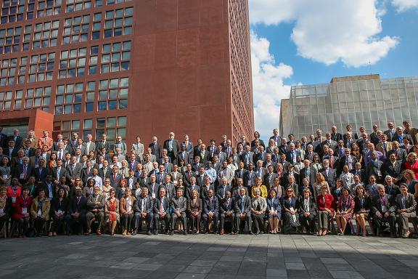
GEO-XII: Mexico City
Strong support for the next decade of GEO.
GEO Strategic Plan 2016-2015 endorsed by Ministers.
New Rules of Procedure adopted, addressing CEOS concerns around Programme Board and ExCom representation.
GEO 2016 Transitional Work Programme adopted.
  GD-5: CEOS-lead “space task” included.
CEOS booth very well attended with significant interest around future data architectures.

Slide 27
What will be different?
Big focus on delivering impact into big global and regional agendas – in particular the Sustainable Development Goals.
  How will we prioritise and coordinate?
Focus on developing stronger and more explicit links with UN institutions and programmes.
  How will we be engaged in that?
  Need for direct relations with key agencies?

Slide 28
What will be different?
Focus on mobilizing resources ($) from ‘outside GEO’. Private sector, development banks, philanthropic organizations.
  How can we appropriately harness this to support CEOS Agency activity?
Emphasis on defining and prioritizing requirements by SBA. Deeper end-user engagement – hopefully fewer ‘wish lists’.
  How can we step up once this occurs, and avoid ‘requirements ping pong’?

Slide 29
What will be different?
Strong focus on in-situ coordination and space/in-situ integration.
How can we use this to help us?
How do we ensure this is not read to imply ‘less’ focus on space data …
POs in top-level governance – observers on ExCom, key Programme Board role.
We may well get what we wanted. Now to deliver and use it effectively …

Slide 30
GEO Programme Board
New entity with the role of developing and monitoring delivery of the 3-year GEO Work Programme.
Intended to place some ‘rigour’ into what becomes a “GEO initiative” while:
  Respecting the ‘best efforts’ and ‘voluntary’ nature of GEO
  Providing mentoring, advice and support
  Helping connect participants and initiatives
CEOS represented by:
  SIT Chair (S. Briggs) [Principal]
  SIT Chair Team (I. Petiteville) and CEO (J.Ross) [Alternates]
First meeting in Geneva early February. 5 task-teams established with goals including:
  Review of goals and targets
  Review of foundational tasks
  Review of candidate GEO initiatives/flagships

Slide 31
GEO ExCom
Historically, only member nations have participated in ExCom.
New GEO Strategic Plan recognises important role of Participating Organizations (like CEOS) in governance and leadership.
Three POs now invited to sit as Observers on ExCom.
POs elected from PO’s represented on Programme Board.
Initial 1-year terms for:
  CEOS
  GOOS
  WMO
CEOS represented by SIT Chair, Stephen Briggs.
First ExCom meeting with CEOS rep discussed topics including:
  Engagement Strategy
  Private Sector Strategy

Slide 32
Annual CEOS-GEO Coordination Meeting
6 | CEOS-GEO to discuss collaboration around WIGOS to explore ways to strengthen their partnership. Meeting week of the symposium to be organised by GEO Sec. A particular attention to the work of CEOS’ future data architectures study and WGISS ‘technology exploration’ sub-group | A. Obregon / CEOS CEO

Slide 33
SIT Chair Priorities
Ensure success of ongoing CEOS Priorities – recent systematic procedures have promoted several major initiatives
Ensure full access to & exploitation of Copernicus Sentinel data in support of the above priorities
Develop further the CEOS-GCOS-IPCC-UNFCCC relationship for climate measures, observations and indicators, post COP-21 with WG-Climate and through the GCOS Implementation Plan (2016) & Satellite Supplement (2016), CEOS Response (2017).
And :
  Maintain and improve effectiveness of strategic partnerships with UN agencies, investment banks, international programmes and agencies and ensure GEO is effective as an instrument in this
  Support the initiatives of the incoming CEOS Chairs in 2016/2017 as partnership with ESA SIT Chairmanship

Slide 34
SIT-31
Hosted by SIT Chair ESA, Frascati, Italy.
SIT Chair aims to respect the role of SIT vs SIT Tech Workshop vs Plenary in structuring meetings:
  “Strategic Implementation Team (SIT), meeting once per year (Mar/Apr) and setting strategic direction of implementation of CEOS Priorities set by Plenary”
Less reporting, more discussion on strategic topics:
  UN relationships
  Investment banks and donors
  CEOS-GEO (now that the next decade is here!)
  Dealing with domain-specific requirements documents
  Putting the Carbon Strategy to work
Discussion papers will be circulated soon.

Slide 35
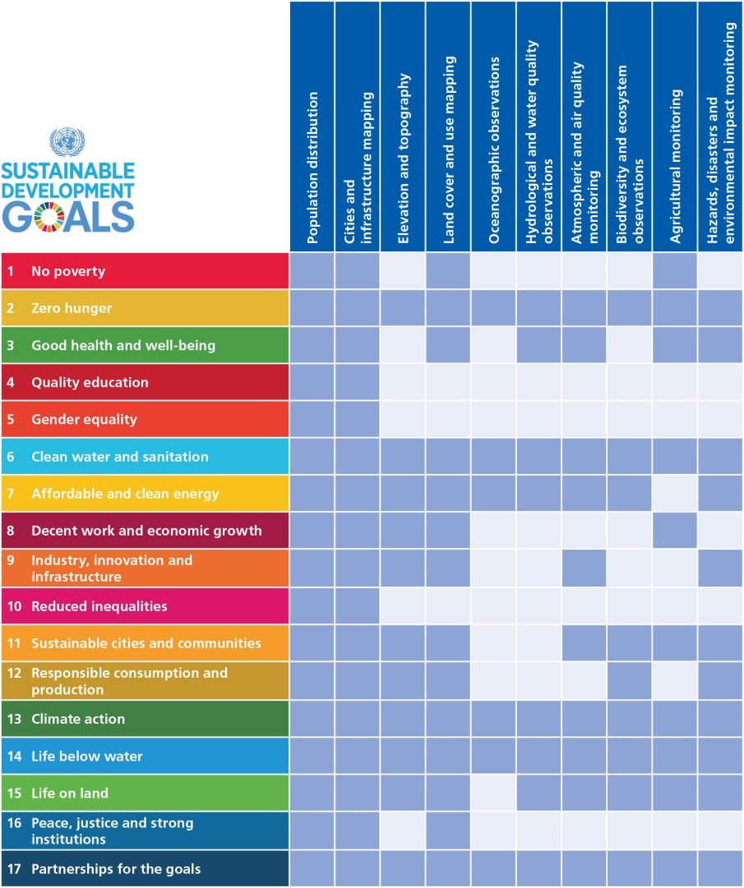
Global Goals for Sustainable Development
Adopted in 2015.
Role for EO identified in:
  Tracking progress.
  Achieving progress.
Working with UN-GGIM and GEO to promote role of EO in ‘indicators framework’.
Statistics agencies key players:
  EO is relatively ‘new’ for them.
  We need to engage in ‘their world’ not expect them to come to us.
  Info systems key to them engaging with ‘big data’.
CSIRO and DCEO leading CEOS engagement.

Slide 36
CEOS Experts
Intended to ensure CEOS has visibility in key domains where no WG/VC exists:
Role ‘formalised’ through invitations from CEOS Chair.
Responsible for:
  Watching brief, and advising Chair and SEC on emerging issues.
  Input to work plan.
  Status tracking.
Initial tranche:
  Paul Di Giacomo (NOAA) – Oceans/BluePlanet
  Yves Crevier (CSA) – Polar
  Mark Dowell (EC) – Carbon
  Martin Wegner (DLR) and Allison Leidner (NASA) - Biodiversity

Slide 37
Terms of Reference Review
Organizational Issues Deliverables: 2016-2018
Objective/Deliverable | Projected Completion Date | Background Information | Responsible CEOS Entity
ORG-7: Refreshed Terms of Reference for Working Groups | Q4 2016 | As a result of the updated Governing Documents, work is required to reformat/translate existing Terms of Reference into the new structure to ensure consistency. A status update will be provided by each Working Group at SIT-31. | Working Groups with support from CEO
Thank you WGISS (Richard) – Done.
Thank you WGCV – Drafted.

