Slide 1
Status of Carbon Action Items
K. Thome
NASA/GSFC
Carbon Action Items
WGCV Plenary # 40
March 14 -18, 2016

Slide 2
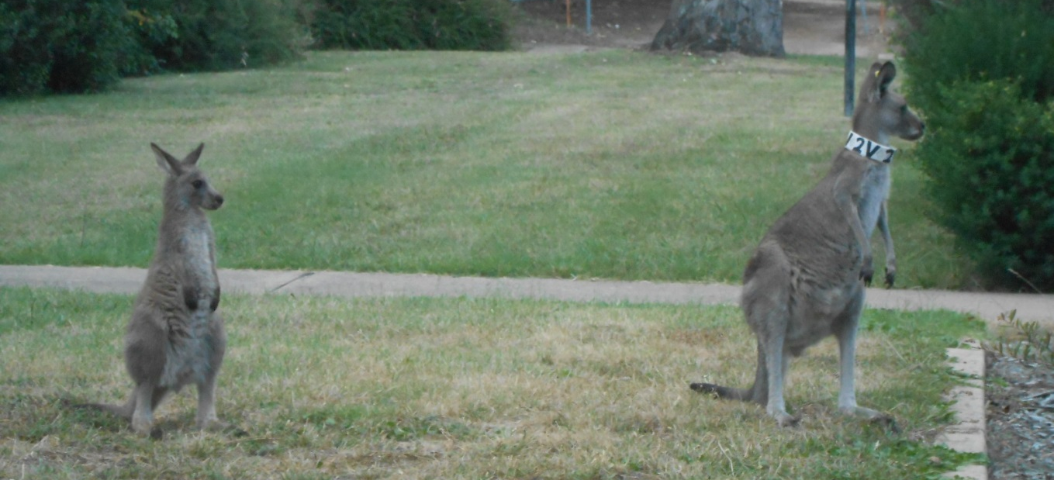
Important to begin looking towards the topics addressed in the Carbon Strategy document
Specifically, there are a set of action items identified in the document
Many of those have direct and indirect relationship to WGCV

Slide 3
Background
At SIT-29 (April 2014), the Ad-Hoc Carbon Strategy Implementation Study Team was established
Determine appropriate way to implement the recommended actions of the CEOS Strategy for Carbon Observations from Space
Identify tasks and appropriate CEOS Entities to take them forward
Results were endorsed at the 28th CEOS Plenary (Oct. 2014) and are now being implemented
VCs and WGs
Oversight by SIT Chair and coordination by CEOS Carbon Expert (EC))

Slide 4
14 actions from Carbon Strategy report are related to WGCV
The view by SIT is a list of actions
Recognized that there is some overlap but still handled as discrete set of items
Easier to track at the SIT level
More difficult to handle at the WGCV level
Action A
Action B
Action C
Action L
Action M
Action N

Slide 5
14 Actions are related to WGCV
Treating the actions as a discrete set is not efficient
Limited resources for WGCV members
There is significant overlap in some of the actions
Necessary to develop an efficient way to close the Carbon Actions
Identifying the overlap allows progress on multiple Carbon Actions through completion of a single WGCV action
Action I
Action J
Action K
Action N
Carbon Actions
Action H
Action F
Action B
Action M
Action C
Action D
Action A
Action E
Action L
Action G

Slide 6
Identifying where the actions fit within the Subgroup will be essential to optimizing effort
Some actions have already been addressed within some of the WGCV Subgroups
Fully addressing the actions will benefit from collaborative efforts
CEOS-WGCV
Action H
ACSG
Action F
Action D
Action E
LPV
IVOS
MW
SAR
TM

Slide 7
What could this look like? Carbon Action #34 as an example
CA-34: Individual CEOS Agencies producing the same (or similar) carbon data products will cooperate to ensure that their products are compared to the other relevant products and, if technically feasible, ensure efforts are made so that their products can be used quantitatively with these other products.
Comment: The recommendation shall be transferred so that CEOS agencies make use of common protocols, definitions of compatible products, etc.. There is a compatibility related to AI-22, AI-26 and AI-29 with guidelines and definitions. Those shall be also allocated at CEOS entities as WGCV for level 1 but also for level 2 at WGCV and VCs in order to ensure overall compatibility with other/additional products and to avoid a duplication of definitions and so on. This is consistent with other actions.

Slide 8
Carbon Action 34 could lead to the following WGCV Actions
WGCV CA34-1: Document WGCV LPV current support of individual CEOS agency efforts through providing best practice validation protocols and online platform for intercomparison of terrestrial carbon products
WGCV CA34-2: Provide list of products currently being documented for validation best practices
WGCV CA34-3: Determine best method for an online platform to make WGCV results of intercomparison of carbon products widely available
WGCV CA34-4: Provide list of Level 1 and 2 products relevant to Carbon Strategy to the SIT Carbon Expert

Slide 9
Collect the WGCV CAs into broad categories and determine overlap
Broad categories have been noted related to
Products
Sensors/Missions
Protocols
In Situ (should we call it Fiducial?)
Organizational
Validation
Broad categories only make it easier to look for overlap

Slide 10
Example using In Situ category
WGCV CA7-1: Forward list of relevant in situ reference data sets and networks for each variable covered by LPV to WGClimate Chair for eventual use by Carbon Subgroup
WGCV CA7-2: Document approach to ensure updating of reference data as time series expand, including collaboration with in situ networks for the validation of carbon variables to ensure temporal continuity
WGCV CA7-4: Identify in situ network stations relevant for carbon variables covered by WGCV
WGCV CA7-6: Present to WGCV Plenary a method for addressing spatial gaps in in-situ networks
WGCV CA9-2: Develop list of core validation sites for automatic subsetting of satellite data
WGCV CA32-6: Document process used for current selection of LPV supersite selection (serving for multiple variables) and validation sites specific to single variables for automated subsetting
WGCV CA32-7: Determine best method to distribute the methodologies and criteria for globally representative site selection documented in the framework of the BELMANIP validation data set for LAI, and recently in a EUMETSAT project (ALBEDOVAL 2) for albedo validation

Slide 11
Combined In Situ WGCV CAs
WGCV CA7-1; WGCV CA7-4; WGCV CA9-2: Document list of relevant in situ reference data sets and networks relevant for carbon varioables covered by WGCV highlighting those sites suitable for automatic subsetting of satellite data
WGCV CA7-2; WGCV CA7-6: Document approach to ensure updating of reference data as time series expand, including collaboration with in situ networks for the validation of carbon variables to ensure temporal continuity and addressing spatial gaps in in-situ networks
WGCV CA32-6: Document process used for current selection of LPV supersite selection (serving for multiple variables) and validation sites specific to single variables for automated subsetting
WGCV CA32-7: Determine best method to distribute the methodologies and criteria for globally representative site selection documented in the framework of the BELMANIP validation data set for LAI, and recently in a EUMETSAT project (ALBEDOVAL 2) for albedo validation

Slide 12
Next steps
Complete distillation of the WGCV CAs to remove overlap
Identify Carbon Strategy Actions covered
Determine Subgroups relevant to actions
Propose responsible parties for actions
Present list of actions to WGCV plenary
Assign responsible parties and begin closing actions
Question
Is it better to have fewer actions that cover broader topics or more actions but having more specific topics?

