Slide 1
CWIC Status Report Yonsook Enloe yonsook.k.enloe@nasa.gov WGISS-41, Canberra AU March 17, 2016

Slide 2
CWIC Session Agenda
Introduction & Status – Yonsook Enloe
Metrics Review
Earth Data Search Client Demo
Partner Reports:
ISRO – Nitant Dube
NOAA Update – Martin Yapur
ROSCOSMOS -- Tamara Ganina

Slide 3
CWIC Status
Data Partners partners:
NASA, USGS, NOAA/GHRSST, CCMEO, INPE, EUMETSAT, ISRO (MOSDAC), ISRO (NRSC) is operational this month
ROSCOSMOS – developing partner
AOE – developing partner
NOAA – will develop access to new and historical data
A big push from NASA to provide access to more data through CWIC in the next year
Australia – GA, CSIRO, BoM (Bureau of Meteorology) – just initiated work to provide search and access to their data through CWIC; Some of the data will also be accessible via Data Cubes…..→ Search and access of analysis ready data in Australia

Slide 4
CWIC Status (Continued)
Support for 2 WGISS adopted standards
OGC CSW 2.0.2
CEOS OpenSearch Best Practices and CEOS OS BP Developer’s Guide package
NASA recommendation for NASA ES data systems https://earthdata.nasa.gov/standards/ceos-opensearch
NASA is developing access to CWIC from the Earth Data Search Client. The source code for this client will be made open source. (Demo later)

Slide 5
CWIC Status (Cont)
IDN/GCMD has a new implementation! All existing APIs supported; better, faster, more reliable and consistent…
IDN Tagging of data collections (e.g. CWIC, GHRSST, ..) offers seamless access to an identified subset of data.
Annual CWIC team meeting – Feb 9-10, 2016 –
https://wiki.earthdata.nasa.gov/display/CWIC/February+2016+CWIC+Meeting
All presentations from the meeting are online
Focus of the meeting was the new IDN implementation and CWIC synchronization with the new implementation

Slide 6
CWIC Metrics
Updated metrics on the CWIC project page
http://wgiss.ceos.org/cwic
Combined metrics for OpenSearch and CSW access
Minimum, maximum, and average times for each type of request
Top 100 datasets searched for
IP addresses of unique visitors
Metrics webpage review

Slide 7
CWIC Status (Continued)
Emergence of a System Level Team
Assistance in registering data collections
On-boarding of new data partners
Tech support for client partners
Bug fixes
System level testing and monitoring
System level metrics
Makes stuff work well!

Slide 8
What is Earthdata Search?
Earthdata Search
Metadata
Catalog Search
Visualizations
Services
Data
Interaction Design

Slide 9
Earth Data Search Client
NASA’s operational client will provide access to CWIC very soon!
Client source code is open source
GCMD Keywords fully integrated into client and can be used to narrow down the collections
Collection Search & Granule search
Live Demo

Slide 10
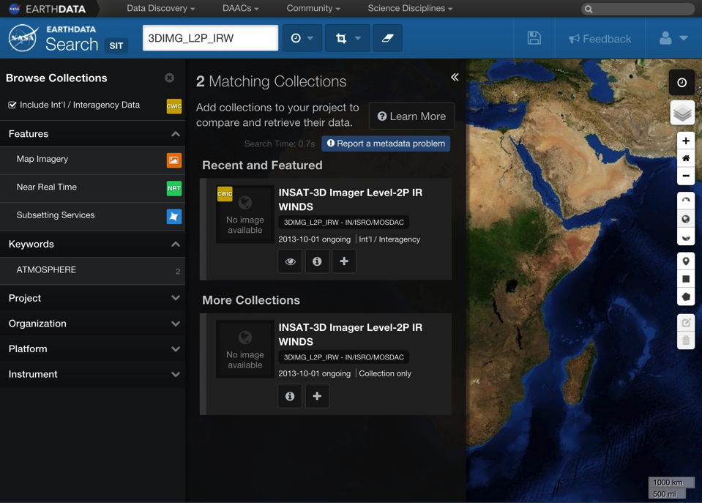

Slide 11
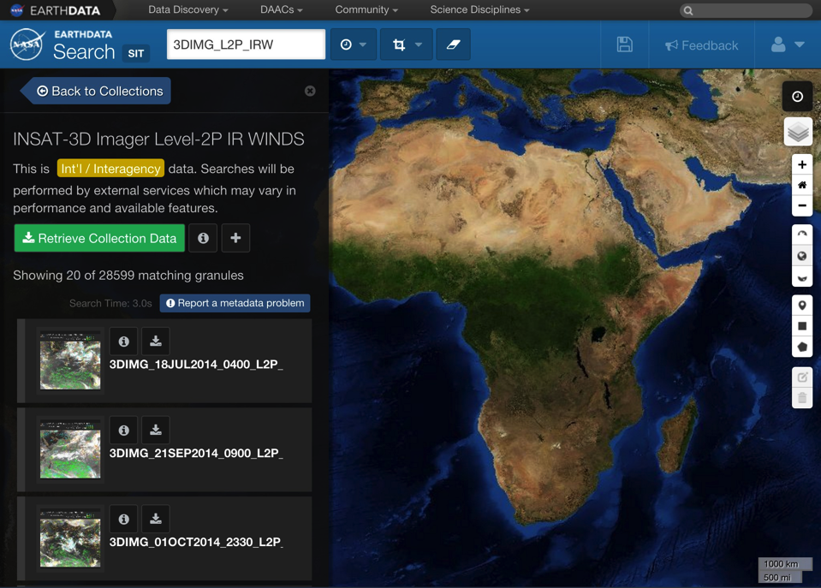

Slide 13
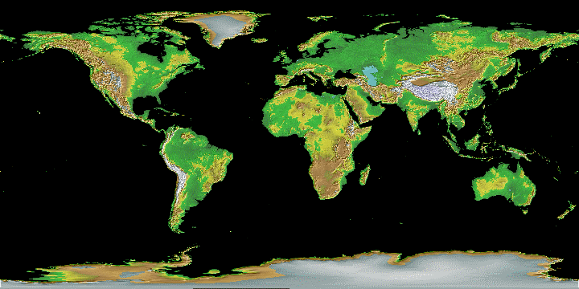
CWIC Data Partners
CCMEO
AOE
AOE
ROSCOSMOS
USGS
NASA
NOAA/
GHRSST
ISRO
INPE
GA/BoM
CSIRO
NASA - National Aeronautics and Space Administration
NOAA - National Oceanic and Atmospheric Administration
CCMEO-Canadian Center for Mapping and Earth Observation
GHRSST – Global High Resolution Sea Surface Temperature
ROSCOSMOS – Russian Federation Space Agency
ISRO - Indian Space Research Organisation
INPE – National Institute for Space Research
USGS – United State Geological Survey
AOE - Academy of Opto-Electronics, Chinese Academy of Sciences (CAS) -- (Beijing-1, NSMC/FengYun, CRESDA)
AUS -- Australia partners (GA/BoM/CSIRO)

