Slide 1
Technology Exploration Workshop on CLOUD COMPUTING : SECURITY (?)
Julien Airaud – CNES
julien.airaud@cnes.fr

Slide 2
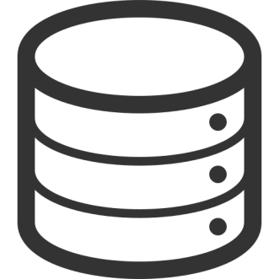
WHAT IS SECURITY ?
Data
Process
Confidentiality
Integrity
Availability

Slide 3
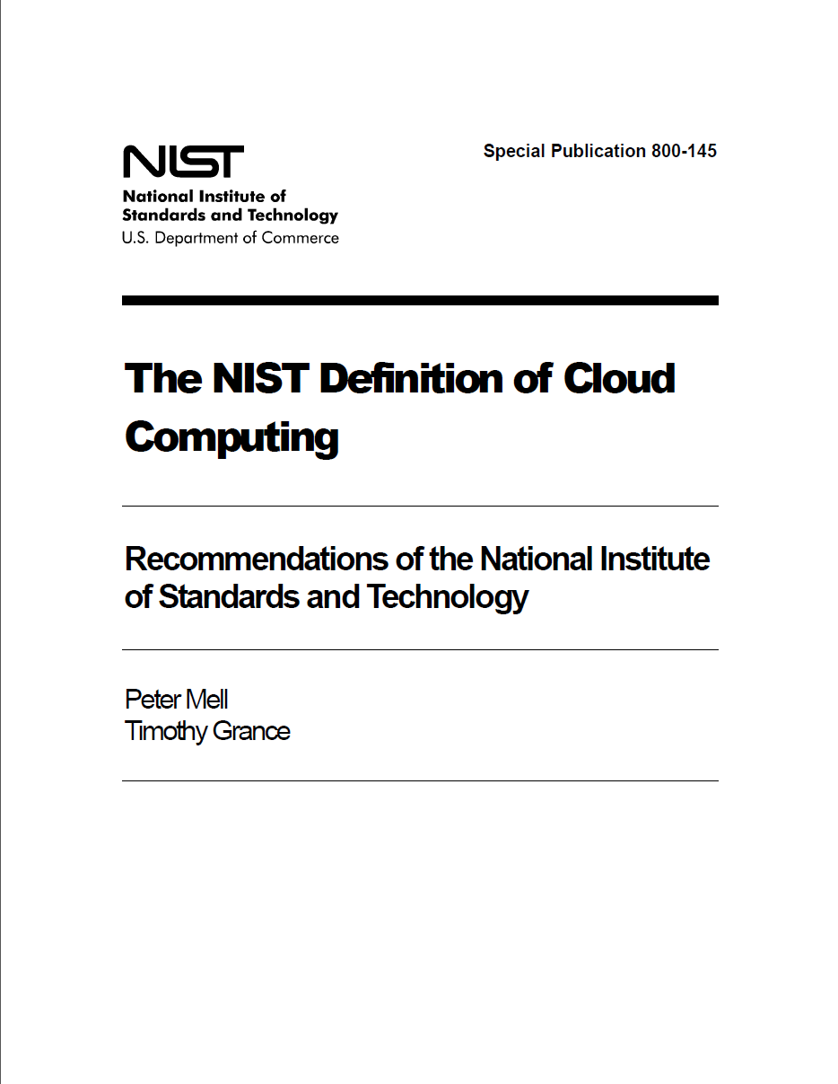

Slide 4
Broad Network Access
Rapid Elasticity
Measured Service
On-demand Service
Essential
Characteristics
Ressource Pooling
Software as a Service (SaaS)
Platform as a Service (PaaS)
Infrastructure as a Service (IaaS)
Service
Models
Public
Private
Community
Hybrid
Deployment
Models
NIST Visual Model of Cloud Computing Definition

Slide 5
Is « the cloud » secure ?

Slide 6
Well…it depends
Cloud
Operational model
There are lots of different types of cloud (and they are not created equal)
Use cases
Data processing, off-loading, analytics, etc.
All uses cases are differents
Notes:
NIST Special Publication 800-145 : The NIST Definition of Cloud Computing
ISO/IEC 17788:2014 : Information technology -- Cloud computing -- Overview and vocabulary

Slide 7
The problem at hand.

Slide 8
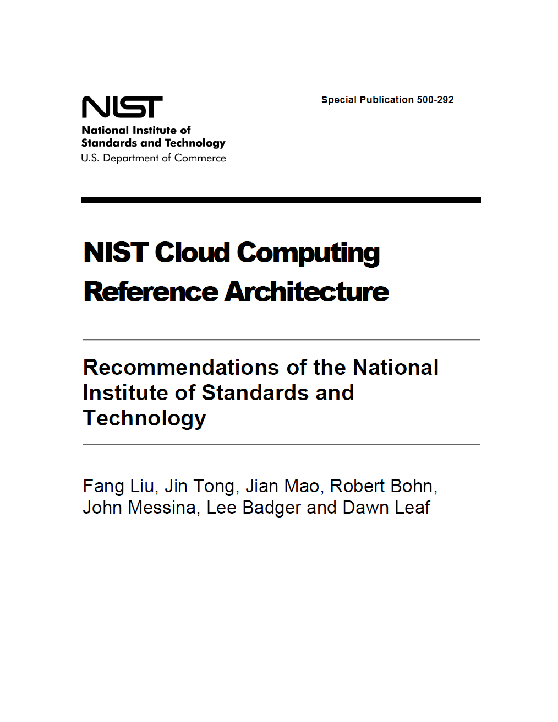

Slide 9
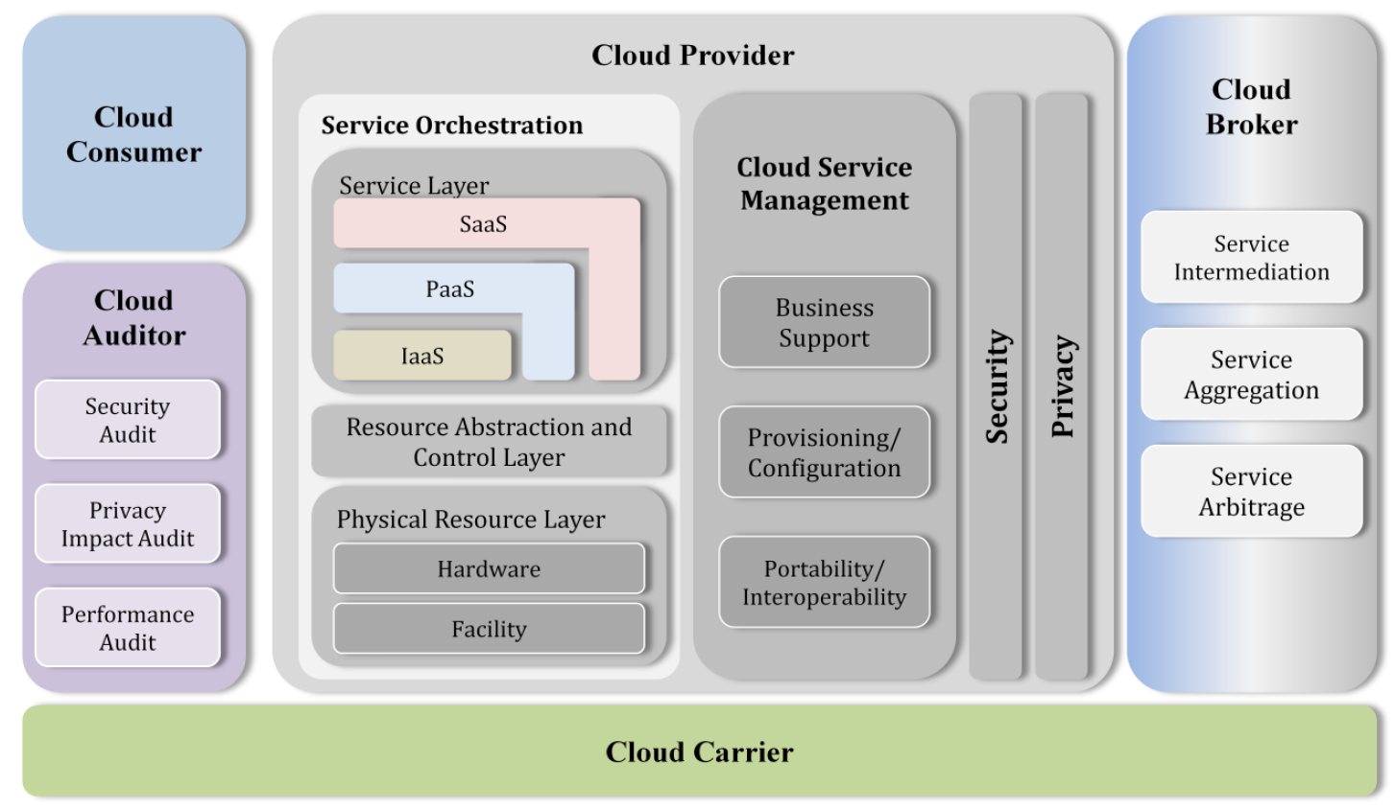

Slide 10
How does cloud computing affect our security practices ?

Slide 11
Multi-tenancy
Presentation
Modality
Presentation
Platform
APIs
Applications
Data
Metadata
Content
Integration & Middleware
APIs
Cloud Security Alliance Multi-tenancy
Core connectivity & Delivery
Abstratction
Hardware
Facilities

Slide 12
Security driver (short version)
Security
Trust
Customers
Providers are usually good at security (compared to what SME or equal size organizations can afford).

Slide 13
Cloud characteristics : Scale
Locations
Elasticity means better availability
Notes:
Elasticity applies to the security mecanisms.
Automation and orchestration provide an error free environment, or any error is noticeable by many.
Better risk management applies to the consumer and provider.
Zones :
Google EU : Western Europe St. Ghislain, Belgium europe-west1-b europe-west1-c europe-west1-d
Amazon: eu-west-1 EU (Ireland) eu-central-1 EU (Frankfurt)
Azure : Europe du Nord Irlande Europe de l'Ouest Pays-Bas
HN : Cloud Sigma en suisse, Atos, T-System en allemagne

Slide 14
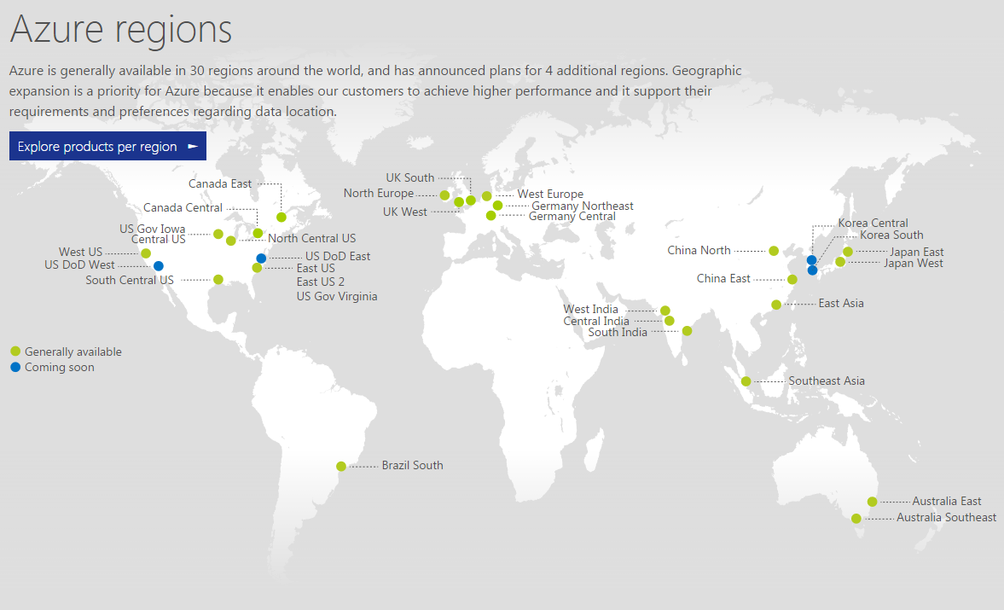

Slide 15
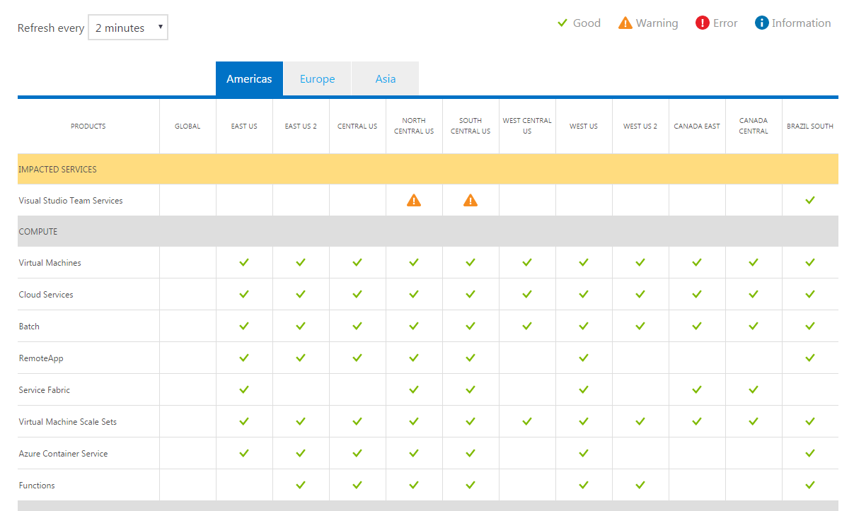
Scale - Zones

Slide 16
Cloud characteristics
Scale
Locations
Elasticity means better availability
Deployment
Robust templates for virtualization
Automation + orchestration = security miracles
Audit and Incident Management
Notes:
Elasticity applies to the security mecanisms.
Automation and orchestration provide an error free environment, or any error is noticeable by many.
Better risk management applies to the consumer and provider.
Zones :
Google EU : Western Europe St. Ghislain, Belgium europe-west1-b europe-west1-c europe-west1-d
Amazon: eu-west-1 EU (Ireland) eu-central-1 EU (Frankfurt)
Azure : Europe du Nord Irlande Europe de l'Ouest Pays-Bas
HN : Cloud Sigma en suisse, Atos, T-System en allemagne

Slide 17
Cloud characteristics : Deployment
Robust systems : defaults hardening, timely updates
Use of masters / virtualization technologies (so security is as good as their vulnerabilities…)
API : Automation and standardization
SECOPS :
Threat management and incidents response
Audit and evidence gathering (when available…)

Slide 18
CLOUD INCIDENTS

Slide 19
Incidents topology
Accidents
Errors
Malicious
+
+
Skill
Internal
External
Notes:
Accidents (failure) or human errors are often underestimated, systems should be built accordingly.
Usual suspects : squirrels, sysadmins, officials, criminals
Who they are ?
Groups
Officials
Criminals

Slide 20
« ACCIDENTS »
9/9/2014 : Amazon rebooted 10% of EC2 instances to patch a Xen vulnerability.
18-19/11/2014 : Microsoft Azure was down for 40 hours
01/2015 : Verizon planed a 48 hours maintenance shutdown of all systems.
Notes:
2015 (according to CloudHarmony / Gartner):
AWS : 56 outages for four major services(2 hours and 30 mins)
Azure : 71 outages for 10h49
Google : 167 11h34

Slide 21
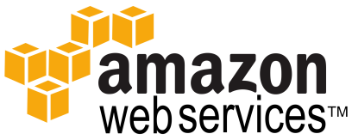
EXPLOITING THE CLOUD
01/2014 Bitcoin rush : AWS xl instances + GPU service (cudaminer).
Caused by careless users putting credentials on GitHub,
Detected by Amazon thanks to Github’s repositories monitoring
Amazon reversed the charges
Defcon 2015 : Cloud Computing : A weapon of Mass Destruction ? (Netspi)
Cloud Usage for DDoS, Botnets C & C,
Easy due to automation, plentiful bandwidth
Notes:
https://www.defcon.org/images/defcon-18/dc-18-presentations/Bryan-Anderson/DEFCON-18-Bryan-Anderson-Cloud-Computing.pdf
https://securosis.com/blog/my-500-cloud-security-screwup/P25

Slide 22
FOR FUN (& PROFIT)
01/2016
New World Hacking claimed responsibility for the 4 hours outage of BBC and Donald Trump campaign websites. It was a “test of [BangStresser DDoS Attack Tool] capabilities”
2 AWS instances « modified ».
The group said they hacked into Amazon’s backoffice to turn bandwidth throttle off.
Back Hat 2015 : Man-in-The-Cloud Attacks (Imperva sponsored talk)
Exploits authentication tokens stored on smartphones to access Dropbox, Google Drive and One drive
Password cracking as a Service : Wi-Fi WPA keys and OS/VPN passwords

Slide 23
Dr. Ryan Ko – rko@cloudsecurityalliance.org & Assoc. Prof. Dr. Stephen S G Lee msglee@ntu.edu.sg in Cloud Computing Vulnerability Incidents: A Statistical Overview

Slide 24
CLOUD FOR SPACE ?

Slide 25
CCSDS
Use case : Standards interoperability testing between spa ce agencies
First test : Space Data Link Security testing within ESA’s provider : CloudSigma
Three cases :
One cloud, one shared VM
One cloud, one VM per agency
Multiple clouds linked though VPN over public space

Slide 26
CCSDS
NASA
Only FEDRAMP services can be used:
AWS FedRAMP zones,
VMware vCloud Government Service
Only US datacentres
ESA
Interoute / Cloud Sigma / OBS
Specific requirements on security & privacy
UK Space Agency
No cloud, no policy
DLR
T-System but difficult to open

Slide 27
PLANING FOR THE CLOUD

Slide 28
Guidance

Slide 29
ORGANISATIONAL SECURITY CONCERNS

Slide 30
Organisational Security Concerns
Governance = contract
Notes:
Governance remains under customer’s responsibility
Security responsibility is transferred partly to the provider :
This transfer can be constrained by poor SLA, contract and no audit possibility
The provider can outsource

Slide 31
ORG risks – Contract ?
THE SERVICE OFFERINGS ARE PROVIDED “AS IS.” WE AND OUR AFFILIATES AND LICENSORS MAKE NO REPRESENTATIONS OR WARRANTIES OF ANY KIND, WHETHER EXPRESS, IMPLIED, STATUTORY OR OTHERWISE REGARDING THE SERVICE OFFERINGS OR THE THIRD PARTY CONTENT, INCLUDING ANY WARRANTY THAT THE SERVICE OFFERINGS OR THIRD PARTY CONTENT WILL BE UNINTERRUPTED, ERROR FREE OR FREE OF HARMFUL COMPONENTS, OR THAT ANY CONTENT, INCLUDING YOUR CONTENT OR THE THIRD PARTY CONTENT, WILL BE SECURE OR NOT OTHERWISE LOST OR DAMAGED. EXCEPT TO THE EXTENT PROHIBITED BY LAW, WE AND OUR AFFILIATES AND LICENSORS DISCLAIM ALL WARRANTIES, INCLUDING ANY IMPLIED WARRANTIES OF MERCHANTABILITY, SATISFACTORY QUALITY, FITNESS FOR A PARTICULAR PURPOSE, NON-INFRINGEMENT, OR QUIET ENJOYMENT, AND ANY WARRANTIES ARISING OUT OF ANY COURSE OF DEALING OR USAGE OF TRADE.
A
I
C

Slide 32
Data Governance

Slide 33
Organisational Security Concerns
Governance
Security responsibility
Notes:
Governance remains under customer’s responsibility
Security responsibility is transferred partly to the provider :
This transfer can be constrained by poor SLA, contract and no audit possibility
The provider can outsource

Slide 34
– IaaS
Shared responsibility
Presentation
Modality
Presentation
Platform
User is responsible for confidentiality and integrity (security starts at the guest/VM)
APIs
Applications
Data
Metadata
Content
Integration & Middleware
APIs
Provider secures the infrastructure to cover availability and multi-tenancy.
Cloud Security Alliance Multi-tenancy
Core connectivity & Delivery
Abstratction
Infrastructure as a Service (IaaS)
Hardware
Facilities
Notes:
https://azure.microsoft.com/en-us/regions/

Slide 35
Shared responsibility
– PaaS
Presentation
Modality
Presentation
Platform
User creates the application. Writing secure applications and
ensuring your data is safe is your
responsibility
APIs
Applications
Data
Metadata
Content
Integration & Middleware
Provider secures compute,
network, storage layers &
programmatic interface
APIs
Cloud Security Alliance Multi-tenancy
Core connectivity & Delivery
Abstratction
Infrastructure as a Service (IaaS)
Platform as a Service (PaaS)
Hardware
Facilities

Slide 36
Shared responsibility
– SaaS
Presentation
Modality
Presentation
Platform
Contract / Access
APIs
Provider secures everything
Applications
Data
Metadata
Content
Integration & Middleware
APIs
Cloud Security Alliance Multi-tenancy
Core connectivity & Delivery
Abstratction
Infrastructure as a Service (IaaS)
Platform as a Service (PaaS)
Software as a Service (SaaS)
Hardware
Facilities

Slide 37
Organisational Security Concerns
Governance
Security responsibility
Compliance to legal and sectorial regulations
Notes:
Governance remains under customer’s responsibility
Security responsibility is transferred partly to the provider :
This transfer can be constrained by poor SLA, contract and no audit possibility
The provider can outsource

Slide 38
COMPLIANCE
Security of information and computer systems
Privacy of personal data
EU Data Protection Regulation
Zone selection
Notes:
The EU-US Privacy Shield : The EU data protection Directive 95/46/EC7 imposes stringent dispositions with regards to the processing of personal data and on the free movement of such data. At the same time, not all member states have adopted the EU data protection directive, resulting in the fragmentation of national data protection legislation.
http://ec.europa.eu/justice/data-protection/international-transfers/eu-us-privacy-shield/index_en.htm

Slide 39
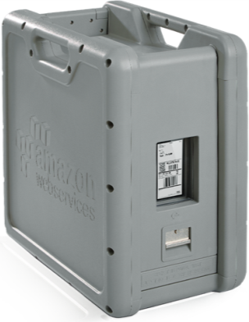
ORG risks – Lock-In
Cloud « gravity » : once inside, it is expensive to move (or rollback).
Caused by the lack of standards or by the low provider’s will
Cloud model dictates the risk management and security controls in place
Notes:
Exemple for lock-in:
Application code for PaaS or logic SaaS.
Dependencies are created between basic services (compute, storage) and advanced ones (including security).

Slide 40
Solutions
Contracts
Supplier Assessments
Compliance, audits of control
Risk management

Slide 41
Cloud Computing risks

Slide 42
Everything old is new again
Information system security
Management
Data security
Infrastructure
Cloud layers
DDoS : Distributed Denial of Service
EDos : Economical Denial of Service

Slide 43
Management Plane
Although abstracted, the management plane is there, web or API based.
Centralisation of everything owned
Malicious insider from the back-office, with high privileges
Management interface is only as secure as your secret credentials
Compromise of the service engine
Notes:
Extension of the shared responsibility model

Slide 44
Data
Data can be intercepted in transit to or from the cloud, or when moving inside
Data at rest
Data erasing
No guarantee (tapes, hard disk, etc.)
No real tool can be used
Notes:
The provider may have access to the data stored or the access keyAn intruder can too if not protected

Slide 45
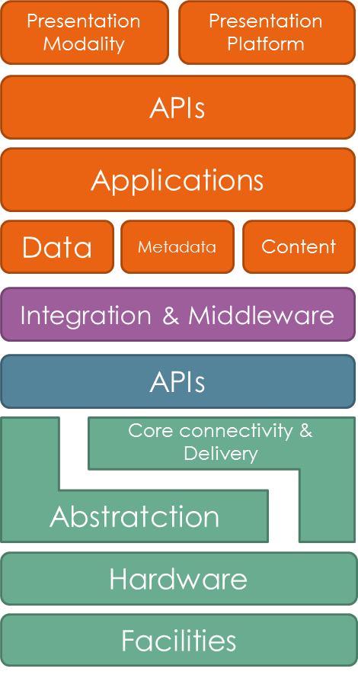
Computations
Infrastructure is based on virtualization, abstraction layers, automation technologies and secret sauce.
Vulnerabilities apply to compute, network and storage (and secret sauce)
A compromised node in a processing infrastructure can lead to :
data leakage,
incorrect output,
Infrastructure attacks (man in the middle, DoS)

Slide 46
SECURITY NEEDS

Slide 47
DATA PROCESSING USE CASE
Availability and Integrity are the primary needs.
The common requirement we have is no interruption shall exceed 5 min.
Confidentiality comes after and is often limited to the Intellectual Property (algorithm or a subset of the data) – classified missions excluded.

Slide 48
So…
Data processing solutions or architectures are built with performance in mind.
Security is left to the surrounding infrastructure
« By default Hadoop runs in non-secure mode in which no actual authentication is required. »
https://hadoop.apache.org/docs/current/hadoop-project-dist/hadoop-common/SecureMode.html
Security features of Hadoop consist of authentication, service level authorization, authentication for Web consoles and data confidentiality.

Slide 49
And…
Data processing infrastructure is connected to untrusted resources (multi-tenancy in community/public deployment).
One component can compromise the entire « cluster », the provider can’t be trusted.
The Virtual Machine or computing node is the new boundary of the system.
So security must be integrated in the design pattern of the system.
Bonus : you have got new tools on your side (automation, APIs…)

Slide 50
SECURING THE CLOUD

Slide 51
Infrastructure Security
Infrastructure needs to be trusted :
Use node authentication and configuration control
Private networks are required for non public facing resources
Automate deployment of security
The code needs to be developed with multi-tenancy in mind (see OWASP for guidelines)
Kill the resources you don’t need

Slide 52
Data Security
Information architectures
IaaS, PaaS and SaaS provides different solutions to store information
Data Dispersion
Information Management and lifecycle
Confidentiality

Slide 53
Data Security
Encryption for data at rest and in transit
Use client, servers or app encryption capabilities
VPN to the cloud, TLS for transports
Keep the control of encryption keys (prefer to use your own PKI)
Data erasing
Provider’s responsibility (certifications like SAS-70 cover this)

Slide 54
Access controls
Use Identity & Access Management
Maintain least privilege
Create suitable roles for users and multiple access keys, security groups
Identity federation & SSO from internal sources.
Trace actions

Slide 55
Security monitoring
The usual + cost monitoring
Be prepared and ready for the coming incidents

Slide 56
Thanks.

Slide 57
CNES ?
As a CNI operator, we are constrained by regulations.
ANSSI will publish a cloud reference, applicable to FR public entities.
Close to FEDRAMP and based on ISO 27002 security controls tailored to cloud.
Two qualification levels
Secure Cloud : regular data → Suitable for mots Data processing cases.
Secure Cloud Plus : RESTRICTED SYSTEMS

Slide 58
Cloud Access Security Brokers

