Slide 1
NASA Earth Science Data Stewardship
Dawn R. Lowe, Project Manager
Earth Science Data & Information Systems (ESDIS) Project
NASA/Goddard Space Flight Center

Slide 2
Data Stewardship
Objective: Ensure that our Earth science data and information content are reliable, of high quality, easily accessible, and usable for as long as they are considered to be of value.
Involves communications with data producing projects throughout their lifecycles
Essential to plan for long term preservation

Slide 3
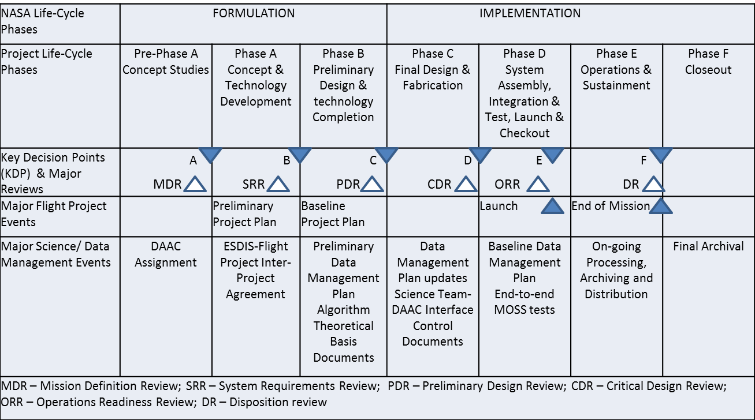
Project Lifecycle Events

Slide 4
Data Preservation
General requirements:
Preserve bits
Ensure:
Discoverability and accessibility
Readability
Understandability
Usability
Reproducibility of results

Slide 5
Bits
Checksums while transferring between subsystems
Regular media migration
Raw (Level 0) data from satellites held at back-up archive physically distant from DAACs
Product generation software held at the DAACs and SIPSs
Guards against catastrophic loss
Raw data and higher level products are backed-up at the DAACs as well – for efficiency
Periodic reassessment of risk of data loss and impact on users given the back-up approach being used at the DAACs

Slide 6
Discoverability and accessibility
Standard metadata are critical for discoverability of data
Processing software automatically generates metadata at individual file level
Metadata repository is constantly populated
Common Metadata Repository (CMR)
Unites collection level and file level metadata
Provides a source of unified, high-quality and reliable Earth Science metadata across NASA’s Earth science data holdings
Improvements to Accessibility
Migration from the near-line robotic tape libraries into on-line disk archives during 2005-2008.
Assignment of Digital Object Identifiers (in progress)

Slide 7
Readability
Hierarchical Data Format (HDF)
Primary format for most EOSDIS datasets
Translations into other formats such as NetCDF, GeoTIFF and binary, upon request by users
HDF is a self-documenting formatting system
Flexible structure for data producer to define “profile”
HDF library facilitates writing and reading
Need to maintain library for future users
Alternative - HDF Archive Mapper
Promoting structural consistency among datasets
Cross-instrument team agreement (EOS Aura – 2004)
HDF Product Designer to enable design of interoperable products compliant with community conventions, and to share designs across teams

Slide 8
Understandability, Usability & Reproducibility
Understandability
Algorithm Theoretical Basis Documents (ATBDs)
Product information pages, guides, answers to frequently asked questions (FAQs), forums
Usability
Information on fitness for purpose
Accuracy assessments, validation and data quality documentation
Reproducibility
Source code and/or software specification documents
Versions of datasets or the means of regenerating them when they result in peer-reviewed publications

Slide 9
Preservation Content Specification (PCS)
Has been in effect since November 2011; latest version dated January 2013
Covers eight categories of content plus a checklist (see next page)
Rigor of application varies among completed, on-going and future missions
Completed missions – requirements had not been in place; some items may no longer be available for preservation; responsible individuals may not be accessible
On-going missions - requirements had not been in place; some of the relevant data and documentation generated early in mission may not be easily available; need additional work to reach responsible individuals
Future missions – requirements are in place; included as part of mission planning

Slide 10
Preservation Content Categories
Preflight/Pre-Operations: Instrument/Sensor characteristics including pre-flight/pre-operations performance measurements; calibration method; radiometric and spectral response; noise characteristics; detector offsets
Science Data Products: Raw instrument data, Level 0 through Level 4 data products and associated metadata
Science Data Product Documentation: Structure and format with definitions of all parameters and metadata fields; algorithm theoretical basis; processing history and product version history; quality assessment information
Mission Data Calibration: Instrument/sensor calibration method (in operation) and data; calibration software used to generate lookup tables; instrument and platform events and maneuvers
Science Data Product Software: Product generation software and software documentation
Science Data Product Algorithm Input: Any ancillary data or other data sets used in generation or calibration of the data or derived product; ancillary data description and documentation
Science Data Product Validation: Records, publications and data sets
Science Data Software Tools: product access (reader) tools.
Checklist: “metadata” about the above 8 categories showing how and where items in each category are preserved

Slide 11
Sources of Preservation Content
Calibration Team
Mission logs
Science Data Product Documentation
Mission Data Calibration
Mission Operations
Product Generation Support Teams (SIPSs)
Instrument Teams / PI’s
Science Data Product Software
Science Data Software Tools
Science Data Products
Level 0 Data
Science Data Product Algorithm Input
Ancillary data sources (e.g., NOAA)
DAACs
Science Data Product Validation
Instrument Developer/ Manufacturer
Preflight/ Pre-Operations
Data gathering project (e.g., flight project)
Validation Team
Notes:
Different entities hold preservation content during the life of a project, but they need to be gathered for long-term preservation.
Some items are part of regular flow during active operational phase. Others need extra effort to collect.

Slide 12
Examples for Scale of Effort
Thousands of items had to be reviewed for deciding what had to be preserved
Category | Number of Items (HIRDLS) | Number of Items (GLAS/ ICESat)
Preflight/Pre-Operations Calibration | 168 | 23
Product Documentation | 18 | 34
Mission Calibration | 10 | 12
Science Data Product Software | 26* | 5
Science Data Product Algorithm Inputs | 1 | 56
Science Data Product Validation | 1** | 3
Science Data Software Tools | 1 | 20
Total | 225 | 153
*Includes source code and documentation
**List of published papers

Slide 13
Standard for Preservation Content
NASA would like to see a broad international standard identifying preservation content – NASA’s PCS is a good starting point, as are ESA’s Long Term Data Preservation documents
ISO Technical Committee on Geographic Information/ Geomatics (TC 211) is working on a standard (ISO 19165)

Slide 14
Summary
NASA has been collecting Earth observation data from many sources for over 50 years
Data and derived scientific products are a valuable asset requiring stewardship and preservation
Attention to preservation is needed throughout lifecycle
Waiting for closeout phase of projects is too late
Preservation Content Specification helps with planning ahead
We would like to see an international standard on preservation content – looking for collaboration

