Slide 1
NASA’s Earth Science Data Systems Update
Kevin Murphy – NASA HQ Earth Science Division
WGISS
3 April 2017

Slide 2
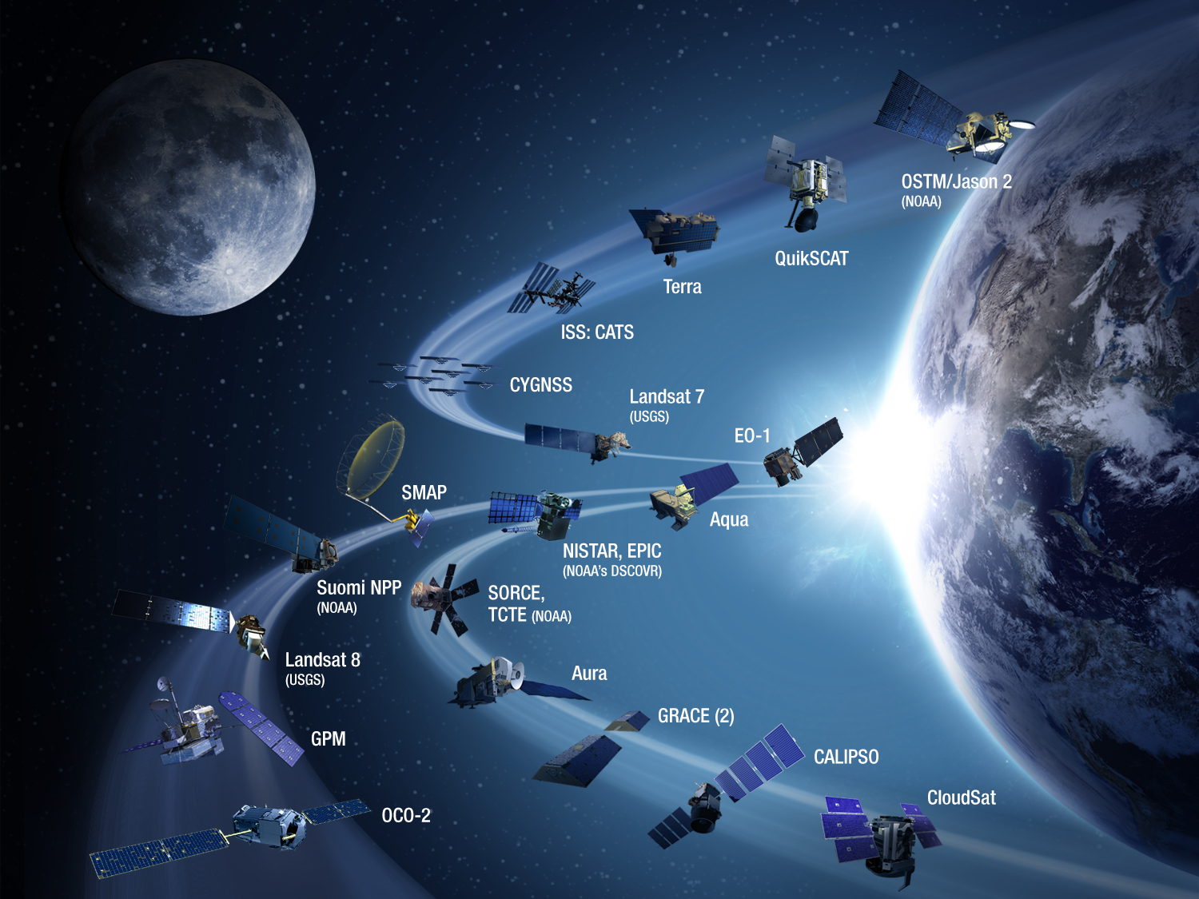
Earth Science Division Budget
The president’s budget continues NASA ESD activities in a substantial, impactful, scientifically viable, balanced, and comprehensive manner.
Continues 15 missions/instruments presently on-orbit.
Continues development of more than 14 ongoing missions and major instruments that are scheduled for launch before 2023-2023 in addition to all planned future Venture-Class and InVEST solicitations and selections.
All pending appropriations.
NASA Operating Missions

Slide 3
New Faces
Andrew Mitchell has replaced Dawn Lowe as the ESDIS Project Manager.
Amanda Whitehurst – Citizen Science Program Manager, NASA HQ
ESDS Deputy Program Manager - TBD

Slide 4
Earth Science Open Source Policy
Core Earth Science Data System software
All new projects and existing core software components shall be released as open source (policy enacted fall 2015)
15 core software projects have been open sourced since policy was initiated.
NASA funded competitive research projects
Reviewers may now consider open source software plan as an evaluation criteria.
Started with NASA’s 2017 Research Announcement (ROSES17) – Section A.1
Notes:
Policy will give favorable consideration to proposals including a plan for committing to publish software as OSS:
From the outset of development
Using permissive licensing
Made available through a publically accessible repository hosting service
https://nspires.nasaprs.com/external/viewrepositorydocument;jsessionid=aliU15GXcubl3AaoX0FTrGhhgM1Y-r0G65xAZsonx3WV9RIxIVYY!206051216!cassini3.nasaprs.com!7006!9008!-541839707!cassini2.nasaprs.com!7006!9007?cmdocumentid=554058&solicitationId={E757EF32-60E6-76AE-A276-21A1F8BA96BB}&viewSolicitationDocument=1

Slide 5
NASA’s Earth Observing System Data and Information System - EOSDIS
Top Line Metrics (FY16)
Unique Data Products (Collections) | 11,140
Distinct Users of EOSDIS Data and Services | 3.21 Million
Web Site Visits of 1 Minute of more | 2.35 Million
Average Daily Archive Growth | 12.1 TB/day
Total Archive Volume | 17.5 PB
End User Distribution Products per year | 1,513 Million
End User Average Daily Distribution Volume | 40.03 TB/day
Notes:
NASA’s end-to-end capability for collecting, processing and distributing Earth science satellite instrument, field campaign and airborne data
Provides data services to ensure data are discoverable, searchable, accessible, and useable
Provides science and engineering domain expertise
Ensures long-term stewardship and preservation of products

Slide 6
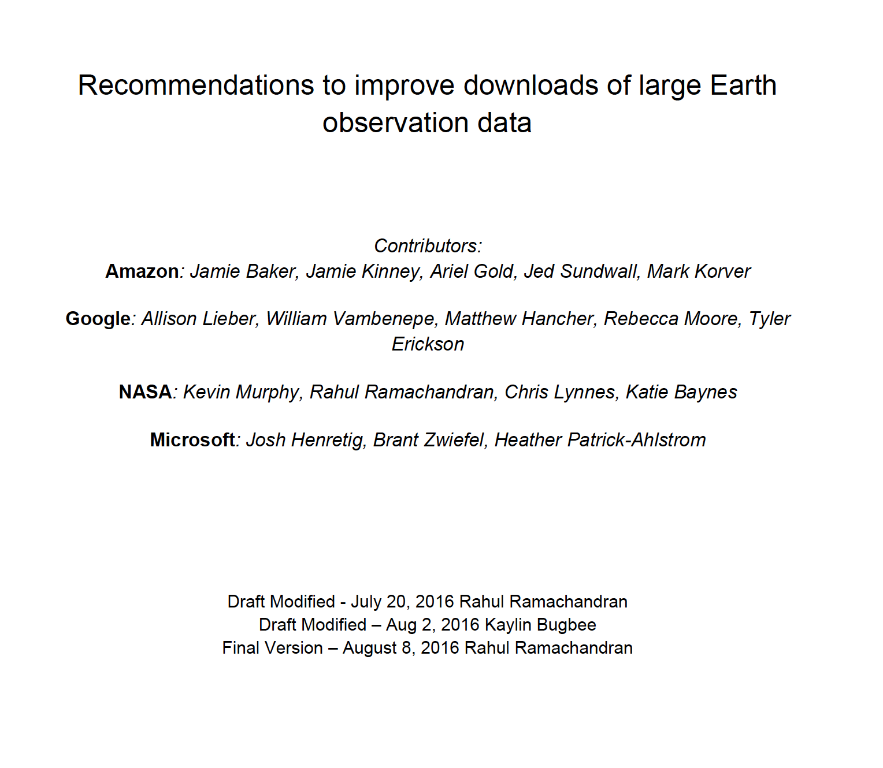
Commercial Cloud Partnerships
Collaborative effort between Amazon, Google, Microsoft and NASA
Goal:
Enable efficient access and transfer of NASA’s Earth science data to different cloud infrastructures to facilitate new data driven applications and foster new user communities
Notes:
1. Shall assess NASA’s Earth Observing System Data and Information Systems (EOSDIS) based on the recommendations in the best practices document
2. Shall develop a recommendations plan for ESDIS and the DAACs to improve NASA’s Earth Observing System Data and Information systems based on assessment
3. Shall jointly develop a “recommendations/best practices document“ that can be shared via USGEO with other organizations and agencies serving Earth science data
Amazon, Google and Microsoft provided NASA a set of “use cases/recommendations”
Covered not only how Earth observations are or will be used by these cloud providers but also documented their experiences interacting with data systems at different federal agencies and other organizations.
Use cases/recommendations collated into a common set of recommendations
Recommendations have been used to assess the existing capabilities of EOSDIS, identify existing gaps and plan for future improvements
Generalized these recommendations for the USGEO draft document
Within the context of Common Framework for Earth-Observation Data,

Slide 7
Preparing for the Future
Preparing for upcoming missions
Looking towards the cloud
Streamlining tools
Continuing commitment to open source
Credit: Chris Lynnes

Slide 8
What will a future data system architecture look like?
EOSDIS works exceptionally well, but can we do better?
Can we evolve NASA archives to better support interdisciplinary Earth science researchers?
What system architecture(s) will allow our holdings to become interactive and easier to use for research and commercial users?
Can we afford additional functionality?
How will data from multiple agencies, international partners and the private sector be combined to study the earth as a system?
GOES-R(16), CubeSats, Copernicus…

Slide 9
5 Years from Today
(Pre)Formulation
Formulation
Implementation
Implementation
MAIA (~2021)
TROPICS (~2021)
GeoCarb (~2022)
Primary Ops
Landsat 9
(2020)
Primary Ops
Extended Ops
Extended Ops
NISAR (2022)
SWOT (2021)
15 new instruments and missions.
TEMPO (2018)
JPSS-2 (NOAA)
RBI, OMPS-Limb (2018)
InVEST/Cubesats
MiRaTA (2017)
RAVAN (2016)
IceCube (2017)
HARP (2017)
TEMPEST-D (2018)
RainCube (2018*)
CubeRRT (2018*)
CIRiS (2018*)
CIRAS (2018*)
LMPC (----)
*Target date, not yet
manifested
Sentinel-6A/B (2020, 2025)
GRACE-FO (2) (2018)
Earth Science Instruments on ISS:
CATS, (2020)
LIS, (2017)
SAGE III, (2017)
TSIS-1, (2018)
ECOSTRESS, (2018)
GEDI, (2019)
TSIS-2 (2020)
ICESat-2 (2018)
CYGNSS (2016)
New missions and measurements from Decadal Survey.
ISS
SORCE, (2017)
TCTE (NOAA)
NISTAR, EPIC (2019)
(NOAA’S DSCOVR)
QuikSCAT (2017)
Landsat 7
(USGS)
(~2022)
EO-1 (2017)
User expectations continue to evolve.
SMAP (>2022)
Terra
(>2021)
Suomi NPP (NOAA) (>2022)
Aqua(>2022)
Landsat 8
(USGS) (>2022)
CloudSat (~2018)
CALIPSO (>2022)
GPM (>2022)
Aura (>2022)
GRACE (2)
(2018)
OSTM/Jason 2 (>2022)
(NOAA)
OCO-2 (>2022)
Notes:
EJD 10/20/16 changed dates of SAGE III and LIS to 2017
Fleet - Earth Science Division - Missions (with color key; editable)
Dec. 15, 2015
Credit: NASA/J. Mottar
------------------------------
SLIDE INFO
CORRECTION DENNING PER RIVERA Feb 18, 2016
Changed misspelling of “Sentinal” to “Sentinel”
UPDATE DENNING PER FREILICH DECISIONS FEB 12, 2016
Changed OCO-3 to Formulation color and moved lower in list
Changed RBI to Formulation color
Changed GEDI to Implementation color and moved to line above it
Added TSIS-2 in Formulation color
UPDATE DENNING PER FREILICH DECISIONS FEB 4, 2016
Changed “Altimetry FO (Formulation in FY16) to “Sentinal-6A/B”
On Landsat 9, removed comma and TIRFF
Change I was going to make – “NISTAR, EPIC (NOAA’s DSCOVR) to green primary ops was already corrected
Dec. 15, 2015 – Updated: TEMPO changed to Implementation phase; NISTAR, EPIC changed to Primary Ops phase; ; OCO-3 and ECOSTRESS changed to Implementation phase; Aquarius removed; slide now fully editable. JMottar
May 18, 2015 – Added to SMD Multimedia Library.
May 18, 2015 – Updated the outdated 2014 version: TRMM was removed; NISTAR, EPIC (NOAA's DSCOVR) were added; SMAP icon was updated; moon at top left was removed; color key moved to top left.-JMottar
ID: I-EA-15-0040 (image)
ID: SL-EA-15-0068 (slide)

Slide 10
EOSDIS Archive Growth Estimate (Prime + Extended Missions)
Notes:
Estimates from Winter 2017.
Major drivers of volume are SWOT and NISAR.

Slide 11
Balanced path forward
Maintain what Earth Science Data Systems do well
Data stewardship expertise to support science community needs.
Flexibility to incorporate new data sources and data producers with little disruption.
Provide free and open access to data products and services all users with open APIs and software.
High level of customer satisfaction.
Improve user functionality and data stewardship efficiency
Ability to conduct regional and global processing without need for data management.
Consistent level of service and performance across the system.
Minimize data movement.

Slide 12
Thank You
Feel Free to Contact Me
Kevin.J.Murphy@nasa.gov

