Slide 1
SEO Report to WGISS
Brian Killough CEOS Systems Engineering Office (SEO)
WGISS-43 Meeting
April 3, 2017

Slide 2
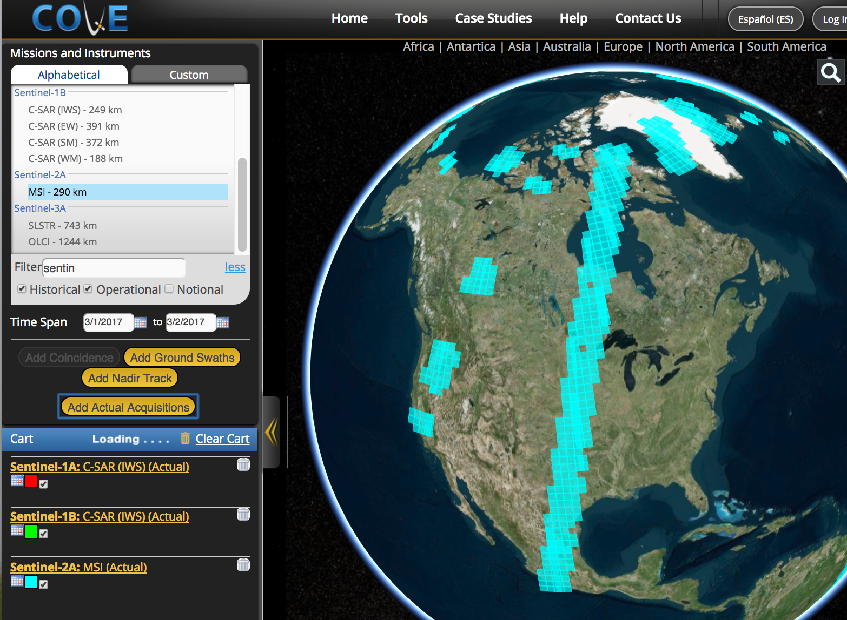
COVE Tool Updates
The CEOS Visualization Environment (COVE) is a browser-based suite of tools for searching, analyzing and visualizing actual and potential satellite sensor coverage.
COVE is FREE and OPEN for anyone to use!
COVE includes 131 missions and 240 mission-instrument combinations.
COVE is linked to several mission archives to get metadata and browse images for past acquired data: Landsat, SPOT, Pleaides, Radarsat-2, ALOS-1, TerraSAR-X, Sentinel-1, and Sentinel-2.
There is a large international user base ... 3700+ unique users in 2016.
Recent updates: Added Sentinel-2 acquisitions
Future updates: Improved coverage analyzer, more links to mission archives
The COVE suite of tools includes:
COVE – The main tool for global visualizations
Rapid Acquisition Tool – A tabular tool for analyses
Coverage Analyzer - A tool for long-term coverage analysis
Mission and Instrument Browser – Details on missions

Slide 3
Miscellaneous Topics
Data Cubes – The SEO is working with GA, CSIRO and USGS to develop an open source architecture for data management and enhanced applications. This “future data architecture” is now called “Open Data Cube”.
Analysis Ready Data – The SEO is working with the Land Surface Imaging (LSI) group to develop a definition and technical specification for “CEOS Analysis Ready Data for Land” (CARD4L). The most recent advancements have been Sentinel-1 ARD definition, though there are still some unresolved items.
Data Interoperability – There is a strong desire to use the Data Cube architecture to test data interoperability. Combining optical and SAR, or using spatially aligned optical datasets with different resolutions are two cases.
More charts to follow on these topics …

Slide 4
Why Data Cubes?
The primary user problems are data access, data preparation, and efficient analyses
Users want to minimize the time and knowledge required to obtain and prepare satellite data
Users want free and open source solutions.
Users want to perform time series analyses
Users want to use multiple datasets together
Users want to use common GIS tools
Users want to “own” the data and keep it locally
Users want customer service and support
Our goal is NOT to sell a product or give out a tool …
Our goal is to provide a SOLUTION that has VALUE and increases the IMPACT of satellite data.

Slide 5
Open Data Cube Vision
A solution supporting CEOS objectives …
Build capability of users to apply CEOS satellite data
Supporting priority CEOS/GEO agendas (SDGs, Paris and Sendai)
CEOS Agencies wanting to participate …
Through provision of CEOS Analysis Ready Data (ARD) products
Contributing to development and uptake of solutions
Customers feel that they are the focus …
Training materials and easy installation/maintenance
A CEOS “Open Data Cube” brand that people know and trust
Users helping each other through an active Data Cube community
Scalable solution …
Supporting Data Cubes in 20 countries by 2022
Key partners (e.g. FAO, World Bank) supporting data cube projects

Slide 6
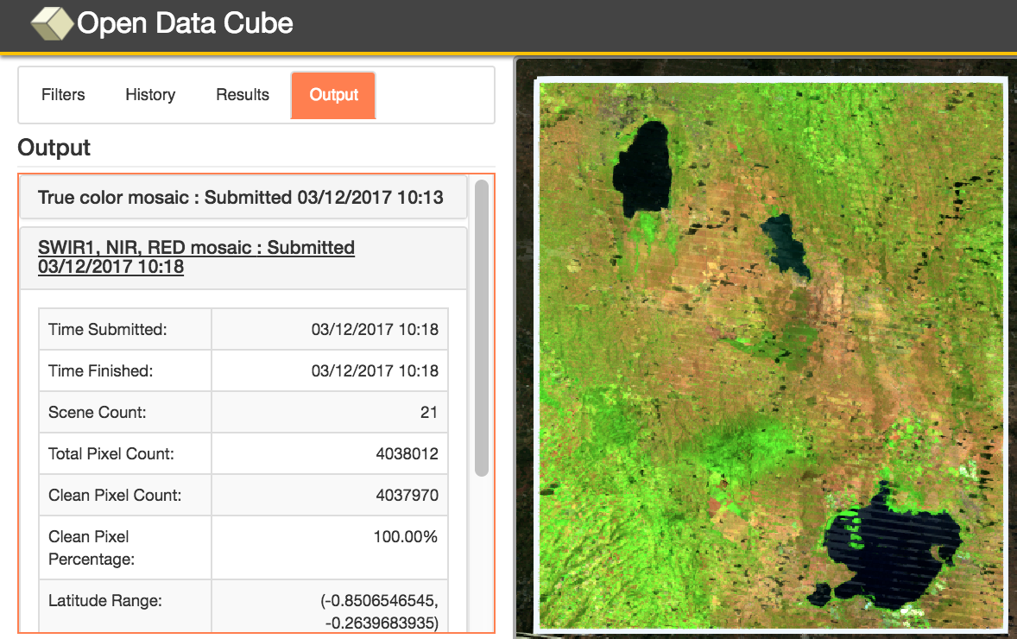
Amazon Cloud (AWS) Data Cube Demonstration Portal
Data Cubes
14 cubes with 10+ years each.
Kenya, Cameroon (Lake Chad), Togo (coastal Africa), Colombia, Tonga (Pacific Islands), Vietnam, Australia (Menindee Lakes), Bangladesh.
User Interface Features
User-selected spatial region and time
7 applications: custom cloud-free mosaics, fractional cover, NDVI anomaly, water detection, water quality (Total Suspended Matter), landslides (SLIP) and coastal change.
Outputs in GeoTIFF and GIF animation.
Free and open!
This is the first “hands-on” global demo of the Data Cube to show its potential for rapid time series analysis and diverse applications
http://tinyurl.com/datacubeui

Slide 7
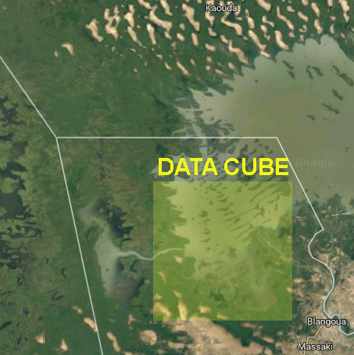
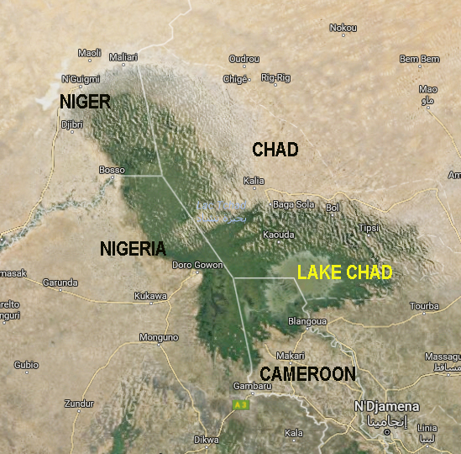
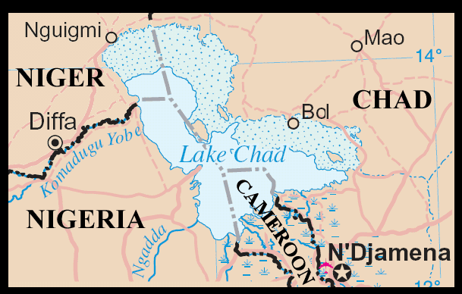
Lake Chad, Africa Water Detection Demonstration
Historically large and shallow lake has shrunk by 95% from 1963 to 1998 due to increased population demand (reference United Nations). Provides water to 68 million people in 4 bordering countries.
Annual rainy season (May-June) gives rise to floods (Aug-Sept) which fill the lake (Oct-Jan) before evaporation during the dry season (Feb-Mar).

Slide 8
Lake Chad, Cameroon, Africa Time Series Water Detection
The product shows the percent of observations detected as water over the 17-year time series (water observations / clear observations).
Purple/Blue: Frequent or permanent water
Red/Yellow: Infrequent water and/or flood events

Slide 9
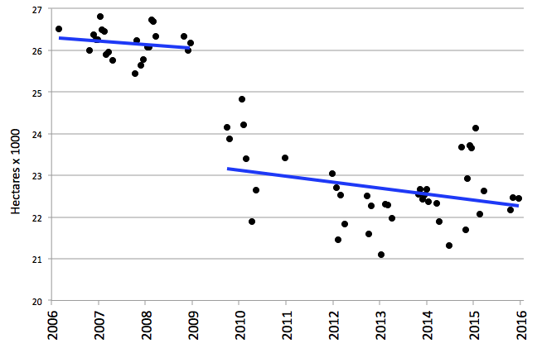
Lake Chad, Cameroon, Africa 10-year Time Series Results
The severe drought in 2008 is evident in the Lake Chad time series results. The overall 10-year trend is a loss of 1.4 hectares per day for this analysis region
Notes:
Lake Chad is a source of livelihood to 30 million people. The shrinking lake has had a substantial impact on the local populations, as entire communities have switched from a fishing-lifestyle to one of farming and agriculture. Local communities that once ringed the shores of the lake are now isolated villages — miles from water — and these populations have literally begun farming the now-dry lake bottom. As of 2015, there are plans are in the works to divert water from the Congo River to the River Chari, which flows into Lake Chad, and revitalize the lake.

Slide 10
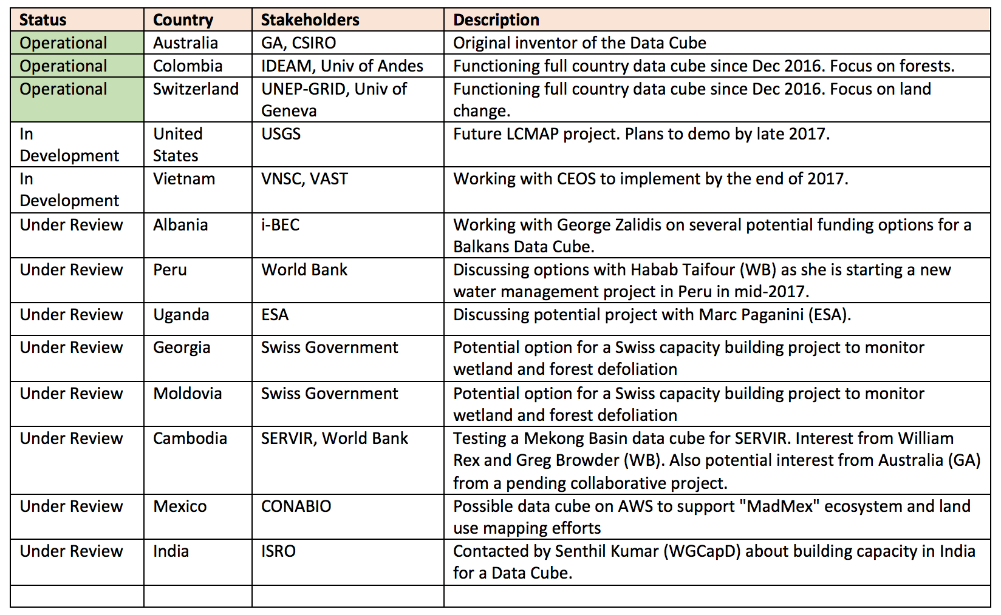
Data Cube Prototypes The Road to 20

Slide 11
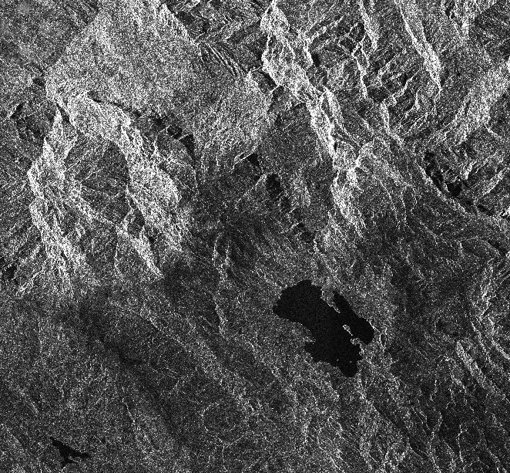
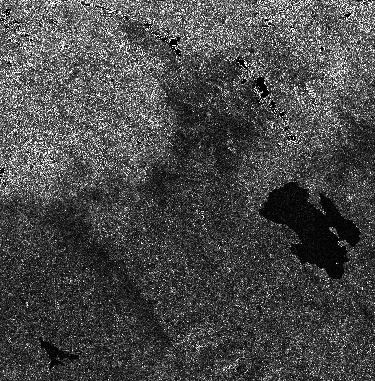
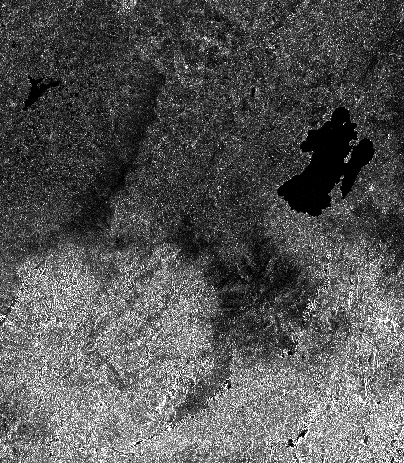
Sentinel-1 ARD Processing
Unprocessed - VH Intensity Lake: Laguna de Tota Location: Sogamoso, Colombia
Steps 1 to 6 Gamma-0, VH Intensity
Step 7 - Orthorectification Gamma-0, VH, UTM-WRS84

Slide 12
Interoperability Test Plans
Demonstrate Landsat 7, Landsat 8, Sentinel-1 and ALOS-PALSAR data interoperability in a Vietnam Data Cube.
Sentinel-1 data (10m) will remain in its native EPSG:4326 (WGS 84) projection.
Landsat 7/8 SR data (30m) will be resampled from UTM to EPSG:4326.
ALOS-PALSAR data (25m) will be resampled from 25m to 30m resolution and reprojected from Lat-Lon (GRS 80) to EPSG:4326 (WGS 84) projection.
The first goal is to evaluate the spatial alignment of the 3 datasets within a nested grid data cube. Each Landsat and ALOS pixel should align. There will be nine (9) Sentinel-1 pixels within each Landsat/ALOS pixel. Preliminary assessment looks good!
The second goal is to conduct a water application analysis where we use Landsat (WOFS) compared to machine learning algorithm results for S1 and ALOS. This will be the focus of a 2017 Summer student project.
Ask WGCV to evaluate RSM geolocation errors after resampling. Users will want to know the impact of resampling and reprojection on their applications.

Slide 13
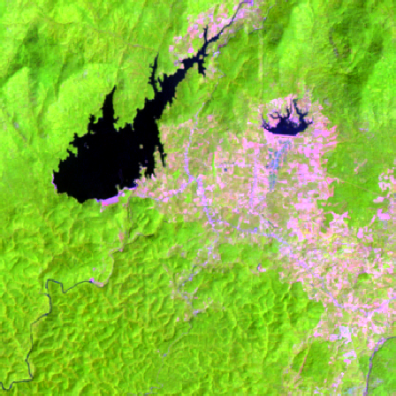
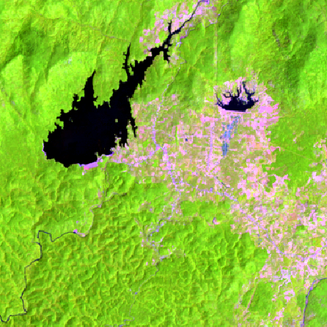
Vietnam Example - Optical
Landsat 7 Median Mosaic – Year 2015 RGB: Bands 5,4,3
Landsat 8 Median Mosaic – Year 2015 RGB: Bands 6,5,4

Slide 14
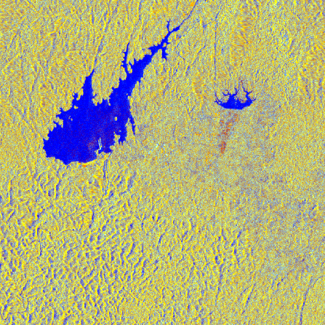
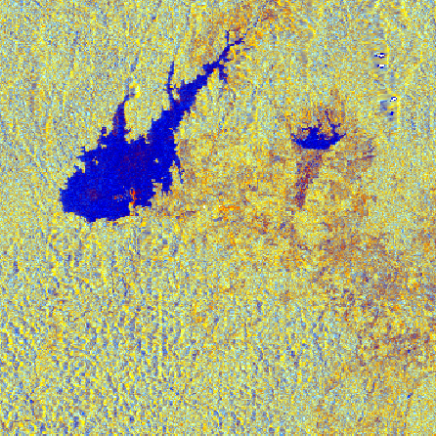
Vietnam Example - Radar
Sentinel-1 Median Mosaic - Year 2015 RGB: VV, VH, VV/VH
ALOS-PALSAR Median Mosaic – 2015 RGB: HH, HV, HH/HV

Slide 15
Proposed WGISS Support
Continue support to expand the connections from mission archives to the COVE tool. Still need to get links to CBERS-4 and ResourcesSat-2 (AWIFS/LISS-3).
We need to develop an approach for automated discovery, processing, downloading and ingesting of data to support global users with Data Cubes.
We would like to explore using cloud-based (e.g. AWS) or mirror (e.g. USGS, ASF) archives to create “on demand” Data Cubes for download or even minor analyses.

