Slide 1
Earthdata Login and Open ID A Look at Federated User Identities
Brett McLaughlin
ESDIS Project
April 4, 2017
This work was supported by NASA/GSFC under Raytheon Co. contract number NNG10HP02C

Slide 2
Agenda
What are Earthdata Login’s Goals?
A Brief Primer on OpenID
Pros and Cons
Questions and Answers

Slide 3
What are Earthdata Login’s Goals?
Earthdata Login and OpenID

Slide 4
Abbreviated Goals
Provide user access information related to ESDIS- and ESDIS-affiliated systems for use in metrics and analysis
Allow users to create and maintain a profile for preference-based data sharing between applications.
Lower the barrier of entry to application from true authentication to user “identification.”

Slide 5
Audience
Internal to NASA, internal to ESDIS
NASA IDs, government affiliation, trusted*
Internal to NASA, external to ESDIS
Nasa IDs, government affiliation, semi-trusted
External to NASA, “trusted” by ESDIS
Possible government affiliation, semi-trusted
External to NASA, unknown by ESDIS
Doubtful government affiliation, untrusted
* Trust here is related to screening prior to providing access to ESDIS systems.

Slide 6
It’s… Complicated
Lower complexity
Higher security
Decreasing Ease of Use

Slide 7
Challenges
Identification “feels like” authentication to users
The “one more password” problem
Passwords are a can of worms…
...moreso if you aren’t even an authentication system!

Slide 8
Wouldn’t it be dreamy if someone else
could handle this authentication stuff,
and just TELL ME who a user is?

Slide 9
Application Architecture
Rails Application
PostgreSQL Database
(application grants)
Profile Management GUI
Application Users
REST API
LDAP Store
(users, groups, permissions)
Applications
OAuth 2 “Responders”

Slide 10
A Brief Primer on OPenID
Earthdata Login and OpenID

Slide 11
What is OpenID?*
“OpenID allows you to use an existing account to sign in to multiple websites, without needing to create new passwords.”
* http://openid.net/what-is-openid/

Slide 12
What is OpenID Connect?*
“It lets app and site developers authenticate users without taking on the responsibility of storing and managing passwords in the face of an Internet that is well-populated with people trying to compromise your users’ accounts for their own gain.”
* http://openid.net/connect/faq/

Slide 13
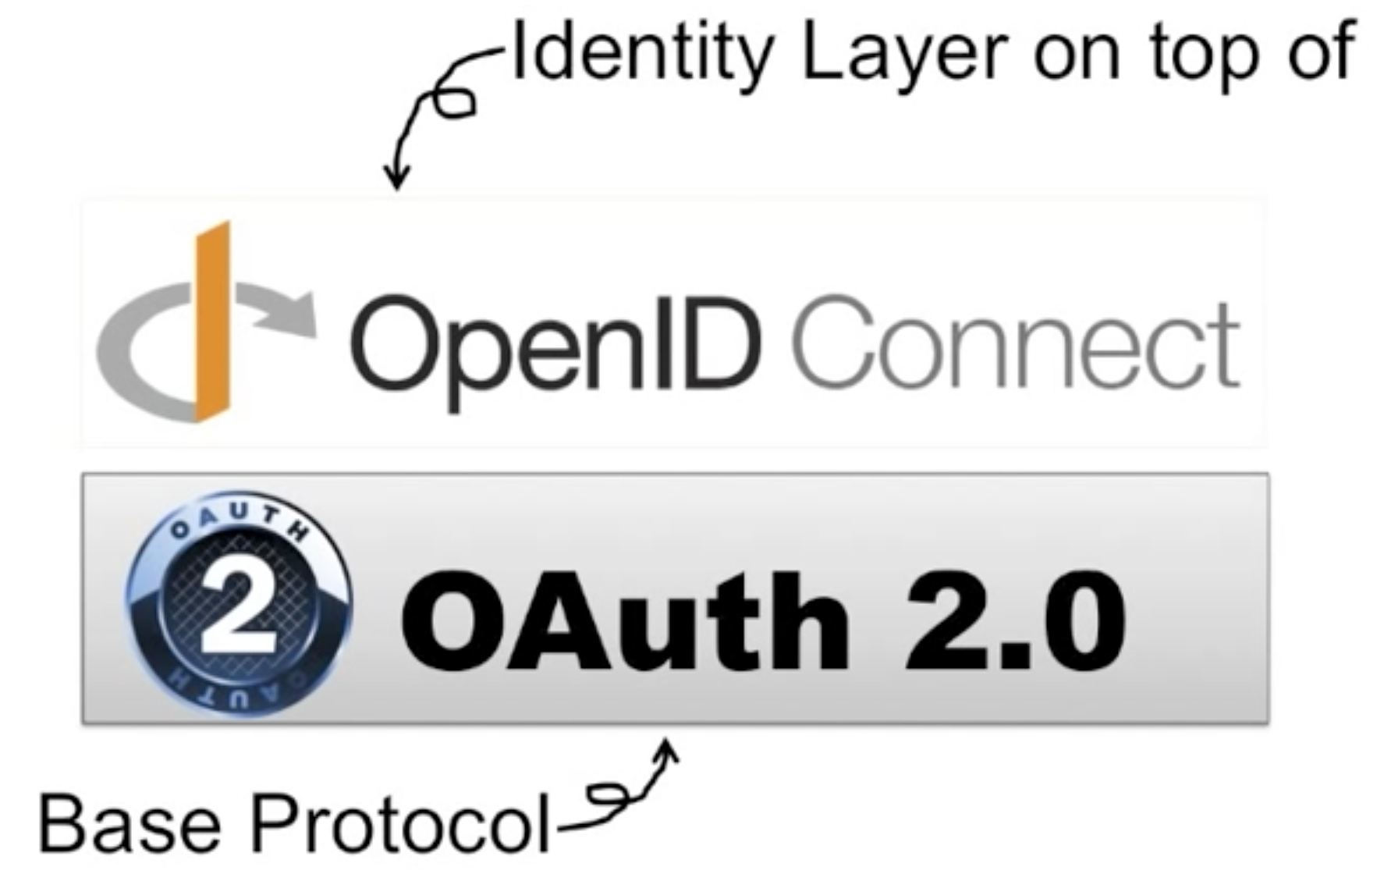
Open ID first, Earthdata Login (and OAuth 2.0) second
http://nat.sakimura.org/2013/07/05/ identity-authentication-oauth-openid-connect/

Slide 14
In other words…

Slide 15
Participating Providers
AOL
Google
PayPal
Verisign
Yahoo
* http://openid.net/ u-s-government-openid-pilot-program-participants/

Slide 16
Pros and Cons
Earthdata Login and OpenID

Slide 17
A Point of Clarity
We are talking about…

Slide 18
Pros
Transfers the burden of authentication from a managed system to a trusted one
Introduces best practices in password/account management
Relies on established OpenID Connect partners: Google, PayPal, etc.

Slide 19
Cons
Introduces additional API (OpenID Connect) and interoperability concerns
Could result in information redundancy between Earthdata Login and OpenID Connect partner
Exacerbates the “Which password?” problem for users with lots of accounts
Builds a “link” between NASA/ESDIS and commercial providers

Slide 20
Questions and Answers
Earthdata Login and OpenID

Slide 21
Earthdata Login and Open ID A Look at Federated User Identities
Brett McLaughlin
ESDIS Project
April 4, 2017
This work was supported by NASA/GSFC under Raytheon Co. contract number NNG10HP02C

Slide 22
This work was supported by NASA/GSFC under Raytheon Co. contract number NNG10HP02C

