Slide 1
Colombia Data Cube
Brian Killough CEOS Systems Engineering Office (SEO)
WGISS-43 Meeting
April 4, 2017

Slide 2
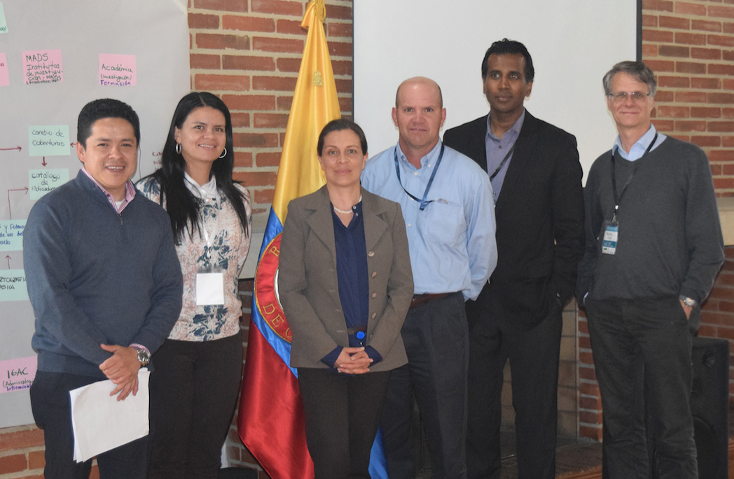
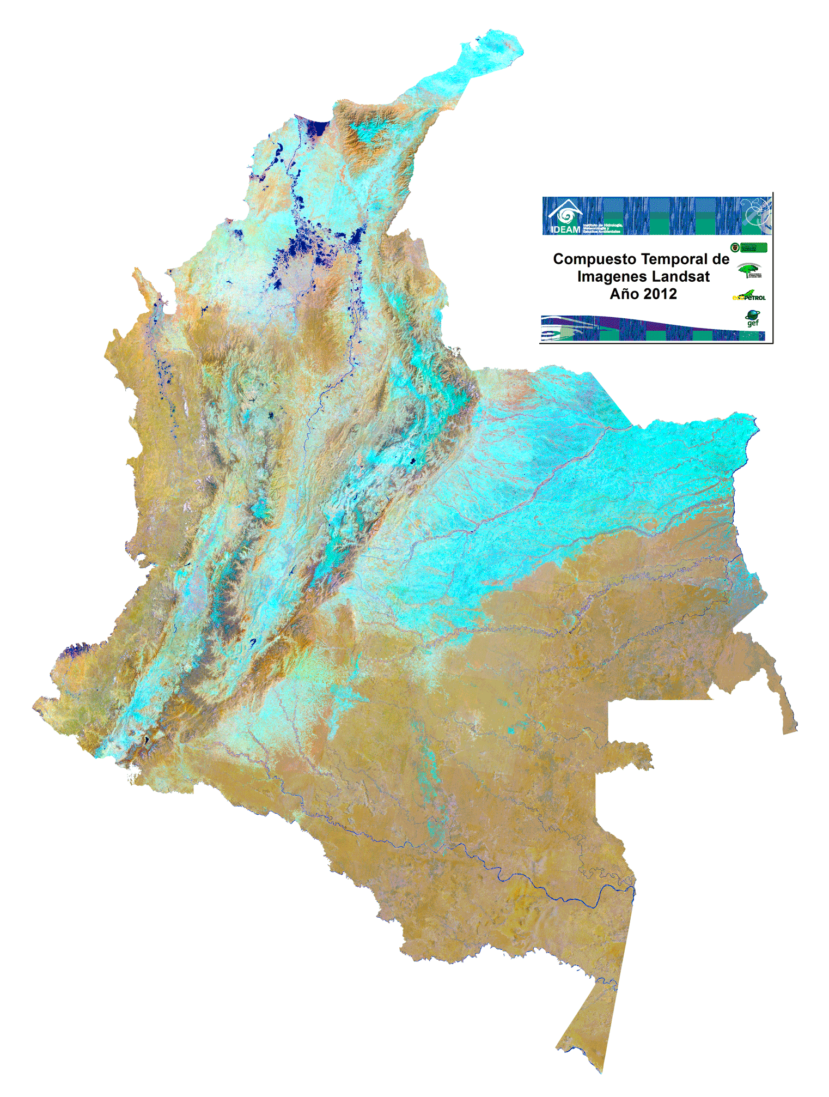
Colombia Prototype
The Government (IDEAM) and University (Andes) have made considerable progress in learning how to create and use Data Cubes!
A complete country-level Landsat Data Cube (25,000 scenes back to year 2000) was completed in Dec 2016.
Forest mapping and land change detection are the primary application needs.
Future plans to add more datasets and applications.
The SEO will continue to support IDEAM and the University of Andes in the coming year.

Slide 3
Colombia Work Items
Colombia team has issues running WOFS (memory overload). They also desire to run WOFS on L5-L7-L8 over long time periods.
Colombia desires to merge their local UI with our application UI.
Colombia team has Landsat cloud mask issues (CFMASK). Gustavo will provide GeoTIFF (input), GeoTIFF (output) and cloud mask samples. The SEO will explore “machine learning” options.
Colombia asked for support to run the median mosaic algorithm on their Data Cube. We will also look into using the new GA geometric median mosaic.
The SEO will explore putting Colombia Sentinel-1 data on AWS. We will consider developing some statistical output products.
Colombia asked if it is possible to get NetCDF ARD for Sentinel-1 from the Alaska Science Facility (ASF). This is basically the concept of a “data cube on demand”.
The Colombia team would like us to explore WMS data cube links to QGIS.

Slide 4
Future support to UN-SDGs
Objective: Investigate how CEOS satellite data can augment or improve statistical analyses to support UN-SDGs for Colombia.
UN-SDG: Goal 6 = Clean Water and Sanitation. Target 6.3 (water quality) and Target 6.5 (water resource management). Indicator 6.3.2 (proportion of bodies of water with good water quality) and Indicator 6.6.1 (change in the extent of water related ecosystems over time).
Approach: Gain an understanding of how CEOS data could support statistical analyses in support of the UN-SDGs. Utilize the existing country-level data cube, installed at the University of Andes and IDEAM, that includes Landsat-7/8 and Sentinel-1/2 data (coming soon) and demonstrate applications for the detection of water (WOFS algorithm) and water quality (Total Suspended Matter).
Brian Killough recently participated (remotely) in a meeting with the Colombia Statistical Agency (DANE) to explore options. We are working with NASA HQ on next steps.

