Slide 1
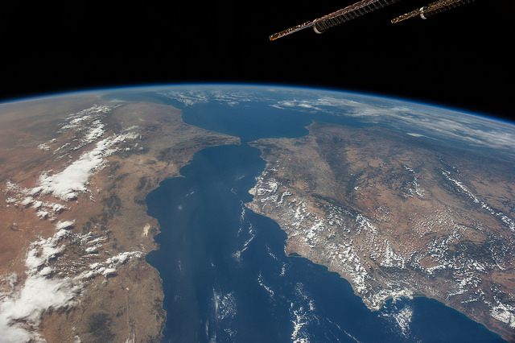
Future Data Access and Analysis Architectures – Discussion
Dr Robert Woodcock – WGISS 43
CSIRO

Slide 2
What do WE need to know?
Examples of topics from OGC ORM:
Enterprise view
Why and the value proposition
Geospatial Information
Information specifications
Spatial referencing
Geographies features
Geospatial Services
Services architectures
OGC Web Services
Reusable Patterns for Deployment
Publish, find, bind pattern
Geospatial portal and clients
Spatial Data Infrastructures
Geoprocessing workflows
Implementation of standards

Slide 3
Future Data Architectures Principles
“Analysis for the masses”
Interaction | Discovery and Download (files) User provides compute | In-place analysis of ready-to-use data User application, data and compute combine from different parties on-demand
Integration | Single sensor discovery Integration a user problem | Comparable observations Global multi-sensor analysis routine
Interoperability | Discovery of files Emphasis on access | Refined discovery of pixels Emphasis on usability for analysis
Interfaces | Independent application development over data Agency stores and distributes data | APIs, Virtual Labs enabled by standards Use of third parties for storage, distribution and analysis
Notes:
This slide shows the architectural principles that change.
Discussion will be mostly providing an brief explanation of each component – most likely only emphasising a few as there will likely not be time for all.
In some respects the before and after picture is really just a repeat of slides 4 and 5 but it starts to tie into architectural practices – so it leads us from the survey and analysis into the next step – how to make it work in practice. Which the AHT has touched on and is recommending is explored more fully in 2017 with both pilots and more technical work…so leads into next slide.

Slide 4
What do WE need to know?
Themes that need attention
Doing and learning
Pilots of different architectures/approaches – engaging users and other key stakeholders (e.g. partner governments, world bank, etc).
Includes producing “ARD” – make it real to find the challenges.
Technical frameworks
Architectural recommendations and best practices.
ARD framework.
User Requirements framework.
Community dimension
Fostering engagement, e.g. open source community, algorithm sharing, etc.
Measuring engagement
Strategic dimension
What do we need to do together to support uptake of satellite EO data from the “CEOS Constellation” e.g. in support of key global agendas?
What should CEOS do to support agencies to do their own things, e.g. best practices etc?
What should be ‘outside scope’ for CEOS?
Connection to CARD4l

Slide 5
CEOS Awesomeness #1
Sensor Integratability Services
Application packages for TEP, OGC Contect
OGC TB13
Single sign-on authentication and identity federation
Needs to be machine to machine too
Data Cube tech (and analysis tech)
Open Data Cube
SciDB
Earth Server (Rasdamann)
Geohazard TEP
Cassandra and related tech stack
Software Libraries and Languages
Python and R
Apache spark
Architecture – a lot of similarity. Reference architecture, shared services implementation?

Slide 6
CEOS Awesomeness #2
Lessons and experience to be shared:
CNES Orfeo toolbox
Jupyter notebooks (Python and R)
Machine learning libraries (MLLib)
TEP Lessons
Savings from Cloud based test environments (and SPOT)
Design patterns – there are a lot of similar patterns
Web Services
pyWPS, WPS, Geoserver, W*S, Domain Services too…
Tech futures
Pyramidal Data Cube for multi-resolution (and OGC DGGS)
DC Consumer and Server split and deployment
Containerisation (Docker)
S3- native architectures

Slide 7
CEOS Awesomeness #3
Global Data Cube network
Interoperability experiment?
Different Data Cube technology with same workflow?
Analytics Tools/Services
BFAST, WTSS, TWDTW, CCDC, … A2Z
Algorithm portability and sharing
Registry of solutions?
Data provenance and ancillary data
Cloud Masks, etc pixel level
General and pixel level consistency
Web Portals
All different branding for good reason but…
Can we use similar components and frameworks (e.g. Angular.js)

Slide 8
CEOS Awesomeness #4
Validation of results – can we work on this together?
Super sites?
CBERS ARD – Brian getting onto this already
Capacity building?
Files vs Web Objects (e.g. AWS S3) – performance, organisation, mindset challenges, experience lessons
Compliance-as-a-Service
Govt-commercial relationship for common large archives in Cloud
User characterisation and success metrics – making it manageable
At scale this is hard – much to learn though can be done

Slide 9
How do we get there?
Grow a community of contributors to underpin FDA technology (e.g. Data Cube) … CEOS, countries, domain experts
Prototype demonstration projects … 3 now + more
Develop a FDA Learning Center with documentation, training tools, and a user forum … end of 2017
Conduct frequent training workshops and webinars?
Agency focus on ARD creation and provision - WGCV
Leverage WGISS exisiting and expand capabilities
Engage key stakeholders who can help with scaling and sustainability
Notes:
Continue and support existing WGISS efforts on:
Discovery Search Engine Optimization (search relevancy, keyword search, persistent identifiers)
Access Common Standards for Interoperability of Product Formats (metadata/data) and Application Program Interface (API)
Exploration of Emerging Big Data services including Cloud Computing

