Slide 1
IDN Capabilities: Registration Tools, Search tools, APIs, and IDN Metadata
Michael Morahan
CEOS WGISS-43 Meeting
GEOSS-WGISS Interoperability Workshop
CEOS WGISS Connected Data Assets Session
Annapolis, Maryland
April 5, 2017

Slide 2
Objectives: Provide a Brief Introduction to IDN Search and Metadata Creation tools
Web-based Search Interfaces
IDN Homepage
Tools for Submitting Metadata
docBUILDER
APIs
RESTful API
Catalog Service for the Web (CSW)
OpenSearch
IDN DIF-10 & DIF-9 Metadata fields
Required fields
Overlap of fields by format
Keywords
Request for Keyword Reviewers
Keyword Schedule

Slide 3
Web-Based Search Interfaces

Slide 4
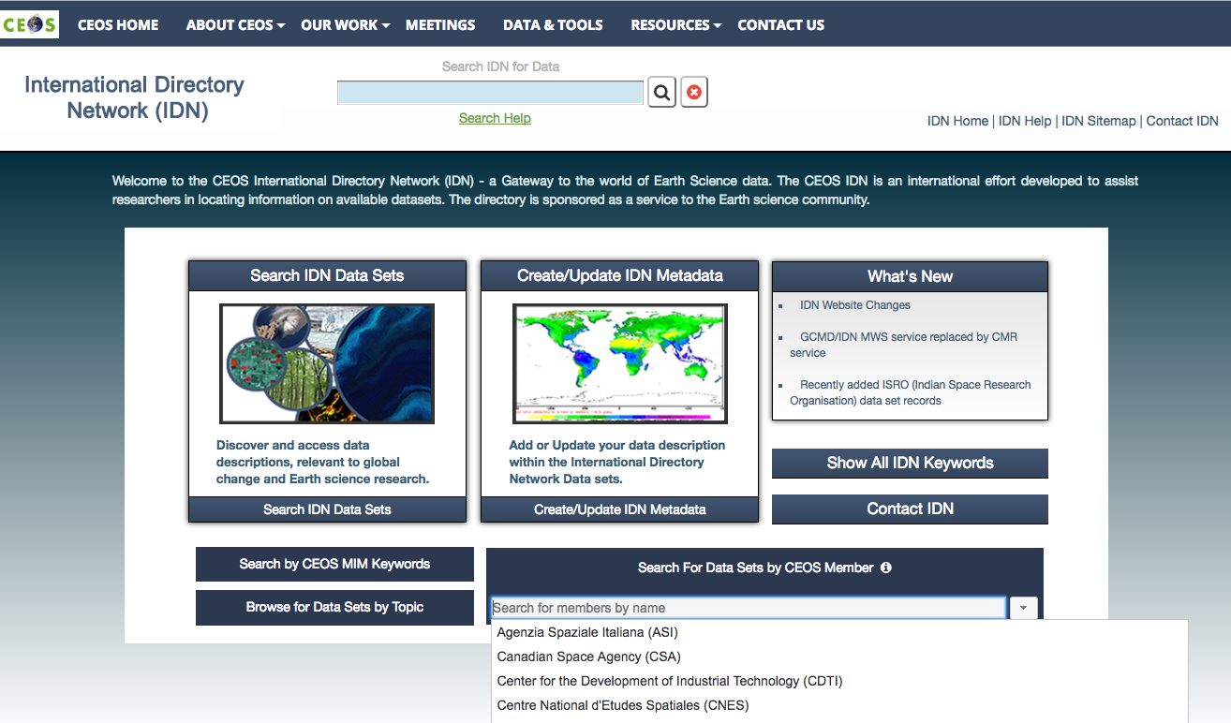
IDN Home Page
idn.ceos.org
Freetext Search
Help
New Developments
Access to
all Records
Keywords
MIM Keywords
Search
CEOS Agencies
Drill Down

Slide 5
IDN Search Interface
Interdisciplinary Search with Facets
Freetext and Refinement Search
Enhanced Sorting by Columns
View IDN Search Results

Slide 6
IDN Search Interface
Click on a record

Slide 7
IDN Search Interface: Entry Display
Click on a record
Record Display

Slide 8
Tools for Submitting Metadata

Slide 9
docBuilder: Overview
Web-based metadata authoring tool that allows authors to add or modify data set descriptions (DIF-9 and DIF-10)
Provides inline Quality assurance (QA) validation of field content, syntax and verification of controlled keywords
Customized QA rules
Implemented of field-to field editing, collapsible fields, tool-tips, and documentation
Download/upload metadata records to/from desktop
Submits directly to the IDN

Slide 10
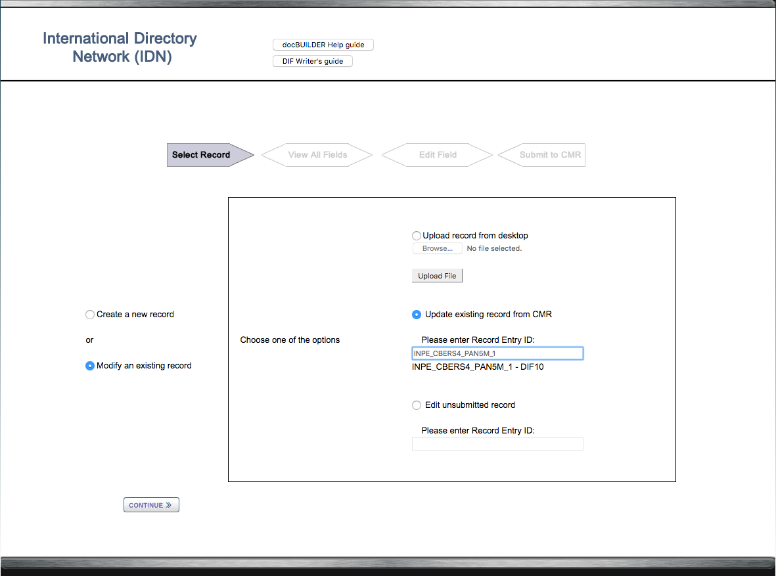
docBuilder: Modify a Record

Slide 11
docBuilder: Modify Metadata Fields Option

Slide 12
docBuilder: Modify Select Field
Immediate QA Feedback from In-line Validation

Slide 13
docBuilder: Generate Error Report

Slide 14
docBuilder: View QA Feedback
14

Slide 15
Search APIs: CMR Search API, Catalog Services for the Web (CSW), and OpenSearch

Slide 16
CMR Search API
Provides access to all IDN Collection metadata
Selected Set of Queryable fields (15 of 32 fields)
Concept ID | DOI | Entry ID | Platform | Entry Title
Archive Center | Temporal | Updated since | Spatial Keyword | Project
Revision date | Instrument | Science Keywords | Provider ID | Spatial (Polygon, Bounding Box, Point, Line)
IDN Search API Result Formats
ATOM | CSV | DIF-9 | DIF-10
ECHO10 | ISO-MENDS | ISO-SMAP | JSON
UMM JSON | KML | Open Data | XML Reference
API Query Methods:
Command-line
Web browser
API client
Search API Collection Query:
Curl "https://cmr.earthdata.nasa.gov/search/collections?platform\[\]=CBERS-4&pretty=true"

Slide 17
IDN Catalog Service for the Web (CSW)
HTTP protocol of the OpenGIS® Catalogue Services Specification version 2.0.2
Complete list of Queryable fields (CSW refers to fields as constraints)
Title | AnyText | Modified | BoundingBox | TempExtent_begin
TempExtent_end | Instrument | Platform | ScienceKeywords | ArchiveCenter
Queryable Tags:
IsCwic
IsGeoss
API Query Methods:
Command-line
CSW API client
IDN Search API result formats:
ISO
Postman Client https://www.getpostman.com
Notes:
Add title to image

Slide 18
List all GEOSS DataCore Data Sets using CSW
Service URL
Query
Results

Slide 19
IDN OpenSearch API
Search implementation based on the OpenSearch 1.1 specification
Complete list of Queryable fields
keyword | satellite | instrument | campaign
processingLevel | sensor | boundingBox | geometry
placeName | startTime | uid | endTime
Queryable Tags: (Future tags isCeos and isFedeo)
isCwic
isGeoss
API Query Methods:
Command-line
Web browser
OpenSearch API client
IDN Search API result formats:
ATOM
HTML

Slide 20
Breakdown Example of an OpenSearch Query
IDN root collection URL with results in ATOM format
Search collection field with a specific value
https://cmr.earthdata.nasa.gov/opensearch/collections.atom?satellite=Aqua
&isGeoss=true&numberOfResults=50&offset=50&clientId=UserClient
Return only GEOSS DataCore Collections
Set the number of results return
Set the next results for the collection field search
Identify your OpenSearch client

Slide 21
OpenSearch Queries
Retrieve All records:
https://cmr.earthdata.nasa.gov/opensearch/collections.atom?&clientId=UserClient
Retrieve One record:
https://cmr.earthdata.nasa.gov/opensearch/collections.atom?uid=C1243477366-GES_DISC&clientId=UserClient
Retrieve all GEOSS DataCore records:
https://cmr.earthdata.nasa.gov/opensearch/collections.atom?isGeoss=true&clientId=UserClient
Subset by ArchiveCenter, Satellite, and GEOSS DataCore:
https://cmr.earthdata.nasa.gov/opensearch/collections.atom?keyword=LAADS&satellite=Aqua&isGeoss=true&numberOfResults=200&clientId=UserClient

Slide 22
IDN DIF-10 & DIF-9 Metadata Fields

Slide 23
DIF-10 Fields
DIF 10
REQUIRED
Entry ID
Entry Title
ISO Topic Category
Metadata Dates
Organization
Platform/Instrument
Project
Related URL
Science Keywords
Spatial Coverage
Summary
Temporal Coverage
OPTIONAL
Access Constraints
Data Resolution
Data Set Citation
Data Set Language
Data Set Progress
Distribution Information
Location
Personnel
Quality
Use Constraints
Additional Attributes
Ancillary Keyword
Collection Data Type
DIF Revision History
Extended Metadata
IDN Node
Metadata Association
Multimedia Sample
Originating Center
Privacy Status
Product Level Id
Publication/Reference
Version Description
Notes:
Remove Highly recommended and recommended opinal

Slide 24
DIF-9 Fields
DIF 9
REQUIRED
Data Center
Entry ID
Entry Title
ISO Topic Category
Science Keywords
Summary
OPTIONAL
Access Constraints
Data Resolution
Data Set Citation
Data Set Language
Data Set Progress
Distribution Information
Instrument
Location
Paleo-Temporal Coverage
Personnel
Platform
Project
Quality
Related URL
Spatial Coverage
Temporal Coverage
Use Constraints
Ancillary Keyword
DIF Creation Date
DIF Revision History
Extended Metadata
Future DIF Review Date
IDN Node
Last DIF Revision Date
Multimedia Sample
Originating Center
Parent DIF
Privacy Status
Publication/Reference

Slide 25
Overlapping: DIF-9 and DIF-10 Metadata Fields
DIF 9
DIF 10
Access Constraints
Ancillary Keyword
Data Center/Organization (9), (10)
Data Resolution
Data Set Citation
Data Set Language
Data Set Progress
DIF Revision History
Distribution Information
Entry ID (9), (10)
Entry Title (9), (10)
Extended Metadata
IDN Node
ISO Topic Category (9), (10)
Location
Multimedia Sample
Originating Center
Personnel
Platform/Instrument (10)
Privacy Status
Project (10)
Publication/Reference
Quality
Related URL (10)
Science Keywords (9), (10)
Spatial Coverage (10)
Summary (9), (10)
Temporal Coverage (10)
Use Constraints
DIF Creation Date
Future DIF Review Date
Instrument
Last DIF Revision Date
Paleo-Temporal Coverage
Parent DIF
Additional Attributes
Collection Data Type
Metadata Dates (10)
Metadata Association
Product Level ID
Version Description
Required Fields by Metadata format:
6 required fields for DIF-9 shown with (9)
12 required fields for DIF-10 shown with (10)

Slide 26
Keywords: Request for Reviewers and Keyword Schedule

Slide 27
Become a Keyword Reviewer
The GCMD Keywords review is facilitated by the NASA ESDIS Standards Office (ESO).
Keyword reviewers will review the proposed keywords and complete a online questionnaire.
If you are interested in becoming a keyword reviewer, please contact the ESO at eso-staff@lists.nasa.gov or Michael.P.Morahan@nasa.gov.
If you have keyword recommendations, please contribute through the Keyword Community Forum: http://earthdata.nasa.gov/gcmd-forum
Science Keyword Release | Science Keyword Topics | Date
Version 8.2 | (Atmosphere, Ecosystem, Terrestrial Hydrosphere, and Locations ) | March 2016
Version 8.3 | (Water Vapor, Water Quality/Chemistry, and Ecosystems) | August 2016
Version 8.4 | (Atmosphere > Atmospheric Phenomena and Atmosphere > Atmospheric Radiation) | August 2016
Version 8.5 | Atmospheric Water Vapor and Atmospheric Winds | April 2017
Version 8.6 | TBD | 2018

Slide 28
IDN DIF, DocBUILDER,
and API Documentation

Slide 29
DIF and docBUILDER Documentation
DIF-10 writer's guide:
http://idn.ceos.org/subset/idn/defaultDif10/index.html
DIF-9 writer’s guide: http://idn.ceos.org/subset/idn/defaultDif/index.html
DIF-10 schema:http://gcmd.gsfc.nasa.gov/Aboutus/xml/dif/dif_v10.2.xsd
DIF-9 schema:
http://gcmd.nasa.gov/Aboutus/xml/dif/dif.xsd
docBUILDER (DIF-10): http://idn.ceos.org/DocumentBuilder/Home.do?Portal=ceos_idn&MetadataType=7
docBUILDER (DIF-9): http://idn.ceos.org/DocumentBuilder/Home.do?Portal=ceos_idn&MetadataType=0

Slide 30
IDN API Documentation
Search API documentation:
https://cmr.earthdata.nasa.gov/search/site/search_api_docs.html
CSW Capabilities document:
https://cmr.earthdata.nasa.gov/csw/collections?request=GetCapabilities&service=CSW&version=2.0.2
OpenSearch Documentation:
https://cmr.earthdata.nasa.gov/opensearch/home/docs
OpenSearch API OpenSearch Descriptor Document (OSDD):
https://cmr.earthdata.nasa.gov/opensearch/collections/descriptor_document.xml?clientId=cswOpenSearchDoc

Slide 31
Questions
Michael.P.Morahan@nasa.gov

