Slide 1
Data Stewardship Interest Group WGISS-43 Meeting
DMP IG as a Maturity Matrix
NASA, Annapolis, MD, USA 03–06 April, 2017

Slide 2
Outline
WGISS EO Data Stewardship Maturity Matrix:
Create a Maturity Matrix with DMP IG simplifying the WGISS EO Data Stewardship Maturity Matrix
Verify the WGISS Data Preservation Guidelines with respect to the WGISS EO Data Stewardship Maturity Matrix
Discussion & Next steps

Slide 3
Definitions
Scientific Data Stewardship Maturity Matrix:
A Unified Framework for Measuring Stewardship Practices Applied to Digital Environmental Datasets.
It indicates all possible activities to be performed to preserve and improve the information content, quality, accessibility, and usability of data and metadata.
Gives a technical evaluation of the level of preservation and helps with self assessment of preservation.
Data Management Principles:
These principles address the need for discovery, accessibility, usability, preservation, and curation of the resources made available through GEOSS.
The DMP provide guidelines that data providers and others can use as they seek to implement the principles.
The DMP provide a basis for assessing how well the principles are being adhered to in practice.
Notes:
Capability Maturity Model Integration (CMMI) is a process improvement training and appraisal program and service administered and marketed by Carnegie Mellon University (CMU) and required by many DoD and U.S. Government contracts, especially in software development. CMU claims CMMI can be used to guide process improvement across a project, division, or an entire organization. CMMI defines the following maturity levels for processes: Initial, Managed and Defined.
CMMI currently addresses three areas of interest:
Product and service development — CMMI for Development (CMMI-DEV),
Service establishment, management, — CMMI for Services (CMMI-SVC), and
Product and service acquisition — CMMI for Acquisition (CMMI-ACQ).
Climate Data Record Maturity Matrix (CDRMM): Bates and Privette, 2012
TECHNOLOGY READINESS LEVELS (TRLs): Standard which measures the maturity of new technologies
Scientific Readiness Levels (SRL): FOR SPACE APPLICATIONS

Slide 4
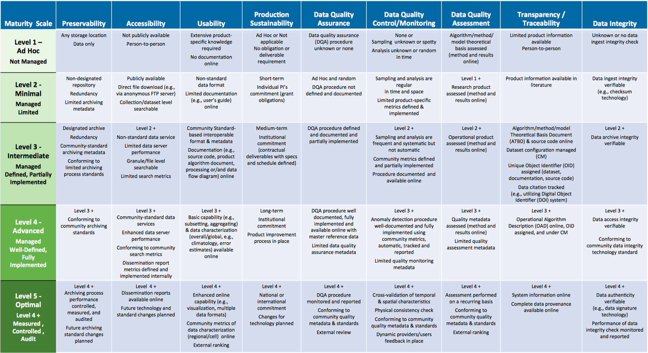
Scientific Data Stewardship Maturity Matrix
Notes:
Preservability: it focuses on assessing practices associated with data storage for resilience requirements, i.e., backup or a duplicate copy in a physically separate facility for disaster recovery, and on compliance to community-accepted archive practices and metadata standards. Preservability metadata are necessary for file storage and retrieval purposes only. They include a unique identifier for the dataset, file naming convention, file size, data volume, and, if available, a unique identifier for the collection- level metadata record associated with the dataset. The file naming convention is treated in this paper as being more relevant to preservability; however, the implication of defined file naming conventions on data usability and interoperability should also be considered when determining file naming conventions.
Accessibility: The maturity of the accessibility key component will focus on whether users can easily find and access data online. It measures whether a dataset is searchable and discoverable for collection only or to the granule level.
Usability: it deals with how easily users are able to use the data and learn whether the data are suitable for their own data requirements. It is closely tied to online documentation availability (e.g., Quick starter guide, Users’ guide, or Readme file), file format for interoperability, online data customization and visualization capability, and data characterization. It strives to alleviate the users’ burden of learning about and understanding the data.
Production Sustainability: it is addressed in terms of various degrees of commitment for and associated requirements on the product. Here, it is assumed that the commitment is backed by the necessary financial support. At maturity level 5, changes for technology in data production should be routinely incorporated into planning for continued, sustained stewardship.
Data Quality Assurance (DQA): is a set of activities or procedures focused on defect prevention to be followed in order to ensure product quality during development. Data quality screening (DQS) is a set of activities intended to ensure the source data are clean. DQS is a commonly used procedure for identifying missing or redundant records.
Data Quality Control/ Monitoring: is a set of activities taken to evaluate the product to ensure that it conforms to the required specifications. It is product-oriented and focuses on data anomaly detection. It is usually carried out after the product is created or at each major milestone of the product development and processing cycle.
Data Quality Assessment: is a set of activities designed to ensure that the products are scientifically sound (i.e., building the right thing), by carefully evaluating the product, usually by comparison with similar well-established and validated observations or data product(s).
Transparency /Traceability: The focus here is on the level of availability of information about the product and how it was created, the level of practices associated with management of documents, source code, and system information, and whether data and publication citations were tracked, such as by utilizing a Digital Object Identifier (DOI) system.
Data Integrity: Data integrity refers to the validity of data, i.e., the accuracy and consistency of data over its entire lifecycle. The Data integrity component in this version of the stewardship maturity matrix primarily assesses the practices applied to datasets to ensure the data files are free of intentional or unintentional corruption during data transfer, ingest, storage, and dissemination and to ensure data authenticity at access.
Level 5 is Level 4 + other things

Slide 5
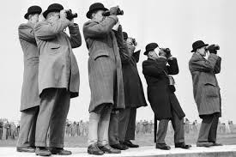
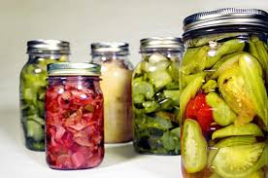
GEOSS DMP Principles
DISCOVERABILITY
DMP-1: Data and metadata will be discoverable
ACCESSIBILITY
DMP-2: Data will be accessible via online services
USABILITY
DMP-3: Encoding DMP-4: Documentation
DMP-5: Traceability DMP-6: Quality
PRESERVATION
DMP-7: Preservation DMP-8: Verification
CURATION
DMP 9: Review and reprocessing
DMP 10: Persistent and resolvable identifiers
Notes:
Discoverability
DMP-1 Data and all associated metadata will be discoverable through catalogues and search engines, and data access and use conditions, including licenses, will be clearly indicated.
Accessibility
DMP-2 Data will be accessible via online services, including, at minimum, direct download but preferably user-customizable services for visualization and computation.
Usability
DMP-3 Data will be structured using encodings that are widely accepted in the target user community and aligned with organizational needs and observing methods, with preference given to non-
proprietary international standards.
DMP-4 Data will be comprehensively documented, including all elements necessary to access, use, understand, and process, preferably via formal structured metadata based on international or community- approved standards. To the extent possible, data will also be described in peer-reviewed publications referenced in the metadata record.
DMP-5 Data will include provenance metadata indicating the origin and processing history of raw observations and derived products, to
ensure full traceability of the product chain.
DMP-6 Data will be quality-controlled and the results of quality control
shall be indicated in metadata; data made
available in advance of quality control will be
flagged in metadata as unchecked.
Preservation
DMP-7 Data will be protected from loss and preserved for
future use; preservation planning will be for the
long term and include guidelines for loss
prevention, retention schedules, and disposal or
transfer procedures.
DMP-8 Data and associated metadata held in data
management systems will be periodically
verified to ensure integrity, authenticity and
readability.
Curation
DMP-9 Data will be managed to perform corrections
and updates in accordance with reviews,
and to enable reprocessing as appropriate;
where applicable this shall follow
established and agreed procedures.
DMP-10 Data will be assigned appropriate
persistent, resolvable identifiers to enable
documents to cite the data on which they
are based and to enable data providers to
receive acknowledgement of use of their data.

Slide 6
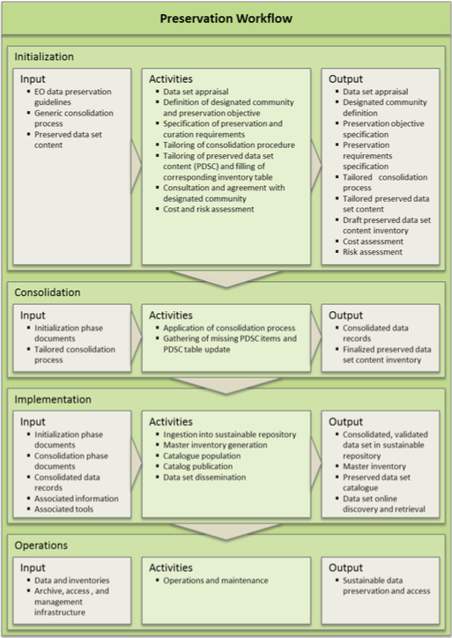
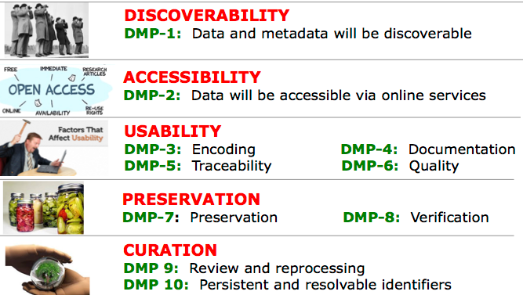
Relations between Maturity Matrix (MM), DMP and Best Practices
Stewardship objectives
DMP
Tailoring
Stewardship Maturity Level

Slide 7
Create a Maturity Matrix with DMP IG simplifying the WGISS EO Data Stewardship Maturity Matrix

Slide 8
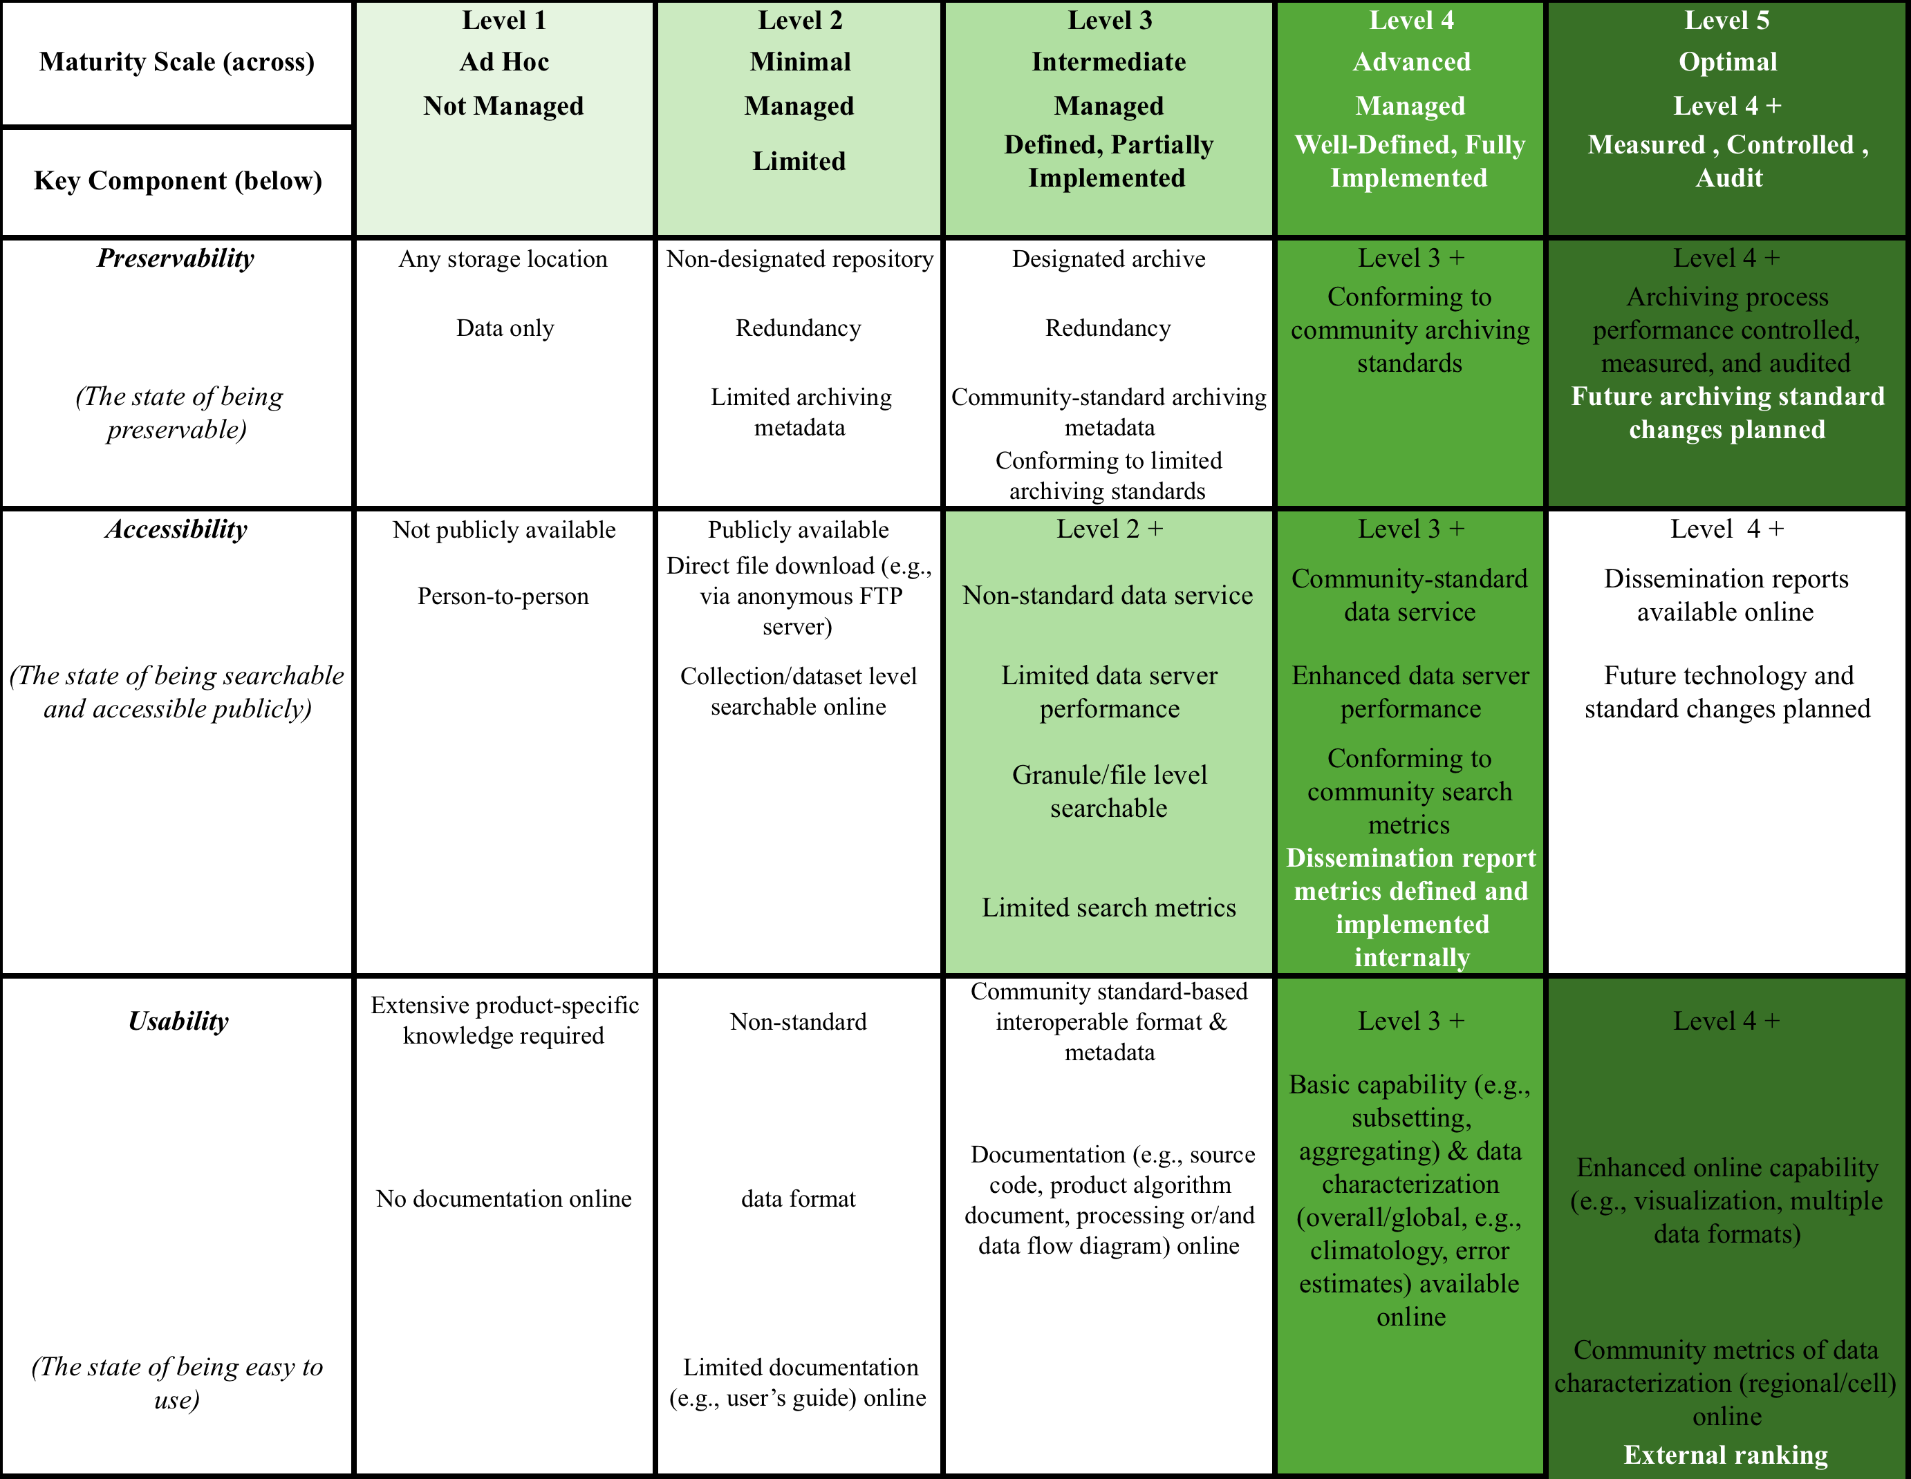
DMP Maturity Matrix Assessment

Slide 9
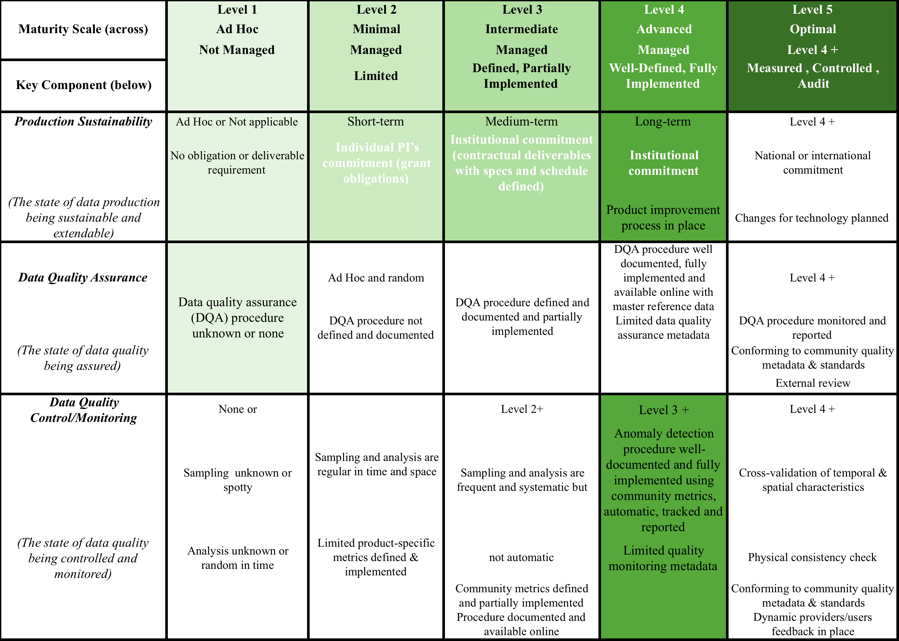
DMP Maturity Matrix Assessment

Slide 10
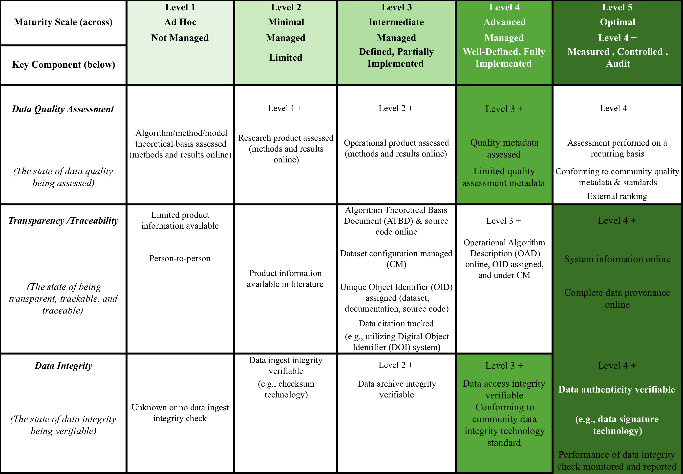
DMP Maturity Matrix Assessment

Slide 11
DMP Measurement Results
Notes:
Preservability: it focuses on assessing practices associated with data storage for resilience requirements, i.e., backup or a duplicate copy in a physically separate facility for disaster recovery, and on compliance to community-accepted archive practices and metadata standards. Preservability metadata are necessary for file storage and retrieval purposes only. They include a unique identifier for the dataset, file naming convention, file size, data volume, and, if available, a unique identifier for the collection- level metadata record associated with the dataset. The file naming convention is treated in this paper as being more relevant to preservability; however, the implication of defined file naming conventions on data usability and interoperability should also be considered when determining file naming conventions.
Accessibility: The maturity of the accessibility key component will focus on whether users can easily find and access data online. It measures whether a dataset is searchable and discoverable for collection only or to the granule level.
Usability: it deals with how easily users are able to use the data and learn whether the data are suitable for their own data requirements. It is closely tied to online documentation availability (e.g., Quick starter guide, Users’ guide, or Readme file), file format for interoperability, online data customization and visualization capability, and data characterization. It strives to alleviate the users’ burden of learning about and understanding the data.
Production Sustainability: it is addressed in terms of various degrees of commitment for and associated requirements on the product. Here, it is assumed that the commitment is backed by the necessary financial support. At maturity level 5, changes for technology in data production should be routinely incorporated into planning for continued, sustained stewardship.
Data Quality Assurance (DQA): is a set of activities or procedures focused on defect prevention to be followed in order to ensure product quality during development. Data quality screening (DQS) is a set of activities intended to ensure the source data are clean. DQS is a commonly used procedure for identifying missing or redundant records.
Data Quality Control/ Monitoring: is a set of activities taken to evaluate the product to ensure that it conforms to the required specifications. It is product-oriented and focuses on data anomaly detection. It is usually carried out after the product is created or at each major milestone of the product development and processing cycle.
Data Quality Assessment: is a set of activities designed to ensure that the products are scientifically sound (i.e., building the right thing), by carefully evaluating the product, usually by comparison with similar well-established and validated observations or data product(s).
Transparency /Traceability: The focus here is on the level of availability of information about the product and how it was created, the level of practices associated with management of documents, source code, and system information, and whether data and publication citations were tracked, such as by utilizing a Digital Object Identifier (DOI) system.
Data Integrity: Data integrity refers to the validity of data, i.e., the accuracy and consistency of data over its entire lifecycle. The Data integrity component in this version of the stewardship maturity matrix primarily assesses the practices applied to datasets to ensure the data files are free of intentional or unintentional corruption during data transfer, ingest, storage, and dissemination and to ensure data authenticity at access.
Level 5 is Level 4 + other things

Slide 12
WAY FORWARD
NEED:
Create a Maturity Matrix with DMP IG simplifying the WGISS EO Data Stewardship Maturity Matrix
Implemented Solutions:
Substituting the Key components of the Maturity Matrix with the DMP IG
Normalizing the number of maturity levels reducing them to new 4 levels
Giving a weight to every components of the principles in order to give an incremental order for the implementation of the preservation and curation activities

Slide 13
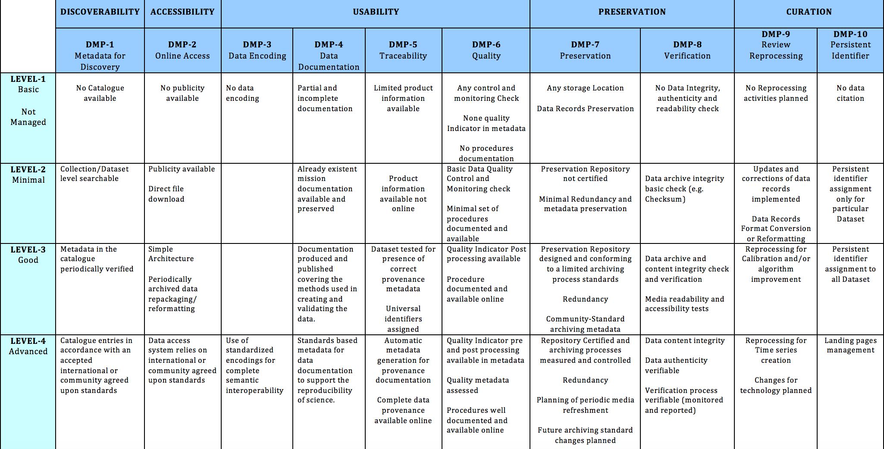
Preliminary Result
Notes:
La sto terminando con materiale che avevo in ufficio

Slide 14
Verify the WGISS Data Preservation guidelines with respect to the WGISS EO Data Stewardship Maturity Matrix

Slide 15
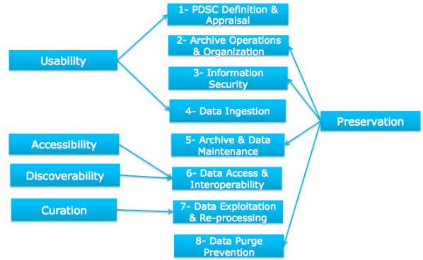
Mapping of the Preservation Guidelines vs. DMP

Slide 16
Mapping of the Preservation Guidelines vs. Stewardship Maturity Matrix
The Preservation Guidelines are already following a Maturity Matrix format thanks to the Adherence level.
The guidelines have been classified into different levels of priority

Slide 17
Preliminary Result
Notes:
Preservability: it focuses on assessing practices associated with data storage for resilience requirements, i.e., backup or a duplicate copy in a physically separate facility for disaster recovery, and on compliance to community-accepted archive practices and metadata standards. Preservability metadata are necessary for file storage and retrieval purposes only. They include a unique identifier for the dataset, file naming convention, file size, data volume, and, if available, a unique identifier for the collection- level metadata record associated with the dataset. The file naming convention is treated in this paper as being more relevant to preservability; however, the implication of defined file naming conventions on data usability and interoperability should also be considered when determining file naming conventions.
Accessibility: The maturity of the accessibility key component will focus on whether users can easily find and access data online. It measures whether a dataset is searchable and discoverable for collection only or to the granule level.
Usability: it deals with how easily users are able to use the data and learn whether the data are suitable for their own data requirements. It is closely tied to online documentation availability (e.g., Quick starter guide, Users’ guide, or Readme file), file format for interoperability, online data customization and visualization capability, and data characterization. It strives to alleviate the users’ burden of learning about and understanding the data.
Production Sustainability: it is addressed in terms of various degrees of commitment for and associated requirements on the product. Here, it is assumed that the commitment is backed by the necessary financial support. At maturity level 5, changes for technology in data production should be routinely incorporated into planning for continued, sustained stewardship.
Data Quality Assurance (DQA): is a set of activities or procedures focused on defect prevention to be followed in order to ensure product quality during development. Data quality screening (DQS) is a set of activities intended to ensure the source data are clean. DQS is a commonly used procedure for identifying missing or redundant records.
Data Quality Control/ Monitoring: is a set of activities taken to evaluate the product to ensure that it conforms to the required specifications. It is product-oriented and focuses on data anomaly detection. It is usually carried out after the product is created or at each major milestone of the product development and processing cycle.
Data Quality Assessment: is a set of activities designed to ensure that the products are scientifically sound (i.e., building the right thing), by carefully evaluating the product, usually by comparison with similar well-established and validated observations or data product(s).
Transparency /Traceability: The focus here is on the level of availability of information about the product and how it was created, the level of practices associated with management of documents, source code, and system information, and whether data and publication citations were tracked, such as by utilizing a Digital Object Identifier (DOI) system.
Data Integrity: Data integrity refers to the validity of data, i.e., the accuracy and consistency of data over its entire lifecycle. The Data integrity component in this version of the stewardship maturity matrix primarily assesses the practices applied to datasets to ensure the data files are free of intentional or unintentional corruption during data transfer, ingest, storage, and dissemination and to ensure data authenticity at access.
Level 5 is Level 4 + other things

Slide 18
Discussion & Next steps

Slide 19
DISCUSSION WAY FORWARD
Next Steps:
Finalize the WGISS Maturity Matrix using the DMP IG and circulate for comments → Due Date: End of May
Present the final results of the exercise for verification of the WGISS Data Preservation guidelines with Maturity Matrix → Due Date: End of May
Possible Future Activities:
Improvement of the Data Management Principles using the WGISS EO Data Stewardship Maturity Matrix.

Slide 20
Back-up

Slide 21
EO Data Stewardship Maturity Matrix utilization versus DMP Implementation Guidelines

Slide 22
EO Data Stewardship Maturity Matrix versus DMP Implementation Guidelines
An exercise has been performed to verify the compatibility of the Data Stewardship Maturity Matrix wrt GEO DMP Principles and guidelines.
Each DMP Principle has been mapped into Maturity Matrix Components and the rating obtained through DMP implementation derived.
This exercise has allowed also to identify possible areas of improvement for the Data Management Principles.

Slide 23
GEOSS DMP Principles
The value of Earth observations are maximized through data life-cycle management based on ten principles supporting five themes.
DISCOVERABILITY
DMP-1: Data and metadata will be discoverable
ACCESSIBILITY
DMP-2: Data will be accessible via online services
USABILITY
DMP-3: Encoding DMP-4: Documentation
DMP-5: Traceability DMP-6: Quality
PRESERVATION
DMP-7: Preservation DMP-8: Verification
CURATION
DMP 9: Review and reprocessing
DMP 10: Persistent and resolvable identifiers
Notes:
Discoverability
DMP-1 Data and all associated metadata will be discoverable through catalogues and search engines, and data access and use conditions, including licenses, will be clearly indicated.
Accessibility
DMP-2 Data will be accessible via online services, including, at minimum, direct download but preferably user-customizable services for visualization and computation.
Usability
DMP-3 Data will be structured using encodings that are widely accepted in the target user community and aligned with organizational needs and observing methods, with preference given to non-
proprietary international standards.
DMP-4 Data will be comprehensively documented, including all elements necessary to access, use, understand, and process, preferably via formal structured metadata based on international or community- approved standards. To the extent possible, data will also be described in peer-reviewed publications referenced in the metadata record.
DMP-5 Data will include provenance metadata indicating the origin and processing history of raw observations and derived products, to
ensure full traceability of the product chain.
DMP-6 Data will be quality-controlled and the results of quality control
shall be indicated in metadata; data made
available in advance of quality control will be
flagged in metadata as unchecked.
Preservation
DMP-7 Data will be protected from loss and preserved for
future use; preservation planning will be for the
long term and include guidelines for loss
prevention, retention schedules, and disposal or
transfer procedures.
DMP-8 Data and associated metadata held in data
management systems will be periodically
verified to ensure integrity, authenticity and
readability.
Curation
DMP-9 Data will be managed to perform corrections
and updates in accordance with reviews,
and to enable reprocessing as appropriate;
where applicable this shall follow
established and agreed procedures.
DMP-10 Data will be assigned appropriate
persistent, resolvable identifiers to enable
documents to cite the data on which they
are based and to enable data providers to
receive acknowledgement of use of their data.

Slide 24
DMP Guidelines and key Components mapping
DMP Implementation Guidelines | Stewardship Maturity Matrix Key Components
DMP-1: Discoverability | Accessibility
DMP-2: Accessibility | Accessibility
DMP-3: Encoding | Usability
DMP-4: Documentation | Usability
DMP-5: Traceability | Transparency /Traceability
DMP-6: Quality | Data Quality Control/ Monitoring Data Quality Assessment Data Quality Assurance
DMP-7: Preservation | Preservability
DMP-8: Verification | Data Integrity
DMP-9: Review and reprocessing | Production Sustainability
DMP-10: Persistent and resolvable identifiers | Transparency /Traceability

Slide 25
DMP Maturity Matrix Assessment

Slide 26
DMP Maturity Matrix Assessment

Slide 27
DMP Maturity Matrix Assessment

Slide 28
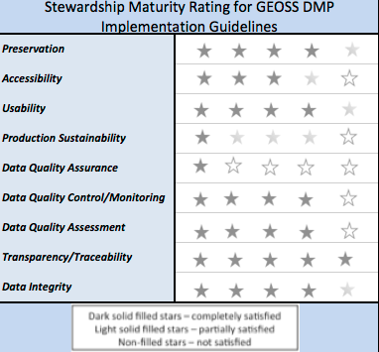
Assessment results and Rating
Data Stewardship Maturity Matrix is highly compatible with GEO DMP Principles.
Possible areas of improvement for the Data Management Principles identified.

Slide 29
References
http://tinyurl.com/DSMMtemplate
http://www.slideshare.net/gepeng86/scientific-data-stewardship-maturity-matrix
https://www.jstage.jst.go.jp/article/dsj/13/0/13_14-049/_article

Slide 30
Interested Organizations
CMMI
Standards for Establishing Trusted Repositories for USGS Digital Assets
A Provenance MM
CDR
Data Stewardship in the Earth Sciences
Data Management Maturity
ISO 16363
Other Organizations
Notes:
The DMM model Editorial Board will recommend strategies for adapting and deploying a DMM model to the Earth and space sciences create guidance documents to assist in its implementation, and provide input on a pilot appraisal process.
The ASF SAR DAAC participates in ESIP to further its goals of supporting national and international Earth science research, field operations, and remote-sensing applications that benefit society. These goals complement ESIP’s focus on “the collection, stewardship and use of Earth science data, information, and knowledge that is responsive to societal needs.”
5.4 Future Work
In the meantime, the ESIP Data Stewardship Committee continues to work towards advancing the state of the art in data stewardship through the establishment of a series of liaisons with other groups working in this area. For example, several of the Research Data Alliance (RDA) Working Groups and Interest Groups have members who act as liaisons between those RDA communities and ESIP. In addition, ESIP has members on the FORCE11 DCIG group, on CODATA groups, and on other groups that are conducting related activities.
ESIP teams also are contributing to the development of standards and best practices within the Earth science community. For example, we have started developing example data citation guidelines for reviewers, editors, and authors to help journals and scientific organizations that are considering updating their guidelines to include data related topics.
To characterize the state of preservation of Earth Science data, we are beginning to test the Data Stewardship Maturity Matrix, originally developed by Ge Peng, of NOAA [46], on data that are external to the NOAA environment. The hope is that the Matrix can be generalized enough to work for Earth Science data more broadly, so that the Matrix can be applied in a uniform fashion by data centers and other data-holding organizations to express the state of any particular data set within their care. In assessing such tools, resources that offer similar utility also will need to be considered.
ESIP community discussions are open to individuals and organizational representatives. Individuals may join discussions by perusing the ESIP wiki and attending any of the listed teleconferences or by adding their names to the posted mailing lists. Organizations are encouraged to join the ESIP Federation by completing a membership application. Organizational membership is free, subject to review of application and approval by the Federation Assembly.

